Slide 1
Classification
Neural Networks 1

Slide 2
Neural networks
Topics
  Perceptrons
    structure
    training
    expressiveness
  Multilayer networks
    possible structures
      activation functions
    training with gradient descent and backpropagation
    expressiveness

Slide 3
Connectionist models
Consider humans:
  Neuron switching time ~ 0.001 second
  Number of neurons ~ 10¹⁰
  Connections per neuron ~ 10⁴⁻⁵
  Scene recognition time ~ 0.1 second
  100 inference steps doesn’t seem like enough
  ⇒ Massively parallel computation

Slide 4
Neural networks
Properties:
  Many neuron-like threshold switching units
  Many weighted interconnections among units
  Highly parallel, distributed process
  Emphasis on tuning weights automatically

Slide 5
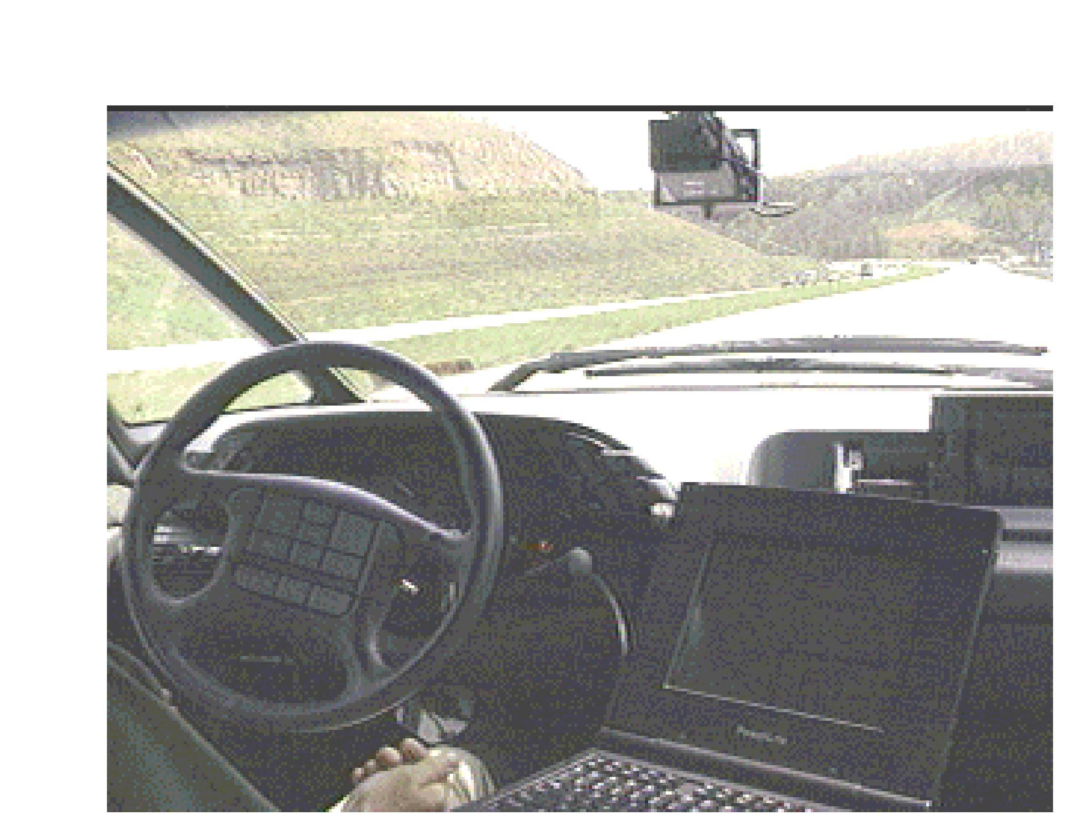
Neural network application
ALVINN: An Autonomous Land Vehicle In a Neural Network
(Carnegie Mellon University Robotics Institute, 1989-1997)
ALVINN is a perception system which learns to control the NAVLAB vehicles by watching a person drive. ALVINN's architecture consists of a single hidden layer back-propagation network. The input layer of the network is a 30x32 unit two dimensional "retina" which receives input from the vehicles video camera. Each input unit is fully connected to a layer of five hidden units which are in turn fully connected to a layer of 30 output units. The output layer is a linear representation of the direction the vehicle should travel in order to keep the vehicle on the road.

Slide 6
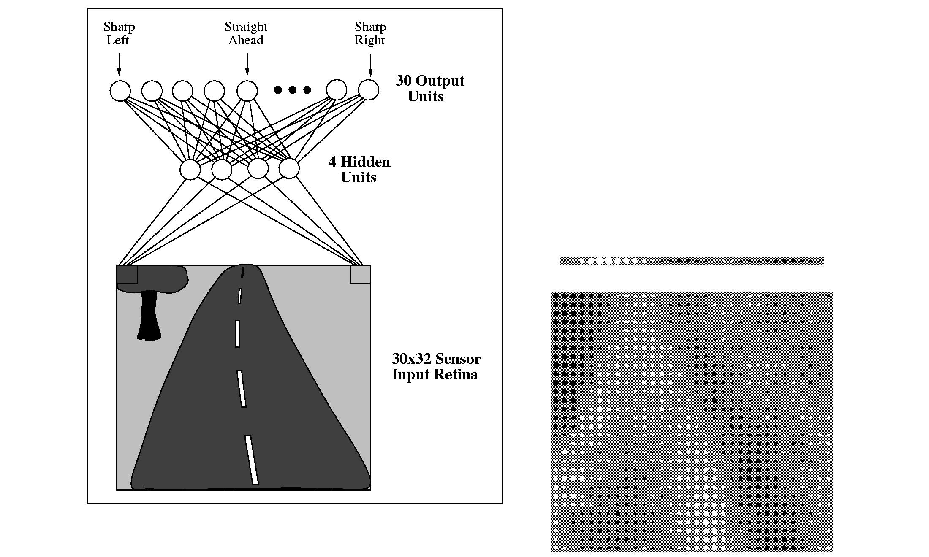
Neural network application
ALVINN drives 70 mph on highways!

Slide 7
Perceptron structure
Model is an assembly of nodes connected by weighted links
Output node sums up its input values according to the weights of their links
Output node sum then compared against some threshold t
or

Slide 8
Example: modeling a Boolean function
Output Y is 1 if at least two of the three inputs are equal to 1.

Slide 9
Perceptron model

Slide 10
Perceptron decision boundary
Perceptron decision boundaries are linear
(hyperplanes in higher dimensions)
Example: decision surface for Boolean function on preceding slides

Slide 11
Expressiveness of perceptrons
Can model any function where positive and negative examples are linearly separable
  Examples: Boolean AND, OR, NAND, NOR
Cannot (fully) model functions which are not linearly separable.
  Example: Boolean XOR

Slide 12
Perceptron training process
Initialize weights with random values.
Do
  Apply perceptron to each training example.
  If example is misclassified, modify weights.
Until all examples are correctly classified, or process has converged.

Slide 13

Perceptron training process
Two rules for modifying weights during training:
  Perceptron training rule
    train on thresholded outputs
    driven by binary differences between correct and predicted outputs
    modify weights with incremental updates
  Delta rule
    train on unthresholded outputs
    driven by continuous differences between correct and predicted outputs
    modify weights via gradient descent

Slide 14
Perceptron training rule
Initialize weights with random values.
Do
  Apply perceptron to each training sample x_{i}.
  If sample x_{i} is misclassified, modify all weights w_{j}.
Until all samples are correctly classified.

Slide 15
Perceptron training rule
  If sample x_{i} is misclassified, modify all weights w_{j}.
Examples:

Slide 16
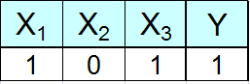
Perceptron training rule
Example of processing one sample

Slide 17
Delta training rule
Based on squared error function for weight vector:
  Note that error is difference between correct output and unthresholded sum of inputs, a continuous quantity (rather than binary difference between correct output and thresholded output).
Weights are modified by descending gradient of error function.

Slide 18
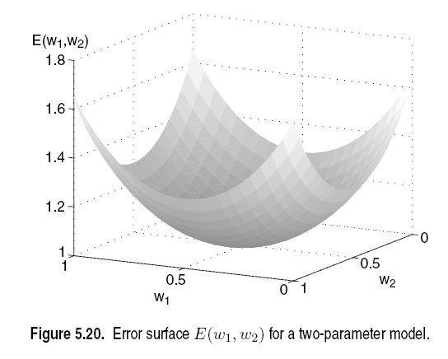
Squared error function for weight vector w

Slide 19
Gradient of error function

Slide 20
Gradient of squared error function

Slide 21
Delta training rule
Initialize weights with random values.
Do
  Apply perceptron to each training sample x_{i}.
  If sample x_{i} is misclassified, modify all weights w_{j}.
Until all samples are correctly classified, or process converges.

Slide 22
Gradient descent: batch vs. incremental
Incremental mode (illustrated on preceding slides)
  Compute error and weight updates for a single sample.
  Apply updates to weights before processing next sample.
Batch mode
  Compute errors and weight updates for a block of samples (maybe all samples).
  Apply all updates simultaneously to weights.

Slide 23
Perceptron training rule vs. delta rule
Perceptron training rule guaranteed to correctly classify all training samples if:
  Samples are linearly separable.
  Learning rate η is sufficiently small.
Delta rule uses gradient descent. Guaranteed to converge to hypothesis with minimum squared error if:
  Learning rate η is sufficiently small.
  Even when:
  Training data contains noise.
  Training data not linearly separable.

Slide 24
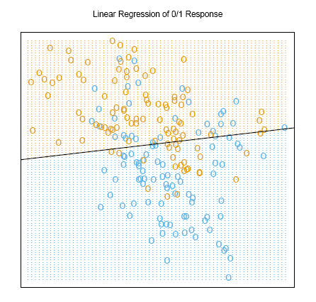
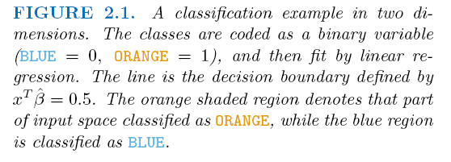
Equivalence of perceptron and linear models
≡

