Slide 1
Classification / Regression
Neural Networks 2

Slide 2
Neural networks
Topics
  Perceptrons
    structure
    training
    expressiveness
  Multilayer networks
    possible structures
      activation functions
    training with gradient descent and backpropagation
    expressiveness

Slide 3
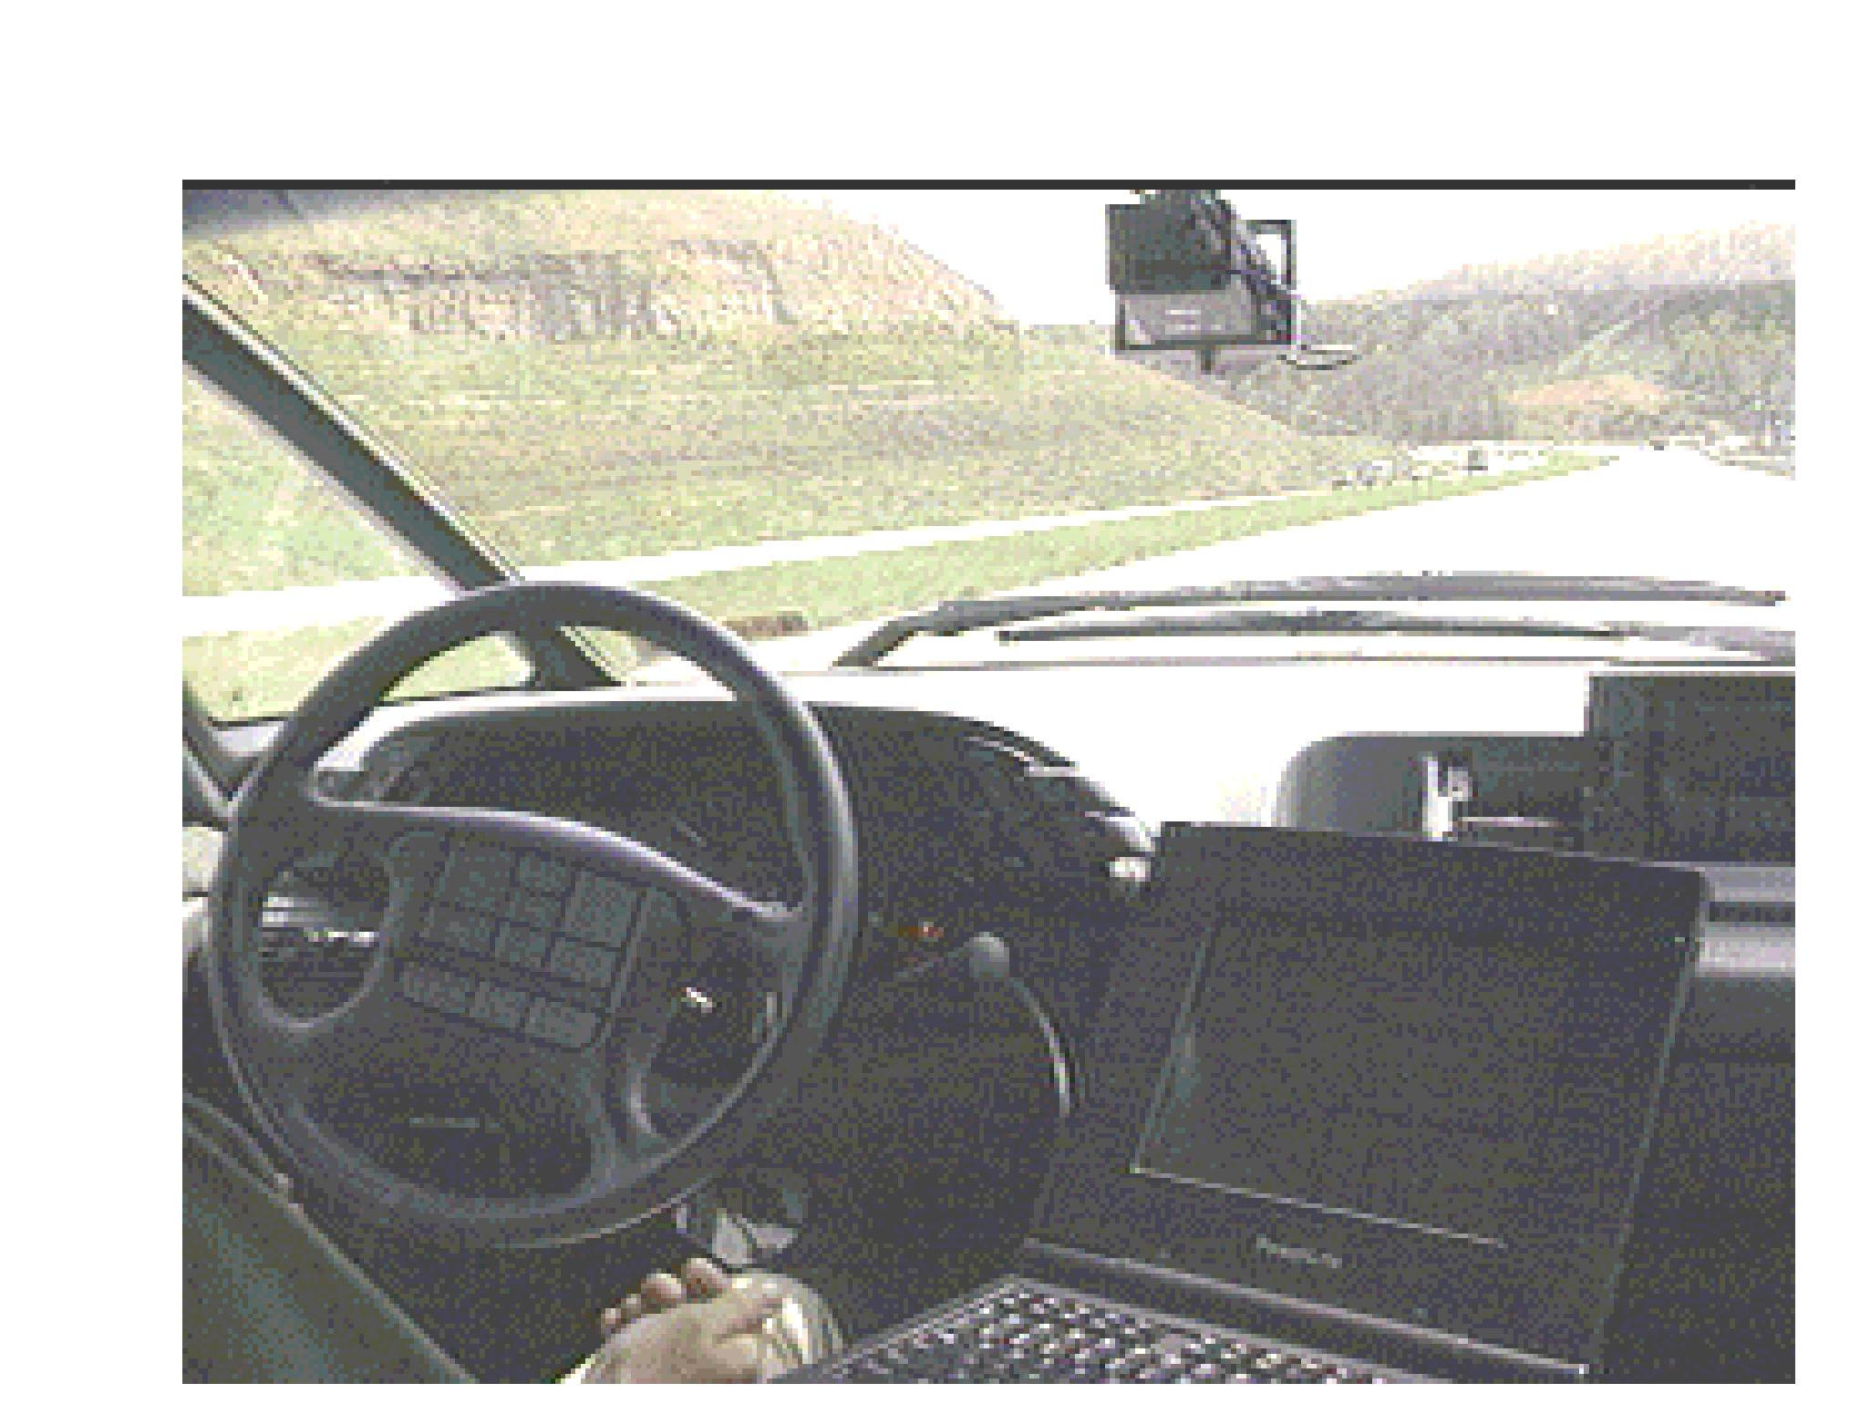
Neural network application
ALVINN: An Autonomous Land Vehicle In a Neural Network
(Carnegie Mellon University Robotics Institute, 1989-1997)
ALVINN is a perception system which learns to control the NAVLAB vehicles by watching a person drive. ALVINN's architecture consists of a single hidden layer back-propagation network. The input layer of the network is a 30x32 unit two dimensional "retina" which receives input from the vehicles video camera. Each input unit is fully connected to a layer of five hidden units which are in turn fully connected to a layer of 30 output units. The output layer is a linear representation of the direction the vehicle should travel in order to keep the vehicle on the road.

Slide 4
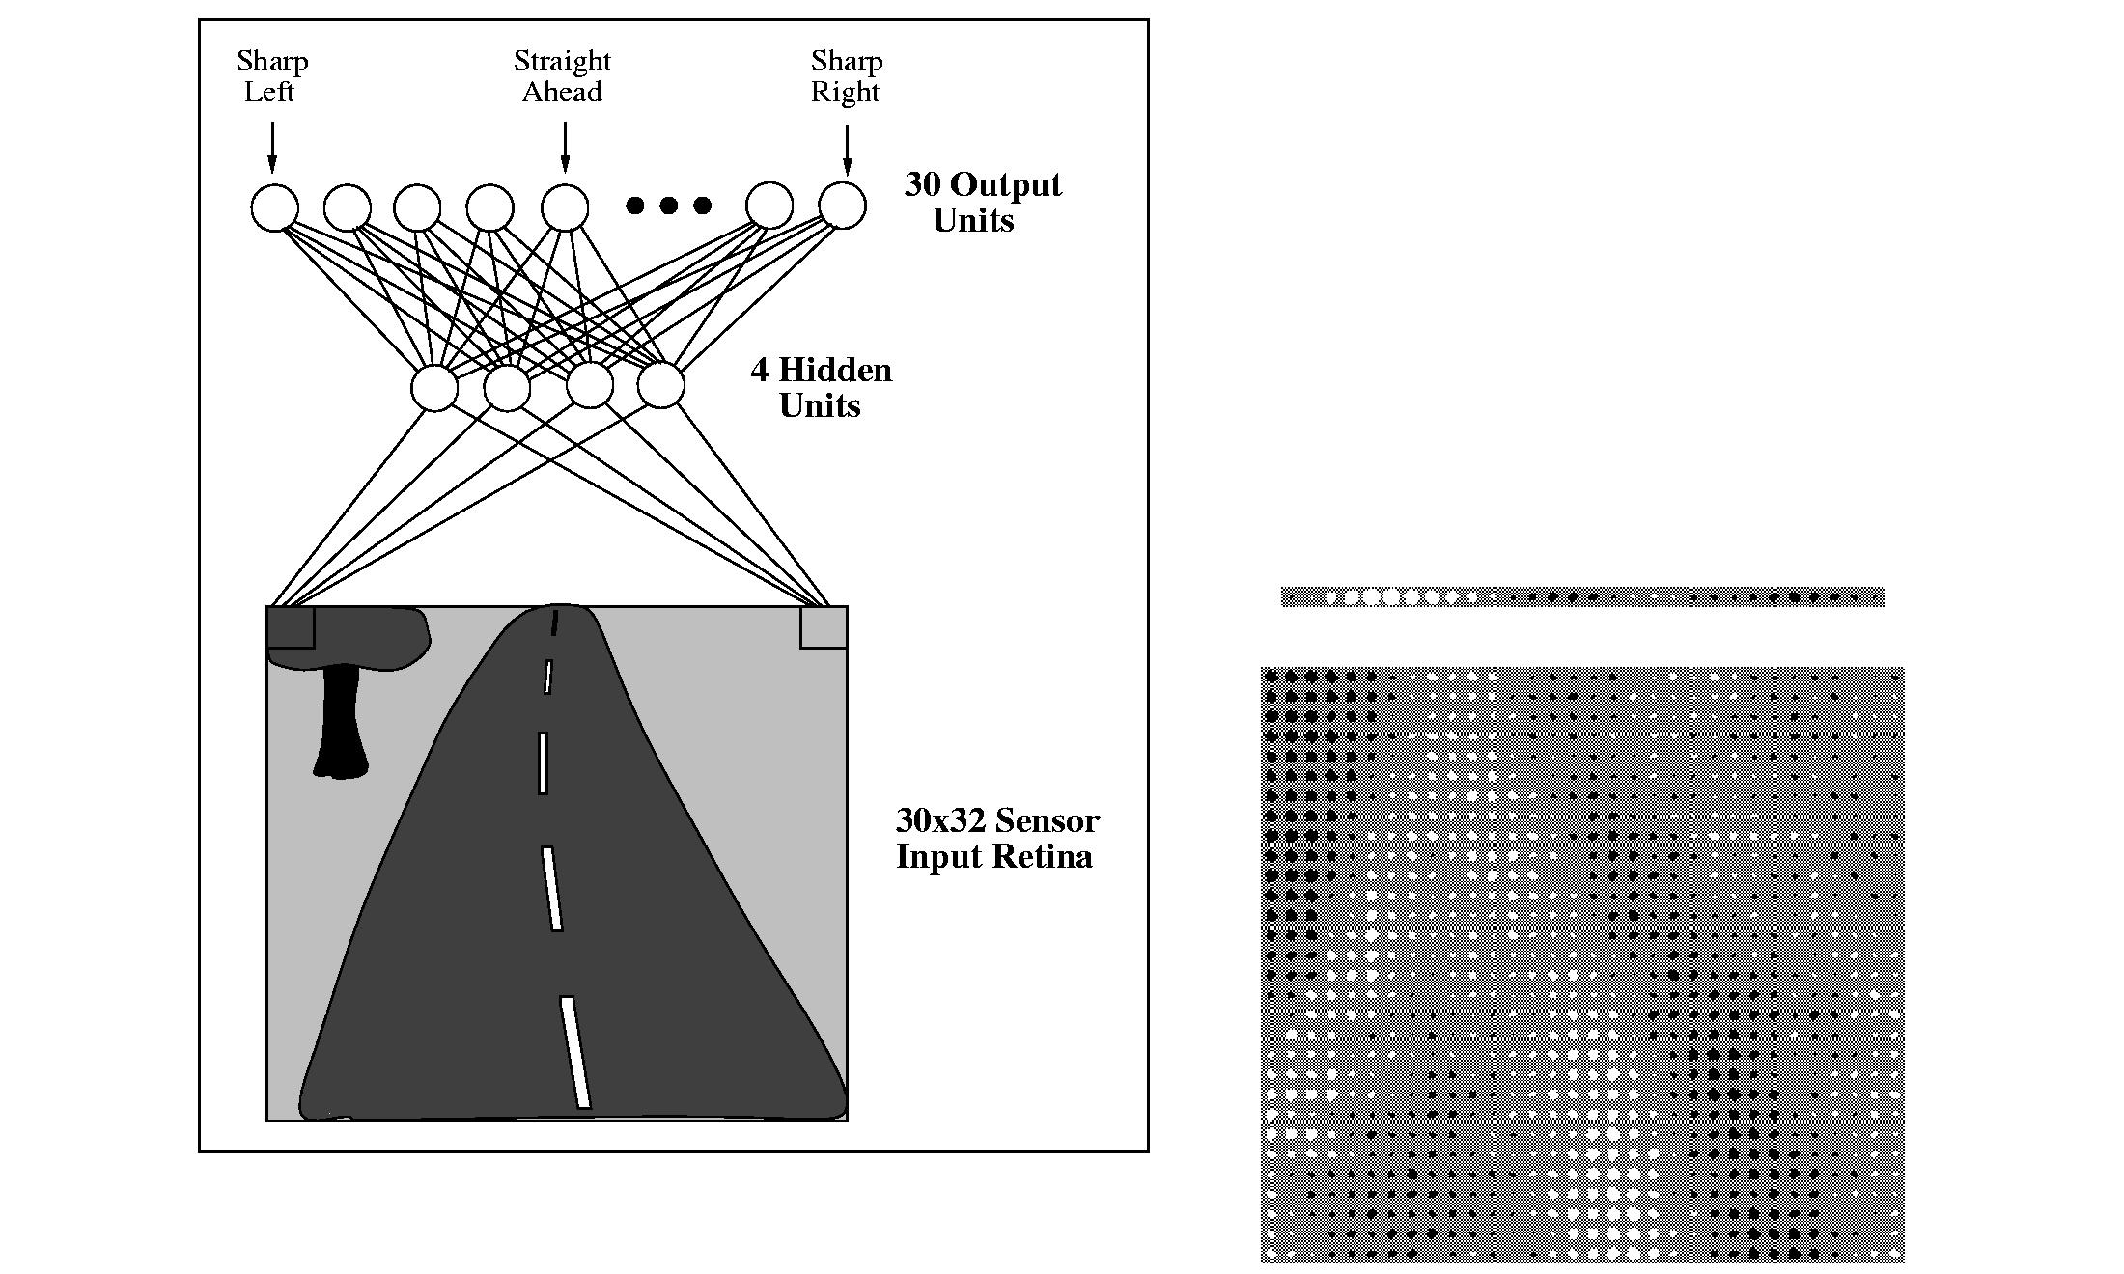
Neural network application
ALVINN drives 70 mph on highways!

Slide 5
General structure of multilayer neural network
hidden unit i
training multilayer neural network means learning the weights of inter-layer connections

Slide 6
Neural network architectures
All multilayer neural network architectures have:
  At least one hidden layer
  Feedforward connections from inputs to hidden layer(s) to outputs
  but more general architectures also allow for:
  Multiple hidden layers
  Recurrent connections
    from a node to itself
    between nodes in the same layer
    between nodes in one layer and nodes in another layer above it

Slide 7
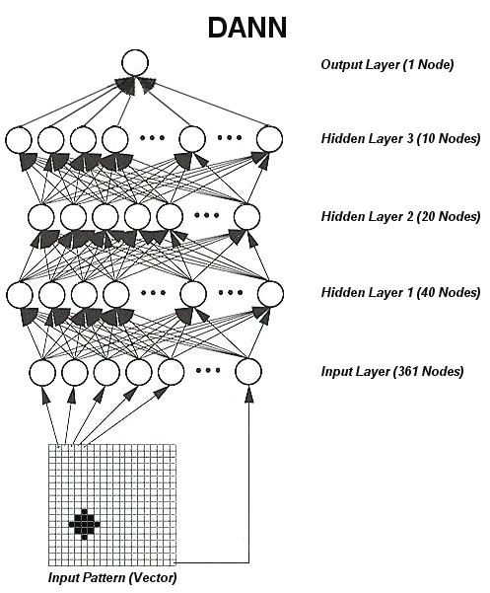
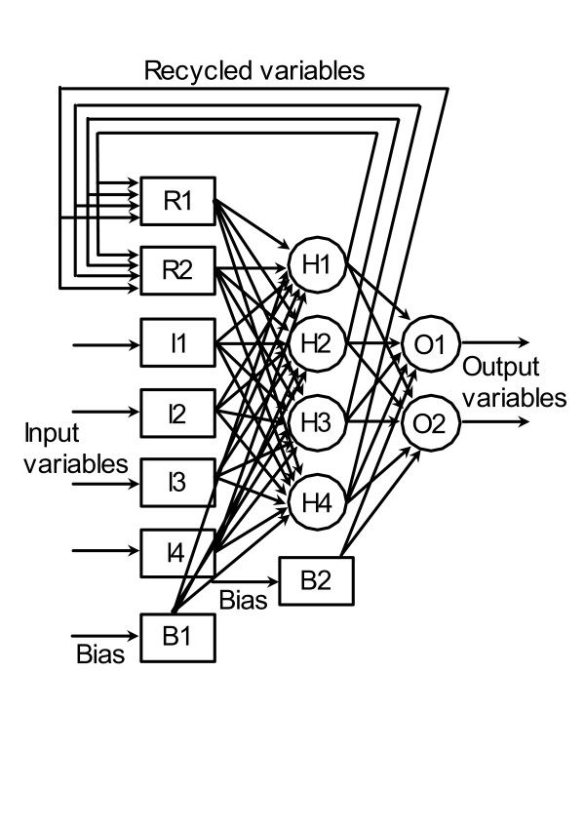
Neural network architectures
Recurrent connections
More than one hidden layer

Slide 8
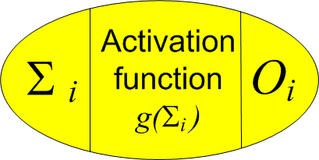
Neural networks: roles of nodes
A node in the input layer:
  distributes value of some component of input vector to the nodes in the first hidden layer, without modification
A node in a hidden layer(s):
  forms weighted sum of its inputs
  transforms this sum according to some
  activation function (also known as transfer function)
  distributes the transformed sum to the nodes in the next layer
A node in the output layer:
  forms weighted sum of its inputs
  (optionally) transforms this sum according to some activation function

Slide 9
Neural network activation functions

Slide 10
Neural network architectures
The architecture most widely used in practice is fairly simple:
  One hidden layer
  No recurrent connections (feedforward only)
  Non-linear activation function in hidden layer (usually sigmoid or tanh)
  No activation function in output layer (summation only)
This architecture can model any bounded continuous function.

Slide 11
Neural network architectures
Regression
Classification: two classes

Slide 12
Neural network architectures
Classification: multiple classes

Slide 13
Classification: multiple classes
When outcomes are one of k possible classes, they can be encoded using k dummy variables.
  If an outcome is class j, then j ^{th} dummy variable = 1, all other dummy variables = 0.
Example with four class labels:

Slide 14
Algorithm for learning neural network
Initialize the connection weights w = (w₀, w₁, …, w_{m})
  w includes all connections between all layers
  Usually small random values
Adjust weights such that output of neural network is consistent with class label / dependent variable of training samples
  Typical loss function is squared error:
  Find weights w_{j} that minimize above loss function

Slide 15
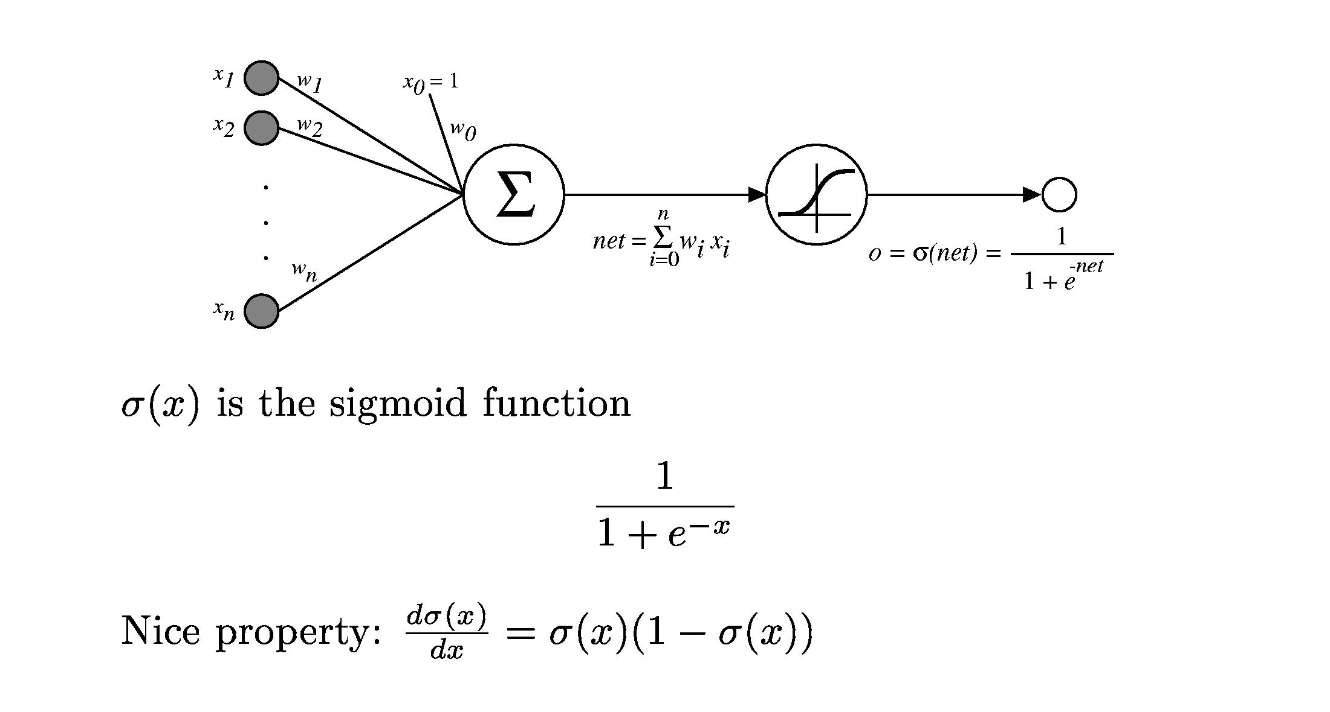
Sigmoid unit

Slide 16
Sigmoid unit: training
We can derive gradient descent rules to train:
  A single sigmoid unit
  Multilayer networks of sigmoid units
    referred to as backpropagation

Slide 17
Backpropagation
Example: stochastic gradient descent, feedforward
network with two layers of sigmoid units
Do until convergence
  For each training sample i = ⟨ x_{i}, y_{i} ⟩
  Propagate the input forward through the network
  Calculate the output o_{h} of every hidden unit
  Calculate the output o_{k} of every network output unit
  Propagate the errors backward through the network
  For each network output unit k, calculate its error term δ_{k}
  δ_{k} = o_{k}( 1 – o_{k} )( y_{ik} – o_{k} )
  For each hidden unit h, calculate its error term δ_{h}
  δ_{h} = o_{h}( 1 – o_{h} ) ∑_{k}( w_{hk}δ_{k} )
  Update each network weight w_{ba}
  w_{ba} = w_{ba} + ηδ_{b}z_{ba}
  where z_{ba} is the a^{th} input to unit b

Slide 18
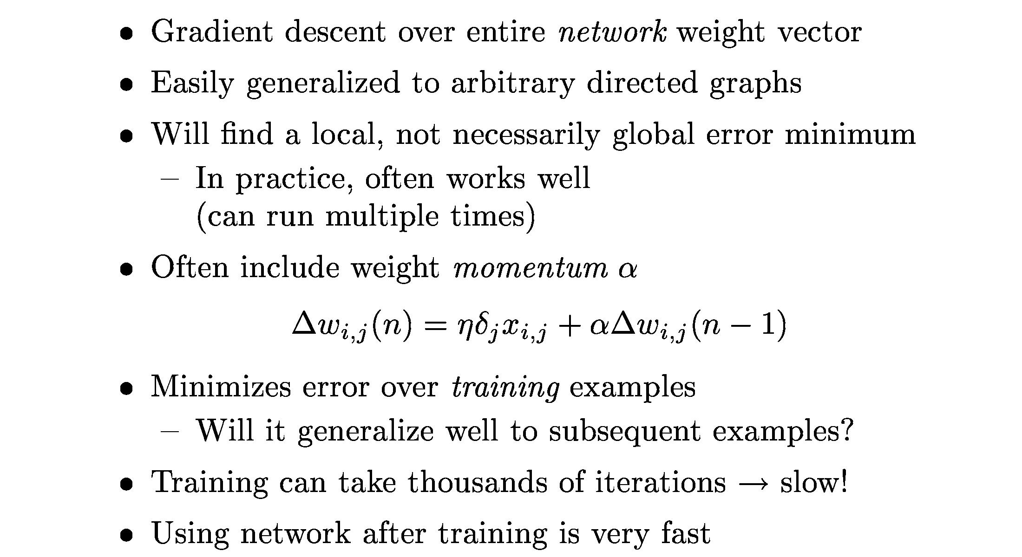
More on backpropagation

Slide 19
MATLAB interlude
matlab_demo_15.m
neural network classification of crab gender
200 samples
6 features
2 classes

Slide 20
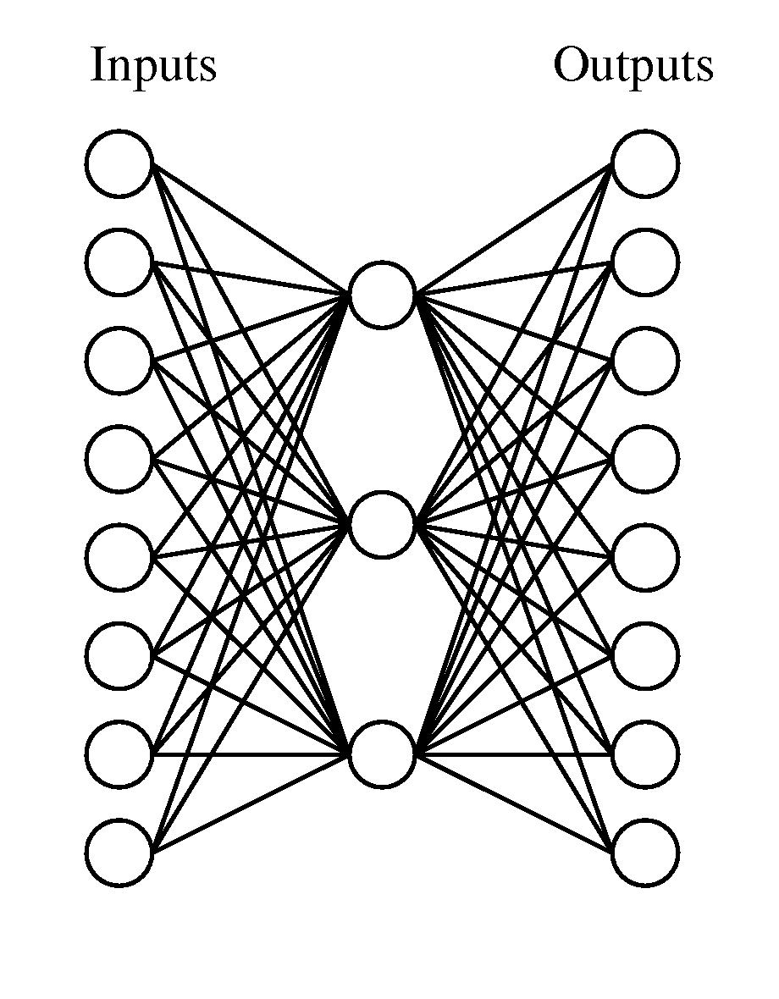
Neural networks for data compression
Goal: learn compressed representation of data
  Number input nodes =
  number of output nodes
  Number of hidden nodes < number of input/output nodes
Train by applying each sample as both input and output
  Otherwise like standard neural network
Learned representation is weights of network

Slide 21
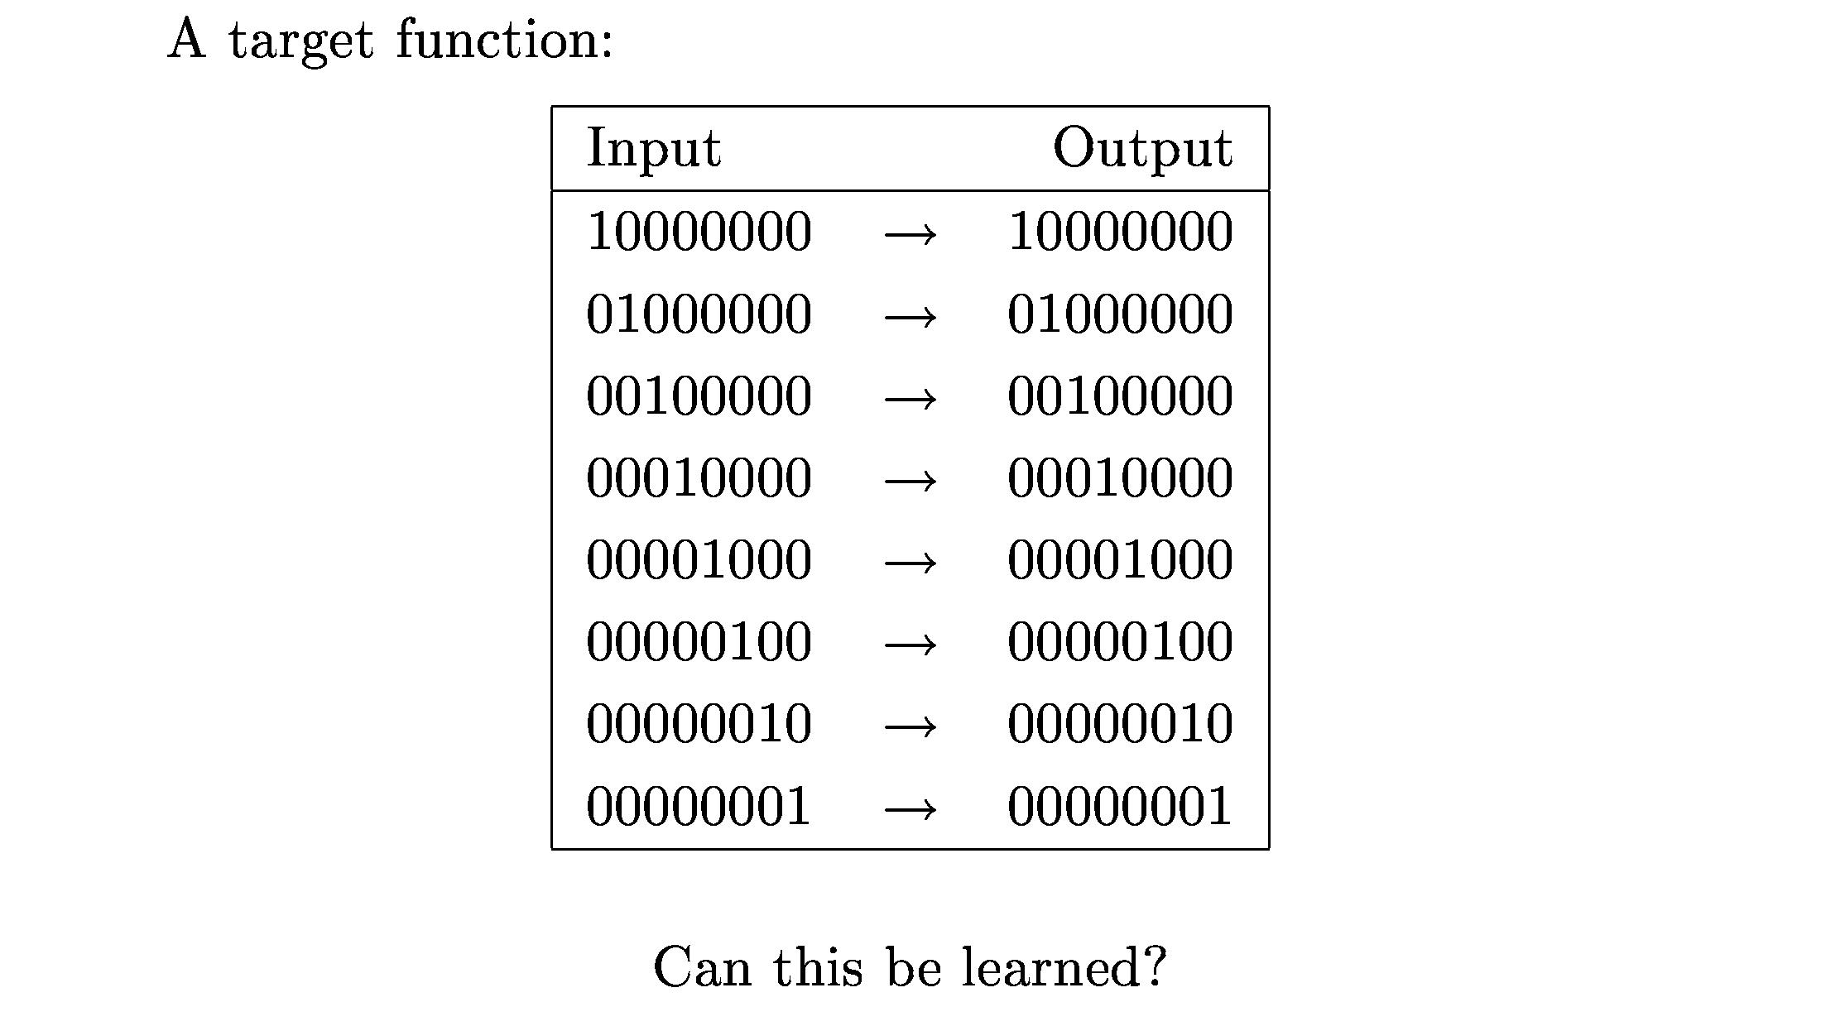
Neural networks for data compression

Slide 22
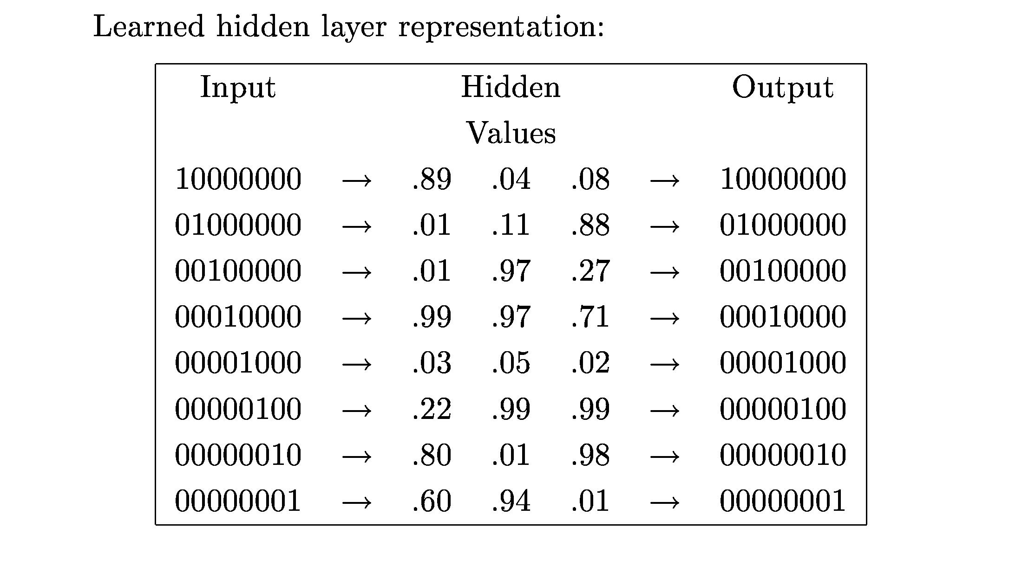
Neural networks for data compression

Slide 23
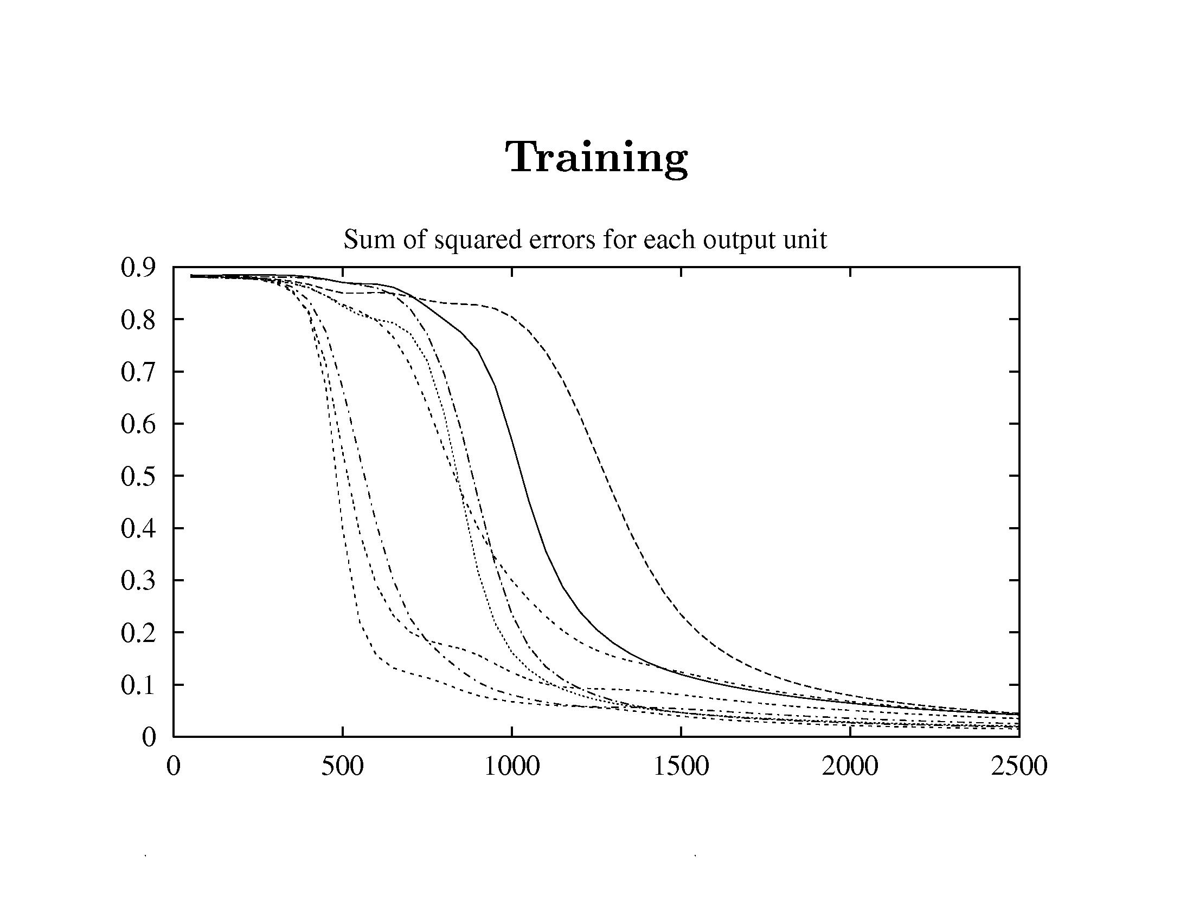

Slide 24
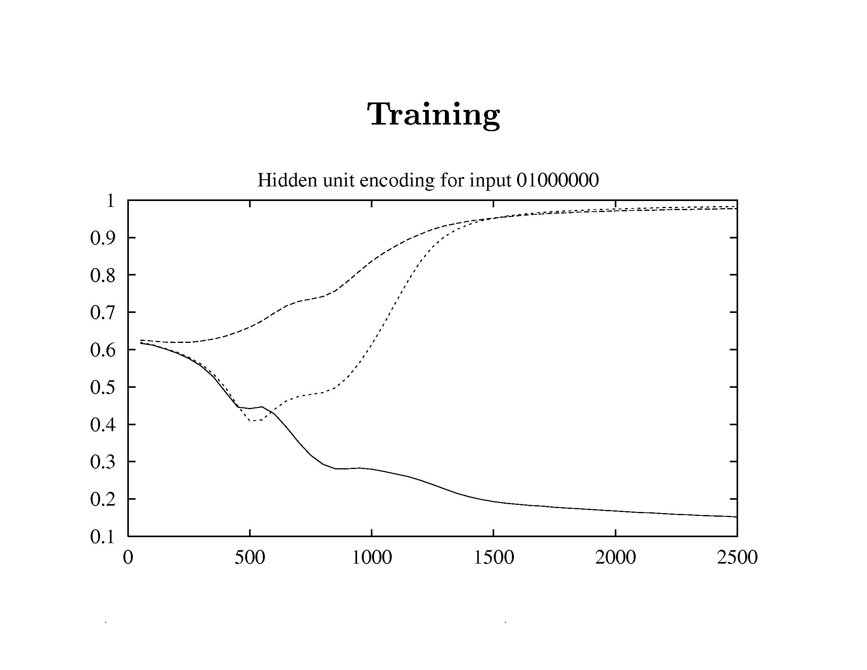

Slide 25
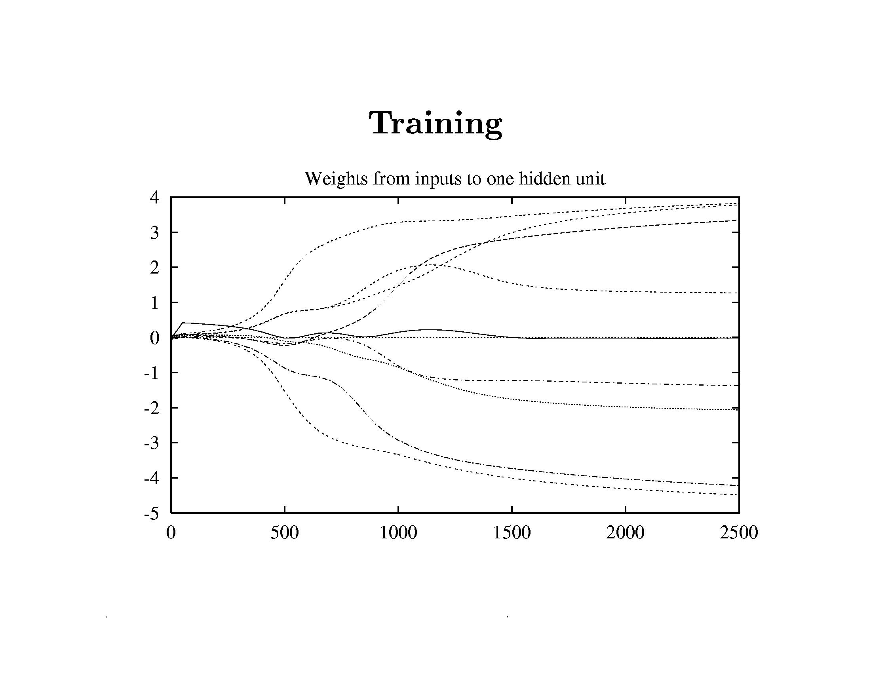

Slide 26
Neural networks for data compression
Once weights are trained:
  Use input > hidden layer weights to encode data
  Store or transmit encoded, compressed form of data
  Use hidden > output layer weights to decode

Slide 27
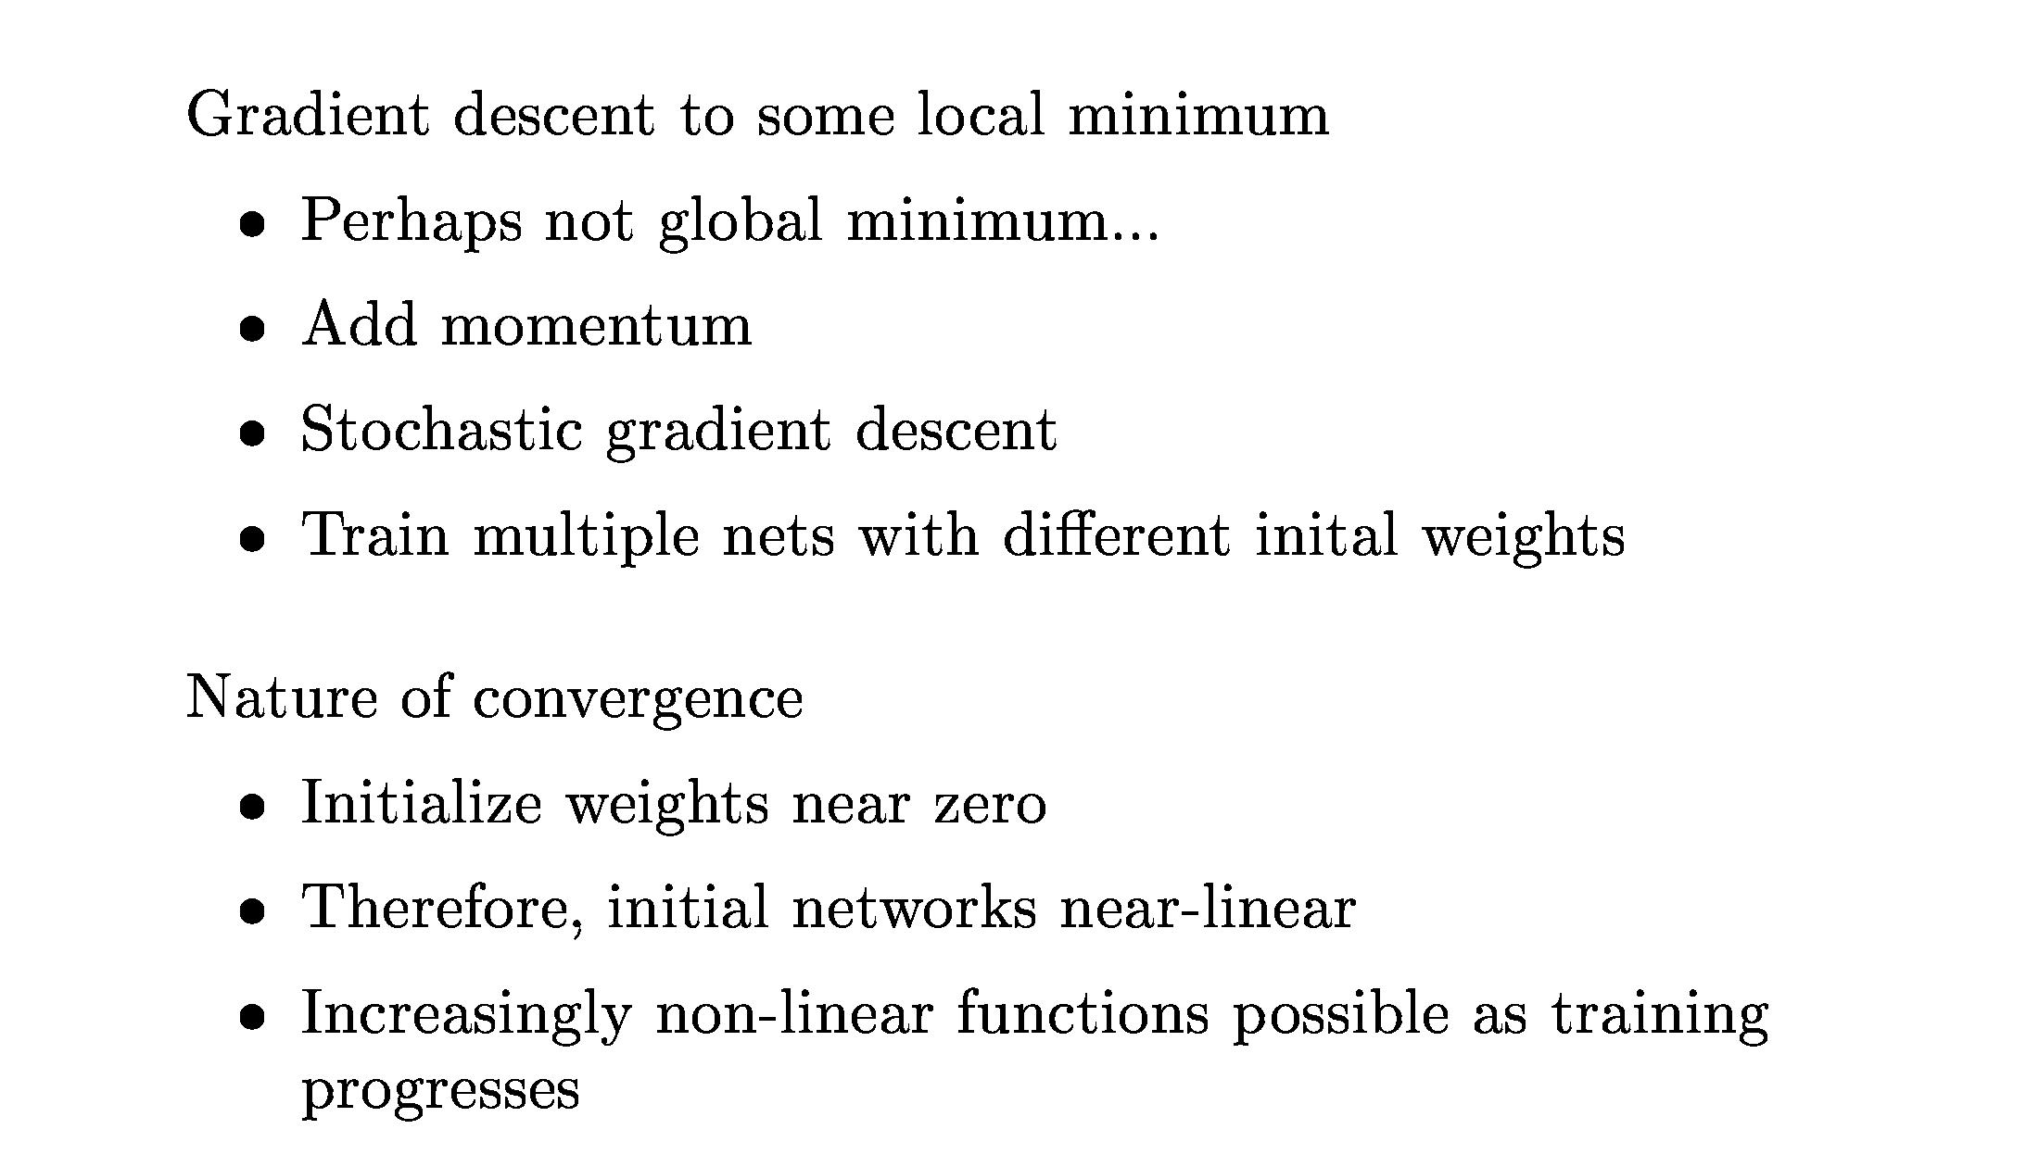
Convergence of backpropagation

Slide 28
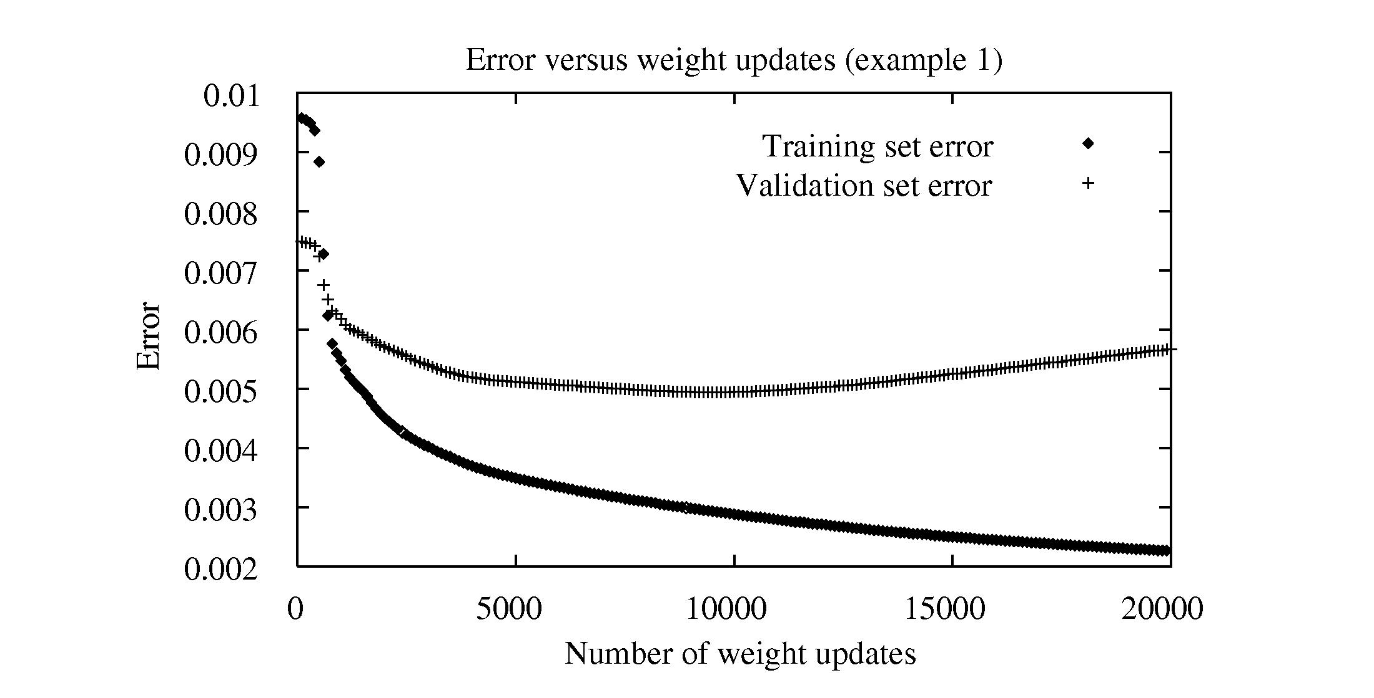
Overfitting in neural networks
Robot perception task (example 1)

Slide 29
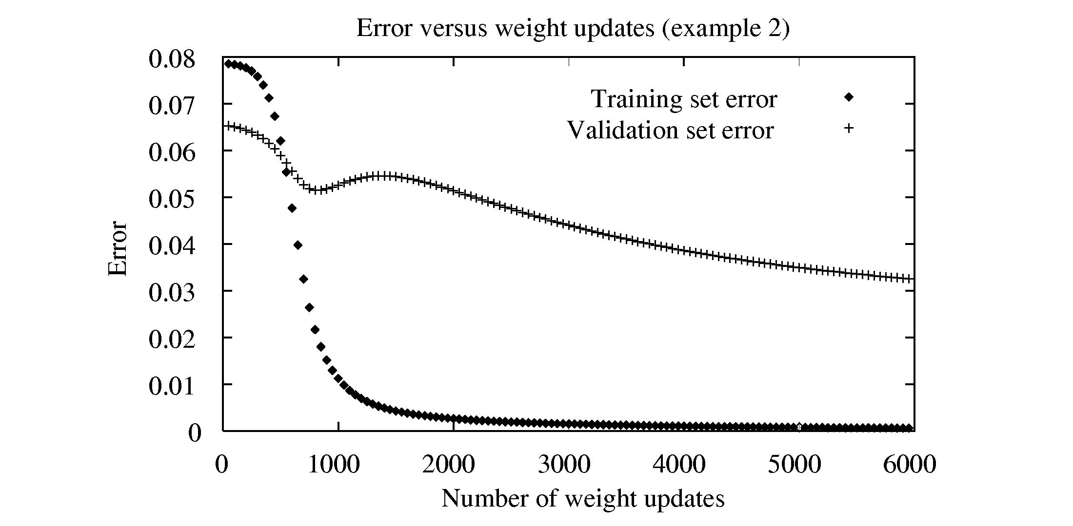
Overfitting in neural networks
Robot perception task (example 2)

Slide 30
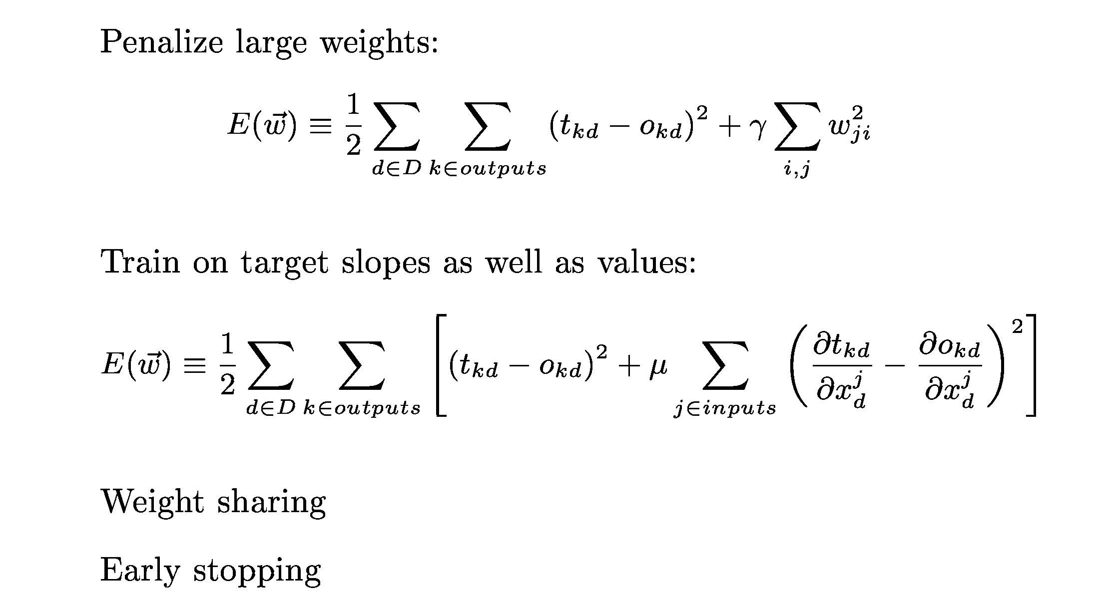
Avoiding overfitting in neural networks

Slide 31
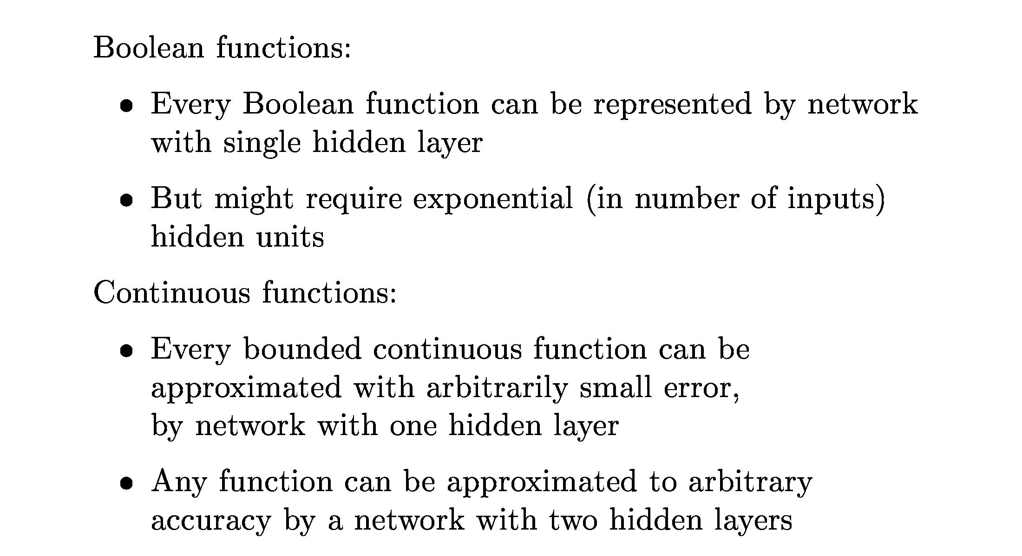
Expressiveness of multilayer neural networks

Slide 32
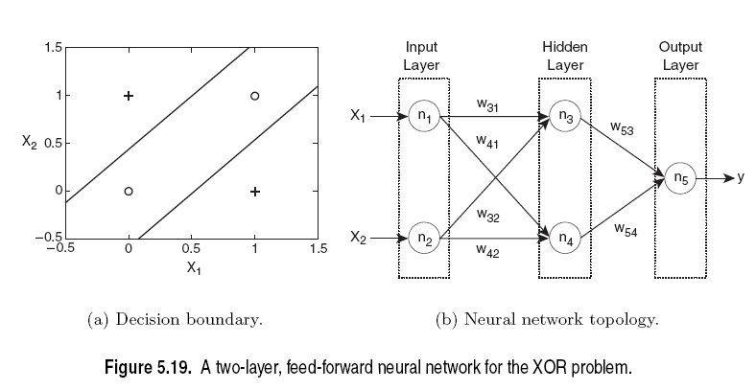
Expressiveness of multilayer neural networks

Slide 33
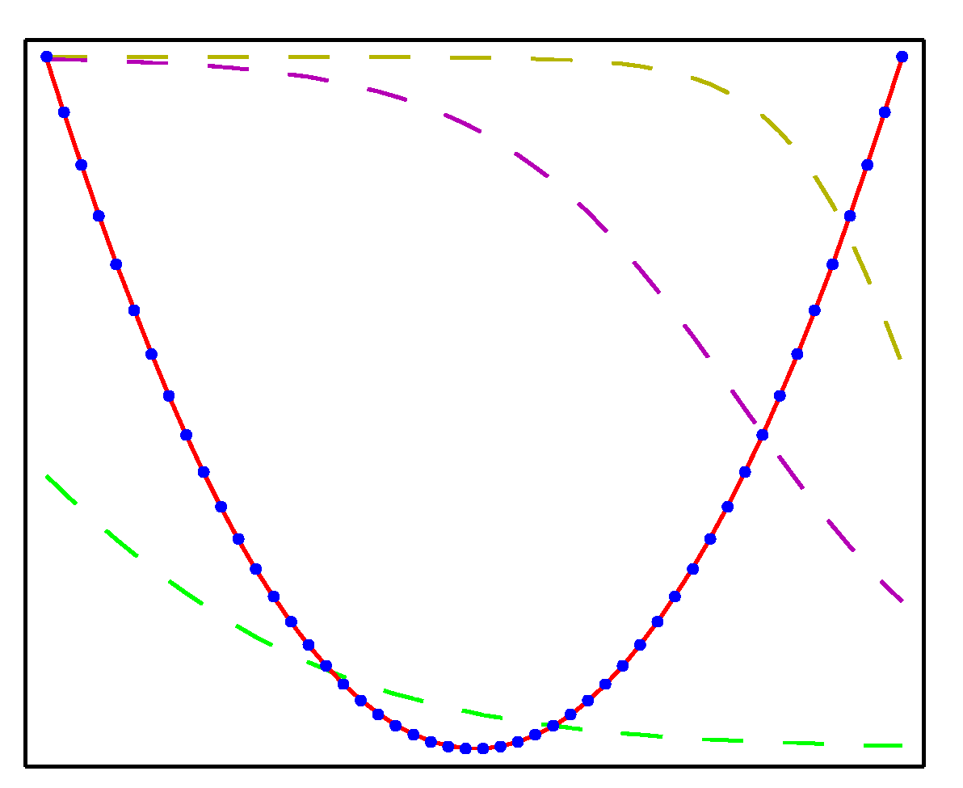
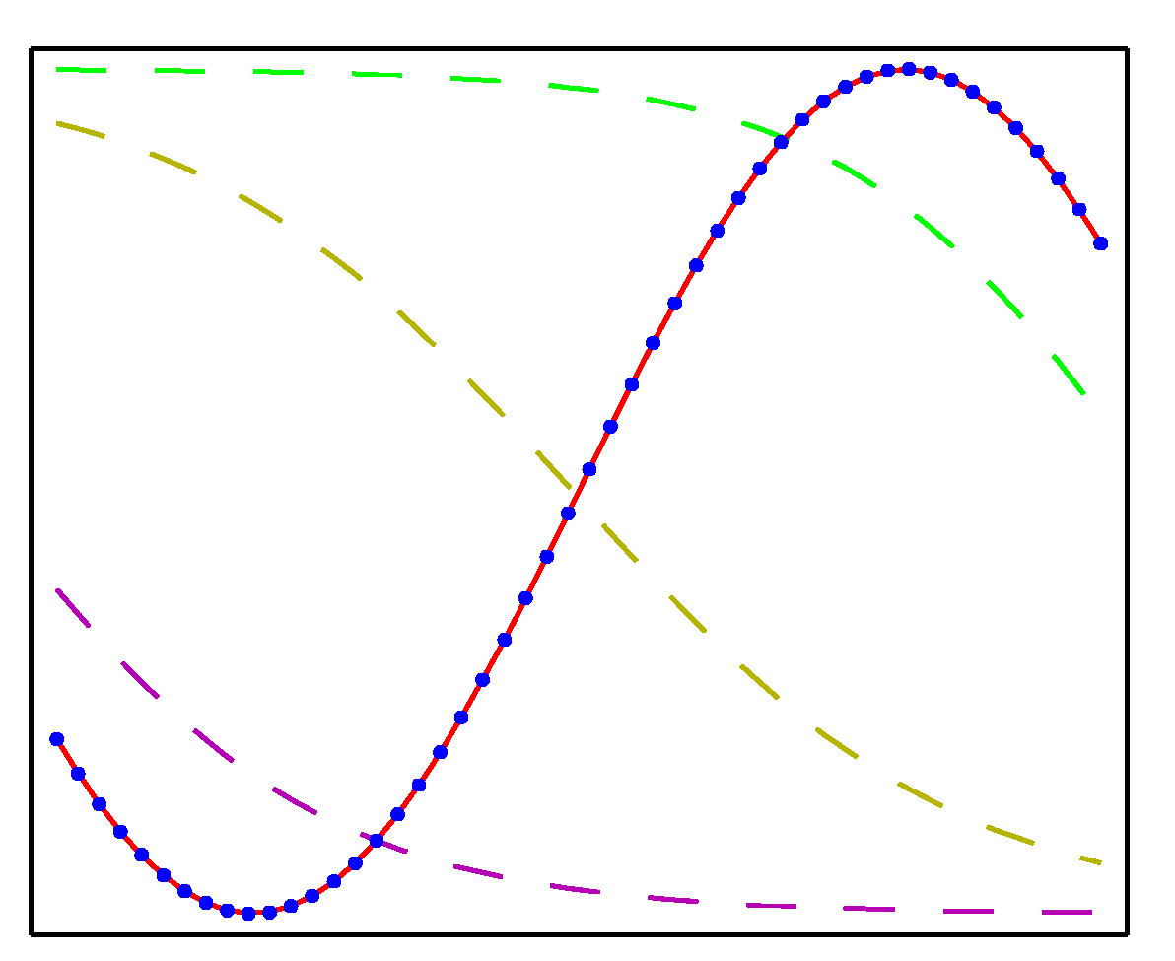
Expressiveness of multilayer neural networks
Trained two-layer network with three hidden units (tanh activation function) and one linear output unit.
  Blue dots: 50 data points from f( x ), where x uniformly sampled over range ( -1, 1 ).
  Grey dashed curves: outputs of the three hidden units.
  Red curve: overall network function.
f( x ) = x²
f( x ) = sin( x )

Slide 34
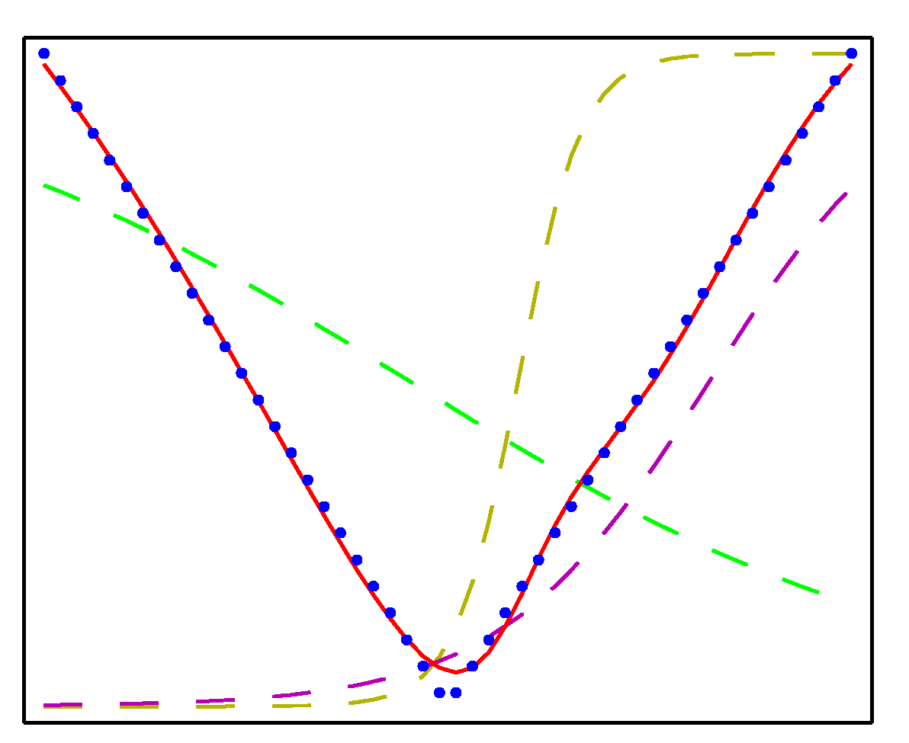
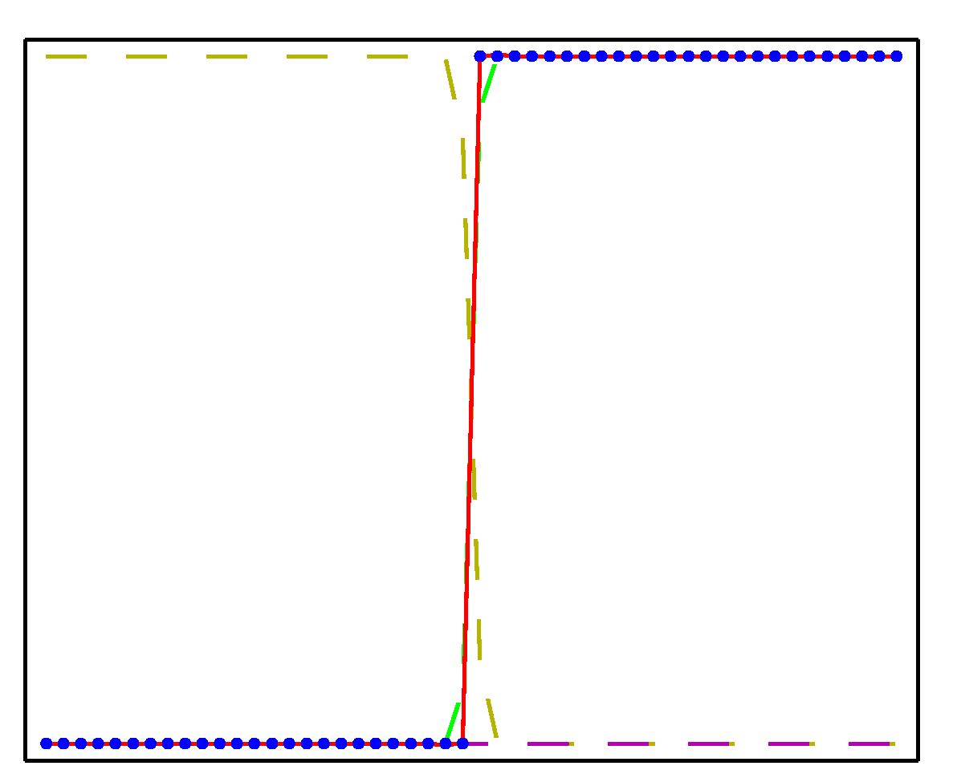
Expressiveness of multilayer neural networks
Trained two-layer network with three hidden units (tanh activation function) and one linear output unit.
  Blue dots: 50 data points from f( x ), where x uniformly sampled over range ( -1, 1 ).
  Grey dashed curves: outputs of the three hidden units.
  Red curve: overall network function.
f( x ) = abs( x )
f( x ) = H( x )
Heaviside step function

Slide 35
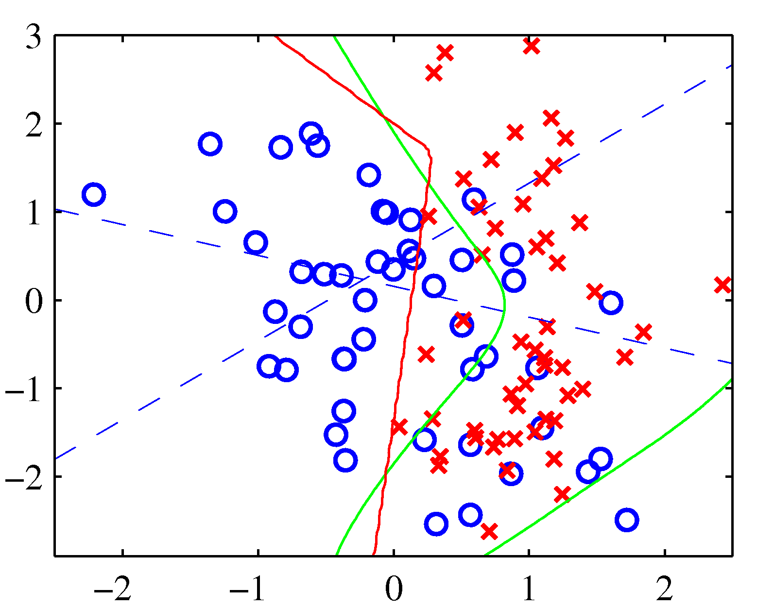
Expressiveness of multilayer neural networks
Two-class classification problem with synthetic data.
Trained two-layer network with two inputs, two hidden units (tanh activation function) and one logistic sigmoid output unit.
  Blue lines:
  z = 0.5 contours for hidden
  units
  Red line:
  y = 0.5 decision surface
  for overall network
  Green line:
  optimal decision boundary
  computed from distributions
  used to generate data

Slide 36
Equivalence of neural networks with other learning algorithms
Each hidden unit is a logistic regression model, whose w vector is being trained while trying to match multiple, competing outputs.
logistic transfer function
linear transfer function

Slide 37
Equivalence of neural networks with other learning algorithms
This entire network is equivalent to:
linear transfer function
Matrix factorization!
linear transfer function

