Slide 1
Anomaly Detection
  Some slides taken or adapted from:
  “Anomaly Detection: A Tutorial”
  Arindam Banerjee, Varun Chandola, Vipin Kumar, Jaideep Srivastava, University of Minnesota
  Aleksandar Lazarevic, United Technology Research Center

Slide 2
Anomaly detection
Anomalies and outliers
are essentially
the same thing:
objects that are different from most other objects
The techniques used for detection are the same.

Slide 3
Anomaly detection
Historically, the field of statistics tried to find and remove outliers as a way to improve analyses.
There are now many fields where the outliers / anomalies are the objects of greatest interest.
  The rare events may be the ones with the greatest impact, and often in a negative way.

Slide 4
Causes of anomalies
Data from different class of object or underlying mechanism
  disease vs. non-disease
  fraud vs. not fraud
Natural variation
  tails on a Gaussian distribution
Data measurement and collection errors

Slide 5
Structure of anomalies
Point anomalies
Contextual anomalies
Collective anomalies

Slide 6
Point anomalies
An individual data instance is anomalous with respect to the data
Y
N₁
o₁
O₃
o₂
N₂
X

Slide 7
Contextual anomalies
An individual data instance is anomalous within a context
Requires a notion of context
Also referred to as conditional anomalies *
Anomaly
Normal
* Song, et al, “Conditional Anomaly Detection”, IEEE Transactions on Data and Knowledge Engineering, 2006.

Slide 8
Collective anomalies
A collection of related data instances is anomalous
Requires a relationship among data instances
  Sequential data
  Spatial data
  Graph data
The individual instances within a collective anomaly are not anomalous by themselves
anomalous subsequence

Slide 9
Applications of anomaly detection
Network intrusion
Insurance / credit card fraud
Healthcare informatics / medical diagnostics
Industrial damage detection
Image processing / video surveillance
Novel topic detection in text mining
…

Slide 10


Intrusion detection
Intrusion detection
  Monitor events occurring in a computer system or network and analyze them for intrusions
  Intrusions defined as attempts to bypass the security mechanisms of a computer or network ‏
Challenges
  Traditional intrusion detection systems are
  based on signatures of known attacks and
  cannot detect emerging cyber threats
  Substantial latency in deployment of newly
  created signatures across the computer
  system
Anomaly detection can alleviate these
limitations

Slide 11
Fraud detection
Detection of criminal activities occurring in commercial organizations.
Malicious users might be:
  Employees
  Actual customers
  Someone posing as a customer (identity theft)
Types of fraud
  Credit card fraud
  Insurance claim fraud
  Mobile / cell phone fraud
  Insider trading
Challenges
  Fast and accurate real-time detection
  Misclassification cost is very high

Slide 12

Healthcare informatics
Detect anomalous patient records
  Indicate disease outbreaks, instrumentation errors, etc.
Key challenges
  Only normal labels available
  Misclassification cost is very high
  Data can be complex: spatio-temporal

Slide 13

Industrial damage detection
Detect faults and failures in complex industrial systems, structural damages, intrusions in electronic security systems, suspicious events in video surveillance, abnormal energy consumption, etc.
  Example: aircraft safety
    anomalous aircraft (engine) / fleet usage
    anomalies in engine combustion data
    total aircraft health and usage management
Key challenges
  Data is extremely large, noisy, and unlabelled
  Most of applications exhibit temporal behavior
  Detected anomalous events typically require immediate intervention

Slide 14

Image processing
Detecting outliers in a image monitored over time
Detecting anomalous regions within an image
Used in
  mammography image analysis
  video surveillance
  satellite image analysis
Key Challenges
  Detecting collective anomalies
  Data sets are very large
Anomaly

Slide 15
Use of data labels in anomaly detection
Supervised anomaly detection
  Labels available for both normal data and anomalies
  Similar to classification with high class imbalance
Semi-supervised anomaly detection
  Labels available only for normal data
Unsupervised anomaly detection
  No labels assumed
  Based on the assumption that anomalies are very rare compared to normal data

Slide 16
Output of anomaly detection
Label
  Each test instance is given a normal or anomaly label
  Typical output of classification-based approaches
Score
  Each test instance is assigned an anomaly score
    allows outputs to be ranked
    requires an additional threshold parameter

Slide 17
Variants of anomaly detection problem
Given a dataset D, find all the data points
x ∈ D with anomaly scores greater than some threshold t.
Given a dataset D, find all the data points
x ∈ D having the top-n largest anomaly scores.
Given a dataset D, containing mostly normal data points, and a test point x, compute the anomaly score of x with respect to D.

Slide 18
Unsupervised anomaly detection
No labels available
Based on assumption that anomalies are very rare compared to “normal” data
General steps
  Build a profile of “normal” behavior
    summary statistics for overall population
    model of multivariate data distribution
  Use the “normal” profile to detect anomalies
    anomalies are observations whose characteristics
    differ significantly from the normal profile

Slide 19
Techniques for anomaly detection
Statistical
Proximity-based
Density-based
Clustering-based
[ following slides illustrate these techniques for
unsupervised detection of point anomalies ]

Slide 20
Statistical outlier detection
Outliers are objects that are fit
poorly by a statistical model.
Estimate a parametric model describing the distribution of the data
Apply a statistical test that depends on
  Properties of test instance
  Parameters of model (e.g., mean, variance)
  Confidence limit (related to number of expected outliers)

Slide 21
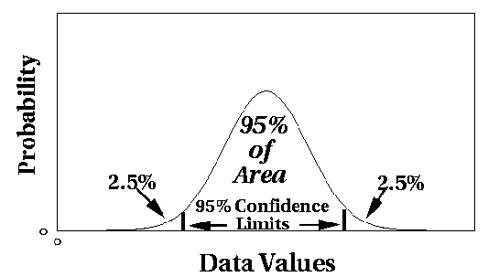
Statistical outlier detection
Univariate Gaussian distribution
  Outlier defined by z-score > threshold

Slide 22
Statistical anomaly detection
Multivariate Gaussian distribution
  Outlier defined by Mahalanobis distance > threshold
 | Distance
 | Euclidean | Mahalanobis
A | 5.7 | 35
B | 7.1 | 24

Slide 23
Grubbs’ test
Detect outliers in univariate data
Assume data comes from normal distribution
Detects one outlier at a time, remove the outlier, and repeat
  H₀: There is no outlier in data
  H_{A}: There is at least one outlier
Grubbs’ test statistic:
Reject H₀ if:

Slide 24
Likelihood approach
Assume the dataset D contains samples from a mixture of two probability distributions:
  M (majority distribution)
  A (anomalous distribution)
General approach:
  Initially, assume all the data points belong to M
  Let L_{t}(D) be the log likelihood of D at time t
  For each point x_{t} that belongs to M, move it to A
    Let L_{t+1} (D) be the new log likelihood.
    Compute the difference, Δ = L_{t}(D) – L_{t+1} (D)
    If Δ > c (some threshold), then x_{t} is declared as an anomaly and moved permanently from M to A

Slide 25
Likelihood approach
Data distribution, D = (1 – λ) M + λ A
M is a probability distribution estimated from data
  Can be based on any modeling method (naïve Bayes, maximum entropy, etc)
A is initially assumed to be uniform distribution
Likelihood at time t:

Slide 26
Statistical outlier detection
Pros
  Statistical tests are well-understood and well-validated.
  Quantitative measure of degree to which object is an outlier.
Cons
  Data may be hard to model parametrically.
    multiple modes
    variable density
  In high dimensions, data may be insufficient to estimate true distribution.

Slide 27
Proximity-based outlier detection
Outliers are objects far away from other objects.
Common approach:
  Outlier score is distance to k^{th} nearest neighbor.
  Score sensitive to choice of k.

Slide 28
Proximity-based outlier detection

Slide 29
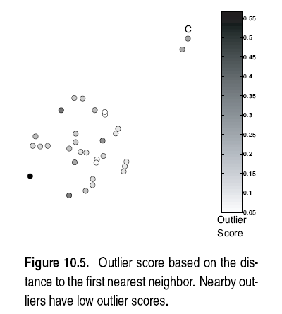
Proximity-based outlier detection

Slide 30
Proximity-based outlier detection

Slide 31
Proximity-based outlier detection

Slide 32
Proximity-based outlier detection
Pros
  Easier to define a proximity measure for a dataset than determine its statistical distribution.
  Quantitative measure of degree to which object is an outlier.
  Deals naturally with multiple modes.
Cons
  O(n²) complexity.
  Score sensitive to choice of k.
  Does not work well if data has widely variable density.

Slide 33
Density-based outlier detection
Outliers are objects in regions of low density.
Outlier score is inverse of density around object.
Scores usually based on proximities.
Example scores:
  Reciprocal of average distance to k nearest neighbors:
  Number of objects within fixed radius d (DBSCAN).
  These two example scores work poorly if data has variable density.

Slide 34
Density-based outlier detection
Relative density outlier score (Local Outlier Factor, LOF)
  Reciprocal of average distance to k nearest neighbors, relative to that of those k neighbors.

Slide 35
Density-based outlier detection
relative density (LOF) outlier scores

Slide 36
Density-based outlier detection
Pros
  Quantitative measure of degree to which object is an outlier.
  Can work well even if data has variable density.
Cons
  O(n²) complexity
  Must choose parameters
    k for nearest neighbor
    d for distance threshold

Slide 37
Cluster-based outlier detection
Outliers are objects that do not
belong strongly to any cluster.
Approaches:
  Assess degree to which object belongs to any cluster.
  Eliminate object(s) to improve objective function.
  Discard small clusters far from other clusters.
Issue:
  Outliers may affect initial formation of clusters.

Slide 38
Cluster-based outlier detection
Assess degree to which object
belongs to any cluster.
For prototype-based clustering (e.g. k-means), use distance to cluster centers.
  To deal with variable density clusters, use relative distance:
Similar concepts for density-based or connectivity-based clusters.

Slide 39
Cluster-based outlier detection
distance of points from nearest centroid

Slide 40
Cluster-based outlier detection
relative distance of points from nearest centroid

Slide 41
Cluster-based outlier detection
Eliminate object(s) to improve objective function.
Form initial set of clusters.
Remove the object which most improves objective function.
Repeat step 2) until …

Slide 42
Cluster-based outlier detection
Discard small clusters far from other clusters.
Need to define thresholds for “small” and “far”.

Slide 43
Cluster-based outlier detection
Pro:
  Some clustering techniques have O(n) complexity.
  Extends concept of outlier from single objects to groups of objects.
Cons:
  Requires thresholds for minimum size and distance.
  Sensitive to number of clusters chosen.
  Hard to associate outlier score with objects.
  Outliers may affect initial formation of clusters.

Slide 44
One-class support vector machines
Data is unlabelled, unlike usual SVM setting.
Goal: find hyperplane (in higher-dimensional kernel space) which encloses as much data as possible with minimum volume.
  Tradeoff between amount of data enclosed and tightness of enclosure; controlled by regularization of slack variables.

Slide 45
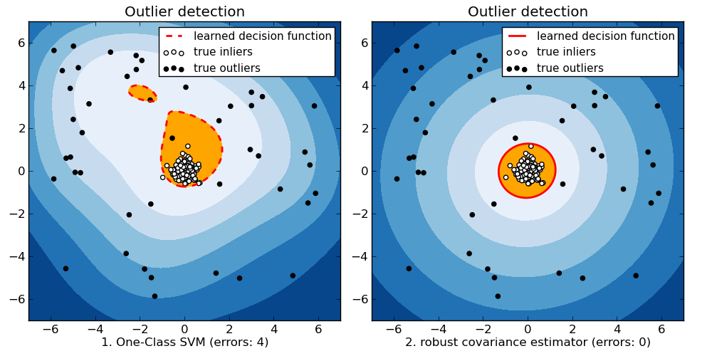
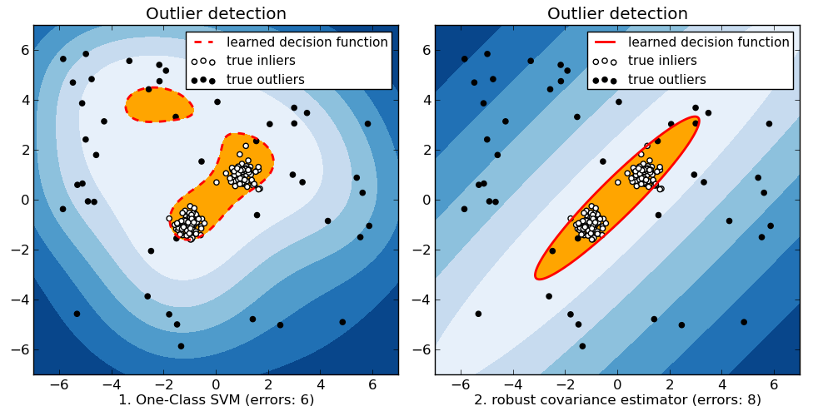
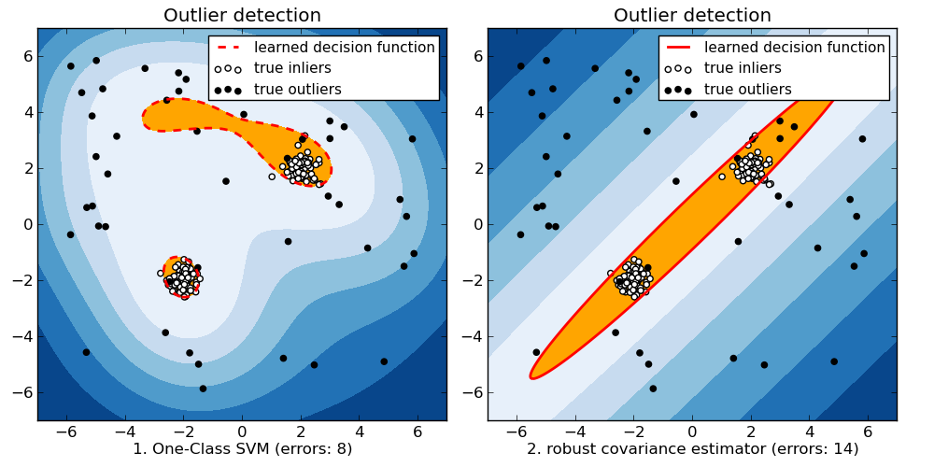
One-class SVM vs. Gaussian envelope
Images from http://scikit-learn.org/stable/modules/outlier_detection.html

Slide 46
One-class SVM demo
LIBSVM
  http://www.csie.ntu.edu.tw/~cjlin/libsvm/
-s 2 -t 2 -g 50 -n 0.35

Slide 47
Anomaly detection on real network data
Three groups of features
  Basic features of individual TCP connections
    source & destination IP Features 1 & 2
    source & destination port Features 3 & 4
    Protocol Feature 5
    Duration Feature 6
    Bytes per packets Feature 7
    number of bytes Feature 8
  Time based features
    For the same source (destination) IP address, number of unique destination (source) IP addresses inside the network in last T seconds – Features 9 (13)
    Number of connections from source (destination) IP to the same destination (source) port in last T seconds – Features 11 (15)
  Connection based features
    For the same source (destination) IP address, number of unique destination (source) IP addresses inside the network in last N connections - Features 10 (14)
    Number of connections from source (destination) IP to the same destination (source) port in last N connections - Features 12 (16)

Slide 48
Typical anomaly detection output
Anomalous connections that correspond to the “slammer” worm
Anomalous connections that correspond to the ping scan
Connections corresponding to Univ. Minnesota machines connecting to “half-life” game servers

Slide 49
Real-world issues in anomaly detection
Data often streaming, not static
  Credit card transactions
Anomalies can be bursty
  Network intrusions

Slide 50
Quote of the day
An excerpt from advice given by a machine
learning veteran on StackOverflow:
“ … you are training and testing on the same data.
A kitten dies every time this happens.”

