Slide 1
Seizure prediction and machine learning
Jeff Howbert
March 11, 2014

Slide 2
Epilepsy
Group of long-term neurological disorders characterized by epileptic seizures.
Seizures involve excessive, abnormal nerve discharge in cerebral cortex.
Wide spectrum of severity and symptoms.
About 60% of patients have convulsive seizures with loss of consciousness.
Frequency of episodes varies from several per day to a few per year.
Underlying causes mostly obscure.
Common disorder affecting 1% of world’s population.

Slide 3
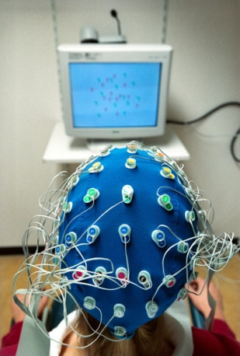
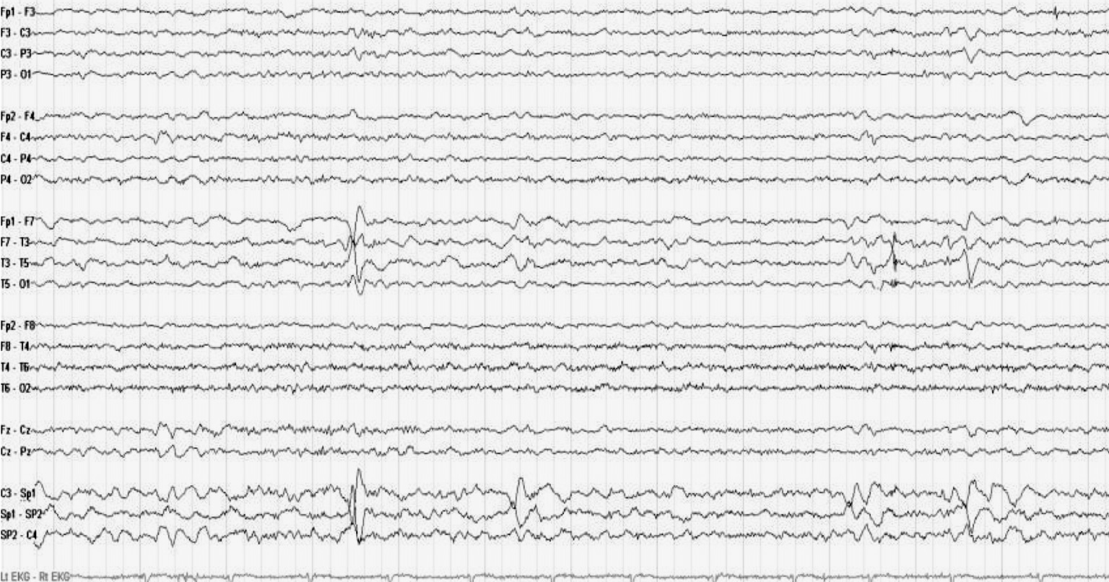
Electroencephalography (EEG)
http://teddybrain.files.wordpress.com/2013/02/interictal-eeg-of-mesial-temporal-lobe-epilepsy.jpg

Slide 4
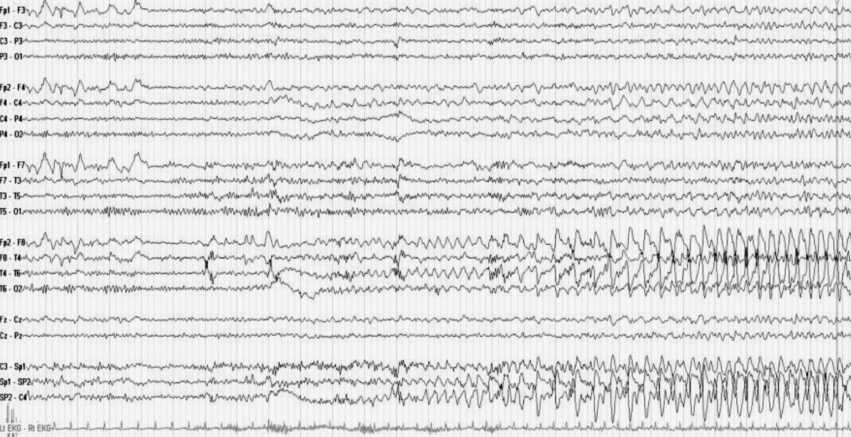
EEG of temporal lobe epilepsy
http://teddybrain.files.wordpress.com/2013/02/ictal-eeg-of-mesial-temporal-lobe-epilepsy.jpg

Slide 5
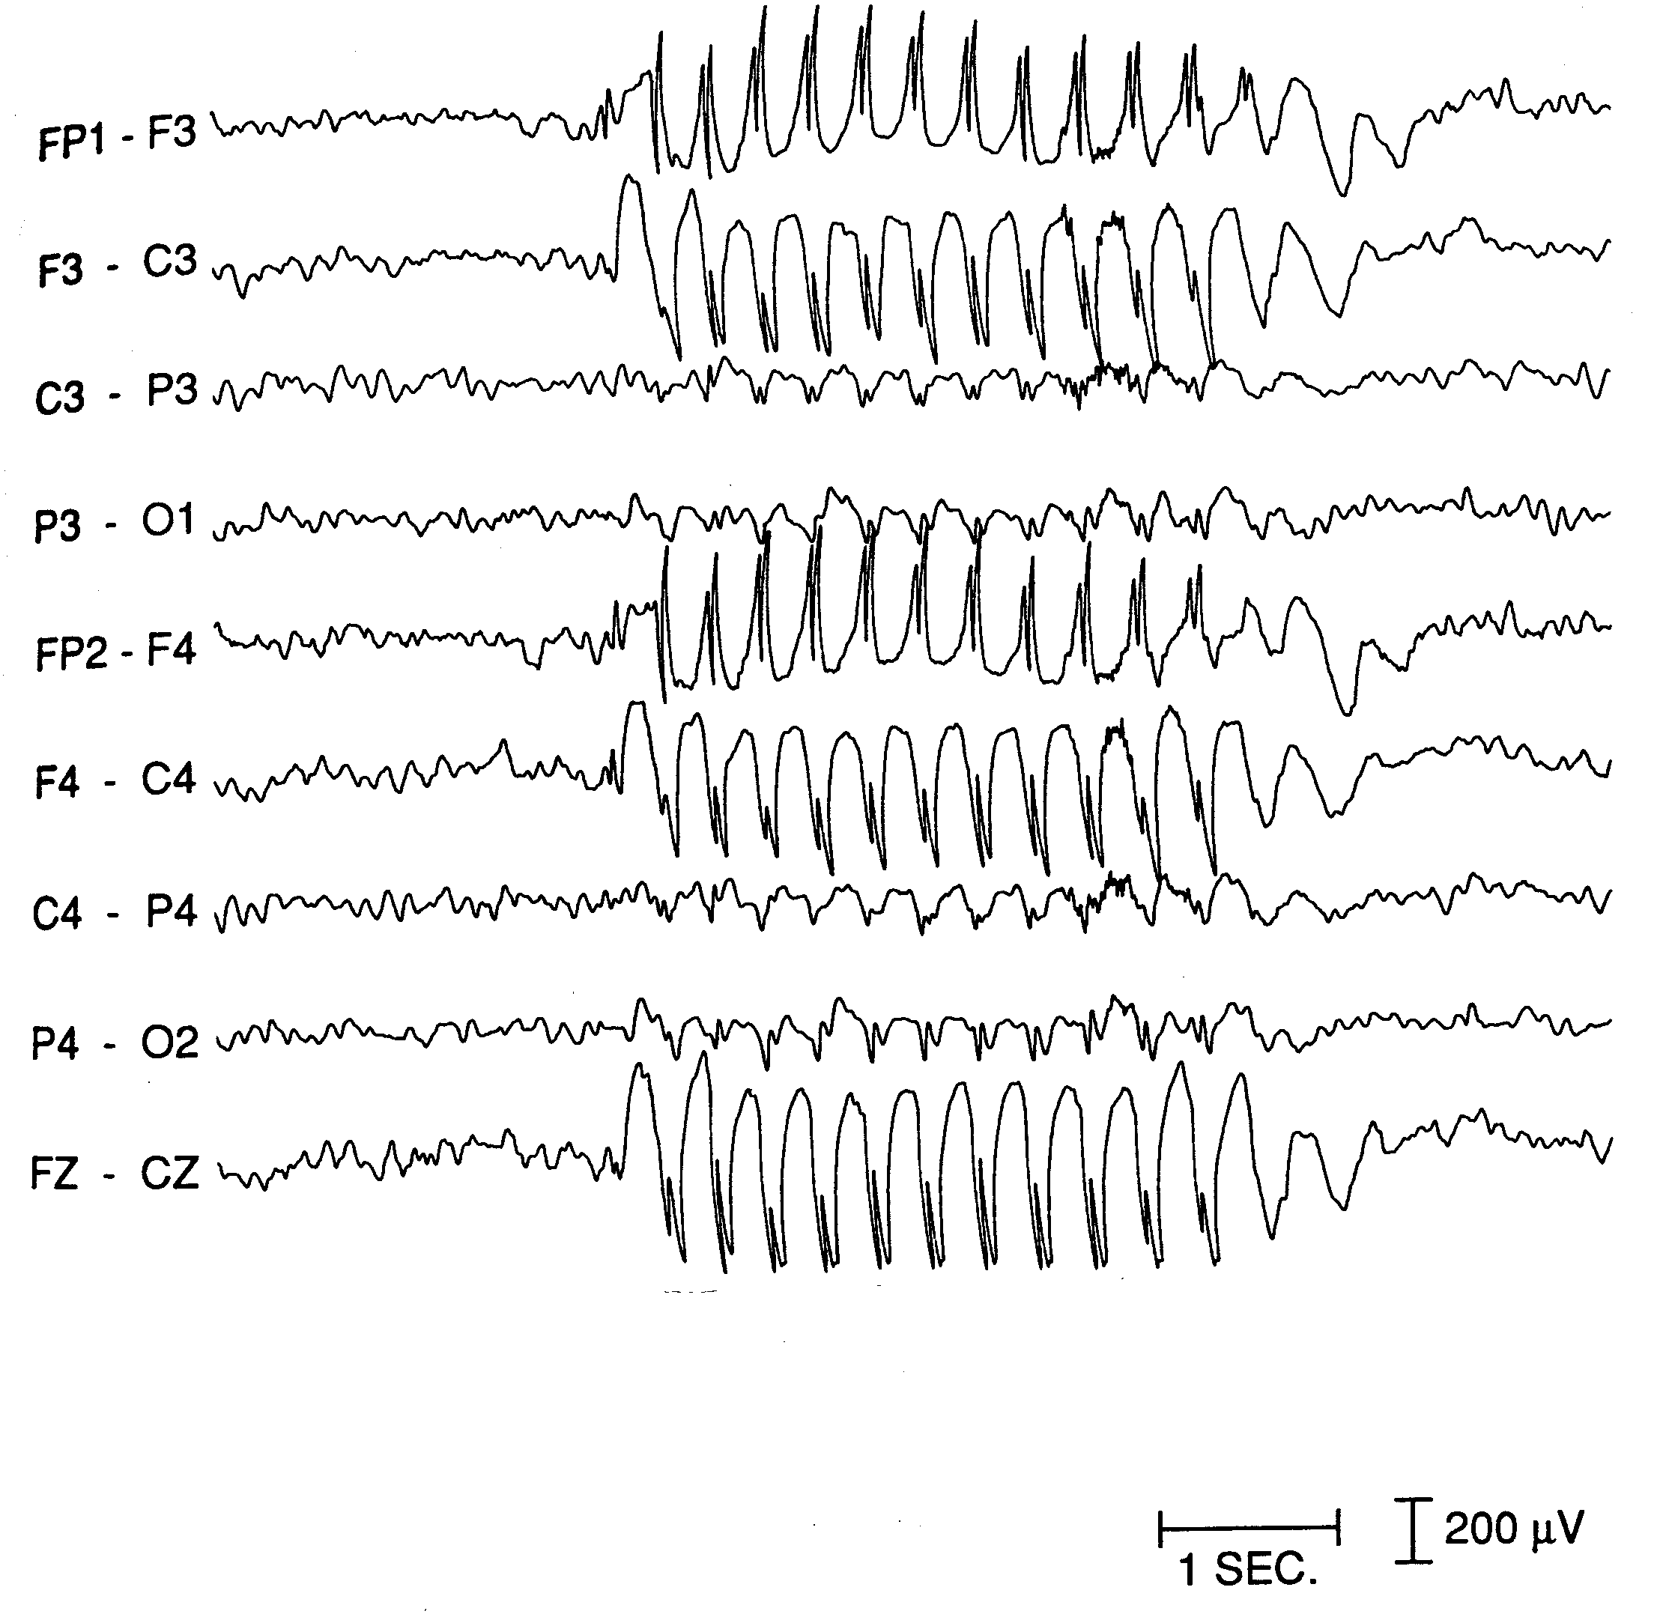
EEG of absence seizure
http://brain.fuw.edu.pl/~suffa/Modeling_SW.html

Slide 6
Epilepsy treatment
Mainstay of therapy is anti-epileptic medications.
Medications produce significant cognitive and physical side-effects.
20 - 40% of patients continue to have seizures.
Alternatives to medication mostly involve surgery.
Major source of disability is anxiety over occurrence of next seizure.
Often leads to self-imposed, severe limitations on physical and social activities.

Slide 7
Seizure prediction
Reliable prediction (forecast) of seizures would allow patients to take prophylactic medication or withdraw to a safe place.
Relative difficulty:
prediction >>> detection
Prediction is hard.
Predictive signals are subtle and buried in mass of other signals.
Proving the predictions are statistically better than a random model is very difficult.

Slide 9
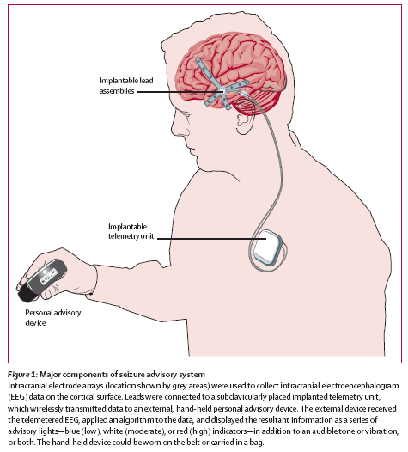
NeuroVista Seizure Advisory System (SAS)
Records intracranial EEG (iEEG)
continuous
long-term
ambulatory

Slide 10
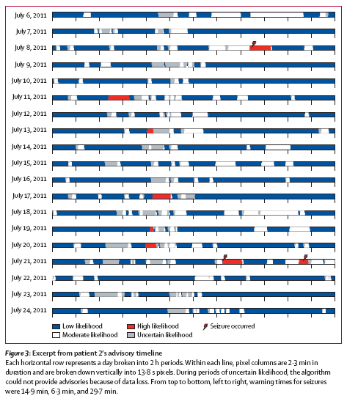
Output from SAS

Slide 11
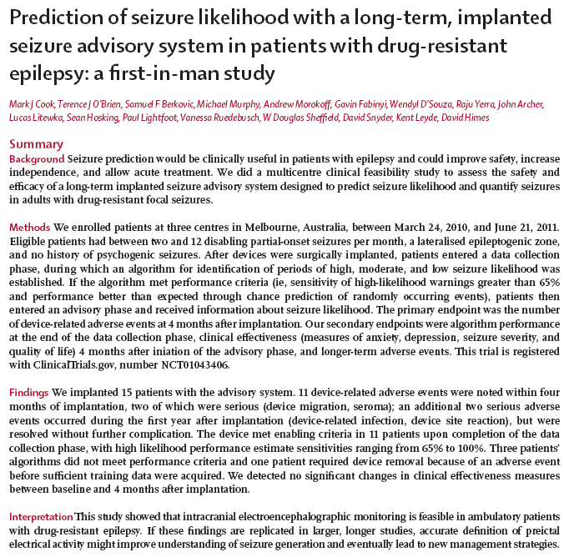

Slide 12
NeuroVista SAS in human trials
Study phases
Implantation
Stabilization of EEG after surgery
Data collection
Minimum of 1 month and 5 lead seizures
Algorithm training on collected data
Must satisfy performance criteria under cross-validation
Advisory enablement
Advisory observation for 4 months
Prospective evaluation of advisory performance

Slide 13
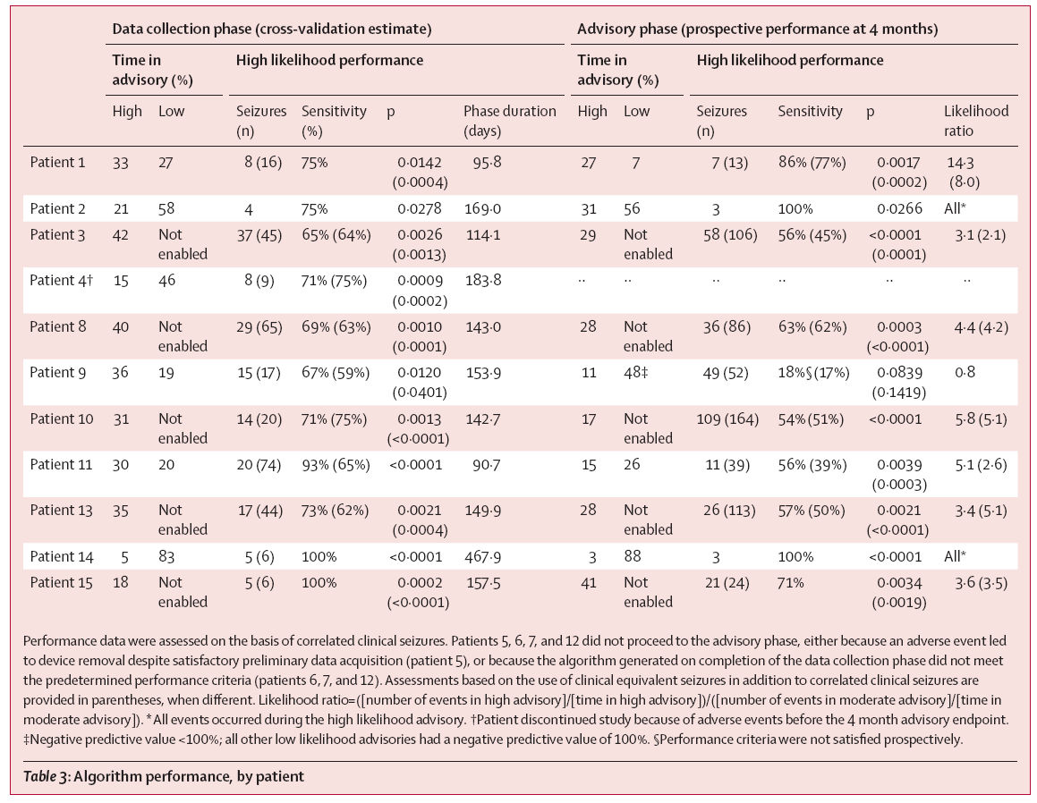
NeuroVista SAS in human trials

Slide 14
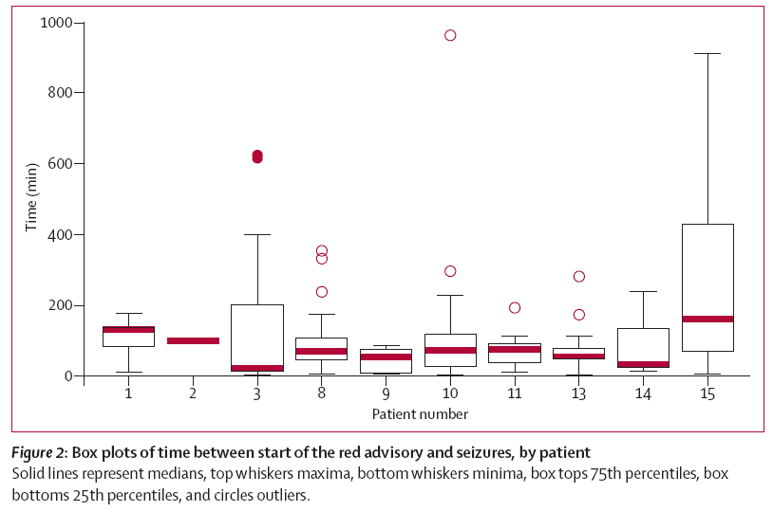
NeuroVista SAS in human trials

Slide 15
Classification definition
Given a collection of records (training set)
Each record contains a set of features.
Each record also has a discrete class label.
Learn a model that predicts class label as a function of the values of the features.
Goal: model should assign class labels to previously unseen records as accurately as possible.
A test set is used to determine the accuracy of the model. Usually, the given data set is divided into training and test sets, with training set used to build the model and test set used to validate it.
Notes:
Attributes: a.k.a. features, independent variables, …

Slide 16
Classification illustrated
categorical
categorical
continuous
class
Training
set
Test
set
Learn
classifier
Model
Predicted
classes

Slide 17
NeuroVista predictive algorithms
 | First generation | Second generation
Features | spectral power based, somewhat complex | ??
Feature resolution | one second | ??
Discriminant function | complex, non-linear | ??
iEEG recordings used for development | short-term human | ??
Human trials | effective | ??

Slide 18
NeuroVista predictive algorithms
 | First generation | Second generation
Features | spectral power based, somewhat complex | ??
Feature resolution | one second | ??
Discriminant function | complex, non-linear | ??
iEEG recordings used for development | short-term human | ??
Human trials | effective | ??

Slide 19
NeuroVista predictive algorithms
 | First generation | Second generation
Features | spectral power based, somewhat complex | ??
Feature resolution | one second | ??
Discriminant function | complex, non-linear | ??
iEEG recordings used for development | short-term human | ??
Human trials | effective | ??

Slide 20
NeuroVista predictive algorithms
 | First generation | Second generation
Features | spectral power based, somewhat complex | spectral power based, simplified
Feature resolution | one second | one minute
Discriminant function | complex, non-linear | logistic regression
iEEG recordings used for development | short-term human | long-term canine
Human trials | effective | untested

Slide 21
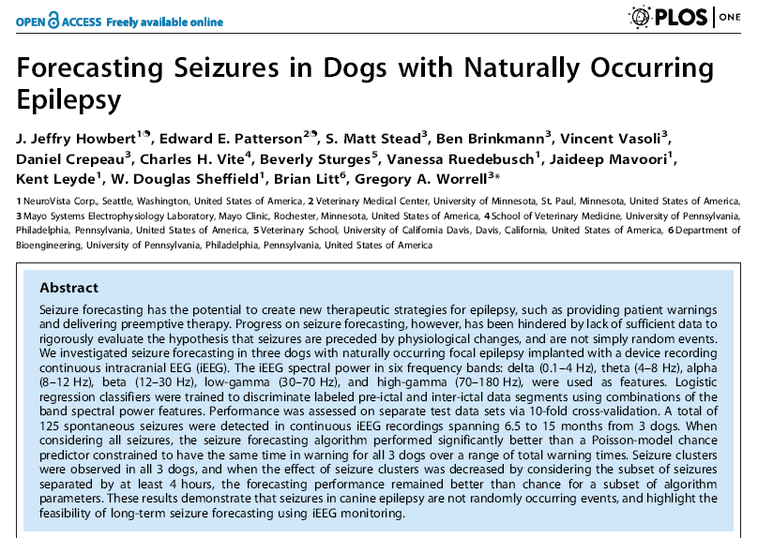

Slide 22
Canine subjects
Specifics of iEEG records for three canines with naturally occurring epilepsy implanted with the NeuroVista Seizure Advisory System.
Subject ID (Breed) | MRI Brain | Recording duration, days | Number all seizures | Number lead seizures
002 Mixed | Normal | 197 * | 27 | 27
004 Mixed | Normal | 330 | 15 | 8
007 Mixed | Normal | 451 | 83 | 18
Group totals (mean ± std) |  | 978 (326 ± 127) | 125 (41.7 ± 36.3) | 53 (17.7 ± 9.5)
Lead seizures were defined as seizures preceded by at least 4 hours of non-seizure.
* Full record was 475 days in duration; only final 197 days used for forecasting to avoid post-surgical non-stationarities in iEEG.

Slide 23
Seizure Advisory System in canines
Implantable Telemetry Unit
Implantable Leads Assembly
Personal Advisory Device
onset of full seizure
single warning triggered
no seizure
(false positive)
repeated warnings triggered
no seizure
(false positive)
repeated warnings triggered
seizure occurs
(true positive)

Slide 24
Seizure Advisory System in canines
onset of full seizure
single warning triggered
no seizure
(false positive)
repeated warnings triggered
no seizure
(false positive)
repeated warnings triggered
seizure occurs
(true positive)

Slide 25
Full seizure record, canine subject 002
197 days

Slide 26
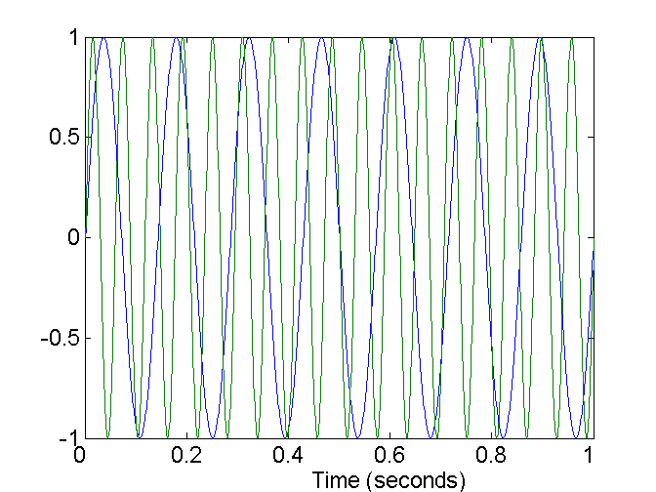
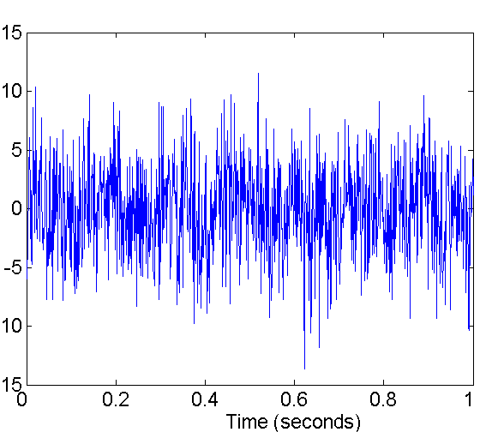
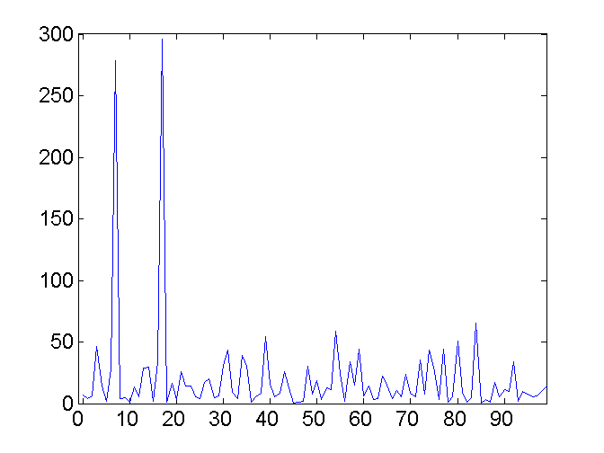
Fourier transform
transform data from time domain to frequency domain
two sine waves
two sine waves + noise
frequency

Slide 27
Extraction of power bands from iEEG
For each one-minute time interval (24000 samples of raw iEEG):
Fourier transform on each of 16 channel EEG to give corresponding channel power spectrum (16384 frequencies)
For whole record:
Normalize power at each frequency in each channel
For each one-minute time interval:
Segment power spectrum into bands
delta (0.1-4 Hz) beta (12-30 Hz) theta (4-8 Hz) gamma-low (30-70 Hz) alpha (8-12 Hz) gamma-high (70-180 Hz)
Create channel-band features by summing values in each band
Output: 96 power-in-band features with temporal resolution of one minute

Slide 28
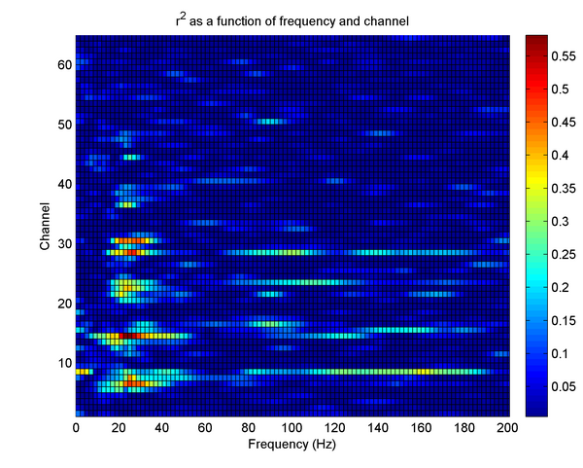
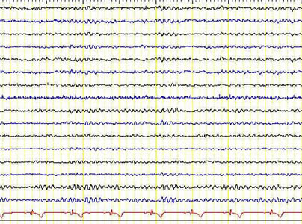
Extraction of power bands from iEEG
time window
Multi-channel iEEG recording
(time domain)
Multi-channel power spectrum
(frequency domain)

Slide 29
Terminology
ictal
period of time during a seizure
preictal
period preceding a seizure
postictal
period following a seizure
interictal
time between seizures (neither ictal nor preictal)

Slide 30
Initial search for predictive algorithm
Set up as standard two-label classification problem
Each one-minute interval labeled as:
preictal if within 90 min. preceding a seizure
interictal otherwise
10-fold cross-validation with block folds
Interictal labels much more abundant than preictal labels
class imbalance problem
address by subsampling interictal labels so have same number as preictal labels in training set
Standard classification algorithms
logistic regression, neural networks, SVMs, others

Slide 31
Power-in-band features
Canine subject 002
Time interval around seizure cluster 2
96 features (black)
6 seizures (red)
90 minute preictal horizon (pink shading)
6 features for
channel 1

Slide 32
Power-in-band features
Canine subject 002
Seizure cluster 2
Expansion of features for channels 9-12
channel 9

Slide 33
Classification of preictal vs. interictal
Canine subject 002
Full record shown
Logistic regression
Trained on all 96 features
Output probability of preictal in range 0.0 - 1.0
AUC-ROC = 0.826
original labels of samples
■ preictal  interictal
missing
data

Slide 34
Classification of preictal vs. interictal
Canine subject 002
Seizure cluster 2 shown
original labels of samples
■ preictal  interictal

Slide 35
Predictive algorithm in advisory setting
Must choose advisory threshold
When output of classifier exceeds threshold, warning is triggered.
Warning has preset persistence interval (90 min.).
New threshold crossing during ongoing warning extends warning.
True positive:
Warning begins at least 5 min. prior to seizure.
Warning still in effect at time of seizure.
False positive:
Warning does not overlap a seizure.

Slide 36
Predictive algorithm in advisory setting
Performance evaluated within a ‘stack’ of calculations
Feature selection
Classifier training
Over sequence of thresholds selected to produce various targeted total time in warning (TIW):
Generate advisories from trained classifier
Generate advisories from chance predictor matched for TIW
Compute statistics comparing performance of trained and chance predictors
10-fold cross validation applied to entire stack

Slide 37
Chance predictor

Slide 38
Chance predictor
Warning triggers generated randomly using a Poisson process
Warning intervals otherwise identical to trained predictor
Persistence
Extension
Rules for true and false positives
Poisson rate parameter adjusted to produce target time in warning

Slide 39
Advisory performance in canines
ID | TIW | S_{n} | p | S_{n-lead} | p_{n-lead} | False Positive/day
002 | 0.1 | 0.482 | 0.0000 | 0.482 | 0.0000 | 1.293
002 | 0.15 | 0.593 | 0.0000 | 0.593 | 0.0000 | 1.818
002 | 0.2 | 0.667 | 0.0000 | 0.667 | 0.0000 | 2.257
002 | 0.3 | 0.741 | 0.0000 | 0.741 | 0.0000 | 2.792
002 | 0.35 | 0.741 | 0.0001 | 0.741 | 0.0001 | 2.910
002 | 0.4 | 0.889 | 0.0000 | 0.889 | 0.0000 | 3.074
002 | 0.5 | 0.889 | 0.0001 | 0.889 | 0.0001 | 3.186
004 | 0.1 | 0.000 | 0.2435 | 0.000 | 0.6081 | 0.811
004 | 0.15 | 0.133 | 1.0000 | 0.125 | 1.0000 | 0.794
004 | 0.2 | 0.467 | 0.0141 | 0.250 | 1.0000 | 1.079
004 | 0.3 | 0.733 | 0.0007 | 0.500 | 0.2534 | 1.954
004 | 0.35 | 0.733 | 0.0035 | 0.500 | 0.4691 | 2.335
004 | 0.4 | 0.733 | 0.0183 | 0.500 | 0.7290 | 2.670
004 | 0.5 | 0.800 | 0.0700 | 0.625 | 0.7407 | 3.026
007 | 0.1 | 0.759 | 0.0000 | 0.222 | 0.7548 | 0.658
007 | 0.15 | 0.819 | 0.0000 | 0.278 | 0.5582 | 0.791
007 | 0.2 | 0.843 | 0.0000 | 0.389 | 0.1658 | 0.991
007 | 0.3 | 0.892 | 0.0000 | 0.556 | 0.0421 | 1.427
007 | 0.35 | 0.892 | 0.0000 | 0.556 | 0.0895 | 1.617
007 | 0.4 | 0.904 | 0.0000 | 0.556 | 0.2270 | 1.695
007 | 0.5 | 0.916 | 0.0000 | 0.611 | 0.2459 | 1.927
10 of 96 PIB features (forward selection)
10-fold cross-validation
TIW: total time in warning
S_{n}: sensitivity
p: p-value
lead: lead seizures only

Slide 40
NeuroVista predictive algorithms
 | First generation | Second generation
Features | spectral power based, somewhat complex | spectral power based, simplified
Feature resolution | one second | one minute
Discriminant function | complex, non-linear | logistic regression
iEEG recordings used for development | short-term human | long-term canine
Human trials | effective | untested

Slide 41
Closing thoughts
Caveats
Some of predictive performance coming from postictal signature
Need high sensitivity at lower total time in warning ( < 0.1 )
Future work
Explore other types of features from iEEG
High-frequency oscillations
Spectral entropy
???
Vary preictal horizon

