Slide 1
Joy Bubbles
Matt Eason, Scott Grosenick, Steve Smith

Slide 2
Main Screen

Slide 3
Register User

Slide 4
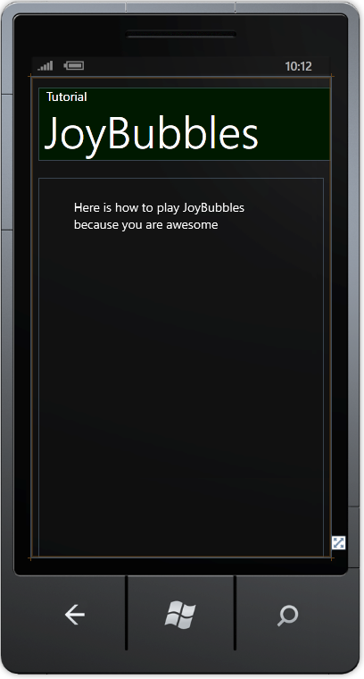
Tutorial

Slide 5
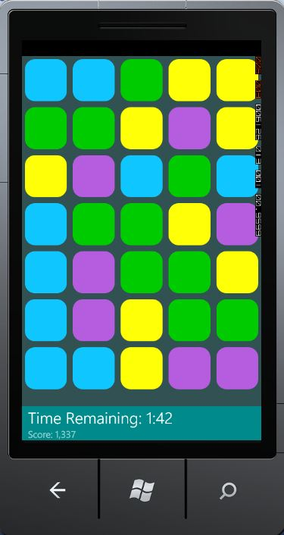
Game Screen

Slide 6
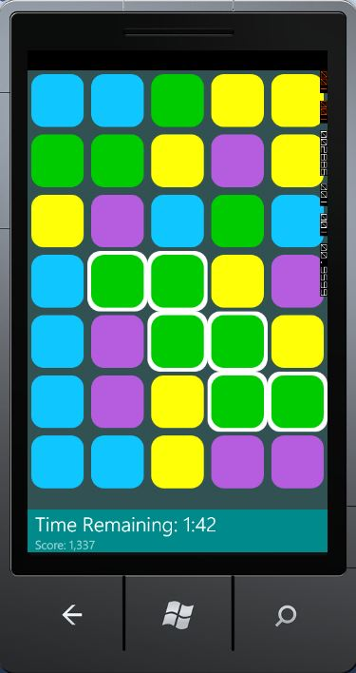
Selecting Bubbles

Slide 7
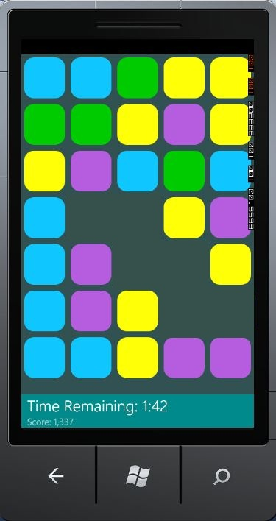
Selecting Bubbles

Slide 8
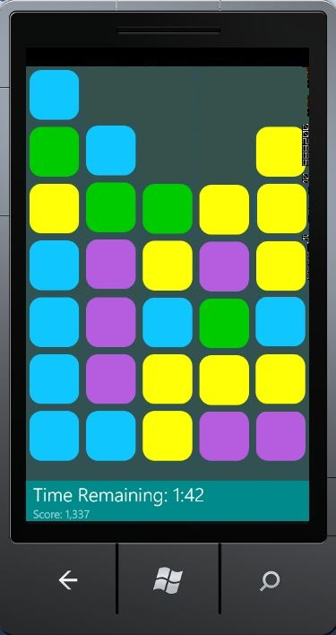
Selecting Bubbles

Slide 9
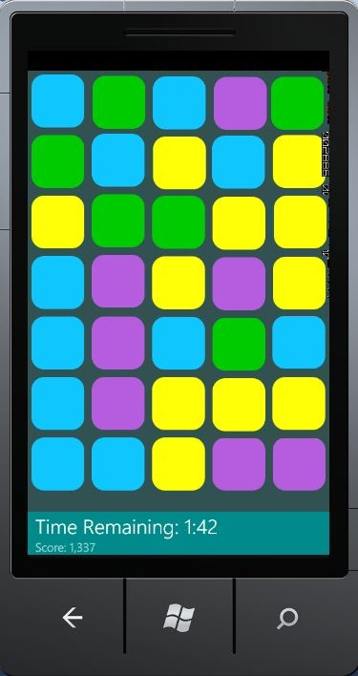
Selecting Bubbles

Slide 10
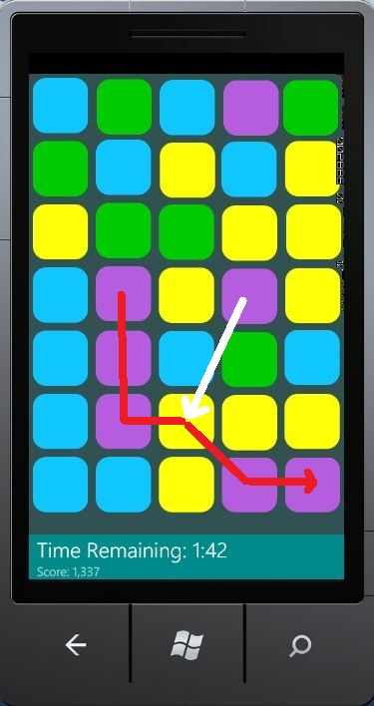
Optimizing Swipes

Slide 11
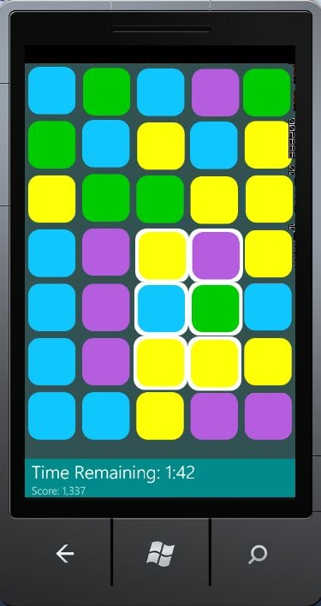
Optimizing Swipes

Slide 12
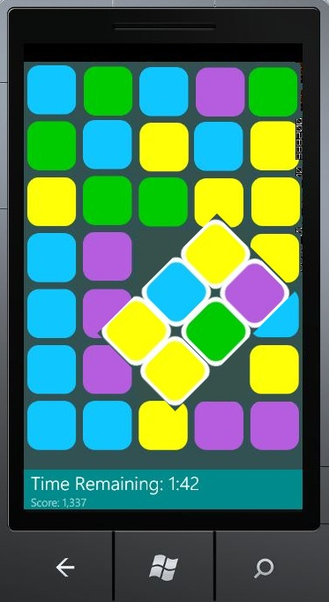
Optimizing Swipes

Slide 13
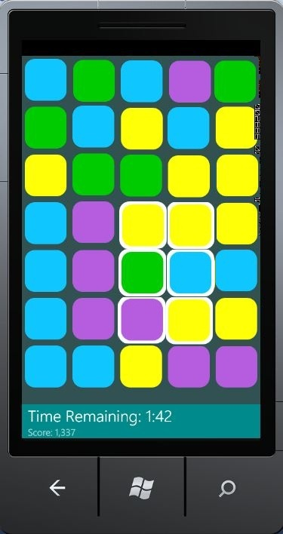
Optimizing Swipes

Slide 14
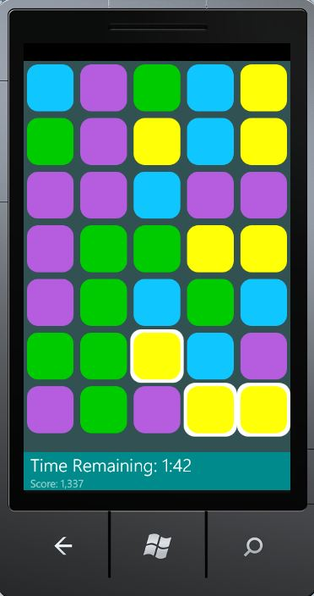
Invalid Swipe

Slide 15
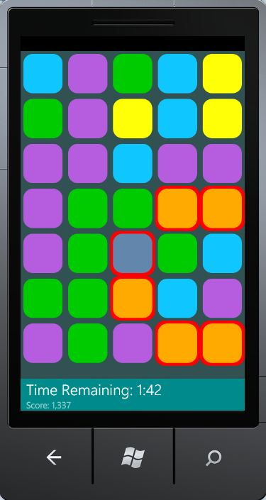
Invalid Swipe

Slide 16
Game End

