Slide 1
JoyBubbles
Matt Eason
Steve Smith
Scott Grosenick

Slide 2
What is JoyBubbles?
A game that is cross between Wordament, Tetris, and Hexic.
It uses synchronized gameplay with an anonymous player community, gesture-based tile group matching, and leaderboards like Wordament
New tiles fall onto the game board like Tetris (rate of tile appearances can be adjusted to change the difficulty)
Tiles can be moved via a constrained mechanism like Hexic to allow players to set up larger groups worth more points.

Slide 3
Why
Casual games are a growing market – everyone with a smartphone who pumps gas or has to wait in line at the bank can be a customer
Competing against an ever-changing set of live, anonymous users keeps the game interesting without risking ridicule for poor performance
It’s simple enough to understand easily, yet difficult to become proficient at.

Slide 4
Technical Specifications
Silverlight UI using gestures on the main game page
Leaderboards and scoring on separate pages (appear in the brief pause between games, ala Wordament)
Server side state tracking (using WCF for communication) & leaderboard calculation

Slide 5
Schedule
Deliverable | Date | Notes
Project proposal | 4/23 | Paper describing project and deliverables along with a class presentation to describe the project.
UI Design | 4/30 | Mocked up screens showing the flow of the game from application boot up to termination
Page Flow | Week of 4/30 | Basic framework of the game, including flow between pages. Basic bubble drawing on gameboard
Server framework | Week of 5/7 | Connections to backend server, including dictating game flow.
Basic scoring | Week of 5/7 | Bubble strain detection and scoring calculation
Implement rotation gestures | Week of 5/14 | Using rotation gestures to transition blocks
Code complete | Week of 5/21 | Finished coding and unit tests
Testing | Week of 5/28 | Test application

Slide 6
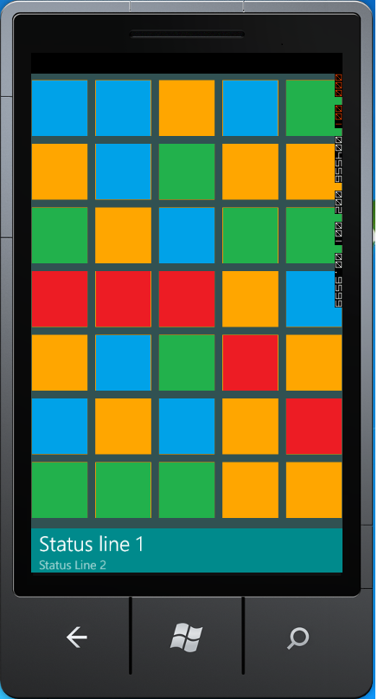
UI Walkthrough – Screen Layout

Slide 7
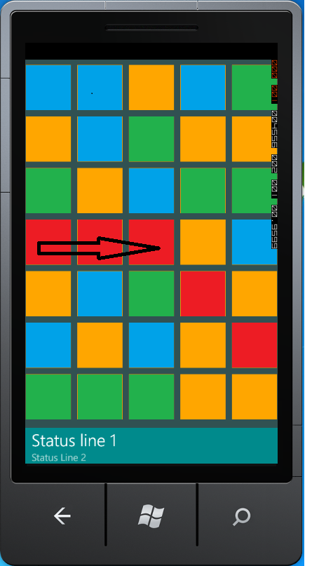
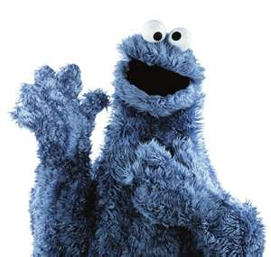
User selects blocks of the same color via a gesture
Tiles are like cookies – the more tiles you can connect in a single swipe, the higher you score.
YUM!

Slide 8
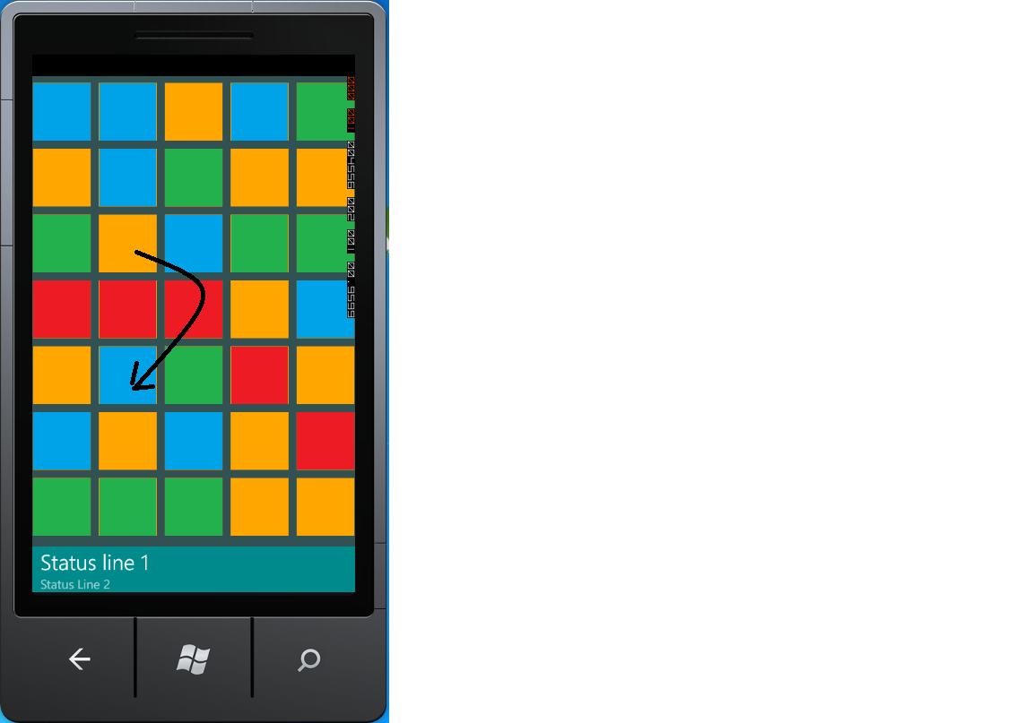
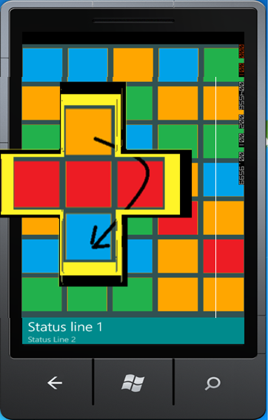
User wants to swap blocks

Slide 9
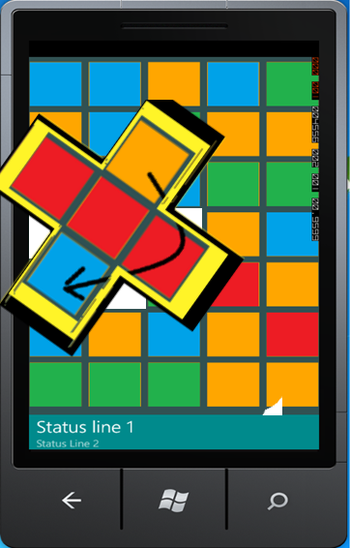
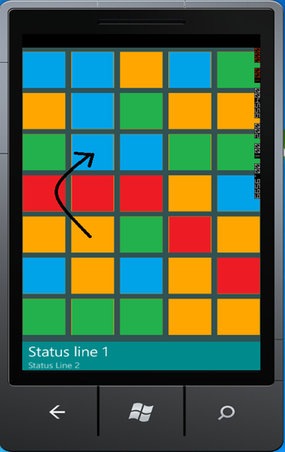
User Wants to swap blocks

Slide 10
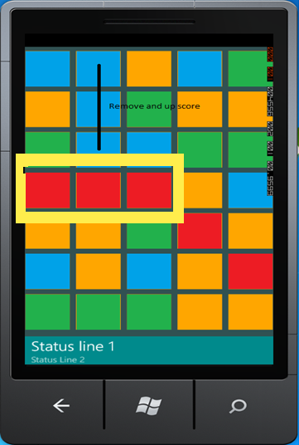
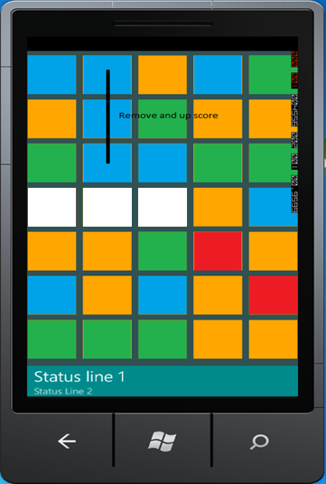
Grouped Blocks Disappear

Slide 11
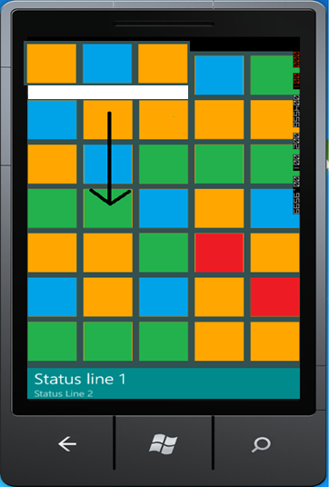
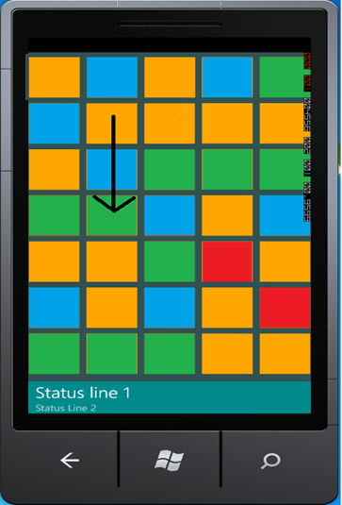
New Blocks Fall in From the Top

