Slide 1
STEM 123 – UX Design
Red Sun LLC
Andrew Greeness
Kris Koford
Lavinder Singh
Note: STEM is an acronym for Science Technology Engineering Math

Slide 2
Navigation graph
1.1 Main / Search Page
1.2 Results
1.4 No results
1.3 View Presentation
2.1 Create / Edit Presentation
1.3.1 Text
1.3.2 Audio
1.3.3 Video
2.1.1 Text
2.1.2 Audio
2.1.3 Video
2.2 Publish result
User can always navigate to 1.1 and 2.1 using the app bar

Slide 3
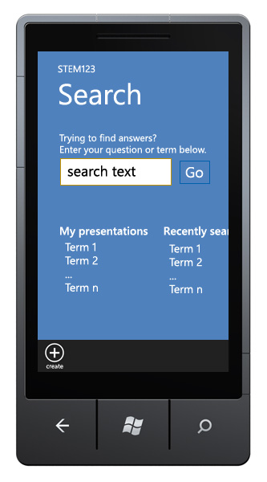

Slide 4
Core Scenario 1: Search & Learn
Actors
X (the user)
App (STEM 123 mobile application)
Context
X is trying to understand the concept of an unsigned integer. He is wondering: What is it? Where is it appropriate to use?
Goal
To help the user understand a concept or get an answer to a question.
Scenario
X launches the app and searches for “unsigned integer”.
X finds multiple STEM presentations available.
X selects one which appears to answer his questions.
App loads the selected presentation.
After viewing the presentation, X is happy because he has found answers to his questions.

Slide 5
Storyboard 1.1 – Main / Search Page
STEM 123 – Welcome
This section displays terms for which presentations were created earlier by the user. Selecting a term brings user to 1.2 search results page.
Trying to find answers? Enter
your term below.
Search term here..
Go
My presentations
Recently searched
Term 1
Term 2
…
Term n
Term 1
Term 2
…
create

Slide 6
Storyboard 1.2 – Results Page
STEM 123 – Search Results
“[Search Term]”
By Date Published
By # of Views
Some visual cue to show media type in slide will be present here.
(Total duration of media)
What is it?
How is it used?
When it is used?
(00:00)
First question answered
Second question answered
Third question answered
(00:00)
What is it?
Where it is found?
How it is applica…
(00:00)
First question answered
Second question answered
Third question answered
Square indicates, currently focused item. Once user selects a presentation, pages 1.3.x will be displayed.
create
main

Slide 7
Storyboard 1.3 – View presentation
STEM 123 – Term
Retrieving… is shown until core data is downloaded.
Preparing… is shown until all media for presentation of first slide is downloaded.
Retrieving presentation… /
Preparing presentation…
Thank for your patience.
create
main

Slide 8
Storyboard 1.3.1 – Presentation Text
User can navigate between slides by swiping left or right.
STEM 123 – Term
Question text…
Image to support answer
Answer text…
Image is optional
Slide 2
Slide 3
create
main

Slide 9
Storyboard 1.3.2 – Presentation Audio
User can navigate between slides by swiping left or right.
STEM 123 – Term
Question text…
Image to support answer
Play/Pause
Rewind
Slide 2
Slide 3
create
main

Slide 10
Storyboard 1.3.3 – Presentation Video
User can navigate between slides by swiping left or right.
STEM 123 – Term
Question text…
Video content
Play/Pause
Rewind
Slide 2
Slide 3
create
main

Slide 11
Storyboard 1.4 – No Results Page
STEM 123 – Search results
Sorry, we were not able to find any presentations for
[search term]
Click here to go back to search again.
create
main

Slide 12
Core Scenario 2: Create Slide
Actors
Y (the user)
App (STEM 123 mobile application)
Context
Friends of Y are confused about how sine wave is applied in real life.
Y explained it earlier to a friend, but now she thinks it would be better if instead of explaining repeatedly, she creates a quick presentation, which can be viewed / re-used by other friends as well.
Goal
To explain a less understood concept or answer a specific question.
Scenario
While Y is going home on the bus, she launches the app and creates a show for the topic. She is happy, because now her explanation can help others and may also increase her reputation for being an intelligent and helpful person. She is famous now!

Slide 13
Storyboard 2.1 – Create / Edit content
STEM 123 – Term
Same page will be used to create each slide. 2.1.x is repeated as needed or till max allowed slides are added.
Select question to be answered.
What is …
How it is ….
Where it is ….
….
Select media to answer the question.
Text will take user to 2.1.1, audio will take user to 2.1.2 and video will take user to 2.1.3 respectively.
Text
main
add slide
play
publish

Slide 14
Storyboard 2.1.1 – Text
STEM 123 – Term
Question text …
Invokes selection of image from phone or elsewhere.
Image to support text
Text
On save / cancel user will be taken back to page 2.1 to continue creating / editing the presentation.
main
save
cancel

Slide 15
Storyboard 2.1.2 – Audio
STEM 123 – Term
Question text …
Invokes selection of image from phone or elsewhere.
Image to support audio
Duration left for recording
On save / cancel user will be taken back to page 2.1 to continue creating / editing the presentation.
record
Play / pause
main
save
cancel

Slide 16
Storyboard 2.1.3 – Video
STEM 123 – Term
Question text …
Video content
Duration left for recording
On save / cancel user will be taken back to page 2.1 to continue creating / editing the presentation.
record
Play / pause
main
save
cancel

Slide 17
Storyboard 2.2 – Publish result
STEM 123 – Term
Publish status:
[Success or error message]
main
cancel

Slide 18
Web Service API

Slide 19
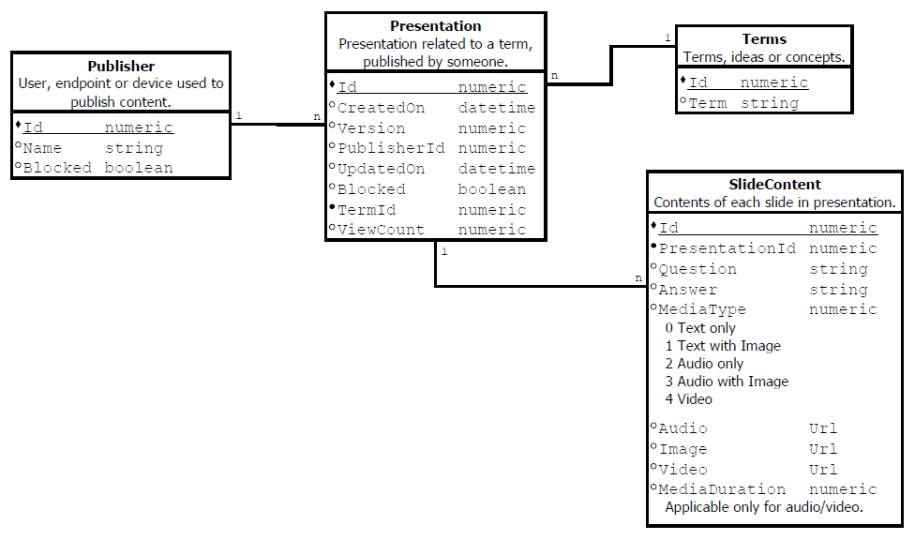
DB Schema

