Slide 1
My FBA Helper
CSS 490 Final Project
Five Light: Weston Winn, Jeremy Oakes
Spring 2012

Slide 2
A Quick Reminder
Functional Behavior Analysis
The “ABC’s” of behavioral analysis (Antecedent, Behavior, Consequence)
App designed to assist parents in recording and organizing data
Emphasis placed on simplicity and user friendliness.

Slide 3
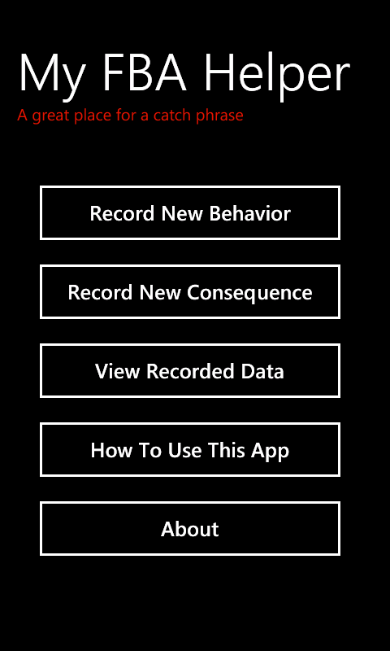
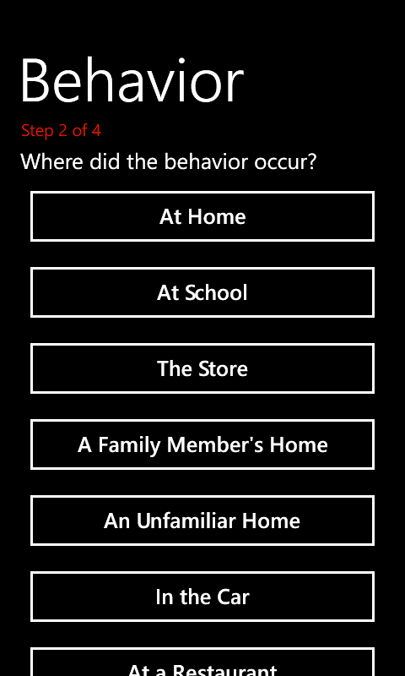
Simplicity In Mind
Clear, straight-forward menu
“How to” section for more detailed instructions
Linear Navigation in Metro style
Clear, readable font, no extra “fluff”
Pages that scroll cut off on bottom (Metro style)

Slide 4
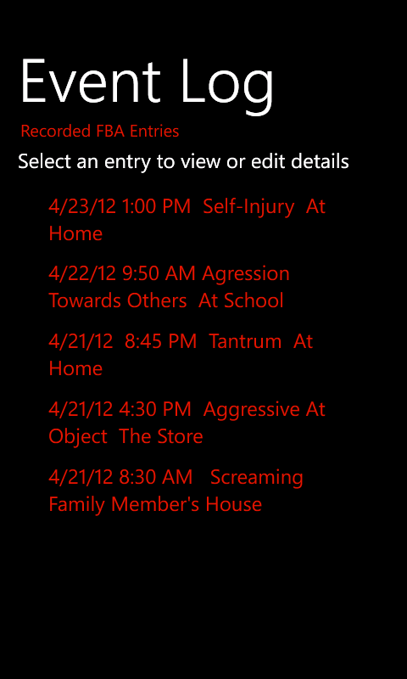
Event Log
User may view previous entries in chronological order.
If desired, the user may edit entries logged previously.
User cycles through screens where info is recorded (fields are entered already)

Slide 5
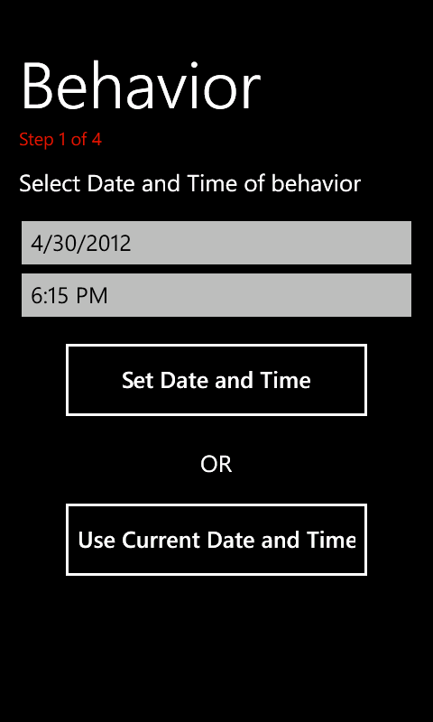
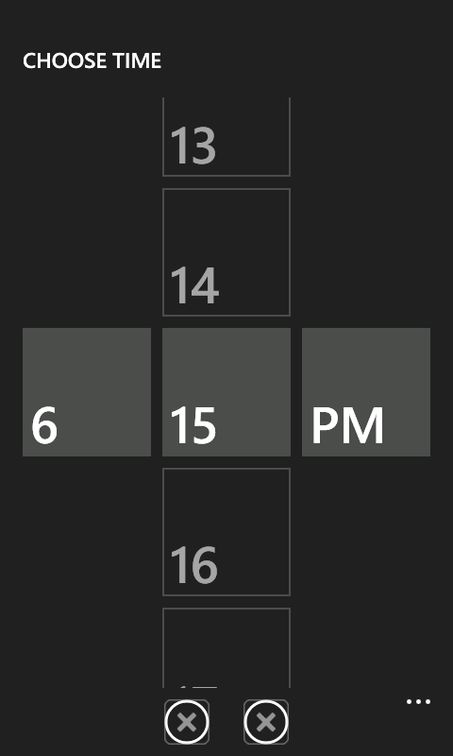
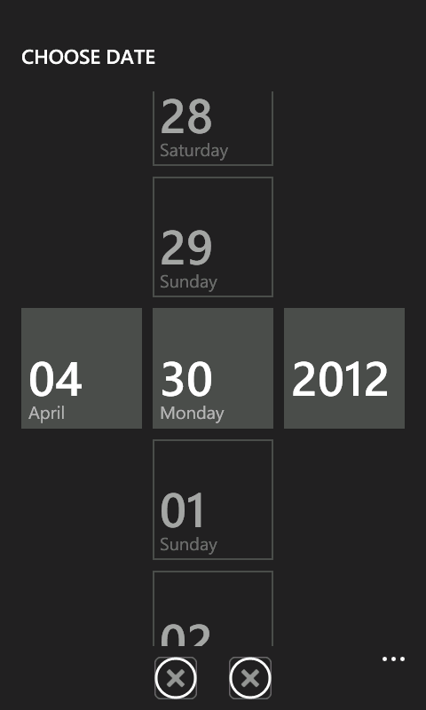
Staying in WP7 Style
Application bar icons designed but not yet implemented.

Slide 6
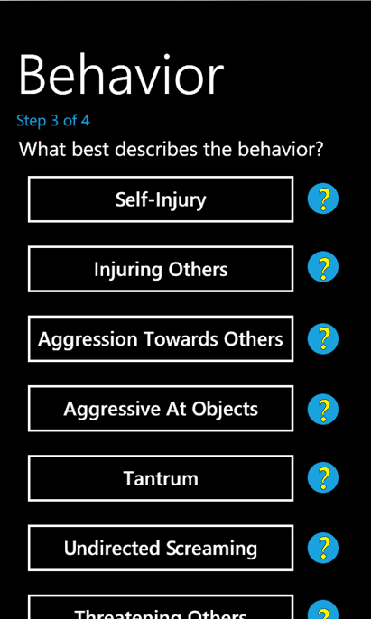
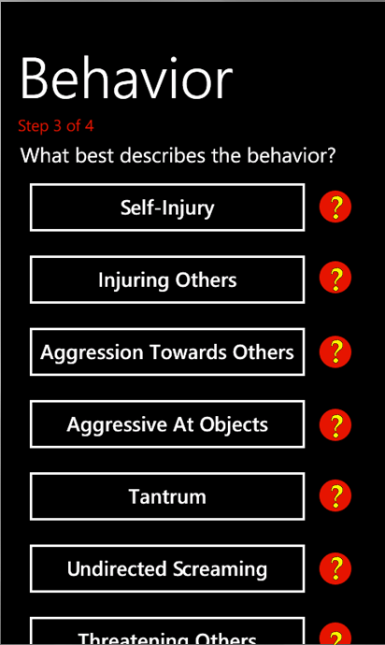
Theme Color Snuck In
Steps and Help Buttons color of user theme
Question mark always yellow
Works well with all themes, light or dark.

Slide 7
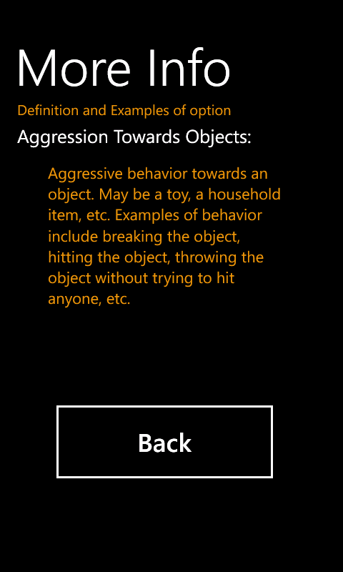
Help!
Question mark buttons go to a sub-menu with brief examples of what the button means.

Slide 8
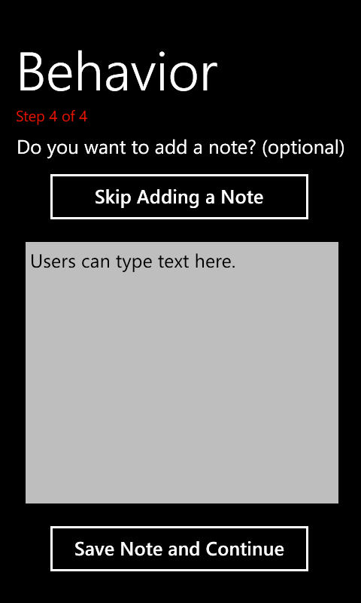
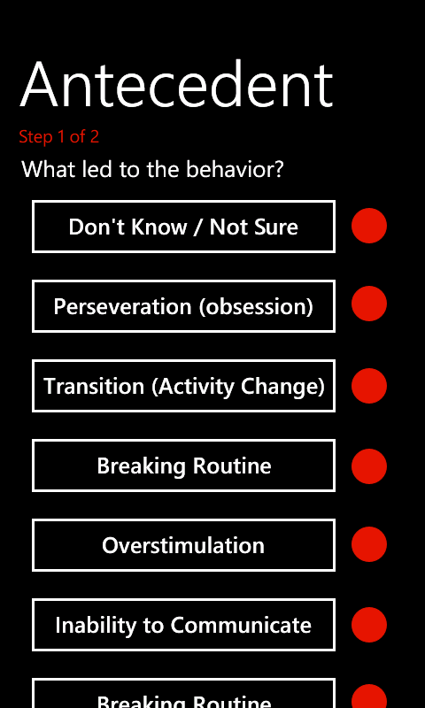
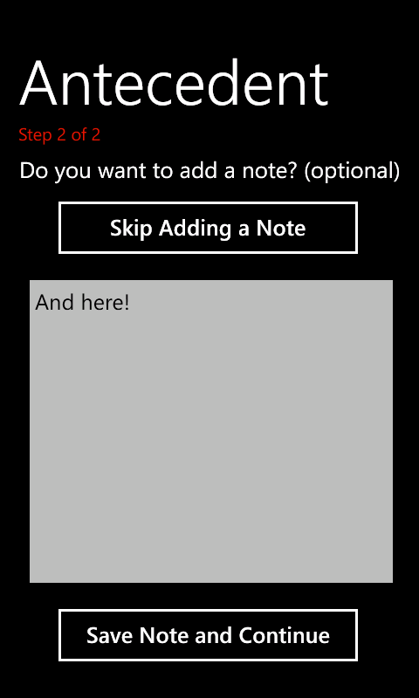
Optional Additional Info

Slide 9
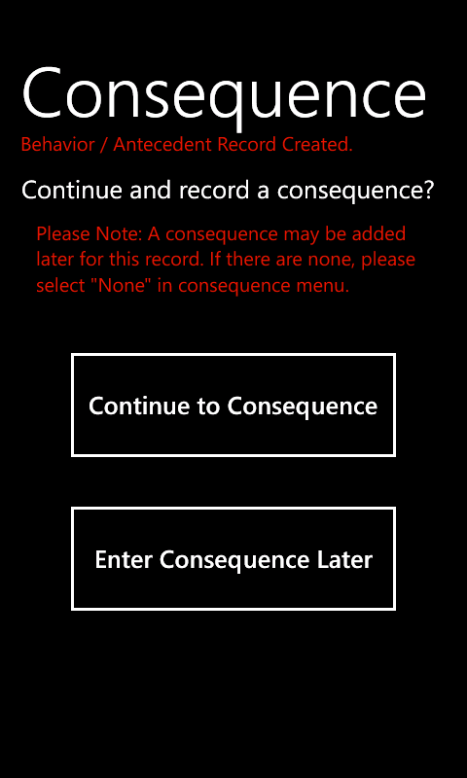
Now Or Later?
Antecedent and behavior logged together.
User has choice whether or not to add consequence now or later.

Slide 10
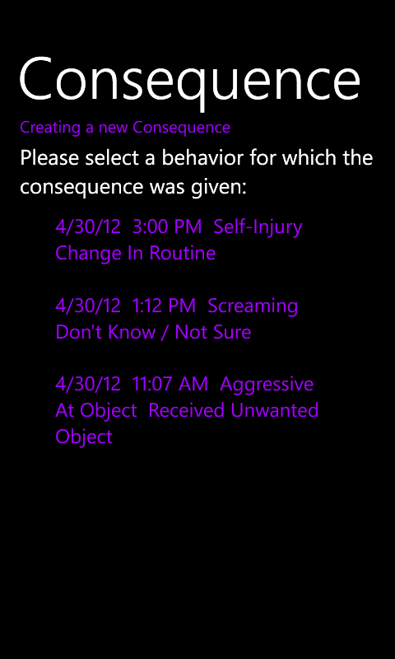
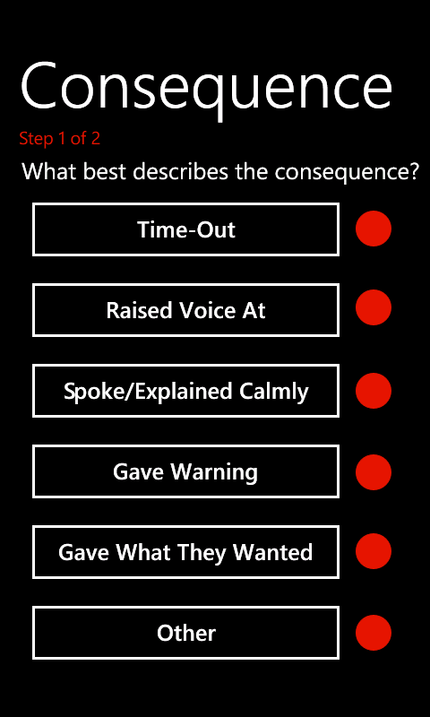
List Population and Links
Consequence from main lists recent behaviors with no attached consequence
When selected consequence entry menu is called

Slide 11
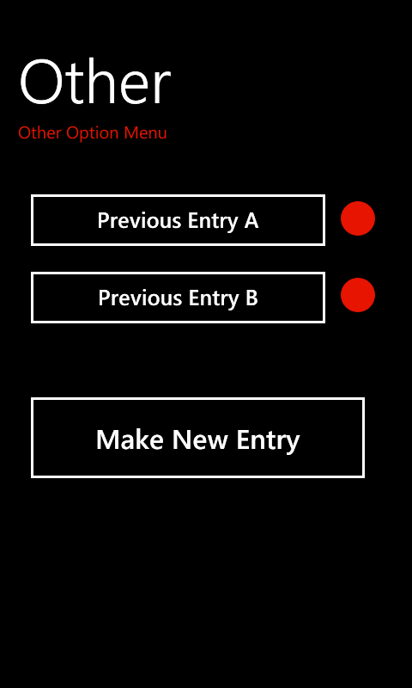
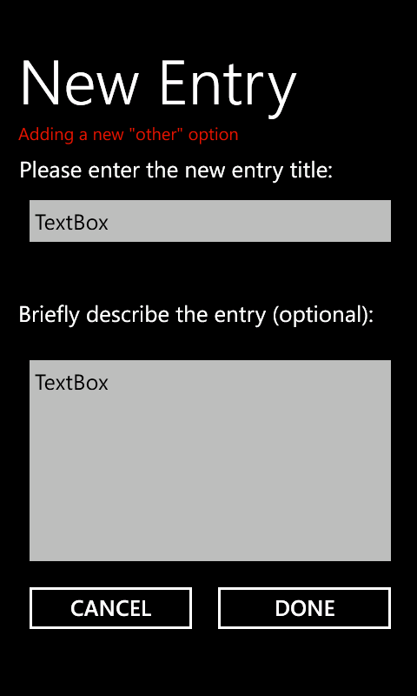
The “Other” Option
User can enter new options they frequently use
They may enter a description as well.

