Slide 1
My FBA Helper
Five Light – Jeremy Oakes, Weston Winn
CSS 490 Final Project Proposal
Spring 2012

Slide 2
What is an FBA?
Functional Behavior Analysis – “ABCs” of behavior
Antecedent, Behavior, Consequence
Identify problematic behavior
Link antecedent to behavior
Record consequence of behavior
Discuss results with therapist

Slide 3
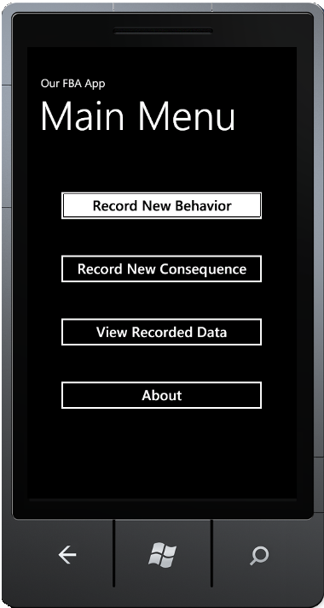
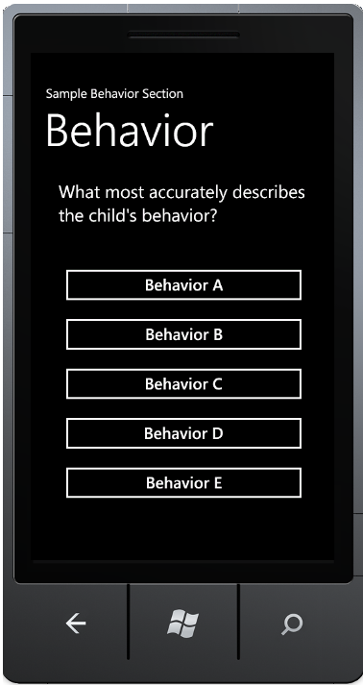
Simplified Data collection

Slide 4
Why A Mobile Application?
Behavioral problems can occur anywhere, anytime.
Hand-writing FBAs can be tedious or forgotten.
Leaving out or incorrectly estimating information can lead to difficulty analyzing results.
Lost or disorganized FBA recordings can add weeks or more to behavioral analysis.

Slide 5
How It Works
Record Data
Save Data
Main Menu
Display List
Memory
View Menu
Get Data

