Slide 1
App Description
App Name: PhotoAtlas
Features:
Display list of photos at the captured location on the map.
Displays all the photos for an entire trip on the map.
Photos with Time-Space.
Allows user to upload photos to Facebook/Flickr.
Why:
No such app available for windows phone.
Provides photo along with itinerary and interesting ways to preserve trip memories.
Helpful to write blogs and story on the trip .
Sync the trip photos on Facebook and Flickr.
Mobile specific features:
GPS.
Phone camera.

Slide 2
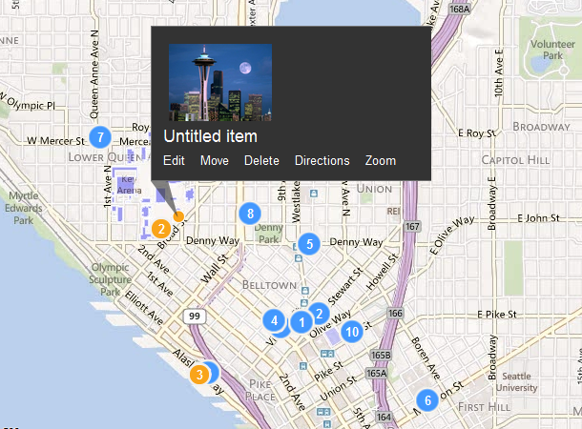
Trip View

Slide 3
Technology used
Geo-Tagging Technique
Adding geographical identification metadata to photos.
Latitude, Longitude coordinates.
How to Geo-Tag?
All digital images have EXIF header.
EXIF tag has a section for GPS position to add location details.

Slide 4
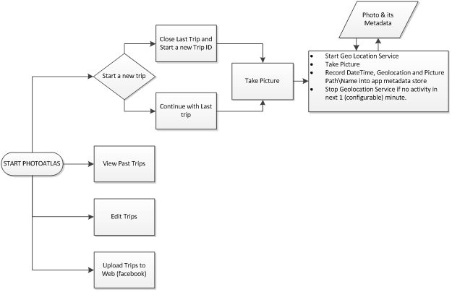
Working

Slide 5
Schedule
Work Item | Assigned To | Expected Days/Hours | ETA
App UI design Diagram | TBD | 5 Days | 30/04/2012
Geo location Helpers | TBD | 3 Days | 4/05/2012
Camera Helpers | TBD | 2 Days | 6/05/2012
Photo metadata Schema | TBD | 5 Days | 11/05/2012
Photo Metadata Helpers | TBD | 5 Days | 16/05/2012
Road Trip Helper | TBD | 3 Days | 19/05/2012
Edit/Delete Trip Workload | TBD | 3 Days | 22/05/2012
Upload Trip workload | TBD | 2 Days | 24/05/2012
Feature Testing | TBD | 1 Day | 25/05/2012
Web Testing | TBD | 1 Day | 26/05/2012
Performance Testing | TBD | 1 Day | 27/05/2012
Battery Testing | TBD | 1 Day | 28/05/2012

