Slide 1
Phix the Bookfinder
Architects United
Dan Becker & Dave Langer

Slide 2
Phix Summary:
Phix helps readers find the books they want to read.
Search once with Phix to find a book in multiple online stores and libraries near you
Relentlessly optimize core use case

Slide 3
Design Process 0: Design Study of built-in WP7 apps
Examples of how to use content as interface
Study details of how typography size, weight, and color are used to differentiate content
When to use Pivot vs. Panorama
Which types of motion are used where (hint: even MS own apps don’t necessarily match the published UI guidelines!)

Slide 4
Design Process 1: Initial Sketches

Slide 5
Design Process 2: Paper Prototype Usability Testing

Slide 6
Design Process 3: Mockups in Balsamiq

Slide 7
Launch & Main Page
Establish Phix/Sphinx brand identity & value proposition with Launch Background
Grey text in search box prompts primary use. Book-lover quotes rotate for ongoing “delight”
Standard keyboard with ‘go’ button for search entry. Search term saved for revision.

Slide 8
Book Search Results Page
Web services provide a list of books that match search
Metro principle: content as interface, not chrome
UI reminds user of search term; back button allows them to revise instead of re-entering entire search
Usability testing with paper prototypes identified key info needed for book search disambiguation
Primary flow: touch the book you want
Alternate flow: back button to revise search

Slide 9
Book Detail Panorama: wireframe
Metro design principles:
content peeking from book details column
content as interface
grid-based design
Additional columns let power users focus on just libraries or just stores–but stay out of the way otherwise.
Book metadata is uneven; design for resiliency
Format field will be blank if not available.
Library source link will be a Google search if URL is not available from Worldcat.
Initial column supports primary use case: show all sources that have book. Usability testing again.
Note the intentional & appropriate violation
of Metro’s infographics > icons principle!

Slide 10
Book Detail Panorama: sample content
Primary flow:
Touch the source you want to get the book from
Secondary flow: look at book details. Usability testing identified which book data content is key in both detail and source lists.

Slide 11
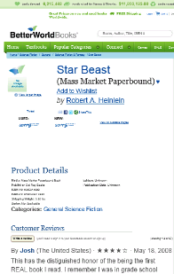
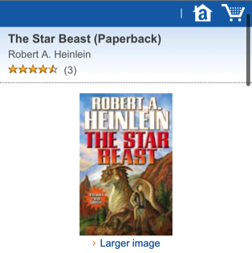
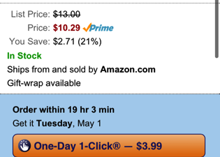
Clicking on a source brings you to that source’s web page for the book
Phix does not attempt to
re-implement the buy/borrow experience of ecommerce and e-library sites
Most sites have mobile-optimized web pages

Slide 12
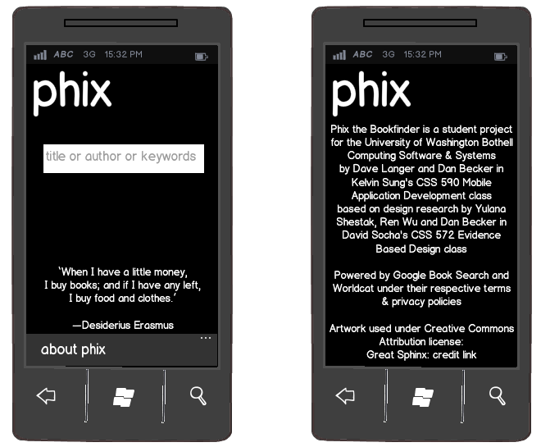
Mapping Libraries using Bing; About screen for credits

Slide 13
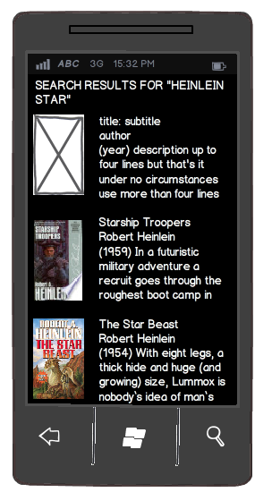
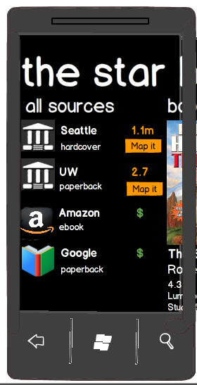
Phix UI Summary: search – find – get

