Slide 1
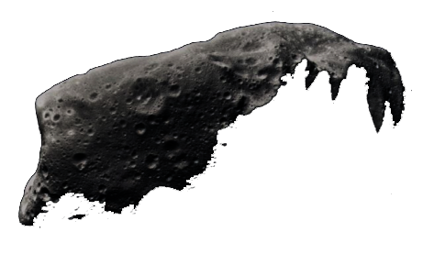
NEreus
A top-down space action shooter for Windows Phone 7.
Soufiane Zeghmi | Ben Davis

Slide 2
About the Project
Our game’s namesake is Nereus 4660, a near-earth orbiting asteroid that will likely be the first target of asteroid mining.
Nereus is a top-down space / asteroids game currently in development for PC and Xbox.
A modern version of Asteroids.
Focus on physics, momentum and gravitation for more interesting gameplay.
Core of the game is currently under development by Ludus Entertainment.
Our aim is to create a Windows Mobile port of Nereus that will be intuitive and addicting.

Slide 3
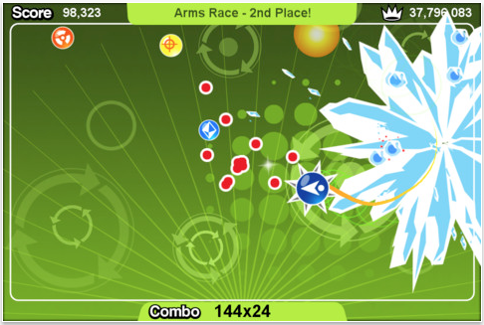
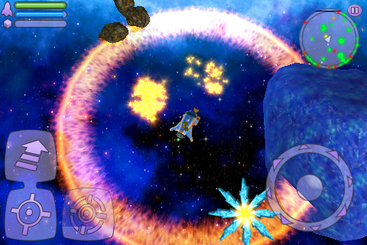
Competitive Analysis
Tilt to Live is a top-down, accelerometer controlled action game for iOS. While it’s not a direct competitor, Tilt to Live gives us a good idea of what works well in a mobile game. Control is very intuitive and elegant, and graphics are clean and smooth.
Space Miner: Space Ore Bust is more of a direct competitor to Nereus. It boasts very attractive space themed graphics and fast paced gameplay. However, controls are touch-screen based, and in order to play, the user must cover up about a quarter of the screen with their thumbs. The view also tends to become overloaded with too many objects and UI elements.

Slide 4
How We’ll Differentiate
Current space-shooter games offered for Windows Phone 7 are:
Visually cluttered and dark
Non-entertaining after a few minutes. Low replay value.
Non-challenging. Trivially easy.
Difficult or cumbersome to control
Nereus will overcome these issues by focusing on
Visual clarity on small screen.
Ease of control via accelerometer.
Presenting a challenge to the player to increase replay value.

Slide 5
Technical Aspects
App Design – Visual and Performance Appeal
Menus / Settings will follow a space-themed Metro design philosophy
Fully adjustable accelerometer
Memory storage for saved games
Performance / speed for smooth gameplay
Game Design – Porting of the PC / Xbox game
Redesign for mobile screen
Redesign for short, quick gameplay
Reduce and simplify control set
Use of FlatRedBall – A free, open source gaming library compatible with Windows, Xbox and Windows Phone

Slide 6
Development Schedule
Milestone | Date |  | Milestone | Date
UI Mockups Completed | 4 / 29 / 2012 |  | 2nd Game Development Cycle (App & Game Tuned for Mobile) | 5 / 20 / 2012
UI Presentation / Hardcopy | 4 / 30 / 2012 |  | Second Public App Test | 5 / 21 / 2012
UI Menus & Settings Functional | 5 / 6 / 2012 |  | Final Changes Complete, Testing | 6 / 3 / 2012
First Public App Test | 5 / 7 / 2012 |  | Final Public App Test | 6 / 4 / 2012
1st Game Development Cycle (Functional App & Game) | 5 / 13 / 2012 |  | Demo Video Recorded | 6 / 6 / 2012
 |  |  | Demo Video Edited & Released | 6 / 8 / 2012

