Slide 1
NEreus
NEreus
UI Preview
A top-down space action shooter for Windows Phone 7.
Soufiane Zeghmi | Ben Davis

Slide 2
UI Map
This map shows an overview of all UI screens and how they are accessed.

Slide 3
Splash SCreen
The Splash Screen is displayed for about 3 seconds when the game is loaded. As a requirement of using FlatRedBall, we must display the FlatRedBall logo on startup.

Slide 4
Volume Selection
Windows Phone does not currently allow applications to poll hardware to find out whether the phone is in vibrate mode. As a workaround, we will show a sound on/off screen at startup.

Slide 5
Main Menu
From the main menu, the settings menu, level selection and gameplay can be accessed. A speaker icon in the corner allows a quick muting of the game if ‘No’ was accidently selected on the Enable Sounds screen.

Slide 6
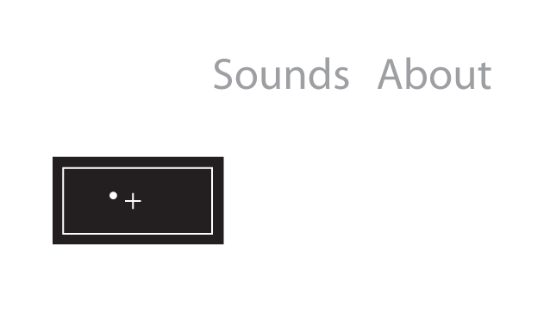
Control Settings
The controls menu can change how weapons are fired and can adjust the accelerometer’s neutral position.

Slide 7
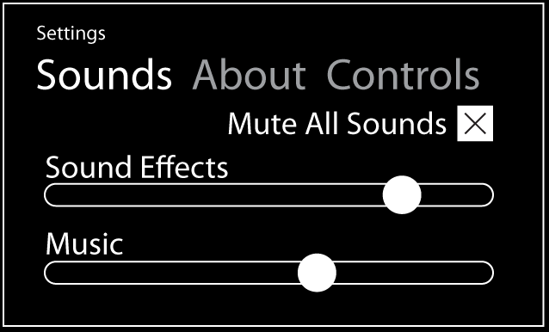
Sound Settings
The sound controls menu allows the adjustment of sound effects separately from music, and allows the user to mute all sounds. The Mute Select splash screen modifies this control directly.

Slide 8
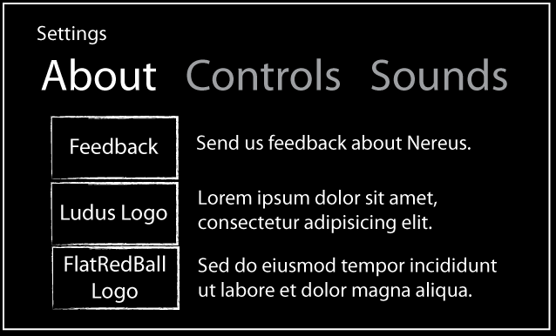
About
The about screen gives the user an opportunity to learn more about Ludus Mobile or FlatRedBall, as well as an email address where feedback email may be sent.

Slide 9
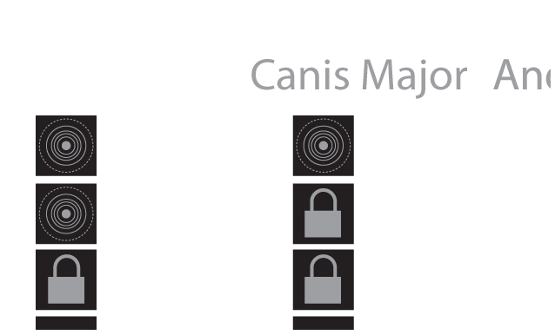
Level Select
The Level Select screen is a pivot, giving the user access directly to levels that they have unlocked.

Slide 10
Gameplay
The game screen is as minimal as possible, showing health and shield bars in the bottom left corner, a weapon control pad in the bottom right, and a pause button in the top right. The player’s ship is centered in the screen.

Slide 11
Pause Menu
The pause menu gives access to settings, level restart and resume buttons. This isn’t so much a screen by itself, as an overlay over the game screen. If possible, the paused game will be visible beneath, at reduced brightness.

Slide 12
Score Screen
After the user has completed a level, the score screen shows their score and the current high score for the level. An option is given to ‘brag’ on social networks, or to go to the next level. The hardware back button will return the user to the main menu.

