Slide 1
Bike Day
Team: Blue
Jens Titterness, Shifan Wu

Slide 2
Advantage (what & why)
Mobility
Customized for windows phone
Fully utilize phone features
Easy to carry while on the road
Convenient
No extra device necessary
Retrieve information at finger tip
Records
Keep track of exercise/commutes records
Early in the marketplace
only two app showed up in a search

Slide 3
Main function
Speed: current, average, highest
Time: total time for current trip
Location: current location on map and coordinates
Connectivity: facebook support

Slide 4
Technology
GPS
calculate speed/distance
Network connection
download map content
upload user information
Location services
locate position on map
Phone storage
save personal records

Slide 5
Schedule
Week 1: UI design and implementation
Week 2: Mapping and location tracking
05/07:first App test
Week 3: Speed/Distance tracking and map visuals completed
5/21: Second App test (On our own)
Week 4: Functionality hardening/bug fixes.
6/4: Final App Test

Slide 6
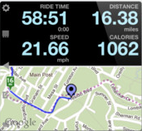
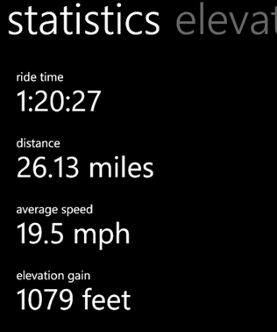
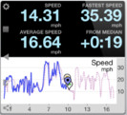
Tentivitive UI design

