Slide 1
Bike Day
Team: Blue
Shifan Wu & Jens Titterness

Slide 2
Where all it begins
From this high level UI discussion among us, we set our feet into user’s view point. We asks ourselves:
”How may our customer want to use this app?”
“What are the necessary features for this app?”
“How to display all the information?”

Slide 3
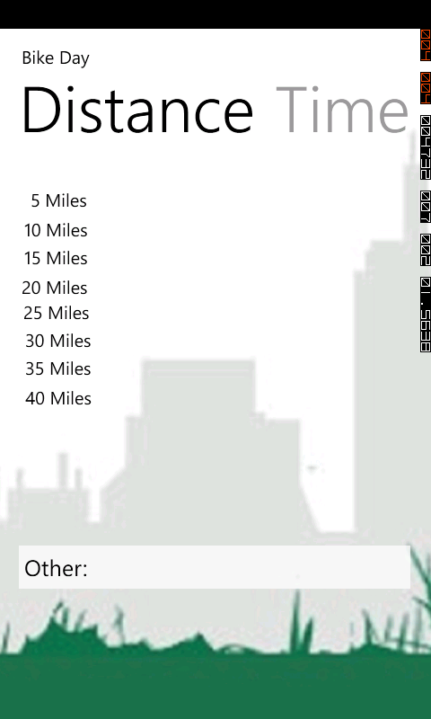
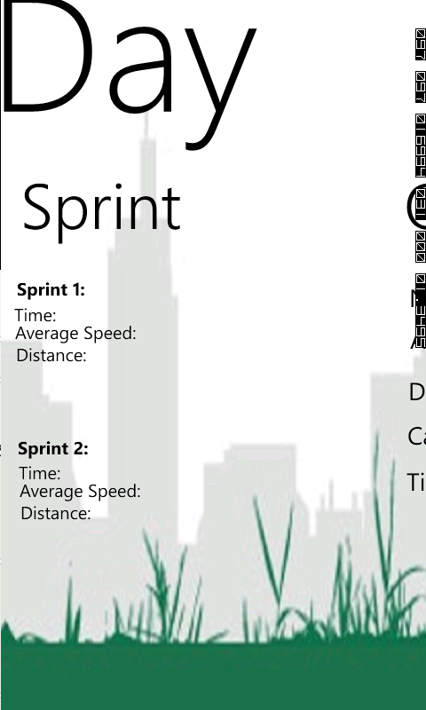
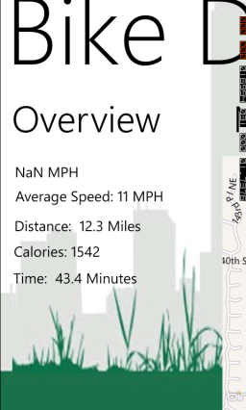
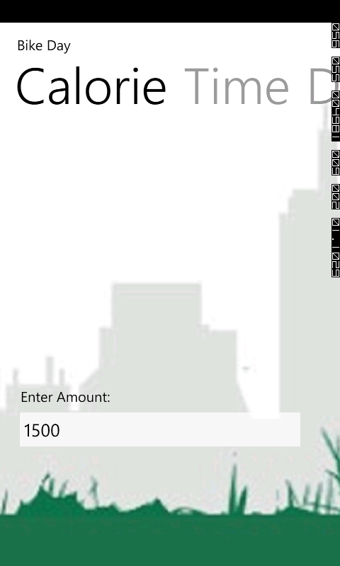
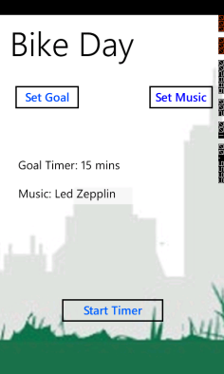
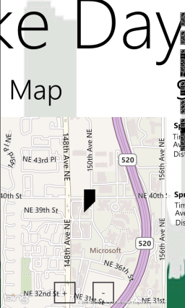
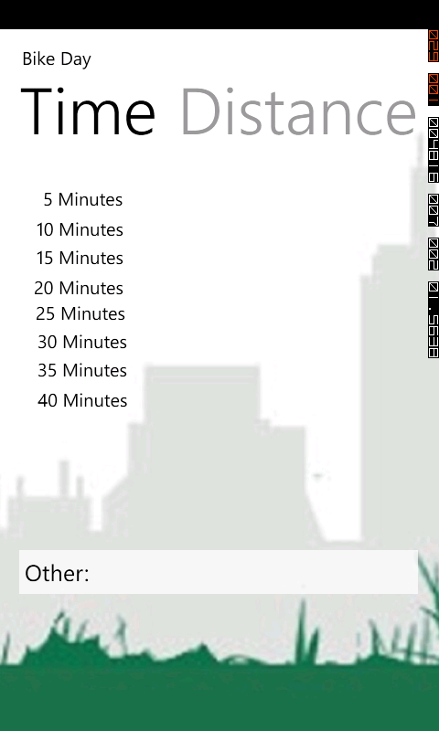
UI flow

Slide 4
UI detail
Set Goal
Choose between calories burn, time and distance.
Set Music
Choose a music/playlist from your Zune library
Start Timer
Start an open-ended exercise
(Remember to quit when you done :-o ).

Slide 5
UI detail
Panorama page shows basic information.
Goal is to give quick glance of key information

Slide 6
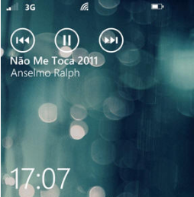
UI detail
Music page uses a pivot page style providing a selected song list.
User can sort them by albums, Artists, and genres.

Slide 7
UI detail
Sprit screen give a detailed information for your workout.
Divide total distance into every 5 miles interval.
Provide time, average speed and distance travelled so far.

Slide 8
UI detail

Slide 9
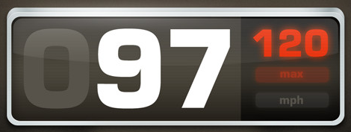
The future plan
Only display a speed, nothing else…
(inspired by a classmate from his favorite app presentation)

Slide 10
New schedule
Week 1: Mapping, location tracking and speed display (already working)
05/07:first App test
Week 2: Display detail information
5/14: Second App test (On our own)
Week 3,4: Additional features: POI, trail info shuffle music and bug fixing
6/4: Final App Test

