Slide 1
Electronic To Do List
Team ACE
Albert Gardner
Christine Di Gino

Slide 2
Problems
Forgetting/losing list
Coordinating multiple people
Weather
Location

Slide 3
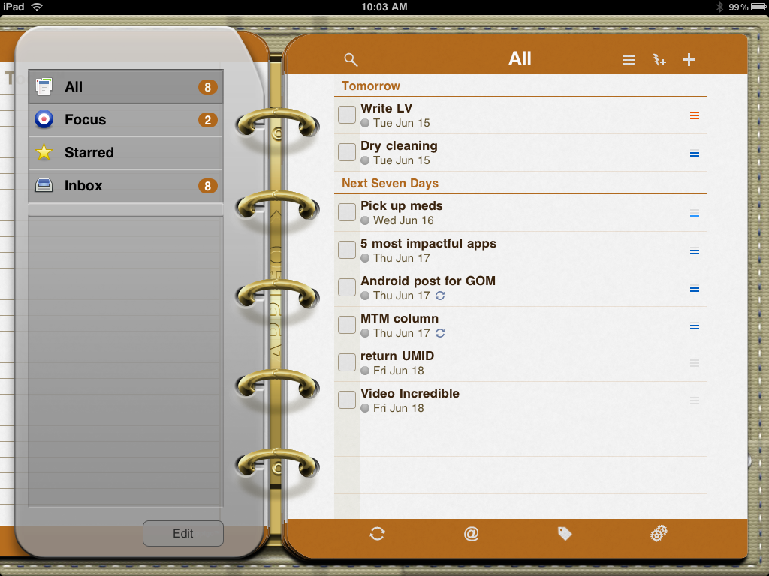
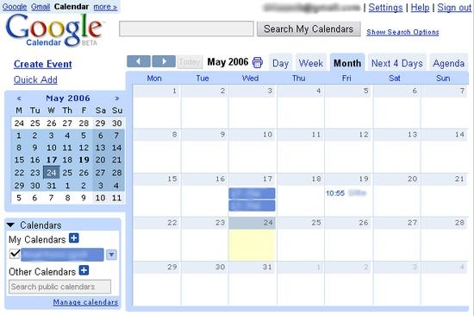
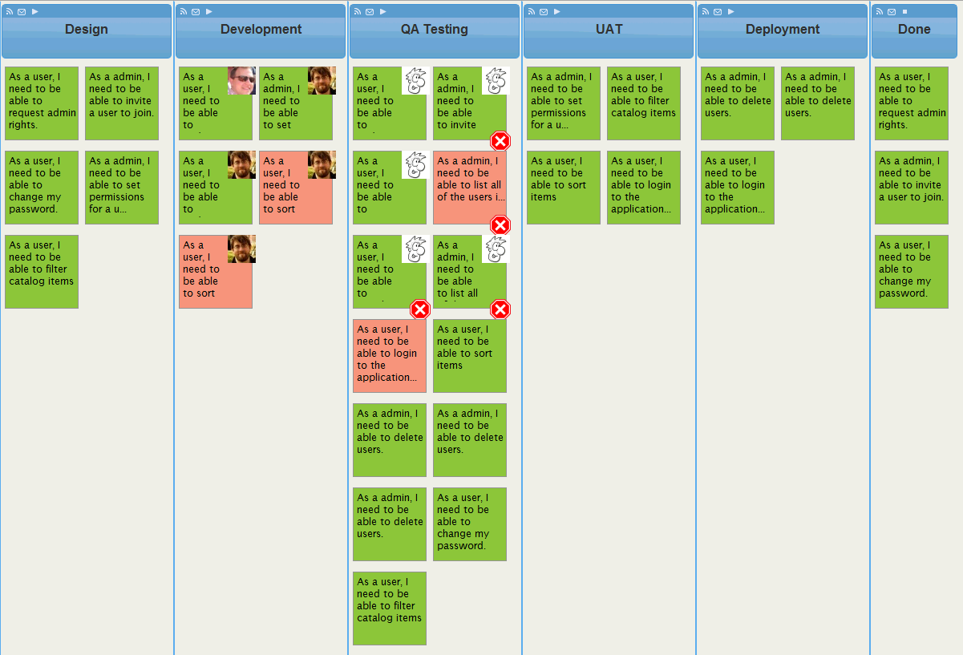
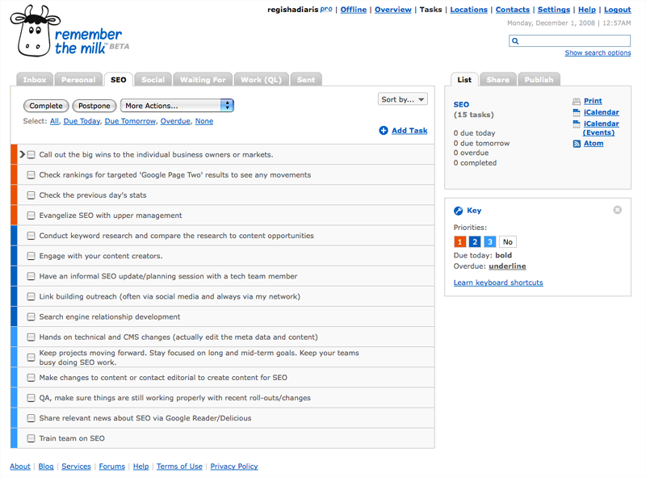
Competition
Notes:
Outlook, Google, Remember the Milk, ToDo, LeanKit Kanban

Slide 4
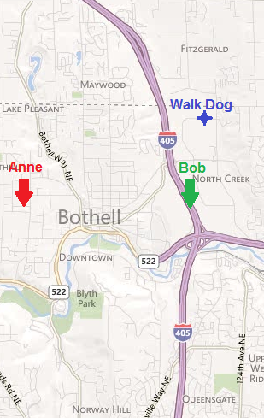
Our Difference
Connect with GPS
Message Sent to Bob:
At 3:00pm Walk Dog is scheduled. You are the closest at 1.1 miles away. You are now scheduled to Walk Dog.

Slide 5
Why…
…Create
Help organize people
Share lists
Connect with GPS
Connect with weather
…Mobile
Almost never without mobile device
Notifications
Insert photos if needed

Slide 6
Technical
Connecting with GPS
Creating & using web services
Tracking users and Tasks with a database
Staying in sync with multiple users

Slide 7
Schedule
Week End | Deliverable
5/4/2012 | Mock Up
5/11/2012 | Navigation of UI Operational
5/18/2012 | Website Operational
5/25/2012 | Whole App Operational
6/1/2012 | Fix Bugs
6/8/2012 | Demo Video

