Slide 1
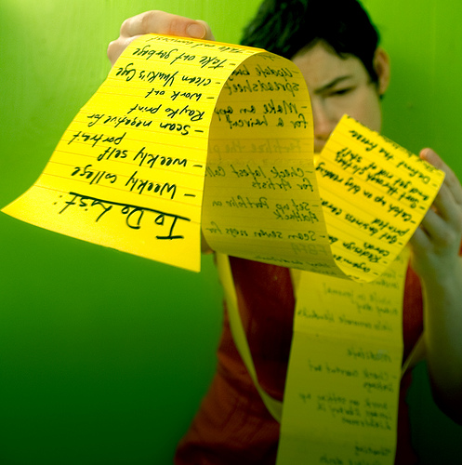
Electronic To Do List
Team ACE
Albert Gardner
Christine Di Gino

Slide 2
Summary
To Do List
Tasks can be assigned by location
Tasks can be set for certain weather conditions

Slide 3
Template
UI Prototype Template From:
Griffin Interactive
http://www.griffininteractive.net/2010/12/windows_phone_7_visio_template.html

Slide 4
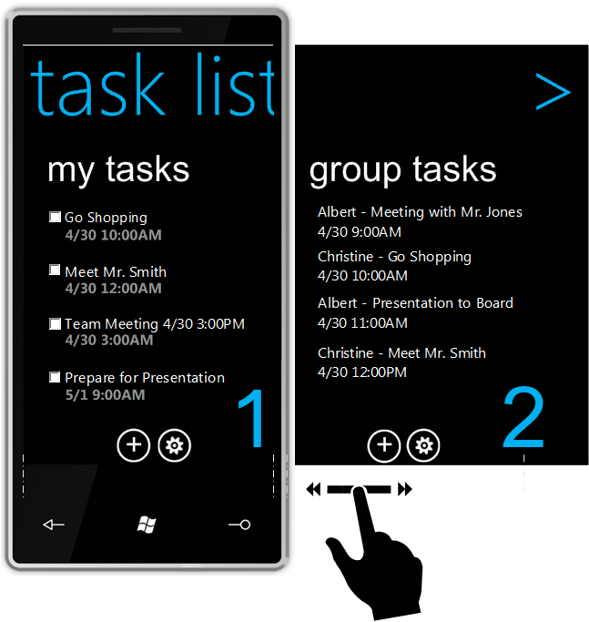
Home Page
Notes:
Outlook, Google, Remember the Milk, ToDo, LeanKit Kanban

Slide 5
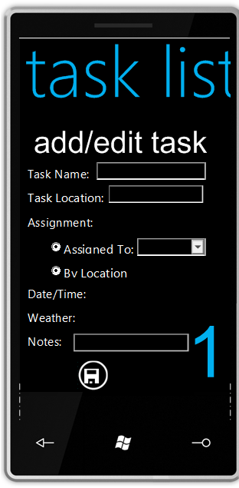
Task Add/ Edit

Slide 6
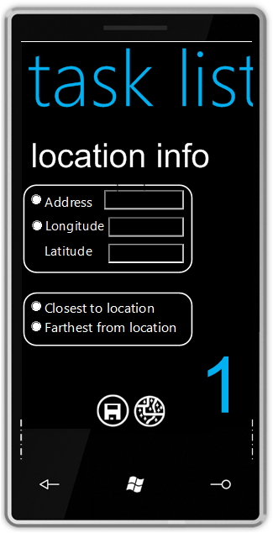
Location Entry

Slide 7
Weather Entry

Slide 8
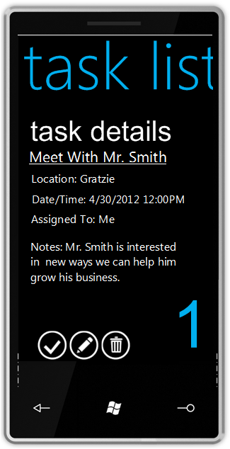
Task Details

Slide 9
Alerts

Slide 10
Schedule
Date | Deliverable
5-2-2012 (Wednesday) | Mock up design document complete.
5-5-2012 (Saturday) | Working UI Prototype with Static Data.
5-7-2012 (Monday) | Present UI Prototype and Gather Feedback
5-9-2012 (Wednesday) | Feedback incorporated into Static UI Prototype
5-14-2012(Monday) | Static webservice created – No Authentication
5-16-2012(Wednesday) | Dynamic webservice created – Authentication added
5-19-2012(Saturday) | Working UI Prototype with Dynamic Data (from Webservice)
5-21-2012(Monday) | Present Dynamic Prototype and Gather Feedback
5-26-2012(Saturday) | Feedback Incorporated into Dynamic prototype
5-30-2012(Wednesday) | Final Release – bug fixes completed – Start Video recording
4-6-2012(Monday) | Release Video

Slide 11
Questions

