Slide 1
*
Backlogged Errand Optimizer
By Team DDR:
Devin McBride
David Schmieder
Ren Wu
Notes:
*

Slide 2
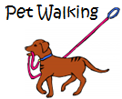
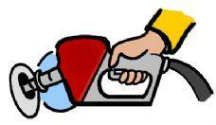
What does the app do
*
The Backlogged Errand Optimizer (BEO) maintains a backlog of errands for a user and optimizes the most efficient route to completing the errands.
Car Repair, 8:00AM-10:00AM
Lynwood,WA
Pet Walking in evening at home
Dry Clean,
Anytime, Bellevue,WA
Post Office, 8:00AM-4:00PM, Redmond,WA
Gas Station,
Anytime, Seattle,WA
Meet Friends, 10:00 AM-12:00PM, Bothell,WA
Library,
10:00 AM-5:00PM, Bothell,WA
Team DDR

Slide 3
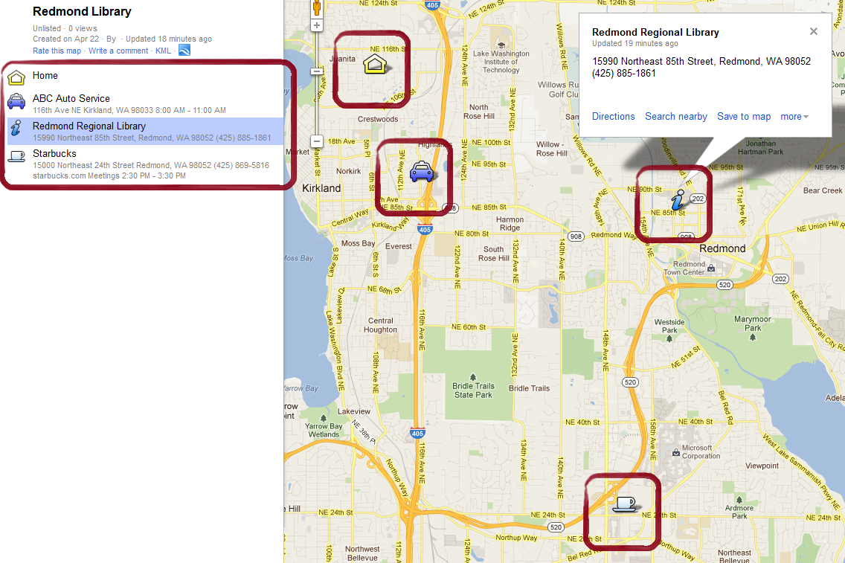
Why is it cool, why you like it
*
Team DDR

Slide 4
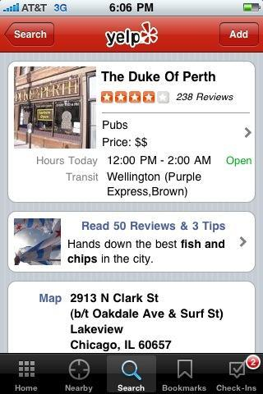
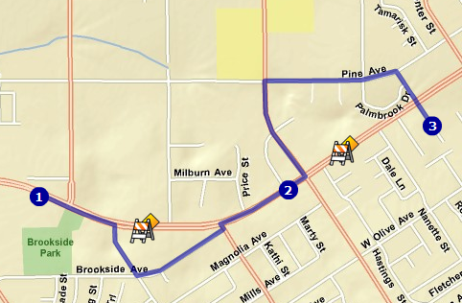
Technical
*
Simple UI
Location Aware using GPS
Yelp: Retrieve information
ArcGIS: Optimal Route Plan
Mapping
Team DDR

Slide 5
Schedule
*
Week of 4/23 | Sprint 1 | *Paper Prototype *UI mockup (1st version)
Week of 4/30 | Sprint 2 | *UI mockup (2nd version) *UI refinement (1st version) *Intuitive to use
Week of 5/7 Week of 5/14 | Sprint 3 | *Friendly UI *Finish the Yelp info. retrieval feature *Finish the mapping feature *Work on the route optimization feature
Week of 5/21 Week of 5/28 Week of 6/4 | Sprint 4 | *Final UI *Finish the route optimization feature *Finish the project
Team DDR

