Slide 1
Dinner and a Movie
Team Hindenburg:
Anthony Nardozza
Charles Pilgrim

Slide 2
Application Features
Contact Friends Online to Arrange Social Outing
Select Movie/Restaurant Randomly or through Voting
Presents Users looking for Social Activities a way to arrange “Get-Togethers.”

Slide 3
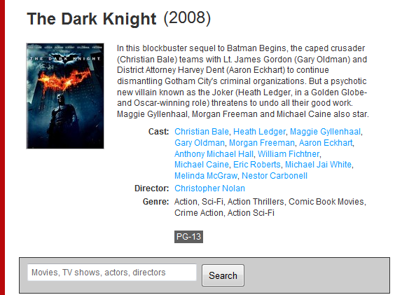
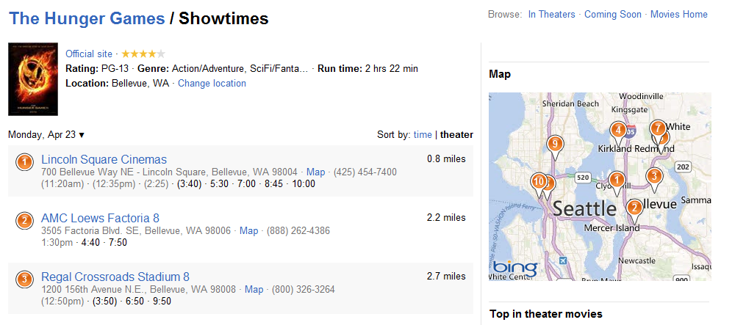
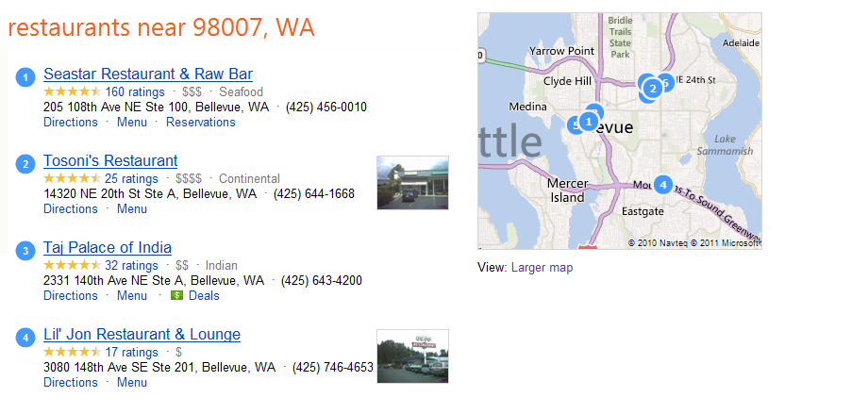
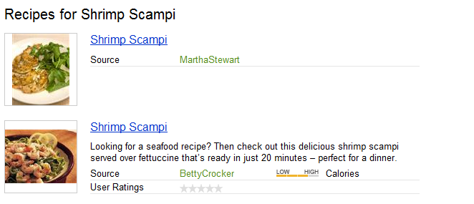
Source Searches

Slide 4
Phone Features/Data Sources
Phone Features
GPS
Text Messaging
Data Sources
Bing
Google
IMDb
NetFlix
…

Slide 5
Schedule
Week 6
Develop full interface mock-up with some real ui pages to determine overall theme.
Begin research into restaurant and movie search APIs (Bing, Netflix, etc).
Week 7
Finish UI design for the app.
Return basic search results based on location.
Determine best source of results needed and any parsing required.
Begin research into social functions (friend messaging or Twitter integration).
Week 8
Determine best method to get search results and display them in the app.
Week 9
Have social functions working with the app.
Finish any remaining UI and search issues.
Week 10
Final testing.

