Slide 1
Today: Concepts
Development for portable devices
  Definition of resources
  Deployment of resources
Begin GUI Elements
  Properties and organization
Events
  Protocols of function calls
  Event driven model
UI Elements
  Definition, appearance, how to modify
  UI element hierarchy
    Event propagation model
    Naming and changing the state of an UI element
For fun:
  The Timer utility, TimeSpan, and a stopwatch

Slide 2
Tools used
Visual Studio 2010
Windows Phone Developer SDK
  SDK: Software Development Kit
Windows Presentation Foundation (WPF)
  The xaml files …. And Expression Blend
Silverlight
Windows Phone 7: because it is fun

Slide 3
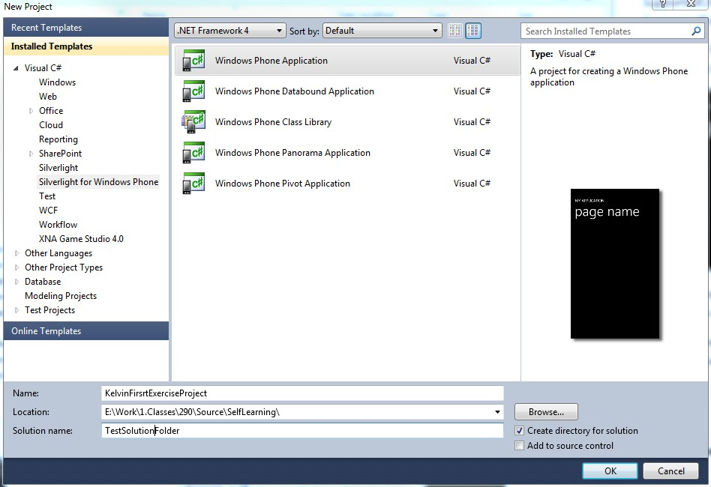
Create Your first project

Slide 4
Working with the IDE
Solution, Project,
Deploy vs. Debug, Run without Debug
Debug vs. Release
View →
  Solution Explorer
    Show/Hide button
    Refresh button
  Toolbox
Properties Window
  Context Sensitive Window

Slide 5
Compile/Build and Run
Compile (build), and Run
  Two separate procedure
  Run on Emulator: The executable
  The .xap file: where is this file?
  How to “run” this program?
    Double click on .exe, what happens?
    How to “load” the .xap onto the phone?
Go check out a Windows Phone

Slide 6
Deployment
Where is your app on the phone?
What is the name of your app?
  How to change this?
  What is your icon? How to change that?
  Explorer: view file extension how?
How to “pin” your all to the main page?
  How to un-pin?
How to delete your app from the phone?
Notice the UI design:
  pressed for a while and see what happens?! ☺

Slide 7
Working with the device
Unlock for development!
  Refer to web-site under WP7 sites, wait a little this process is going to be MUCH easier in a few weeks
Zune must be running
  Communication channel
Load and run on the phone
  From the .xap file
  From the IDE
Limited number of Apps you can load!

Slide 8
Images in the project
Background: 173x173, Icon: 62x62
  WMAppManifest.xml: Look for Background.png
  Or, project properties: GUI view vs. xaml view
How to include your own images
  Must “Include into project”
Properties of the newly added image:
  Build Action: Content
  Copy to Output: Copy if newer
  Remove all unused images!!
  Hint:
    If you don’t see changes on the phone
    un-install + Re-deploy

Slide 9
Project Properties
Double click on Properties (Under Project) + Application Tab:
  XAP file name
  Deployment Title + Icon: in the app area
  Pin to main: Tile + Background image
Hint: If you can’t see your images in the properties windows
  Close/open the property window to see them in the drop-down menu
.XAP files:
  Simple zip file: change file extension
  See all the images?! Remove unused images!!

Slide 10
Files in the project
Which are the useful/useless files?
Build in Release:
  Save the .xap file (your APP) from the Bin/Release folder.
Useless files:
Bin, obj folders can be deleted!
Any files ending with:
  .cache, .user ← can remove these files

Slide 11
PROJECTS for This class
For exercises and MPs
  DO NOT copy projects
  Always create from scratch
    Project and App naming convention: help me grade
    GUID: actual project name
      AssemblyInfo.cs, WMAppManifest.xml

Slide 12
Windows Presentation Foundation (WPF)
Fancy name for simple idea
Source files:
  .xaml and .xaml.cs
  Two sets: App and MainPage
App: don’t worry about this … but …
  this is the “Entry point:” the Main()
  Calls: MainPage()!
Double click on
  MainPage.xaml .cs: C# source code … whooo …
  MainPage.xaml

Slide 13
GUI Elements
Elements of Graphical User Interface:
  A Textbox, a Button, a Sliderbar, etc
  A Window, a “Panel”
Open in Expression Blend
Relationships: Expression Blend vs. Properties Window
  Try: Save in one window and see in the other
  Notice how .xaml file content changes! Two programs shares data via a file!
  Don’t change in both at the same time!!

Slide 14
Expression Blend
Cool? Easy way of edit the appearance of GUI elements
Text color, font size, location of textbox …
Windows →
  Tools, Assets, Properties, Objects and Timeline, Device
  Tools and Assets: overlaps!
  Properties: lets you control the appearance
Important insight!!

Slide 15
GUI Element Hierarchy
The Default Hierarchy of the GUI element!
  LayoutRoot parent of: TitlePanel and ContentPanel
  TitlePanel and ContentPanel:
    are siblings
    Children of LayoutRoot
  ApplicationTitle and PageTitle: siblings
    Children of ContentPanel
Why is this important?
  Try deleting LayoutRoot?!
  Or moving it!
  Important to know parents of a GUI element!!

Slide 16
Events
GUI Elements as variables
GUI Element Alignment problem
  Window Size change (e.g., Phone orientation change)
Event Driven Programming Structure
  Event propagation model
  Notice: same event in entire ancestry tree
Service Events
  Event service routines

Slide 17
Let’s try:
Add in a TextBox
  Change alignment
  Change alignment with offset
  Change color
Add a rectangle
How to “group” the rectangle and TextBox under the same alignment?
  Hint: Canvas
  How to move existing elements into a canvas?
WATCH OUT:
  Properties window: the Event vs. Properties Tab!!

Slide 18
Expression Blend
Add in a new textbox
Give this textbox a name: A NAME?
  GUI element hierarchy
  The object that contains the variable name:
    Which one?
  Exercise: Create a canvas move the textbox into the canvas … Notice,
    the textbox has a new GUI parent
    The textbox’s variable belongs to MainPage
    Learn: cannot name two GUI elements the same name!
  MainPage.xaml.cs: MainPage()
    Set the Text content on the textbox
    ALL properties of all GUI elements can be changed in the .cs file!!

Slide 19
Switch on Orientation support
Expression Blend
  Notice which GUI element you select!!
    Only one (the very root) has Orientation property
  See the exact same property can be access via Visual Studio (IDE)
  Remember, same data!!
    Find the file being changed! Which one?
Now, run, the MainPage reacts “intuitively”
  Nice? No?
  What’s happening to your textBox, what do you want from it?

Slide 20
Text (or: ANY GUI) Placement
This is a real problem in general!
  GUI Window size change!!
  Look at your WORD document, when you resize your window what happens?
  Choice: Policy!!
    Statically defined: does not change during runtime
      Specify measured from which boundary, how many pixels
    Program control: Policy
      At run time, move GUI according to some policy
        E.g., distance from the Top/Left
  How does WORD support its menus?

Slide 21
Aligning Text or ANYTHING!
Align Text wrt Top/Left (TL)
Align Rectangle wrt Bottom Left
How to align two GUI elements at the same time?
  Canvas!
Silverlight datatypes to work with:
  Orientation: enumerated datatype
  Panel/Layout:
    ActualWidth/Height
    RenderSize

Slide 22
Events and Event Services
Select Content Panel
  Properties Tab: look at all the events!!
  Let’s look at size change
  Add in a “Service Function: <CR>!!
  BAM!!
    Just Registered a event service function with the ContentPanel
What? This function will be called when ContentPanel size changes
  Who is calling this function? WPF
  What do we do in this function?
  One thing! One thing and return!
Let’s see what is the size, and size change

Slide 23
Events and Service Routines
Events are generated by user action
Events are “sent” to a GUI element
  Root window, Panel, textbox, etc. etc.
We can choose to let a GUI “service” an event
  Find the GUI
  Find the event
  Define the service routine!
    Same event service tag can exists all along the UI element parentage hierarchy
Now, what should we do to receive orientation change?

Slide 24
Inter-Dependent Events
An event implies another one will be generated!
  Mouse Buttons: Down → Drag → Up
  Touch → Drag → Up
Usually wants to keep track of what is happening along the way!!
Manipulation series of Touch events
  Notice exists on ALL GUI elements!
  Remember about Event propagation/Routing: start from Parent
Use Manipulation to capture movements
  Delta: what just happened
  Cumulative: what happened since the beginning
  Print out the Translation.X/Y to verify

Slide 25
Example: Event Routing
Look at the EventRouting source code
Structure
  Blue: Grandparent: lowest priority in event handling
    Red: Parent: blocks delta from grandParent
      Green Region: highest priority: blocks End from Parent
Hint: Panel without Fill cannot receive Touch events.

Slide 26
Event Routing Details
Always sent to the leve!! (lowest-level child)!!
Child-Green panel: touch/move:
  Start from all three generation
  Delta only from Child/Parent (Parent blocked the event from GrandParent)
  Completed: only from Child (Child blocked event from everyone!)
Red Region: touch/move
  Start: from parent and grandParent
  Delta: only from Parent (parent blocked from grandParent)
  Completed: from both parent and grandParent (parent did not block Completed)
Blue region: touch/move see all messages

Slide 27
Example: Timer
Start a “System Timer”
Variable types:
  Instances vs. Local ← the difference?!
The StopWatchTimer app:
  DispatcherTimer (Systems.Windows.Threading)
    Interval, Tick, and Start()
  Date and time:
    DateTime, TimeSpan
  Rectangle UI element
    SolidColorBrush

Slide 28
Appendix: Misc Info
.xaml.cs vs. .cs
Properties Window
  Properties vs. Event tabs
Debugging, stop and examine results
Editing/running from Expression Blend
Event call backs
  Which GUI element is generating the event

