Slide 1
Engineering Design Process
Feng-Ju Hsieh

Slide 2
Engineering Design Process
ENGINEERING is the process of applying scientific and mathematical principles, experience, judgments, and common sense to DESIGN products or processes that
benefit society. It is an ITERATIVE process composed of the following parts:

Slide 3
Problem Definition
Problem Definition
Identifying needs to be served by the design, determining design objectives and constraints.
For the tower project
Our needs is to build a strong tower to support water tank

Slide 4
Information Gathering
We need to Find out
design problem,
Engineering science,
knowledge of Material and structure
available technology,
Strong, light and cheap material
Manufacturing Technology
and previous solutions.
What is the previous design

Slide 5
Idea Generation
Generating multiple creative design possibilities
For tower project
3 kinds of material
Spaghetti
adhesive tape;
square foam board
Where is the idea from
Feeling
Experience
Common sense
tensile strength
Compressive strength
torsion
bending moment
Structure Mechanics

Slide 6
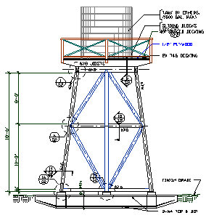
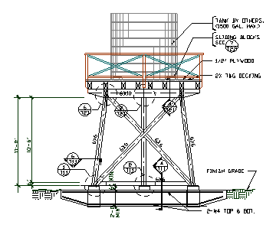
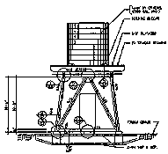
Idea Selection
Evaluating design possibilities and deciding to go with one
Open water tower
Diamond Braced
X Braced Tower
Force analysis is needed
to know which one is better !!!!!

Slide 7
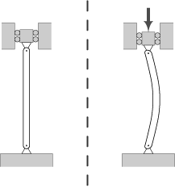
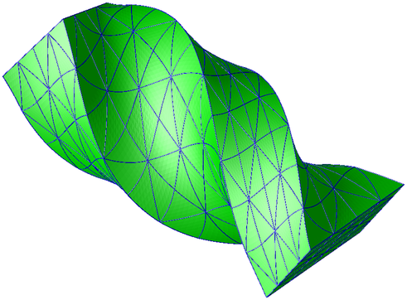
Structure Mechanics
Tension
Torsion
Compression
Buckling:
Moment generation

Slide 8
3 sticks problem
What would you do if you only have 3 spaghetti ?

Slide 9
Implementation
Building a prototype
You will not succeed at first time
Building the final design

Slide 10
Important thing to know
Team Work
Communication
Planning
Management
Modeling
Simulation or calculation before you actually do it!

Slide 11
Design process diagram

