Slide 1
Memo format and Force analysis
Feng-Ju Hsieh

Slide 2
Grading Policy of Memo
Format-50%
Address
TO: ENGR 100 C
FROM: YourName
DATE: Jan. 07, 2009
SUBJECT: Proper Memorandum Style and Format
Introduction
Body-content
Conclusion
Content-50%
Clarity:30%
Conclusion:20%
It is better to type it!!

Slide 3
Force Analysis
Force
Something that can move things in a straight line.
Force has magnitude, direction and point of application (Where it works on).
Force can cause an object with mass to accelerate
Force can transfer energy
People usually use the "arrow" to represent the force.

Slide 4
Newton’s Laws of Motion
In the absence of a net force, the center of mass of a body either is at rest or moves at a constant velocity. (law of inertia)
A body experiencing a force F experiences an acceleration a related to F by F = ma, where m is the mass of the body. Alternatively, force is equal to the time derivative of momentum.
Whenever a first body exerts a force F on a second body, the second body exerts a force −F on the first body. F and −F are equal in magnitude and opposite in direction. (action-reaction law)

Slide 5
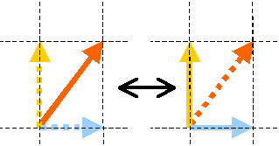
Parallelogram Method
Force is a vector. It can be decoupled or combined by the parallelogram method.
One force can be decoupled into two forces; tow forces can be combined into one force. They will still have the same effect.
How many?
Parallelogram of force

Slide 6
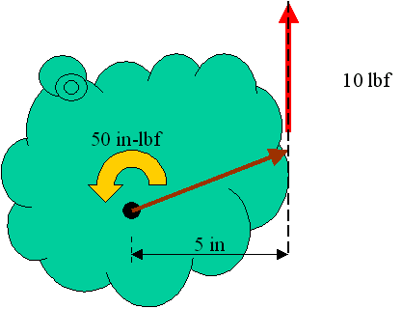
Moment
Something that can rotate things. Make it spin.
Moment also has magnitude, direction
Moment is a result from force that make thing rotate
Moment =5in*10lbf=50(in*lbf)
Fix point

Slide 7
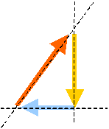
Force and moment balance
Force and moment in the opposite direction can cancel out each other

Slide 8
Force analysis on cantilever
F
When you design your bridge, think about moment!!!
F
x
F*x=Moment
Moment
x

Slide 9
Truss Bridge Force Analysis (Free Body Diagram)
http://www.garrettsbridges.com/design/trussdesign
http://www.jhu.edu/virtlab/bridge/bridge.htm

Slide 10
Truss Bridge Force Analysis (Free Body Diagram)

Slide 11
Truss Bridge Force Analysis (Free Body Diagram)

Slide 12
Truss Bridge Force Analysis (Free Body Diagram)

Slide 13
Truss Bridge Force Analysis (Free Body Diagram)

Slide 14
Warren Truss Bridge

Slide 15
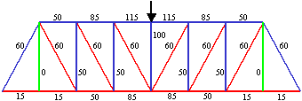
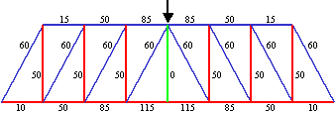
Pratt Truss & Howe Truss
Compressed member is shorter
Compression force is smaller

Slide 16
K Truss
The lengths of the compression members is shorter
Extra weight?

Slide 17
Already Known
Force can be represented in vector:
External Forces:
Surface forces : direct contact of two bodies (concentrated/distributed forces)
Body forces: no physical contact (EM forces, G- forces)
Internal Forces:
Particle bounding
Reacted force
Reaction force at support may induce normal forces and couple moments in vector:

Slide 18
Kinematics and Dynamics (ME 230)
Equations of equilibrium
(statics force/moment analysis)
Only can figure out the F&M to maintain steady state...
Not to translate or move Not to rotate

Slide 19
Kinematics and Dynamics (ME 230)
Example to get F&M
Don’t know whether the material can hold it or not

Slide 20
Mechanics of Materials (ME 354)
External force<->Internal force <->Material
Stress
The distribution of these internal forces acting over a sectioned area of the body
Strain
Normalized deformation of body in response to stress
Relationships between the external loads applied to a deformable body and the intensity of internal forces acting within the body as well as the deformations of the body.

Slide 21
Stress
Normal Stress
acting perpendicular to the plane of the area
Tensile/compressive stress
Shear Stress
acting parallel to the plane of the area

Slide 22
Strain
Whenever a force is applied to a body, it will tend to change the body's shape and size.
Normal Strain
elongation or contraction of a line segment per unit length resulting in a volume change
tensile strain = elongation (+)
compressive strain = contraction (-)
Shear Strain
angle change between two line segments resulting in a shape change

Slide 23
Stress Strain Relationship
Elastic area
Recoverable deformation (Hook’s Law)
F = k x
Plastic area
Non-recoverable deformation (yielding)

Slide 24
How to get the plot?
Test it!

Slide 25
Test Machine

Slide 26
Stress-Strain Plot (Tensile Test)
our case?

Slide 27
Test Any Material?

