Slide 1
Theremin
William Soetanto
MyDaq Musical Instrument Example
ENGR 100 TA

Slide 2
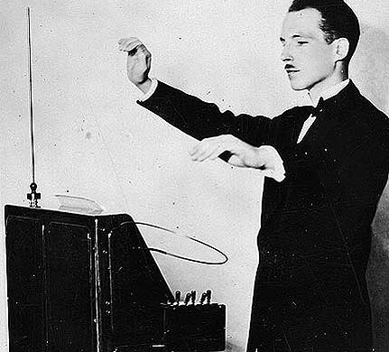
History
Invented by a physicist Leon Theremin, and patented in 1928
Lenin was impressed with the invention and started taking lessons
Featured in 1951 The Day the Earth Stood Still, 1945 The Lost Weekend

Slide 3
Operation Method
Played without physical contact
Uses 2 Antennae forms the input
Pitch
Volume
Hands become ground plate for antenna
Becomes a variable capacitor
LC circuit

Slide 4
Our Version

Slide 5
TSL 260R LF
Light Intensity to Voltage Converter
λ=940 nm
Characteristics
VDD= 2.7–5.5 V
VOM= 3.3V
at VDD=4.5V

Slide 6
Wiring Schematics
TSL 260R LF
TSL 260R LF

Slide 7
Software Design Steps
Mapping analog to system input
Human hearing range 20 -20000 Hz
Piano frequency range 16 – 5000 Hz
Amplitude range -2 to 2 V
Harmonics vs True Tone
Pure sine waveform is true tone
Musical instrument never generate true tone
Limitation
DAQ maximum sampling rate 200k Hz
DAQ audio out voltage -2 to 2 V

Slide 8
VI Front Panel

Slide 9
Wiring Diagram VI

