Slide 1
ENGR100
Class Wrap up
Feng-Ju Hsieh

Slide 2
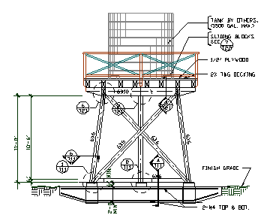
Water Tower Project
Engineering Design Process
Assumption
Material Limits?
IBM-Think
APPLE-Think Different

Slide 3
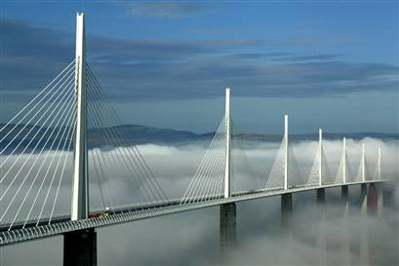
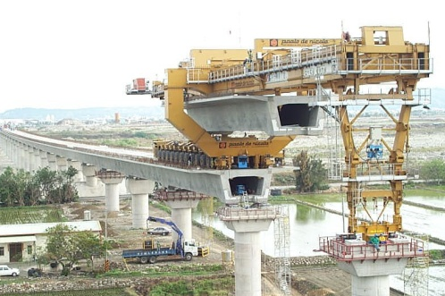
Bridge Project
Bridge Type
Force Analysis: Tension vs Compression
How to do Teamwork, Time line?
Component Test.
Simulation Software
Prototype, Final Design
Tips: length, strength, shape…

Slide 4
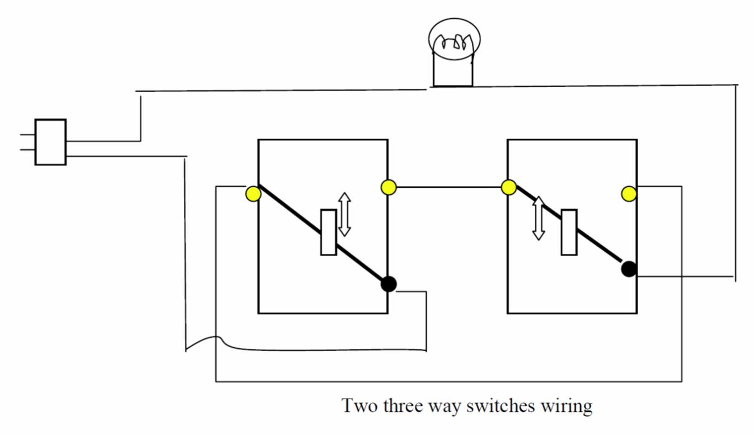
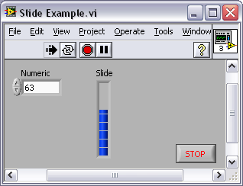
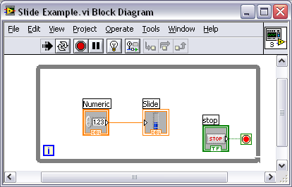
Logic and Electric Wiring Project
Logic Gate
Switch combination
Real Application
LabVIEW

Slide 5
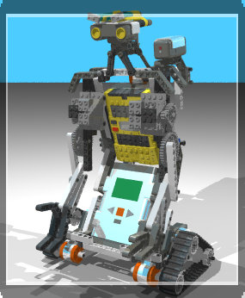
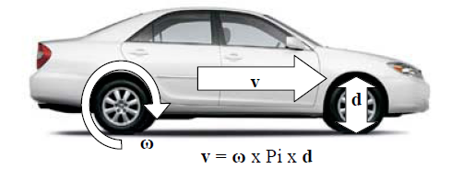
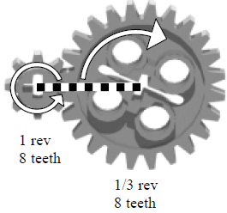
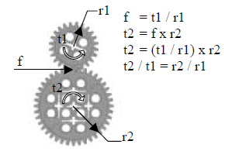
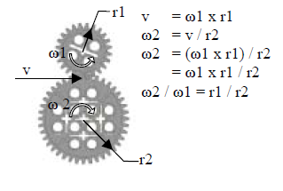
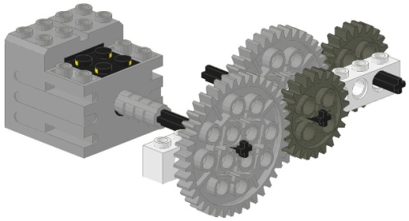
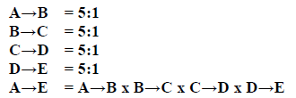
Robot Project
History and Future
Basic Two Components of Robot (Brain, Body)
Brain Storming Strategy (Offense and defense)
Programming Skill
Gear Ratio= driven gear R2 : driving gear R1
A small gear driving a larger gear will amplify torque

Slide 6
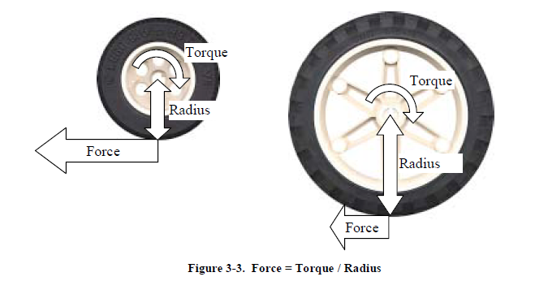
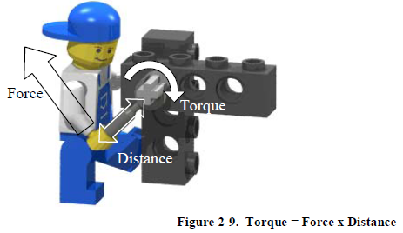
Question for Extra Points
If big wheels are less efficient for towing, why do tractors have big wheels?
[Hint] Think about the force that actually pushes the vehicle to move forward. What’s the criteria of this kind of force and its relationship to the torque generated from engine and to the force that tows cargo?

