Slide 1
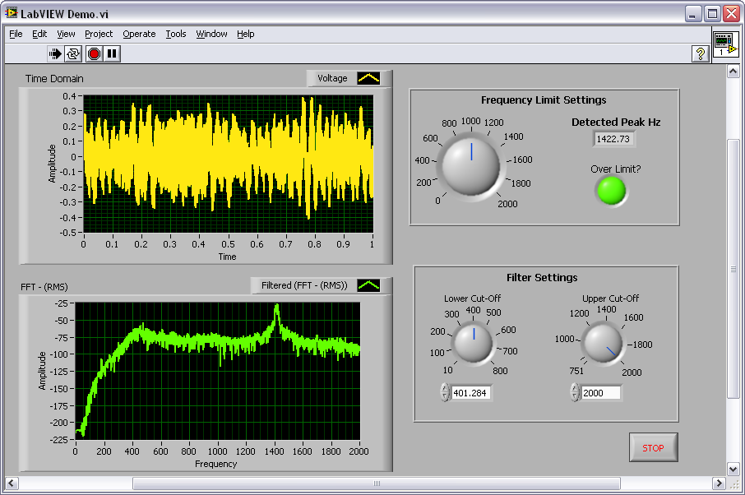

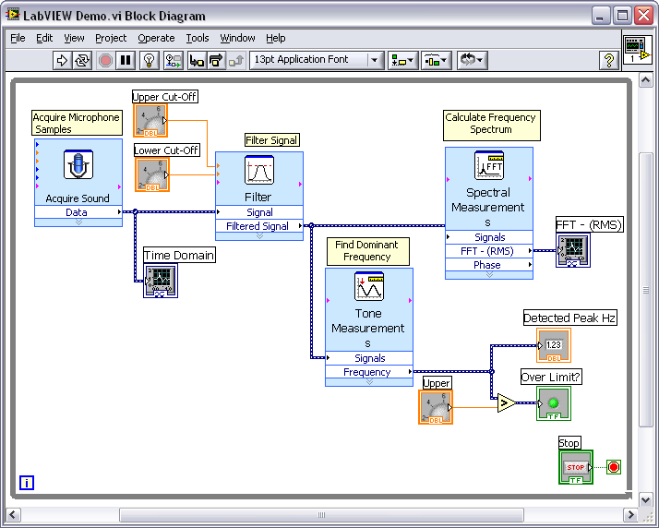
Hands-On Material
From National Instruments
Introduction to LabVIEW
Electrical Wiring
GRAPHICAL PROGRAMMING
FOR ENGIEERS AND SCIENTISTS
Feng-Ju Hsieh
Notes:
© National Instruments Corporation 1 Introduction to LabVIEW Hands-On

Slide 2
Course Goals
Become comfortable with the LabVIEW environment and data flow execution
Ability to use LabVIEW to simulate Electrical Wiring
LabVIEW Concepts
  Find and use math and complex analysis functions
  Work with data types, such as Boolean, integer, and
  Displaying
Notes:
This is a list of the objectives of the course.
This course prepares you to do the following:
• Use LabVIEW to create applications.
• Understand front panels, block diagrams, and icons and connector panes.
• Use built-in LabVIEW functions.
• Create and save programs in LabVIEW so you can use them as subroutines.
• Create applications that use plug-in DAQ devices.
This course does not describe any of the following:
• Programming theory
• Every built-in LabVIEW function or object
• Analog-to-digital (A/D) theory
NI does provide free reference materials on the above topics on ni.com.
The LabVIEW Help is also very helpful:
LabVIEW»Help»Search the LabVIEW Help…
Introduction to LabVIEW Hands-On 2 ni.com

Slide 3
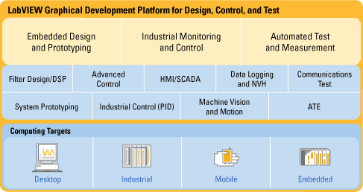
LabVIEW Graphical Development System
Graphical Programming Environment
Compile code for multiple OS and devices
Useful in a broad range of applications
Notes:
National Instruments LabVIEW is an industry-leading software tool for designing test, measurement, and control systems. Since its introduction in 1986, engineers and scientists worldwide who have relied on NI LabVIEW graphical development for projects throughout the product design cycle have gained improved quality, shorter time to market, and greater engineering and manufacturing efficiency. By using the integrated LabVIEW environment to interface with real-world signals, analyze data for meaningful information, and share results, you can boost productivity throughout your organization. Because LabVIEW has the flexibility of a programming language combined with built-in tools designed specifically for test, measurement, and control, you can create applications that range from simple temperature monitoring to sophisticated simulation and control systems. No matter what your project is, LabVIEW has the tools necessary to make you successful quickly.
Introduction to LabVIEW Hands-On 4 ni.com

Slide 4
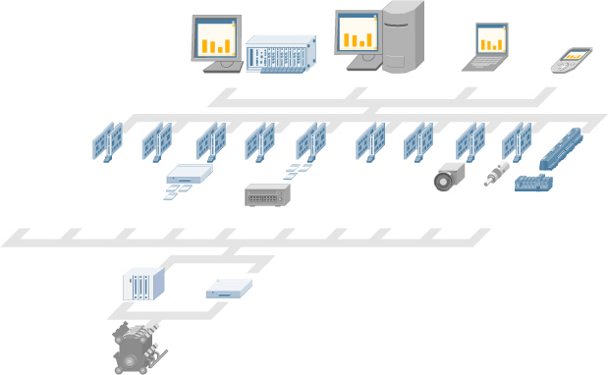
The NI Approach – Integrated Hardware Platforms
PXI Modular Instrumentation
Desktop PC
Laptop PC
PDA
High-Speed
Digitizers
High-Resolution
Digitizers and DMMs
Multifunction
Data Acquisition
Dynamic
Signal Acquisition
Instrument
Control
Digital I/O
Counter/
Timers
Machine
Vision
Motion
Control
Distributed I/O and
Embedded Control
Signal Conditioning
and Switching
Unit Under Test
Notes:
Integrated Hardware Platforms
A virtual instrument consists of an industry-standard computer or workstation equipped with powerful application software, cost-effective hardware such as plug-in boards, and driver software, which together perform the functions of traditional instruments.
Virtual instruments represent a fundamental shift from traditional hardware-centered instrumentation systems to software-centered systems that exploit the computing power, productivity, display, and connectivity capabilities of popular desktop computers and workstations.
Although the PC and integrated circuit technology have experienced significant advances in the last two decades, software truly offers the flexibility to build on this powerful hardware foundation to create virtual instruments, providing better ways to innovate and significantly reduce cost. With virtual instruments, engineers and scientists build measurement and automation systems that suit their needs exactly (user-defined) instead of being limited by traditional fixed-function instruments (vendor-defined).
Introduction to LabVIEW Hands-On 6 ni.com

Slide 5
Section I – LabVIEW Environment
A. Getting Data into your Computer
  Data Acquisition Devices
    NI-DAQ
    Simulated Data Acquisition
    Sound Card
B. LabVIEW Environment
  Front Panel / Block Diagram
  Toolbar /Tools Palette
C. Components of a LabVIEW Application
  Creating a VI
  Data Flow Execution
D. Additional Help
  Finding Functions
  Tips for Working in LabVIEW
Notes:
© National Instruments Corporation 7 Introduction to LabVIEW Hands-On

Slide 6
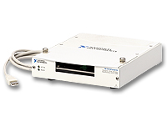
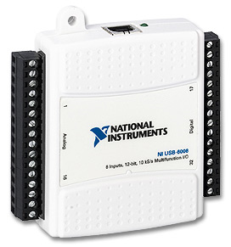
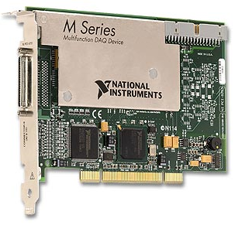
A. Setting Up Your Hardware
Data Acquisition Device (DAQ)
  Actual USB, PCI, or PXI Device
  Configured in MAX
Simulated Data Acquisition Device (DAQ)
  Software simulated at the driver level
  Configured in MAX
Sound Card
  Built into most computers
Track A
Track B
Track C
Notes:
This LabVIEW course is designed for audiences with or without access to National Instruments hardware.
Each exercise is divided into three tracks, A, B, and C:
Track A is designed to be used with hardware supported by the National Instruments DAQmx driver. This includes most USB, PCI, and PXI data acquisition devices with analog input. Some signal conditioning and excitation is required to use a microphone with a DAQ device. (Some sensors, like microphones, require external power to work (excitation)).
Track B is designed to be used with no hardware. Hardware can be simulated with the NI-DAQmx Driver Version 7.5 and newer. A simulated NI-DAQmx device is a replica of a device created using the NI-DAQmx Simulated Device option in the Create New menu of MAX for the purpose of operating a function or program without hardware. An NI-DAQmx simulated device behaves similar to a real device. Its driver is loaded, and programs using it are fully verified.
Track C is designed to be used with a standard sound card and microphone. LabVIEW includes simple VIs for analog input and analog output using the soundcard built into many PCs. (This is very convenient for laptops because the soundcard and microphone are usually already built-in.)
Introduction to LabVIEW Hands-On 8 ni.com

Slide 7
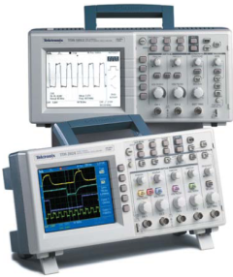
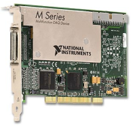
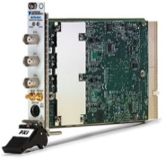

What type of device should I use?
 | Sound Card* | NI USB DAQ | NI PCI DAQ | Instruments*
AI Bandwidth | 8–44 KS/s | 10–200 KS/s | 250 K–1.2 Ms/s | 20kS/s–2 GS/s
Accuracy | 12–16 bit | 12–16 bit | 14–18 bit | 12–24 bit
Portable | x | x | — | some
AI Channels | 2 | 8–16 | 16–80 | 2
AO Channels | 2 | 1–2 | 2–4 | 0
AC or DC | AC | AC/DC | AC/DC | AC/DC
Triggering | — | x | x | x
Calibrated | — | x | x | x
* The above table may not be representative of all device variations that exist in each category
Notes:
What type of device should I use?
There are many types of data acquisition and control devices on the market. A few have been highlighted above. The trade-off usually falls between sampling rate (samples/second), resolution (bits), number of channels, and data transfer rate (usually limited by “bus” type: USB, PCI, PXI, etc.). Multifunction DAQ (data acqusion) devices are ideal because they can be used in a wide range of applications.
USB-6008 & USB-6009 Low-Cost USB DAQ
The National Instruments USB-6009 provides basic data acquisition functionality for applications such as simple data logging, portable measurements, and academic lab experiments. The NI USB-6008 and NI USB-6009 are ideal for students. Create your own measurement application by programming the NI USB-6009 using LabVIEW and NI-DAQmx driver software for Windows. For Mac OS X and Linux users, download and use the NI-DAQmx Base driver.
NI USB-6009 Specifications:
Eight 14-bit analog inputs
12 digital I/O lines
2 analog outputs
1 counter
http://www.ni.com/daq/
Introduction to LabVIEW Hands-On 10 ni.com

Slide 8
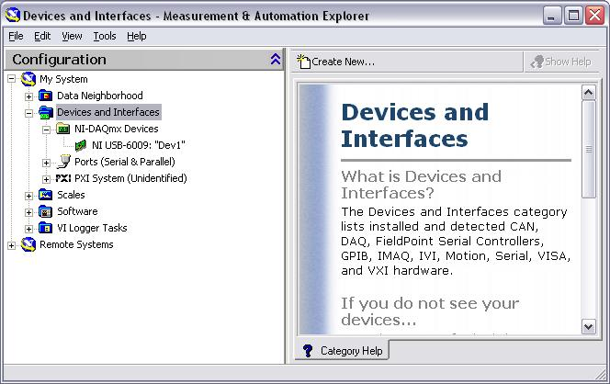

What is MAX?
MAX stands for Measurement & Automation Explorer.
MAX configures and organizes all your National Instruments DAQ, PCI/PXI instruments, GPIB, IMAQ, IVI, Motion, VISA, and VXI devices.
Used for configuring and testing devices.
Icon Found on
Windows Desktop
Notes:
The next level of software we are concerned with is called Measurement & Automation Explorer (MAX). MAX is a software interface that gives you access to all of your National Instruments DAQ, GPIB, IMAQ, IVI, Motion, VISA, and VXI devices. The shortcut to MAX will be placed on your desktop after installation. A picture of the icon is shown above. MAX is mainly used to configure and test your National Instruments hardware, but it does offer other functionality such as checking to see if you have the latest version of NI-DAQ installed. When you run an application using NI-DAQmx, the software reads the MAX configuration to determine the devices you have configured. Therefore, you must configure DAQ devices first with MAX.
The functionality of MAX is broken into seven categories:
Data Neighborhood
Devices and Interfaces
IVI Instruments
Scales
Historical Data
Software
VI Logger Tasks
For this course, we will focus on Data Neighborhood, Devices and Interfaces, Scales, and Software. We will now step through each one of these categories and learn about the functionality each one offers.
© National Instruments Corporation 11 Introduction to LabVIEW Hands-On

Slide 9
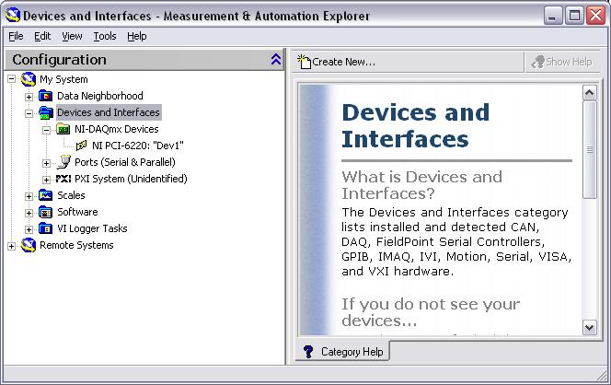
Exercise 1 – Setting Up Your Device
Track B
Use Measurement and Automation Explorer (MAX) to:
  Configure and test your Simulated Data Acquisition (DAQ) device
Notes:
Exercise 1 – Setting Up Your Device (Track B)
In this exercise you will use Measurement and Automation Explorer (MAX) to configure a simulated DAQ device.
Launch MAX by double-clicking the icon on the desktop or by selecting Start»Programs»National Instruments»Measurement & Automation.
Expand the Devices and Interfaces section to view the installed National Instruments devices. MAX displays the National Instruments hardware and software in the computer. The device number appears in quotes following the device name. The data acquisition VIs use this device number to determine which device performs DAQ operations.
Create a simulated DAQ device for use later in this course. Simulated devices are a powerful tool for development without having hardware physically installed in your computer. Right-click Devices and Interfaces and select Create New…»NI-DAQmx Simulated Device. Click “Finish”.
Expand the M Series DAQ section. Select PCI-6220 or any other PCI device of your choice. Click “OK”.
The NI-DAQmx Devices folder will expand and you will see a new entry for PCI-6220: “Dev1”. You have now created a simulated device!
Perform a self-test on the device by right-clicking it in the configuration tree and choosing Self-Test or clicking “Self-Test” along the top of the window. This tests the system resources assigned to the device. The device should pass the test because it is already configured.
Check the pinout for your device. Right-click the device in the configuration tree and select Device Pinouts or click “Device Pinouts” along the top of the center window.
Open the test panels. Right-click the device in the configuration tree and select Test Panels… or click “Test Panels…” along the top of the center window. The test panels allow you to test the available functionality of your device, analog input/output, digital input/output, and counter input/output without doing any programming.
On the Analog Input tab of the test panels, change Mode to “Continuous”. Click “Start” and observe the signal that is plotted. Click “Stop” when you are done.
Introduction to LabVIEW Hands-On 14 ni.com

Slide 10
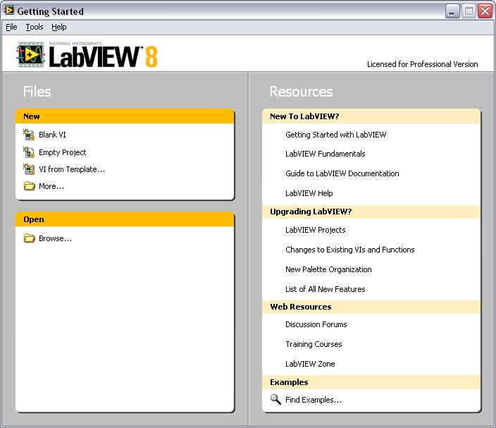
Open and Run LabVIEW
Start»All Programs»National Instruments LabVIEW 8.6
»
Startup Screen:
Start from a Blank VI:
New»Blank VI
Start from an Example:
Examples»Find Examples…
or
Notes:
LabVIEW
LabVIEW is a graphical programming language that uses icons instead of lines of text to create applications. In contrast to text-based programming languages, where instructions determine program execution, LabVIEW uses dataflow programming, where the flow of data determines execution order.
You can purchase several add-on software toolkits for developing specialized applications. All the toolkits integrate seamlessly in LabVIEW. Refer to the National Instruments Web site for more information about these toolkits.
LabVIEW also includes several wizards to help you quickly configure your DAQ devices and computer-based instruments and build applications.
LabVIEW Example Finder
LabVIEW includes hundreds of example VIs you can use and incorporate into VIs that you create. In addition to the example VIs that ship with LabVIEW, you also can access hundreds of example VIs on the NI Developer Zone (zone.ni.com). You can modify an example VI to fit an application, or you can copy and paste from one or more examples into a VI that you create.
© National Instruments Corporation 17 Introduction to LabVIEW Hands-On

Slide 11
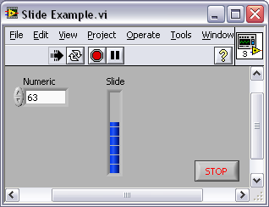
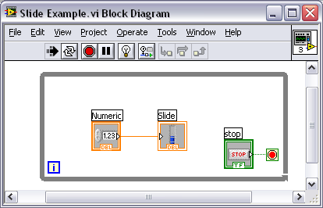
LabVIEW Programs Are Called Virtual Instruments (VIs)
Each VI has 2 Windows
Front Panel
User Interface (UI)
  Controls = Inputs
  Indicators = Outputs
Block Diagram
Graphical Code
  Data travels on wires from controls through functions to indicators
  Blocks execute by Dataflow
Notes:
LabVIEW programs are called virtual instruments (VIs).
Controls are inputs and indicators are outputs.
Each VI contains three main parts:
Front Panel – How the user interacts with the VI.
Block Diagram – The code that controls the program.
Icon/Connector – Means of connecting a VI to other VIs.
In LabVIEW, you build a user interface by using a set of tools and objects. The user interface is known as the front panel. You then add code using graphical representations of functions to control the front panel objects. The block diagram contains this code. In some ways, the block diagram resembles a flowchart.
Users interact with the Front Panel when the program is running. Users can control the program, change inputs, and see data updated in real time. Controls are used for inputs such as, adjusting a slide control to set an alarm value, turning a switch on or off, or to stop a program. Indicators are used as outputs. Thermometers, lights, and other indicators display output values from the program. These may include data, program states, and other information.
Every front panel control or indicator has a corresponding terminal on the block diagram. When a VI is run, values from controls flow through the block diagram, where they are used in the functions on the diagram, and the results are passed into other functions or indicators through wires.
Introduction to LabVIEW Hands-On 18 ni.com

Slide 12
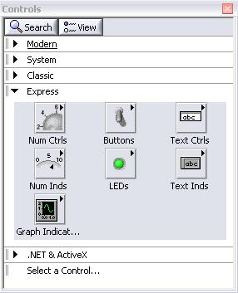
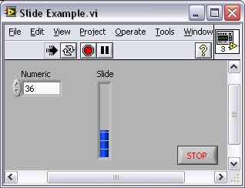
Controls Palette
(Controls & Indicators)
(Place items on the Front Panel Window)
Customize Palette View
Control:
Numeric
Indicator:
Numeric Slide
Notes:
Use the Controls palette to place controls and indicators on the front panel. The Controls palette is available only on the front panel. To view the palette, select Window»Show Controls Palette. You also can display the Controls palette by right-clicking an open area on the front panel. Tack down the Controls palette by clicking the pushpin on the top left corner of the palette.
© National Instruments Corporation 19 Introduction to LabVIEW Hands-On

Slide 13
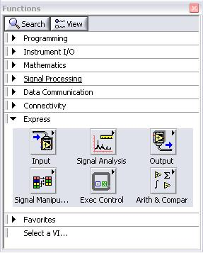
Functions (and Structures) Palette
(Place items on the
Block Diagram Window)
Structure:
While Loop
Notes:
Use the Functions palette to build the block diagram. The Functions palette is available only on the block diagram. To view the palette, select Window»Show Functions Palette. You also can display the Functions palette by right-clicking an open area on the block diagram. Tack down the Functions palette by clicking the pushpin on the top left corner of the palette.
Introduction to LabVIEW Hands-On 20 ni.com

Slide 14

Tools Palette
Recommended: Automatic Selection Tool
Tools to operate and modify both front panel and block diagram objects
Automatic Selection Tool
Automatically chooses among the following tools:
Operating Tool
Positioning/Resizing Tool
Labeling Tool
Wiring Tool
Notes:
If automatic tool selection is enabled and you move the cursor over objects on the front panel or block diagram, LabVIEW automatically selects the corresponding tool from the Tools palette. Toggle automatic tool selection by clicking the Automatic Tool Selection button in the Tools palette.
Use the Operating tool to change the values of a control or select the text within a control.
Use the Positioning tool to select, move, or resize objects. The Positioning tool changes shape when it moves over a corner of a resizable object.
Use the Labeling tool to edit text and create free labels. The Labeling tool changes to a cursor when you create free labels.
Use the Wiring tool to wire objects together on the block diagram.
Other important tools:
© National Instruments Corporation 21 Introduction to LabVIEW Hands-On

Slide 15
Status Toolbar
Run Button
Continuous Run Button
Abort Execution
Additional Buttons on the Diagram Toolbar
Execution Highlighting Button
Retain Wire Values Button
Step Function Buttons
Notes:
Click the Run button to run the VI. While the VI runs, the Run button appears with a black arrow if the VI is a top-level VI, meaning it has no callers and therefore is not a subVI.
Click the Continuous Run button to run the VI until you abort or pause it. You also can click the button again to disable continuous running.
While the VI runs, the Abort Execution button appears. Click this button to stop the VI immediately.
Note: Avoid using the Abort Execution button to stop a VI. Either let the VI complete its data flow or design a method to stop the VI programmatically. By doing so, the VI is at a known state. For example, place a button on the front panel that stops the VI when you click it.
Click the Pause button to pause a running VI. When you click the Pause button, LabVIEW highlights on the block diagram the location where you paused execution. Click the Pause button again to continue running the VI.
Select the Text Settings pull-down menu to change the font settings for the VI, including size, style, and color.
Select the Align Objects pull-down menu to align objects along axes, including vertical, top edge, left, and so on.
Select the Distribute Objects pull-down menu to space objects evenly, including gaps, compression, and so on.
Select the Resize Objects pull-down menu to change the width and height of front panel objects.
Introduction to LabVIEW Hands-On 22 ni.com

Slide 16
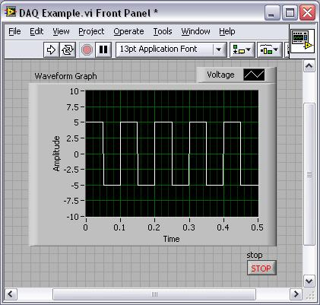
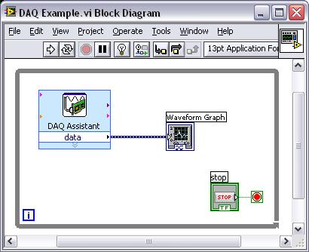
Demonstration 1: Creating a VI
Front Panel Window
Graph
Indicator
Block Diagram Window
Output
Terminal
Boolean
Control
Input
Terminals
Notes:
When you create an object on the Front Panel, a terminal will be created on the Block Diagram. These terminals give you access to the Front Panel objects from the Block Diagram code.
Each terminal contains useful information about the Front Panel object it corresponds to. For example, the color and symbols provide information about the data type. For example: The dynamic data type is a polymorphic data type represented by dark blue terminals. Boolean terminals are green with TF lettering.
In general, blue terminals should wire to blue terminals, green to green, and so on. This is not a hard-and-fast rule; LabVIEW will allow a user to connect a blue terminal (dynamic data) to an orange terminal (fractional value), for example. But in most cases, look for a match in colors.
Controls have an arrow on the right side and have a thick border. Indicators have an arrow on the left and a thin border. Logic rules apply to wiring in LabVIEW: Each wire must have one (but only one) source (or control), and each wire may have multiple destinations (or indicators).
Introduction to LabVIEW Hands-On 24 ni.com

Slide 17
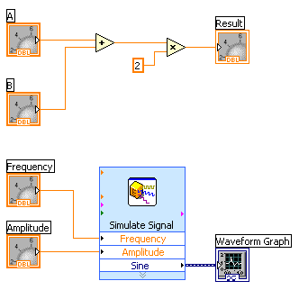
Dataflow Programming
Block diagram execution
  Dependent on the flow of data
  Block diagram does NOT execute left to right
Node executes when data is available to ALL input terminals
Nodes supply data to all output terminals when done
Notes:
LabVIEW follows a dataflow model for running VIs. A block diagram node executes when all its inputs are available. When a node completes execution, it supplies data to its output terminals and passes the output data to the next node in the dataflow path. Visual Basic, C++, JAVA, and most other text-based programming languages follow a control flow model of program execution. In control flow, the sequential order of program elements determines the execution order of a program.
Consider the block diagram above. It adds two numbers and then multiplies by 2 from the result of the addition. In this case, the block diagram executes from left to right, not because the objects are placed in that order, but because one of the inputs of the Multiply function is not valid until the Add function has finished executing and passed the data to the Multiply function. Remember that a node executes only when data are available at all of its input terminals, and it supplies data to its output terminals only when it finishes execution. In the second piece of code, the Simulate Signal Express VI receives input from the controls and passes its result to the Graph.
You may consider the add-multiply and the simulate signal code to co-exist on the same block diagram in parallel. This means that they will both begin executing at the same time and run independent of one another. If the computer running this code had multiple processors, these two pieces of code could run independent of one another (each on its own processor) without any additional coding.
© National Instruments Corporation 25 Introduction to LabVIEW Hands-On

Slide 18
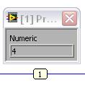
Debugging Techniques
Finding Errors
Execution Highlighting
Probes
Click on broken Run button.
Window showing error appears.
Click on Execution Highlighting button; data flow is animated using bubbles. Values are
displayed on wires.
Right-click on wire to display probe and it shows data as it flows through wire segment.
You can also select Probe tool from Tools palette and click on wire.
Notes:
When your VI is not executable, a broken arrow is displayed in the Run button in the palette.
Finding Errors: To list errors, click on the broken arrow. To locate the bad object, click on the error message.
Execution Highlighting: Animates the diagram and traces the flow of the data, allowing you to view intermediate values. Click on the light bulb on the toolbar.
Probe: Used to view values in arrays and clusters. Click on wires with the Probe tool or right-click on the wire to set probes.
Retain Wire Values: Used in conjunction with probes to view the values from the last iteration of the program.
Breakpoint: Set pauses at different locations on the diagram. Click on wires or objects with the Breakpoint tool to set breakpoints.
Introduction to LabVIEW Hands-On 26 ni.com

Slide 19
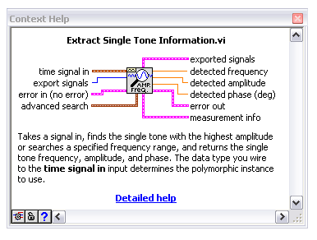

Context Help Window
Help»Show Context Help, press the <Ctrl+H> keys
Hover cursor over object to update window
Additional Help
  Right-Click on the VI icon and choose Help, or
  Choose “Detailed Help.” on the context help window
Notes:
The Context Help window displays basic information about LabVIEW objects when you move the cursor over each object. Objects with context help information include VIs, functions, constants, structures, palettes, properties, methods, events, and dialog box components.
To display the Context Help window, select Help»Show Context Help, press the <Ctrl+H> keys, or press the Show Context Help Window button in the toolbar
Connections displayed in Context Help:
Required – bold
Recommended – normal
Optional – dimmed
Additional Help
VI, Function, & How-To Help is also available.
Help» VI, Function, & How-To Help
Right-click the VI icon and choose Help, or
Choose “Detailed Help.” on the context help window.
LabVIEW Help – reference style help
Help»Search the LabVIEW Help…
Introduction to LabVIEW Hands-On 32 ni.com

Slide 20
Tips for Working in LabVIEW
Keystroke Shortcuts
  <Ctrl+H> – Activate/Deactivate Context Help Window
  <Ctrl+B> – Remove Broken Wires From Block Diagram
  <Ctrl+E> – Toggle Between Front Panel and Block Diagram
  <Ctrl+Z> – Undo (Also in Edit Menu)
Tools»Options… – Set Preferences in LabVIEW
VI Properties–Configure VI Appearance, Documentation, etc.
Notes:
LabVIEW has many keystroke shortcuts that make working easier. The most common shortcuts are listed above.
While the Automatic Selection Tool is great for choosing the tool you would like to use in LabVIEW, there are sometimes cases when you want manual control. Once the Automatic Selection Tool is turned off, use the Tab key to toggle between the four most common tools (Operate Value, Position/Size/Select, Edit Text, Set Color on Front Panel and Operate Value, Position/Size/Select, Edit Text, Connect Wire on Block Diagram). Once you are finished with the tool you choose, you can press <Shift+Tab> to turn the Automatic Selection Tool back on.
In the Tools»Options… dialog, there are many configurable options for customizing your Front Panel, Block Diagram, Colors, Printing, and much more.
Similar to the LabVIEW Options, you can configure VI specific properties by going to File»VI Properties… There you can document the VI, change the appearance of the window, and customize it in several other ways.
© National Instruments Corporation 33 Introduction to LabVIEW Hands-On

Slide 21
Section II – Elements of Typical Programs
A. Loops
  While Loop
  For Loop
B. Functions and SubVIs
  Types of Functions
  Creating Custom Functions (SubVI)
  Functions Palette & Searching
C. Decision Making and File IO
  Case Structure
  Select (simple If statement)
  File I/O
Notes:
© National Instruments Corporation 35 Introduction to LabVIEW Hands-On

Slide 22
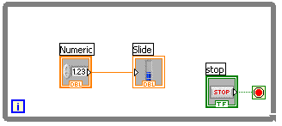
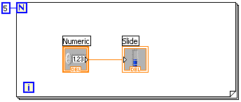
Loops
While Loops
  i terminal counts iteration
  Always runs at least once
  Runs until stop condition is met
While Loop
For Loop
For Loops
  i terminal counts iterations
  Run according to input N of count terminal
Notes:
Both the While and For Loops are located on the Functions»Structures palette. The For Loop differs from the While Loop in that the For Loop executes a set number of times. A While Loop stops executing the subdiagram only if the value at the conditional terminal exists.
While Loops
Similar to a Do Loop or a Repeat-Until Loop in text-based programming languages, a While Loop, shown at the top right, executes a subdiagram until a condition is met. The While Loop executes the sub diagram until the conditional terminal, an input terminal, receives a specific Boolean value. The default behavior and appearance of the conditional terminal is Stop If True. When a conditional terminal is Stop If True, the While Loop executes its subdiagram until the conditional terminal receives a TRUE value. The iteration terminal (an output terminal), shown at left, contains the number of completed iterations. The iteration count always starts at zero. During the first iteration, the iteration terminal returns 0.
For Loops
A For Loop, shown above, executes a subdiagram a set number of times. The value in the count terminal (an input terminal) represented by the N, indicates how many times to repeat the subdiagram. The iteration terminal (an output terminal), shown at left, contains the number of completed iterations. The iteration count always starts at zero. During the first iteration, the iteration terminal returns 0.
Introduction to LabVIEW Hands-On 36 ni.com

Slide 23
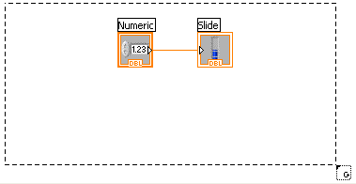
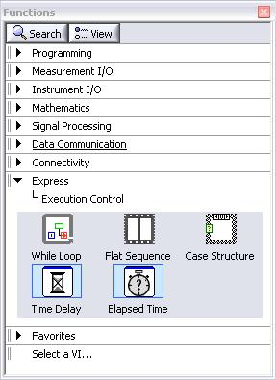
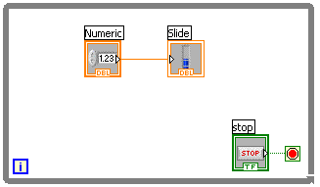
Drawing a Loop
2. Enclose code to be repeated
1. Select the structure
3. Drop or drag additional nodes and then wire
Notes:
Place loops in your diagram by selecting them from the Structures palette of the Functions palette:
When selected, the mouse cursor becomes a special pointer that you use to enclose the section of code you want to repeat.
Click the mouse button to define the top-left corner, click the mouse button again at the bottom-right corner, and the While Loop boundary is created around the selected code.
Drag or drop additional nodes in the While Loop if needed.
© National Instruments Corporation 37 Introduction to LabVIEW Hands-On

Slide 24
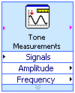

3 Types of Functions (from the Functions Palette)
Express VIs: interactive VIs with configurable dialog page (blue border)
Standard VIs: modularized VIs customized by wiring (customizable)
Functions: fundamental operating elements of LabVIEW; no front panel or block diagram (yellow)
Notes:
LabVIEW 7.0 introduced a new type of subVI called Express VIs. These are interactive VIs that have a configuration dialog box that allows the user to customize the functionality of the Express VI. LabVIEW then generates a subVI based on these settings.
SubVIs are VIs (consisting of a front panel and a block diagram) that are used within another VI.
Functions are the building blocks of all VIs. Functions do not have a front panel or a block diagram.
Introduction to LabVIEW Hands-On 38 ni.com

Slide 25
What Types of Functions are Available?
Input and Output
  Signal and Data Simulation
  Acquire and Generate Real Signals with DAQ
  Instrument I/O Assistant (Serial & GPIB)
  ActiveX for communication with other programs
Analysis
  Signal Processing
  Statistics
  Advanced Math and Formulas
  Continuous Time Solver
Storage
  File I/O
Express Functions Palette
Notes:
LabVIEW includes several hundreds of pre-built functions that help you to acquire, analyze, and present data. You would generally use these functions as outlined on the slide above.
LabVIEW Toolkits
Additional toolkits are available for adding domain specific functionality to LabVIEW. These toolkits include:
http://www.ni.com/toolkits/
© National Instruments Corporation 39 Introduction to LabVIEW Hands-On

Slide 26
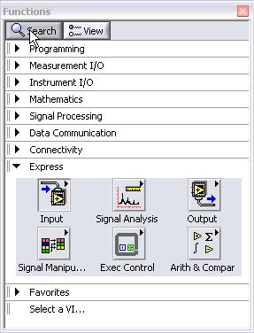
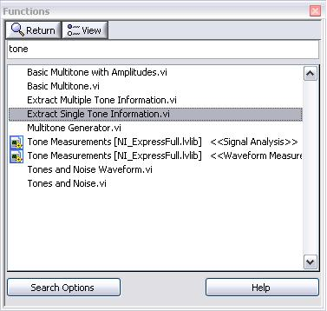
Searching for Controls, VIs, and Functions
Palettes are filled with hundreds
of VIs
Press the search button to index the all VIs for text searching
Click and drag an item from the search window to the block diagram
Double-click an item to open the owning palette
Notes:
Use the buttons on top of the palette windows to navigate, search, and edit the palettes.
You can search for controls, VIs, and functions that either contain certain words or start with certain words. Double clicking a search result opens the palette that contains the search result. You also can click and drag the name of the control, VI, or function directly to the front panel or block diagram.
Introduction to LabVIEW Hands-On 40 ni.com

Slide 27
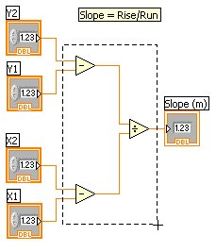
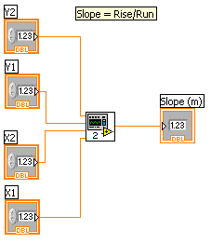

Create SubVI
Enclose area to be converted into a subVI.
Select Edit»Create SubVI from the Edit Menu.
Notes:
Creating SubVIs
After you build a VI, you can use it in another VI. A VI called from the block diagram of another VI is called a subVI. You can reuse a subVI in other VIs. To create a subVI, you need to build a connector pane and create an icon.
A subVI node corresponds to a subroutine call in text-based programming languages. A block diagram that contains several identical subVI nodes calls the same subVI several times.
The subVI controls and indicators receive data from and return data to the block diagram of the calling VI. Click the Select a VI icon or text on the Functions palette, navigate to and double-click a VI, and place the VI on a block diagram to create a subVI call to that VI.
A subVI input and output terminals and the icon can be easily customized. Follow the instructions below to quickly create a subVI.
Creating SubVIs from Sections of a VI
Convert a section of a VI into a subVI by using the Positioning tool to select the section of the block diagram you want to reuse and selecting Edit»Create SubVI. An icon for the new subVI replaces the selected section of the block diagram. LabVIEW creates controls and indicators for the new subVI, automatically configures the connector pane based on the number of control and indicator terminals you selected, and wires the subVI to the existing wires.
See Help»Search the LabVIEW Help…»SubVIs for more information.
© National Instruments Corporation 41 Introduction to LabVIEW Hands-On

Slide 28
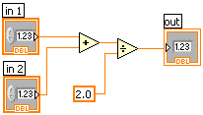
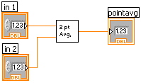
LabVIEW Functions and SubVIs operate like Functions in other languages
Function Pseudo Code
function average (in1, in2, out)
{
out = (in1 + in2)/2.0;
}
SubVI Block Diagram
Calling Program Pseudo Code
main
{
average (in1, in2, pointavg)
}
Calling VI Block Diagram
Notes:
A subVI node corresponds to a subroutine call in text-based programming languages. The node is not the subVI itself, just as a subroutine call statement in a program is not the subroutine itself. A block diagram that contains several identical subVI nodes calls the same subVI several times.
The modular approach makes applications easier to debug and maintain.
The functionality of the subVI does not matter for this example. The important point is the passing of two numeric inputs and one numeric output.
Introduction to LabVIEW Hands-On 42 ni.com

Slide 29
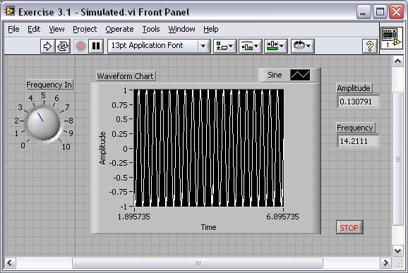
Exercise 3.1 – Analysis
Track A,B,&C
Use LabVIEW Express VIs to:
  Simulate a signal and display its amplitude and frequency
This exercise should
take 15 minutes.
Notes:
Exercise 3.1 – Analysis (Track A, B, & C)
Create a VI that produces a sine wave with a specified frequency and displays the data
on a Waveform Chart until stopped by the user.
Open a blank VI from the Getting Started screen.
Place a chart on the front panel. Right-click to open the controls palette and select Controls»Modern»Graph»Waveform Chart.
Place a dial control on the front panel. From the controls palette, select Controls»Modern »Numeric»Dial. Notice that when you first place the control on the front panel, the label text is highlighted. While this text is highlighted, type “Frequency In” to give a name to this control.
Go to the block diagram (<Ctrl+E>) and place a while loop down. Right-click to open the functions palette and select Express»Execution Control»While Loop. Click and drag on the block diagram to make the while loop the correct size. Select the waveform chart and dial and drag them inside the while loop if they are not already. Notice that a stop button is already connected to the conditional terminal of the while loop.
Place the Simulate Signal Express VI on the block diagram. From the functions palette, select Express»Signal Analysis»Simulate Signal and place it on the block diagram inside the while loop. In the configuration window under Timing, choose “Simulate acquisition timing.” Click “OK.”
6. Place a Tone Measurements Express VI on the block diagram (Express»Signal Analysis»Tone Measurements). In the configuration window, choose Amplitude and Frequency measurements in the Single Tone Measurements section. Click “OK.”
© National Instruments Corporation 43 Introduction to LabVIEW Hands-On

Slide 30
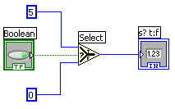
How Do I Make Decisions in LabVIEW?
Case Structures
Select
(a)
(b)
(c)
Notes:
Case Structure
The Case Structure has one or more subdiagrams, or cases, exactly one of which executes when the structure executes. The value wired to the selector terminal determines which case to execute and can be boolean, string, integer, or enumerated type. Right-click the structure border to add or delete cases. Use the Labeling tool to enter value(s) in the case selector label and configure the value(s) handled by each case. It is found at Functions»Programming»Structures»Case Structure.
Select
Returns the value wired to the t input or f input, depending on the value of s. If s is TRUE, this function returns the value wired to t. If s is FALSE, this function returns the value wired to f. The connector pane displays the default data types for this polymorphic function. It is found at Functions»Programming» Comparison»Select.
Example a: Boolean input: Simple if-then case. If the Boolean input is TRUE, the true case will execute; otherwise the FALSE case will execute.
Example b: Numeric input. The input value determines which box to execute. If out of range of the cases, LabVIEW will choose the default case.
Example c: When the Boolean passes a TRUE value to the Select VI, the value 5 is passed to the indicator. When the Boolean passes a FALSE value to the Select VI, 0 is passed to the indicator.
© National Instruments Corporation 47 Introduction to LabVIEW Hands-On

Slide 31
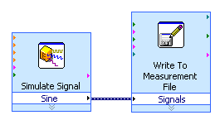
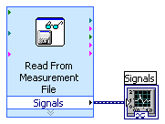
File I/O
File I/O – passing data to and from files
Files can be binary, text, or spreadsheet
Write/Read LabVIEW Measurements file (*.lvm)
Writing to LVM file
Reading from LVM file
Notes:
Use LabVIEW measurement data files to save data that the Write Measurement File Express VI generates. The LabVIEW data file is a tab-delimited text file you can open with a spreadsheet application or a text-editing application. In addition to the data an Express VI generates, the .lvm file includes information about the data, such as the date and time the data was generated.
File I/O operations pass data from memory to and from files. In LabVIEW, you can use File I/O functions to:
Open and close data files
Read data from and write data to files
Read from and write to spreadsheet-formatted files
Move and rename files and directories
Change file characteristics
Create, modify, and read a configuration file
Write to or read from LabVIEW Measurements files.
In the next example we will examine how to write to or read from LabVIEW Measurements files (*.lvm files).
Introduction to LabVIEW Hands-On 48 ni.com

Slide 32
Section III – Presenting your Results
A. Displaying Data on the Front Panel
  Controls and Indicators
  Graphs and Charts
  Loop Timing
B. Signal Processing
  MathScript
  Arrays
  Clusters
  Waveforms
Notes:
© National Instruments Corporation 51 Introduction to LabVIEW Hands-On

Slide 33
What Types of Controls and Indicators are Available?
Numeric Data
  Number input and display
  Analog Sliders, Dials, and Gauges
Boolean Data
  Buttons and LEDs
Array & Matrix Data
  Numeric Display
  Chart
  Graph
  XY Graph
  Intensity Graph
  3D graph: point, surface, and model
Decorations
  Tab Control
  Arrows
Other
  Strings and text boxes
  Picture/Image Display
  ActiveX Controls
Express Controls Palette
Notes:
Controls and Indicators are Front Panel items that allow the user to interact with your program to both provide input and display results. You can access Controls and Indicators by right-clicking the front panel.
In addition, you will get additional controls and indicators when you install toolkits and modules.
For example, when you install the Control Design tools, you will get specialized plots such as Bode and Nyquist plots that are not available by default.
Introduction to LabVIEW Hands-On 52 ni.com

Slide 34
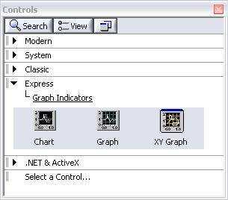
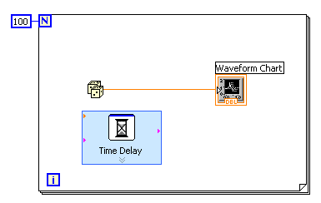
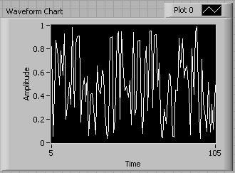
Charts – Add 1 data point at a time with history
Waveform chart – special numeric indicator that can display a history of values
Chart updates with each individual point it receives
Functions»Express»Graph Indicators»Chart
Notes:
The waveform chart is a special numeric indicator that displays one or more plots. The waveform chart is located on the Controls»Modern»Graph palette. Waveform charts can display single or multiple plots. The following front panel shows an example of a multi-plot waveform chart.
You can change the min and max values of either the x or y axis by double clicking on the value with the labeling tool and typing the new value. Similarly, you can change the label of the axis. You can also right click the plot legend and change the style, shape, and color of the trace that is displayed on the chart.
© National Instruments Corporation 53 Introduction to LabVIEW Hands-On

Slide 35
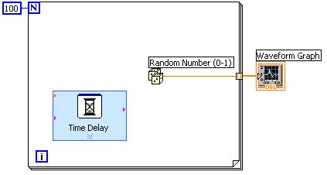
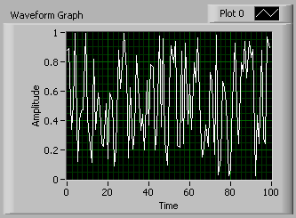
Graphs – Display many data points at once
Waveform graph – special numeric indicator that displays an array of data
Graph updates after all points have been collected
May be used in a loop if VI collects buffers of data
Functions»Express»Graph Indicators»Graph
Notes:
Graphs are very powerful indicators in LabVIEW. The can are highly customizable, and can be used to concisely display a great deal of information.
The properties page of the graph allows you to display settings for plot types, scale and cursor options, and many other features of the graph. To open the properties page, right-click the graph on the front panel and choose Properties.
Graphs also allow you to create technical paper quality graphics with the “export simplified image” function. Right-click the graph, select Data Operations»Export Simplified Image…
Introduction to LabVIEW Hands-On 54 ni.com

Slide 36
Building Arrays with Loops (Auto-Indexing)
Auto-Indexing Enabled
Wire becomes thicker
Loops can accumulate arrays at their boundaries with auto-indexing
For Loops auto-index by default
While Loops output only the final value by default
Right-click tunnel and enable/disable auto-indexing
1D Array
0 1 2 3 4 5
Auto-Indexing Disabled
Wire remains the same size
Only one value (last iteration) is passed out of the loop
5
Notes:
For Loops and While Loops can index and accumulate arrays at their boundaries. This is known as auto-indexing.
The indexing point on the boundary is called a tunnel.
The For Loop default is auto-indexing enabled.
The While Loop default is auto-indexing disabled.
Examples:
Enable auto-indexing to collect values within the loop and build the array. All values are placed in array upon exiting loop.
Disable auto-indexing if you are interested only in the final value.
© National Instruments Corporation 55 Introduction to LabVIEW Hands-On

Slide 37
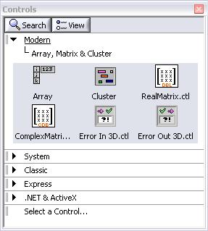
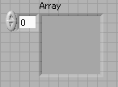
Creating an Array (Step 1 of 2)
From the Controls»Modern»Array, Matrix, and Cluster subpalette, select the Array icon.
Drop it on the Front Panel.
Notes:
To create an array control or indicator as shown, select an array on the Controls»Modern»Array, Matrix, and Cluster palette, place it on the front panel, and drag a control or indicator into the array shell. If you attempt to drag an invalid control or indicator such as an XY graph into the array shell, you are unable to drop the control or indicator in the array shell.
You must insert an object in the array shell before you use the array on the block diagram. Otherwise, the array terminal appears black with an empty bracket.
Introduction to LabVIEW Hands-On 56 ni.com

Slide 38
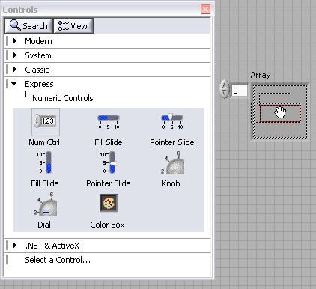
Create an Array (Step 2 of 2)
Place an Array Shell.
Insert datatype into the shell (i.e. Numeric Control).
Notes:
To add dimensions to an array one at a time, right-click the index display and select Add Dimension from the shortcut menu. You also can use the Positioning tool to resize the index display until you have as many dimensions as you want.
1D Array Viewing a Single Element:
1D Array Viewing Multiple Elements:
2D Array Viewing a Single Element:
2D Array Viewing Multiple Elements:
© National Instruments Corporation 57 Introduction to LabVIEW Hands-On

Slide 39
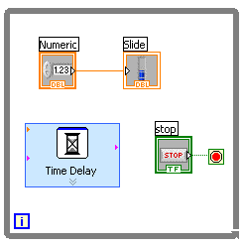
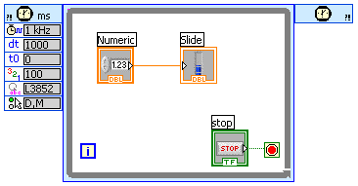
How Do I Time a Loop?
1. Loop Time Delay
  Configure the Time Delay Express VI for seconds to wait each iteration of the loop (works on For and While loops).
2. Timed Loops
Configure special timed While loop for desired dt.
Time Delay
Timed Loop
Notes:
Time Delay
The Time Delay Express VI delays execution by a specified number of seconds. Following the rules of Data Flow Programming, the while loop will not iterate until all tasks inside of it are complete, thus delaying each iteration of the loop.
Timed Loops
Executes each iteration of the loop at the period you specify. Use the Timed Loop when you want to develop VIs with multi-rate timing capabilities, precise timing, feedback on loop execution, timing characteristics that change dynamically, or several levels of execution priority.
Double-click the Input Node or right-click the Input Node and select Configure Timed Loop from the shortcut menu to display the Loop Configuration dialog box, where you can configure the Timed Loop. The values you enter in the Loop Configuration dialog box appear as options in the Input Node.
Wait Until Next ms Multiple
Waits until the value of the millisecond timer becomes a multiple of the specified millisecond multiple. Use this function to synchronize activities. You can call this function in a loop to control the loop execution rate. However, it is possible that the first loop period might be short. This function makes asynchronous system calls, but the nodes themselves function synchronously. Therefore, it does not complete execution until the specified time has elapsed.
Functions»Programming»Timing»Wait Until Next ms Multiple
Introduction to LabVIEW Hands-On 58 ni.com

Slide 40
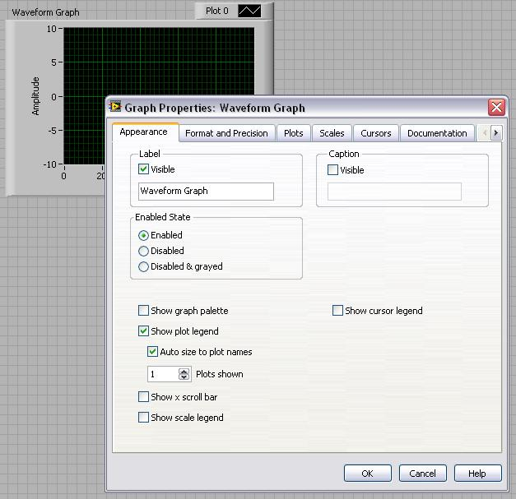
Control & Indicator Properties
Properties are characteristics or qualities about an object
Properties can be found by right clicking on a Control or Indicator
  Properties Include:
    Size
    Color
    Plot Style
    Plot color
  Features include:
    Cursors
    Scaling
Notes:
Properties are all the qualities of a front panel object. With properties, you can set or read such characteristics as foreground and background color, data formatting and precision, visibility, descriptive text, size and location on the front panel, and so on.
© National Instruments Corporation 59 Introduction to LabVIEW Hands-On

Slide 41


Math with the MathScript Node
Implement equations and algorithms textually
Input and Output variables created at the border
Generally compatible with popular m-file script language
Terminate statements with a semicolon to disable immediate output
(Functions»Programming»
Structures»MathScript)
Prototype your equations in the interactive MathScript Window.
Notes:
The MathScript Node enhances LabVIEW by adding a native text-based language for mathematical algorithm implementation in the graphical programming environment. M-file scripts you’ve written and saved from the MathScript window can be opened and used in the MathScript node. M-file scripts you created in other math software will generally run as well. The MathScript allows you to pick the syntax you are most comfortable with to solve the problem. Equations can be instrumented with the MathScript Node for parameter exploration, simulation, or deployment in a final application.
The MathScript Node:
Located in the Programming»Structures subpalette.
Resizable box for entering textual computations directly into block diagrams.
To add variables, right-click and choose Add Input or Add Output.
Name variables as they are used in formula. (Names are case sensitive.)
The data type of the output can be changed by right-clicking the input or output node.
Statements should be terminated with a semicolon to suppress output.
Ability to import & export m-files by right-clicking on the node.
Introduction to LabVIEW Hands-On 62 ni.com

Slide 42

The Interactive MathScript Window
Rapidly develop and test algorithms
Share Scripts and Variables with the Node
View /Modify Variable content in 1D, 2D, and 3D
Variable
Workspace
Output
Window
View/Modify
Variable Contents
User Commands
m-file Script
(LabVIEW»Tools»MathScript Window)
Notes:
The MathScript Window provides an interactive environment where equations can be prototyped and calculations can be made. The MathScript Window and Node share a common syntax and global variables making the move from prototype to implementation seamless. The data preview pane provides a convenient way to view variable data as numbers, graphically, or audibly (with soundcard support).
Help for MathScript
Help for the environment can be accessed using the Mathscript Interactive Environment Window. Type Help in the command window for an introduction to MathScript help. Help followed by a function will display help specific to that function.
Features of the interactive MathScript Window:
Prototype equations and formulas through the command Window
Easily access function help by typing Help <function> in the Command Window
Select a variable to display its data in the Preview Pane and even listen to the result
Write, Save, Load, and Run m-files using the Script tab
Share data between the MathScript Node in LabVIEW and the MathScript Window using Global Variables
Advanced plotting features and image export features
© National Instruments Corporation 63 Introduction to LabVIEW Hands-On

Slide 43

Review of Data Types Found in LabVIEW
Notes:
LabVIEW utilizes many common datatypes. These Datatypes include:
Boolean, Numeric, Arrays, Strings, Clusters, and more.
The color and symbol of each terminal indicate the data type of the control or indicator. Control terminals have a thicker border than indicator terminals. Also, arrows appear on front panel terminals to indicate whether the terminal is a control or an indicator. An arrow appears on the right if the terminal is a control, and an arrow appears on the left if the terminal is an indicator.
Definitions
Array: Arrays group data elements of the same type. An array consists of elements and dimensions. Elements are the data that make up the array. A dimension is the length, height, or depth of an array. An array can have one or more dimensions and as many as (2³¹) – 1 elements per dimension, memory permitting.
Cluster: Clusters group data elements of mixed types, such as a bundle of wires in a telephone cable, where each wire in the cable represents a different element of the cluster.
See Help»Search the LabVIEW Help… for more information. The LabVIEW User Manual on ni.com provides additional reference for data types found in LabVIEW.
© National Instruments Corporation 67 Introduction to LabVIEW Hands-On

Slide 44



Electrical Wiring
2-Way Switch
3-Way Switch
4-Way Switch
LEVITION
LEVITION
LEVITION

Slide 45

Single 2-Way Switch Layout

Slide 46

3-3 Switch Layout

Slide 47

3-4-3 Switch Layout

Slide 48

Logic Gate

Slide 49

Logic Gate

Slide 50

Logic Gate

Slide 51


Logic Gate

Slide 52




2-Way Logic Switch

Slide 53


2 2-Way Switch (Logic AND) Layout

Slide 54


Logic Switch
AND OR EOR(XOR)…

Slide 55






3-Way Logic Switch
1 Input 2 Output v.s. 2 Input 1 Output

Slide 56

2 3-Way Switch (Logic ?) Layout

Slide 57


Assignment:
4-Way Switch and 3-4-3 Switch Layout

Slide 58

3 Phase Power Source

Slide 59

Light Bulb

Slide 60


2-Way Switch
LEVITION

Slide 61

2 2-Way Switch (Logic AND) Layout

Slide 62

3-Way Switch (1 Input 2 Outputs)
LEVITION

Slide 63

3-Way Switch (2 Inputs 1 Output)
LEVITION

Slide 64

4-Way Switch
LEVITION

Slide 65
Electrical Wiring Memo Requirements
Remember to use memo format and use proper spelling and grammar.
Questions:
1. If you have more than one entrance to a room, it's handy to have more than one switch to turn the light on and off.
Can you figure out other way to connect two switches and explane the current flow across the switches?
2. Can you do the three switches configuration? How many different ways of wiring can you come up?
3. How to connect multiple light fixture to single or multiple switches? Can you come up with some unique multiple switches design?
4. Figure out switch configurations for logic AND, OR, NAND, XOR, and NXOR.

