Slide 1
Interpreting a contour map

Slide 2
Contour interval
Contour lines are lines of equal elevation
Contour interval is the difference in elevation between two contour lines (1’, 2’, 5’, etc.)
Every fifth contour line is often darker and has the elevation marked on it.

Slide 3
Contour characteristics
Concentric circles of contour lines indicate a hill.
Evenly spaced contours indicate uniform slope.
Widely spaced contours indicate a gentle slope
Widely spaced contours at the top of a hill indicate a flat hilltop

Slide 5
Close together contours indicate a steep slope, wall or cliff.
Close together contours at the top of a hill indicate a pointed hilltop.
Crossing or touching contours indicate an overhang or cliff.
Jagged, rough contours indicate large outcrops of rocks, cliffs and fractured areas.

Slide 6
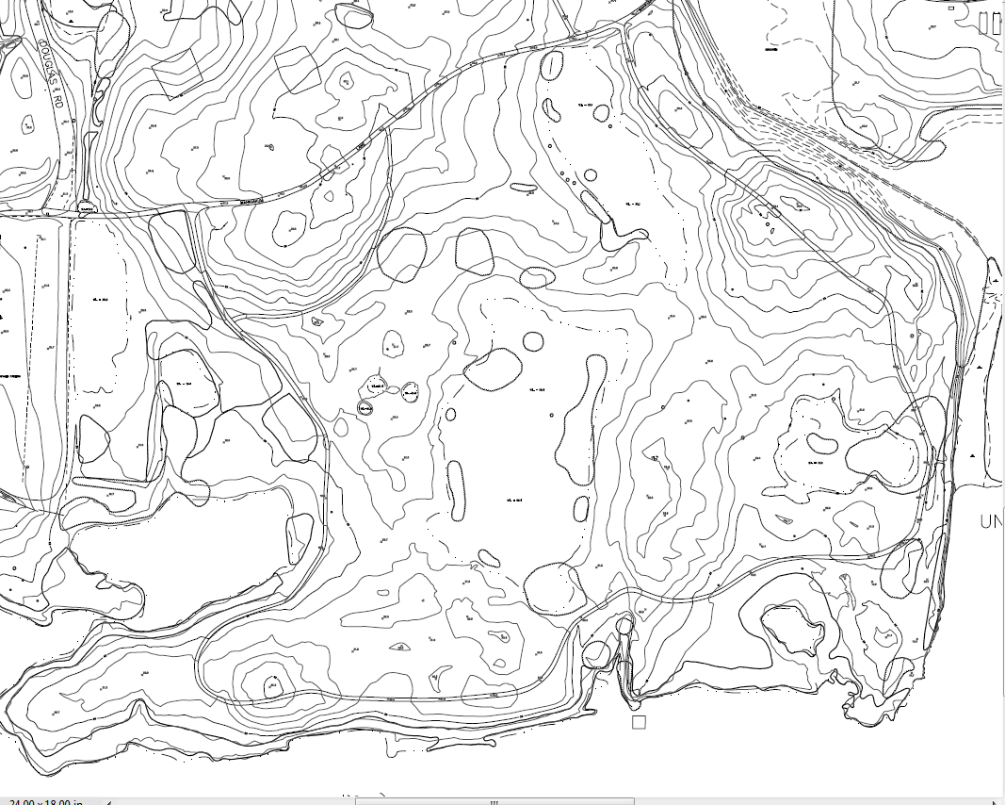

Slide 7
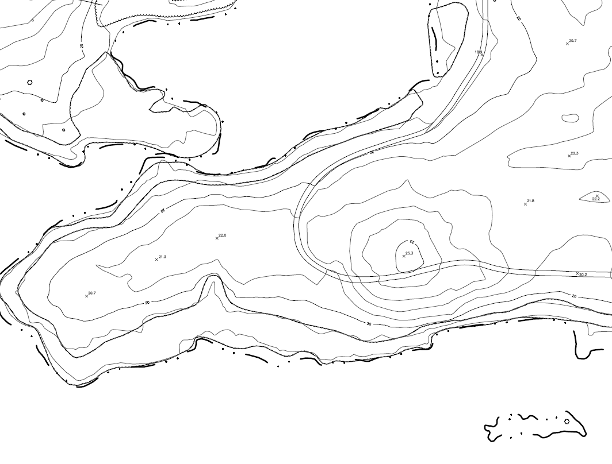

Slide 8
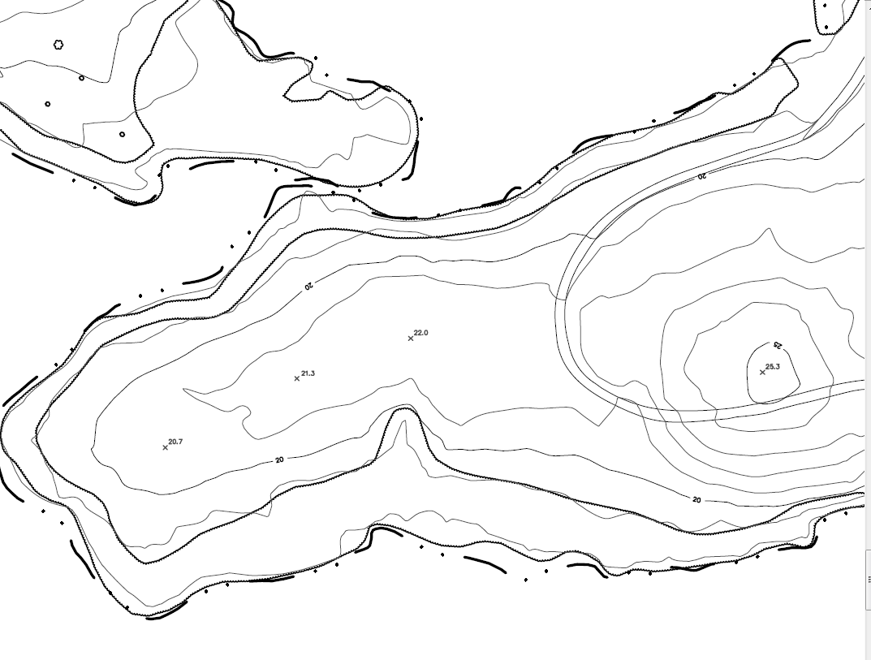

Slide 9
“V” shaped contours indicate streams and drainage, with the point of the “V” pointing uphill.
“U” shaped contours indicate ridges, with the bottom of the “U” pointing downhill.
A saddle is a ridge between two hills or summits.
“M” or “W” shaped contours can be found upstream from stream junctions.

Slide 11
Circles with hachures or hatch lines (short lines extending from the contour lines at right angles) indicate a depression, a pit or a sinkhole.
Spot elevations are often shown at summits, road intersections and the surfaces of lakes.
Contour lines do not cross each other, divide or split.

Slide 12
Hydrologic rules
Water runs downhill, perpendicular to the contour line above it.
Drainageways or streams may be drawn by connecting the apexes of upward-pointing, “V” shaped contour lines.
When water reaches a drainageway, it follows the line connecting the apexes and proceeds downhill.

Slide 13
Watersheds are bowls that collect water from a large area and direct it all to a single outlet that is the lowest elevation of the watershed boundary.
You can draw a watershed by connecting the bottoms of the “U” shaped contours that indicate ridges.
Given enough water, any depression will eventually fill and spill into the next lower watershed.

Slide 14
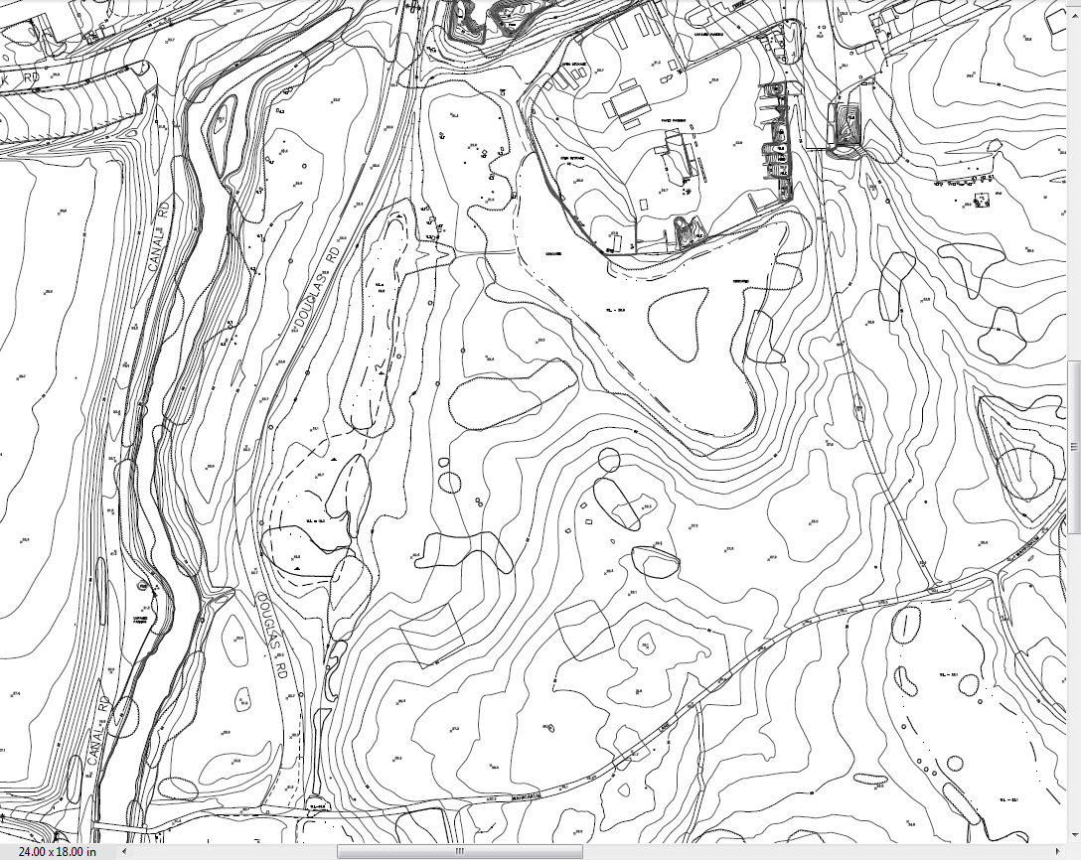

Slide 15
Class: Draw the watershed boundary.

Slide 16
Some uses of contour maps

Slide 17
Calculating runoff

Slide 18
A simple way to calculate runoff is the Rational Formula
Q = ACi
Q is the runoff in cubic feet
A is the subwatershed area in square feet
C is the runoff coefficient
Ratio of runoff to total rainfall
i is the rainfall intensity
Rainfall is usually reported in in/hr.
Convert to feet

Slide 19
Values of C
Forest 0.10
Pasture 0.20
Cultivated soil 0.50
Pavement, roofs 0.90

Slide 20
To use this formula you calculate watershed area from the contour map.
To calculate the watershed area, you need to determine the watershed boundaries.
The watershed boundary is a ridgeline that surrounds the watershed.
From this ridge, water always flows downward into the watershed

Slide 21
20
25
30

Slide 22
Class: Calculate watershed area.

Slide 23
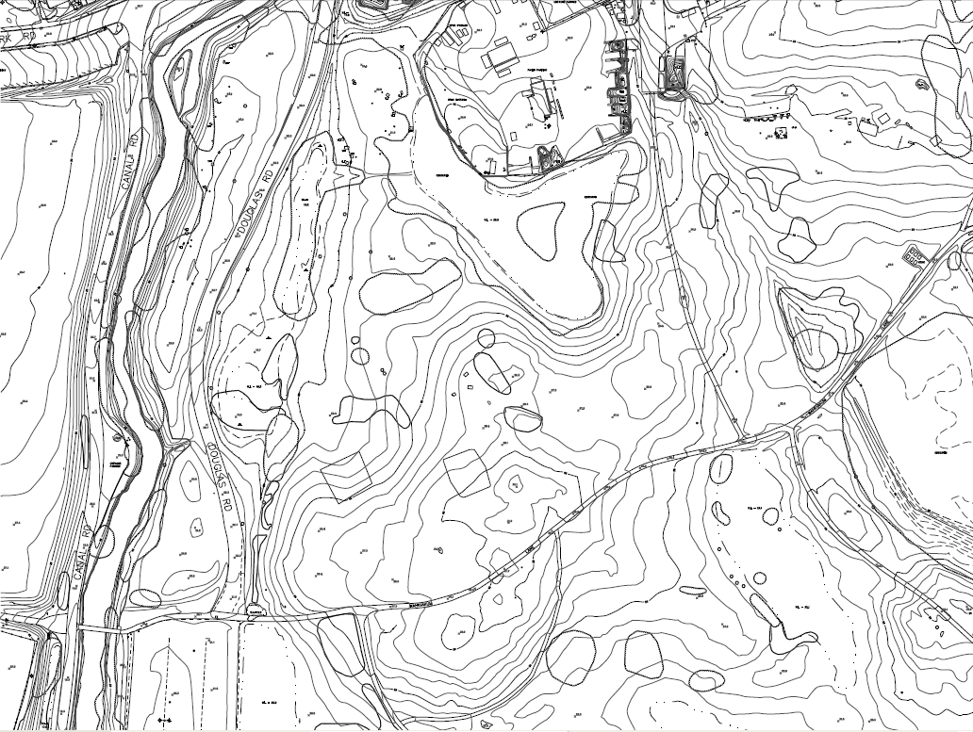
6.0 acres
2.3 acres

Slide 24
Q = ACi
A = 6 acres
6 x 43560 = 261,360 sq. ft.
C = 0.75
i = Annual rainfall = 36”
36” = 3’
Q = 261,360 x 0.75 x 3 = 588,060 cu. ft.

Slide 25
Creating an impoundment
Pond
Wetland
Detention
Infiltration

Slide 26
An impoundment holds water.
Contour lines inside the impoundment will all be lower than the contour line around the top
You will be creating a mini-watershed
Water is released from an impoundment through a pipe or structure.

Slide 27
You may create an impoundment in two ways
Excavate and create a depression that is deeper than the surrounding landscape.
Place a dike or levee across a normal drainage path so that water backs up behind it.

Slide 28
Calculating volume of excavation
Create cross-sections
Calculate the area of each cross-section
Multiply the distance in feet between cross-sections times the average end area of any two adjacent cross-sections
This gives you the volume in cubic feet

Slide 29
You may also calculate the water storage capacity (volume in cubic feet) in a similar manner.

Slide 30
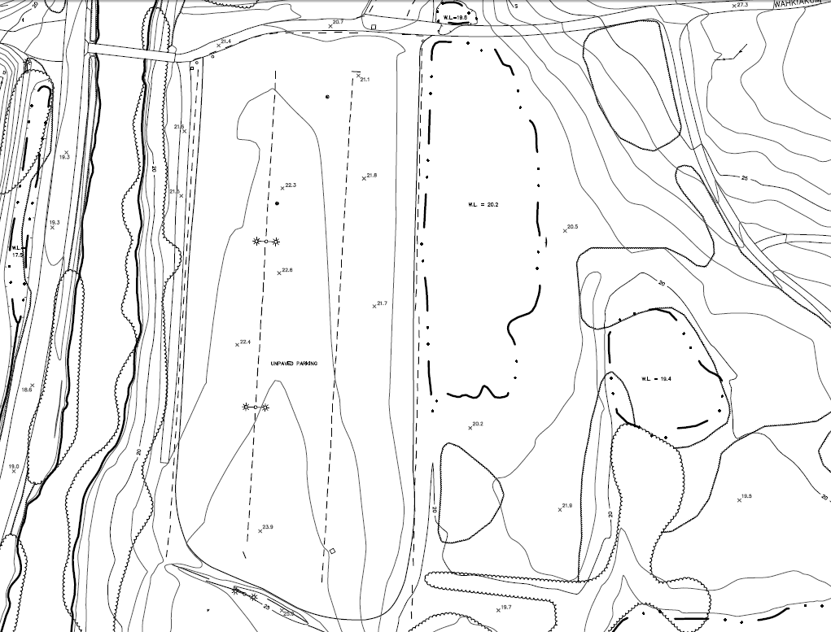
21
22
23

Slide 32
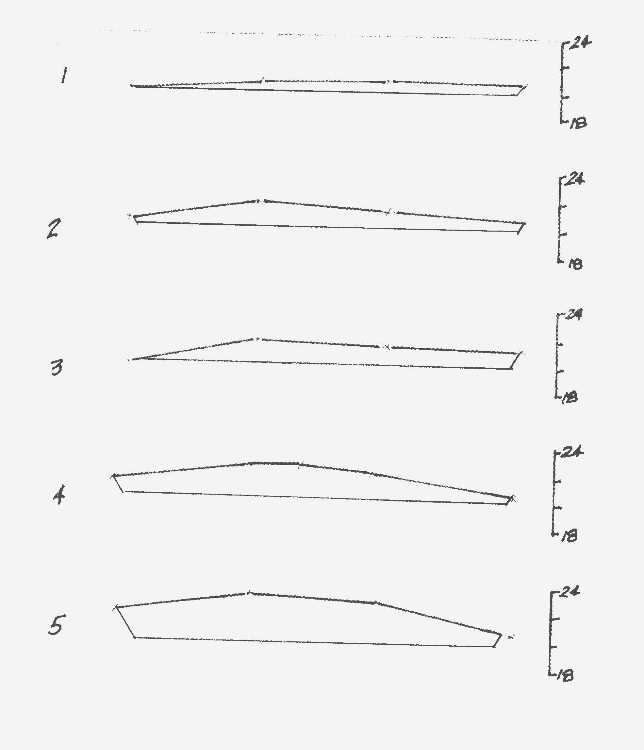

Slide 33
Class: How big a hole would you have to dig to hold one tenth of the runoff from this watershed?

Slide 34
Rough example of the size of an excavated depression to hold the runoff calculated.
Depression 3’ deep.
Volume 58,806 cu. ft.
Volume = depth x surface area
Surface area = 58,806/3 = 19,602 sq. ft.
Could be a square (140’ x 140’)

Slide 35
Making a contour map

Slide 36
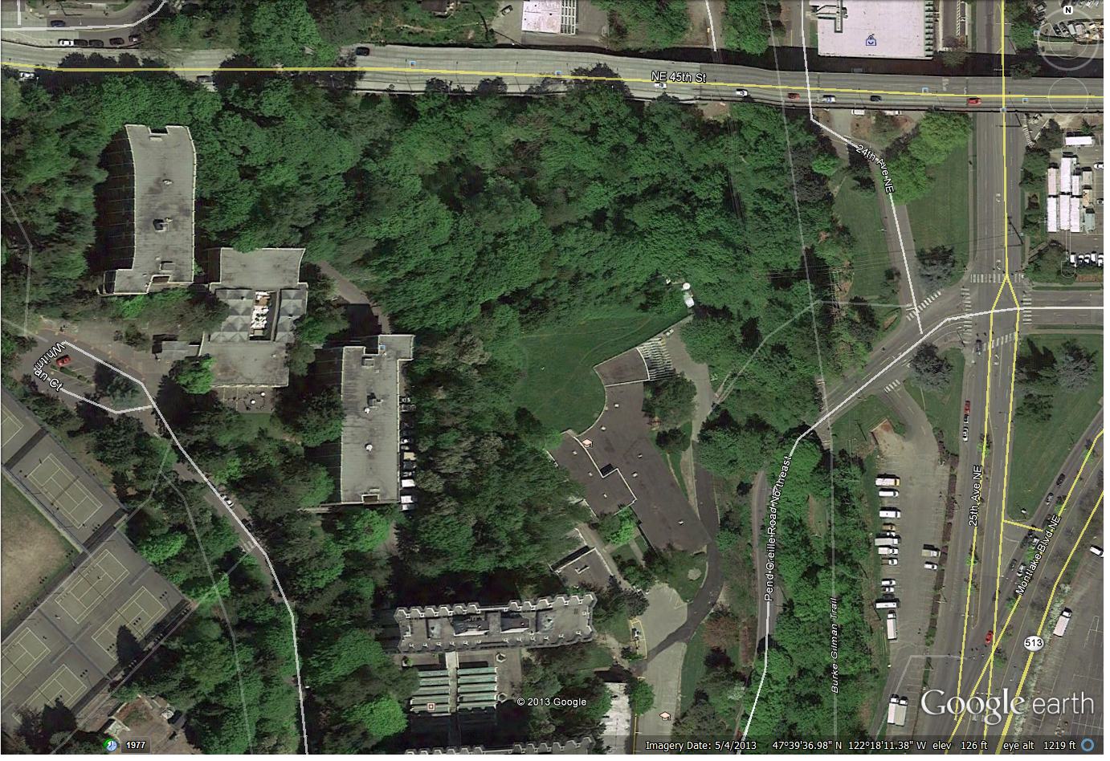
Kincaid Ravine

Slide 37
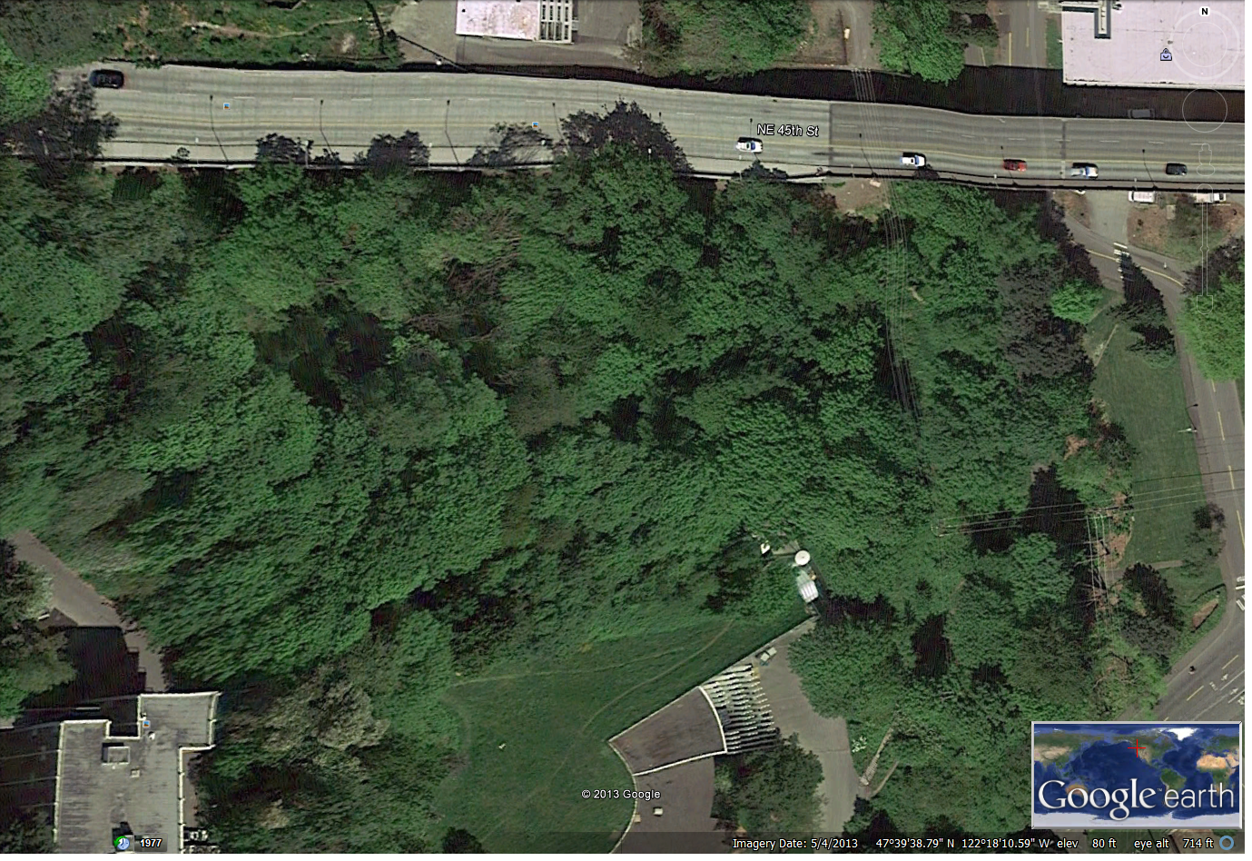

Slide 39
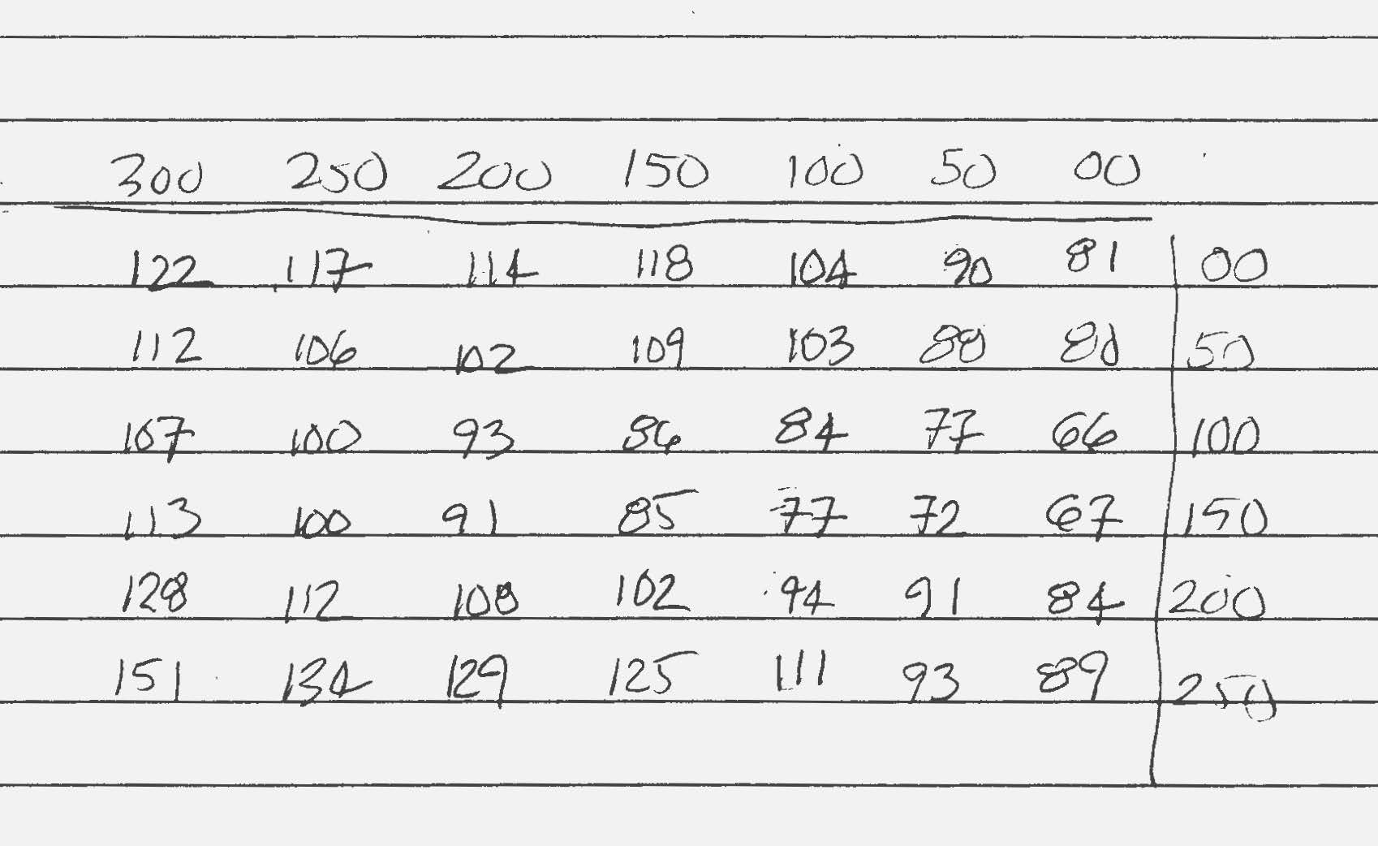

Slide 41
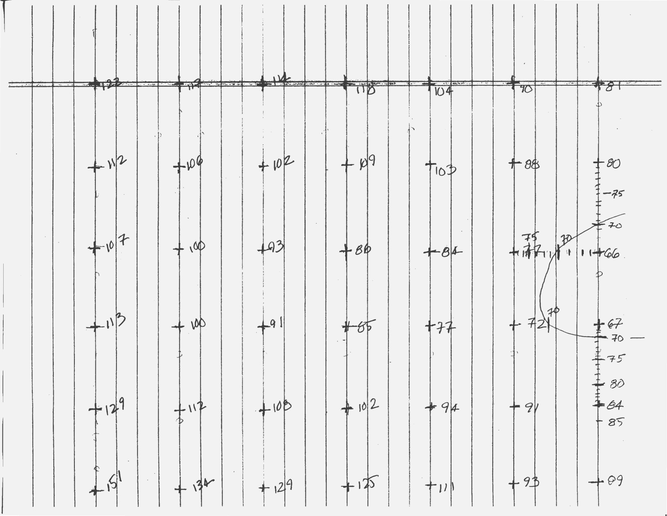

Slide 42
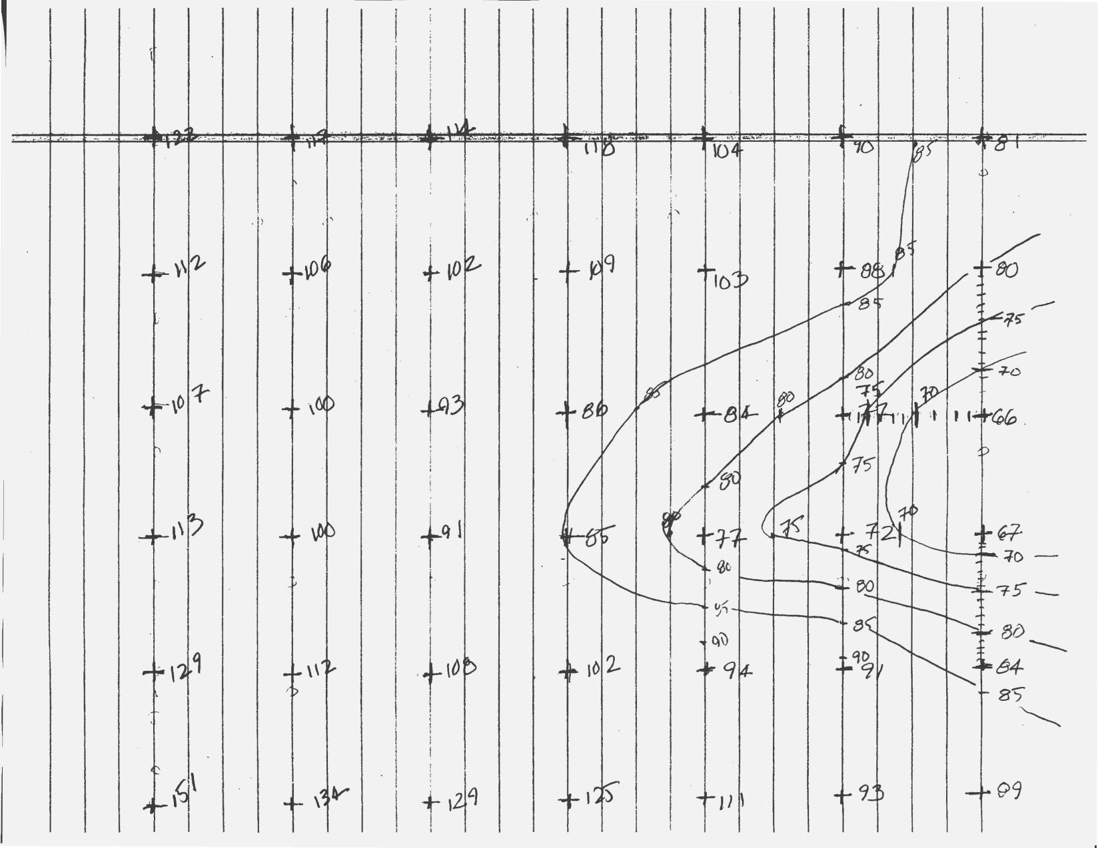

Slide 43
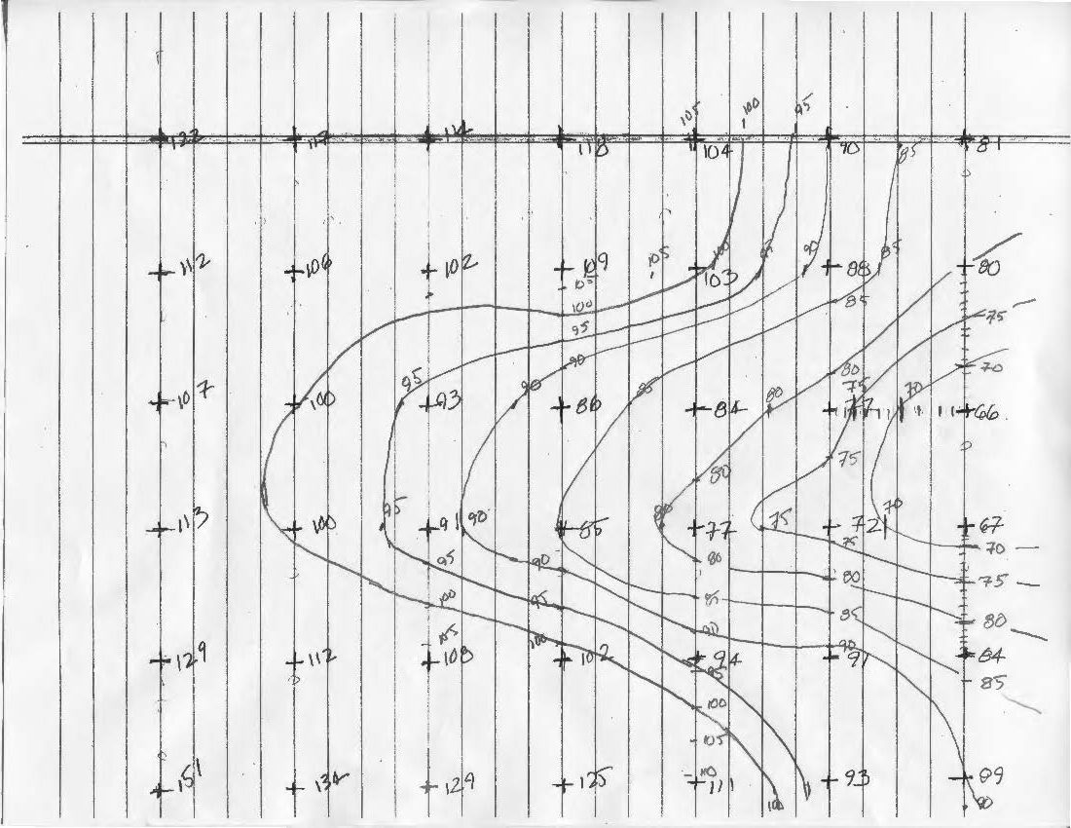

Slide 44
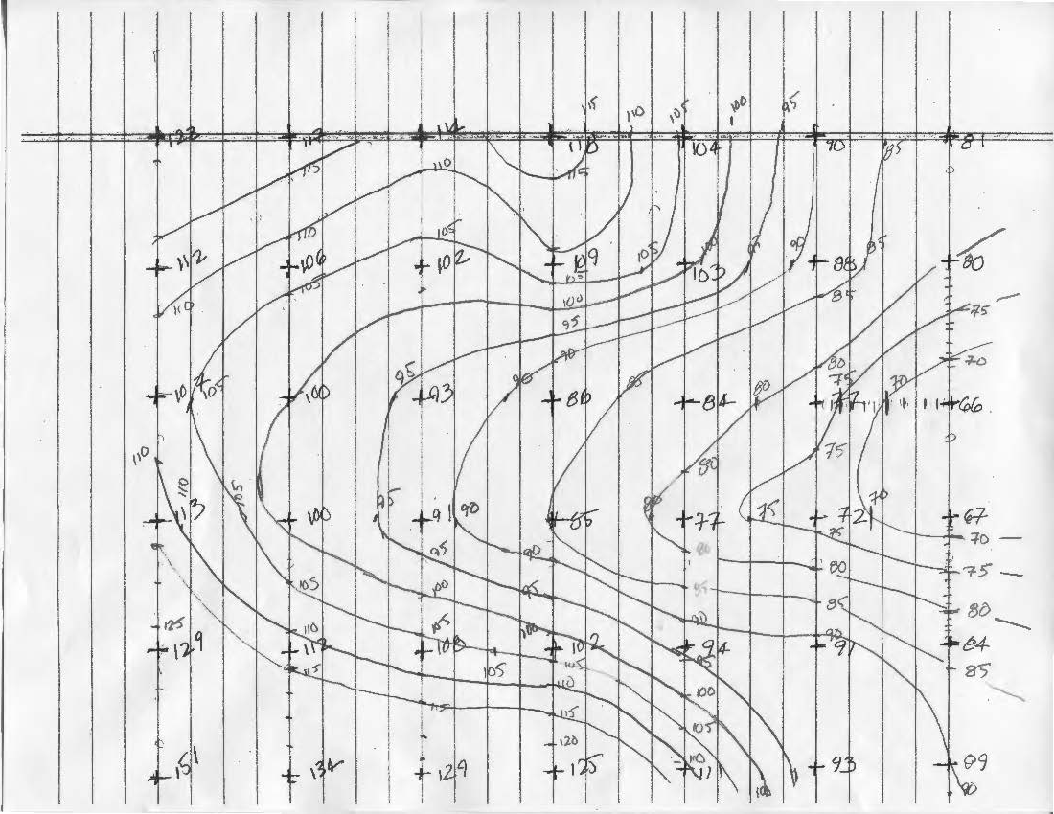

Slide 45
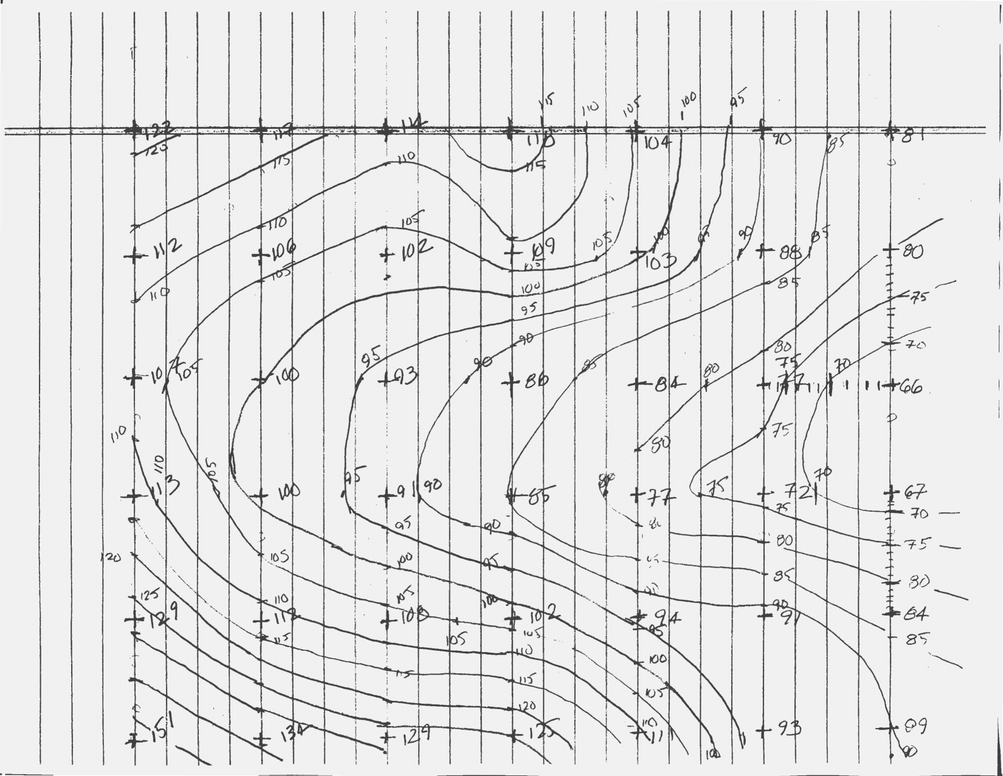

Slide 46
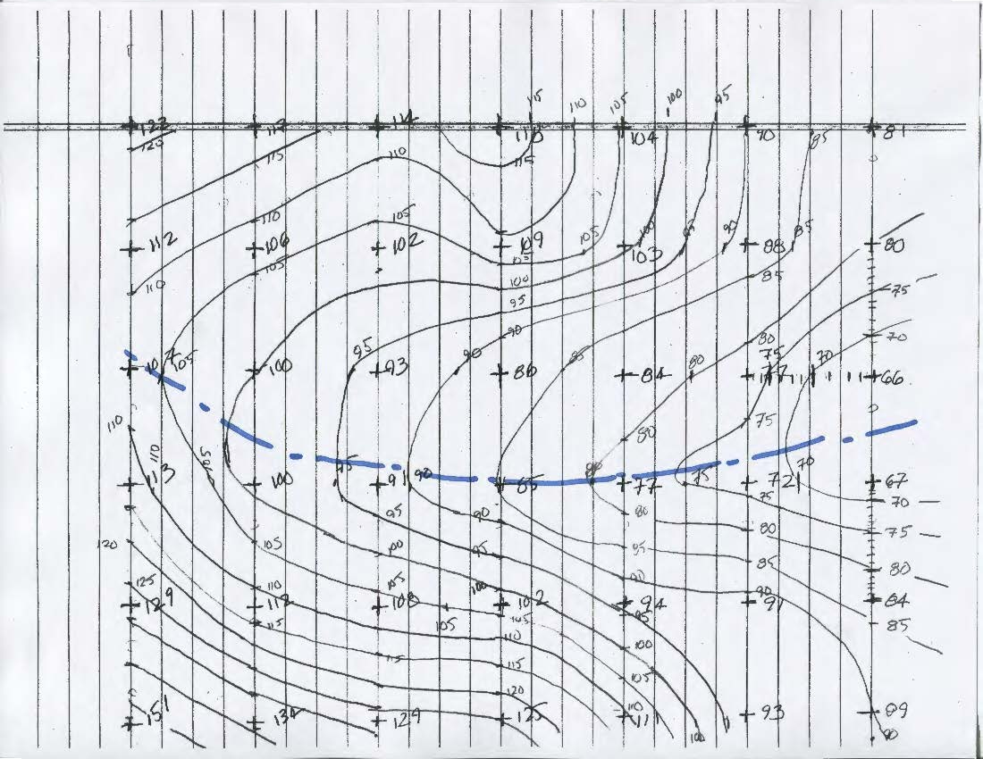

Slide 47
