Slide 1
The Social-Scientific Method: The People Method
ESRM 304 Environmental & Resource Assessment
Module Instructor: Miku Lenentine
Office Hours: By appointment

Slide 2
Learning Goals & Today’s Cue Card Mission
Learning and Experience Goals
Concepts in social science
Observation and data collection skills
Analysis and bias
Effective team collaboration
Appreciation for unique aspects of studying people
Have fun!
TODAY’s Cue Card Mission is to write down
1 thing you learned today
1 question you have
1 reason why social science might be important to you in your own life
(VERY IMPORTANT – In order to get credit you need to include your????)

Slide 3
Rapid Rounds
Practicing being humans:
Say Hello!
Attention (where is your attention?)
Intention (what is your intention for being here for the next 45 minutes?)
Prompt:
What is social science?
Why might it be important for natural resource assessment?

Slide 4
Scientific/Science
One of the most loaded words you will ever find
The scientific attitude:
Universal permanent truths
It has something to do with being:
Systematic
Skeptical
Ethical

Slide 5
The Scientific Attitude☺
Systematic
Rigorous about what you are doing, how, & why
What observations are you making
Under what circumstances?
Your role in making them—self-observation/examination and critique
Skeptical
Subjecting your observations & conclusions to scrutiny
Subjecting those to disconfirmation
Ethical
Interests and concerns of those taking part in the research are safeguarded
Similarly for those who may be affected by the research

Slide 6
Improving the Human Condition Social Scientific Attitude
The Social:
Studying Humans
&
Interactions with
Their Environments
What is the goal?...

Slide 7
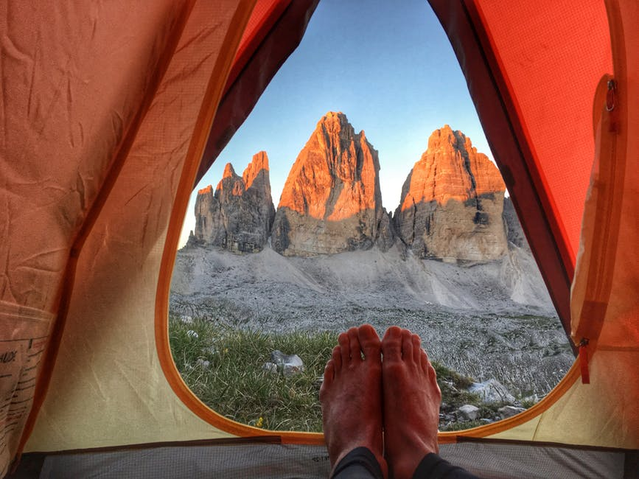
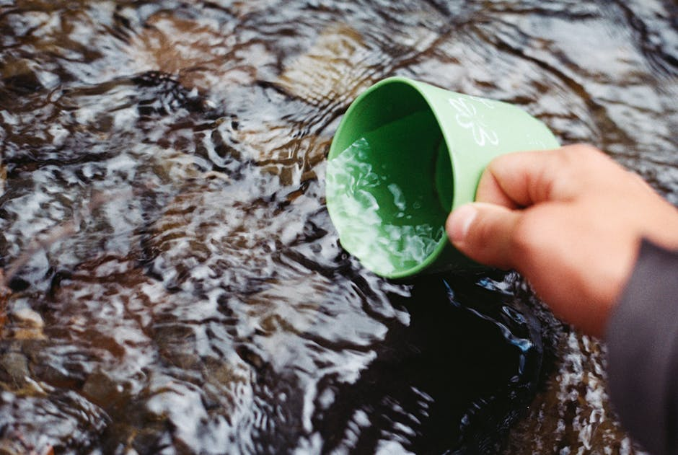
Social Science Disciplines
psychology
sociology
economics
political science
anthropology
geography
policy
planning
etc

Slide 8
Doing Social Science Assessments
Purpose help
develop research questions/Objectives
Choose research approach/Methods
Report: How do your results help meet purpose
Research Cycle
Data
Conduct analysis
Robson & Galvan

Slide 9
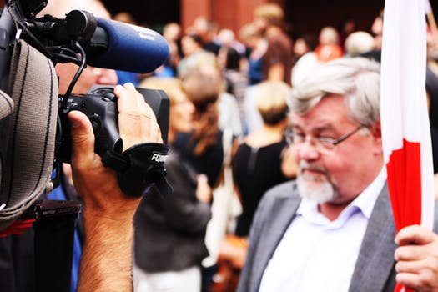
Social Science Data
Human Data

Slide 10
Learning Goals & Today’s Cue Card Mission
Learning and Experience Goals
Concepts in social science
Observation and data collection skills
Analysis and bias
Effective team collaboration
Appreciation for unique aspects of studying people
Have fun!
TODAY’s Cue Card Mission is to write down
1 thing you learned today
1 question you have
1 reason why social science might be important to you in your own life
(VERY IMPORTANT – In order to get credit you need to include your????)

Slide 11
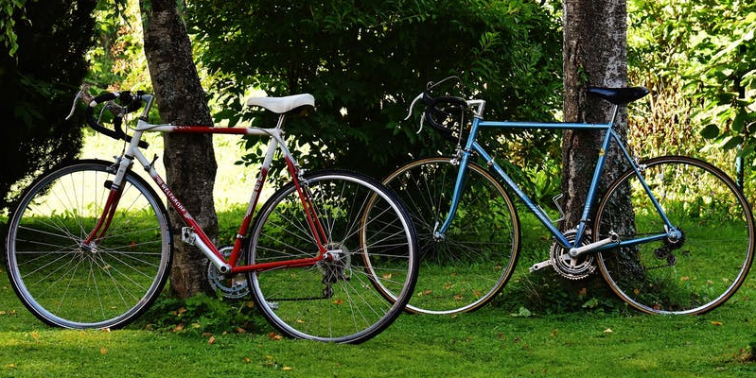
Lab Exercise: Next Class Session
Problem: Too many bike accidents on campus, most likely caused by hippies (or who else?) going all over the place with their squeaky organic engine-driven devices
UW wants you to conduct research and give them advice that will help improve bike safety.

Slide 13
The Social-Scientific Method: The People Method
ESRM 304 Environmental & Resource Assessment
Module Instructor: Miku Lenentine
Email: miku2@uw.edu
Office Hours: By appointment

Slide 14
Recap from Monday…
Discussion of social science, defining elements and what makes it unique
Review of different social science disciplines
Social science research cycle

Slide 15
Research Cycle for Lab this Week
Purpose help
develop research questions/Objectives
Choose research approach/Methods
Report: How do your results help meet purpose
Data
Conduct analysis
Robson & Galvan

Slide 16
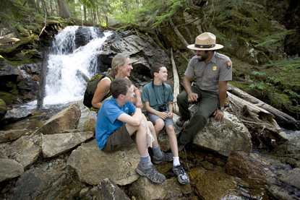
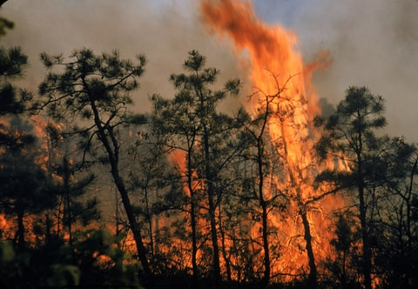
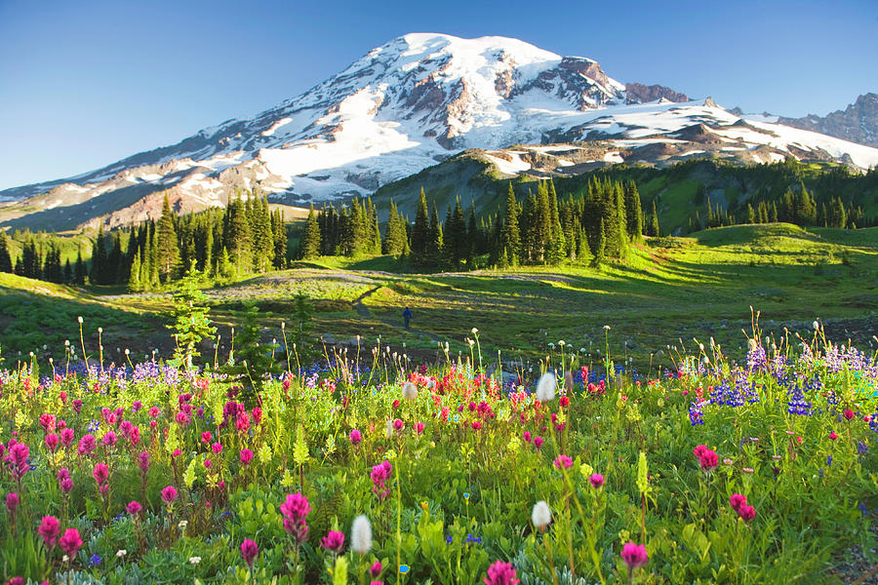
Example Questions in SSNRM
How many people visit a region?
How many people use certain recreation facilities?
What values does a population associate with a resource such as the forest?
What attitudes and knowledge do stakeholder groups have about wildland fuels management, and how do these attitudes compare across jurisdictions?
Is there a relationship between forest harvest rates and population dynamics in communities?
How would respondents describe the scenic beauty of a particular landscape or park?

Slide 17
Research problem determines methods & approaches
Several Approaches
historical
descriptive
developmental
case
true experiment
quasi experimental
Three broad Methods:
Qualitative
Quantitative
Mix methods

Slide 18
Which approach and broad method will you use for your lab?
Approaches
historical
descriptive
developmental
case
true experiment
quasi experimental
Three broad Methods:
Qualitative
Quantitative
Mix methods

Slide 19
Reasons for Research and Units of Observation and Analysis
Reasons
Units
management issue
program evaluation
personal curiosity
individual
group
community
public
relationship among variables

Slide 20
Approaches
Historical – to reconstruct the past objectively and accurately
When (and why) did hippies start running away from the cities to go sleep in plastic bags in the woods, and how has that changed over time?
Descriptive – To describe systematically a situation or area of interest factually and accurately.
Population census studies, public opinion surveys, observations studies, status studies, survey of the literature.

Slide 21
Approaches
Developmental – To investigate patterns & sequences of growth &/or change as a function of time.
A longitudinal study following the patterns of nature-based activity participation from adolescence through retirement.
Case – To study intensively the background, current status, and environmental interactions of a given social unit.
The case history of the youngest hippie to summit Mt. Everest;
An intensive study of the socio-economic characteristics of second home communities by Mount Rainier.

Slide 22
Approaches
True experiment – Examine cause and effect relationships by exposing one or more experimental groups to one or more conditions, and comparing the results of one or more control groups not receiving the condition.
To investigate the effectiveness of three methods of teaching outdoor skills to backpacking hippies, and rednecks.
Quasi experimental – To approximate the conditions of the true experiment in a setting which does not allow the control &/or manipulations of all relevant variables.

Slide 23
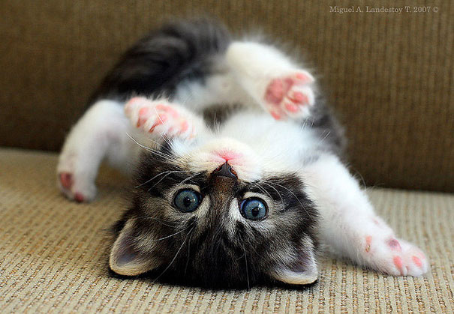
Your Prize!

Slide 24
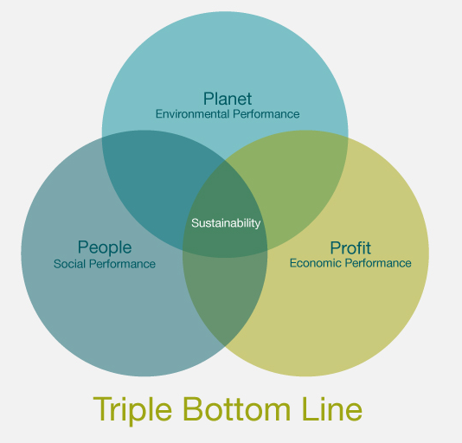
Let’s Hop to it! (Turn to your neighbor and get started)
Rapid Rounds
Say Hello! (Introduce yourself)
Attention / Intention
(Share where your attention is and what your intention is for being here for the next 45 minutes)
Prompt:
1) What is the Triple Bottom Line?
2) How might social and economic be different?
TODAY’s Cue Card Mission:
1 thing you learned today
1 question you have
(on back) How do you define community? How is it different then public?
Photo from: thefamilyfishfarmsnetwork.com

Slide 25
Happy Friday!
Pine tree tops
In the blue night frost haze, the sky glows with the moon pine tree tops bend snow-blue, fade into sky, frost, starlight. The creak of boots. Rabbit tracks, deer tracks, what do we know.
- Gary Snyder

Slide 26
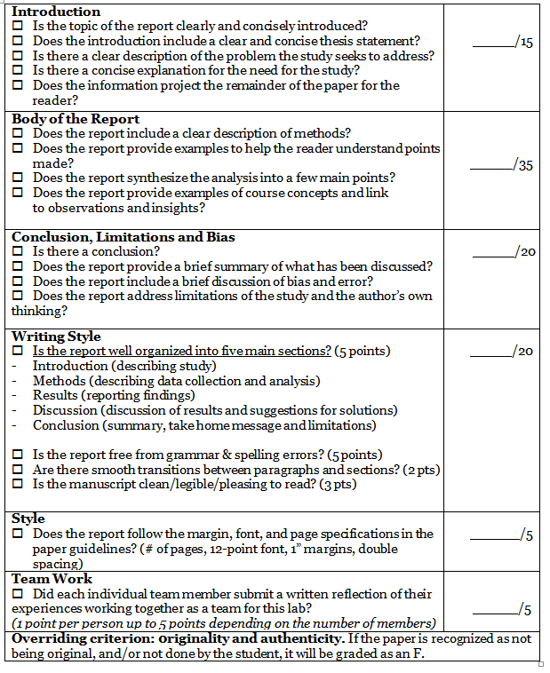
Let’s Hop to it! (Find your team from lab & start chatting)
Rapid Rounds with your Team
Say Hello!
Attention / Intention
Prompt:
1) What are the expectations for the lab report?
2) What questions do you have?
(We will go over this together next)
TODAY’s Cue Card Mission:
1 example of how to study bike safety on campus using a new method you learned today (we will go through methods)
(on back) What would make a good exam question [I will post these for people to practice with for the exam]

Slide 27
Expectations for Lab Assignment
Turn in observation sheet Today! (Both observer names)
(In-person Today or scan and upload copy by 8pm)
Turn in 1 page reflection Sunday by 8pm
(In-person today or scan and upload to drop-box)
Typed lab report, 5 pages double space, 12 point font, see rubric for format and details. Due one week from your lab either 10/31 or 11/1. (Please include team name & members)

Slide 28
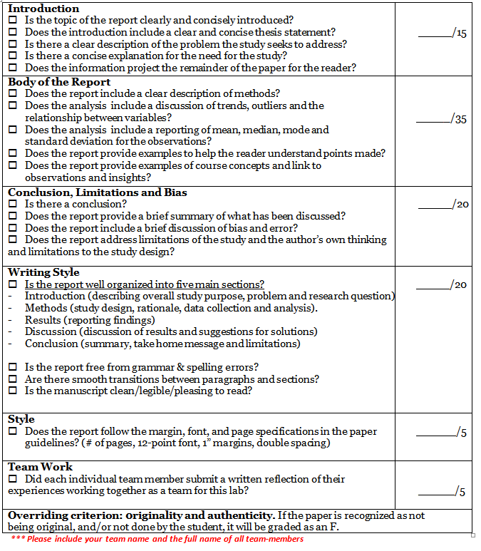
Rubric Online…

Slide 29
Last time…
Approaches
historical
descriptive
developmental
case
true experiment
quasi experimental
Three broad Methods:
Qualitative
Quantitative
Mix methods

Slide 30
Reasons for Research and Units of Observation and Analysis
Reasons
Units
management issue
program evaluation
personal curiosity
individual
group
community
public
relationship among variables

Slide 31
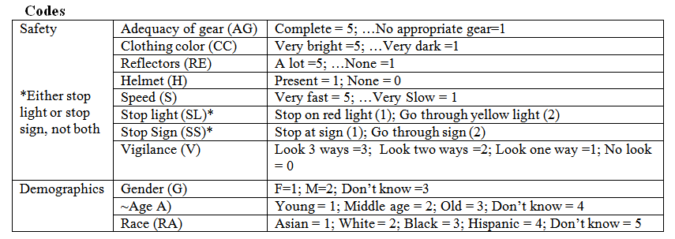
Is there a relationship among variables?
Concepts
Variables
Values
Specifically, variables with values associated with more unsafe biking behavior?

Slide 32
Social Science Research Cycle
Purpose help
develop research questions/Objectives
Choose research approach/Methods
Report: How do your results help meet purpose
Data
Conduct analysis
Robson & Galvan

Slide 33
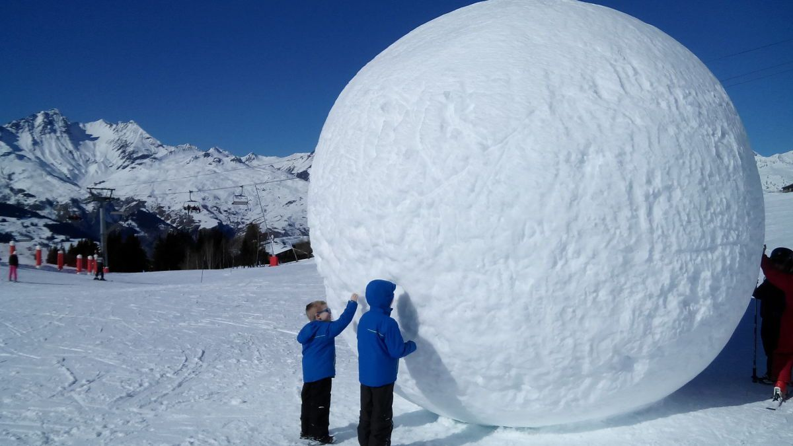
Methods
Feasibility
access to data
time
cost
human subjects protection
Sampling frame
random sample
stratified random sample
“snowball” sample
purposeful

Slide 34
Methods – What would you do?
Field observations
Participant
Non Obstructive
Interviews
Surveys
Data sets
Archival materials
Ethnography
Memos
Documents
Discourse

Slide 35
Methods
Field Observation– Observations of human behavior. The two main types include participant observation and non-obtrusive observation.
Non-obtrusive: Observing wild UW cyclists on campus
Obtrusive: trying out square dancing to understand the culture of the dance community in Ballard
Interview–Describing the meanings of central themes in the lifeworld of the subjects.
Can be in-person, online or via phone
Examples include focus groups, one on one and small group interviews
Can be very structured or more open-ended

Slide 36
Methods
Surveys– Administering a standardized questionnaire to a subset of the population.
Surveys can be administered online, face to face, or via phone.
Questions can be closed or open-ended
Data Sets– Access to existing data
Census data
Surveys administered by the Park Service
GIS data
Social media data repository

Slide 37
Methods
Archival Material– Examining historical documents, video, images.
For example, visiting the local historical society to discover the history of logging in the region to further context for the cause of a mill closure.
Ethnography– The study and systematic recording of culture.
For example, exploring the dumpster diving culture around Seattle! (Actually, taught at UW)
Living with a rural community for months to years to explore the culture and connection to natural resource use

Slide 38
Methods
Memos– Notes that are collected based on observations during a given study.
Documents– Existing relatively recent documents related to the phenomenon of interest.
Agency documents
Public meeting records
Websites

Slide 39
Methods
Discourse & Communication– Systematic design and collection of symbols of communication for the purpose of developing inferences or interpretation.
Examples include content analysis, narrative analysis and thematic analysis.
Discourse and communication is ubiquitous. It can be found in many forms in many spheres from small group meetings, online chat-rooms to Tweets.

Slide 40
Take a minute to talk and write down on your card
Field observations
Participant
Non Obstructive
Interviews
Surveys
Data sets
Archival materials
Ethnography
Memos
Documents
Discourse

Slide 41
Analysis, Results & Interpretation
Analytic Techniques
spatial analysis
narrative analysis
content analysis
Quotes, narratives, etc
statistics
Counts, etc
Patterns
difference / diversity
relationships
causality
Inference/interpretation
For Whom?
research sponsors
scientific community
professionals/managers
collaborators
public
Communicate: Media!
scientific journals
technical reports
manuals
books
public presentations
posters

Slide 42
Email: miku2@uw.edu

