Slide 1
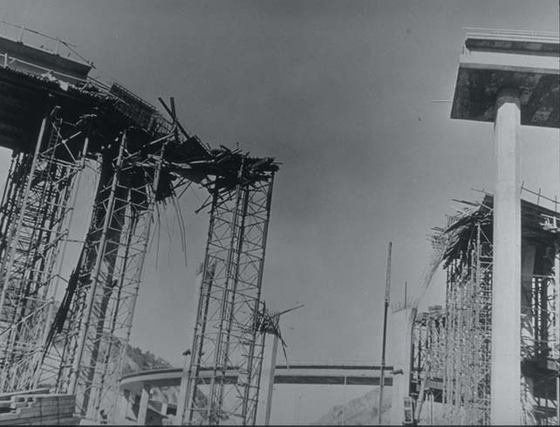
ESS 202
5 and 210 interchange

Slide 2
Global tour of quakes
California
Rest of country
Biggest quakes
1960 Chile, 1964 Alaska, 2004 Sumatra
Rest of world
Japan, Turkey, India
1755 Lisbon

Slide 3
International quakes
Japan
1923 Tokyo quake, horrific casualties
1995 Kobe most expensive, $150 billion
China - 1975 Haichang & 1976 Tangshan
Most fatalities, prediction experiment
India - very active
Europe - somewhat active

Slide 4
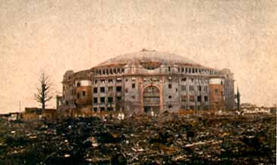
Tokyo 1923
Great Kanto Earthquake. Destruction of Kokugikan
(National Sumo Wrestling arena), Ryogoku district.

Slide 5
India
Quakes are the result of the India-Asia collision
California quakes pale in comparison
Many great quakes
8.7 in 1897
8.6 in 1905
8.4 in 1934
8.7 in 1950
Prototype for intensity XII shaking

Slide 6
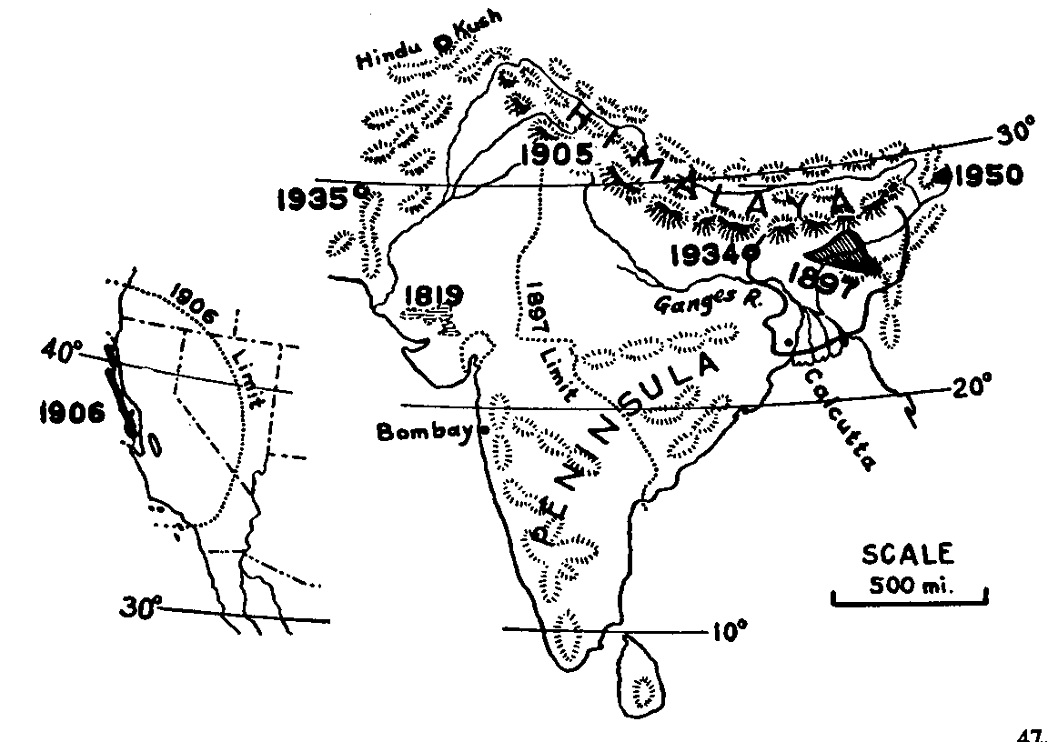
Map: Indian quakes
Richter, 5-1

Slide 7
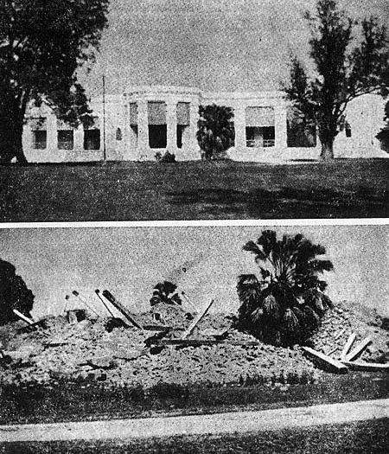
1897: Intensity XII
Judge’s house:
Before and after
Richter, 5-6

Slide 8
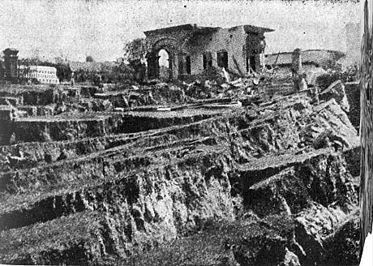
Formerly
level ground
1897 quake Intensity XII
Richter, 5-8

Slide 9
Deadly quake in Pakistan, October 8, 2005
M7.6, a shade bigger than Landers
9am, 70,000+ fatalities
Losses about $5,000,000,000
Had to talk at dawn on MSNBC
Earbrow trim, make-up, Godiva choc
8:30am east coast time

Slide 10
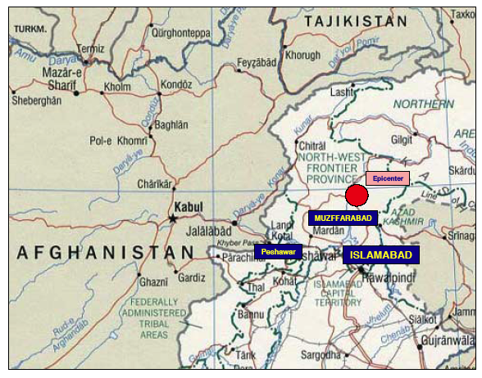
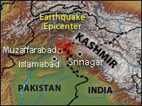

Slide 11
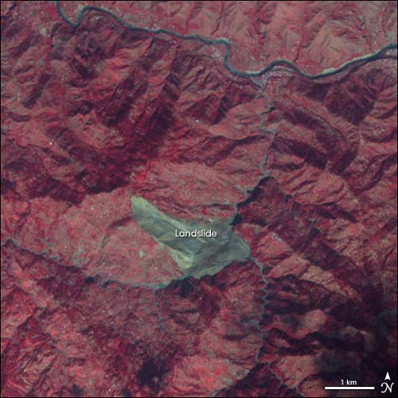
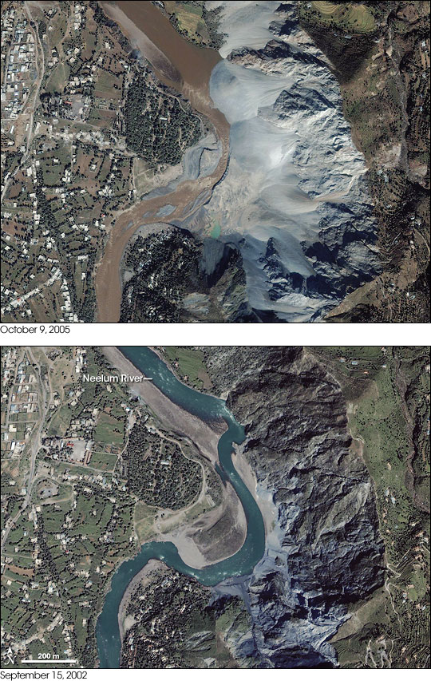
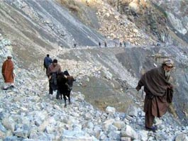
Landslides

Slide 12
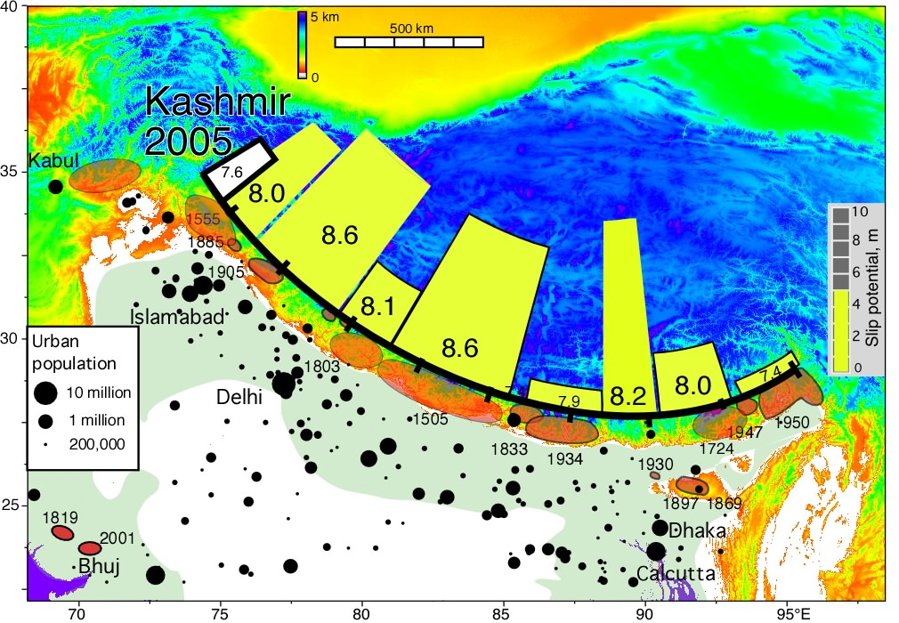
Earthquake potential

Slide 13
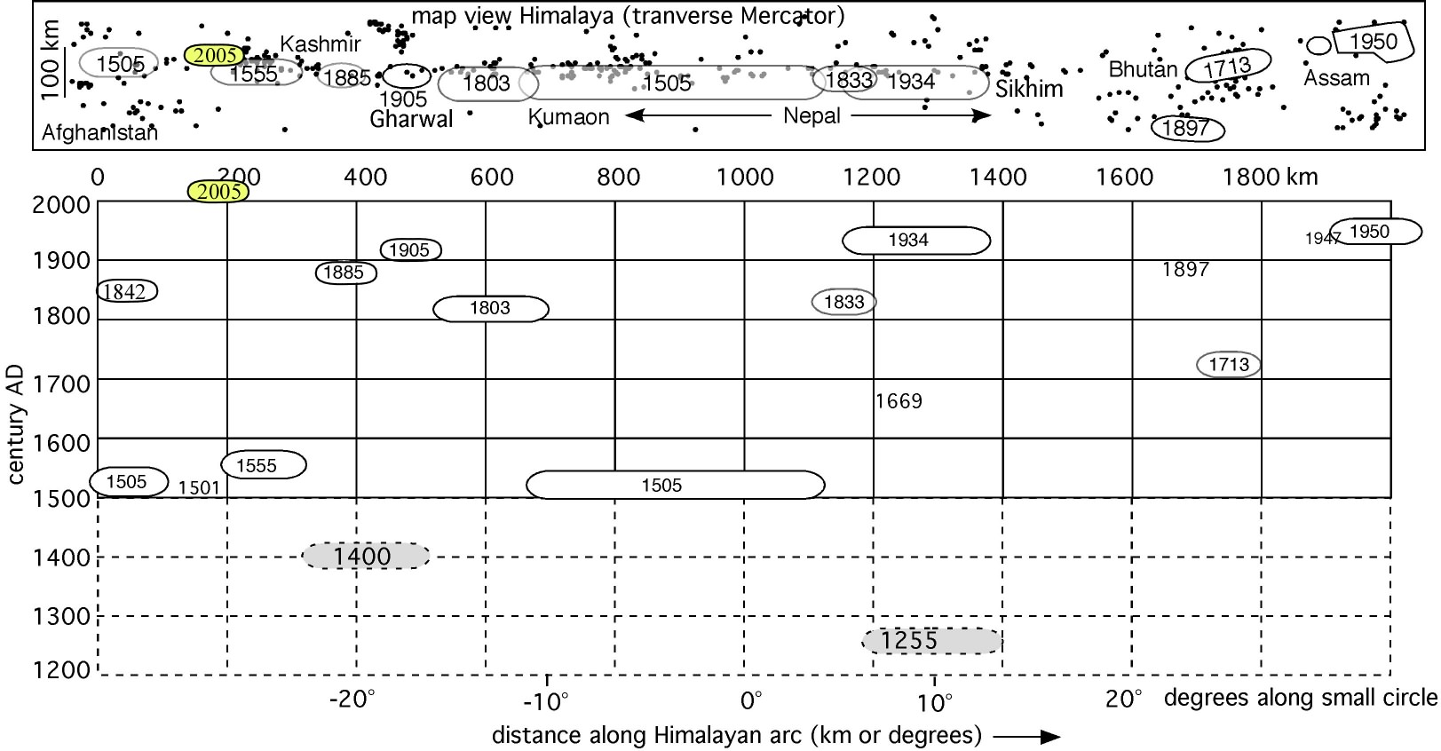
Space-time EQ’s across Tibet

Slide 14
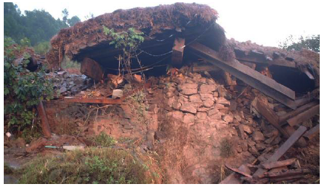
Poor construction

Slide 15
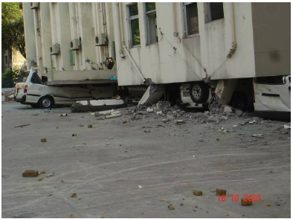
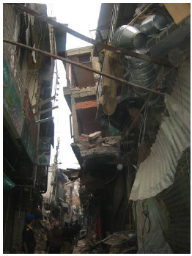
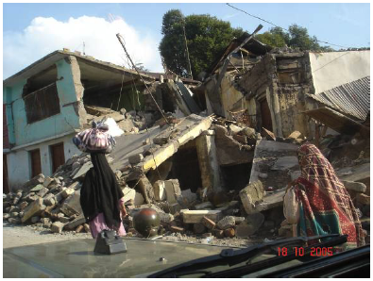

Slide 16
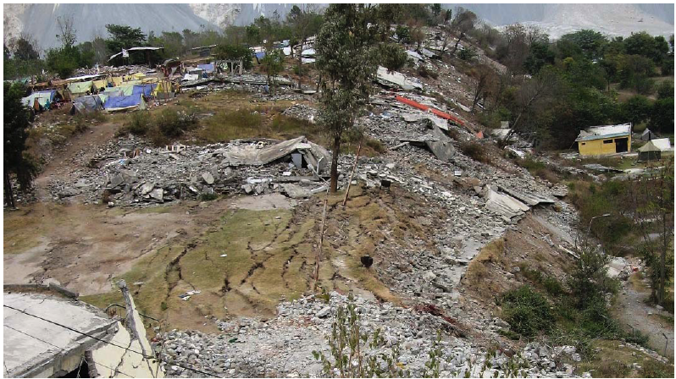
Cracked hilltop, and damage

Slide 17
Quakes in Europe
Plate boundaries complicated
Italy and Greece
Some damaging moderate quakes
Old buildings, in 2000, there was $1 billion M=5.
Volcanoes also a hazard, like Etna
Turkey and Israel like California
Big strike-slip quakes
Sequence in 1940’s showed alarming series of events marching along Anatolian Fault
Lisbon 1755 an important event

Slide 18
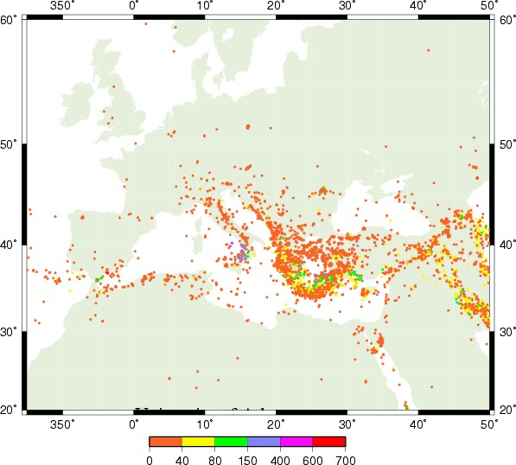
Mediterranean Seismicity

Slide 19
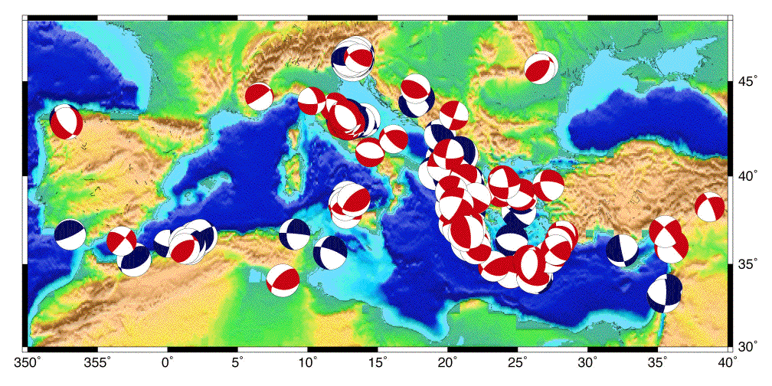
Focal mechanisms

Slide 20
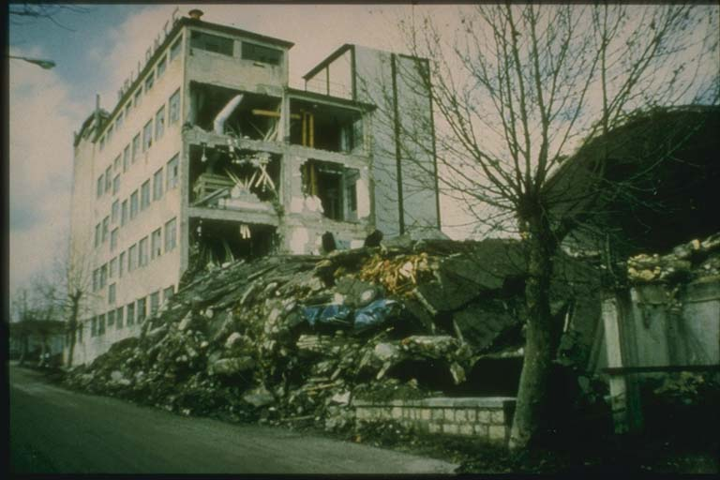
1980 Naples, Italy quake
4000 killed
250,000 homeless
http://www.ngdc.noaa.gov/cgi-bin/seg/m2h?seg/haz_volume1.men+Earthquakes+(General)+,I&19

Slide 21
Deadly quake in Turkey, August 17, 1999
M7.4, like Landers
20,000 to 30,000 fatalities
Losses about $10,000,000,000
Govt. heavily criticized for slow response
Sumatran earthquake well reported

Slide 22
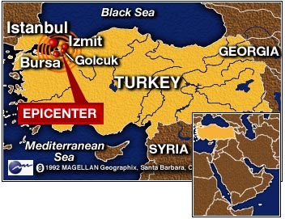

Slide 23
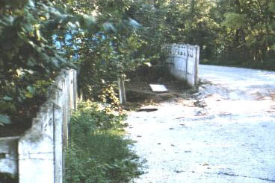
Offset wall

Slide 24
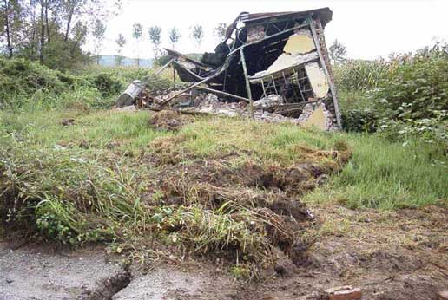
Faulted barn

Slide 25
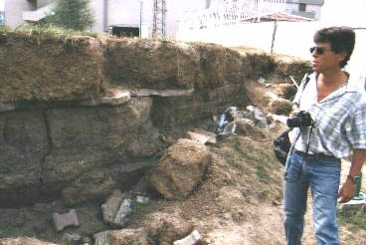
Fault scarp

Slide 26
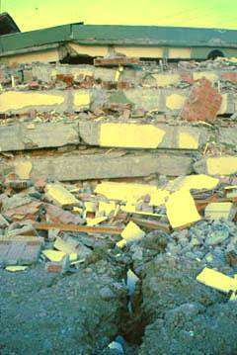
Faulted building
“pancaking”

Slide 27
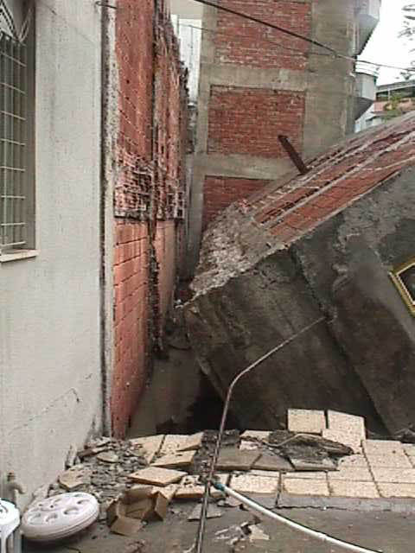
??

Slide 28
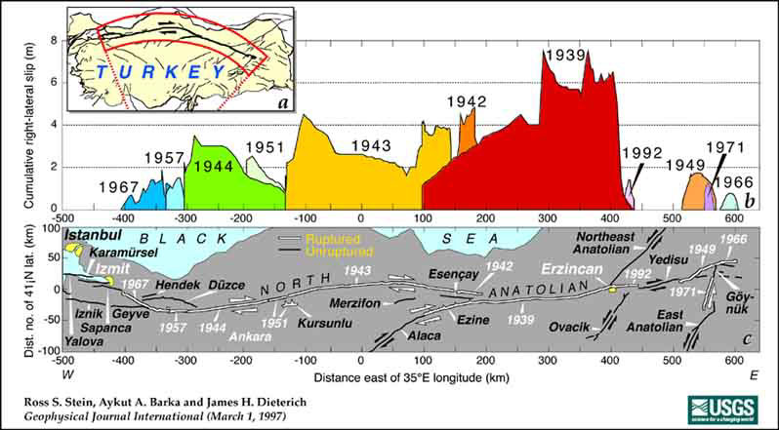
History of Turkish quakes

Slide 29
A worry
Fault much like California
M6 in 1939
M8 in 1939
M7.3 in 1942
M7.6 in 1943
M7.6 in 1944
What if this happened in California?

Slide 30
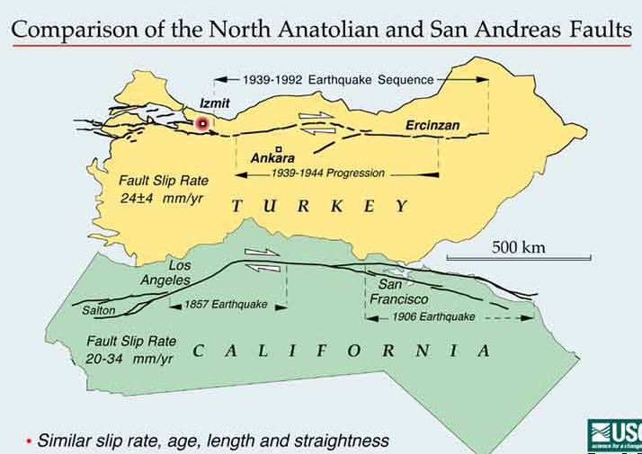

Slide 31
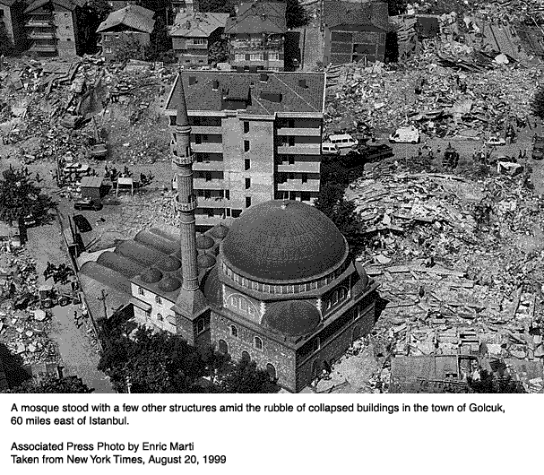

Slide 32
1755 Lisbon quake
M = 8.5?, felt across most of Europe
We still don’t know what fault it was on
Timing unlucky, 9:30 am on Nov. 1
All Saint’s Day, people were in church
Also brought fires and a big aftershock at noon
Tsunami - water receded then smashed boats
10 m waves
As high as 3 m in Holland and the Caribbean

Slide 33
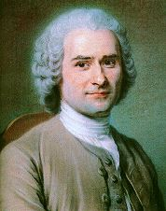
Rousseau concluded “Live Outdoors!”

Slide 34
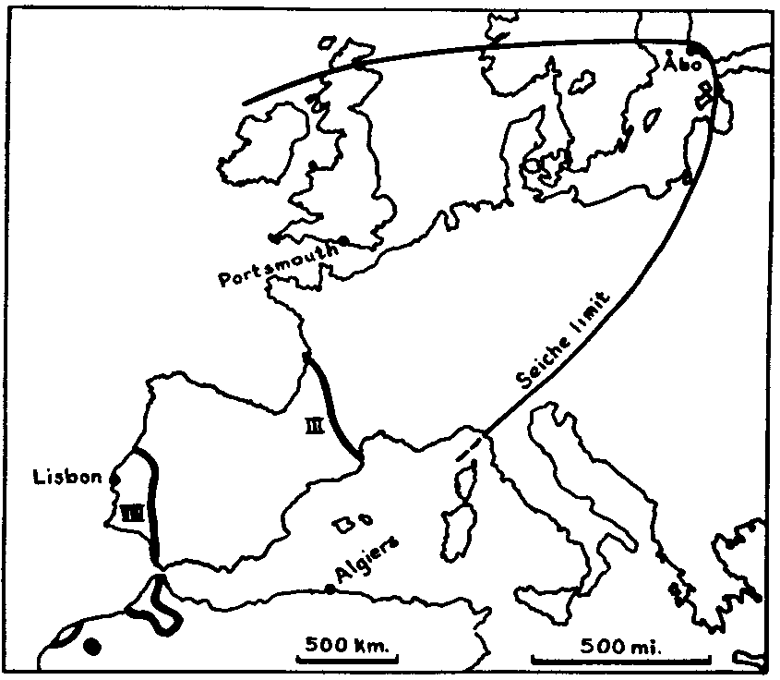
Effects of 1755 Lisbon quake
60,000
killed
Portugal
devastated
Richter, 9-1

Slide 35
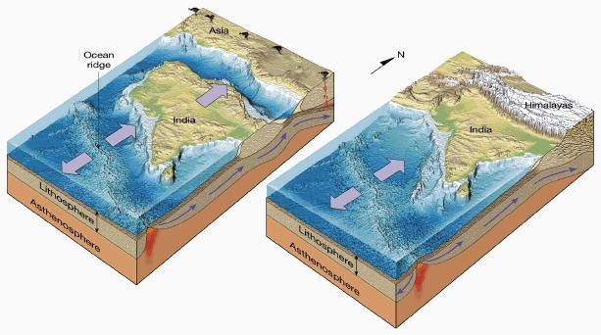
Tectonic bumper cars
Gotoknow.org

Slide 36
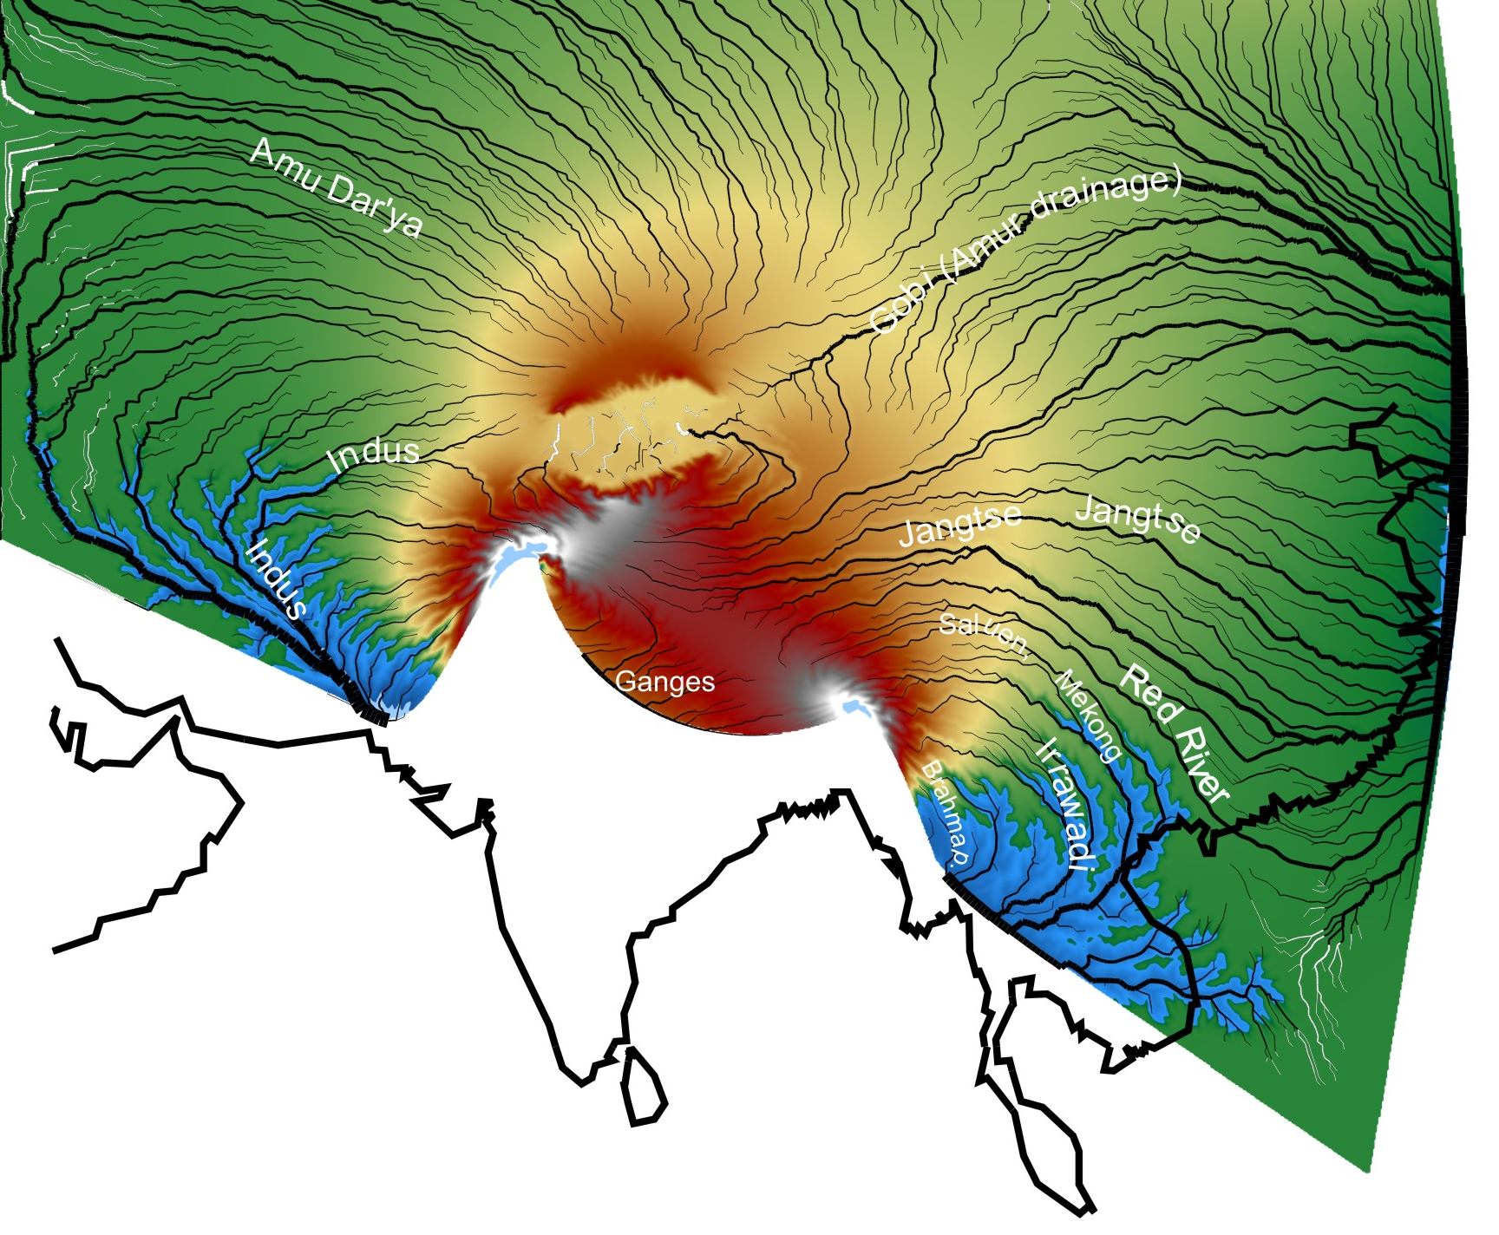
A numerical model
Robl & Hergarten

Slide 37
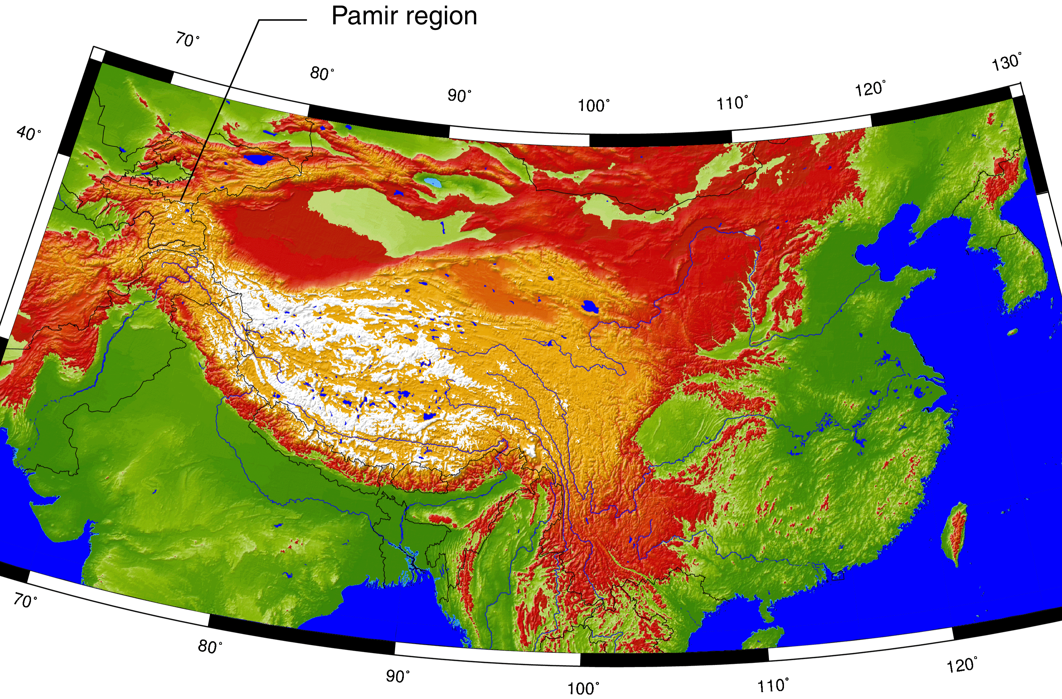
The result
Arrowsmith & Strecker, 1999

Slide 38
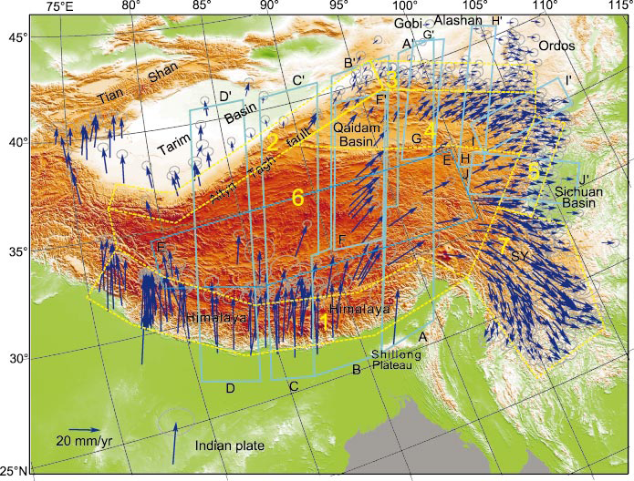
Zhang & Molnar, 2004

Slide 39
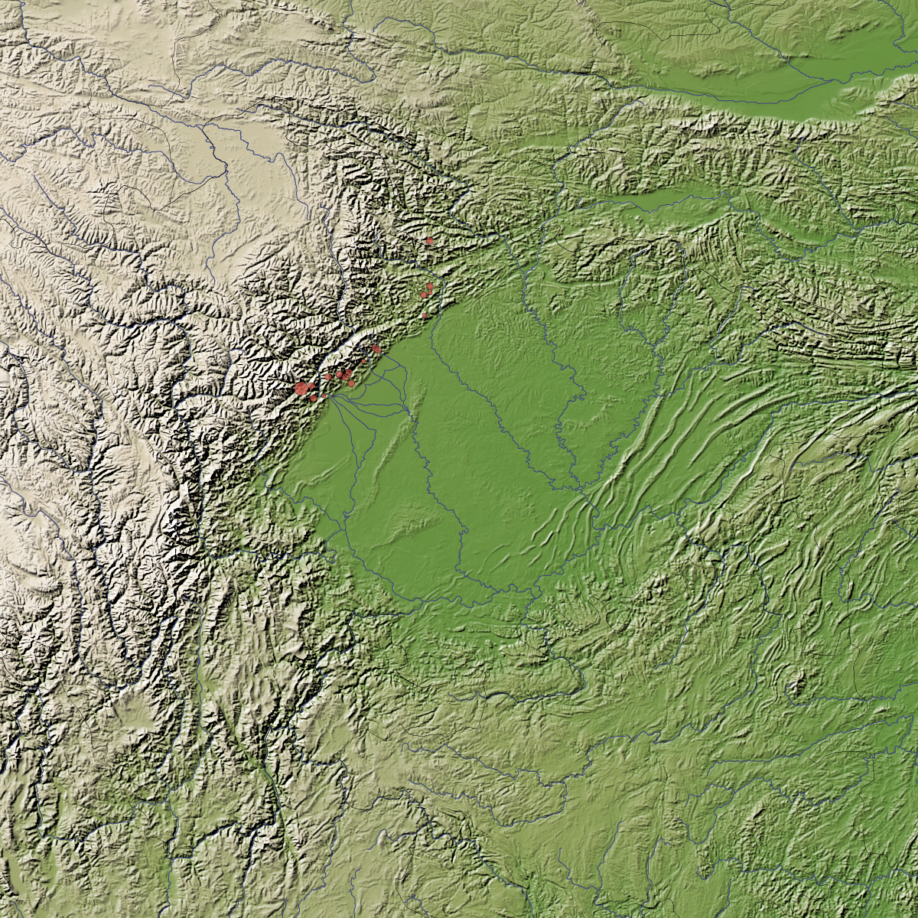
The landscape

Slide 40
Boulder Creek fault
Bellingham
Victoria
Devils Mtn FZ
Utsalady Pt
fault
?
Little River fault
SWIF
Courtesy R. Haugerud, USGS
Seattle
Seattle fault
Cascadia megathrust
Tacoma fault
Olympia fault

Slide 41
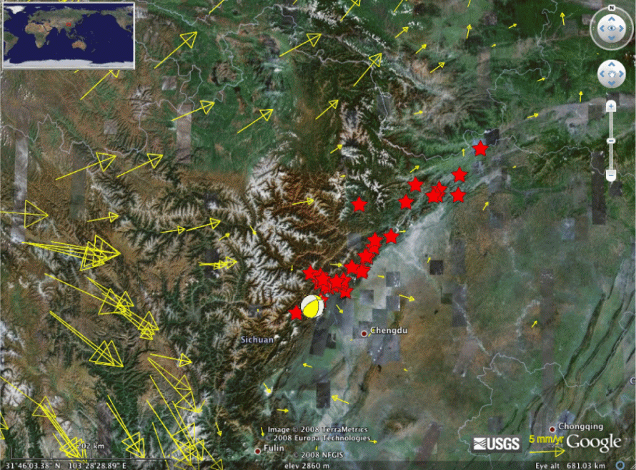
MIT-Chengdu effort

Slide 42
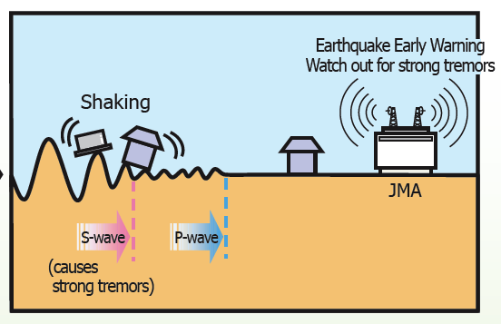
Problems
Buildings
Ill-founded rumors
Monitoring
Not enough mapping
Progress
Growing monitoring
Continued fault mapping
Possible “early warning”
20s warning for Chengdu, for example

Slide 43
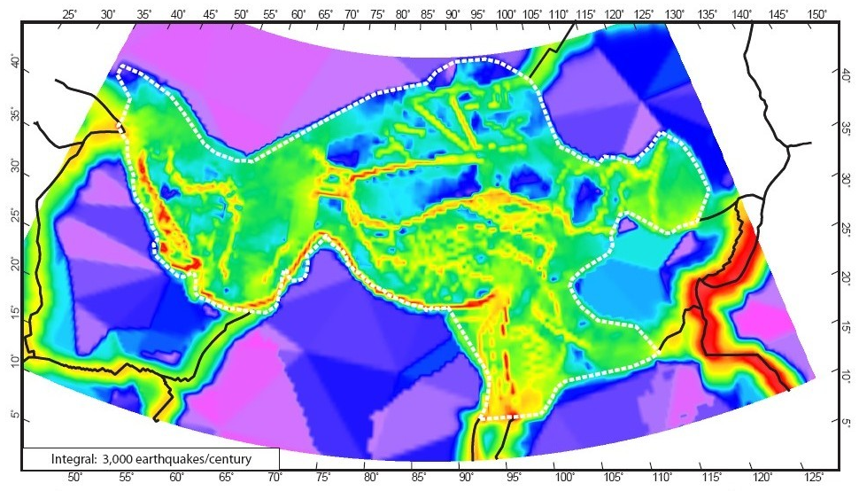
Not unique
*
*
*
*
*
*
Previous quakes in China, with 200K+ fatalities: 1556, 1920, 1927, 1976 Pakistan, 2005, 80K
Quake risk across Asia, Liu & Bird, 2008

Slide 44
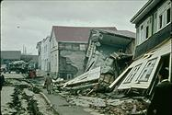
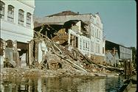
1960 Chile earthquake
M 9.5!!
160,000 square km fault
21 meter average slip
Loss of life and property in Chile, Hawaii, and Japan

Slide 45
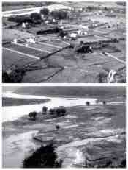
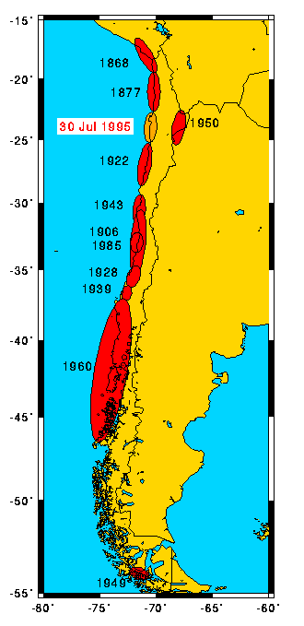
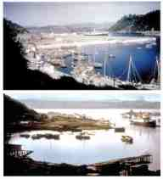

Slide 46
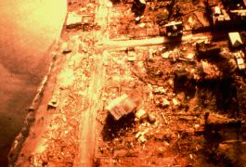
Isla Chiloe, Chile

Slide 47
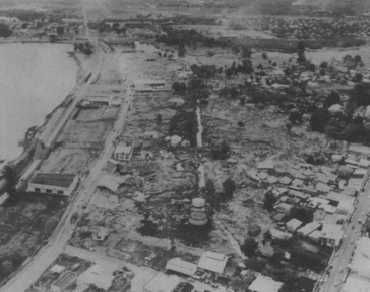
Hilo after 1960 Chile quake

Slide 48
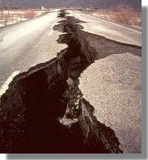
1964 Alaska
M 9.2 !
Several meters of uplift over a huge fault area
119 deaths in Alaska and California
2-7m waves along open California coast
Crescent City hardest hit
Thirty blocks of Crescent City were devastated
Gas truck smashed into electric wires
Texaco tank fire burned for three days

Slide 49
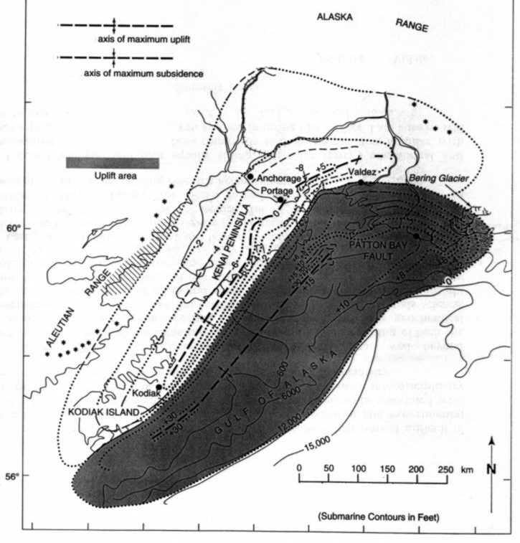
1964 Alaska displacement
No wonder there was
a large tsunami.
USGS Prof. Paper 5460

Slide 50
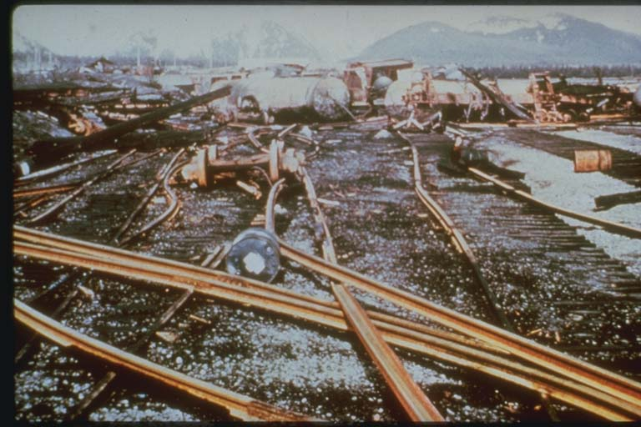
Railroad station - Steward Port

Slide 51
Lituya Bay
This image shows Lituya Bay, Alaska, after a huge, landslide-generated tsunami occurred on July 9, 1958. The earthquake-induced rockslide, shown in upper right-hand corner of this image, generated a 525 m splash-up immediately across the bay, and razed trees along the bay and across LaChausse Spit before leaving the bay and dissipating in the open waters of the Gulf of Alaska. Source: Lander, and P. Lockridge

Slide 52
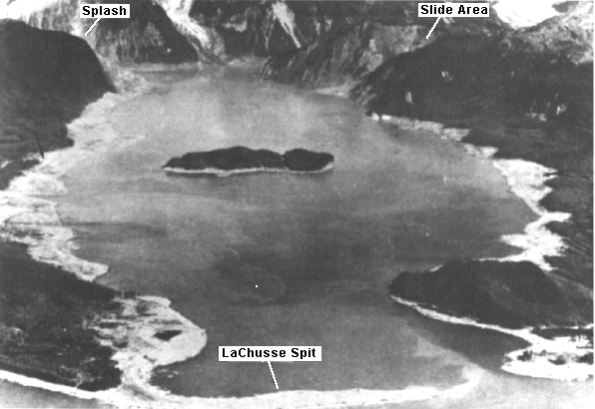
Lituya Bay slide

Slide 53
1720 ft high splash!

Slide 54
Tsunami from impact

Slide 55
Chain of impact spots on the surface of Jupiter
Shoemaker-Levy comet, 1994, hours after impacts

Slide 56
Meteorites
Roughly once a year, a meteorite 2-3 meters across hits Earth.

Slide 57
Powerful meteorites
A former asteroid pierces the atmosphere and releases the energy equivalent of five kilotons (5,000 tons) of TNT about once a year. In comparison, the explosive power is almost half that of the bomb dropped on Hiroshima, Japan during World War II.

Slide 58
Tungushka in 1908
An object big enough to cause destruction, like the approximately 60-meter-wide asteroid or comet that exploded over Tungushka, Siberia in 1908, hits about once a millennium.
(Conspiracy theorists think otherwise.)
The blast, equivalent to 10 megatons of TNT, flattened 500,000 acres (2,000 square km) of uninhabited forest. Had the bull's-eye been on New York City, it would have been destroyed.

Slide 60
Tree Fall
Probably exploded about 6 km above the ground

Slide 61
Meteor crater, Arizona
1 km diameter meteorite, 50,000 years ago

Slide 62
King of known impacts
Cretaceous-Tertiary boundary impact
Probably 10 km radius meteorite
Caused the downfall of the dinosaurs
Many other animals and plants
Global fires?
Greenhouse effect?
Darkness for days? Years?
Sprayed a lot of vaporized rock across the western hemisphere

Slide 63
Chicxulub impact crater

Slide 64
King of suspected impacts
Moon-forming impact
Probably collision of two Mars-sized objects
More than 4 billion years ago
Sprayed out large amounts of pulverized and melted rock and iron
Much of spray captured in orbit
Collected to formed the Moon
King of possible impacts
Colliding super-massive black holes …

Slide 65
Earthquakes M>5, 1963-1988
Quakes that we’ve discussed
*
Nevada
Charleston
*
*
*
*
*
*
New Madrid
*
Keller, 1-5

