Slide 1

ESS 454
Hydrogeology
Module 3
Principles of Groundwater Flow
Point water Head, Validity of Darcy’s Law
Diffusion Equation
Flow in Unconfined Aquifers & Refraction of Flow lines
Flownets
Instructor: Michael Brown
brown@ess.washington.edu

Slide 2
Groundwater
NOT Ground water or Ground-water
March 26, 2009
USGS TECHNICAL MEMORANDUM 2009.03
Subject: GROUNDWATER: Ground water versus groundwater
It has been a longstanding practice within the USGS to spell ground water as two words and to hyphenate when ground water is used as a modifier (e.g., ground-water hydrology). Language evolves, and it is clear that the one-word spelling of groundwater has become the preferred usage both nationally and internationally. The one-word spelling has been used by the Merriam-Webster online dictionary since 1998. Most water-resources publications also use the one-word spelling, as do many technical groups, such as the National Research Council. With the emphasis on interdisciplinary science, many USGS scientists who are not specialists in the field commonly use the one-word form, as increasingly do many hydrologists within the Water Resources Discipline.
The term surface water has not seen the same language simplification that has occurred with the term “groundwater.” “Surface water” continues in the English language universally spelled as two words. Use of the two terms together spelled as “groundwater and surface water” has become common usage.
With this memorandum, we are making a transition to the use of groundwater as one word in USGS. Changeover to use of the one-word spelling in our publications and web sites will be accomplished as seamlessly as possible. Reports in preparation should be converted to the one-word spelling where this does not require a special effort. Reports submitted for approval after August 1, 2009, will be expected to use the one-word form. During this transition period, the one-word or two-word spelling should be used consistently throughout a publication.
William M. Alley Chief, Office of Groundwater
This memorandum supersedes Ground Water Branch Technical Memorandum No. 75.03

Slide 3
Module Three Vocabulary
Point water/freshwater head
Reynolds number R=ρvd/μ (dimensionless)
Linear Velocity v=q/n (L/t)
Discharge per unit width q’=Kh(dh/dx) (L²/t)
“Steady-state” vs “time dependent”
Diffusion equation LaPlace’s equation
Diffusivity: η = T/S (L²/t)
Infiltration w (L/t)
Flow line Refraction
Flownet
Darcy’s Law: q=-K∇h (flux is proportional to gradient)
  Head gradient: dh/dl or dh/dx or ∇h (dimensionless)
  Hydraulic Conductivity: K (L/t)
  Specific discharge (Darcy velocity): q (L/t)
  Permeameters: Q = -KA dh/dl
Head:
  Pressure head: ρ_{w}g∆h (force/area)
  Elevation head
Permeability: K_{i} = K/(ρg/μ)
Transmissivity T= Kb
Storativity (V_{w} = S A ∆h) S= bS_{s} or S = S_{y}+bS S_{s}=ρg(α+nβ)
Properties of geologic materials:
  K, S_{s}, and S_{y}
Related properties of entire aquifer:
  T and S

Slide 4
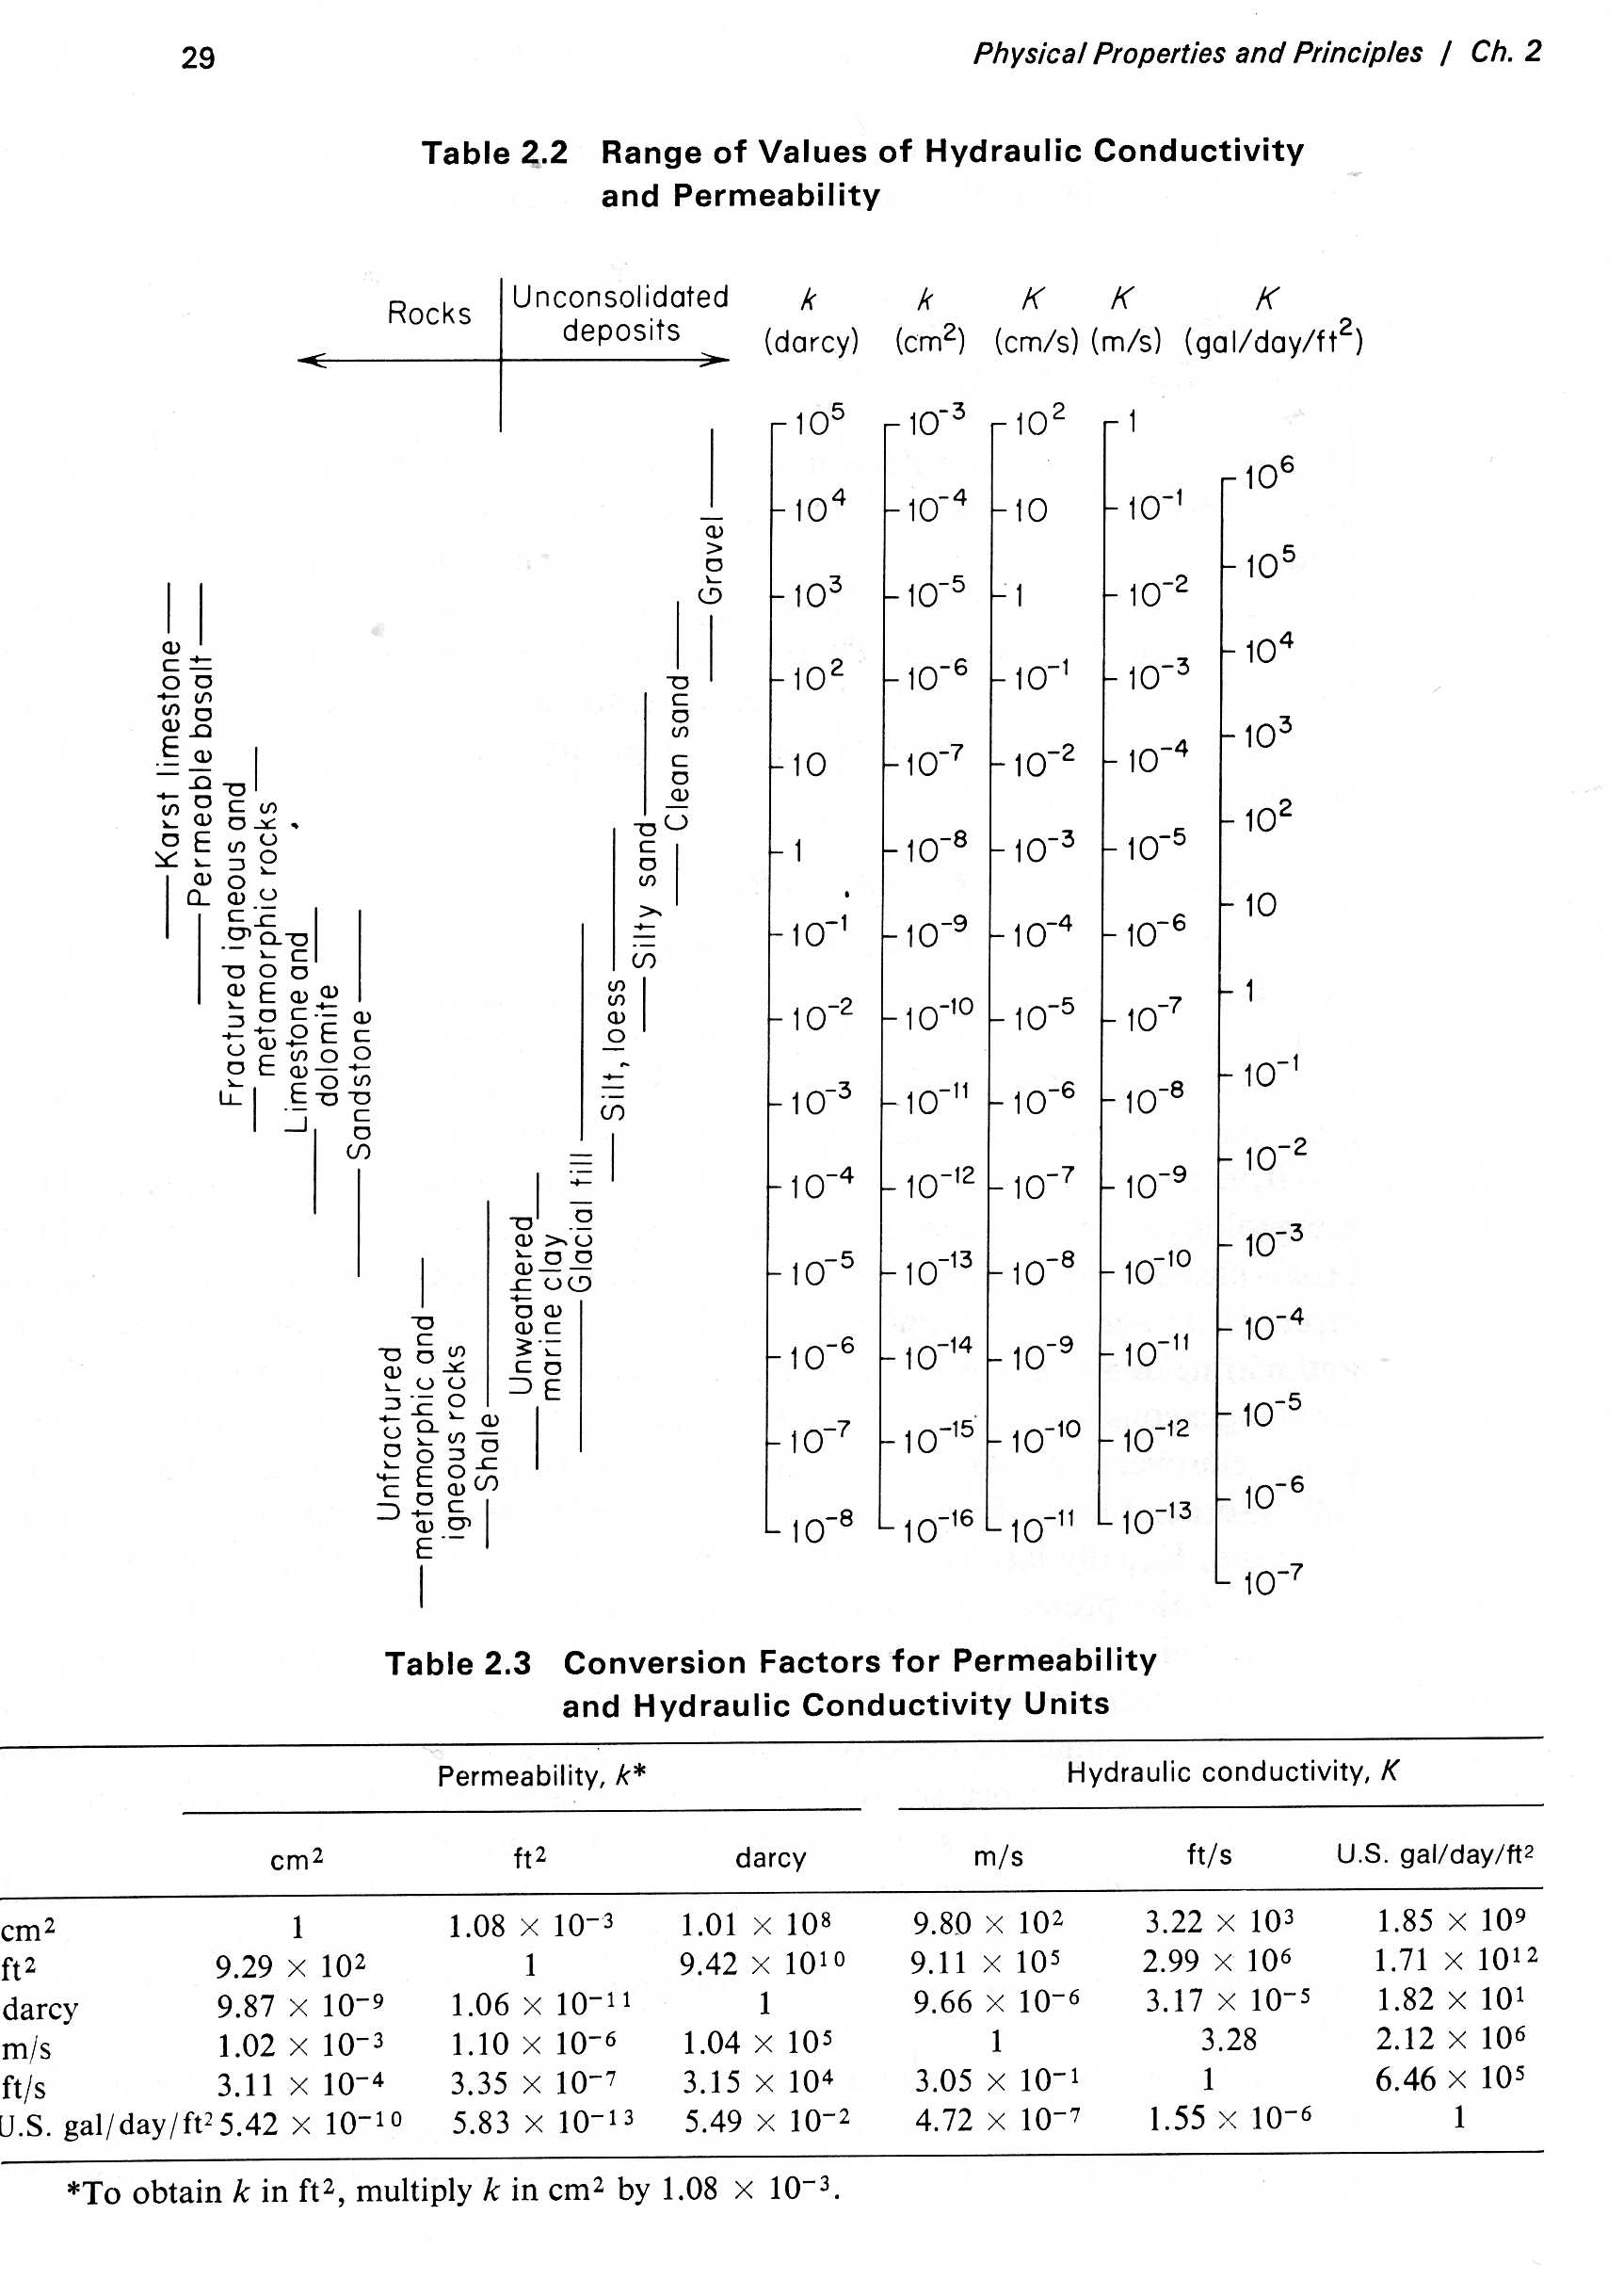
More information about geologic materials
Another table later will show Storativities
Freeze, A., and J. Cherry, Groundwater, 1997, Prentice Hall

Slide 5
Outline and Learning Goals
Master vocabulary
Be able to adjust measured hydraulic heads to account for water with variable density
Understand the range of validity for Darcy’s Law
Understand how to determine the “linear velocity” of groundwater
Understand how Darcy’s Law and conservation of water leads to the “diffusion equation”
Be able to quantitatively determine characteristic lengths or times based on “scaling” of the diffusion equation
Be aware of the range of diffusivities for various rock types
Understand how to quantitatively calculate heads and water fluxes in unconfined aquifers
Be able to qualitatively and quantitatively estimate how flow lines are bent at interfaces between materials having different hydraulic conductivities
Know the appropriate boundary conditions of head and flux for various types of boundaries
Be able to qualitatively estimate equipotential lines and flux lines using flownets

Slide 6
Outline and Learning Goals
Be able to adjust measured hydraulic heads to account for water with variable density
Understand the range of validity for Darcy’s Law
Understand how to determine the “linear velocity” and discharge per unit with of groundwater

Slide 7
Groundwater of Variable Density
Consider confined aquifer filled with salty water
Fill with Freshwater
ρ_{fw} = 1000 kg/m³
h_{sw} = P/ρ_{sw}g
h_{fw}>h_{sw}
h_{fw} = P/ρ_{fw}g
Define h_{sw} as “Point-water pressure Head”
Define h_{fw} as “Freshwater pressure Head”
saltwater
ρ_{sw} =1100 kg/m³
Convert Point head to freshwater head
h_{fw} = ρ_{sw}/ρ_{fw} * h_{sw}
Pressure = P
Elevation head
Elevation head
datum
Need to use freshwater heads in order to determine hydraulic gradient for vertical flow between aquifers

Slide 8
Example with three aquifers
Water table
h_{pA}
A
ρ=999 kg/m³
h_{pB}
aquitard
B
h_{pC}
Aquifer Density(kg/m) Elevation Head (m) Total Head(m)
A 999 50.00 55.00
B 1040 31.34 54.67
C 1100 7.95 51.88
ρ=1040 kg/m³
aquitard
Based on these heads, you might (incorrectly) suggest that water flows from A to B to C
C
Z_{A}
Z_{B}
Z_{C}
ρ=1100 kg/m³
datum
Aquifer Pointwater head (m) ρ_{p}/ρ_{f} Freshwater pressure head (m) Freshwater Total Head (m)
A
B
C
5.00
23.33
43.93
1.000
1.040
1.100
5.00
24.26
48.32
55.00
55.60
56.27
+ Elevation
Heads
Corrected Heads show that water will flow upwards

Slide 9
Range of Darcy Law Validity
Applies to “laminar flow”
Not to “turbulent flow”
Reynolds Number (R) is (dimensionless) ratio of inertial forces to viscous forces
Where ρ is density of fluid, v is velocity, d is channel size, and μ is viscosity
Turbulent flow happens when R is large
(increase ρ, v or d or decrease μ)
Experiments show groundwater turbulence for R > 1-10
Use properties of water and a sand aquifer with a channel size of 0.5 mm, solve for velocity of water at the transition to turbulent flow (R=1):
Conversion
3000 ft/d ~ 1 cm/s
R=1= ρ v d/μ => v=Rμ/ρd
v=1*10⁻²/1000/.05 =0.2 cm/s
As long as flow is less than 0.2 cm/s (600 ft/d) Darcy’s Law is applicable in this aquifer

Slide 10
Range of Darcy Law Validity
Valid for most groundwater flow
May not be valid for:
  Flow through basalt fissures
  Flow through limestone (karst) caves
  Flow near production well intakes or in well pipes

Slide 11
Darcy Velocity
Imagine a cube of water
V = Area*length
V = A*x
Imagine the cube flowing through a surface at x=0
Cube moved distance x in time t
Flux = volume per time
Q = V/t
Define “Specific Discharge” as
q = Q/A
Area A
= V/t/A
= A*x/A/t
=x/t
Individual points in cube moved at velocity x/t
q is velocity of points in the cube
x
Flow Direction
Specific Discharge is “Darcy Velocity”
It is volume flux per unit area
(multiply q by area to get total flux)

Slide 12
Linear Velocity
To move the same volume of water in time t through half the space, individual particles need to move twice as fast
If the rock porosity is 0.5, only half the volume is available for transport of water
Area A
Specific Discharge is “Darcy Velocity”
2x
But velocity of water
(the “linear velocity” ) is
Specific discharge/porosity
q/n
x
Individual points in cube moved twice the distance in time t
Flow Direction

Slide 13
q’: Discharge per unit Width
Define as q’ = Q/y
h
Area A
y
x
Flow Direction

Slide 14
The End
Coming up next: Derivation of the Diffusion Equation

