Slide 1

ESS 454
Hydrogeology
Module 1
Course Overview,
Hydrogeology History,
Hydrologic Cycle,
Sustainability I & II

Slide 2
What is Hydrogeology?
Study of water from the time it infiltrates to the time it emerges from ground
Interrelationship between geologic materials and processes with water
Ultimately at the intersection of natural resources and society
Both a descriptive and quantitative science

Slide 3
Intersection with Society
“Can our aquifer support development of another subdivision?”
“Will the stream dry up and kill salmon if the farmer doubles his irrigation pumping?”
“Will the water pumped out of the aquifer for the new salmon hatchery cause saltwater intrusion into my well?”
“Will my neighbor’s septic system contaminate my well?”
“Did chemicals leaking from that dry cleaning facility travel through the aquifer to my well and make me sick?”

Slide 4
A Matter of Global Impact
See “water crisis” in Wikipedia
How long can you go without water?
a few days
What fraction of world population does not have adequate access to water?
13% drinking, >30% sanitation
What fraction of world population depends on groundwater (drinking/agriculture/industry)
nearly 100%
Where is groundwater being exploited (pumped faster than it is recharged?)
nearly everywhere
When will this impact you, your family, society?
certainly within your lifetime

Slide 5
Overarching Goals
Understand the science basis for groundwater management
Be sufficiently informed to be an environmentally aware citizen
Improve quantitative skills that are generally useful in science and technology
Know enough basic hydrogeology to
  Pass the “professional geologist” licensing test
  Gain entry employment in the field leading to the hydrogeology certification

Slide 6
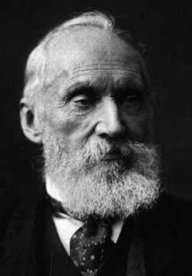
Science Basis for Groundwater Management
This course has a quantitative focus
“I often say that when you can measure what you are speaking about and express it in numbers you know something about it”
“but when you cannot measure it, when you cannot express it in numbers, your knowledge is of a meager and unsatisfactory kind”
“It may be the beginning of knowledge, but you have scarcely, in your thoughts, advanced to the stage of science, whatever the matter may be”
William Thompson (Lord Kelvin) 1891

Slide 7
Hydrogeology:
Professional Applications
Water resources
Contaminant transport
Civil engineering support
  Geotechnical engineering
  Water control
Waste management
  Solid
  Radioactive

Slide 8
Hydrogeology is
Quantitative and Integrative
Math:
  algebra, linear algebra, calculus, differential equations, partial differential equations
Physics:
  Energy (kinetic/potential), force, work, pressure, gravity, fluid flow, Diffusion equation, LaPlace’s Equation
Chemistry:
  reactions, equilibrium, activities, acids/bases, oxidation
Geology:
  see following slides

Slide 9
Hydrogeology:
Earth Sciences Cross-Connections
Fluid flow is a essential component of most geologic processes
Examples follow:

Slide 10
Structural geology
  Pore pressure and deformation – faulting
  Dissolution and transport in rock deformation
Seismology – earthquake trigger, prediction
Magmatic processes
Sedimentary/diagenetic processes
Geomorphologic evolution
Glaciology
Geothermal systems
Hydrothermal systems
  Ore generation
Geo-biologic systems
Extra-terrestrial systems

Slide 11
Related Fields
Heat Flow
  Shares much of the same theory
  Interconnected measurements
Soil Physics
  Study mainly of unsaturated flow in agricultural soils
Civil and Mining Engineering
  Slopes, consolidation, tunnel and mine inflows, dewatering, pore pressure in geomechanics
Petroleum Engineering
  Similar conceptual underpinnings. Main difference is greater emphasis on multiphase flow
  Opaque units reduce communication between fields

Slide 12
Limitations
This is “introductory level” hydrogeology
This course is not sufficiently comprehensive or detailed to make you a “practicing hydrogeologist” out of the box.

Slide 13
What are you going to learn?
(and what is the distribution of your effort)
Principals controlling flow of water in subsurface
  math, physics, and geology
  40%
Principals controlling how water flows out of wells
  10%
Computer modeling
  10%
Chemistry of groundwater and transport of contaminants
  20%
Basic legal concepts controlling access to groundwater
  10%
Factors associated with the sustainable use of groundwater
  Distributed and ubiquitous

Slide 14
Course Resources
Lectures
Web Site: courses.washington.edu/ess454
Text: Fetter Applied Hydrogeology
  Course will follow book with some supplemental material
Contact: Michael Brown brown@ess.washington.edu

Slide 15
Course Outline
Module Reading from Fetter Topics
1 Chapters 1&2 Hydrogeology Introduction, History,
Elements of the hydrological cycle
2 Chapter 3 Properties of aquifers
3 Chapter 4 Principles of groundwater flow
4 Chapter 5 Groundwater flow to wells
5 Chapter 7 Regional groundwater flow
6 Chapter 8 Geology of groundwater occurrences
7 Chapter 13 Groundwater modeling
8 Chapter 9 Groundwater chemistry
9 Chapter 10 Groundwater quality and contaminant transport
10 Chapter 11 Groundwater Law, Development and Management
Professional licensing

Slide 16
My Background
  BS, MS from UW (Physics, Geophysics)
  PhD from U. Minnesota
  Faculty at Texas A&M 1980-1984
  Faculty UW 1984-present
    Teaching: mineralogy, geology, geophysics (exploration, gravity, magnetic, heat flow, seismology), nature of science
    Research on planetary materials under extreme conditions
      Measuring the chemical properties of aqueous solutions
      Measuring elastic & thermal properties of minerals
    Prior Chair of Geological Sciences and Geophysics

Slide 17
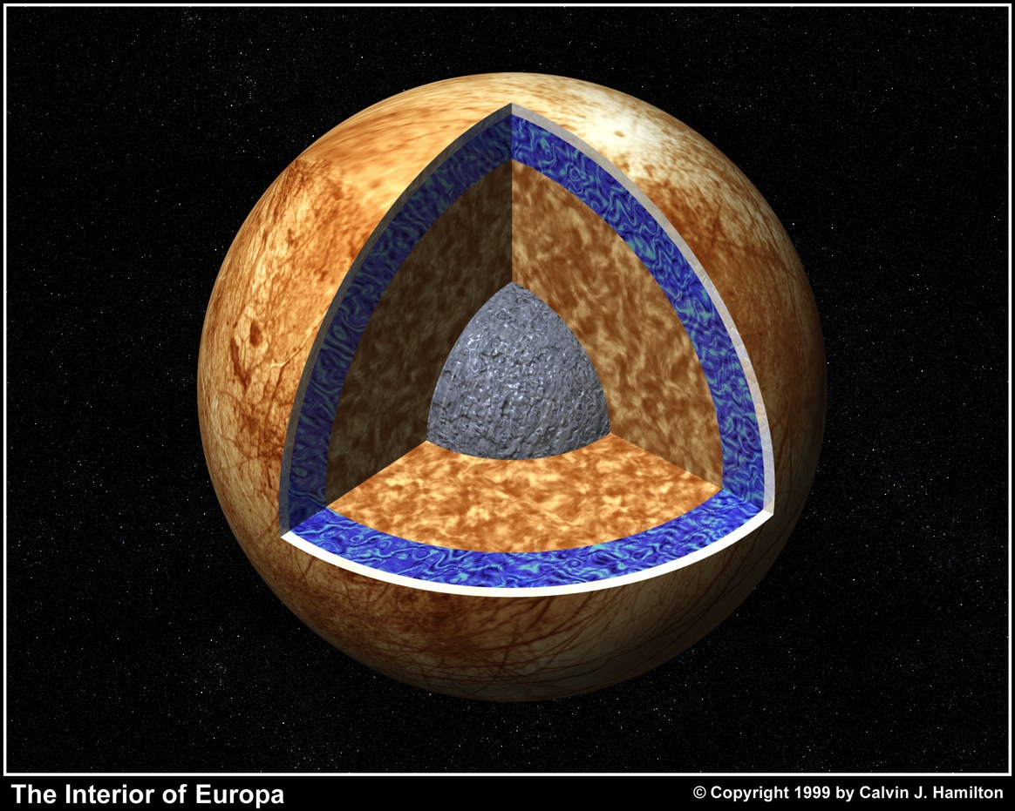
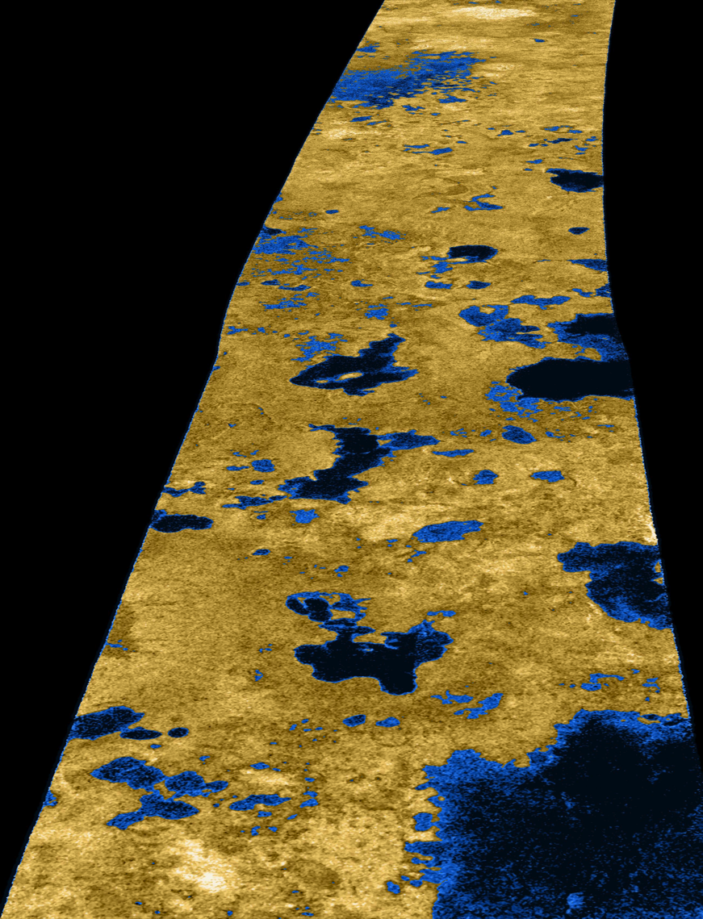
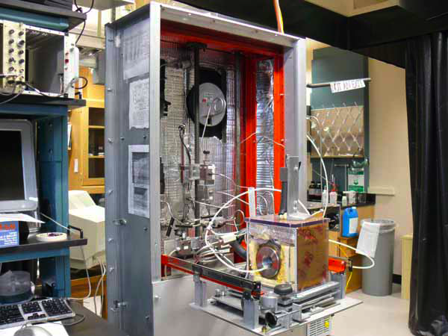
100-200 km deep Ocean
Europa/Titan Simulator
Ethane/methane lakes on Titan possibly connected by subsurface passages
Extra-Terrestrial hydrogeology

Slide 18
Your Responsibilities
Read book and supplementary material
Watch lectures
Ask questions
Complete Cross Word Puzzles (5%)
Complete Video Lessons (5%)
Complete Quizzes(30%)
Do Homework (30%):
  On-line material and instructions
  Ten exercise sets- mostly drawn from Fetter
Take Final Exam (20%)
Turn in Final Report (10%)
About 100 hours of effort for an “average” student for an “average” grade

Slide 19
Module One Outline
Course Overview
What is Hydrogeology?
Brief History
Sustainability Perspective
  Ogallala Aquifer
Hydrologic Cycle
  Quantitative Details and Concepts
Southern Nevada groundwater- what is the science basis for current decisions (and litigation)?
This video

Slide 20
Module One Vocabulary
Surface water / groundwater
Isohyetal lines and Thiessen polygons
Stream Hydrograph
Overland flow, Interflow, Base flow, run off
Meyboom Method for determining groundwater recharge
Infiltration
Vadose zone
Capillary fringe
Zone of saturation
Water Table
Evapotranspiration
Hydrologic equation: Outflow = Inflow +/- Storage
Sustainability of groundwater resources
Science basis for groundwater management
Water mining

Slide 21
Module One Learning Objectives
Master vocabulary
Be able to identify and use appropriate units in calculations
Understand correct usage of “significant figures” in calculations
Be familiar with the historical context of hydrogeology
Understand the “Hydrologic Equation”
Understand the basic components of a water budget including precipitation, infiltration, run-off, evapotranspiration, recharge, discharge, base flow
  Understand that stream flow includes both run off and ground water discharge!!!!
Be able to separate overland flow, interflow, and base flow components from stream hydrographs
Be able to calculate annual recharge and discharge of an aquifer using stream hydrographs
Be able to critically evaluate regional groundwater sustainability issues on the basis of water budget arguments.
Be familiar with several current examples of groundwater sustainability concern

Slide 22
Some Notes on Calculations
Hydrogeology is a quantitative science
  - even if numbers are sometimes guesses

Slide 23
Units are a Nightmare
Hydrology uses mixes of English, USGS, metric (non-SI) and SI units
Additional units creep in from petroleum and engineering
Always pay attention to units
An answer without units is automatically wrong
(if dimensionless you need to say so)

Slide 24
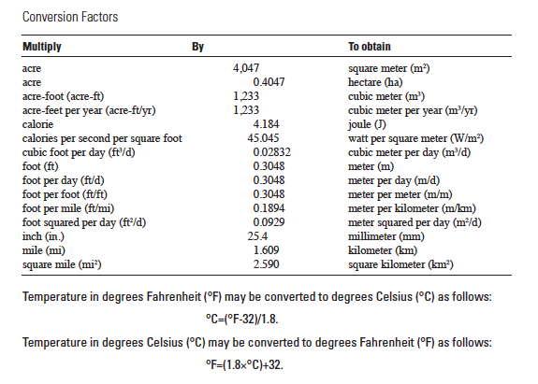

Slide 25
Significant Figures
  You must be aware of significant figures
  An answer has no more significant figures than the least number contained in any input
  An answer never increases in significant figures from units conversions or from use of irrational numbers like π or e
  An answer correctly derived and calculated is wrong if it has inappropriate numbers of significant figures

Slide 26
Significant Figures
3.63491579e3 * 1.1 = 3.9984073e3
= 4.0 e3 (0.2 e3) 1.1 could represent a number between 1.05 and 1.14 Thus, the final answer lies in the +/-5% range. = 4000 (200)
In Excel always use the “format cells” dialog box to reduce significant figures to the correct number

Slide 27
The End: Course Overview
Coming Next: Brief History of Hydrogeology

