Slide 1

ESS 454
Hydrogeology
Module 2
Properties of Materials
Basic Physics
Darcy’s Law
Characteristics of Aquifers
Elasticity and Storage
Instructor: Michael Brown
brown@ess.washington.edu

Slide 2
Module Two Vocabulary
Basic physics (mass, acceleration, specific weight, density, force,
work, energy, pressure, gradients)
Grain size, phi, sorting, uniformity coefficient
Flux, specific discharge, Darcian velocity
Porosity (primary or secondary)
Viscosity
Hydraulic Head: pressure and elevation
piezometer
Permeability (intrinsic), Permeameter
Hydraulic conductivity, Darcy’s Law
Water Table, Potentiometric surface and gradient
Aquifers: confined, unconfined, flowing, artesian, perched
Storativity specific storage, specific retention, specific yield, pendular water
Transmissivity
Compressibility (of water, of aquifer skeleton)
Effective stress
Isotropy and anisotropy

Slide 3
Outline and Learning Objectives
Master new vocabulary
Understand how geologic materials control hydrological properties and how such characteristics and properties are described and determined.
Understand the connection between energy, pressure, and forces acting on groundwater
Be able to use Darcy’s Law to calculate water fluxes and to quantify permeameter properties
Be able to describe and distinguish, and use in quantitative calculations: hydraulic conductivity, permeability, and hydraulic head (total, elevation, pressure)
Understand the basic concepts associated with aquifers and be able to draw geologic cross-sections to illustrate these ideas
Be able to calculate hydraulic gradients based on potentiometric surfaces
Understand the concepts of isotropy and homogeneity and understand the geologic factors that impact these concepts
Understand the concept of aquifer elasticity and specific storage and be able to undertake quantitative analysis of aquifer properties

Slide 4
Porosity
n = V_{void}/V_{total}x100 (%)
  “effective” vs “total”
Close-packed spheres: n=26%
  Independent of size
  Lower n with mixed size grains
Water transport => “well sorted”
Landslide, glacier, volcanic flow => “poorly sorted”

Slide 5
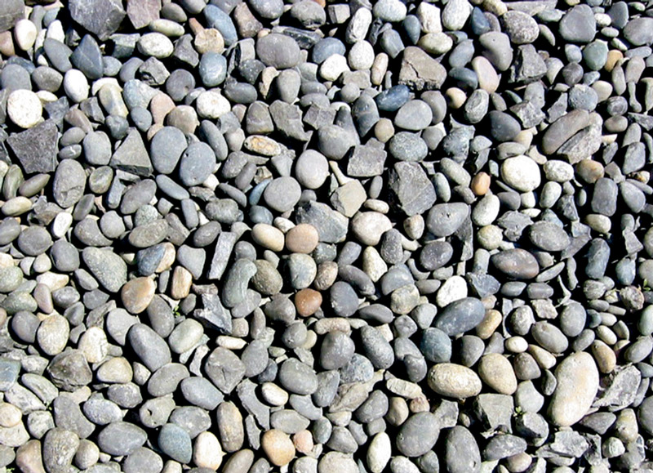
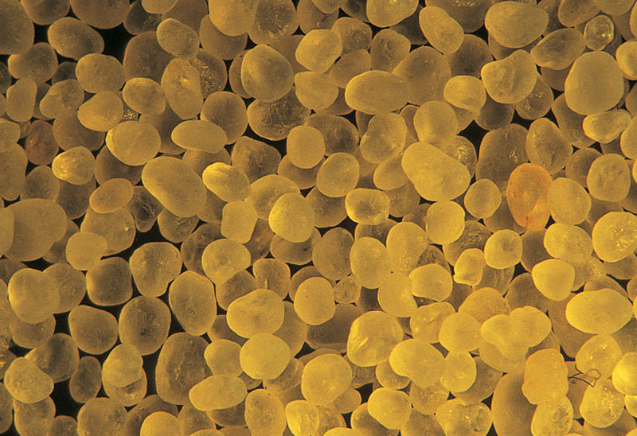
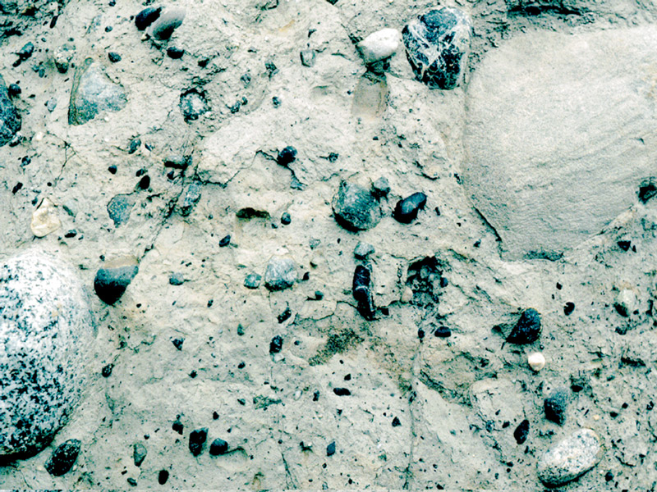
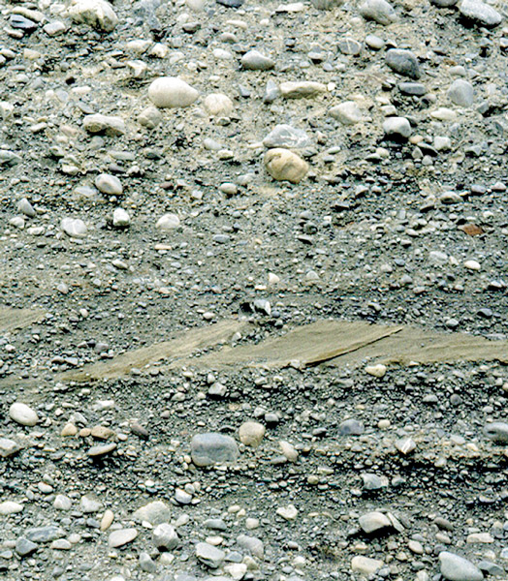

Slide 6
Φ (phi) for grain size
Φ = −log₂(size (mm))
Size (mm) | Φ
1 | 0
2 | -1
1/2 | +1
1/4 | +2
1/8 | +3
1/16 | +4
1/32 | +5
(31 microns)

Slide 7
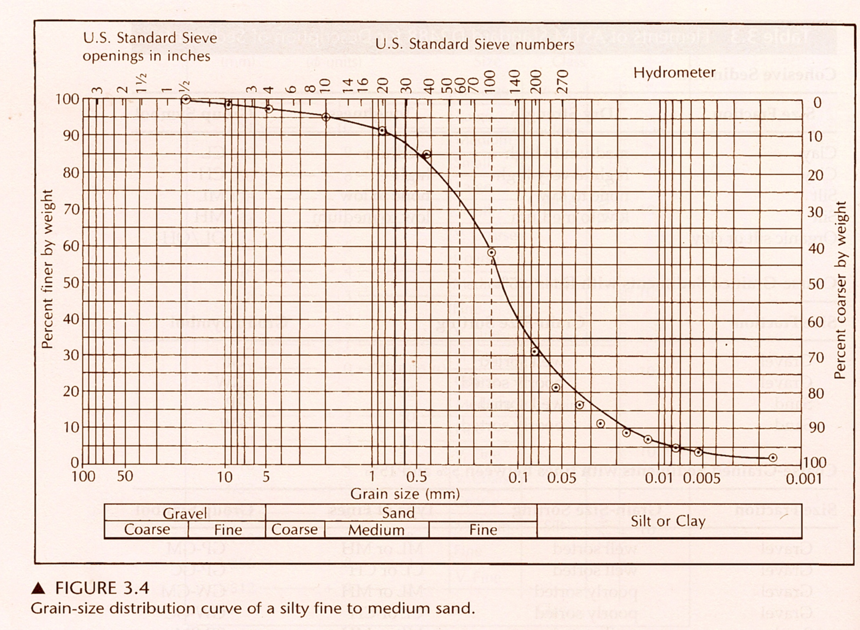
Cumulative Plots
Φ=
-1
0
1
2
4
Uniformity coefficient C_{u}=d₆₀/d₁₀ =0.15/0.018 = 8.3 (poorly sorted)

Slide 8
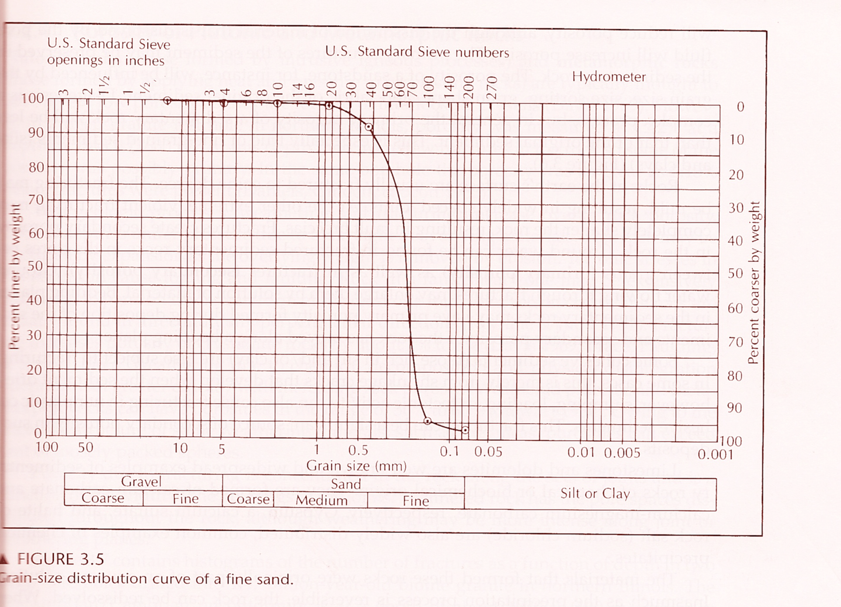
Uniformity coefficient C_{u}=d₆₀/d₁₀ = .21/.15 = 1.4 (well sorted)

Slide 9
Porosity of Geologic Materials
Sediments and Sedimentary rocks 3-30% porosity
  Sands and gravels: high effective porosity
  Silts and clays: high porosity but low “effective porosity”
  “Lithification” reduces porosity (compaction and cementation)
  Special case: Carbonates (limestone)
Igneous/metamorphic porosity is typically <2%
  Cracks and joints typically provide most porosity
“Primary” vs “Secondary” Porosity

Slide 10
Specific Yield (S_{y}) and Retention (S_{r})
The sum of S_{y} and S_{r} is the porosity
  n = S_{y} + S_{r}
S_{y} is the fraction that drains by gravity
Example: Sponge and steel wool; Both are very porous
but water will drain out of steel wool and is retained in sponge

Slide 11
“Pendular water” clings to grain boundaries and does not drain
S_{y} is low for clay/silt and nearly equal to porosity for sands and gravels

Slide 12
The End – Material Properties
Continue with Basic Physics

