Slide 1

ESS 454
Hydrogeology
Module 1
Course Overview,
Hydrogeology History,
Hydrologic Cycle,
Sustainability I & II

Slide 2
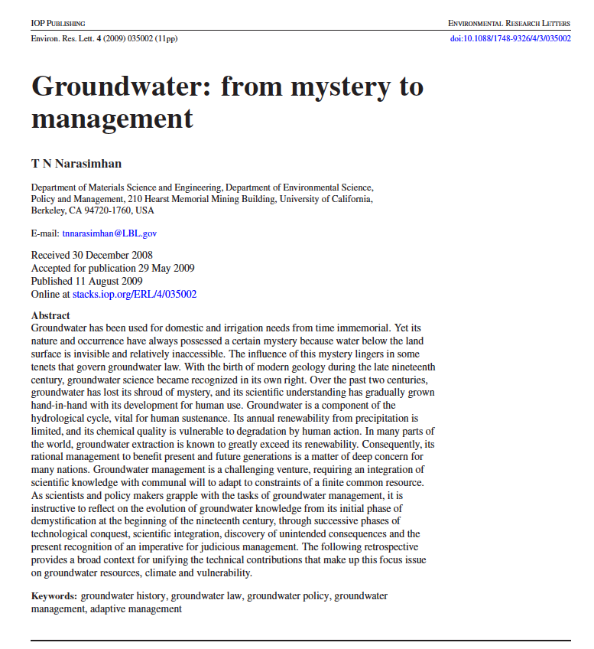
History of Groundwater Science
“As scientists and policy makers grapple with the tasks of groundwater management, it is instructive to reflect on the evolution of groundwater knowledge from its initial phase of demystification at the beginnings of the nineteenth century through successive phases of technological conquest, scientific integration, discovery of unintended consequences, and the present recognition of an imperative for judicious management”

Slide 3
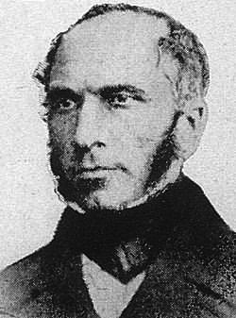
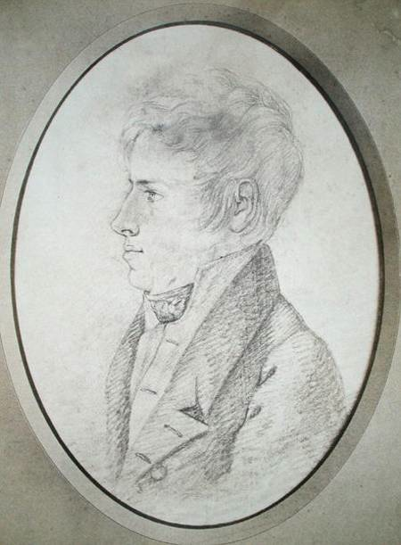
Brief History:
19th Century
French development of drilling in Paris Basin
  Quantitative hydrogeology
    Applications of heat flow theory
    Henri Darcy: gravity-driven flow (1856)
    Jules Dupuit: basin flow and artesian wells (1863)

Slide 4
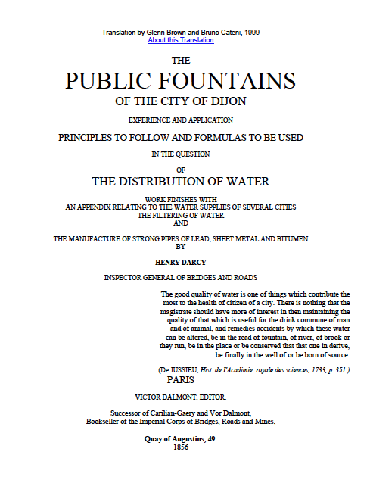
Darcy’s illustration of the “permeameter” he used to discover the relationship between hydraulic head and discharge

Slide 5
19th Century-continued
United States Geologic Survey (USGS) founded 1879
  Serve the Nation by providing reliable scientific information to describe and understand the Earth
    minimize loss of life and property from natural disasters;
    quantify water, biological, energy, and mineral resources
  Carry out studies on a national scale and sustain long-term monitoring and assessment of natural resources and hazards.
  With no regulatory or management mandate, the USGS provides impartial science analysis.

Slide 6
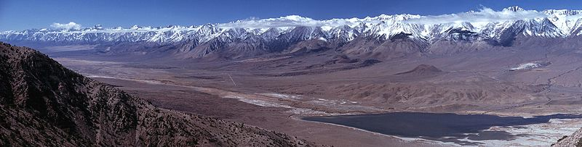
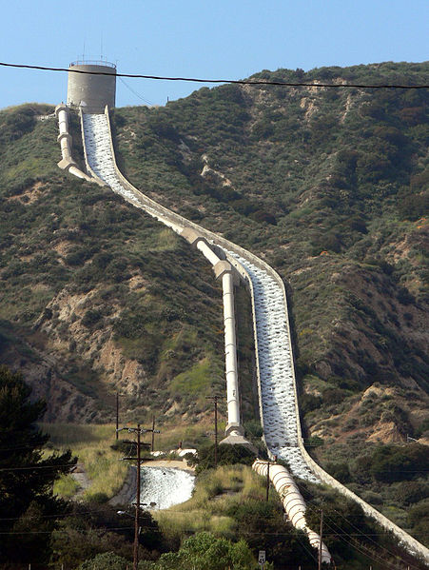
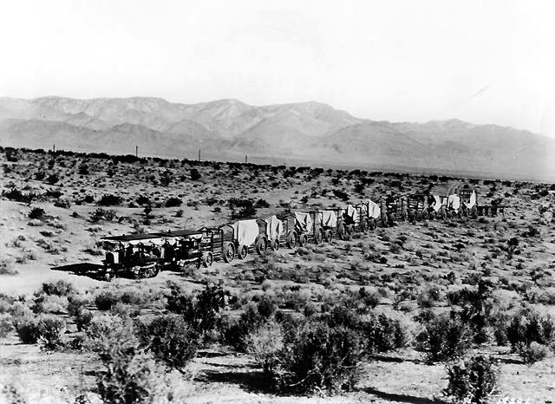
History – Early 20th Century
Water budget analysis of Owen’s Valley to support Los Angeles water development, 1912
Wikipedia: The construction of the Los Angeles Aqueduct effectively ended the development of the Owens Valley as a farming community and devastated the ecosystem of Owen’s Lake. Mulholland and his associates (known as the "San Fernando Syndicate"), including Los Angeles Times publisher Harrison Gray Otis have been criticized for using deceptive tactics to obtain Bureau of Reclamation rights to the Owens River’s flow. Mulholland, his associates and the City of Los Angeles forced out farmers and even used violent tactics to intimidate farmers who refused to sell their land. In retaliation and protest, some Owens Valley residents sabotaged and destroyed portions of the aqueduct. The aqueduct's water was crucial in the development of Los Angeles through WWII.

Slide 7
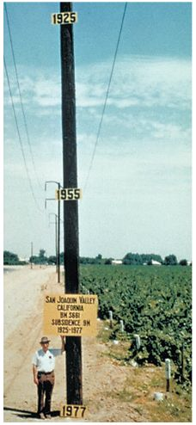
History – Early 20th Century
Aquifer characterization
    Subsidence effects in oil and water wells
      Karl von Terzaghi (1923)
    Elastic storage in aquifers
      O.E. Meinzer (1928)
    Transient (time-dependent) radial flow to wells
      C.V. Theis (1935)

Slide 8
History – Late 20th Century
Analytical models of flow systems
  J. A. Toth (1962)and others
Computer simulation methods (1980’s – present)
  “MODFLOW” (USGS), “FEFLOW”, “MIKE SHE” (Danish Hydrological Institute)
Contaminant hydrology(1970’s – present)
Radioactive Waste Disposal
  Working on “tight” rocks, fracture flow
Geobiologic interactions

Slide 9
Future:
Groundwater Sustainability
Population growth and water demand
Water is a defining resource for modern industrial civilization
  Human consumption
  Irrigation
  Industrial use
  Sanitation
How long can we keep this up?

Slide 10
The End: Brief History of Hydrogeology
Coming Up: Ogallala Sustainability Concerns

