Slide 1

ESS 454
Hydrogeology
Module 4
Flow to Wells
Preliminaries, Radial Flow and Well Function
Non-dimensional Variables, Theis “Type” curve, and Cooper-Jacob Analysis
Aquifer boundaries, Recharge, Thiem equation
Other “Type” curves
Well Testing
Last Comments
Instructor: Michael Brown
brown@ess.washington.edu

Slide 2
Learning Objectives
Understand what is meant by a “non-dimensional” variable
Be able to create the Theis “Type” curve for a confined aquifer
Understand how flow from a confined aquifer to a well changes with time and the effects of changing T or S
Be able to determine T and S given drawdown measurements for a pumped well in a confined aquifer
  Theis “Type” curve matching method
  Cooper-Jacob method

Slide 3
Theis Well Function
Confined Aquifer of infinite extent
Water provided from storage and by flow
  Two aquifer parameters in calculation
  T and S
Choose pumping rate
Calculate Drawdown with time and distance
Forward Problem

Slide 4
Theis Well Function
What if we wanted to know something about the aquifer?
  Transmissivity and Storage?
Measure drawdown as a function of time
Determine what values of T and S are consistent with the observations
Inverse Problem

Slide 5
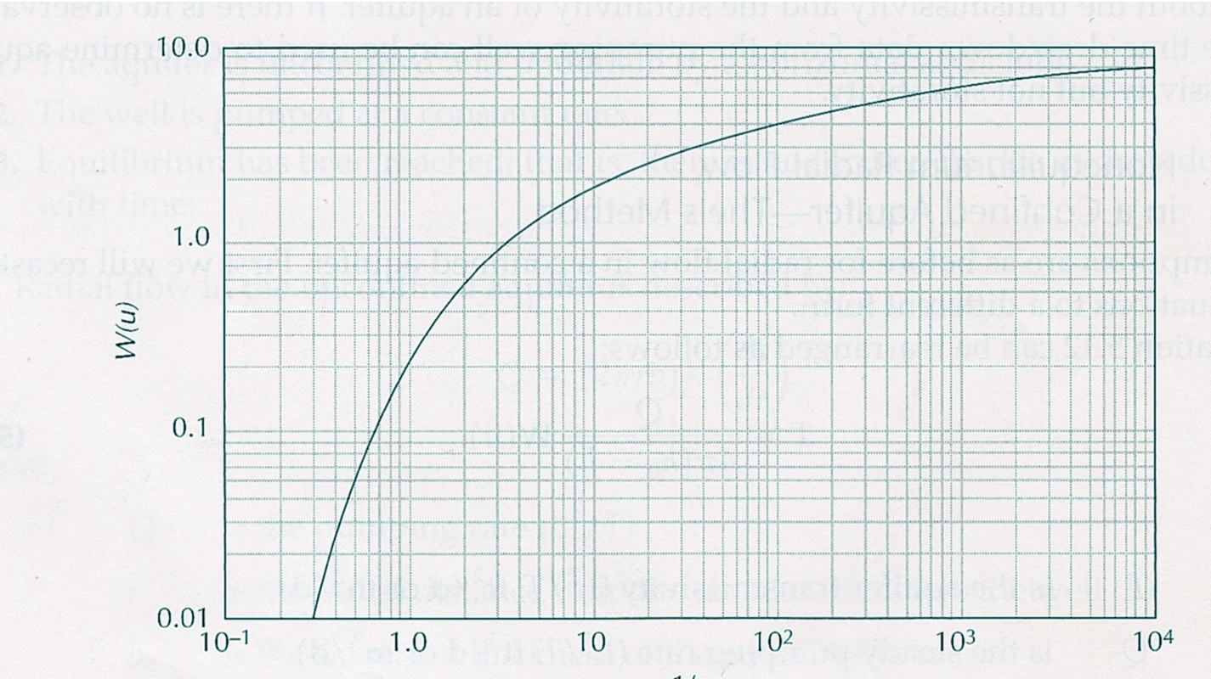
Theis Well Function
u | W
10⁻¹⁰ | 22.45
10⁻⁹ | 20.15
10⁻⁸ | 17.84
10⁻⁷ | 15.54
10⁻⁶ | 13.24
10⁻⁵ | 10.94
10⁻⁴ | 8.63
10⁻³ | 6.33
10⁻² | 4.04
10⁻¹ | 1.82
10⁰ | 0.22
10¹ | <10⁻⁵
Non-dimensional variables
Plot as log-log
3 orders of magnitude
Using 1/u
“Type” Curve
Contains all information about how a well behaves if Theis’s assumptions are correct
5 orders of magnitude
Use this curve to get T and S from actual data
1/u

Slide 6
Theis Well Function
Why use log plots?
Several reasons:
If quantity changes over orders of magnitude, a linear plot may compress important trends
Feature of logs:
log(A*B/C) = log(A)+log(B)-log(C)
Plot of log(A)
is same as plot of log(A*B/C)
with offset log(B)-log(C)
We will determine this offset when “curve matching”
Offset determined by identifying a “match point”
log(A²)=2*log(A)
Slope of linear trend in log plot is equal to the exponent

Slide 7
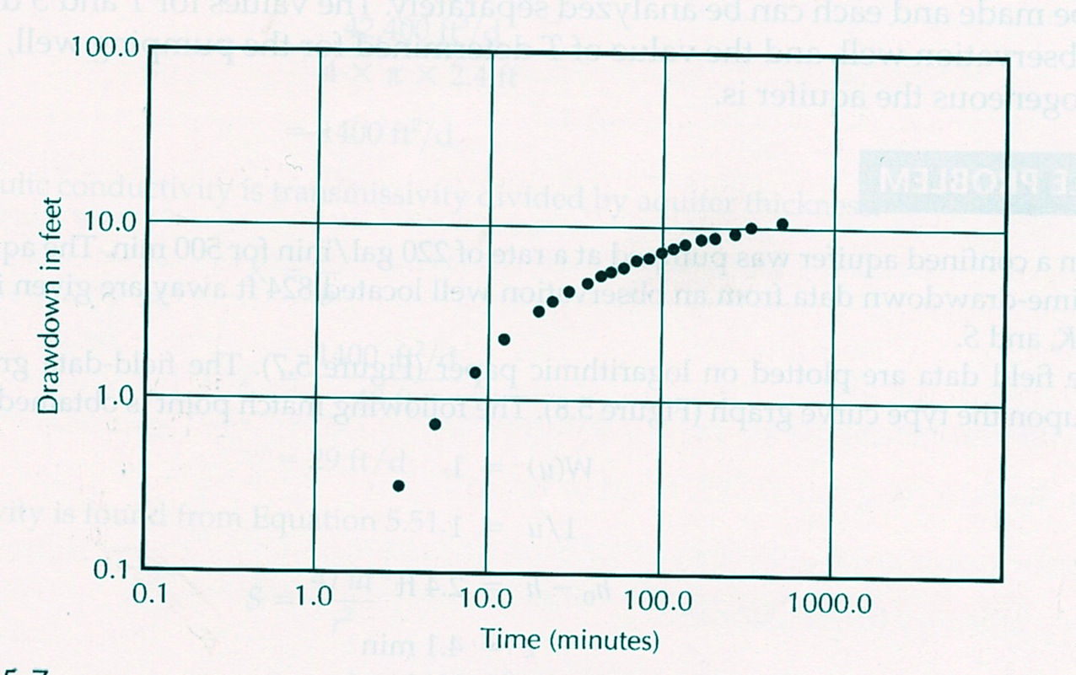
Theis Curve Matching
Plot data on log-log paper with same spacing as the “Type” curve
Slide curve horizontally and vertically until data and curve overlap
Δh=2.4 feet
Match point at u=1 and W=1
time=4.1 minutes

Slide 8
Semilog Plot of “Non-equilibrium” Theis equation
After initial time, drawdown increases with log(time)
Ideas:
At early time water is delivered to well from “elastic storage”
  head does not go down much
  Larger intercept for larger storage
After elastic storage is depleted water has to flow to well
  Head decreases to maintain an adequate hydraulic gradient
  Rate of decrease is inversely proportional to T
2T
Initial non-linear curve then linear with log(time)
T
Linear drawdown
Double T -> slope decreases to half
Log time
Intercept time increases with S
Delivery from
elastic storage
Double S and intercept changes but slope stays the same
Delivery from flow

Slide 9
Cooper-Jacob Method
Theis Well function in series expansion
These terms become negligible as time goes on
If t is large then u is much less than 1. u² , u³, and u⁴ are even smaller.
Theis equation
for large t
Head decreases linearly with log(time)
constant
slope
– slope is inversely proportional to T
Conversion to base 10 log
– constant is proportional to S

Slide 10
Cooper-Jacob Method
Works for “late-time” drawdown data
Solve inverse problem:
Given drawdown vs time data for a well pumped at rate Q, what are the aquifer properties T and S?
Using equations from previous slide
intercept
t_{o}
Calculate T from Q and Δh
Fit line through linear range of data
Need to clearly see “linear” behavior
Line defined by slope and intercept
Not acceptable
Slope =Δh/1
Δh for 1 log unit
Need T, t_{o} and r to calculate S
1 log unit

Slide 11
Summary
Have investigated the well drawdown behavior for an infinite confined aquifer with no recharge
  Non-equilibrium – always decreasing head
  Drawdown vs log(time) plot shows (early time) storage contribution and (late time) flow contribution
Two analysis methods to solve for T and S
  Theis “Type” curve matching for data over any range of time
  Cooper-Jacob analysis if late time data are available
Deviation of drawdown observations from the expected behavior shows a breakdown of the underlying assumptions

Slide 12
Coming up: What happens when the Theis assumptions fail?

