Slide 1

ESS 454
Hydrogeology
Module 1
Course Overview,
Hydrogeology History,
Hydrologic Cycle,
Sustainability I & II

Slide 2
An issue of sustainability
Withdrawal of groundwater faster than it is recharged (groundwater mining) is not sustainable. When the groundwater is gone, what are the alternatives?

Slide 3

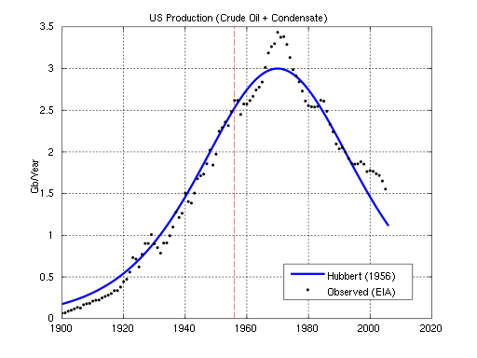
Aspects of our current economic and social thinking which are based on the premise that current rates of growth can be sustained indefinitely must be revised.
M.K. Hubbert 1975
cited in Narasimhan (2009)
Failure to respond promptly
and rationally to these impending
changes could lead to a global
ecological crisis in which
human beings will be the
main victims.

Slide 4
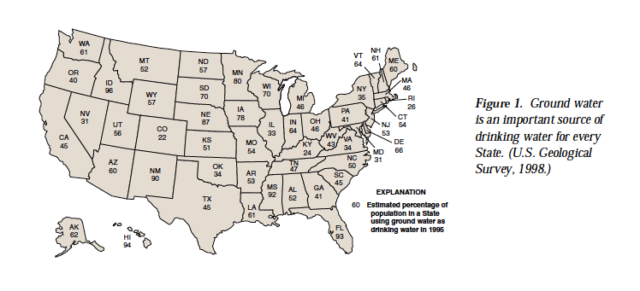
USGS circular 1186

Slide 5
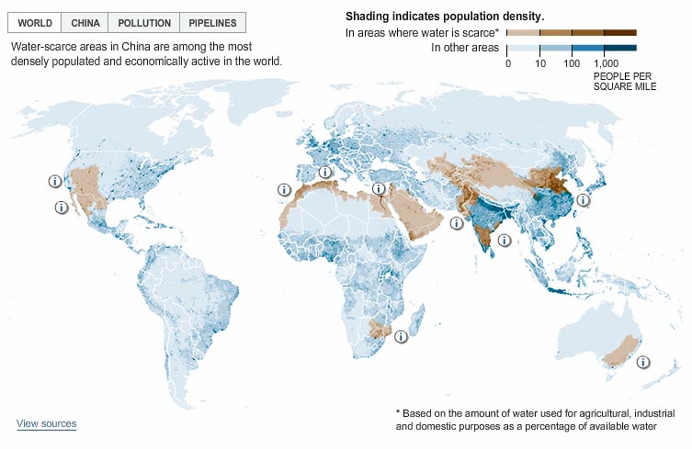
New York Times 2007

Slide 6
New York Times 2007

Slide 7
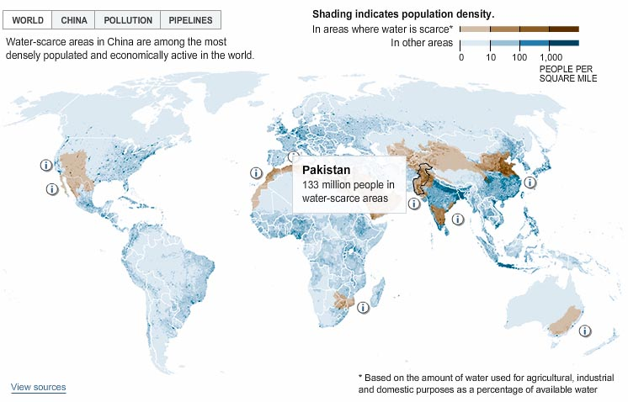
New York Times 2007

Slide 8
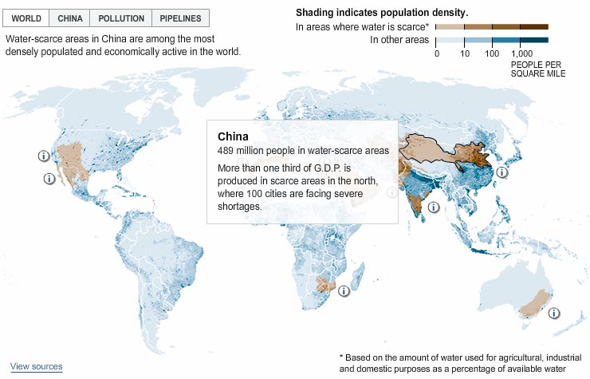
New York Times 2007

Slide 9
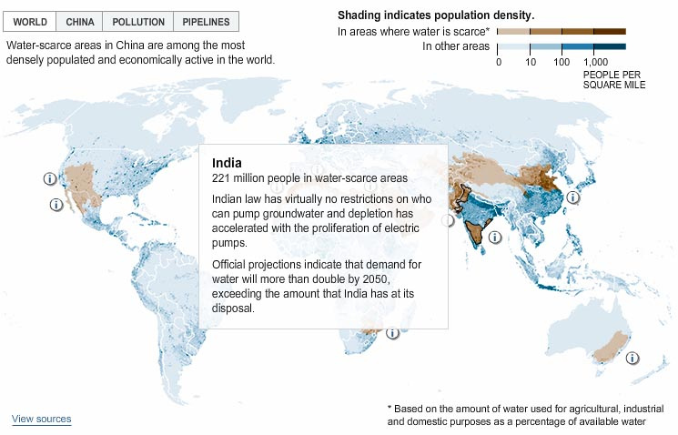
New York Times 2007

Slide 10
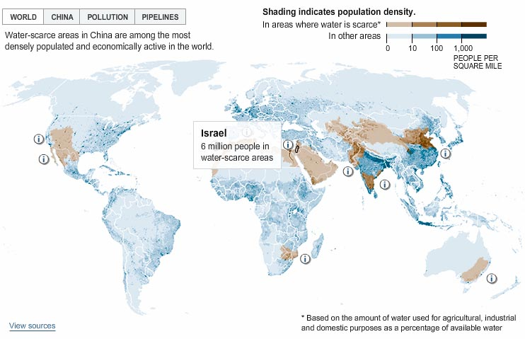
New York Times 2007

Slide 11
Ogallala Aquifer
The leading irrigation area of the Western Hemisphere
450,000 sq. km over eight states
Pliocene sand, silt, gravel, 30-300 m saturated thickness
Total storage equal to Lake Huron

Slide 12
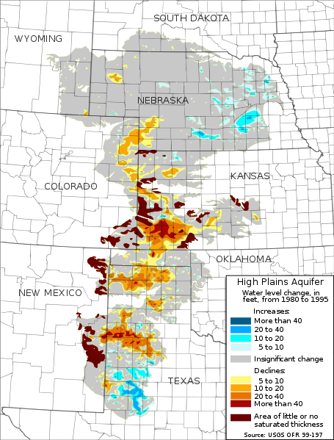
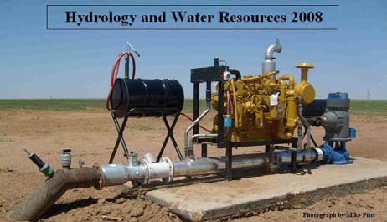
Ogallala Aquifer
http://en.wikipedia.org/wiki/File:Ogallala_changes_1980-1995.svg

Slide 13
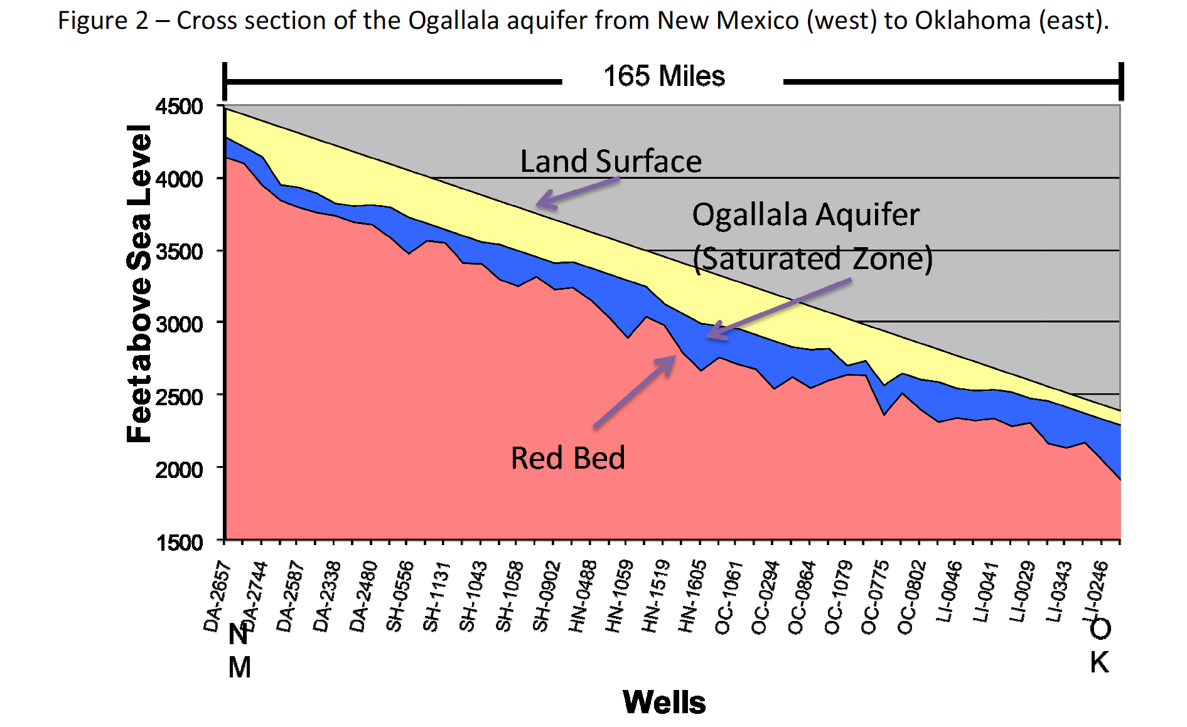
Ogallala Aquifer
From “Proposed Desired Future Conditions for the Ogallala Aquifer” by the Northern Plains Ground Water Conservation District (2008)

Slide 14
Issues of Depletion and
Contamination
Level declines > 30 m since 1940’s
Current “mining” ~ 82 cm/year
Contamination especially from agricultural sources
  Note – lag time of aquifer contamination appearing today from the beginning of chemical agriculture in 50 years ago

Slide 15
Collision between
Rational (science based) Sustainability Goals
2. Policy Tools (laws)
3. Political Realities
  Who will be voted out of office?
  Which laws will be changed?

Slide 16
Panhandle Area Water
Management Goals

Slide 17
In 2060, even with planning goals of reduced usage:
As much as 70% of remaining water will be gone
Remaining water will be harder to pump and will be more contaminated
Agriculture in the heartland of the US will experience significant challenges in your lifetime.

Slide 18
The End: Sustainability I
Coming Up: The Hydrologic Cycle

