Slide 1

ESS 454
Hydrogeology
Module 4
Flow to Wells
Preliminaries, Radial Flow and Well Function
Non-dimensional Variables, Theis “Type” curve, and Cooper-Jacob Analysis
Aquifer boundaries, Recharge, Thiem equation
Other “Type” curves
Well Testing
Last Comments
Instructor: Michael Brown
brown@ess.washington.edu

Slide 2
Learning Objectives
Recognize causes for departure of well drawdown data from the Theis “non-equilibrium” formula
Be able to explain why a pressure head is necessary to recover water from a confined aquifer
Be able to explain how recharge is enhanced by pumping
Be able to qualitatively show how drawdown vs time deviates from Theis curves in the case of leakage, recharge and barrier boundaries
Be able to use diffusion time scaling to estimate the distance to an aquifer boundary
Understand how to use the Thiem equation to determine T for a confined aquifer or K for an unconfined aquifer
Understand what Specific Capacity is and how to determine it.

Slide 3
When Theis Assumptions Fail
Total head becomes equal to the elevation head
  To pump, a confined aquifer must have pressure head
  Cannot pump confined aquifer below elevation head
  Pumping rate has to decrease
Aquifer ends at some distance from well
  Water cannot continue to flow in from farther away
  Drawdown has to increase faster and/or pumping rate has to decrease

Slide 4
When Theis Assumptions Fail
“Negative” pressure does not work to produce water in a confined aquifer
Reduce pressure by “sucking”
straw
No amount of “sucking” will work
Air pressure in unconfined aquifer pushes water up well when pressure is reduced in borehole
cap
If aquifer is confined, and pressure in borehole is zero, no water can move up borehole

Slide 5
When Theis Assumptions Fail
Leakage through confining layer provides recharge
  Decrease in aquifer head causes increase in Δh across aquitard
    Pumping enhances recharge
    When cone of depression is sufficiently large, recharge equals pumping rate
Cone of depression extends out to a fixed head source
  Water flows from source to well

Slide 6
Flow to well in Confined Aquifer with leakage
As cone of depression expands, at some point recharge through the aquitard may balance flow into well
larger area -> more recharge
larger Δh -> more recharge
surface
h_{o}: Initial potentiometric surface
Δh
Aquifer above Aquitard
Increased flow through aquitard
Confined Aquifer

Slide 7
Flow to Well in Confined Aquifer with Recharge Boundary
surface
Lake
h_{o}: Initial potentiometric surface
Gradient from fixed head to well
Confined Aquifer

Slide 8
Flow to Well –Transition to Steady State Behavior
Both leakage and recharge boundary give steady-state behavior after some time interval of pumping, τ
Hydraulic head stabilizes at a constant value
Steady-state
The size of the steady-state cone of depression or the distance to the recharge boundary can be estimated
Non-equilibrium
τ

Slide 9
Steady-State Flow
Thiem Equation – Confined Aquifer
When hydraulic head does not change with time
Darcy’s Law in radial coordinates
surface
Rearrange
h₁
h₂
r₁
r₂
Confined Aquifer
Integrate both sides
Determine T from drawdown at two distances
Result
In Steady-state – no dependence on S

Slide 10
Steady-State Flow
Thiem Equation – Unconfined Aquifer
When hydraulic head does not change with time
Darcy’s Law in radial coordinates
surface
Rearrange
b₁
b₂
r₁
r₂
Integrate both sides
Determine K from drawdown at two distances
Result
In Steady-state – no dependence on S

Slide 11
  Specific Capacity (driller’s term)
1. Pump well for at least several hours – likely not in steady-state
2. Record rate (Q) and maximum drawdown at well head (Δh)
3. Specific Capacity = Q/Δh
This is often approximately equal to the Transmissivity
Why??
??
Specific Capacity

Slide 12
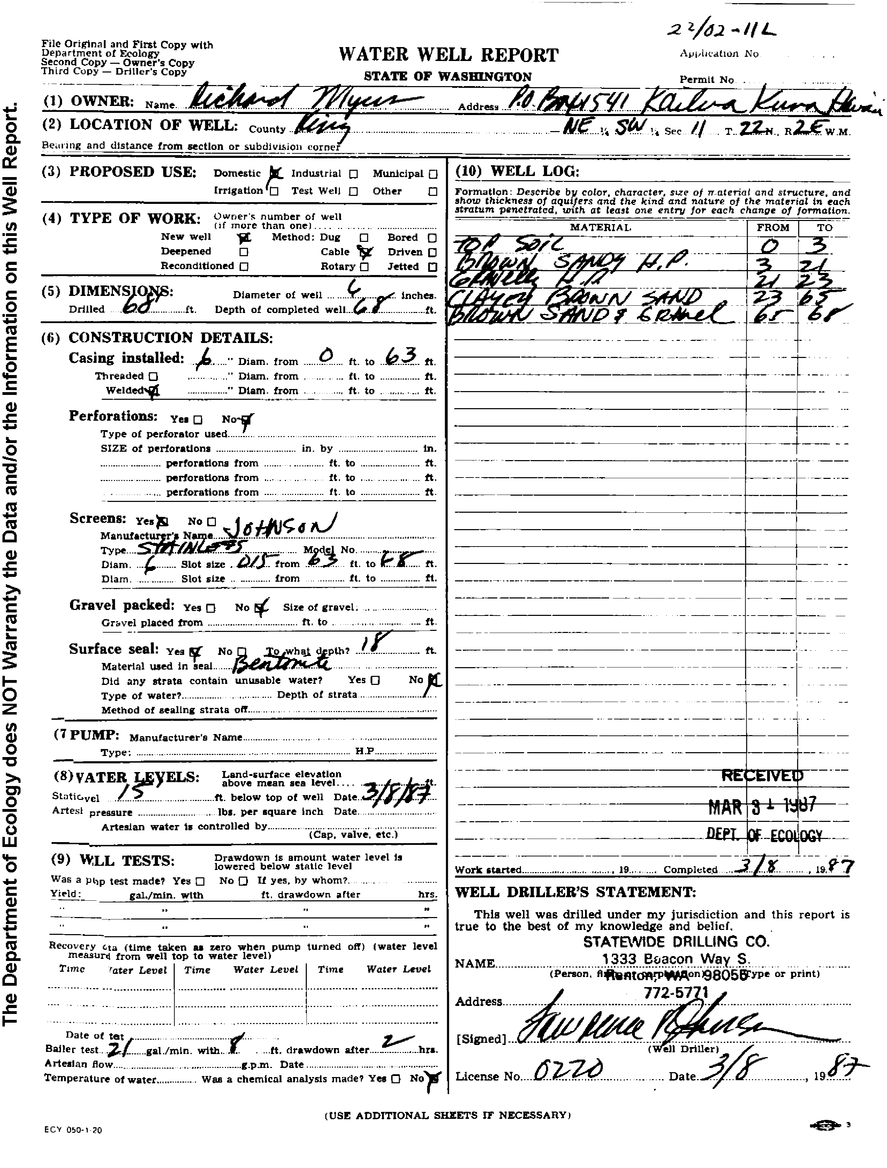
Example: My Well
Driller’s log available online through Washington State Department of Ecology
Typical glaciofluvial geology
Till to 23 ft
Clay-rich sand to 65’
6” bore
Screened for last 5’
Sand and gravel to 68’
Q=21*.134*60*24
= 4.1x10³ ft³/day
Static head is 15’ below surface
Specific capacity of:
=4.1x10³/8=500 ft²/day
Pumped at 21 gallons/minute for 2 hours
K is about 100 ft/day
(typical “good” sand/gravel value)
Drawdown of 8’

Slide 13
The End: Breakdown of Theis assumptions and steady-state behavior
Coming up: Other “Type” curves

