Slide 1

ESS 454
Hydrogeology
Module 2
Properties of Materials
Basic Physics
Darcy’s Law
Characteristics of Aquifers
Elasticity and Storage
Instructor: Michael Brown
brown@ess.washington.edu

Slide 2
Characteristics of Aquifers
Learning Objectives
Water table:
  Define and Illustrate examples of aquifers
  Understand the relationship between flow directions and geometry of the surface
    If flat -> no flow
    Sloping -> flow in down-hill direction
    Discharge at lowest point
Aquifer
  Understand that it is a geologic unit capable of storing and transmitting water to wells
    Know that permeability of aquifer materials is typically > 10⁻² Darcy
Confining layers:
    Understand definitions of aquitards, aquifuge, and leaky confining layer
    Know that permeability of confining layers is typically < 10⁻² Darcy
K>0.5 inches/day

Slide 3
Understand the difference between Unconfined and Confined aquifers
Know what an Artesian aquifer and a Perched aquifer are
  Be able to draw representative cross sections to illustrate
Potentiometric Surfaces
  Know what is meant by a “screened well”
  Be able to illustrate a confined aquifer with a collection of wells screened at a common depth
  Be able to contour Head (elevation of water in each well) to illustrate the “Potentiometric Surface”
  Be able to determine the magnitude and direction of the gradient of the Potentiometric surface and correctly determine the direction of water flow.
Be able to connect aquifer properties (Transmisivity and Storativity) with properties of geologic materials (K, S_{y}, compressibility)
Understand the significance of Homogeneity and Anisotropy

Slide 4
Water Table
Unconfined
Vadose or unsaturated zone
Horizontal water table => no flow
Capillary Fringe
Water Table
Saturated zone
screen

Slide 5
Water Table
Unconfined
Hydraulic gradient = Δh/Δl
Δh
Groundwater flows in direction of decreasing hydraulic head
Δl
Flow Direction

Slide 6
Water Table
flow
Can map hydraulic head
as contour plot
dh/dl
Surface defined by location of water table is the “Potentiometric Surface”
Gradient of hydraulic head is in “uphill” direction

Slide 7
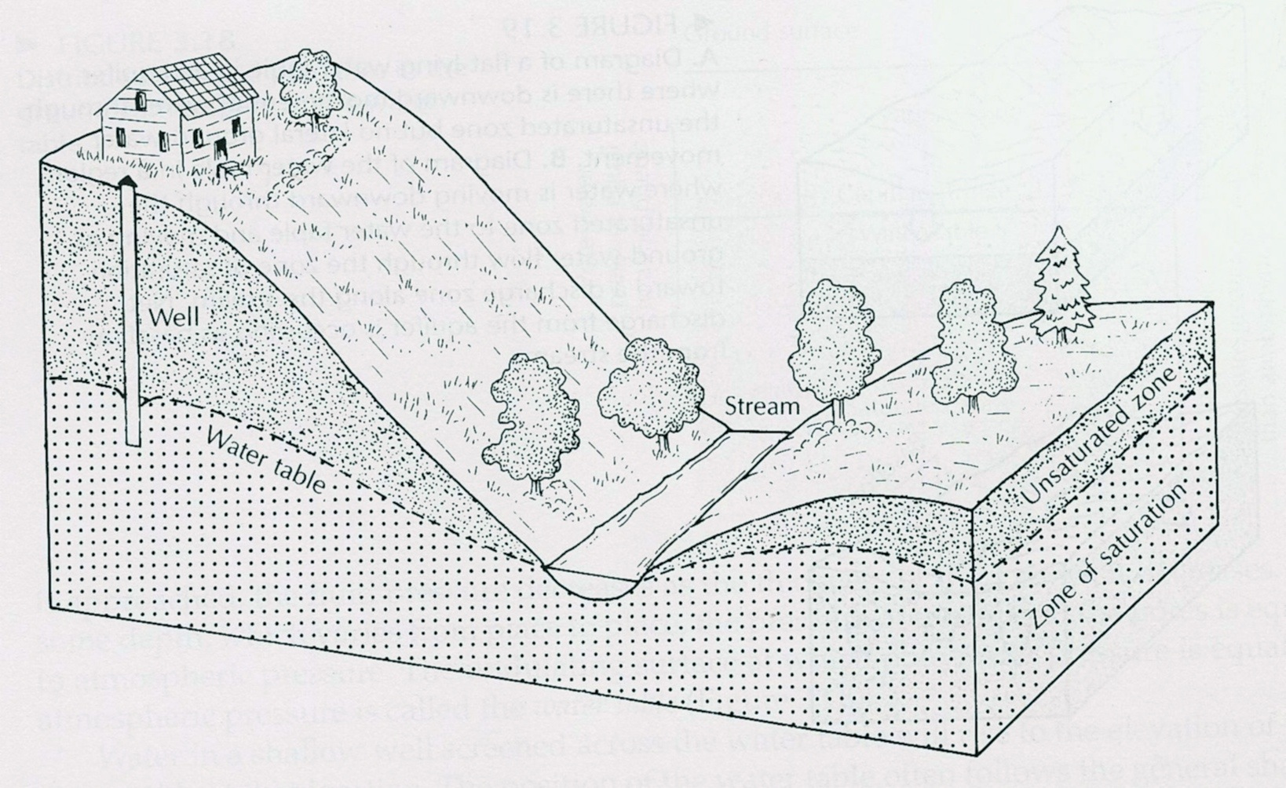
Water Table
Some Humid Climate Generalities
In absence of flow, water table is flat
  Sloping water table implies flow
The water table has the general shape as the surface topography
Groundwater flow is usually from topographic highs to topographic lows
Groundwater discharges at topographic low spots
Recharge by
  Infiltration
  Lateral or vertical flow from other aquifers

Slide 8
Aquifers
“A geologic unit capable of storing and transmitting water to wells”
Typically need permeability > 0.01 Darcy
Hydraulic Conductivity K > 0.5 inches/day
Confined (artesian) aquifer has bounding units with lower hydraulic conductivity
aquitard
aquifuge
Recharge by slow infiltration through “leaky confining layer” or by lateral flow
Hydraulic head is higher than boundary with upper confining layer
Well is “flowing” if hydraulic head is above local surface
Upper confining layer
aquifer
lower confining layer

Slide 9
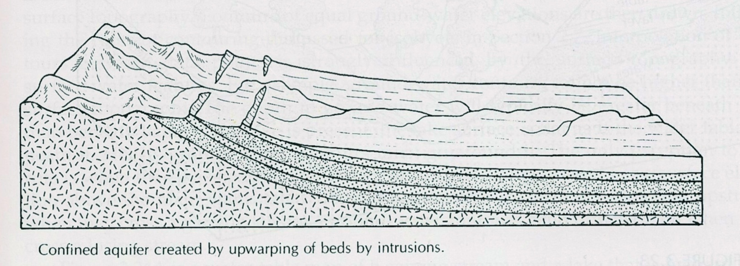
Aquifers
confined
Recharge region
aquifers
confining layers
A variety of geologic situations give rise to layers having different hydraulic conductivities

Slide 10
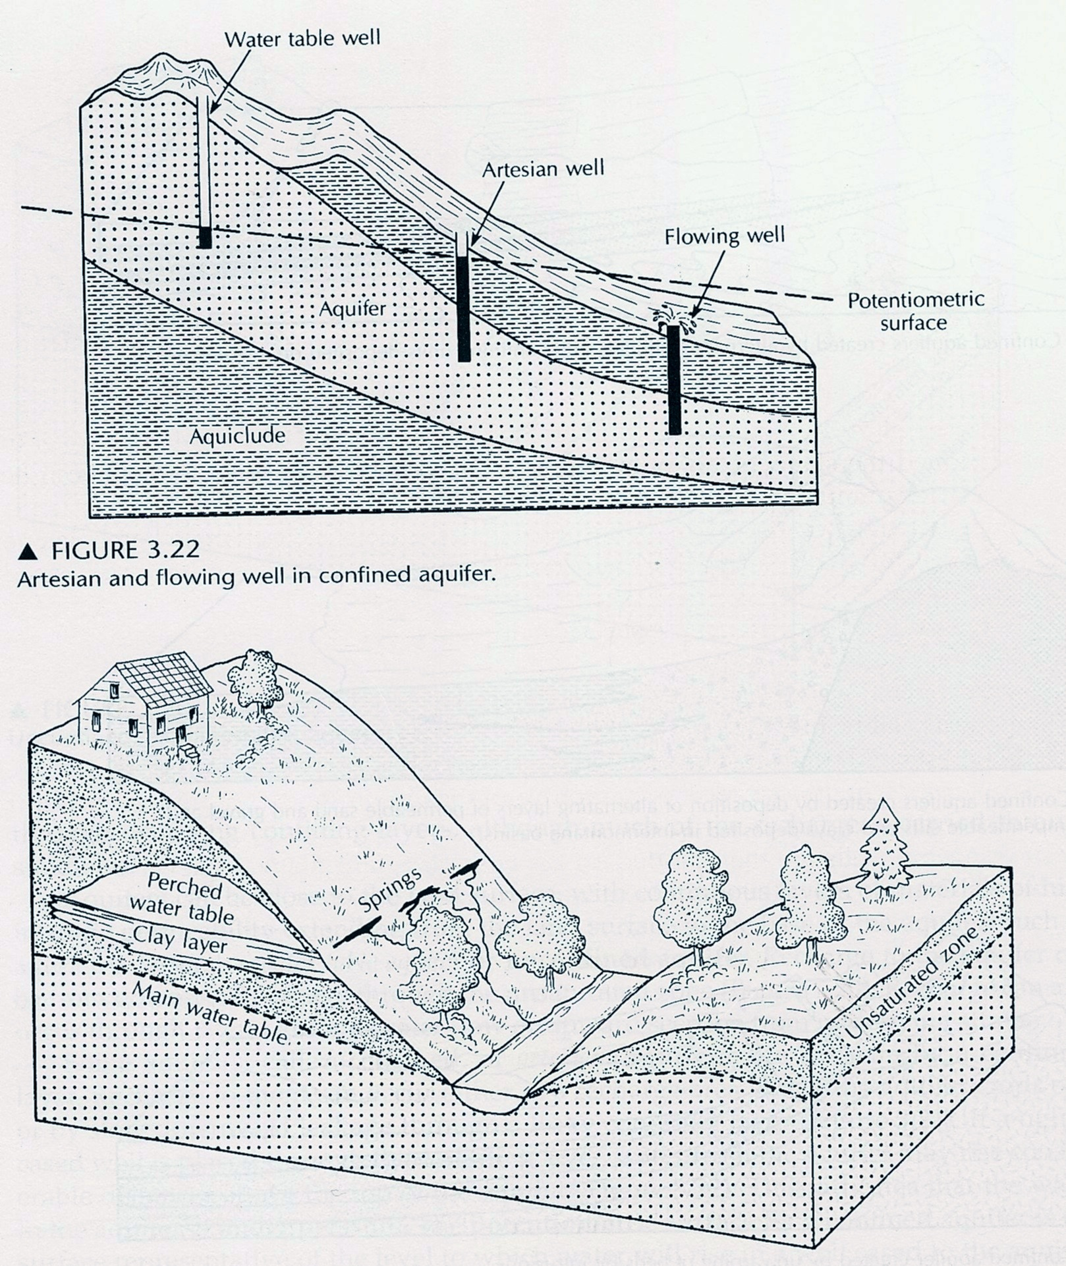
Aquifers
Transition from Unconfined to “artesian” to “flowing” aquifer

Slide 11
Aquifers
“Perched: aquifer and generation of “springs”

Slide 12
Aquifer Characteristics
Remember that geologic materials were characterized by their “hydraulic Conductivity” (K) and their “Specific Yield” (S_{y})
Transmisivity – T
T = b * K
b is aquifer thickness, SI units of m²/s
for horizontal flow T is sum of T’s for all layers
Storativity – S
For a volume of water V_{w} generated from an area “A” for a drop in hydraulic head of Δh
V_{w} = S A Δh
S is dimensionless & <1
volume

Slide 13
Homogeneity and Isotropy
Homogeneous: property is the same in all locations
Isotropic: property is the same when measured in every direction
Aquifers are generally “Inhomogeneous” and “Anisotropic”
Regions of lower K
Joints with higher K
But in Ignorance this is frequently overlooked

Slide 14
Anisotropy
A largest difference in Hydraulic Conductivity may exist between the horizontal and vertical directions
  For horizontal flow: K = sum (K_{hm}b_{m})/b
  For vertical flow: K = b /sum(b_{m}/K_{vm})
K is a “tensor property”
  If K is scalar (isotropic) flow is in direction of head gradient
  If K is tensor (anisotropic), flow is not parallel to gradient
    Flow can be determined from linear algebra
    Will quantitatively develop this idea later

Slide 15
Coming Up:
Specific Storage
Preview of important concepts
Elasticity: water and rock are elastic
  Hooke’s Law: dx/x = α dσ
Effective Stress:
  σ_{T} = σ_{e} + P (total stress is supported by rock and by fluid)
  dσ_{T} = dσ_{e} + dP (if σ_{T} is constant dP = -dσ_{e})
Specific Storage (S_{s}) = ρ_{water}g (α + nβ)
  Units of 1/L
  Storativity S = b S_{s} (dimensionless)

