Slide 1

ESS 454
Hydrogeology
Module 1
Course Overview,
Hydrogeology History,
Hydrologic Cycle,
Sustainability I & II

Slide 2
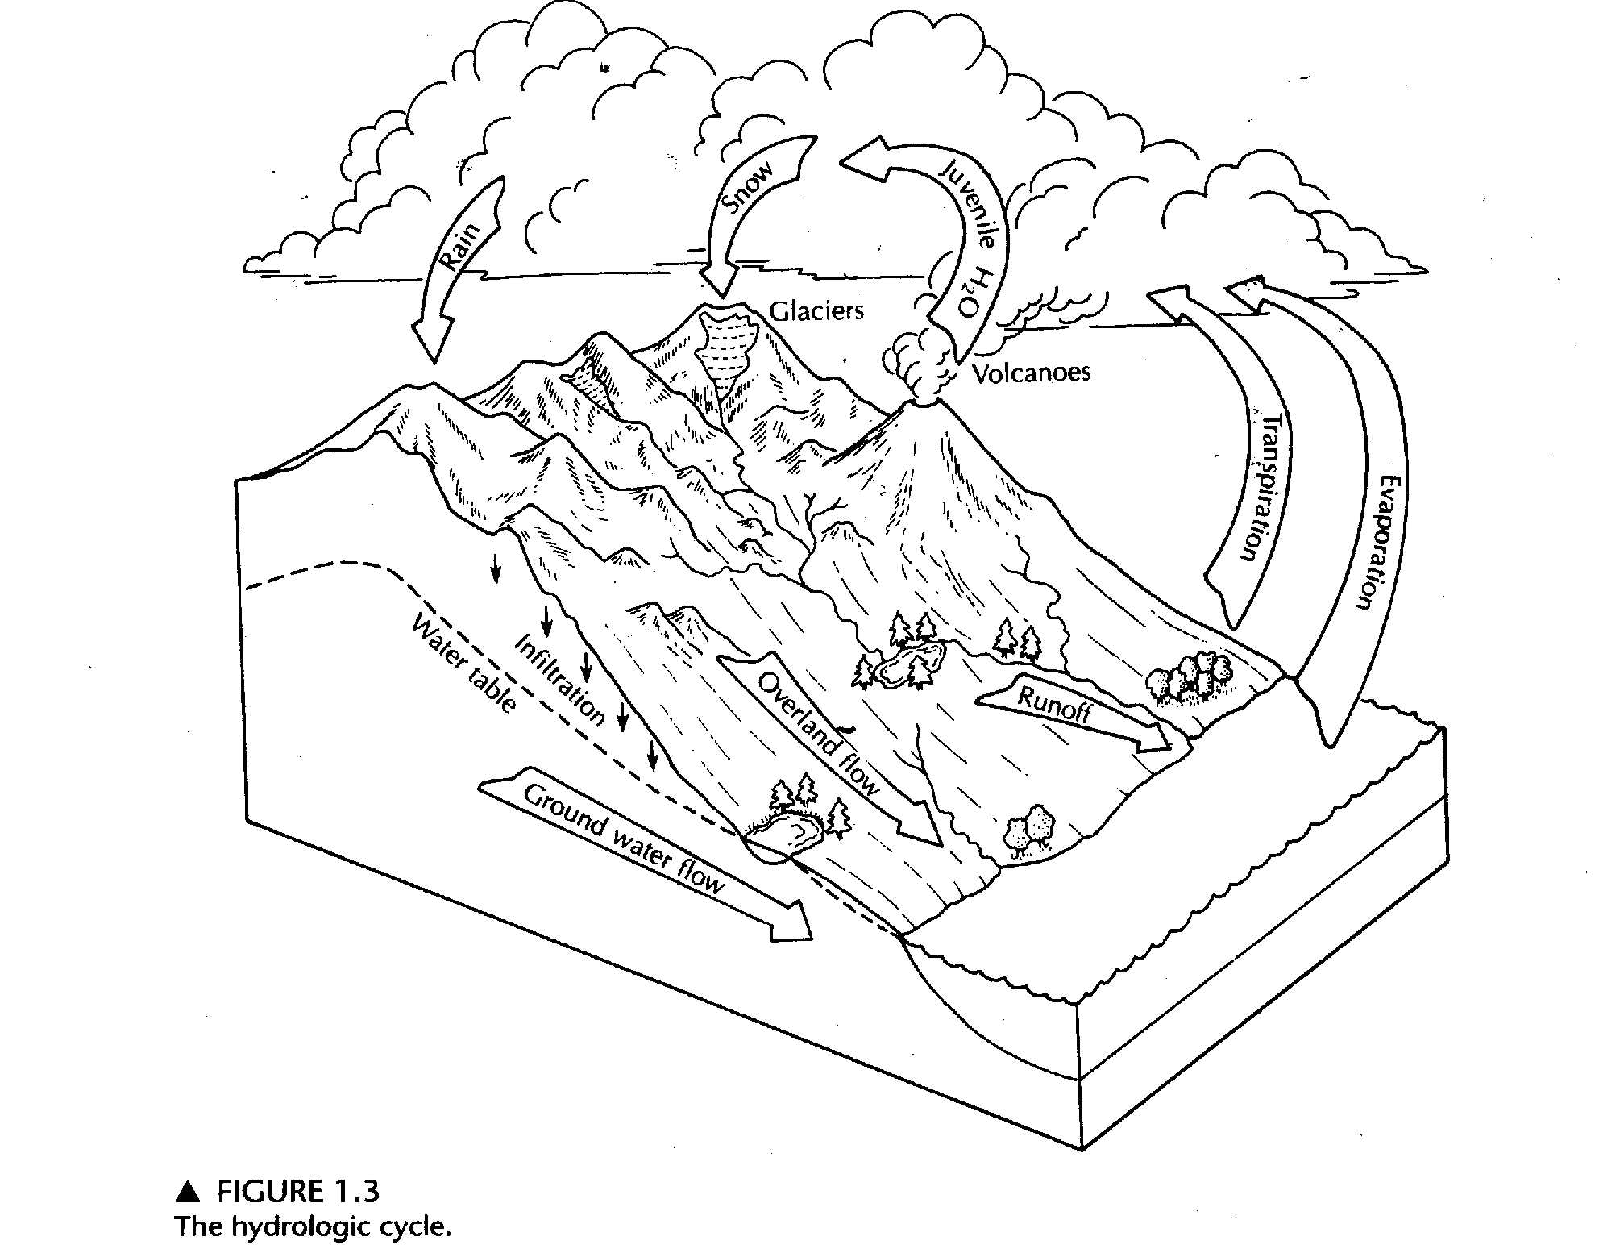
Hydrologic Cycle
Precipitation
  Rain
  Snow
Evapotranspiration
  Direct evaporation
  Transpiration
Infiltration
  Unsaturated or Vadose Zone
  Perched water table
Water Table
  Saturated Zone
  Capillary fringe
  Saltwater wedge
Perched Water

Slide 3
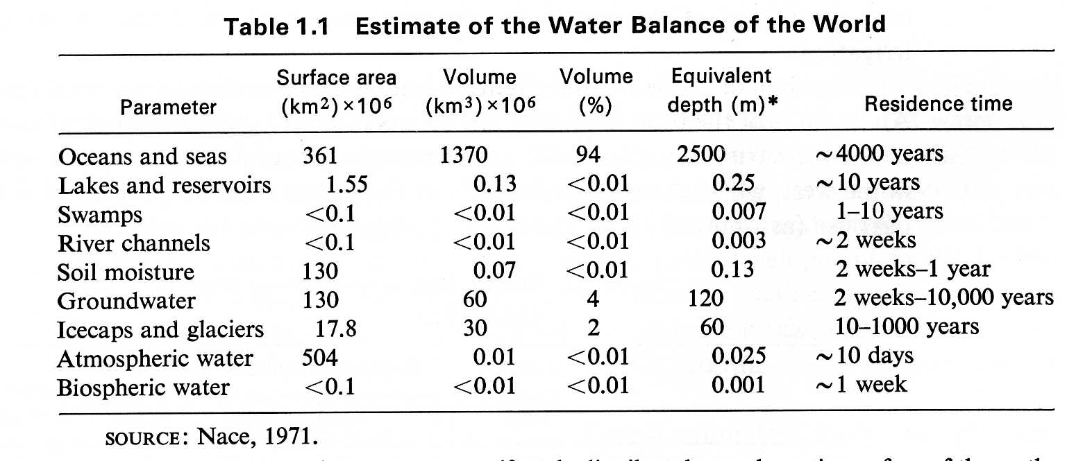
Freeze, R. and J. Cherry, 1979, Groundwater, Prentice Hall, Table 1-2; Nace, R.L., 1971,Scientific framework of world water balance, UNESCO Tech Papers Hydrol, 7, 27 p.

Slide 4
Key Concepts
Precipitation goes to:
  Overland flow/runoff
  Interflow
  Evapotranspiration (direct evaporation and plant exhalations)
  Infiltration – what makes it in the ground (10% rule of thumb)

Slide 5
  Groundwater includes:
  Vadose zone or zone of aeration:
    Partially saturated with water
    Capillary effects interact with gravity
  Capillary Fringe
    Zone of saturation above water table where water is drawn up by capillary suction (negative pore pressure)
  Water Table
    Except for capillary fringe, zone of saturation. Surface where pore pressure is atmospheric
  Perched Water Table
    Zone of saturation above water table where hydraulic conductivity is less than infiltration and water “ponds”

Slide 6
Recharge
  Water entering groundwater system through infiltration
  or from surface water
Discharge
  Water leaving groundwater system usually to surface
  water or other flow system boundaries
Storage
  Water in the the groundwater system

Slide 7
The Hydrologic Equation
(Conservation of Mass)
(Water Budget)
Outflow = Inflow ± Changes in Storage
  Applicable to surface features like lakes
  Applicable to rivers
  Applicable to aquifers
  Applicable to basins

Slide 8
The Water Budget:
Continental US Average
30 inches of rain
22 inches evaporate or transpiration
8 inches flow to ocean in rivers
What about groundwater??
(70x more than SW)

Slide 9
30 inches of precipitation
Use “rule of thumb” : 3 inches of infiltation to groundwater
Groundwater Outflow = Inflow ± Changes in Storage
= 3 inches ± Changes in Storage
8 inches of flow to ocean comes from 5 inches of runoff and 3 inches of discharge from aquifers
If Storage is constant, then Outflow is 3 inches

Slide 10
Focus on Details of:
Evaporation and transpiration
Determination of groundwater recharge from streams

Slide 11
Evaporation
Thermodynamics:
  Energy input required to move molecules of H₂O from liquid to vapor phase (590 cal/gm)
  In equilibrium, air has a maximum amount of H₂O vapor – the “saturation humidity”
    Amount is temperature dependent
      T up -> Saturation humidity up
Terms:
  absolute humidity
    mass of water in volume of air (gm/cc)
  relative humidity
    ratio of absolute to saturation humidity (dimensionless)
  Dew point
    temperature at which air is saturated (relative humidity = 100%)

Slide 12
Driving terms for evaporation
Free-water surfaces, Temperature, relative Humidity
Energy
  from sun
    flux of about 1 KW/m² at noon
    Energy unit Langley: cal/cm² or 41.8 kJ/m²
      500 Ly -> 6 KWH/m²
Wind
  replace saturated air near surface with less saturated air
  Disturb water surface to enhance rates of molecular diffusion

Slide 13
Need to Quantify
Even with “accurate” measurement – unlikely that this is better than 10% proposition

Slide 14
Land Pans
450 in US
4 feet by 10” unpainted galvanized metal, on supports with air flow all around
Daily record of how much water added to maintain level
  Separate rain gauge to measure precipitation
Measure wind movement in miles/day
Multiply by “pan coefficient” to estimate free water evaporation

Slide 15
Evaporation Calculation using a “Nomograph”
Given:
  Mean temperature: 76°F
  Insolation: 500 Ly
  Mean Dewpoint: 50°F
  Wind Movement: 200 mi/day
Calculate:
  amount of evaporation from a standing body of water

Slide 16
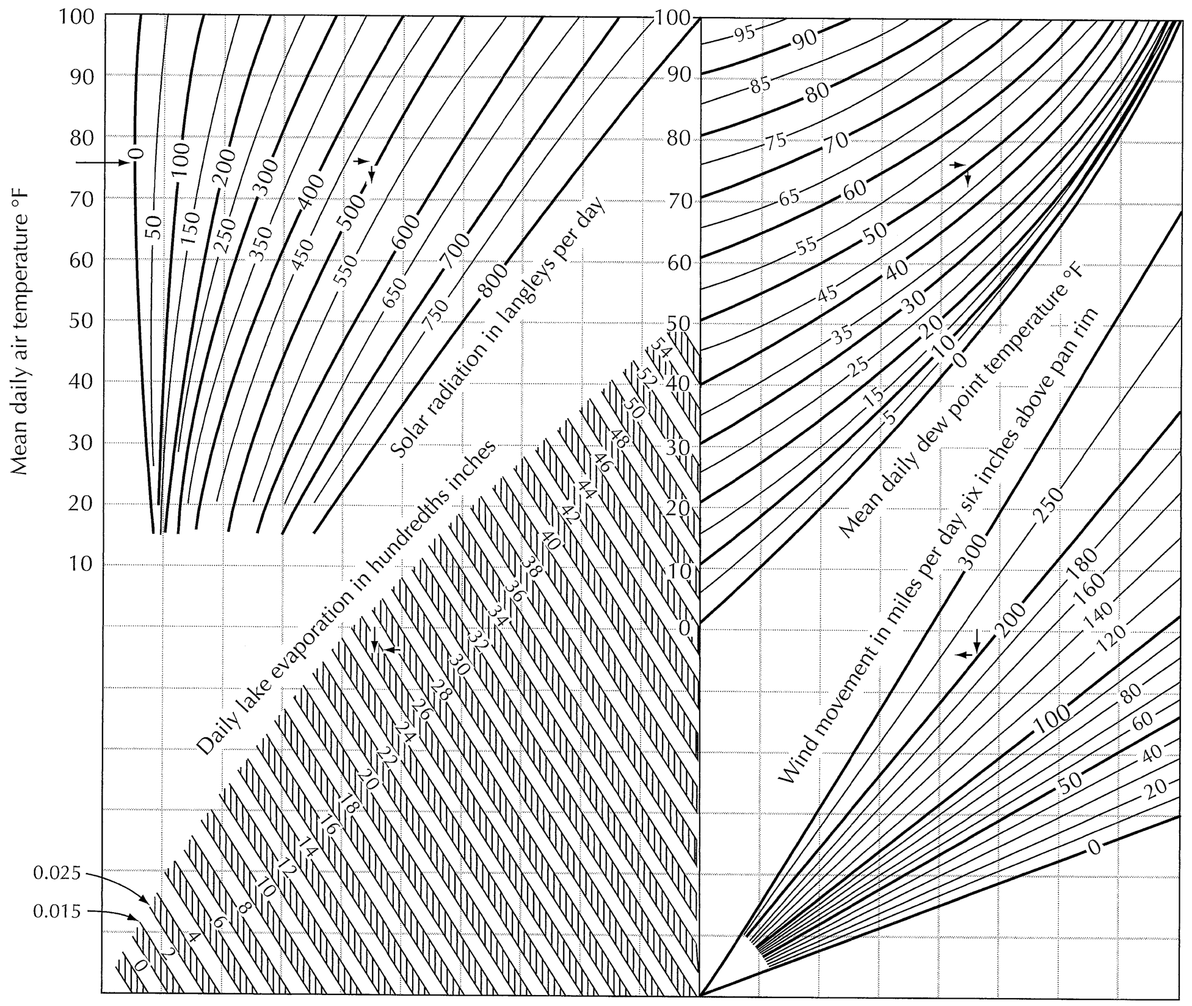
0.25” of
evaporation

Slide 17
Transpiration
Plants pump water into air
  Variable with season and time of day
  Limited by available soil water (& root depth)
    Wilting point
Possible to measure under lab conditions
  But not easy in the field.

Slide 18
Evapotranspiration
Combination of two = ET
  More amenable to practical study
“Potential” vs “Actual”
  “Thornthwaite” method for “Potential ET”
    Relies on meterological conditions only
Energy Balance method
  solar radiation, energy output from ground, loss of heat to atmosphere, heats of vaporization, etc
Lysimeter
  Large container of soil and plants ET
    measure inputs to determine

Slide 19
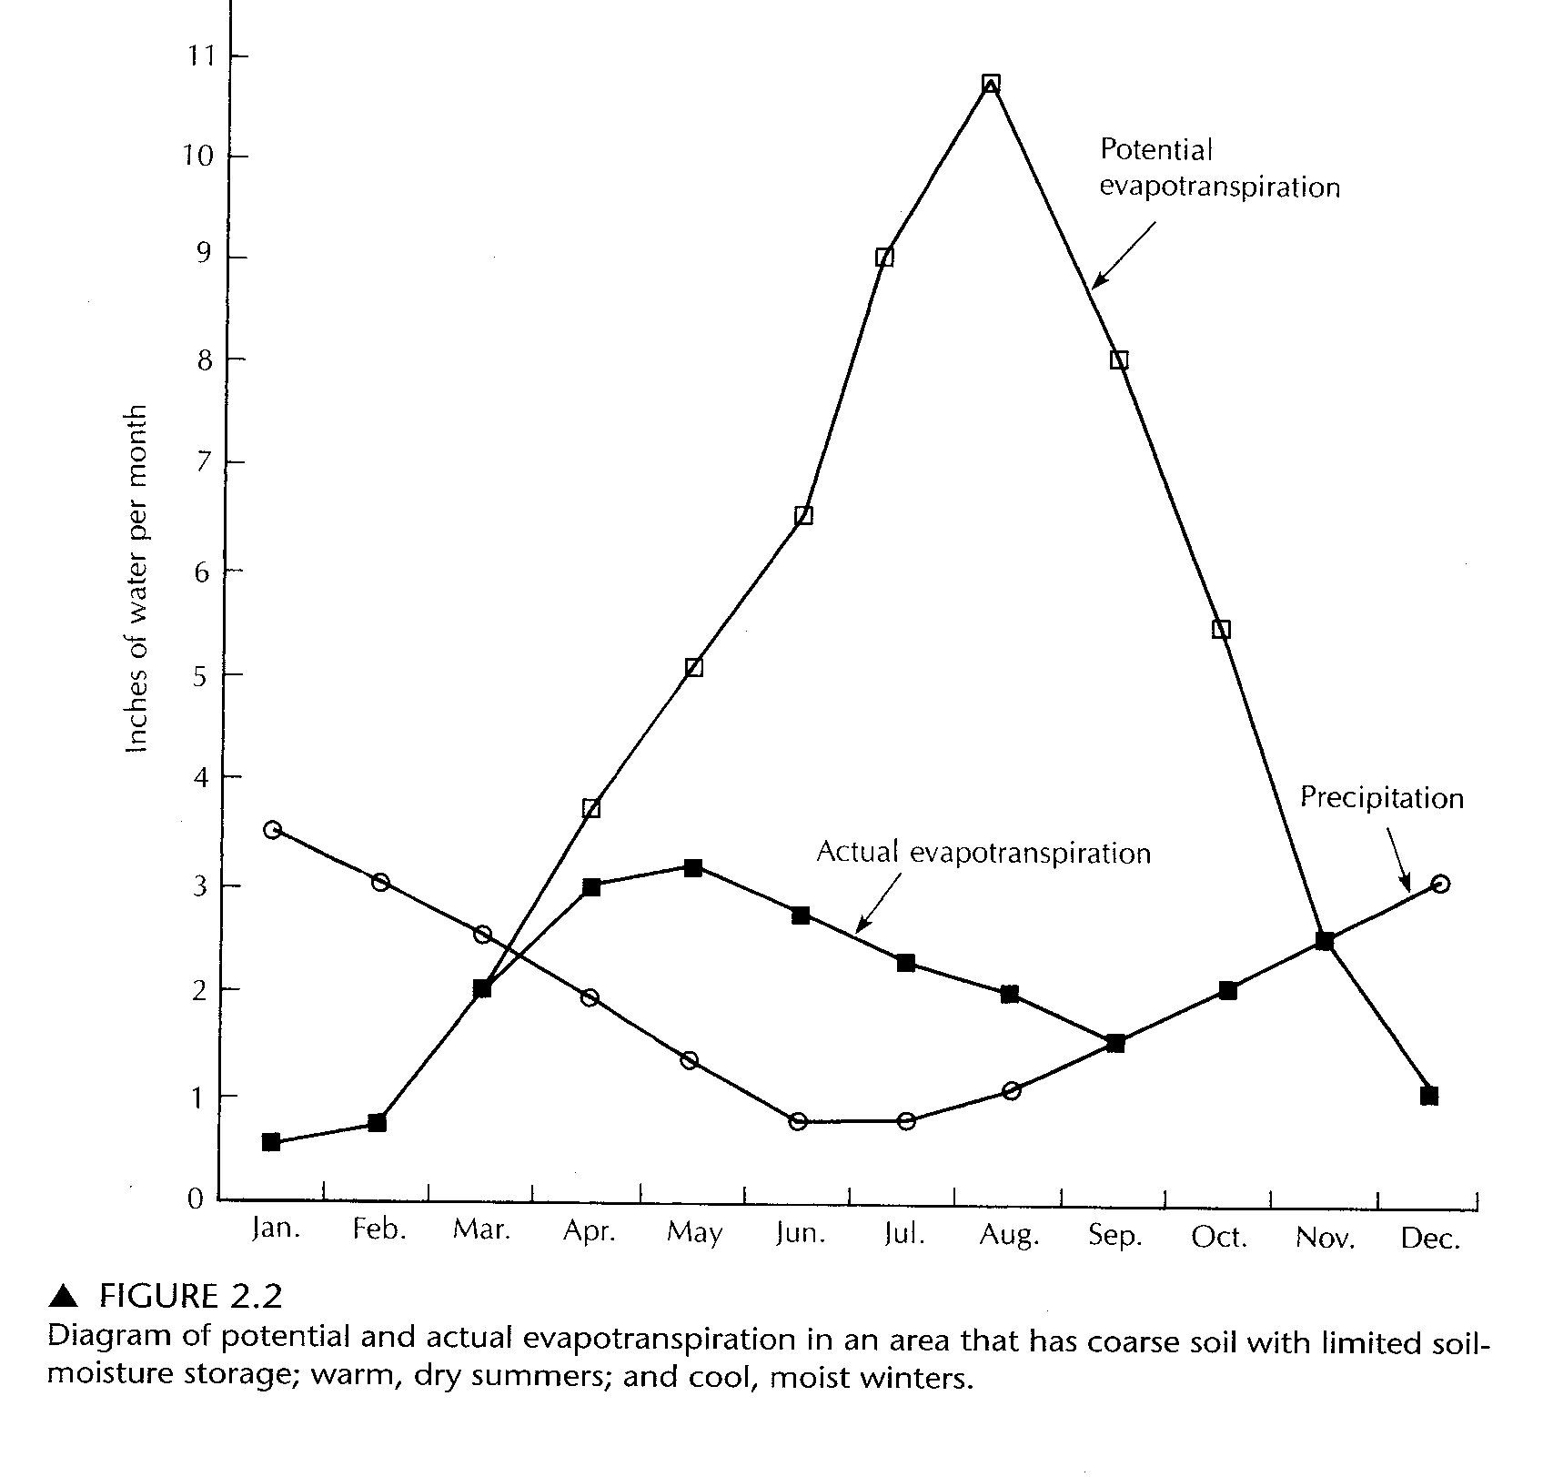
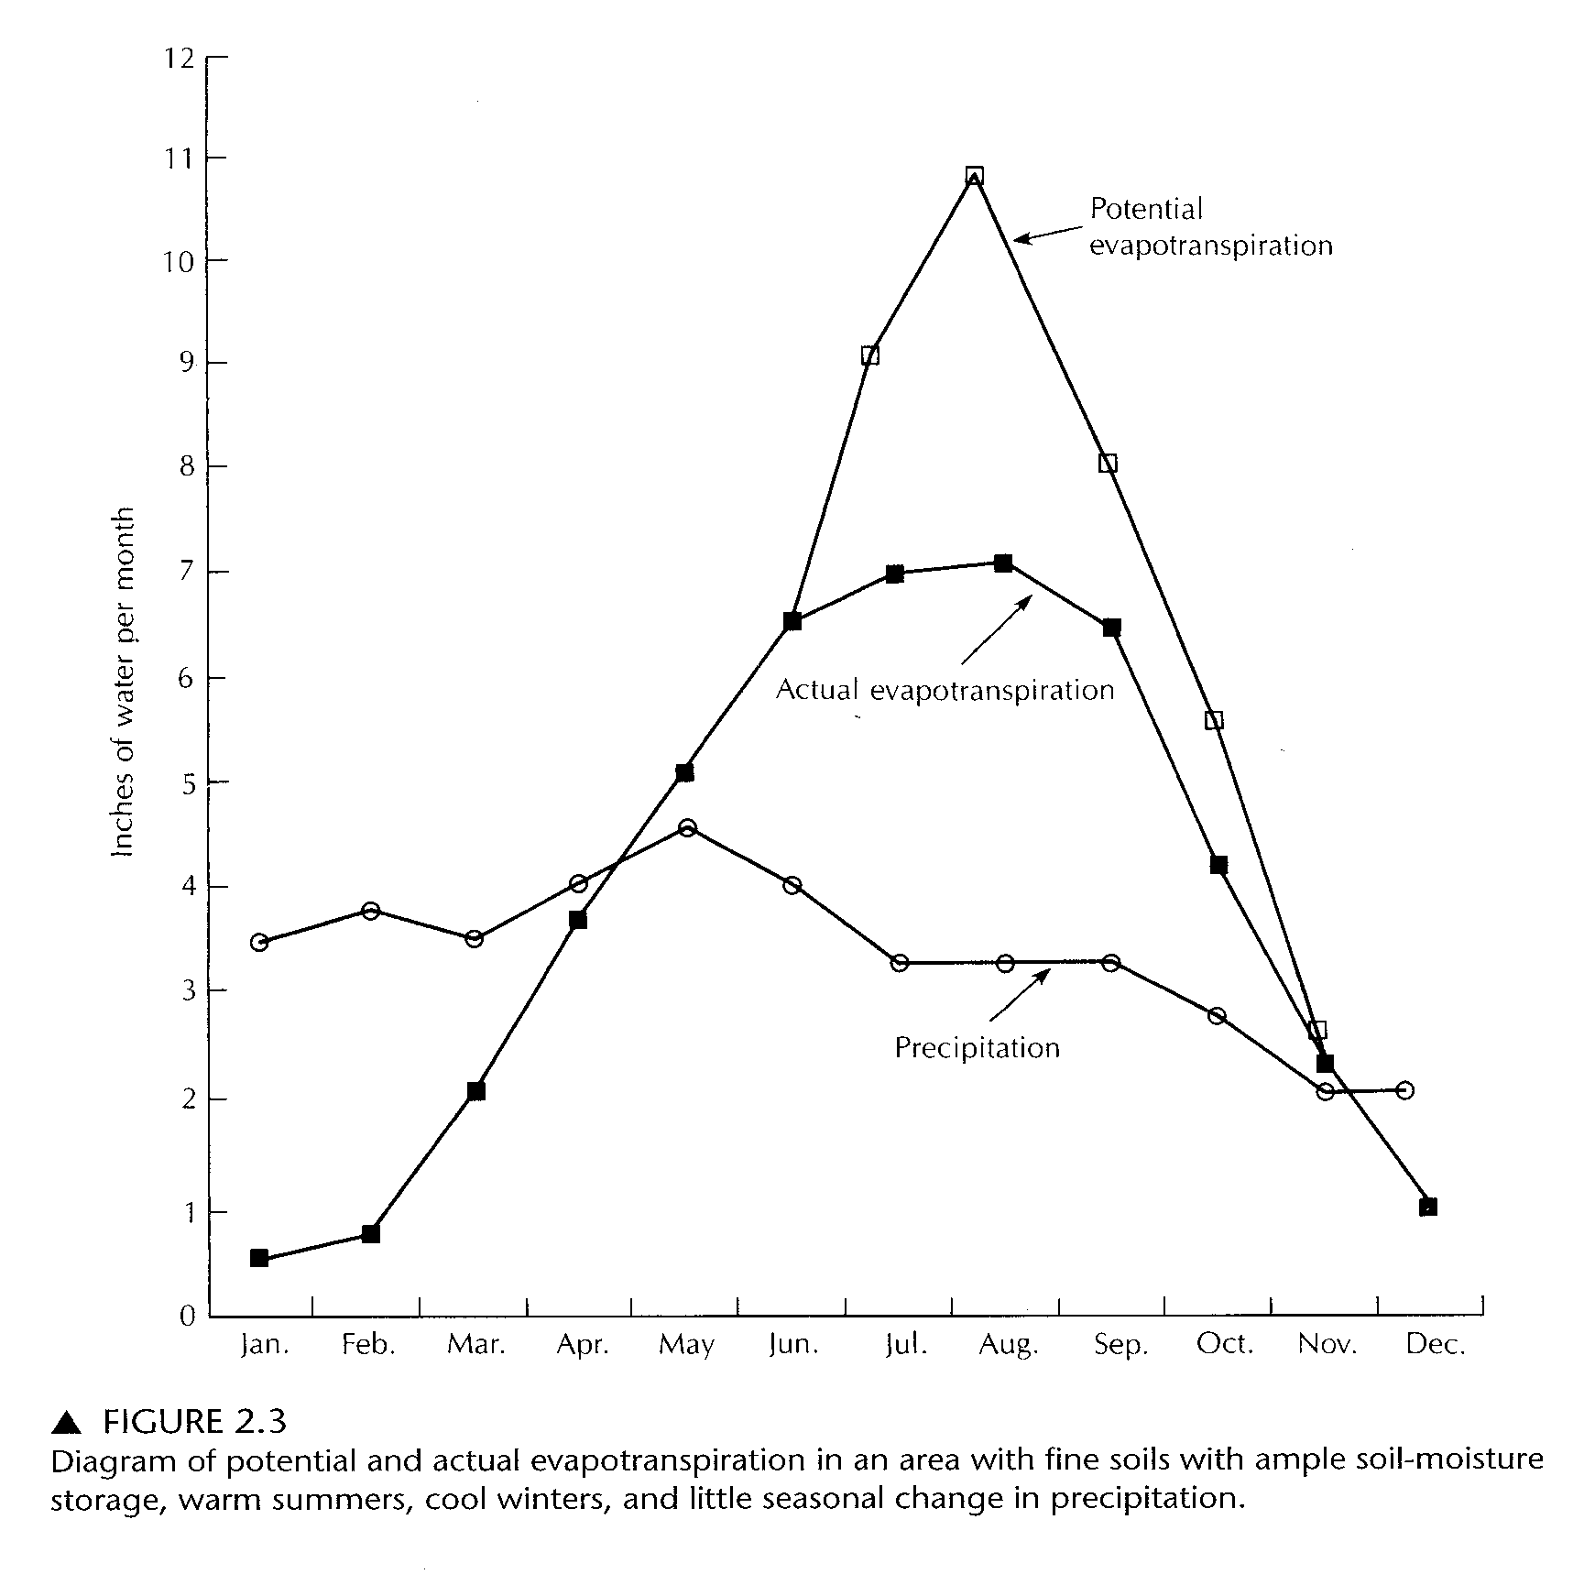

Slide 20
General Trends
(relating to local conditions)
ET is the dominant use of water in all but most humid locals
Runoff is larger after logging
  less ET
Transition of chaparral to grass in AZ –> less ET,
  Grass not as deeply rooted
Transition of sagebrush to grass in CO –> unchanged ET
    But more grazing decreased ET
Transition of farm to forest (decreased stream flow -> more ET)
More ET in conifer forest than in deciduous forest
Increased ET in urban areas
  less runoff in dry periods
  Although more pavement etc, patterns of planting increase ET

Slide 21
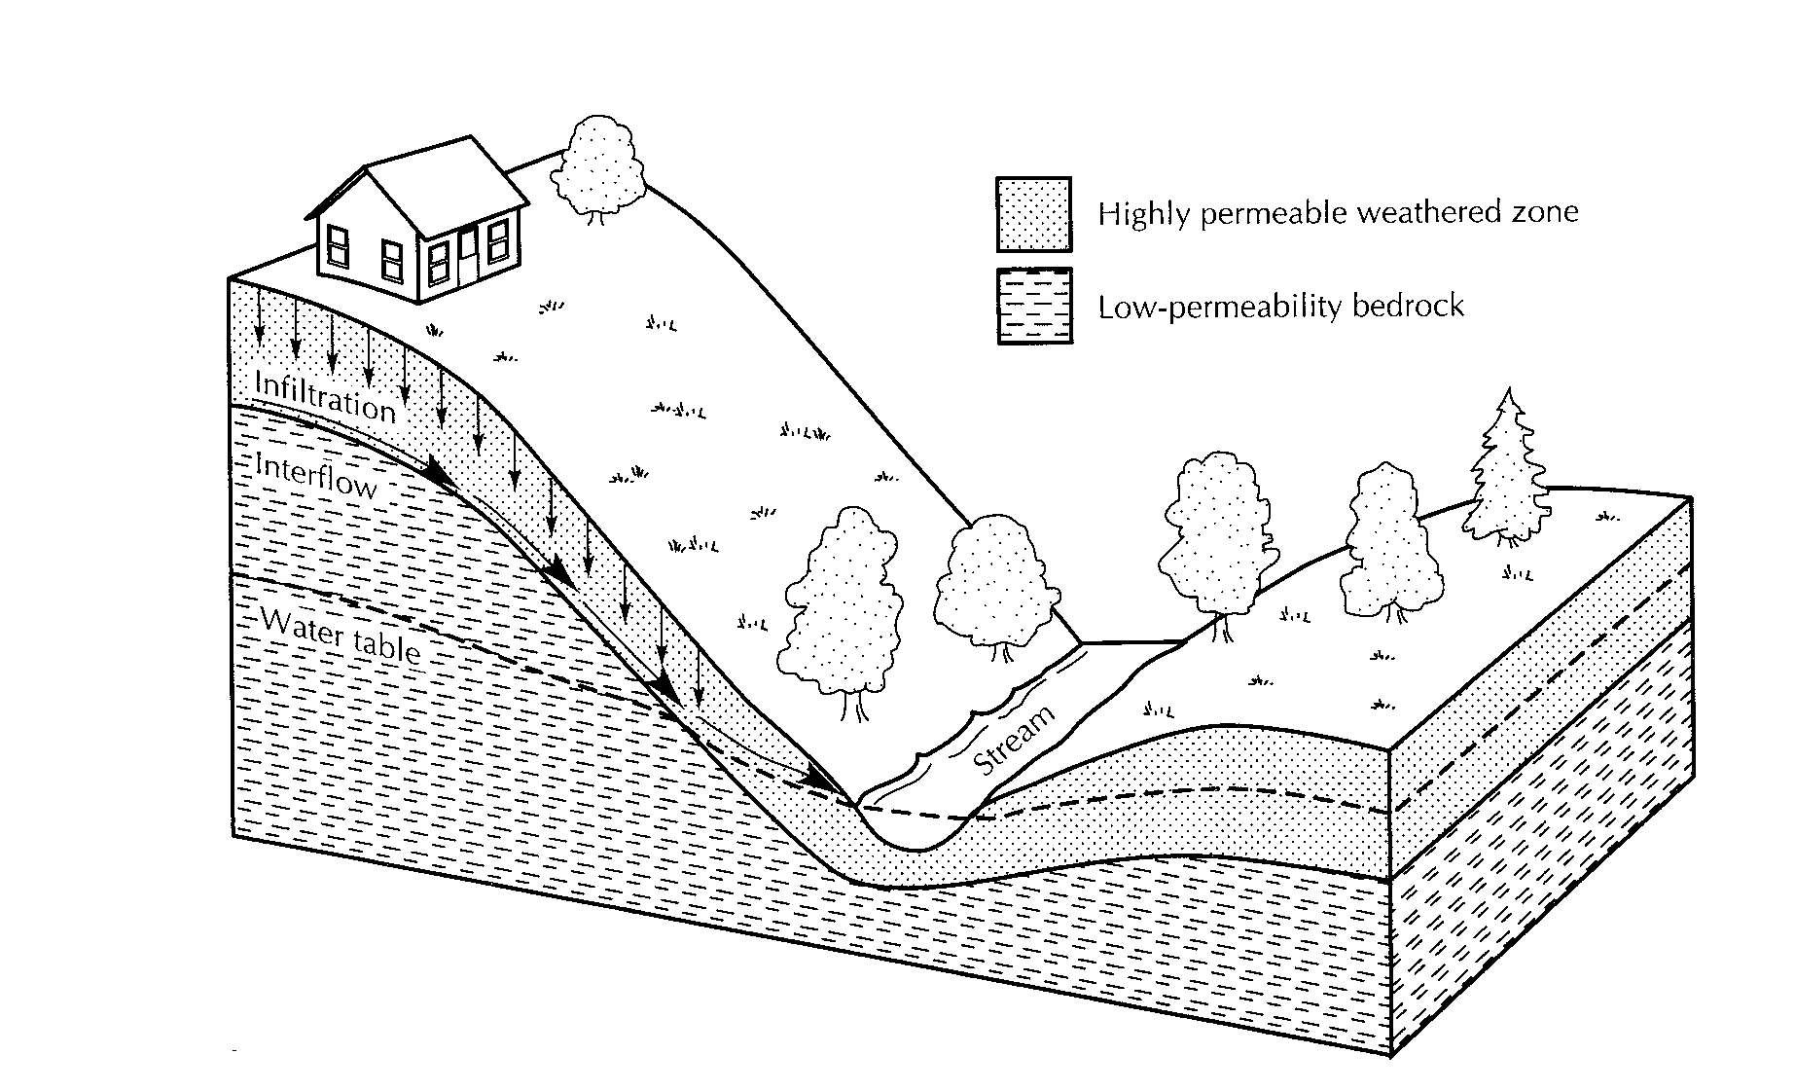
Water that does not go to evapotranspiration
Interflow (intermediate)
Overland Flow (fastest)
Groundwater Flow (slowest)

Slide 22
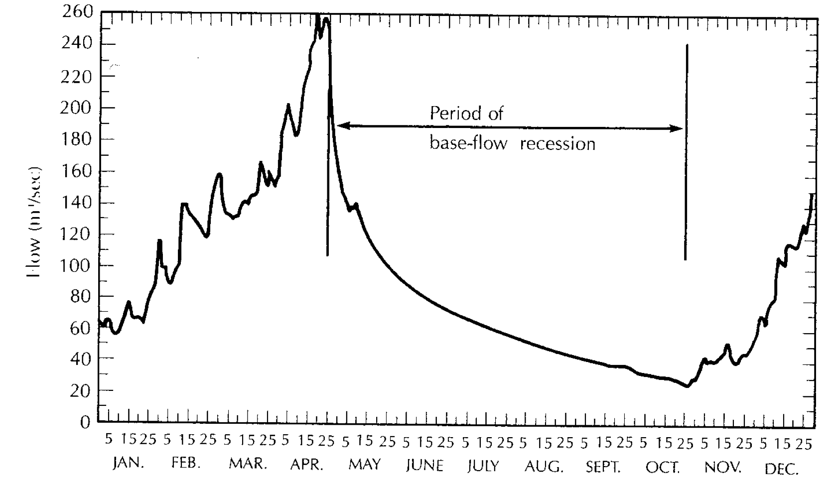
Stream Hydrographs
Precipitation Events (Direct, Overland, Interflow)
No precipitation, no overland or interflow. Only Baseflow s
Baseflow decreases as aquifer is drained

Slide 23
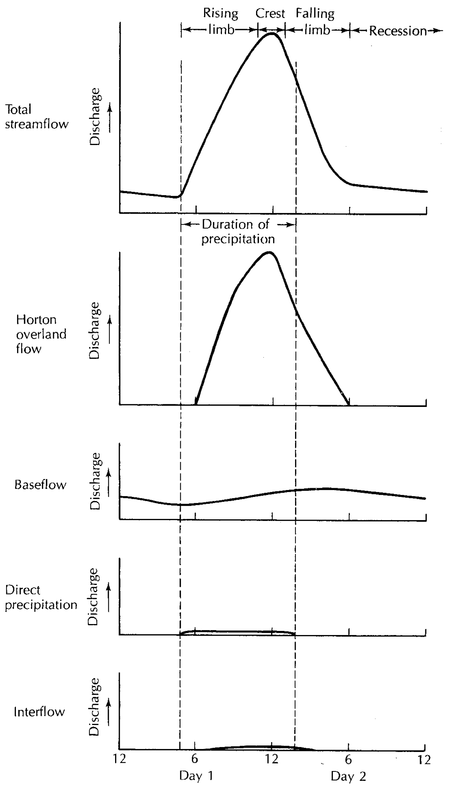
How to Separate:
Overland flow
Direct precipitation
Interflow
Baseflow

Slide 24
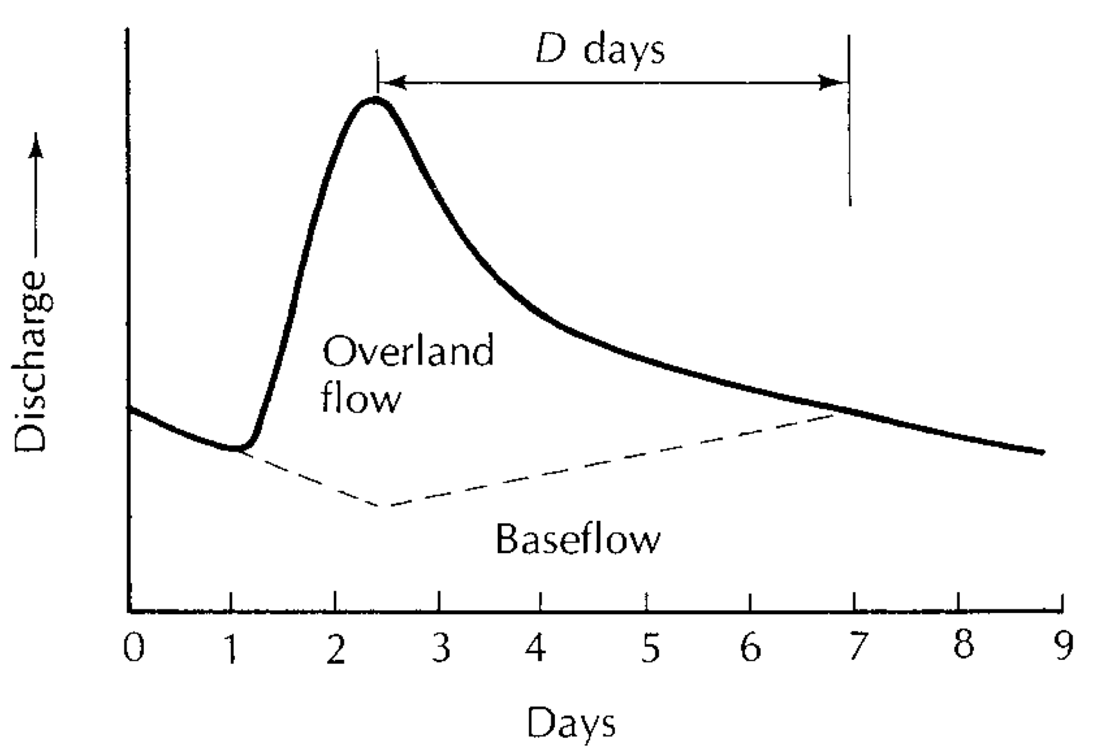
  Overland flow duration:
  D(days)=A(miles²)^{0.2}
  1 10 100 1000 miles²=
  1 1.6 2.5 4 days
  rule of thumb supported by empirical data
  not a fundamental theory
  Not dimensionally correct

Slide 25
  Methods to determine stream discharge
    Interesting but will not be on quizzes or tests
  Measurement of distribution of precipitation
    Homework: Isohyetal lines & Theissen polygons
  Estimation of groundwater recharge from baseflow recession

Slide 32
Baseflow
0.5 log units in 50 days
τ = 100 days = 8.6e6 s

Slide 34
The End: Hydrologic Cycle
Coming Up: Southern Nevada Water

