Slide 1

ESS 454
Hydrogeology
Module 4
Flow to Wells
Preliminaries, Radial Flow and Well Function
Non-dimensional Variables, Theis “Type” curve, and Cooper-Jacob Analysis
Aquifer boundaries, Recharge, Thiem equation
Other “Type” curves
Well Testing
Last Comments
Instructor: Michael Brown
brown@ess.washington.edu

Slide 2
Learning Objectives
Forward problem: Understand how to use the Hantush-Jacob formula to predict properties of a confined aquifer with leakage
Inverse problem: Understand how to use Type curves for a leaky confined aquifer to determine T, S, and B
Understand how water flows to a well in an unconfined aquifer
  Changes in the nature of flow with time
  How to use Type curves

Slide 3
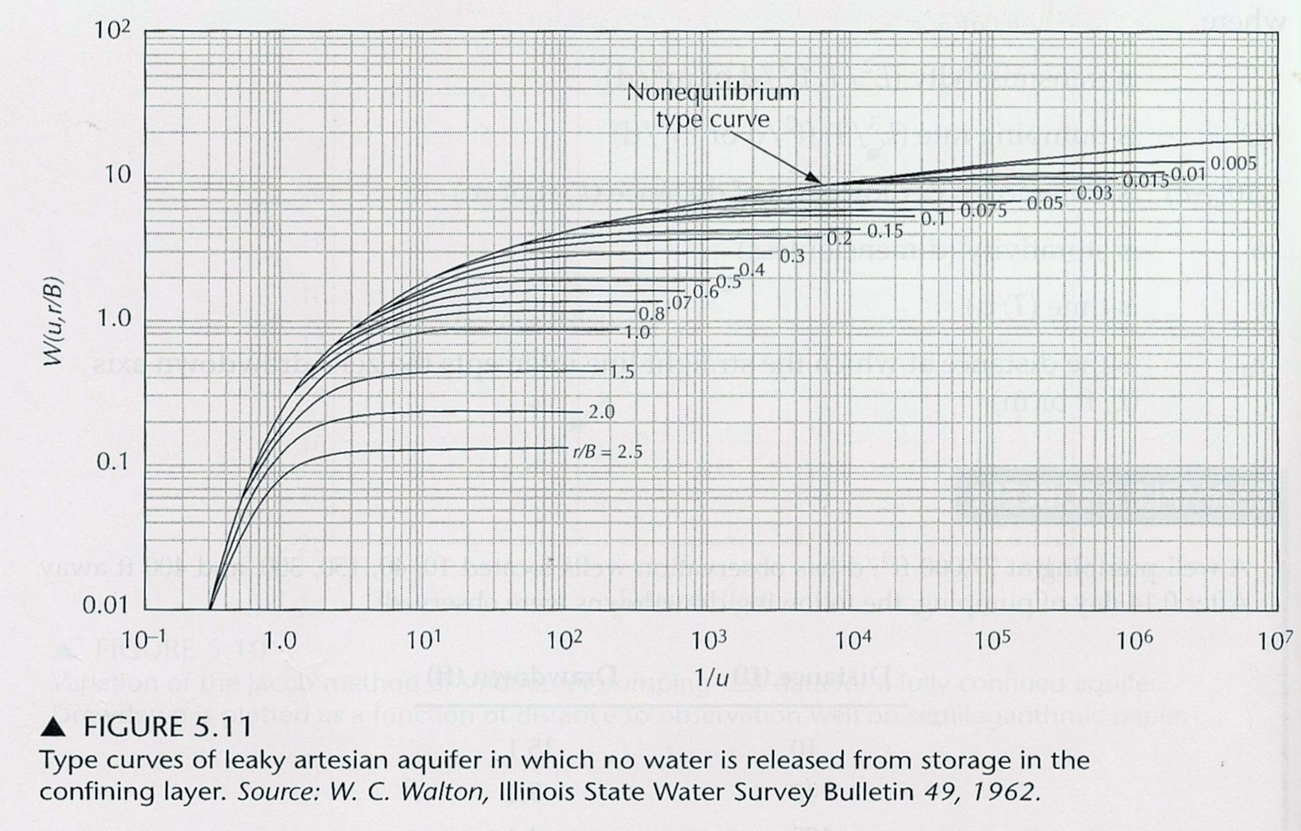
Other Type-Curves
Given without Derivations
Leaky Confined Aquifer
  Hantush-Jacob Formula
  Appendix 3 of Fetter
Same curve matching exercise as with Theis Type-curves
New dimensionless number
Larger r/B -> smaller steady-state drawdown
Drawdown reaches “steady-state” when recharge balances flow
Large K’ makes r/B large
“Type Curves” to determine T, S, and r/B

Slide 4
Other Type-curves –
Given without Derivations
Similar to Theis but more complicated:
Initial flow from elastic storage - S
Late time flow from gravity draining – S_{y}
  Remember: S_{y}>>S
Vertical and horizontal flow –
  K_{v} may differ from K_{h}
2. Unconfined Aquifer
  Neuman Formula
  Appendix 6 of Fetter
Three non-dimensional variables
Initial flow from Storativity
Difference between vertical and horizontal conductivity is important
Later flow from gravity draining

Slide 5
Flow in Unconfined Aquifer
Start Pumping
surface
Time order
Vertical flow (gravity draining)
1. Elastic Storage
Flow from gravity draining and horizontal head gradient
Flow from elastic storage
Horizontal flow induced by gradient in head

Slide 6
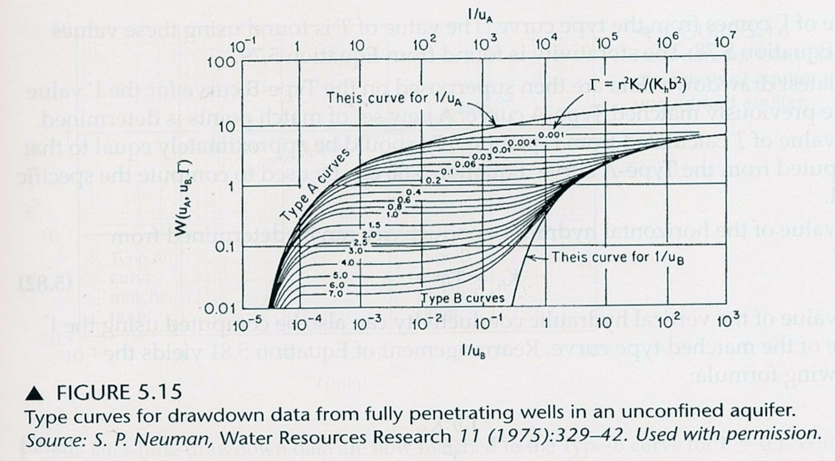
Other Type-curves –
Given without Derivations
Theis curve using Specific Yield
2. Unconfined Aquifer
  Neuman Formula
  Appendix 6 of Fetter
Transition depends on ratio r²K_{v}/(K_{h}b²)
Theis curve using Elastic Storage
Two-step curve matching:
Fit early time data to A-type curves
Fit late time data to B-type curves
Depends on Elastic Storage S
Depends on Specific Yield S_{y}
S_{y}=10³*S
S_{y}=10⁴*S

Slide 7
The End: Other Type Curves
Coming up: Well Testing

