Slide 1

ESS 454
Hydrogeology
Module 4
Flow to Wells
Preliminaries, Radial Flow and Well Function
Non-dimensional Variables, Theis “Type” curve, and Cooper-Jacob Analysis
Aquifer boundaries, Recharge, Thiem equation
Other “Type” curves
Well Testing
Last Comments
Instructor: Michael Brown
brown@ess.washington.edu

Slide 2
Wells:
Intersection of Society and Groundwater
Hydrologic Balance in absence of wells:
Flux_{in}- Flux_{out}= ΔStorage
Removing water from wells MUST change natural discharge or recharge or change amount stored
Consequences are inevitable
It is the role of the Hydrogeologist to evaluate the nature of the consequences and to quantify the magnitude of effects

Slide 3
Road Map
A Hydrogeologist needs to:
Understand natural and induced flow in the aquifer
Determine aquifer properties
  T and S
Determine aquifer geometry:
  How far out does the aquifer continue,
  how much total water is available?
Evaluate “Sustainability” issues
  Determine whether the aquifer is adequately “recharged” or has enough “storage” to support proposed pumping
  Determine the change in natural discharge/recharge caused by pumping
Math:
plethora of equations
All solutions to the diffusion equation
  Given various geometries and initial/final conditions
Goal here:
Need an entire course devoted to “Wells and Well Testing”
1. Understand the basic principles
2. Apply a small number of well testing methods

Slide 4
Module Four Outline
Flow to Wells
  Qualitative behavior
  Radial coordinates
  Theis non-equilibrium solution
  Aquifer boundaries and recharge
  Steady-state flow (Thiem Equation)
“Type” curves and Dimensionless variables
Well testing
  Pump testing
  Slug testing

Slide 5
Concepts and Vocabulary
Radial flow, Steady-state flow, transient flow, non-equilibrium
Cone of Depression
Diffusion/Darcy Eqns. in radial coordinates
  Theis equation, well function
  Theim equation
Dimensionless variables
Forward vs Inverse Problem
Theis Matching curves
Jacob-Cooper method
Specific Capacity
Slug tests
    Log h vs t
      Hvorslev falling head method
    H/H₀ vs log t
      Cooper-Bredehoeft-Papadopulos method
Interference, hydrologic boundaries
Borehole storage
  Skin effects
  Dimensionality
  Ambient flow, flow logging, packer testing

Slide 6
Module Learning Goals
Master new vocabulary
Understand concepts of “non-equilibrium flow”, ”steady-state flow” and “transient flow” and the geologic conditions that control flow
Recognize the diffusion equation and Darcy’s Law in axial coordinates
Understand (qualitatively and quantitatively) how water is produced from an aquifer to the well for both confined and unconfined aquifers
Understand how the Theis equation was derived and be able to use the well function to calculate drawdown as a function of time and distance
Be able to use non-dimensional variables to characterize the behavior of flow from wells
Be able to identify when the Thiem equation is appropriate and use it in quantitative calculations
Be able to use Theis and Jacob-Cooper methods to determine aquifer transmissivity and storativity
Be able to describe how draw-down curves are impacted by aquifer properties or recharge/barrier boundaries and quantitatively estimate the size of an aquifer
Understand how aquifer properties are determined in slug tests and be able to undertake quantitative analysis of Hvorslev and Cooper-Bredehoeft-Papadopulos tests.
Be able to describe what controls flow from wells starting at early time and extending to long time intervals
Be able to describe quantitatively how drawdown behaves if nearby wells have overlapping cones of depression
Understand the limits to what has been developed in this module

Slide 7
Learning Goals- This Video
Understand the role of a hydrogeologist in evaluating groundwater resources
Be able to apply the diffusion equation in radial coordinates
Understand (qualitatively and quantitatively) how water is produced from a confined aquifer to the well
Understand the assumptions associated with derivation of the Theis equation
Be able to use the well function to calculate drawdown as a function of time and distance

Slide 8
Important Note
Will be using many plots to understand flow to wells
  Some are linear x and linear y
  Some are log(y) vs log(x)
  Some are log(y) vs linear x
  Some are linear y vs log(x)
Make a note to yourself to pay attention to these differences!!

Slide 9
Assumptions Required for Derivations
Cone of Depression
Pump well
Observation Wells
surface
Potentiometric surface
Draw-down
Radial flow
Confined Aquifer
Assumptions
Aquifer bounded on bottom, horizontal and infinite, isotropic and homogeneous
Initially horizontal potentiometric surface, all change due to pumping
Fully penetrating and screened wells of infinitesimal radius
100% efficient – drawdown in well bore is equal to drawdown in aquifer
Radial horizontal Darcy flow with constant viscosity and density

Slide 10
Equations in axial coordinates
Cartesian Coordinates: x, y, z
Axial Coordinates: r, θ, z
r
θ
z
Will use Radial flow:
No vertical flow
Same flow at all angles θ
Flow only outward or inward
Flow size depends only on r
r
b
Flow through surface of area 2πrb
For a cylinder of radius
r and height b :

Slide 11
Equations in axial coordinates
Darcy’s Law:
Diffusion Equation:
Leakage:
Water infiltrating through confining layer with properties K’ and b’ and no storage.
Area of cylinder
Need to write in axial coordinates with no θ or z dependences
Equation to solve for flow to well

Slide 12
Flow to Well in Confined Aquifer with no Leakage
Pump at constant flow rate of Q
surface
h_{o}: Initial potentiometric surface
h_{o}
r
Gradient needed to induce flow
Wanted: h_{o}-h
Drawdown as function of distance and time
Drawdown must increase to maintain gradient
h(r,t)
Radial flow
Confined Aquifer

Slide 13
Theis Equation
His solution (in 1935) to Diffusion equation for radial flow to well subject to appropriate boundary conditions and initial condition:
Story: Charles Theis went to his mathematician friend C. I. Lubin who gave him the solution to this problem but then refused to be a co-author on the paper because Lubin thought his contribution was trivial. Similar problems in heat flow had been solved in the 19th Century by Fourier and were given by Carlslaw in 1921
for all r at t=0
for all time at r=infinity
Important step: use a non-dimensional variable that includes both r and t
For u=1, this was the definition of characteristic time and length
Solutions to the diffusion equation depend only on the ratio of r² to t!
W(u) is the “Well Function”
No analytic solution

Slide 14
Theis Equation
Need values of W for different values of the dimensionless variable u
Get from Appendix 1 of Fetter
  u is given to 1 significant figure – may need to interpolate
Calculate “numerically”
  Matlab® command is W=quad(@(x)exp(-x)/x, u,10);
Use a series expansion
  Any function can over some range be represented by the sum of polynomial terms
For u<1

Slide 15
Well Function
u | W
10⁻¹⁰ | 22.45
10⁻⁹ | 20.15
10⁻⁸ | 17.84
10⁻⁷ | 15.54
10⁻⁶ | 13.24
10⁻⁵ | 10.94
10⁻⁴ | 8.63
10⁻³ | 6.33
10⁻² | 4.04
10⁻¹ | 1.82
10⁰ | 0.22
10¹ | <10⁻⁵
Units of length
dimensionless
dimensionless
11 orders of magnitude!!
For a fixed time:
As r increases, u increases and W gets smaller
Less drawdown farther from well
At any distance
As time increases, u decreases and W gets bigger
More drawdown the longer water is pumped
Non-equilibrium: continually increasing drawdown

Slide 16
Well Function
Examples
Use English units: feet and days
Aquifer with:
T=10³ ft²/day
S = 10⁻³
T/S=10⁶ ft²/day
Pumping rate:
Q=0.15 cfs
Q/4πT ~1 foot
Well diameter 1’
u= (S/4T)x(r²/t)
u=2.5x10⁻⁷(r²/t)
Δh (ft)
How much drawdown at well screen (r=0.5’) after 24 hours?
6.2x10⁻⁸
16.0
How much drawdown 100’ away after 24 hours?
2.5x10⁻³
5.4
How much drawdown 157’ away after 24 hours?
6.3x10⁻³
4.5
How much drawdown 500’ away after 10 days?
6.3x10⁻³
4.5
Same drawdown for different times and distances

Slide 17
Well Function
Cone of Depression
Continues to go down
After 1000 Days of Pumping
After 30 Days of Pumping
After 1 Day of Pumping
Notice similar shape for time and distance dependence
Notice decreasing curvature with distance and time

Slide 18
The End: Preliminaries, Axial coordinate, and Well Function
Coming up “Type” matching Curves

Slide 19
ESS 454
Hydrogeology
Module 4
Flow to Wells
Preliminaries, Radial Flow and Well Function
Non-dimensional Variables, Theis “Type” curve, and Cooper-Jacob Analysis
Aquifer boundaries, Recharge, Thiem equation
Other “Type” curves
Well Testing
Last Comments
Instructor: Michael Brown
brown@ess.washington.edu

Slide 20
Learning Objectives
Understand what is meant by a “non-dimensional” variable
Be able to create the Theis “Type” curve for a confined aquifer
Understand how flow from a confined aquifer to a well changes with time and the effects of changing T or S
Be able to determine T and S given drawdown measurements for a pumped well in a confined aquifer
  Theis “Type” curve matching method
  Cooper-Jacob method

Slide 21
Theis Well Function
Confined Aquifer of infinite extent
Water provided from storage and by flow
  Two aquifer parameters in calculation
  T and S
Choose pumping rate
Calculate Drawdown with time and distance
Forward Problem

Slide 22
Theis Well Function
What if we wanted to know something about the aquifer?
  Transmissivity and Storage?
Measure drawdown as a function of time
Determine what values of T and S are consistent with the observations
Inverse Problem

Slide 23
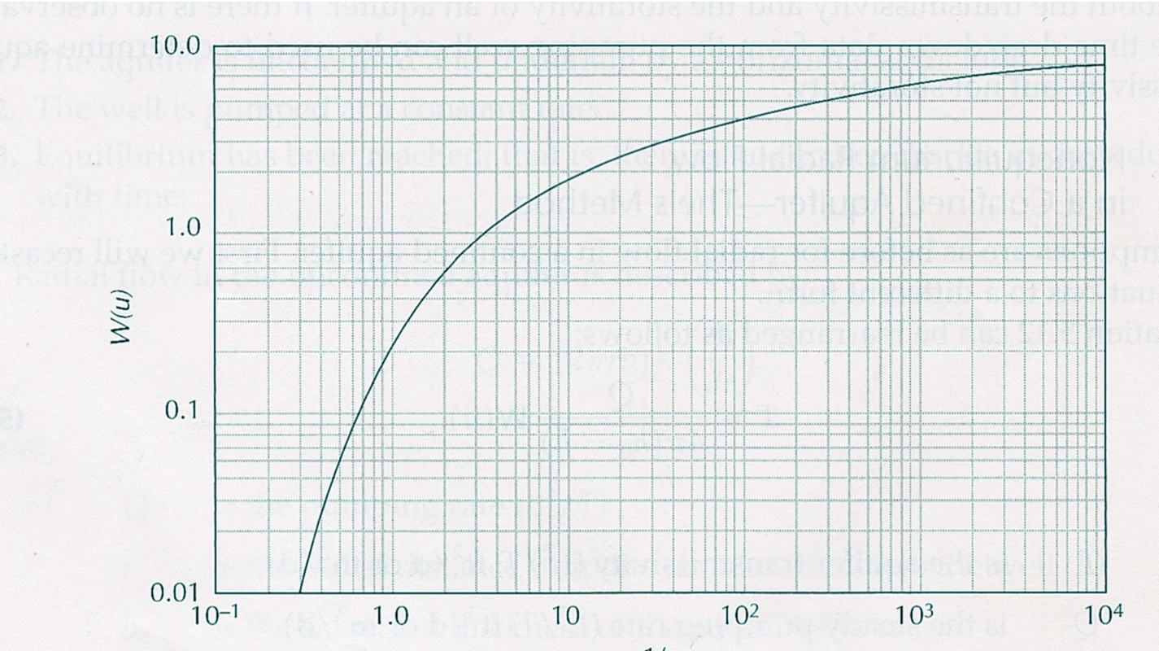
Theis Well Function
u | W
10⁻¹⁰ | 22.45
10⁻⁹ | 20.15
10⁻⁸ | 17.84
10⁻⁷ | 15.54
10⁻⁶ | 13.24
10⁻⁵ | 10.94
10⁻⁴ | 8.63
10⁻³ | 6.33
10⁻² | 4.04
10⁻¹ | 1.82
10⁰ | 0.22
10¹ | <10⁻⁵
Non-dimensional variables
Plot as log-log
3 orders of magnitude
Using 1/u
“Type” Curve
Contains all information about how a well behaves if Theis’s assumptions are correct
5 orders of magnitude
Use this curve to get T and S from actual data
1/u

Slide 24
Theis Well Function
Why use log plots?
Several reasons:
If quantity changes over orders of magnitude, a linear plot may compress important trends
Feature of logs:
log(A*B/C) = log(A)+log(B)-log(C)
Plot of log(A)
is same as plot of log(A*B/C)
with offset log(B)-log(C)
We will determine this offset when “curve matching”
Offset determined by identifying a “match point”
log(A²)=2*log(A)
Slope of linear trend in log plot is equal to the exponent

Slide 25
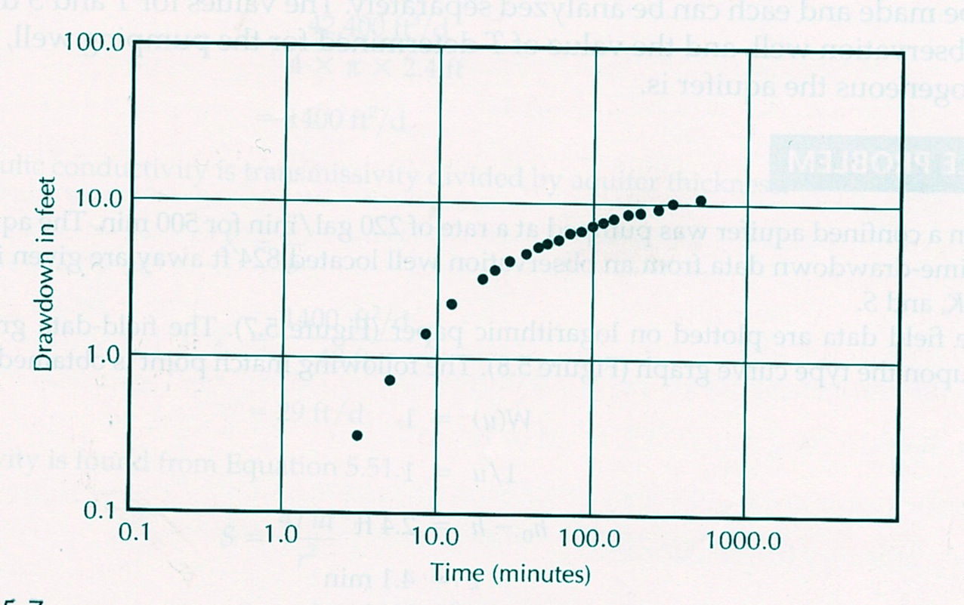
Theis Curve Matching
Plot data on log-log paper with same spacing as the “Type” curve
Slide curve horizontally and vertically until data and curve overlap
Δh=2.4 feet
Match point at u=1 and W=1
time=4.1 minutes

Slide 26
Semilog Plot of “Non-equilibrium” Theis equation
After initial time, drawdown increases with log(time)
Ideas:
At early time water is delivered to well from “elastic storage”
  head does not go down much
  Larger intercept for larger storage
After elastic storage is depleted water has to flow to well
  Head decreases to maintain an adequate hydraulic gradient
  Rate of decrease is inversely proportional to T
2T
Initial non-linear curve then linear with log(time)
T
Linear drawdown
Double T -> slope decreases to half
Log time
Intercept time increases with S
Delivery from
elastic storage
Double S and intercept changes but slope stays the same
Delivery from flow

Slide 27
Cooper-Jacob Method
Theis Well function in series expansion
These terms become negligible as time goes on
If t is large then u is much less than 1. u² , u³, and u⁴ are even smaller.
Theis equation
for large t
Head decreases linearly with log(time)
constant
slope
– slope is inversely proportional to T
Conversion to base 10 log
– constant is proportional to S

Slide 28
Cooper-Jacob Method
Works for “late-time” drawdown data
Solve inverse problem:
Given drawdown vs time data for a well pumped at rate Q, what are the aquifer properties T and S?
Using equations from previous slide
intercept
t_{o}
Calculate T from Q and Δh
Fit line through linear range of data
Need to clearly see “linear” behavior
Line defined by slope and intercept
Not acceptable
Slope =Δh/1
Δh for 1 log unit
Need T, t_{o} and r to calculate S
1 log unit

Slide 29
Summary
Have investigated the well drawdown behavior for an infinite confined aquifer with no recharge
  Non-equilibrium – always decreasing head
  Drawdown vs log(time) plot shows (early time) storage contribution and (late time) flow contribution
Two analysis methods to solve for T and S
  Theis “Type” curve matching for data over any range of time
  Cooper-Jacob analysis if late time data are available
Deviation of drawdown observations from the expected behavior shows a breakdown of the underlying assumptions

Slide 30
Coming up: What happens when the Theis assumptions fail?

Slide 31
ESS 454
Hydrogeology
Module 4
Flow to Wells
Preliminaries, Radial Flow and Well Function
Non-dimensional Variables, Theis “Type” curve, and Cooper-Jacob Analysis
Aquifer boundaries, Recharge, Thiem equation
Other “Type” curves
Well Testing
Last Comments
Instructor: Michael Brown
brown@ess.washington.edu

Slide 32
Learning Objectives
Recognize causes for departure of well drawdown data from the Theis “non-equilibrium” formula
Be able to explain why a pressure head is necessary to recover water from a confined aquifer
Be able to explain how recharge is enhanced by pumping
Be able to qualitatively show how drawdown vs time deviates from Theis curves in the case of leakage, recharge and barrier boundaries
Be able to use diffusion time scaling to estimate the distance to an aquifer boundary
Understand how to use the Thiem equation to determine T for a confined aquifer or K for an unconfined aquifer
Understand what Specific Capacity is and how to determine it.

Slide 33
When Theis Assumptions Fail
Total head becomes equal to the elevation head
  To pump, a confined aquifer must have pressure head
  Cannot pump confined aquifer below elevation head
  Pumping rate has to decrease
Aquifer ends at some distance from well
  Water cannot continue to flow in from farther away
  Drawdown has to increase faster and/or pumping rate has to decrease

Slide 34
When Theis Assumptions Fail
“Negative” pressure does not work to produce water in a confined aquifer
Reduce pressure by “sucking”
straw
No amount of “sucking” will work
Air pressure in unconfined aquifer pushes water up well when pressure is reduced in borehole
cap
If aquifer is confined, and pressure in borehole is zero, no water can move up borehole

Slide 35
When Theis Assumptions Fail
Leakage through confining layer provides recharge
  Decrease in aquifer head causes increase in Δh across aquitard
    Pumping enhances recharge
    When cone of depression is sufficiently large, recharge equals pumping rate
Cone of depression extends out to a fixed head source
  Water flows from source to well

Slide 36
Flow to well in Confined Aquifer with leakage
As cone of depression expands, at some point recharge through the aquitard may balance flow into well
larger area -> more recharge
larger Δh -> more recharge
surface
h_{o}: Initial potentiometric surface
Δh
Aquifer above Aquitard
Increased flow through aquitard
Confined Aquifer

Slide 37
Flow to Well in Confined Aquifer with Recharge Boundary
surface
Lake
h_{o}: Initial potentiometric surface
Gradient from fixed head to well
Confined Aquifer

Slide 38
Flow to Well –Transition to Steady State Behavior
Both leakage and recharge boundary give steady-state behavior after some time interval of pumping, τ
Hydraulic head stabilizes at a constant value
Steady-state
The size of the steady-state cone of depression or the distance to the recharge boundary can be estimated
Non-equilibrium
τ

Slide 39
Steady-State Flow
Thiem Equation – Confined Aquifer
When hydraulic head does not change with time
Darcy’s Law in radial coordinates
surface
Rearrange
h₁
h₂
r₁
r₂
Confined Aquifer
Integrate both sides
Determine T from drawdown at two distances
Result
In Steady-state – no dependence on S

Slide 40
Steady-State Flow
Thiem Equation – Unconfined Aquifer
When hydraulic head does not change with time
Darcy’s Law in radial coordinates
surface
Rearrange
b₁
b₂
r₁
r₂
Integrate both sides
Determine K from drawdown at two distances
Result
In Steady-state – no dependence on S

Slide 41
  Specific Capacity (driller’s term)
1. Pump well for at least several hours – likely not in steady-state
2. Record rate (Q) and maximum drawdown at well head (Δh)
3. Specific Capacity = Q/Δh
This is often approximately equal to the Transmissivity
Why??
??
Specific Capacity

Slide 42
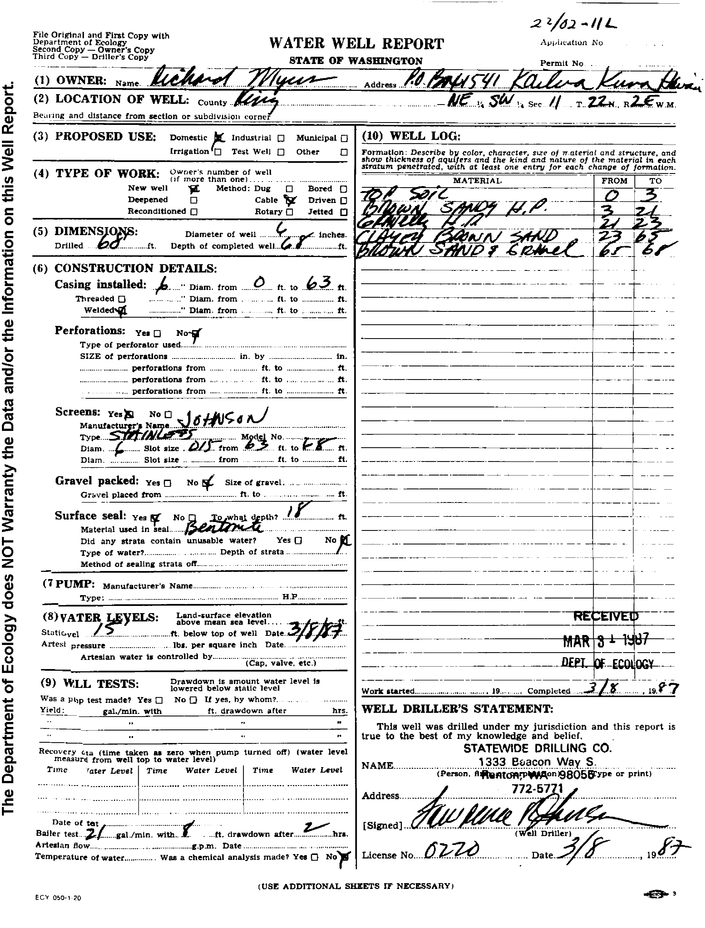
Example: My Well
Driller’s log available online through Washington State Department of Ecology
Typical glaciofluvial geology
Till to 23 ft
Clay-rich sand to 65’
6” bore
Screened for last 5’
Sand and gravel to 68’
Q=21*.134*60*24
= 4.1x10³ ft³/day
Static head is 15’ below surface
Specific capacity of:
=4.1x10³/8=500 ft²/day
Pumped at 21 gallons/minute for 2 hours
K is about 100 ft/day
(typical “good” sand/gravel value)
Drawdown of 8’

Slide 43
The End: Breakdown of Theis assumptions and steady-state behavior
Coming up: Other “Type” curves

Slide 44
ESS 454
Hydrogeology
Module 4
Flow to Wells
Preliminaries, Radial Flow and Well Function
Non-dimensional Variables, Theis “Type” curve, and Cooper-Jacob Analysis
Aquifer boundaries, Recharge, Thiem equation
Other “Type” curves
Well Testing
Last Comments
Instructor: Michael Brown
brown@ess.washington.edu

Slide 45
Learning Objectives
Forward problem: Understand how to use the Hantush-Jacob formula to predict properties of a confined aquifer with leakage
Inverse problem: Understand how to use Type curves for a leaky confined aquifer to determine T, S, and B
Understand how water flows to a well in an unconfined aquifer
  Changes in the nature of flow with time
  How to use Type curves

Slide 46
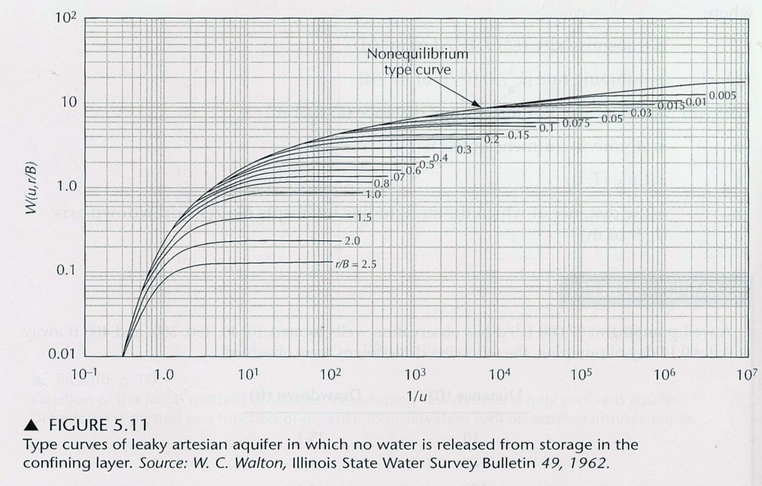
Other Type-Curves
Given without Derivations
Leaky Confined Aquifer
  Hantush-Jacob Formula
  Appendix 3 of Fetter
Same curve matching exercise as with Theis Type-curves
New dimensionless number
Larger r/B -> smaller steady-state drawdown
Drawdown reaches “steady-state” when recharge balances flow
Large K’ makes r/B large
“Type Curves” to determine T, S, and r/B

Slide 47
Other Type-curves –
Given without Derivations
Similar to Theis but more complicated:
Initial flow from elastic storage - S
Late time flow from gravity draining – S_{y}
  Remember: S_{y}>>S
Vertical and horizontal flow –
  K_{v} may differ from K_{h}
2. Unconfined Aquifer
  Neuman Formula
  Appendix 6 of Fetter
Three non-dimensional variables
Initial flow from Storativity
Difference between vertical and horizontal conductivity is important
Later flow from gravity draining

Slide 48
Flow in Unconfined Aquifer
Start Pumping
surface
Time order
Vertical flow (gravity draining)
1. Elastic Storage
Flow from gravity draining and horizontal head gradient
Flow from elastic storage
Horizontal flow induced by gradient in head

Slide 49
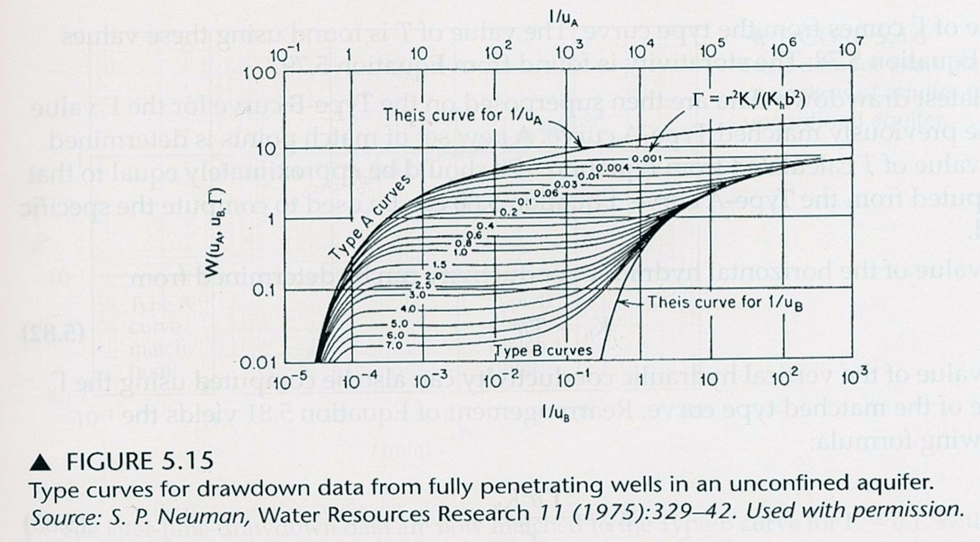
Other Type-curves –
Given without Derivations
Theis curve using Specific Yield
2. Unconfined Aquifer
  Neuman Formula
  Appendix 6 of Fetter
Transition depends on ratio r²K_{v}/(K_{h}b²)
Theis curve using Elastic Storage
Two-step curve matching:
Fit early time data to A-type curves
Fit late time data to B-type curves
Depends on Elastic Storage S
Depends on Specific Yield S_{y}
S_{y}=10³*S
S_{y}=10⁴*S

Slide 50
The End: Other Type Curves
Coming up: Well Testing

Slide 51
ESS 454
Hydrogeology
Module 4
Flow to Wells
Preliminaries, Radial Flow and Well Function
Non-dimensional Variables, Theis “Type” curve, and Cooper-Jacob Analysis
Aquifer boundaries, Recharge, Thiem equation
Other “Type” curves
Well Testing
Last Comments
Instructor: Michael Brown
brown@ess.washington.edu

Slide 52
Learning Objectives
Understand what is learned through “well testing”
Understand how “pump tests” and “slug (bailer) tests” are undertaken
Be able to interpret Cooper-Bredehoeft-Papadopulos and Hvorslev slug tests

Slide 53
Testing
Desired Outcome:
Gain understanding of the aquifer
Its “size” both
  physical extent and geometry
  amount of water
The ease of water flow and how it moves to well
Consequences of pumping

Slide 54
Testing
Goals:
Determine Aquifer T
and S (not all methods)
Identify recharge or barrier boundaries

Slide 55
Testing
Methods:
Already worked examples in process of developing understanding of how water flows to wells
Pump Testing
  Maintain a constant flow
    Measure the transient pressure/head
    Best to use “observation wells” but often too expensive
  Maintain constant pressure/head
    Measure transient flow
  Recovery test
    stop pumping and measure head as it return to initial state
Topics for follow on courses

Slide 56
Testing
Methods:
Slug Test (can be done in a single well)
  Look at pressure/head decay after instant charge of water level
  Various methods
  Skin-effects
Can (1) pour water in rapidly
(2) drop in object (slug) to raise water level
(3) bail water out (to rapidly drop water level)
Unwanted complication: Low hydraulic conductivity around well as a result of the drilling process

Slide 57
Cooper-Bredehoeft-PapadopolosTest
Goes from 1 to 0
Dimensionless number
Plot: H(t)/H_{o} vs log(Tt/r_{c}²)
Call it z
surface
r_{c}
1
r_{s}²/r_{c}² S
Smaller S
H(t)
H_{o}
Initial head
H(t)/H_{o}
Head returns to initial state
slug
Increased head causes radial flow into aquifer
0
b
0.01
0.1
1.0
10.0
z=Tt/r_{c}²
r_{s}

Slide 58
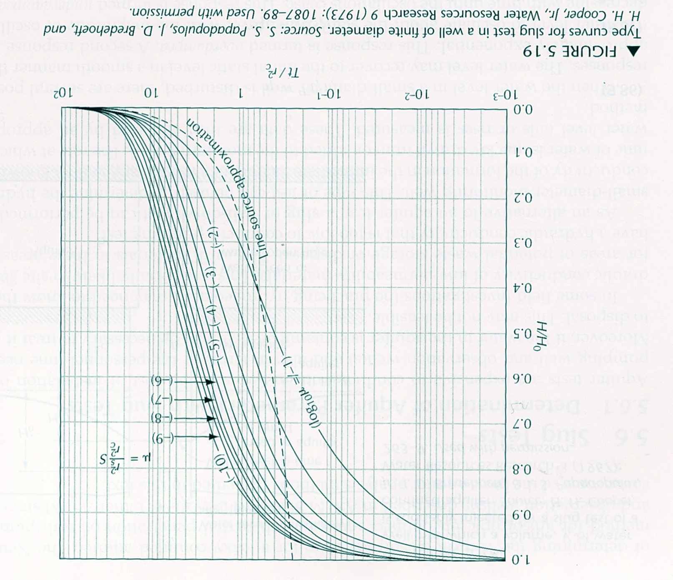
Cooper-Bredehoeft-PapadopolosTest
1
r_{s}= 1.0’
r_{c}= 0.5’
.8
.6
H/H_{o}
.4
.2
Match point at z=1, t=21 minutes
0
1
10
100
1000
minutes

Slide 59
Hvorslev Slug Test
Works for piezometer or auger hole placed to monitor water or water quality – not fully penetrating
r
Log scale
K only determined
1
.8
.7
.6
casing
.5
H/H_{o}=.37
.4
H/H_{o}
.3
L_{e}/R must be >8
Gravel pack
.2
L_{e}
t₃₇
Screen
.1
2
4
6
8
10
minutes
Linear scale
Partially Penetrating OK
high K material
R

Slide 60
The End: Well Testing
Coming up: Final Comments

Slide 61
ESS 454
Hydrogeology
Module 4
Flow to Wells
Preliminaries, Radial Flow and Well Function
Non-dimensional Variables, Theis “Type” curve, and Cooper-Jacob Analysis
Aquifer boundaries, Recharge, Thiem equation
Other “Type” curves
Well Testing
Last Comments
Instructor: Michael Brown
brown@ess.washington.edu

Slide 62
Learning Objectives
Understand contribution of borehole storage and skin effects to flow to wells
Be able to identify factors controlling well flow from initiation of pumping to late time
Understand (qualitatively and quantitatively) what is meant by well interference
Understand the effect of boundaries (recharge and barrier) on flow to wells
Understand what is meant by ambient flow in a borehole and what information can be gained from flow logging or a packer test
Recognize the large range of geometries in natural systems and the limits to application of the models discussed in this module

Slide 63
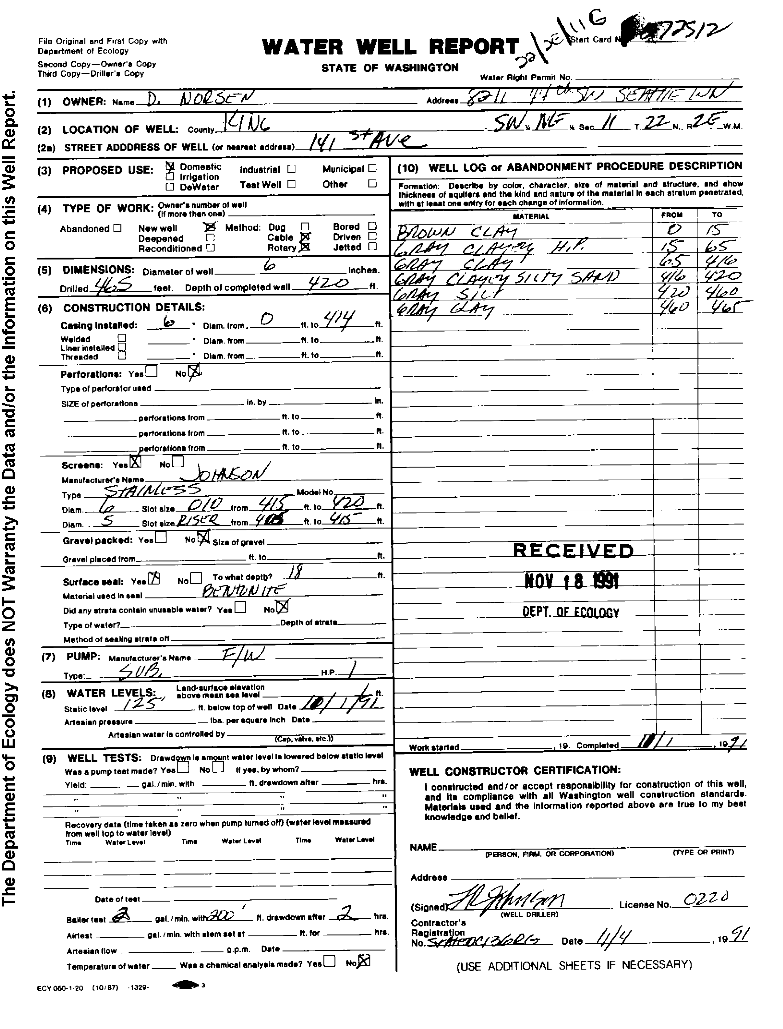
Borehole Storage
When pumping begins, the first water comes from the borehole
If the aquifer has low T and S, a large Δh may be needed to induce flow into the well
If water is coming from Borehole Storage, Δh will be proportional to time
Example: A King County domestic water well
1 gallon =.134 ft³
200’ of 0.5’ well bore = π*0.25²*200=39 ft³
420’ deep
0.5’ diameter
Head is 125’ below surface
5’ screened in silty sand
2 gallons/minute = 32 ft³ in 2 hour
During pump test all water came from well bore.
Pump test:
Q=2 gallons/minute
Δh=200’ after 2 hours
This is not a very good well
Need to know how long it takes for water to recover when pump is turned off

Slide 64
Skin Effects
Drilling tends to smear clay into aquifer near the borehole
  Leads to low conductivity layer around the screen
  Tends to retard flow of water into well
Slug test (or any single well test) may
  measure properties of skin and not properties of aquifer
Critical step is “Well development”
  water is surged into and out of well to clear the skin

Slide 65
Controls on flow in wells:
in order of impact from early to late time
  Borehole storage
  Skin effect
  Aquifer Storativity
  Aquifer Transmissivity
  Recharge/barrier boundaries

Slide 66
Well interference
And Barrier Boundary
Drawdown with barrier boundary of aquifer can be calculated as the interference due to an “image” well
Confined Aquifer
Greater drawdown
Smaller hydraulic gradient
Reduced flow to wells
Flow divide between wells
Hydraulic head is measure of energy
Energy is a scalar and is additive
Just add drawdown for each well to get total drawdown

Slide 67
Boundary and Dimension Effects
2-D
1-D
3-D
Reservoir geometry
Network/Flow geometry
Discussion of ways to deal with these “real-world” situations is beyond the scope of this class

Slide 68
Last Comments on well testing
If data don’t fit the analysis
    Wrong assumptions
    Interesting geology
Don’t “force a square peg through a round hole”
  Don’t try to make data fit a curve that is inappropriate for the situation
Much more to cover in a follow up course!

Slide 69
Well Logging
Ambient Flow logging
  measurement of flow in borehole at different depths in absence of pumping
  In an open (uncased) well, water will flow between regions with different hydraulic head
“Packer test”
  utilizes a device that closes off a small portion of an uncased well
  measures the local hydraulic head
Much more to discuss in follow-on courses

Slide 70
Summary
Master new vocabulary
Understand concepts of “non-equilibrium flow”, ”steady-state flow” and “transient flow” and the geologic conditions that control flow
Recognize the diffusion equation and Darcy’s Law in axial coordinates
Understand (qualitatively and quantitatively) how water is produced from an aquifer to the well for both confined and unconfined aquifers
Understand how the Theis equation was derived and be able to use the well function to calculate drawdown as a function of time and distance
Be able to use non-dimensional variables to characterize the behavior of flow from wells
Be able to identify when the Thiem equation is appropriate and use it in quantitative calculations
Be able to use Theis and Jacob-Cooper methods to determine aquifer transmissivity and storativity
Be able to describe how draw-down curves are impacted by aquifer properties or recharge/barrier boundaries and quantitatively estimate the size of an aquifer
Understand how aquifer properties are determined in slug tests and be able to undertake quantitative analysis of Hvorslev and Cooper-Bredehoeft-Papadopulos tests.
Be able to describe what controls flow from wells starting at early time and extending to long time intervals
Be able to describe quantitatively how drawdown behaves if nearby wells have overlapping cones of depression
Understand the limits to what has been developed in this module

Slide 71
The End: Flow to Wells
Coming Up: Regional Groundwater Flow

