Slide 1

ESS 454
Hydrogeology
Module 1
Course Overview,
Hydrogeology History,
Hydrologic Cycle,
Sustainability I & II

Slide 2
Water Budget and
Sustainability
The water budget for the American Southwest
(a role for hydrogeology)
How can growth be accommodated?
What are alternative water resources?

Slide 3
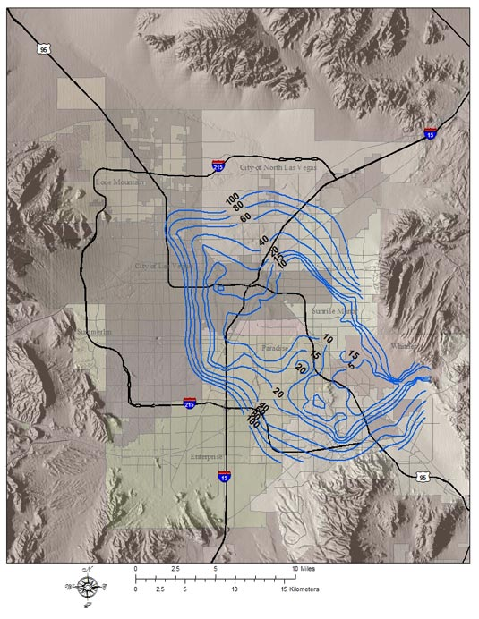
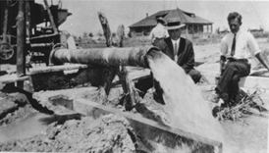
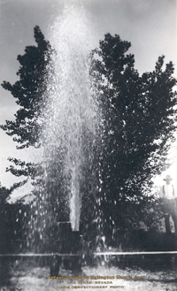
Las Vegas Groundwater
Shallow Aquifer Water Depth
http://www.lasvegasgmp.com

Slide 4
Las Vegas Water Supply
Originally desert springs and artesian wells
  Groundwater main supply before 1971
  Serious subsidence problems
Replaced in part by Colorado River Water in 1970’s – problem of over-subscription
Artificial recharge of aquifers using reclaimed Colorado River water (sewage treatment)
Long-term plans to tap other groundwater sources accelerated by drought of 1990’s
See on-line supporting documents

Slide 5
History of water usage by Las Vegas

Slide 6
Proposed Future Usage and Sources

Slide 7
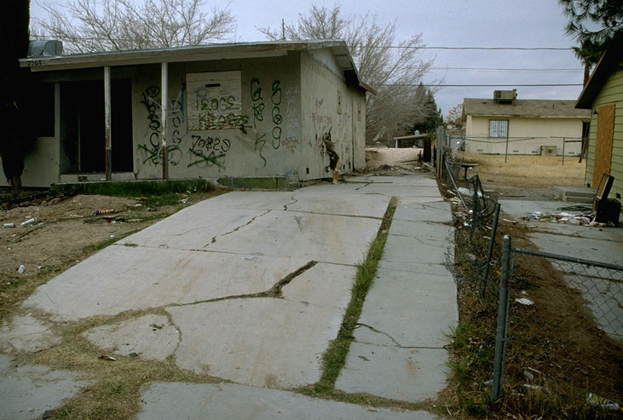
Subsidence in north Las Vegas associated with
groundwater removal: marlimillerphoto.com

Slide 8
Continued use of Colorado River Water is problematic

Slide 9
Timeline
Spring Valley
1989: Las Vegas applies for water withdrawal rights
1991: Southern Nevada Water Authority formed
Snake Valley
2007: USGS releases groundwater study
2007: SNWA water rights for
Spring Valley approved
2008: water rights for
Delamar, Dry Lake, and
Cave valleys approved
2009-2010: Interstate agreement reached for
allocation of Snake Valley water; BLM
proceeds with EIS preparation for pipe
line and environmental effects of
withdrawal
2014-2019 Water flows to Las Vegas

Slide 11
Is the proposed water usage Sustainable?
Is 170,000 acre-ft/year available? Small or Large compared to sources?

Slide 12
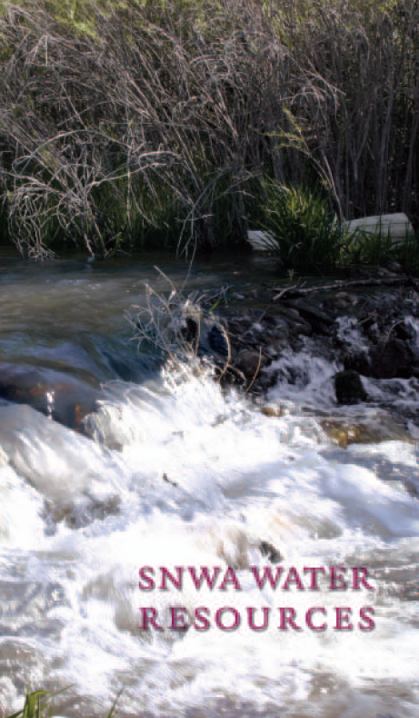
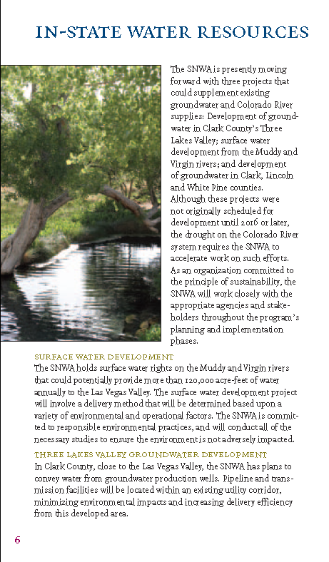
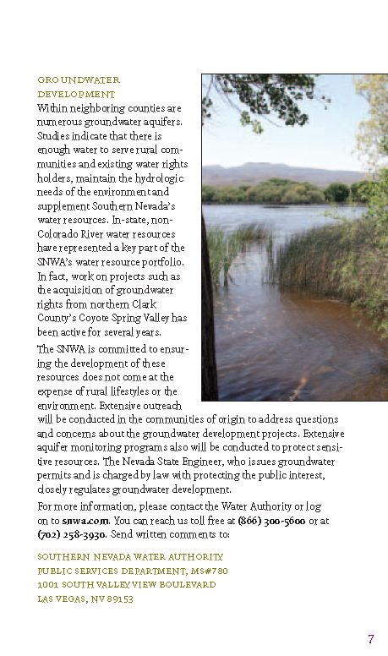
The SNWA is committed to ensuring
the development of these resources does not come at the expense of rural lifestyles or the environment. Extensive outreach
will be conducted in the communities of origin to address questions and concerns about the groundwater development projects. Extensive aquifer monitoring programs also will be conducted to protect sensitive resources.

Slide 13
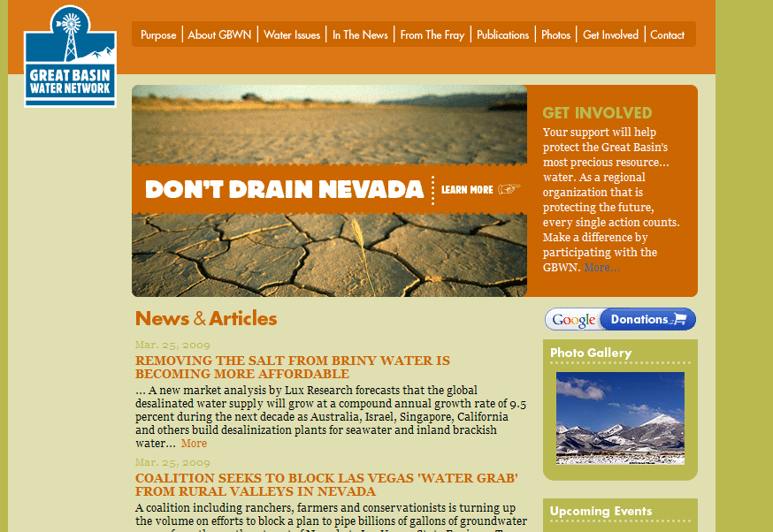


Slide 14
USGS Hydrogeology Report
Directed by Congress to evaluate:
the extent, thickness, and hydrologic properties of aquifers,
the volume and quality of water stored in aquifers,
subsurface geologic structures controlling groundwater flow,
groundwater flow directions and gradients, and
distributions and rates of recharge and groundwater discharge.

Slide 15
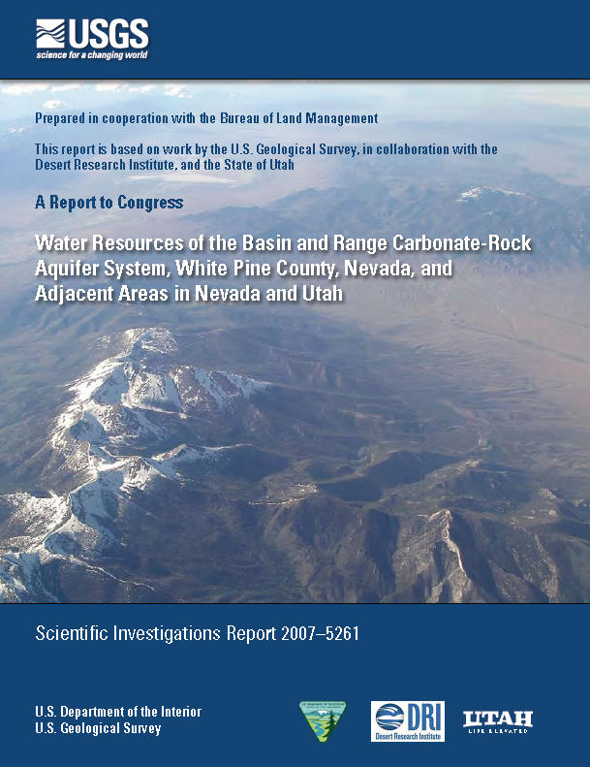
Hydrogeologic study three years of effort
Should provide “science basis” for decision making

Slide 16
USGS Water Budget
Groundwater Recharge
  Precipitation patterns
Groundwater Discharge
  Mean Annual Evapotranspiration
  Water Use
Groundwater Storage
Interbasin/Regional Flow Estimates
  Steady-State Water-Budget Accounting Model
  Hydrologic and Geochemical Constraints

Slide 17
Hydrologic Cycle (USGS)

Slide 18
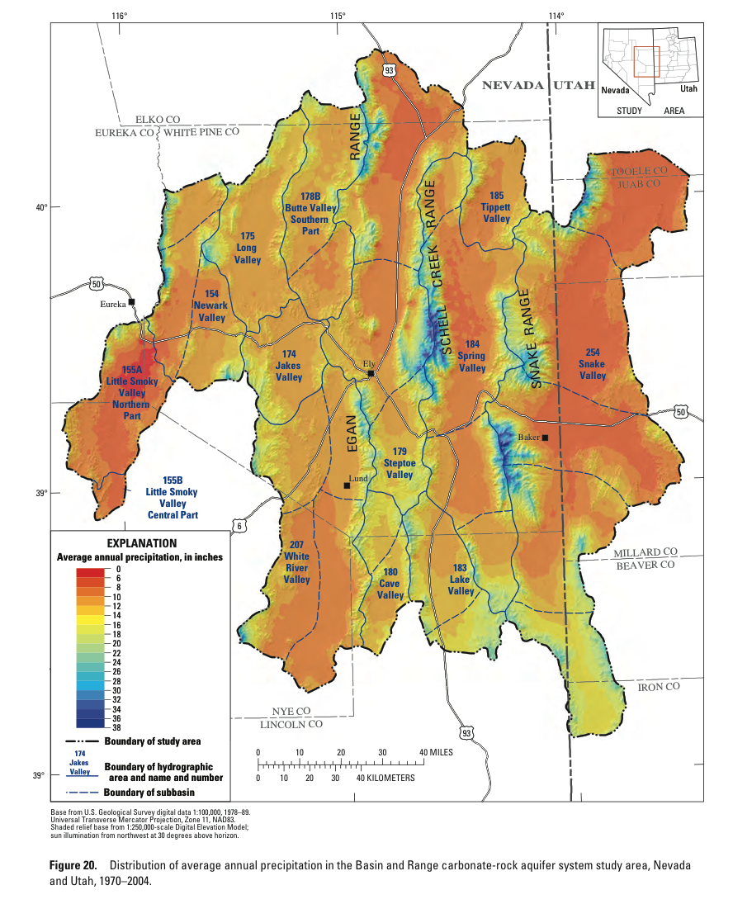
Precipitation

Slide 19
Recharge in the Mountains

Slide 20
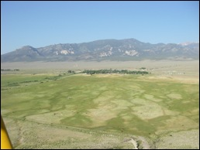
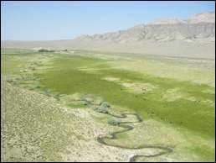
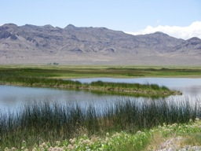
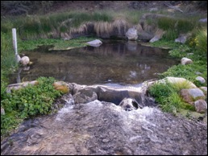
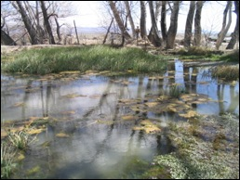
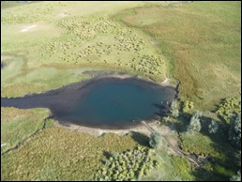
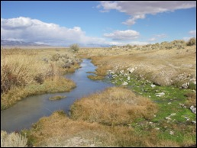
Discharge in the Valleys
From http://protectsnakevalley.com/watertour.html

Slide 22
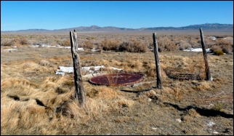
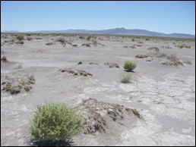
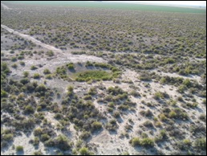
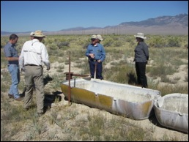
Results of modest groundwater removal for irrigation.

Slide 23
Recharge Estimates

Slide 24
Discharge
Ground water discharges naturally from the study area through
  spring and seep flow
  transpiration by local phreatophytic vegetation
  evaporation from soil and open water
  subsurface outflow.
About 17% of water leaves area by subsurface flow to Colorado River or Salt Lake

Slide 25
Discharge Estimates

Slide 26
Bottom Line: Is there enough to go around?
SNWA Authorized

Slide 27
USGS Storage Estimates
If SNWA usage came entirely from storage, the supply would last 100 years

Slide 28
The water budget in Snake and Spring Valleys will be altered
The water that is now available for ET (supplying springs, plants, wildlife) and local usage cannot remain unaffected.
The only way to accommodate SNWA use will be through changes in storage

Slide 29
Alternatives to Groundwater?
Yes but expensive

Slide 30
Desalinate Ocean water and transport to Las Vegas:
From a SNWA 2009 document

Slide 31
No sustainable solutions are currently under consideration
Groundwater mining will continue for the foreseeable future. There will be both short term and long term consequences

Slide 32
The End: Module One

