Slide 1

ESS 454
Hydrogeology
Module 4
Flow to Wells
Preliminaries, Radial Flow and Well Function
Non-dimensional Variables, Theis “Type” curve, and Cooper-Jacob Analysis
Aquifer boundaries, Recharge, Thiem equation
Other “Type” curves
Well Testing
Last Comments
Instructor: Michael Brown
brown@ess.washington.edu

Slide 2
Learning Objectives
Understand what is learned through “well testing”
Understand how “pump tests” and “slug (bailer) tests” are undertaken
Be able to interpret Cooper-Bredehoeft-Papadopulos and Hvorslev slug tests

Slide 3
Testing
Desired Outcome:
Gain understanding of the aquifer
Its “size” both
  physical extent and geometry
  amount of water
The ease of water flow and how it moves to well
Consequences of pumping

Slide 4
Testing
Goals:
Determine Aquifer T
and S (not all methods)
Identify recharge or barrier boundaries

Slide 5
Testing
Methods:
Already worked examples in process of developing understanding of how water flows to wells
Pump Testing
  Maintain a constant flow
    Measure the transient pressure/head
    Best to use “observation wells” but often too expensive
  Maintain constant pressure/head
    Measure transient flow
  Recovery test
    stop pumping and measure head as it return to initial state
Topics for follow on courses

Slide 6
Testing
Methods:
Slug Test (can be done in a single well)
  Look at pressure/head decay after instant charge of water level
  Various methods
  Skin-effects
Can (1) pour water in rapidly
(2) drop in object (slug) to raise water level
(3) bail water out (to rapidly drop water level)
Unwanted complication: Low hydraulic conductivity around well as a result of the drilling process

Slide 7
Cooper-Bredehoeft-PapadopolosTest
Goes from 1 to 0
Dimensionless number
Plot: H(t)/H_{o} vs log(Tt/r_{c}²)
Call it z
surface
r_{c}
1
r_{s}²/r_{c}² S
Smaller S
H(t)
H_{o}
Initial head
H(t)/H_{o}
Head returns to initial state
slug
Increased head causes radial flow into aquifer
0
b
0.01
0.1
1.0
10.0
z=Tt/r_{c}²
r_{s}

Slide 8
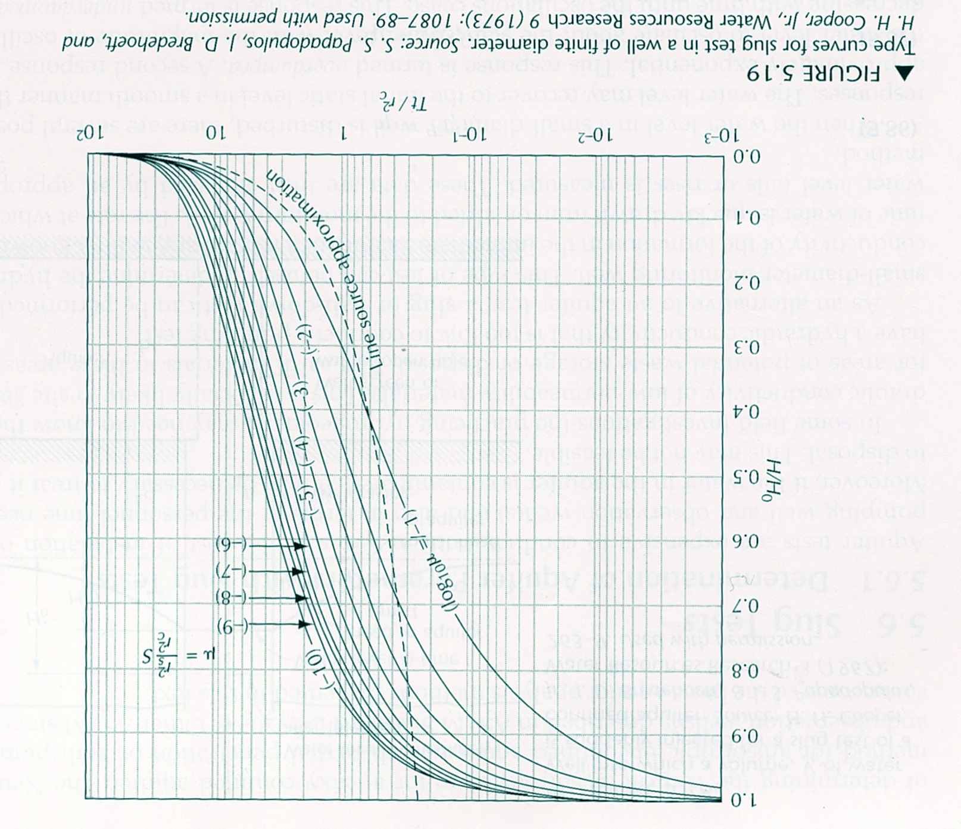
Cooper-Bredehoeft-PapadopolosTest
1
r_{s}= 1.0’
r_{c}= 0.5’
.8
.6
H/H_{o}
.4
.2
Match point at z=1, t=21 minutes
0
1
10
100
1000
minutes

Slide 9
Hvorslev Slug Test
Works for piezometer or auger hole placed to monitor water or water quality – not fully penetrating
r
Log scale
K only determined
1
.8
.7
.6
casing
.5
H/H_{o}=.37
.4
H/H_{o}
.3
L_{e}/R must be >8
Gravel pack
.2
L_{e}
t₃₇
Screen
.1
2
4
6
8
10
minutes
Linear scale
Partially Penetrating OK
high K material
R

Slide 10
The End: Well Testing
Coming up: Final Comments

