Slide 1

ESS 454
Hydrogeology
Module 5
Regional Groundwater Flow
Regional and Local Flow
Vectors, Matrixes, and Coordinate transformation
Anisotropic Hydraulic Conductivity
Groundwater interactions with surface water
Instructor: Michael Brown
brown@ess.washington.edu

Slide 2
Module 5 Concepts
Recharge and discharge regions
Local and regional flow systems
Stream lines and equipotential lines
Flow system boundary, stagnation point
Effects due to
  Buried lenses
  Layered hydraulic conductivity differences
Anisotropy => tensor properties of K and Darcy’s Law
Dynamic equilibrium
Fossil water/connate water/juvenile water/magmatic water
Karst terrains
Springs- depression/contact/fault/fracture/sinkhole

Slide 3
Learning Goals
Master new vocabulary and geologic terms
Be able to construct qualitatively correct flownets for all cross-sectional examples given in Chapter 7
Be able to identify areas of recharge and discharge and to be able to show how hydraulic heads varies with depth.
Understand the concepts of local vs regional flow and be able to identify it in flownets given in chapter 7
Be able to locate and label “flow system boundaries” and “stagnation points” on flownets
Understand qualitatively how anisotropy of hydraulic conductivity impacts flow direction
Be able to undertake quantitative calculation of flow direction and fluxes in anisotropic situations
Be able to give examples that illustrate the principal of “dynamic equilibrium” in groundwater systems
Understand that some groundwater is “non-cyclical”
Understand principals associated with the interaction of groundwater with surface water

Slide 4
Learning Goals-This Video
Be able to construct qualitatively correct flownets for all cross-sectional examples given in Chapter 7
Be able to identify areas of recharge and discharge and to be able to show how hydraulic heads varies with depth.
Understand the concepts of local vs regional flow and be able to identify it in flownets given in chapter 7
Be able to identify flow system boundaries and stagnation points
Be able to construct flownet with layered conductivity

Slide 5
Flownet Review
Applicable for 2-D steady-state flow
Graphical solution to LaPlace’s Equation
Identify flow boundary types
  No flow
    Flow parallel to boundary potential lines perpendicular to boundary
  Constant head
    Flow perpendicular, local potential parallel
  Water table
    No recharge – flow parallel, potential perpendicular
    Recharge – flow oblique downward
Construct flow lines and equipotential lines that
  do not cross
  are mutually perpendicular
  match boundary conditions

Slide 6
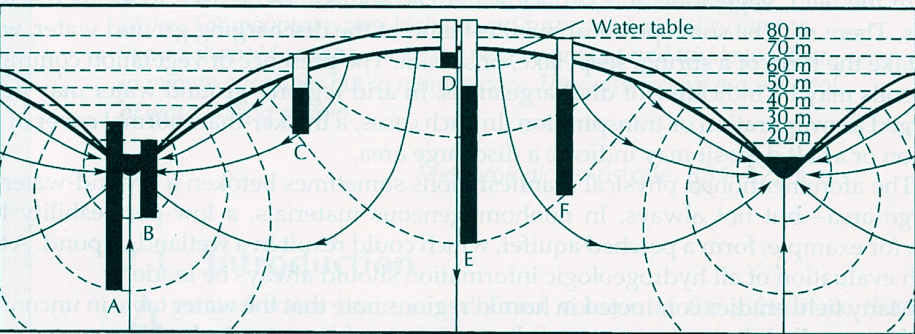
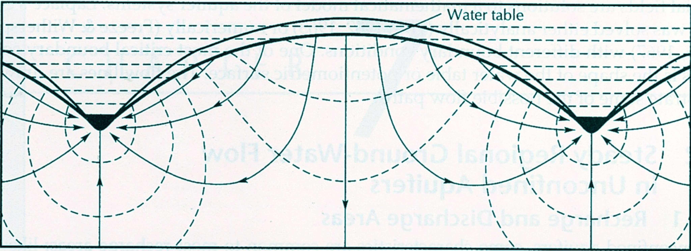
Piezometers – measure heads at bottom of holes
Recharge Region
flow
Flow down
Discharge Region
Δh
Discharge Region
Flow up
Δh
Lines close->high flow
Flow divide
Lines far apart-> low flow
Flow Divide
Bottom is not shown
Fetter 7.1-2 from M.K. Hubbert 1940
Flownet for isotropic homogeneous aquifer

Slide 7
Sloping water table (High on right side)
Fetter 7.3 from Toth 1960
Flownet for regional groundwater flow with sloping water table

Slide 8
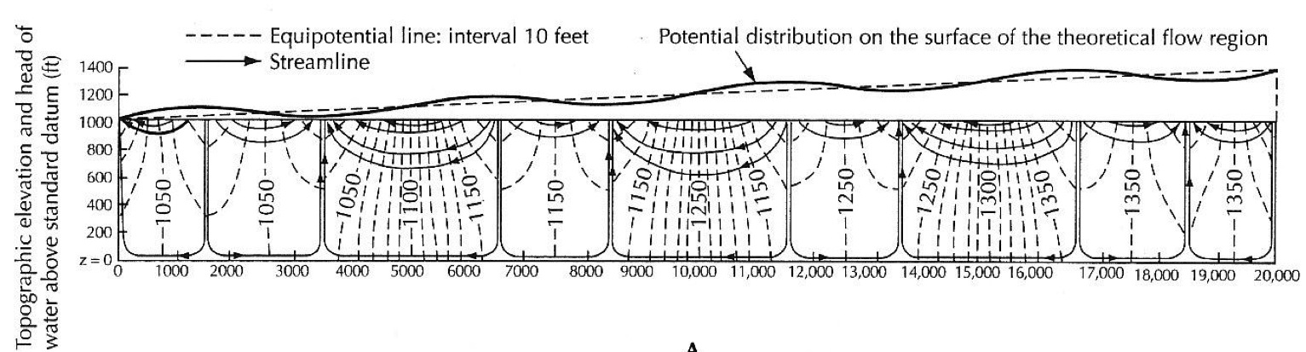
Flow
Flow
Flow
Flow
Flow
Flow
Flow
Flow
Fetter 7.4A
From Toth 1963
Flownet for basin with 20:1 aspect ratio and sloping water table with undulations

Slide 9
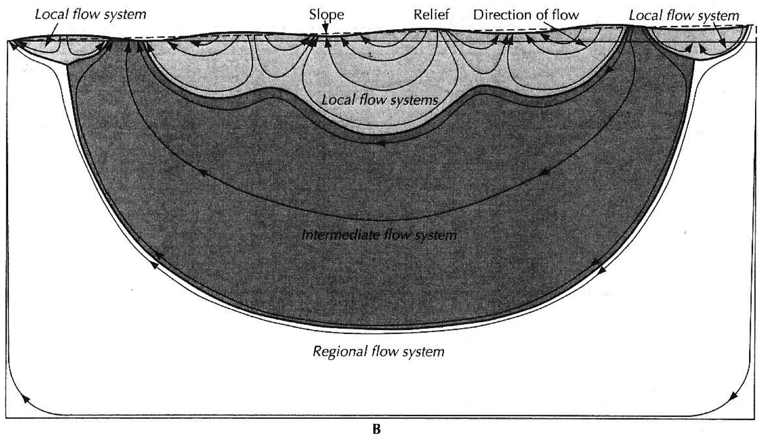
Fetter 7.4B
From Toth 1963
Flownet for basin with 2:1 aspect ratio and sloping water table with undulations

Slide 10
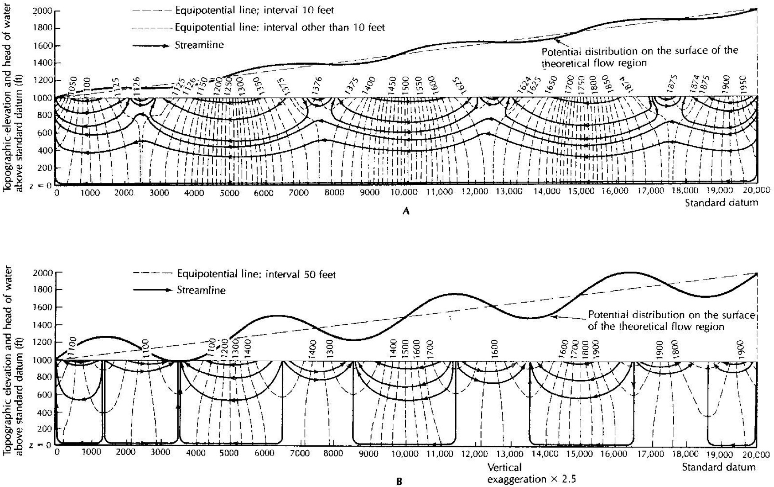
Figure 7.5 from Toth 1963
Flownets showing effect of undulation amplitude

Slide 11
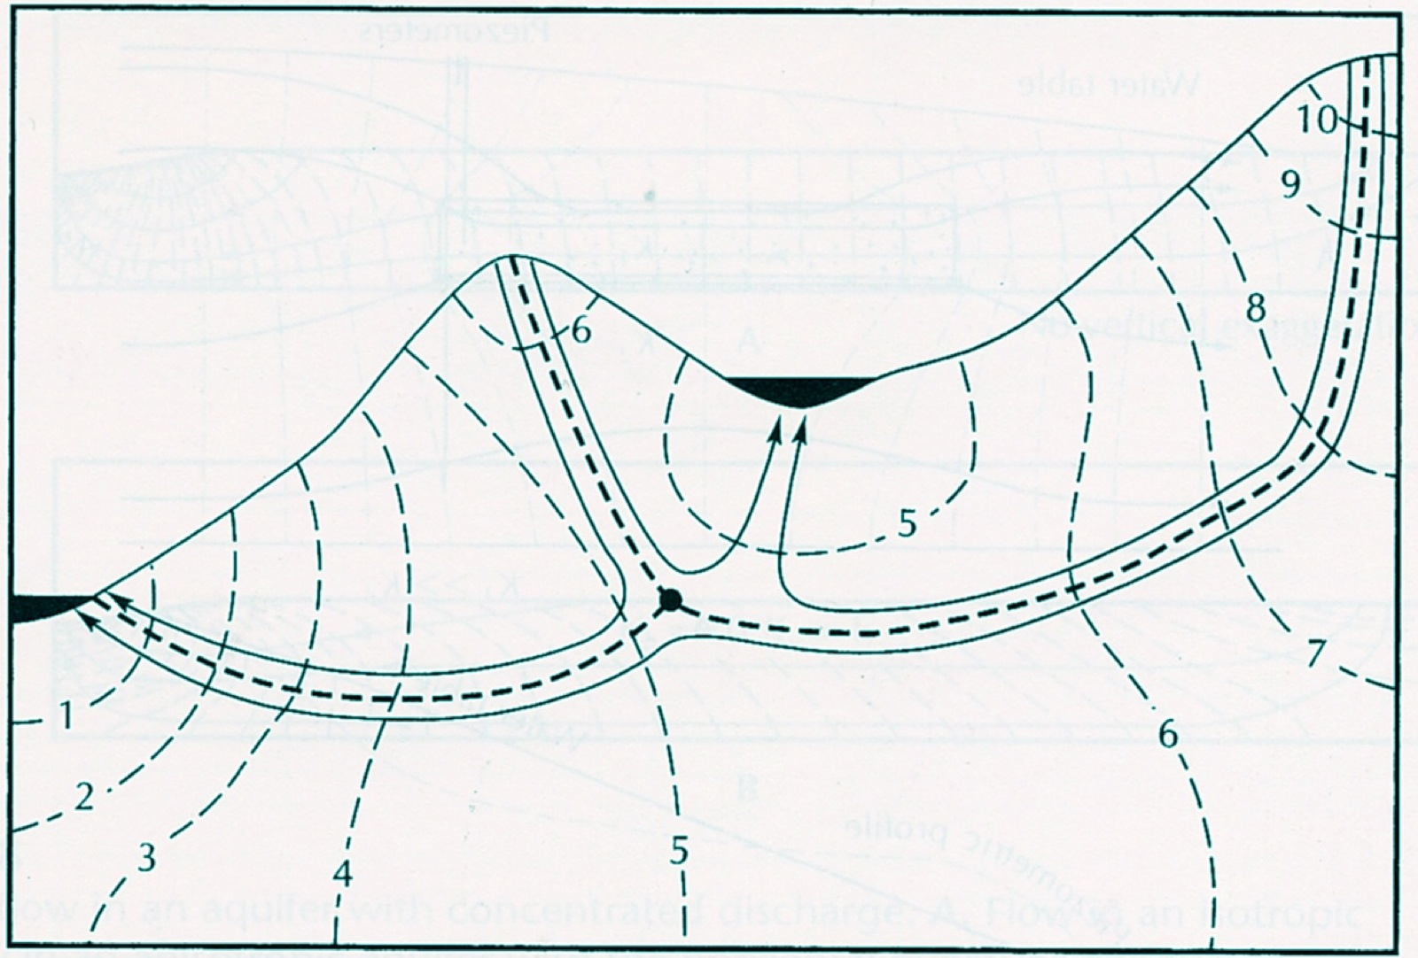
Stagnation point
(no local gradient)
Flow System Boundary
Fetter 7.6

Slide 12
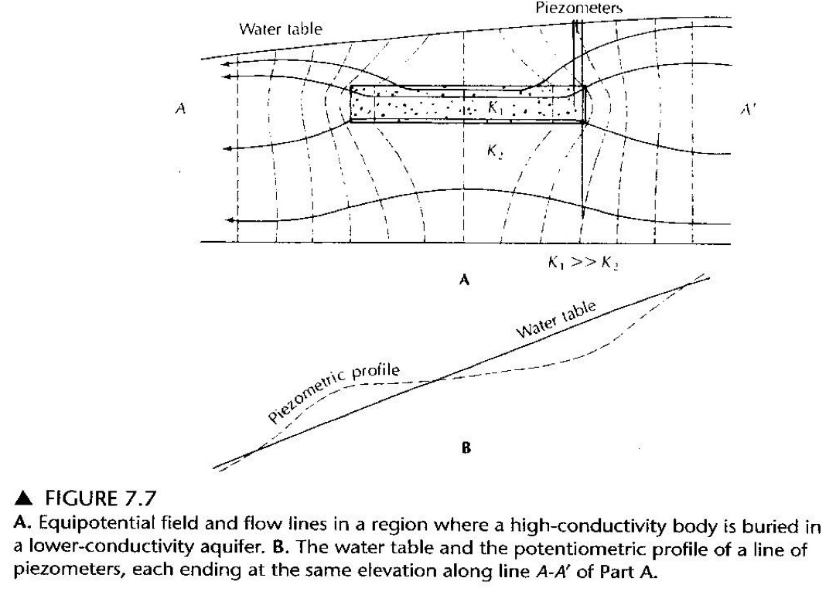

Slide 13
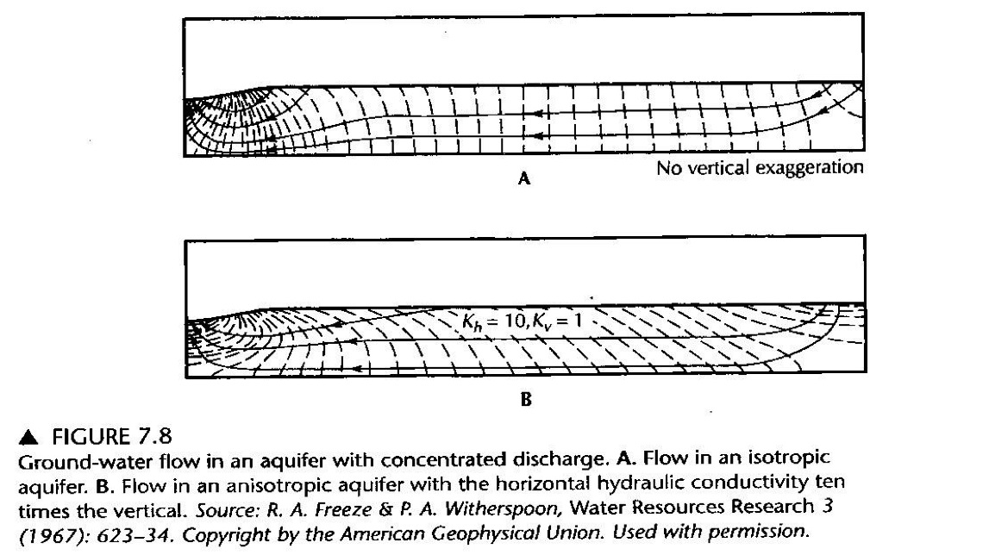

Slide 14
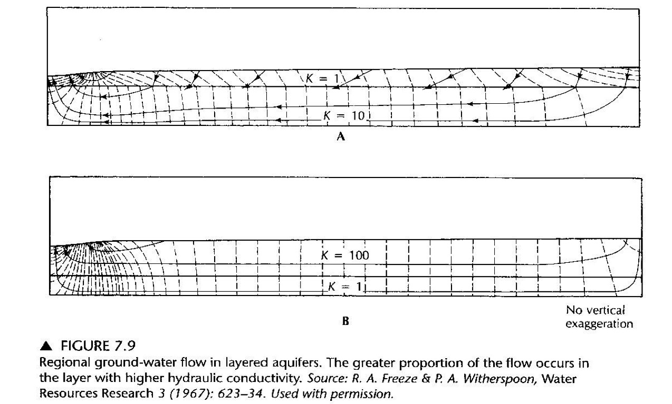

Slide 15
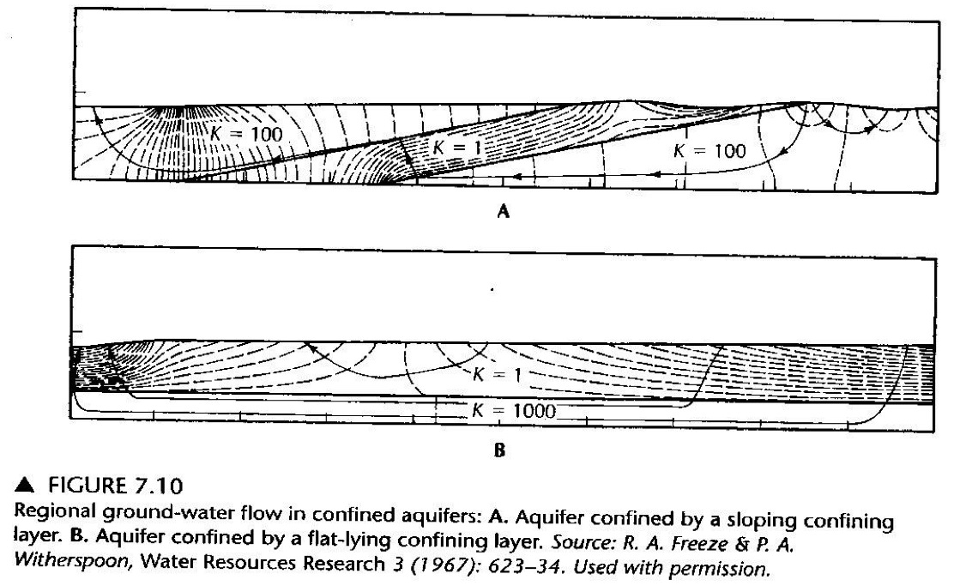
Low Conductivity
Highest head

Slide 16
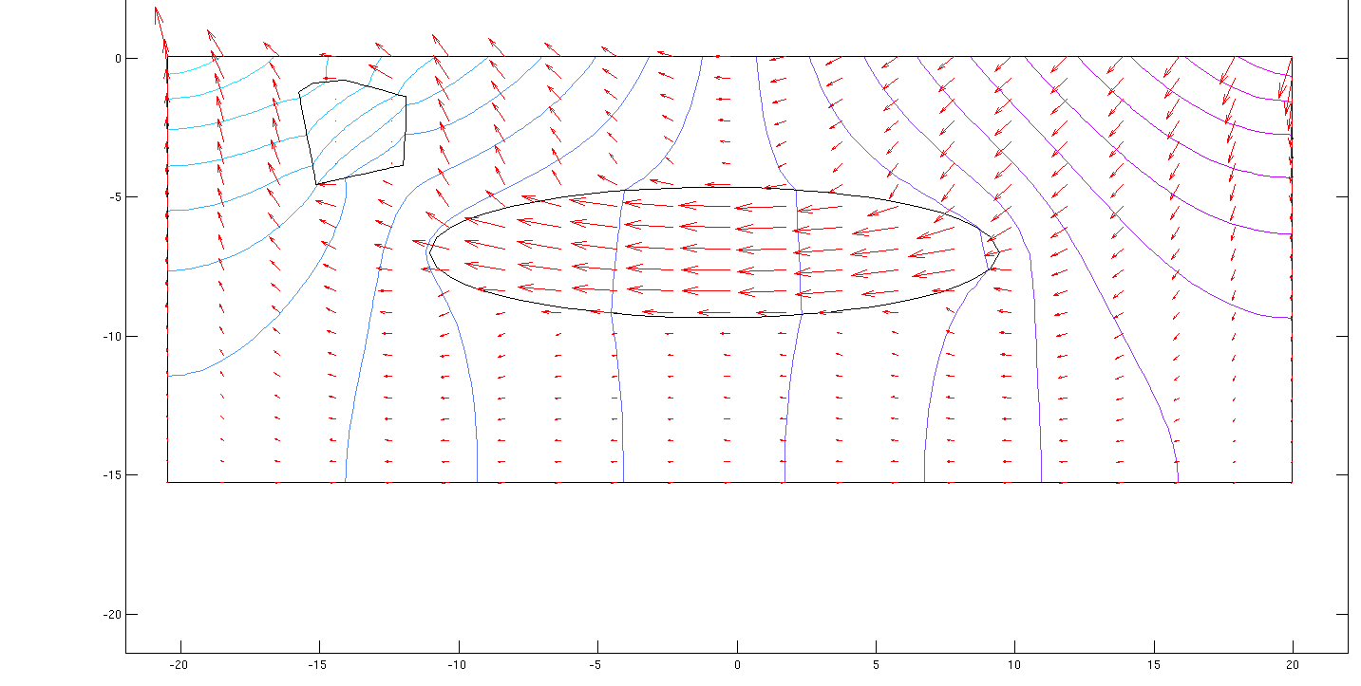
Example using MATLAB pdetool

Slide 17
The End
Coming up: Vectors and Matrixes

Slide 18
ESS 454
Hydrogeology
Module 5
Regional Groundwater Flow
Regional and Local Flow
Vectors, Matrixes, and Coordinate transformation
Anisotropic Hydraulic Conductivity
Groundwater interactions with surface water
Instructor: Michael Brown
brown@ess.washington.edu

Slide 19
Learning Objectives
Review of vectors and matrixes
  How to represent vectors
  How to describe their properties
    direction and magnitude
  How to represent a Matrix
  How to multiply a matrix and a vector
How to rotate coordinate systems

Slide 20
Vectors
z
r
“size” or “magnitude” is length of r
r_{z}
y
r_{y}
r_{x}
x
Often convenient to write r as column

Slide 21
Vector Directions
North
y
N30E
θ
How do you describe this vector?
3
Given
East
x
7
Description :
To two significant figures
z
Horizontal length
Magnitude is 7.9
Direction is N67E
Dip angle is 15°
Dip angle
7.62
I
-2
Dip angle

Slide 22
Matrixes
Matrix: array of numbers
j is row index
i is column index

Slide 23
Multiply a Matrix and a Vector
Result will be a new Vector
Matrix times a vector
Gives a vector

Slide 24
Multiply a Matrix and a Matrix
Result will be new Matrix

Slide 25
Comment
Matrix and vector multiplication is “easy” but “tedious”
>> m=[1 2 3
4 5 6
7 8 9];
>> n=[11 12 13
14 15 16
17 18 19];
>> m*n
90 96 102
216 231 246
342 366 390
Best to use numerical environment like Mathematica or Matlab
Matlab example:
Enter two matrixes and multiply them together

Slide 26
Coordinate Rotation
Why?
Geologic structures do not necessarily line up with map coordinates
y
y’
x’
Consider x’ to be a vector
– need tools to transform from “natural” coordinates of the geology to map coordinates
θ
θ
x
Put this together as matrix multiplies
It “transforms” coordinates xyz into coordinates x’y’z’
Call this 3x3 matrix the transformation matrix
Convention: θ is measured counter-clockwise

Slide 27
Coordinate Rotation
Use a_{ij} as label for transformation matrix
Rotation about the x-axis
Rotation about the y-axis
Can make compound rotation (first rotate about x, then rotate about y) by multiplying transformation matrixes together

Slide 28
Coordinate Rotation
Make substitution: 1==x, 2==y, 3==z
Old coordinates
x y z
x’
Converting to new coordinates
x’=[a_{xx}x , a_{xy}y, a_{xz}z]
y’
And similarly for y’ and z’
New coordinates
Going from new back:
z’
z=[a_{xz}x’,a_{yz}y’,a_{zz}z’]
And similarly for y and x
Sum of squares of any row or column is 1

Slide 29
Coordinate Rotation
Example:
N
R=[2x,1y,0z]
y
x
dip
θ
θ=45°
E
strike
A clock-wise rotation is needed here
What is the direction of R in map coordinates?
N??E

Slide 30
The End: Review of Vectors and Matrixes and Coordinate rotation
Coming Up: Tensor Representation of Hydraulic Conductivity

Slide 31
ESS 454
Hydrogeology
Module 5
Regional Groundwater Flow
Regional and Local Flow
Vectors, Matrixes, and Coordinate transformation
Anisotropic Hydraulic Conductivity
Groundwater interactions with surface water
Instructor: Michael Brown
brown@ess.washington.edu

Slide 32
Learning Objectives
What is a Tensor?
How do Tensors transform with Coordinate systems?
Why is hydraulic conductivity a Tensor?
How can Tensor values of K be determined?
How is Flow calculated for Tensor conductivity?

Slide 33
Tensors
What are they?
0th rank Tensor is a scalar
1st rank Tensor is a vector (3 components)
2nd rank Tensor is a 3x3 matrix
Mathematical definition: Tensors are objects that obey “certain”
rules for transformation of coordinates
Physical (pragmatic) definition: Tensors describe the directional
properties of physical systems
We will use a 2nd rank tensor (a 3x3 matrix) to describe the directional properties of K, the hydraulic conductivity
Scalar K becomes
a 3x3 matrix of numbers

Slide 34
Tensors
Transformation Rule:
a is the matrix to change coordinates
a^{t} is the transpose of a
Switch matrix elements across the diagonal
1. Do K times a^{t}
2. Multiply a and that
product

Slide 35
Why is K a Tensor?
K often is different in different directions
1. Vertical relative to horizontal
Particles can align under gravity so that the flow path is “easier” in one direction
Vertical flow may be more “tortuous” than horizontal flow
K_{v} < K_{h}
Plate-like (clay) particles

Slide 36
Why is K a Tensor?
2. Fracture direction
Flow is “easy” in direction of fractures
Flow is “hard” between fracture planes
K within plane of fractures is large
K in direction between fractures is small
And many other geologic reasons

Slide 37
K as Tensor
Look intimidating – But really not so bad
At worst, 6 numbers are needed (Tensor is symmetric – K_{xy}=K_{yx})
Even Better:
There is a coordinate system where K is “diagonal” – with only three independent values

Slide 38
K as Tensor
Math Theorem: In a particular coordinate system, the conductivity tensor is diagonal. Call this the “Principal Coordinates”
In this coordinate system, there is a simple interpretation of the three non-zero values
K₁ is conductivity in x-direction
K₂ is conductivity in y-direction
K₃ is conductivity in z-direction
Off-diagonal components are generated when coordinates are shifted to non-principal coordinates

Slide 39
Rotate K about z-axis

Slide 40
Rotate K about z-axis
If
And θ=45°
Rotation about the z-axis “generated” off-diagonal (but symmetric) elements

Slide 41
General Rules
To determine Tensor K, use the “natural coordinates” of the situation:
(Coordinates aligned with “hard” and “easy” directions of flow)
These will be “Principal Coordinates” where K is diagonal and the three non-zero values can be assigned by “inspection”
Example: flow with planar and parallel fractures:
K in the plane of the fractures (2 directions) will be the
“fracture” conductivity
K perpendicular to the fracture plane will be much smaller
Once you know the “principal coordinate” tensor, simply rotate it to the standard (map-based) coordinate system

Slide 42
Determining K Example
North
Fractures trend N40E
K in fracture direction is 10 ft/day
N40E
K perpendicular to fractures is 1 ft/day
East
What is the tensor representation of K using map coordinates?
Assume east is x-axis, north is the y-axis and z is up and down

Slide 43
Determining K Example
y
North
The x and z axes are in the fracture plane
In Natural coordinates
(aligned with the fractures)
North
x
East
East
Thus
K_{x} is large in fracture plane
and K_{y} is small across fractures
Now we need to rotate K into the map coordinates

Slide 44
Determining K Example
We need to rotate our tensor from natural coordinates to map coordinates
North
East
50°
The natural coordinate x is in the fracture direction
The map direction x’ (East) is a 50° clockwise rotation from x
Thus to rotate the natural coordinates to map coordinates we need a -50° rotation:

Slide 45
Determining K Example
Remember the result for a rotation about the z-axis
Substituting in -50° and K₁=10, K₂=1
Tensor K in map coordinates

Slide 46
Darcy’s Law with Tensor Conductivity
Use simple example where the vertical conductivity is smaller than the horizontal conductivity
K_{h}>K_{v}

Slide 47
Examples
z
x
Gradient along principal axis causes flow parallel to axis
z
x
Gradient in general direction results in flow that is NOT parallel to gradient
z
27° from x
x
45° from x

Slide 48
The End
Coming Up: Groundwater Interactions with Surface Water

Slide 49
ESS 454
Hydrogeology
Module 5
Regional Groundwater Flow
Regional and Local Flow
Vectors, Matrixes, and Coordinate transformation
Anisotropic Hydraulic Conductivity
Groundwater interactions with surface water
Instructor: Michael Brown
brown@ess.washington.edu

Slide 50
Learning Objectives
Be able to give examples that illustrate the principal of “dynamic equilibrium” in groundwater systems
Understand that some water is “non-cyclical”
  fossil, connate, magmatic, juvenile
Understand principals associated with the interaction of groundwater with surface water

Slide 51
“Dynamic equilibrium”
Flux_{out} = Flux_{in} +/- change in storage
“Equilibrium” implies steady-state
  Net flow in is balanced by flow out
A system cannot continue to add to or subtract from storage
  Natural systems reach situation where change in storage is zero or nearly zero
  It is in “equilibrium” at that point
However, changes are inherent to natural systems
  Annual precipitation varies
  Amount of groundwater pumping changes
Thus, the “equilibrium state” must shift to match new conditions
  Call this a “Dynamic Equilibrium”

Slide 52
Non-cyclical water
Not all groundwater is free to cycle through the groundwater-surface water system
Fossil water has been locked in rock that is sufficiently impermeable to eliminate flow for a long time
Connate water was trapped in the rock at the time of its formation and resides in pores that are not interconnected
“Juvenile water” is water that is making it’s first appearance at Earth’s surface
  At least four oceans worth of water are still trapped in Earth’s mantle.
  Some of this water finds its way into volcanic systems and is vented at Earth’s surface
“Magmatic water” is water released from volcanic systems ( both “juvenile” and groundwater that is dissolved in the magma)

Slide 53
Springs
Aquifer hydraulic head is at local surface level, a path to surface is available, and surface water can flow away
Unconfined water table reaches surface
Local surface low

Slide 54
Springs
Aquifer hydraulic head is above local surface level, a path to surface is available, and surface water can flow
Lower confining layer and aquifer terminate at a steep slope
Spring water emerges at contact

Slide 55
Springs
Aquifer hydraulic head is above local surface level, a path to surface is available, and surface water can flow
Fault offsets aquifer and creates barrier boundary

Slide 56
Springs
Aquifer hydraulic head is above local surface level, a path to surface is available, and surface water can flow
Karst Terrain includes “solution cavities” (frequently aligned with joints and cracks)
“Sinkholes” occur when cavity ceiling collapses

Slide 57
Springs
Aquifer hydraulic head is above local surface level, a path to surface is available, and surface water can flow
Path to surface may be provided by natural cracks (joints).

Slide 58
Springs
Aquifer hydraulic head is above local surface level, a path to surface is available, and surface water can flow
“Fracture zone” implies more pervasive jointing due to stress-induced breakage

Slide 59
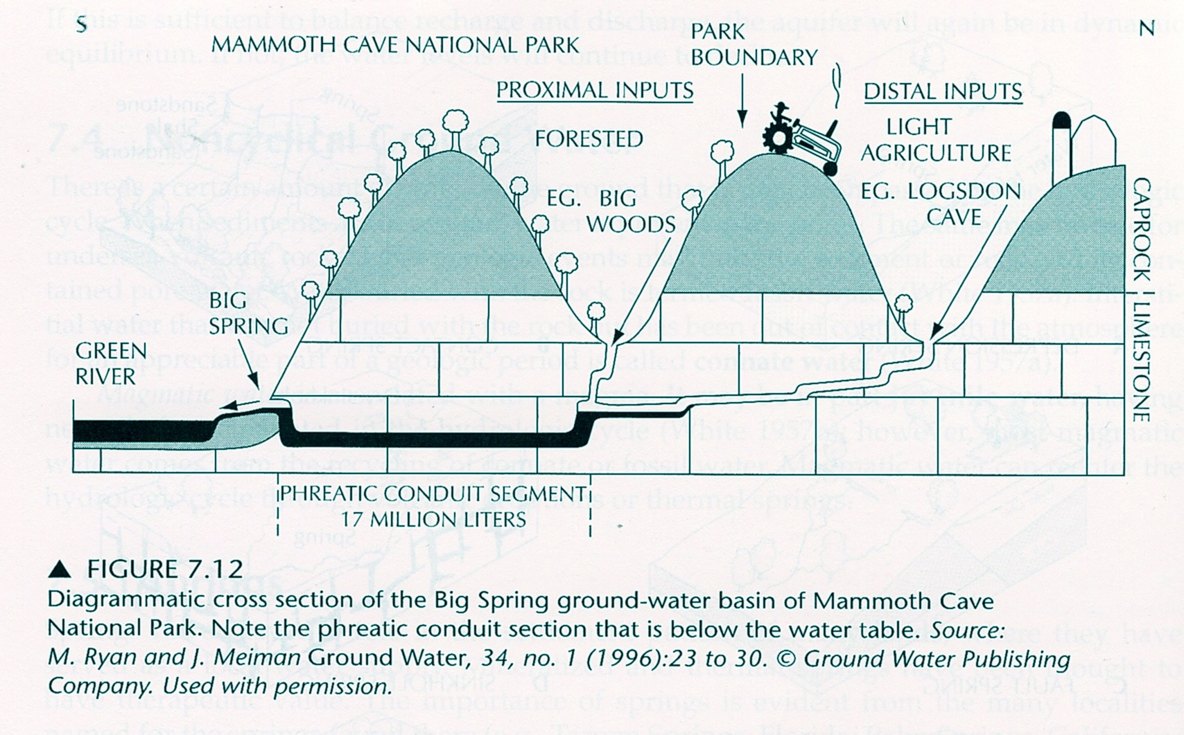

Slide 60
Streams, lakes and wetland interactions
Gradient induced flow to lake
Contours give levels of hydraulic head
Wetlands or lakes are found where hydraulic head and surface are at same elevation
Surface water can feed into groundwater or be replenished by ground water
Pay attention to direction of flow
Gradient induced flow from lake

Slide 61
Streams, lakes and wetland interactions
Lake can gain water from groundwater
and loses water through a stream
Stream has flow from lake
and is gaining flow from groundwater

Slide 62
Streams, lakes and wetland interactions
Lake gaining from groundwater and from stream flow
Streams gaining from groundwater
Lake losing only from groundwater flow

Slide 63
Streams, lakes and wetland interactions
Lake gaining from streams and groundwater flow
Lake losing from streams and groundwater flow
All streams gaining from groundwater

Slide 64
Streams, lakes and wetland interactions
Lake gaining from streams a nd groundwater
Lake losing from stream and groundwater
Lower stream losing to groundwater

Slide 65
Streams, lakes and wetland interactions
Lake gaining from groundwater and from streams
No surface or groundwater leaving lake

Slide 66
Module 5 Summary
Master new vocabulary and geologic terms
Be able to construct qualitatively correct flownets for all cross-sectional examples given in Chapter 7
Be able to identify areas of recharge and discharge and to be able to show how hydraulic heads varies with depth.
Understand the concepts of local vs regional flow and be able to identify it in flownets given in chapter 7
Be able to locate and label “flow system boundaries” and “stagnation points” on flownets
Understand qualitatively how anisotropy of hydraulic conductivity impacts flow direction
Be able to undertake quantitative calculation of flow direction and fluxes in anisotropic situations
Be able to give examples that illustrate the principal of “dynamic equilibrium” in groundwater systems
Understand that some groundwater is “non-cyclical”
Understand principals associated with the interaction of groundwater with surface water

Slide 67
The End: Module 5 - Regional Groundwater Flow
Coming Up: Geologic Occurrences of Groundwater

