Slide 1

ESS 454
Hydrogeology
Module 4
Flow to Wells
Preliminaries, Radial Flow and Well Function
Non-dimensional Variables, Theis “Type” curve, and Cooper-Jacob Analysis
Aquifer boundaries, Recharge, Thiem equation
Other “Type” curves
Well Testing
Last Comments
Instructor: Michael Brown
brown@ess.washington.edu

Slide 2
Learning Objectives
Understand contribution of borehole storage and skin effects to flow to wells
Be able to identify factors controlling well flow from initiation of pumping to late time
Understand (qualitatively and quantitatively) what is meant by well interference
Understand the effect of boundaries (recharge and barrier) on flow to wells
Understand what is meant by ambient flow in a borehole and what information can be gained from flow logging or a packer test
Recognize the large range of geometries in natural systems and the limits to application of the models discussed in this module

Slide 3
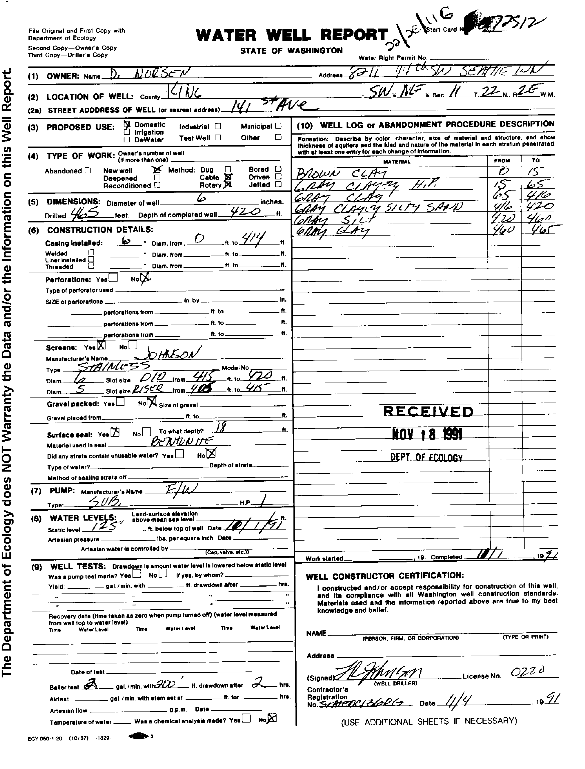
Borehole Storage
When pumping begins, the first water comes from the borehole
If the aquifer has low T and S, a large Δh may be needed to induce flow into the well
If water is coming from Borehole Storage, Δh will be proportional to time
Example: A King County domestic water well
1 gallon =.134 ft³
200’ of 0.5’ well bore = π*0.25²*200=39 ft³
420’ deep
0.5’ diameter
Head is 125’ below surface
5’ screened in silty sand
2 gallons/minute = 32 ft³ in 2 hour
During pump test all water came from well bore.
Pump test:
Q=2 gallons/minute
Δh=200’ after 2 hours
This is not a very good well
Need to know how long it takes for water to recover when pump is turned off

Slide 4
Skin Effects
Drilling tends to smear clay into aquifer near the borehole
  Leads to low conductivity layer around the screen
  Tends to retard flow of water into well
Slug test (or any single well test) may
  measure properties of skin and not properties of aquifer
Critical step is “Well development”
  water is surged into and out of well to clear the skin

Slide 5
Controls on flow in wells:
in order of impact from early to late time
  Borehole storage
  Skin effect
  Aquifer Storativity
  Aquifer Transmissivity
  Recharge/barrier boundaries

Slide 6
Well interference
And Barrier Boundary
Drawdown with barrier boundary of aquifer can be calculated as the interference due to an “image” well
Confined Aquifer
Greater drawdown
Smaller hydraulic gradient
Reduced flow to wells
Flow divide between wells
Hydraulic head is measure of energy
Energy is a scalar and is additive
Just add drawdown for each well to get total drawdown

Slide 7
Boundary and Dimension Effects
2-D
1-D
3-D
Reservoir geometry
Network/Flow geometry
Discussion of ways to deal with these “real-world” situations is beyond the scope of this class

Slide 8
Last Comments on well testing
If data don’t fit the analysis
    Wrong assumptions
    Interesting geology
Don’t “force a square peg through a round hole”
  Don’t try to make data fit a curve that is inappropriate for the situation
Much more to cover in a follow up course!

Slide 9
Well Logging
Ambient Flow logging
  measurement of flow in borehole at different depths in absence of pumping
  In an open (uncased) well, water will flow between regions with different hydraulic head
“Packer test”
  utilizes a device that closes off a small portion of an uncased well
  measures the local hydraulic head
Much more to discuss in follow-on courses

Slide 10
Summary
Master new vocabulary
Understand concepts of “non-equilibrium flow”, ”steady-state flow” and “transient flow” and the geologic conditions that control flow
Recognize the diffusion equation and Darcy’s Law in axial coordinates
Understand (qualitatively and quantitatively) how water is produced from an aquifer to the well for both confined and unconfined aquifers
Understand how the Theis equation was derived and be able to use the well function to calculate drawdown as a function of time and distance
Be able to use non-dimensional variables to characterize the behavior of flow from wells
Be able to identify when the Thiem equation is appropriate and use it in quantitative calculations
Be able to use Theis and Jacob-Cooper methods to determine aquifer transmissivity and storativity
Be able to describe how draw-down curves are impacted by aquifer properties or recharge/barrier boundaries and quantitatively estimate the size of an aquifer
Understand how aquifer properties are determined in slug tests and be able to undertake quantitative analysis of Hvorslev and Cooper-Bredehoeft-Papadopulos tests.
Be able to describe what controls flow from wells starting at early time and extending to long time intervals
Be able to describe quantitatively how drawdown behaves if nearby wells have overlapping cones of depression
Understand the limits to what has been developed in this module

Slide 11
The End: Flow to Wells
Coming Up: Regional Groundwater Flow

