Slide 1
Finding GIS data
Importing GIS data
ESRM 250/CFR 520 Autumn 2009
Phil Hurvitz

Slide 2
Overview
Finding and importing data sets
Searching for data
Importing data

Slide 3
Overview
Searching for data
Web search engines
NSDI Geospatial Data Clearinghouse
USGS GeoData site
The Geography Network
University of Washington Map Library Geospatial Data Archive (WAGDA)
GIS Data Depot

Slide 4
Overview
Searching for data
Web search engines
NSDI Geospatial Data Clearinghouse
USGS GeoData site
The Geography Network
University of Washington Map Library Geospatial Data Archive (WAGDA)
GIS Data Depot

Slide 5
Searching for data: Web search engines
Primary method for searching for general data on the net
(+) Keyword searching
(+) Logical parsing of searches
(+) Search is far and wide
(+) Possible to use meta-searchers
(+) Graphical results
(–) Low precision

Slide 6
Searching for data: Web search engines
Search for “GIS & data”
results are
fairly good

Slide 7
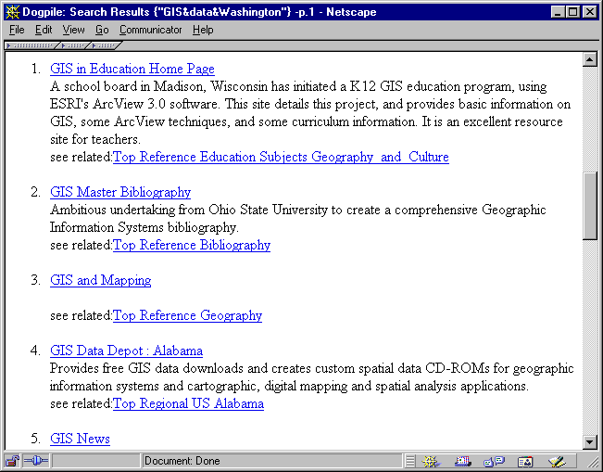
Searching for data: Web search engines
Search for “GIS & data & Washington”
results are
NOT good

Slide 8
Searching for data: Web search engines
Why are web search engines not the best tool for searching GIS data?
Search engine indexes are created by “spiders”
Spiders only find and index keywords, not meaning
Searching for keywords is not efficient
Too many erroneous matches
Not a true database query
No spatial coordinates in normal search engines
Too many dead ends and broken links
No standard format for searching various engines

Slide 9
Overview
Searching for data
Web search engines
NSDI Geospatial Data Clearinghouse
USGS GeoData site
The Geography Network
University of Washington Map Library Geospatial Data Archive (WAGDA)
GIS Data Depot

Slide 10
Searching for data: NSDI
Better/more efficient methods are needed for obtaining GIS data
Federal Geospatial Data Committee (FGDC)
Federal agency with mission to increase access/use of geospatial data
National Spatial Data Infrastructure ( NSDI)
Coordinated effort among many participants

Slide 11
Searching for data: NSDI GDC
NSDI Geospatial Data Clearinghouse
Built on a distributed database
Database is Z39.50 compliant (international library data standard)
Queries are run against specific fields rather than as simple keywords
Fields are specifically for geospatial data description

Slide 12
Searching for data: NSDI GDC
Specific GDC server network built on top of the Network
Use of common search engine
Metadata (“data about data” = data description files) are the keystone

Slide 13
Searching for data: NSDI GDC: Metadata
Content-standardized metadata is the foundation of a robust searching tool
Records for individual data sets contain data for specific fields, e.g.,
Title
Abstract
Spatial extent, projection, coordinate system
Data type
Currency of time scale
Source scale
Developer/Contact information

Slide 14
Searching for data: NSDI GDC: Indexed databases
Metadata records are indexed into international library standard (“Z39.50 protocol”) databases
Specific sites containing indexes (nodes) are registered with search server sites
Searching functions are embedded in web interfaces
Searches can be limited to individual nodes or to many nodes
Databases are searchable across TCP/IP networks (web, simple terminal)
Results are displayed in web pages
This is impossible with a simple Google search!

Slide 15
Searching for data: NSDI GDC: Searching
Search by place name or geographic location

Slide 16
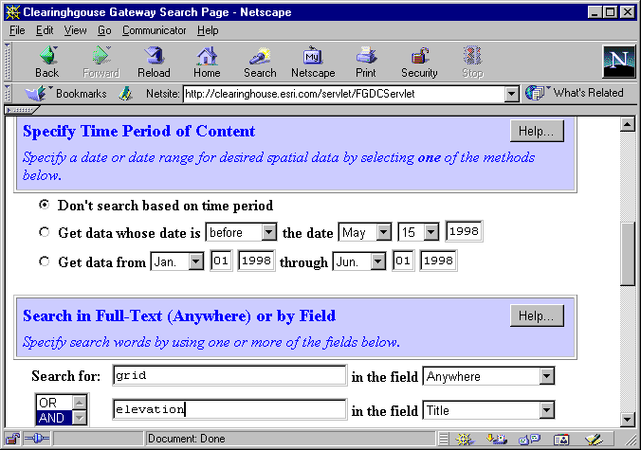
Searching for data: NSDI GDC: Searching
Search by time period or various other fields

Slide 17
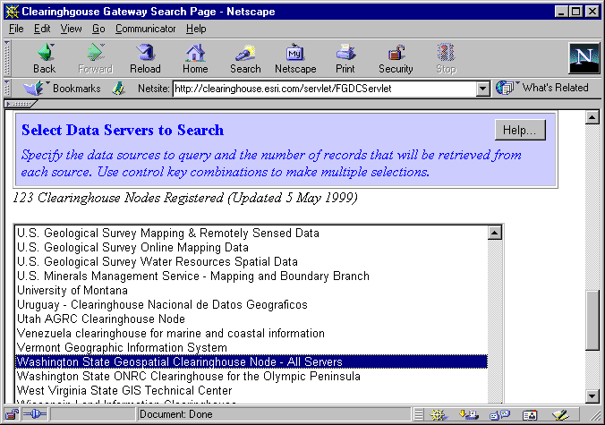
Searching for data: NSDI GDC: Searching
Select node to search

Slide 18
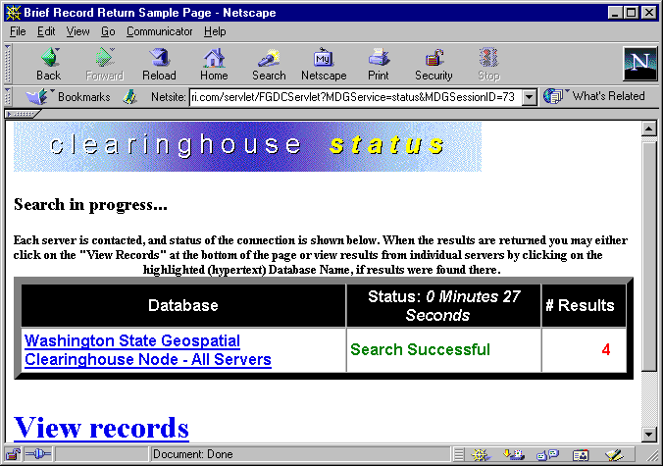
Searching for data: NSDI GDC: Results
Number of hits is displayed

Slide 19
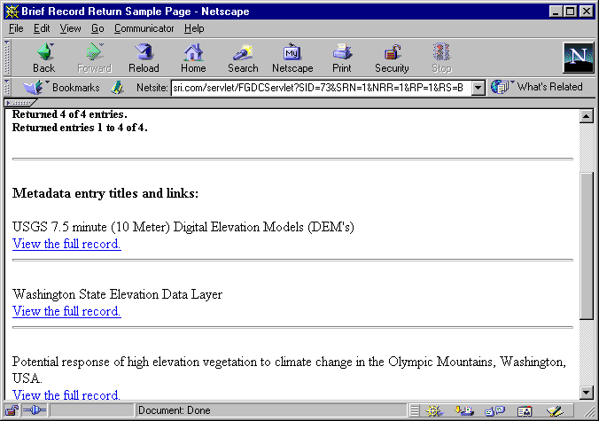
Searching for data: NSDI GDC: Results
Individual record titles can be viewed

Slide 20
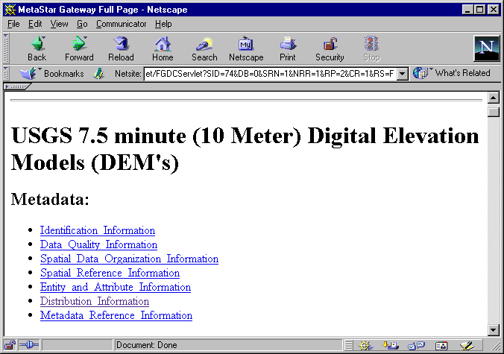
Searching for data: NSDI GDC: Results
Individual records can be read

Slide 21
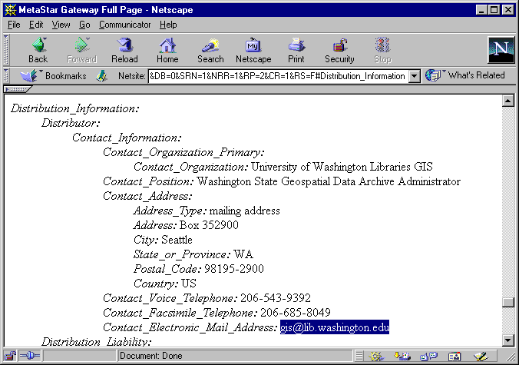
Searching for data: NSDI GDC: Results
Distribution information should be included

Slide 22
Searching for data: NSDI GDC: Results
Drawbacks:
Content is not always up to date
Metadata records have no requirement to provide actual data sets!
Links may be bad

Slide 23
Overview
Searching for data
Web search engines
NSDI Geospatial Data Clearinghouse
USGS GeoData site
The Geography Network
University of Washington Map Library Geospatial Data Archive (WAGDA)
GIS Data Depot

Slide 24
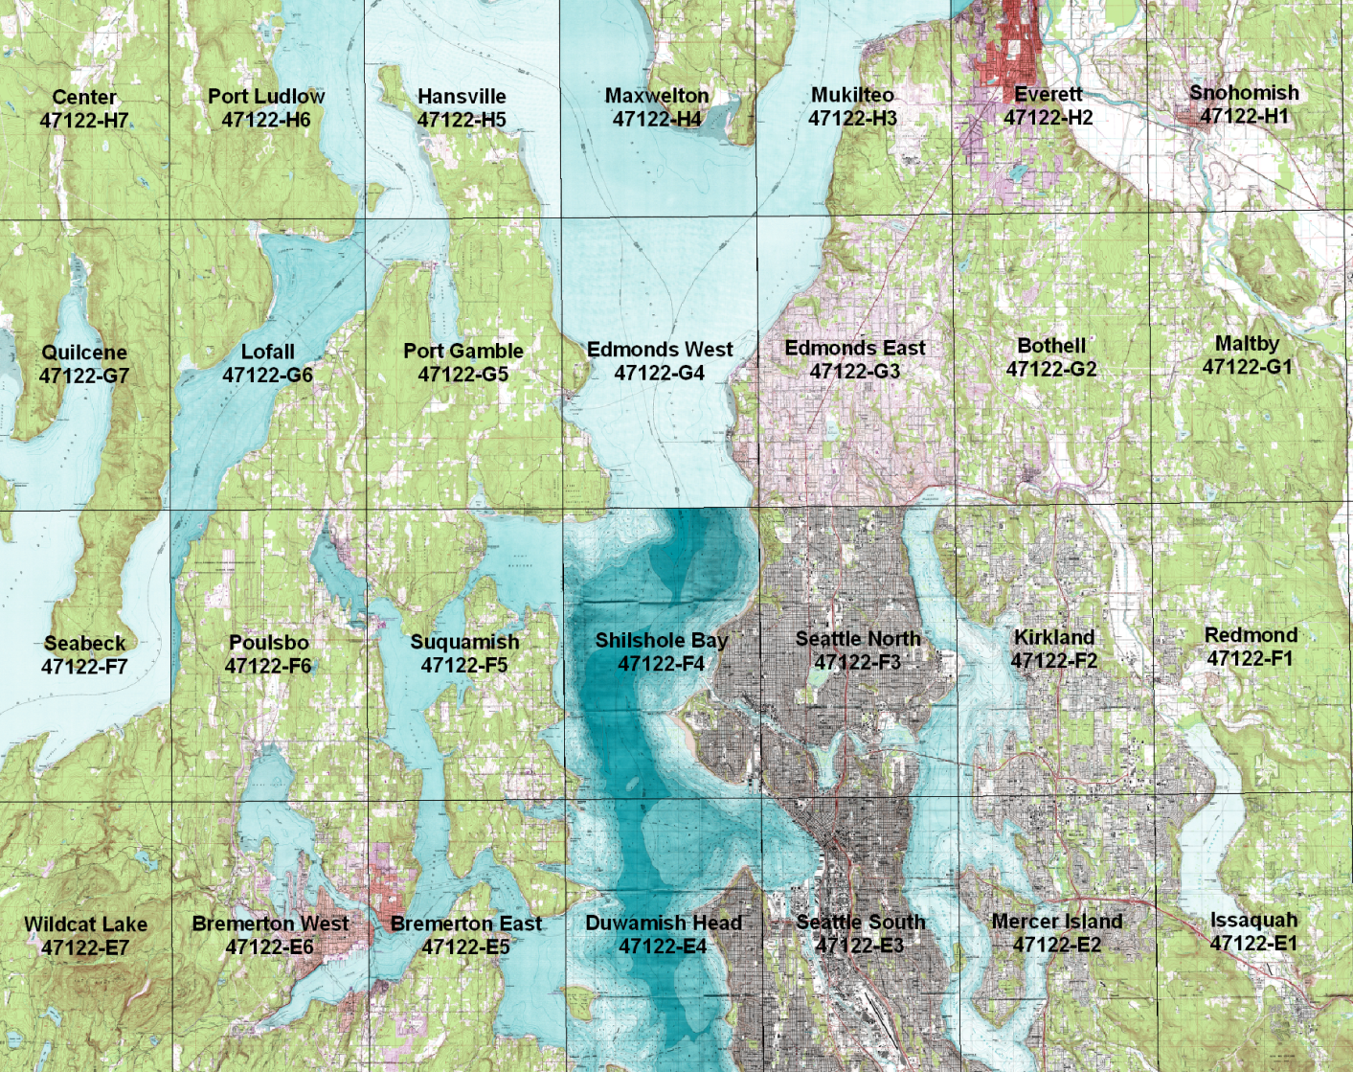
USGS Data Organization
By quadrangles of different size and scale

Slide 25
Searching for data: USGS GeoData site
A tremendous amount of data area available for “free” (who paid??)
Data sets representing USGS topographic quadrangles
Data from paper maps converted to digital format
DEM (raster elevation) data
Vector data for a variety of themes
Variety of source scales

Slide 26
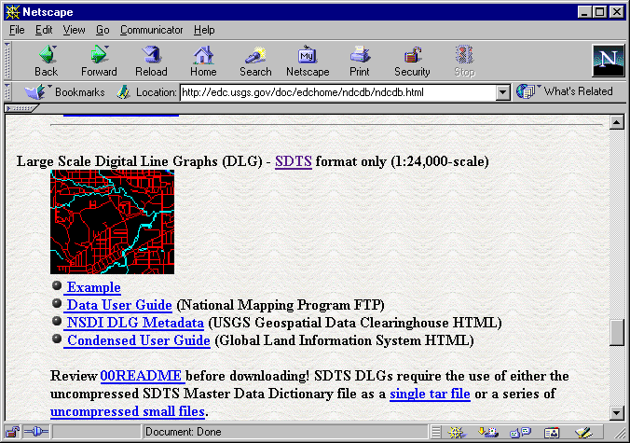
Searching for data: USGS GeoData site
7.5’ (1:24,000) topographic quadrangle vector data series

Slide 27
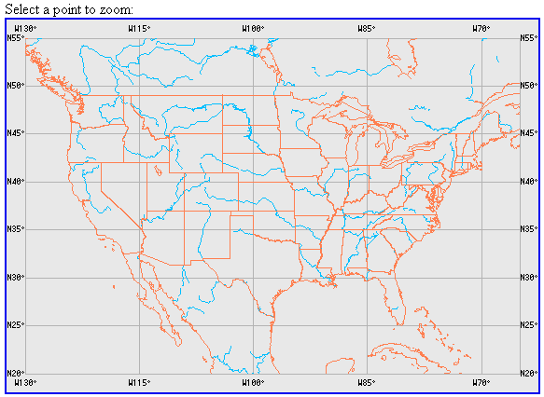
Searching for data: USGS GeoData site: Downloading
Interactive searching

Slide 28
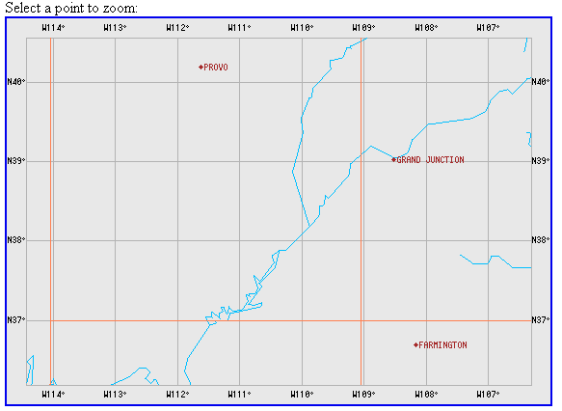
Searching for data: USGS GeoData site: Downloading
Interactive searching

Slide 29
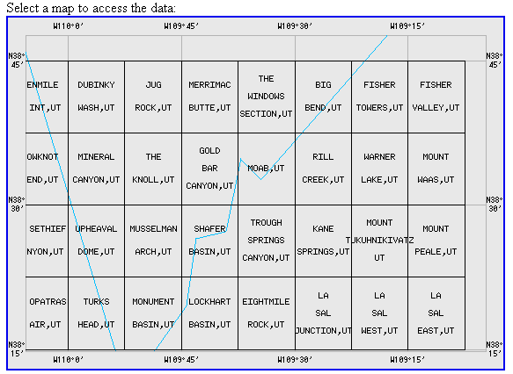
Searching for data: USGS GeoData site: Downloading
Interactive searching

Slide 30
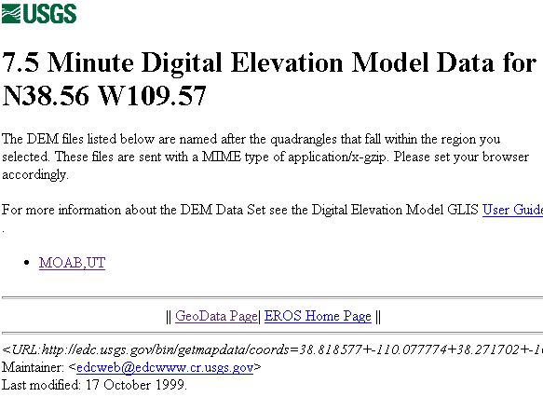
Searching for data: USGS GeoData site: Downloading
Individual files for a quad can be downloaded

Slide 31
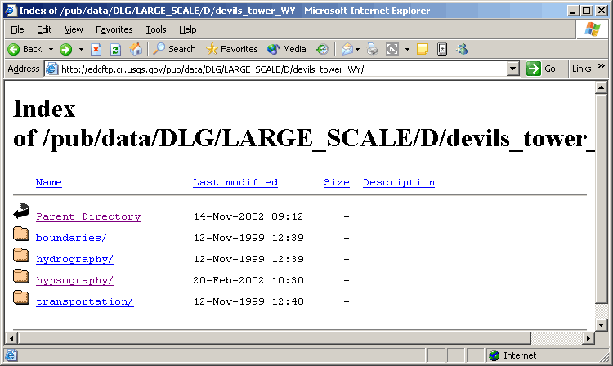
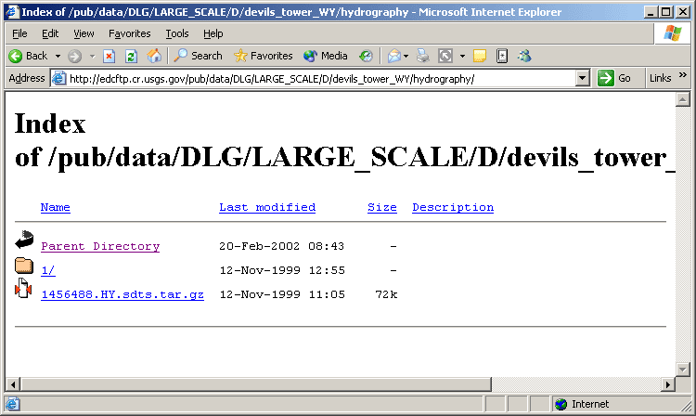
Individual files for a quad
Available files are listed

Slide 32
Overview
Searching for data
Web search engines
NSDI Geospatial Data Clearinghouse
USGS GeoData site
The Geography Network
University of Washington Map Library Geospatial Data Archive (WAGDA)
GIS Data Depot

Slide 33
The Geography Network
The Geography Network
Server network built on ESRI technology
Searchable
Some data available for download
Some free
Some at a cost
Much “live” data (can add to ArcGIS but not download)

Slide 34
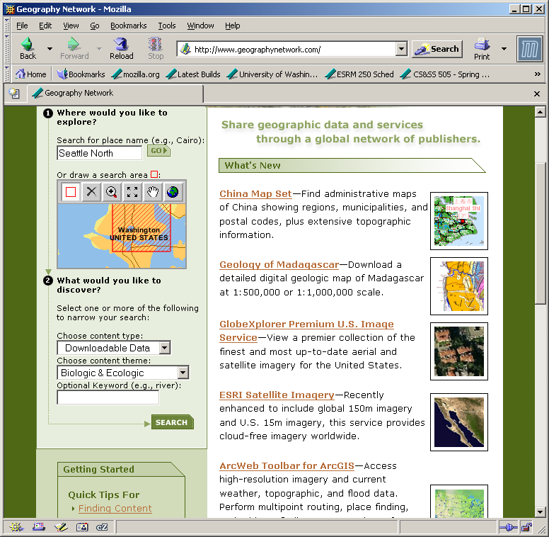
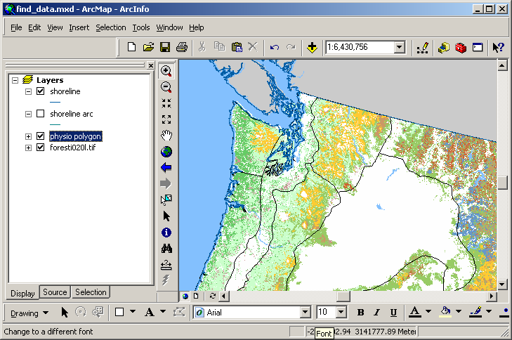
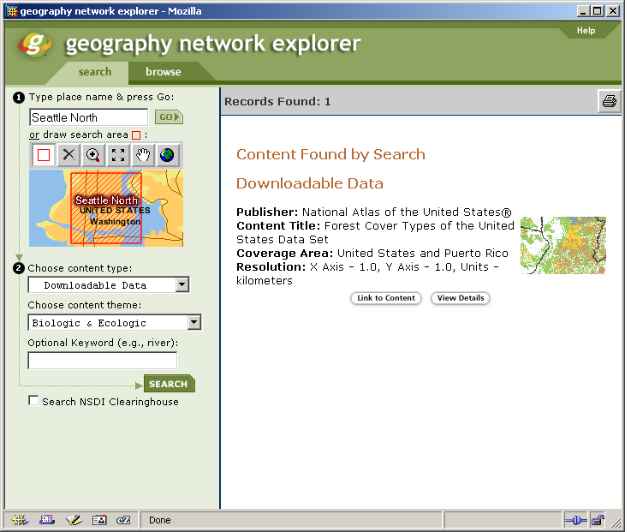
The Geography Network
Searching is easy

Slide 35
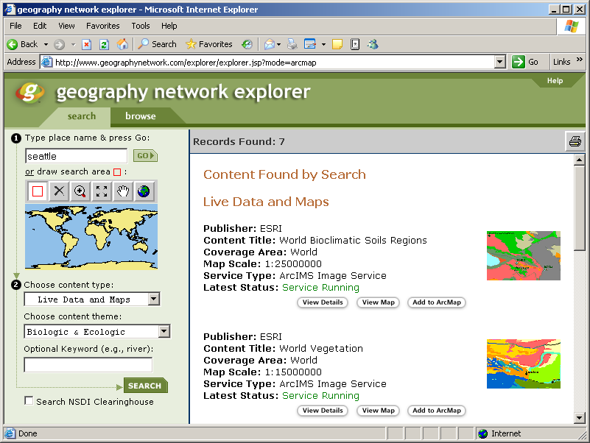
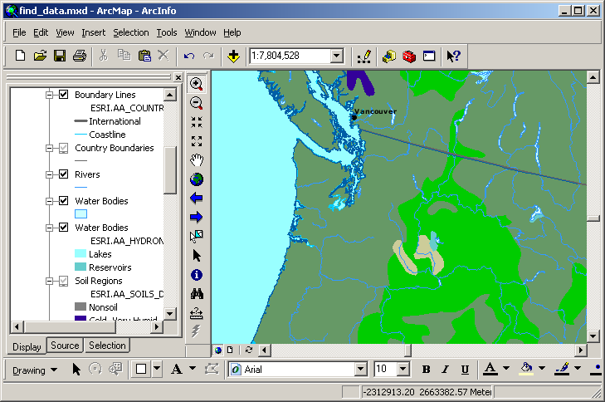
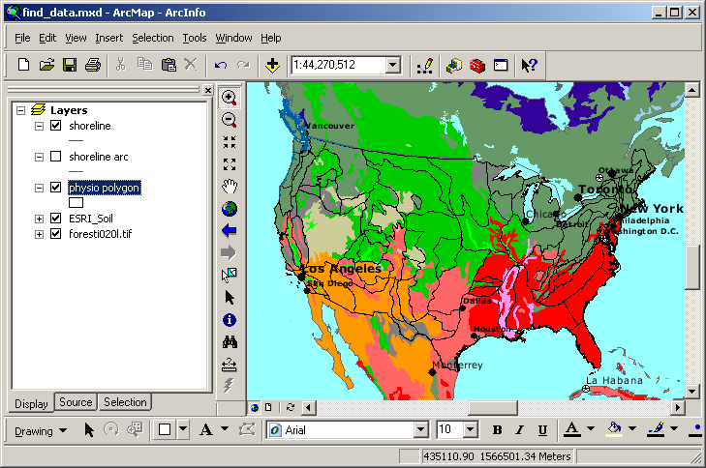
The Geography Network
Using “live” data from the Geography Network

Slide 36
Overview
Searching for data
Web search engines
NSDI Geospatial Data Clearinghouse
USGS GeoData site
The Geography Network
University of Washington Map Library Geospatial Data Archive (WAGDA)
GIS Data Depot

Slide 37
Searching for data: WAGDA
University of Washington Map Library Geospatial Data Archive
http://wagda.lib.washington.edu
Staffed by “GIS Librarians”
Should be your first stop when searching for GIS data
UW is a depository library: lots of items available
Located in Suzzallo Library basement
Data repository for Washington and PNW data
Both on-line and off-line (e.g., CD/DVD) data sets
City of Seattle GIS database
King County GIS database
10 m USGS DEMs
Large collection of paper maps & aerial photos

Slide 38
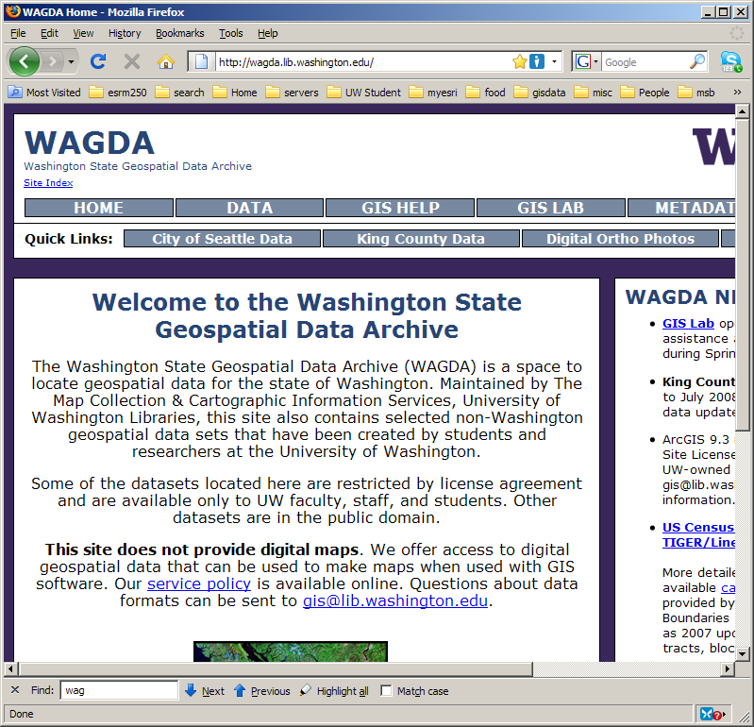
Searching for data: WAGDA Web page
Main WAGDA site

Slide 39
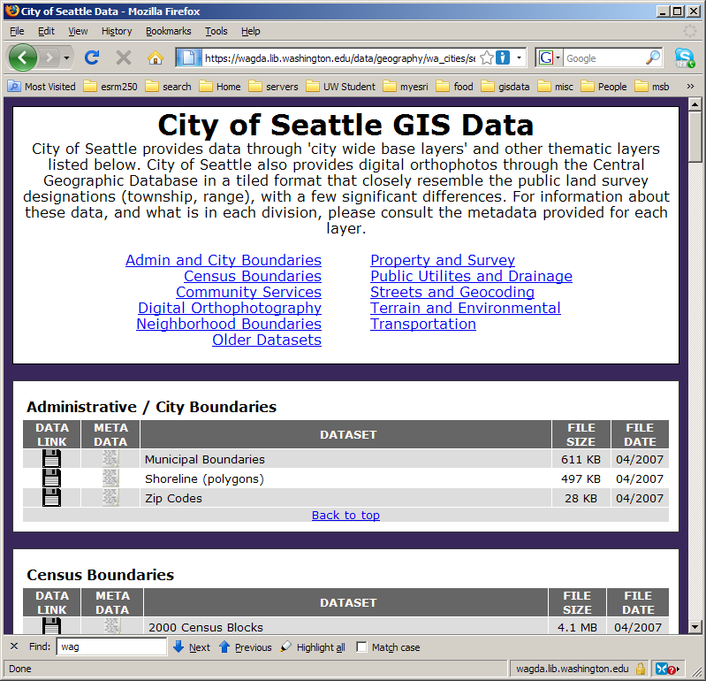
Files on WAGDA
Example: City of Seattle data

Slide 40
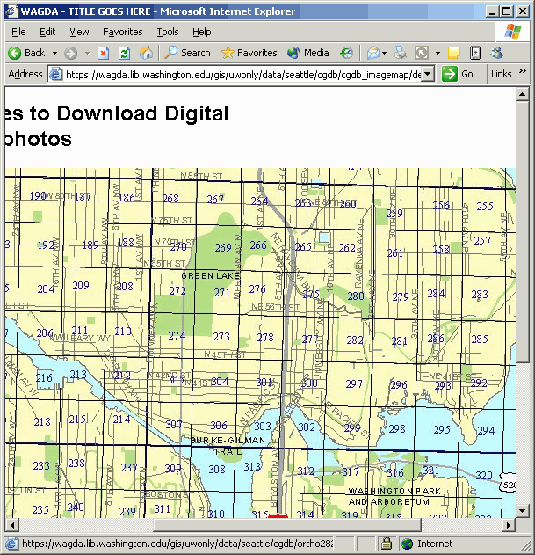
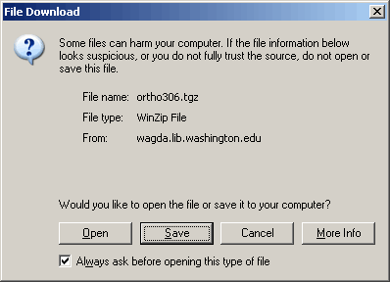
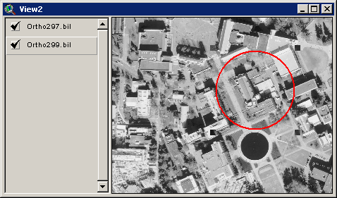
Files on WAGDA
Example: Seattle digital orthophoto data

Slide 41
Overview
Searching for data
Web search engines
NSDI Geospatial Data Clearinghouse
USGS GeoData site
The Geography Network
University of Washington Map Library Geospatial Data Archive (WAGDA)
GIS Data Depot

Slide 42
GIS Data Depot
GIS Data Depot:
www.gisdatadepot.com
Lots of free data
US data
Worldwide data
Official source for USGS DEM data sets

Slide 43
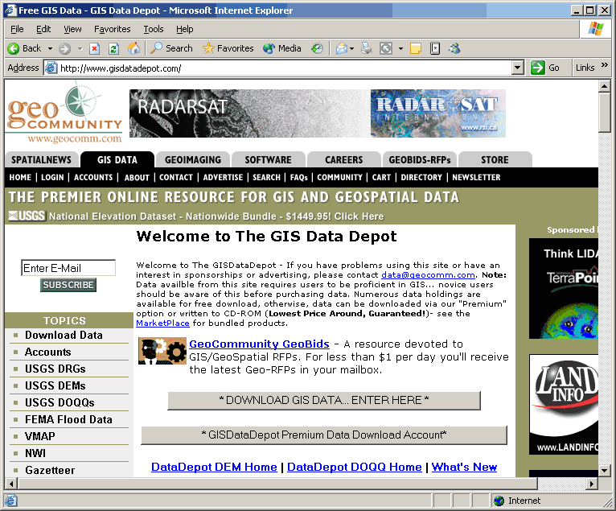
GIS Data Depot
Lots of free data for the US and the world

Slide 44
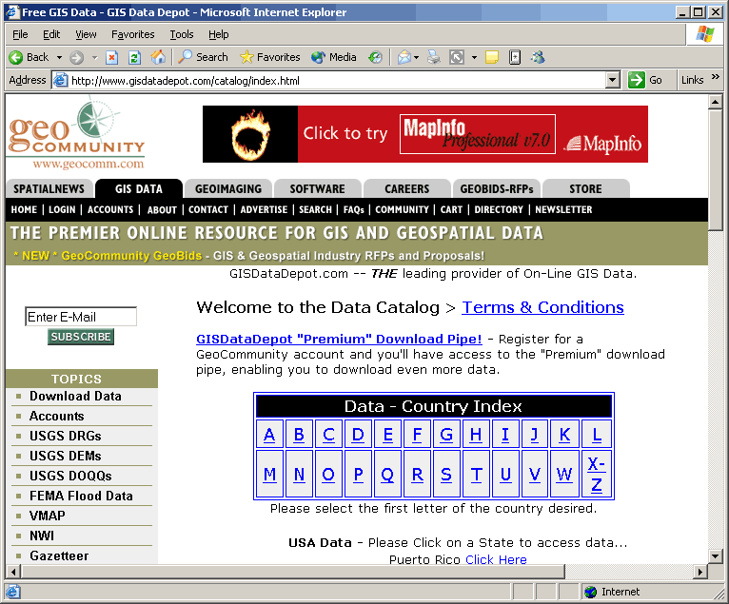
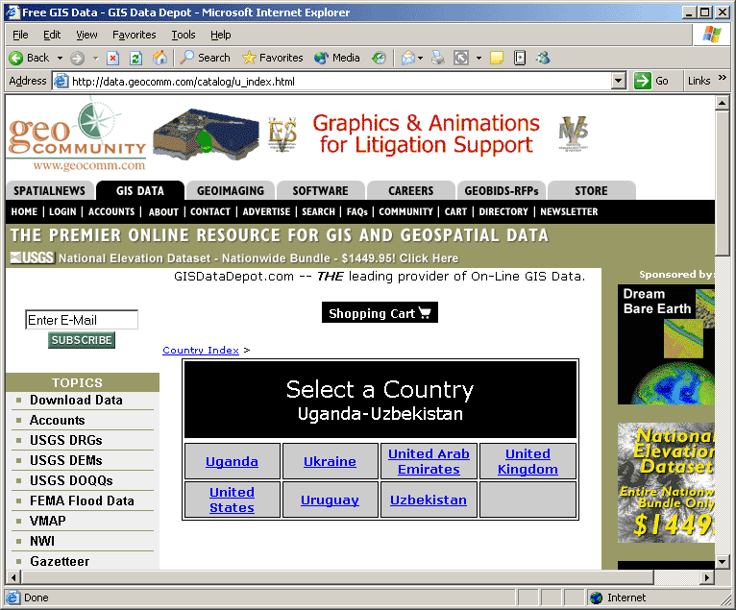
GIS Data Depot

Slide 45
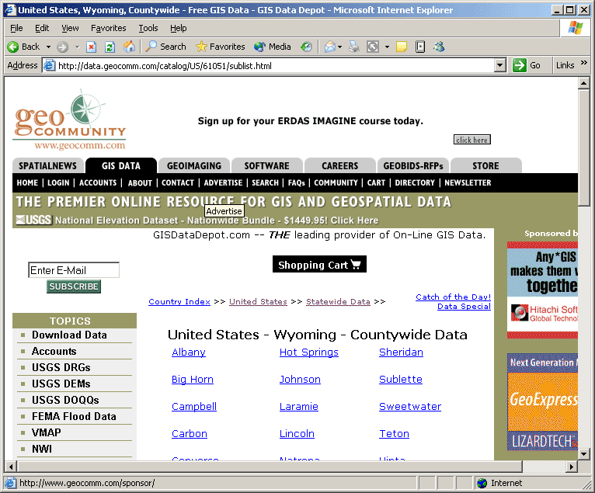
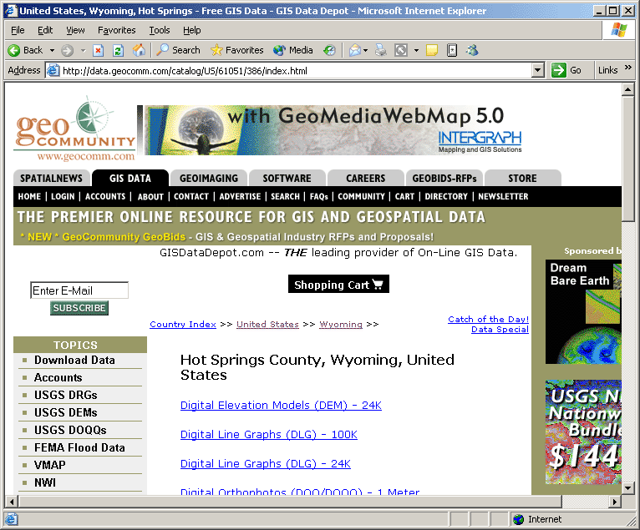
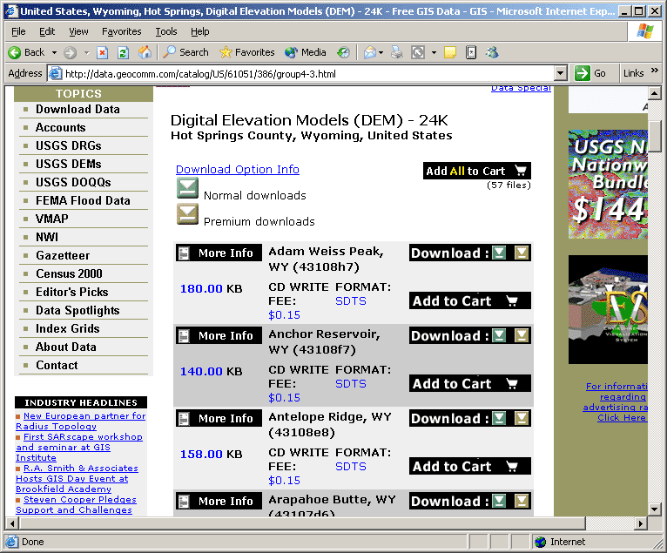
GIS Data Depot

Slide 46
Overview
Importing data
ArcInfo interchange file
ArcInfo generate file
Spatial Data Transfer Standard (SDTS) files
USGS DEM (raster) data
USGS DLG (vector) data
DRG

Slide 47
Overview
Importing data
ArcInfo interchange file
ArcInfo generate file
Spatial Data Transfer Standard (SDTS) files
USGS DEM (raster) data
USGS DLG (vector) data
DRG

Slide 48
Importing data: ArcInfo interchange file
ArcInfo has been a leading software
ArcInfo has a very common file format for movement of data
Known as “interchange,” “export,” or “E00” file
Solves ArcInfo file system problem for data sharing
Easy to transfer from machine to machine or across file system; easy to distribute via the Network
Can be imported to ArcGIS

Slide 49
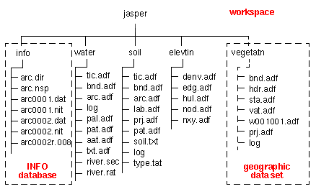
Importing data: ArcInfo file structure
Distributed file layout of ArcInfo coverage
some of these files
are associated with
this data set

Slide 50
Importing data: ArcInfo file structure
Problematic file structure for file management
Directories for ArcInfo data sets cannot be altered, copied, or moved arbitrarily
The interchange file “packages” the coverage directory and info files into a single file
The interchange file can be copied or moved and then imported
Importing recreates original file structure

Slide 51
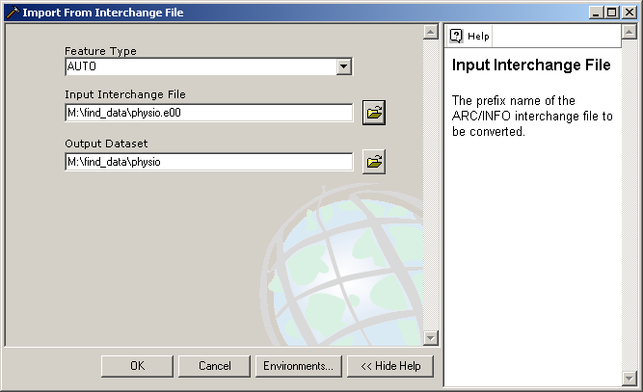
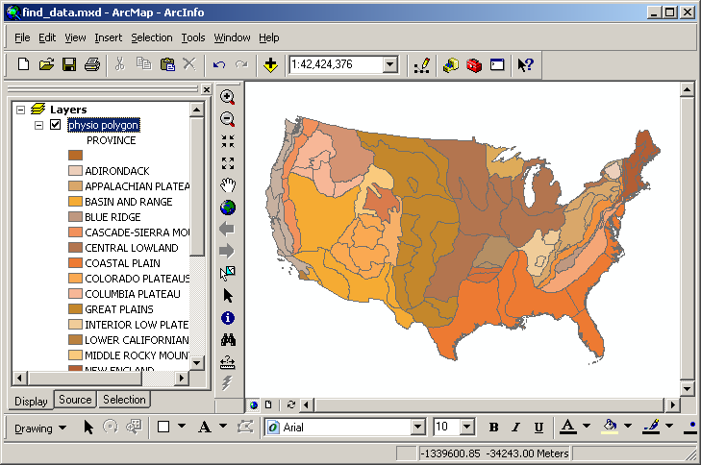
Importing data: ArcInfo file structure: ArcToolbox
Import with ArcToolbox

Slide 52
Overview
Importing data
ArcInfo interchange file
ArcInfo generate file
Spatial Data Transfer Standard (SDTS) files
USGS DEM (raster) data
USGS DLG (vector) data
DRG

Slide 53
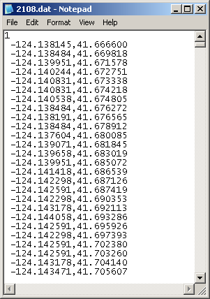
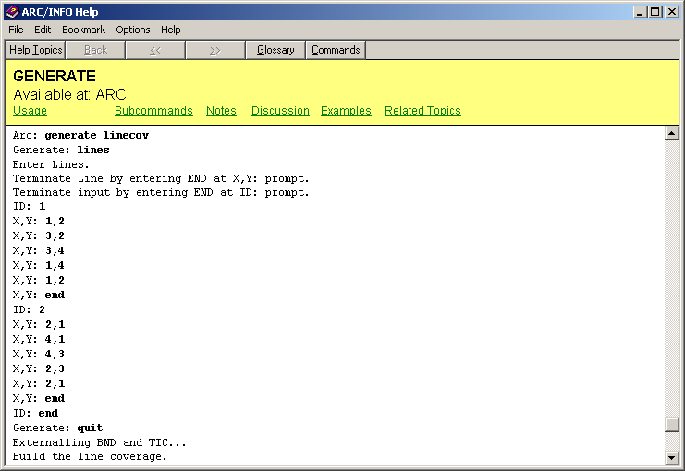
ArcInfo generate file
Coordinates from an ArcInfo coverage in a specially formatted text file created by ArcInfo Workstation

Slide 54
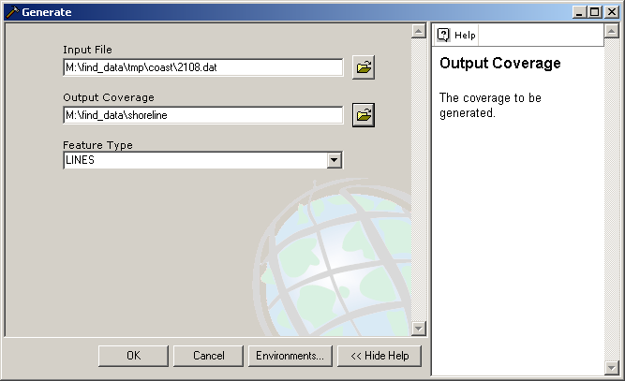
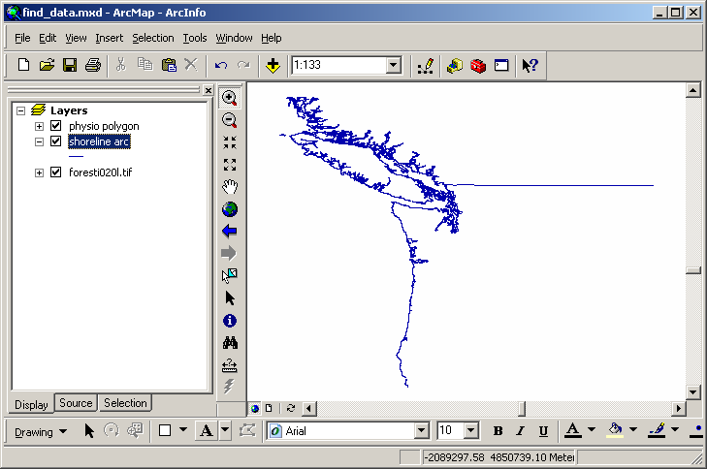
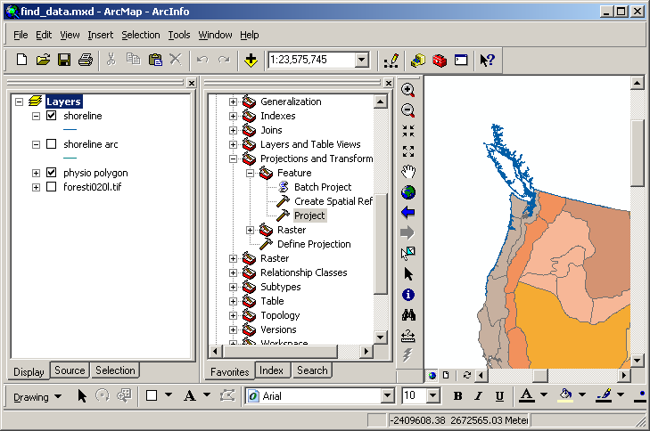
ArcInfo generate file
Imported with ArcCatalog

Slide 55
Overview
Importing data
ArcInfo interchange file
ArcInfo generate file
Spatial Data Transfer Standard (SDTS) files
USGS DEM (raster) data
USGS DLG (vector) data
DRG

Slide 56
Importing data: SDTS files
Spatial Data Transfer Standard
Publicly available data sets
Distributed by USGS in SDTS file format
USGS digital elevation model (DEM) data
USGS digital line graph (DLG) vector data

Slide 57
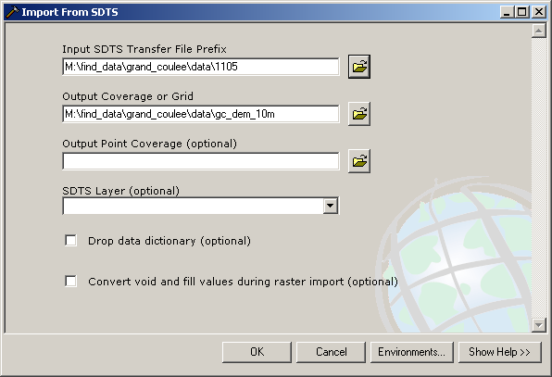
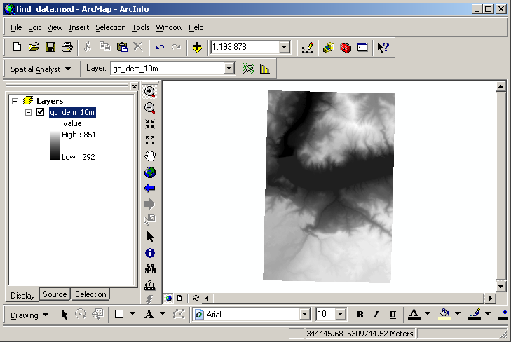
Importing data: SDTS files: USGS DEM data
DEM: Imported with ArcToolbox

Slide 58
Overview
Importing data
ArcInfo interchange file
ArcInfo generate file
Spatial Data Transfer Standard (SDTS) files
USGS DEM (raster) data
USGS DLG (vector) data
DRG

Slide 59
Importing data: SDTS files: USGS DLG data
Digital Line Graph (DLG)
Vector format data
Publicly available data sets
Distributed in SDTS file format
ArcInfo Workstation needed for full conversion of SDTS to GIS data sets

Slide 60
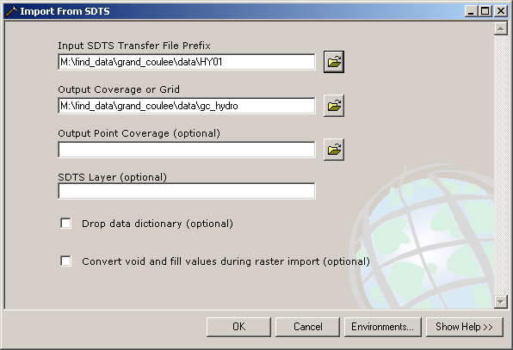
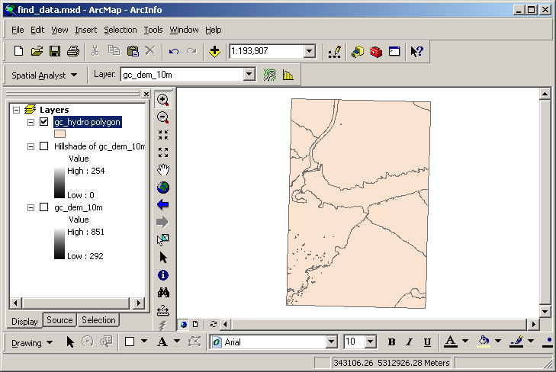
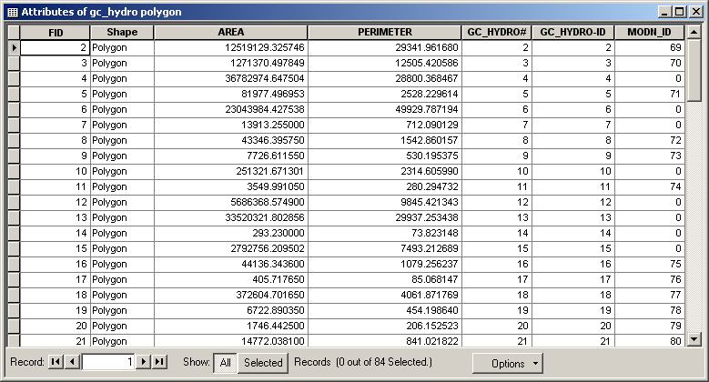
Importing data: SDTS files: Importing STDS DLG to DXF
ArcToolbox import
limited attributes

Slide 61
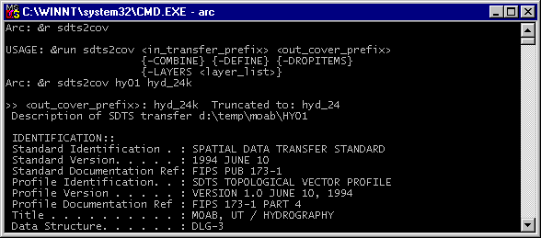
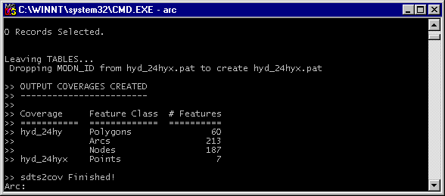
Importing data: SDTS files: DLG to ArcInfo coverage
ArcInfo Workstation for full conversion

Slide 62
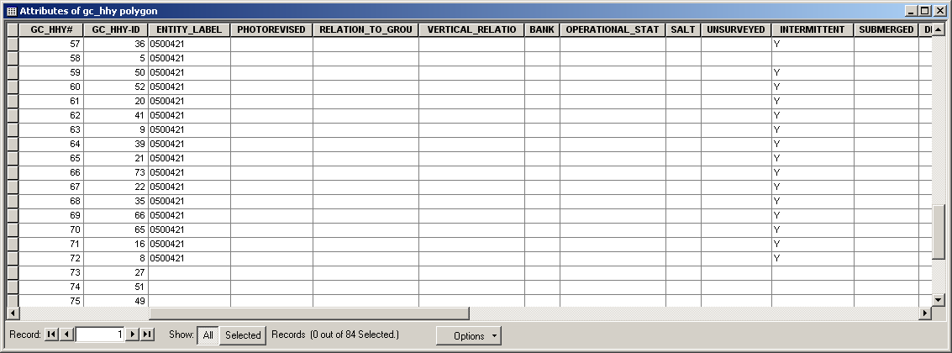
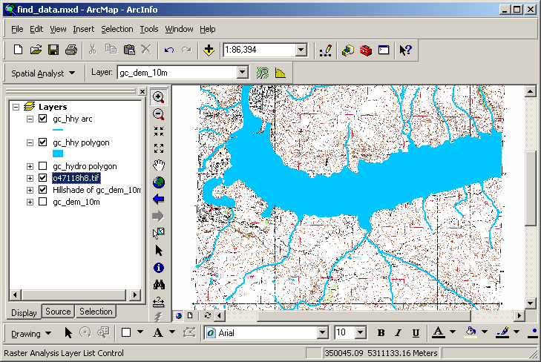
Importing data: SDTS files: DLG to ArcInfo coverage
Fully converted data set has full attribute coding

Slide 63
Overview
Importing data
ArcInfo interchange file
ArcInfo generate file
Spatial Data Transfer Standard (SDTS) files
USGS DEM (raster) data
USGS DLG (vector) data
DRG

Slide 64
DRG: Digital Raster Graphic
Digital Raster Graphic (DRG)
USGS topographic quadrangles
Scanned
Georeferenced
TIFF format

Slide 65
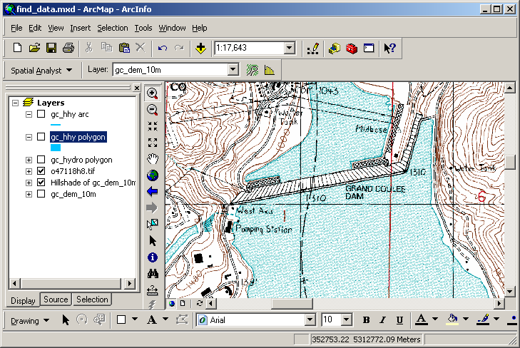
DRG: Digital Raster Graphic
Can be used as data set in ArcGIS

