Slide 1
Multi-criteria Design of X-bar control chart
Zhaojun (Steven) Li
IND E 516 Homework 1

Slide 2
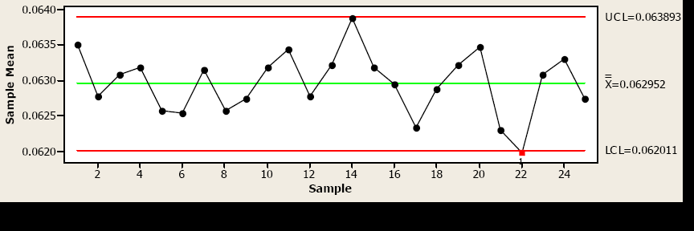
Basics of an X-bar chart
A typical X-bar control chart:
  Central line
  Upper /lower control limits (e.g., 3 sigma)
How to evaluate the performance of a
X-bar control chart?

Slide 3
Design of X-bar control chart
Performance metrics
  Economic (cost)
  Fast to detect a mean shift (effectiveness)
  Fewer false alarms (efficiency)
All the above performance metrics could be integrated to one performance index in terms of cost

Slide 4

Main assumptions
The measurements of process characteristic follows normal distribution
Assignable cause occurs with a Poisson process
Mean shift from u0 to u0 + δ*σ
The process is not stopped even after an out-of-control point is detected
Decision variables

Slide 5
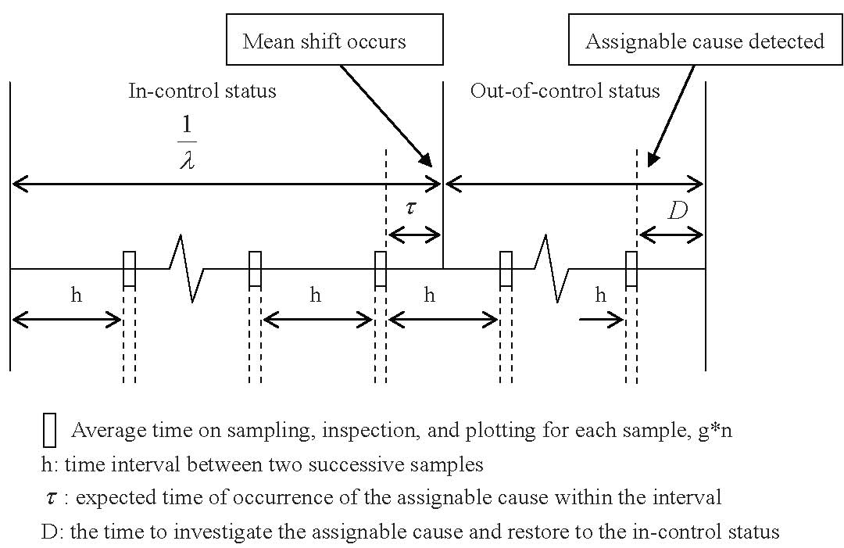
One cycle of a control process

Slide 6


Some performance metrics
Probability of false alarm (Type I error - α)
The detection power p after out-of-control

Slide 7
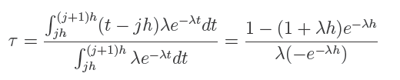


Some performance metrics-cont’d
The conditional expectation time of occurrence of the assignable cause within two consecutive samples
The expected number of false alarms
The average cycle length

Slide 8
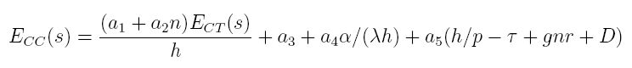
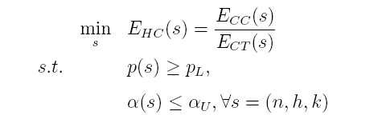
Problem formulation
P(1) single objective formulation
a_1: fixed cost of sampling
a_2: variable cost of sampling
a_3: cost of searching
a_4: cost of investigating a false alarm
a_5: unit time penalty when operating in out-of-control status

Slide 9
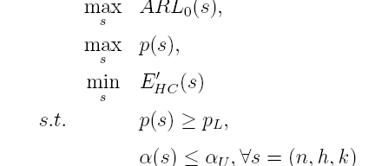

Problem formulation-cont’d
P(2) Multi-criteria decision making
where
a_1: fixed cost of sampling
a_2: variable cost of sampling

Slide 10
Comparison of two formulations
Avoid the difficulties to estimate some costs associated with false alarms and operation in out-of-control status
Facilitate decision process (without specifying target values for some desired attributes
Provide more reasonable and wider solution choices

Slide 11
Discussion and future work
Propose and compare different methods in addressing the MCDM formulation of X-bar control chart
Develop and apply an algorithm to solve the multi-criteria X-bar control chart
Prune the possible large Pareto optimal solution set to few workable solutions/designs

Slide 12
Comments and Questions?
  Thank you

