Slide 1
Quay Crane Scheduling Problem in Port Container Terminal
Wenjuan Zhao, Xiaolei Ma

Slide 2
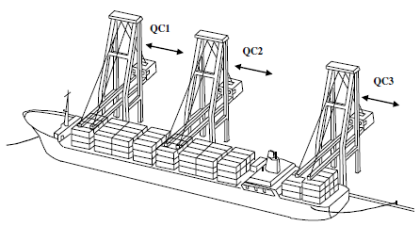
What is QC Scheduling Problem
Determine the sequence of discharging and loading operations in a ship by each Quay Crane and the time schedule for the operation.
Notes:
QC scheduling is crucial for the productivity of container terminal
Figure: a drawing of QCs working on vessel.

Slide 3
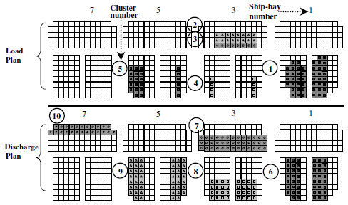
Major Input: Ship Stowage Plan
Ship bay
Deck
Hatch
Hold
Notes:
The stowage plan is divided into two parts, the load plan and the discharge plan.
Each ship-bay is partitioned into two parts by hatch, with lower partition as the hold and the upper part as the deck.
Each shaded pattern corresponds to a cluster. A cluster is a collection of adjacent slots into which outbound containers of the same group are planned to be loaded, or into which inbound containers are stacked.
Here we define a task as a discharging or loading operation for a cluster.

Slide 4
Problem characteristics
Similar to m-parallel machine problem
Different from it with unique characteristics
  Precedence relationships among tasks
    Tasks on deck and in hold from the same bay
  Certain tasks cannot be performed simultaneously
    Cranes could not cross with each other
Notes:
Precedence: Discharging tasks on the deck must be performed before loading tasks in the hold of the same ship-bay; also the loading tasks in the hold must precede the loading tasks on the deck of the same ship-bay.

Slide 5
Problem inputs
Ship stowage plan (with all constraints)
Time required to carry each task
Crane travel time between different tasks
Crane ready time

Slide 6
Problem Notations
Indices
    Tasks to be performed
    QCs where
Problem Data
    The time required to perform task i
    The earliest available time of QC
    The location of task (expressed by the ship bay number)
    The starting position of QC
    The final position of QC k
    The travel time of a QC from location ( ) of task i to
    location ( ) of task j
Notes:
Tasks are ordered in an increasing order of their relative locations in the direction of increasing ship-bay numbers.

Slide 7
Problem Notations
Sets of indices
    The set of all tasks
    The set of pairs of tasks not be performed simultaneously
    The set of ordered pairs of with precedence relationship
Decision variables
    1 if crane k performs task j right after task i; 0 otherwise
    The completion time of QC k
    The completion time of task i
    1 if task j starts later than the completion time of task i; 0
    Time at which all tasks are completed

Slide 8
Problem Formulation
Minimize
Subject to:
(1) Define makespan
(2) Start from task 0
(3) End at task T
(4) Each task assigned to one QC
(5) Flow balance
(6) Time constraint
(7) Precedence constraint

Slide 9
Problem Formulation
(8) Define Zij
(9) Non-simultaneous constraint
(10) Non-interference
(11) QC completion time
(12) QC starting time
(13) Binary variables
(14) Non-negative

Slide 10
Reference:
(1) Kim, K.H., Park, Y.M., 2004. A crane scheduling method for port container terminals. European Journal of Operation Research 156, 752–768.
(2) Lee, D.H., Wang H.Q., Miao L.X., 2008. Quay crane scheduling with non-interference constraints in port container terminals. Transportation Research Part E 44, 124–135.

