Slide 1
Create an ePortfolio

Slide 2
INFO 424 Class Design Project

Slide 3
HCI
Design Model
Studio
Design Model
Needs Assessment
Design Brief
Development
Prototype and User Testing cycles
Development
Problem definition
+
Design solution
Critique cycles & learning
from each other

Slide 4
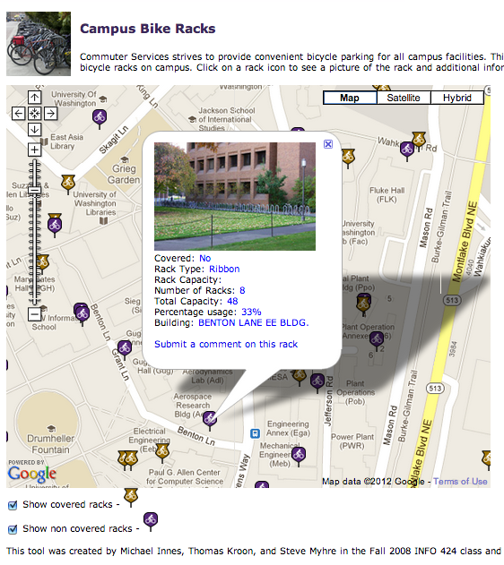

Slide 5
Our Design Brief:
Where can you get on the bus from the UW campus without transferring?

Slide 6
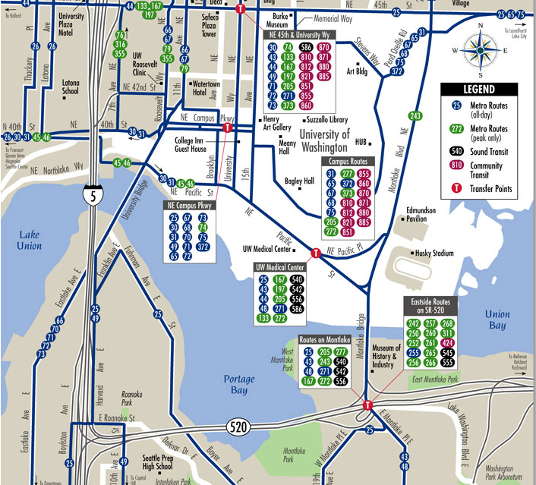
Notes:
Where can you go? How far can you get? How long does it take to get there?

Slide 7
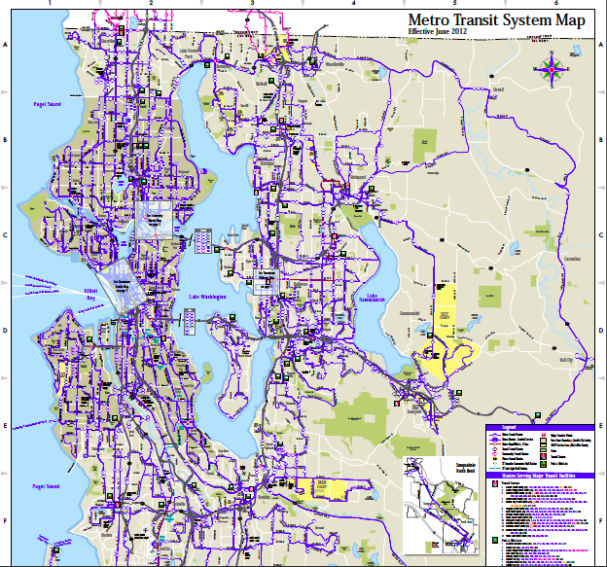

Slide 8
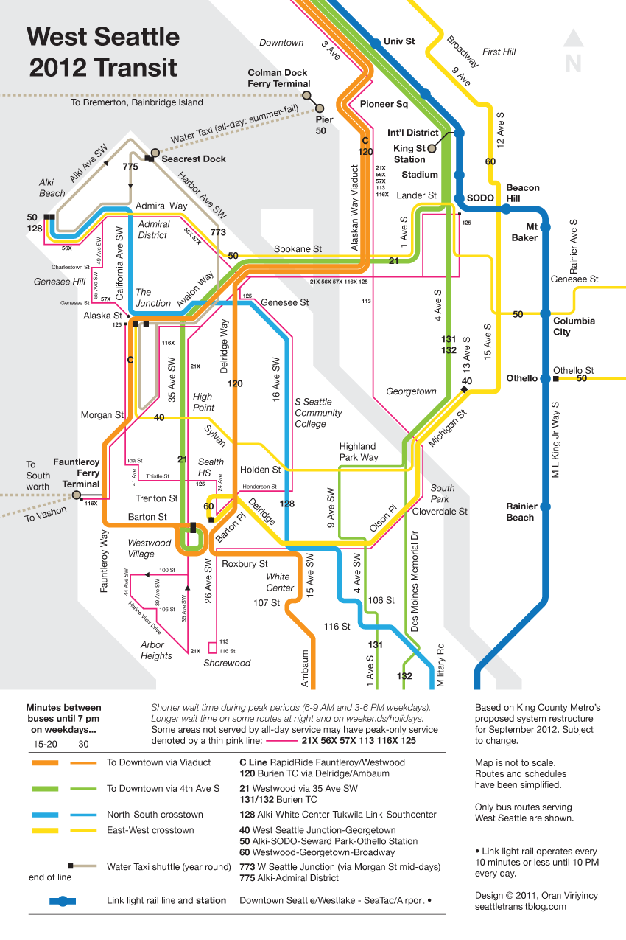

Slide 9
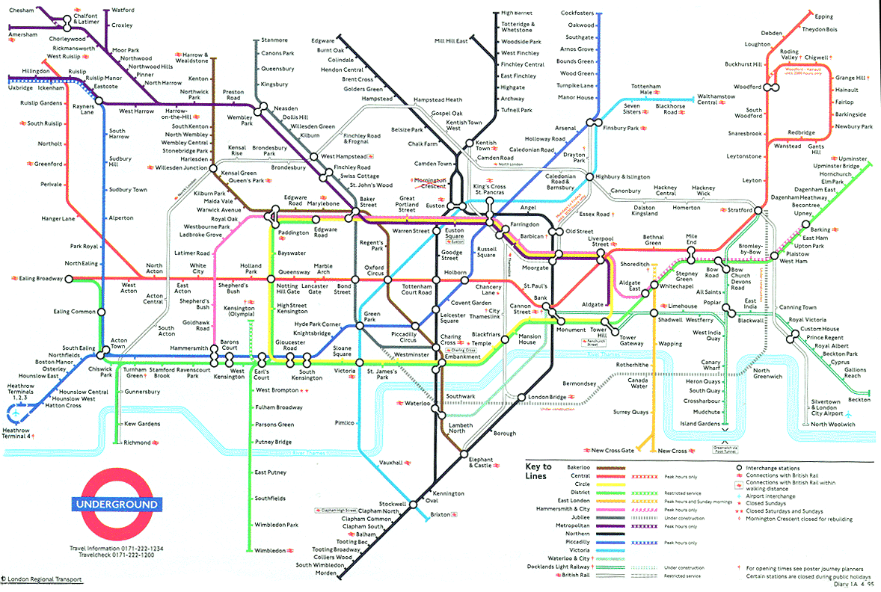

Slide 10
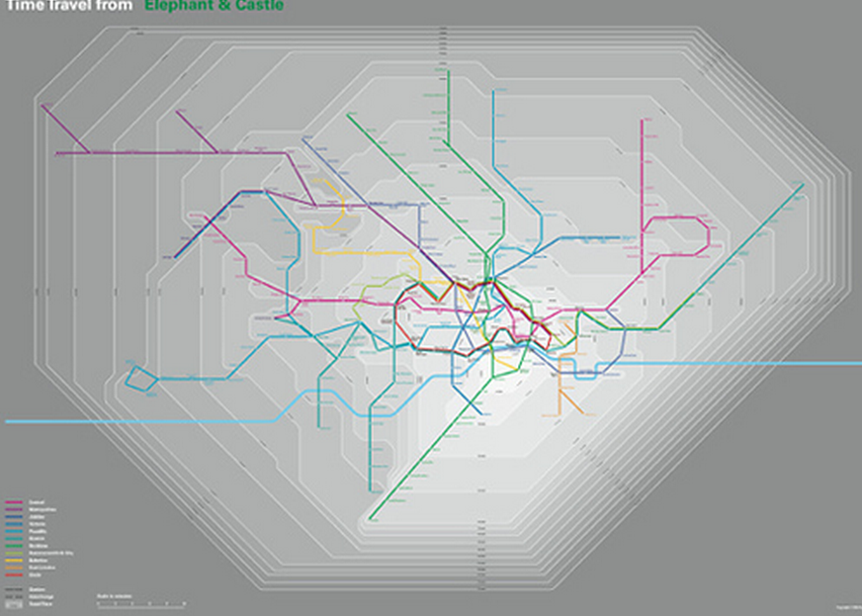

Slide 11
It’s 2014. You’ve graduated and have a great job working for a cool tech company. You’ve been asked to work on a project.
The first step is to get creative…

Slide 12
You want to document your ideas for your next meeting, in your ePortfolio, write down your answer to these questions:
If a friend said “I just saw an awesome website that showed buses that stop at the UW,” what would you see when you went to that site?
  What would it show?
  What would happen when you clicked on it?
Imagine 70,000 UW commuters…they all might want to see different information. Write an exhaustive list of things a person might want to know about bus routes (at least 10)

Slide 13
Next step
Look for inspiration…
Google images “bus routes” “interesting route map”…

