Slide 1
Ling 566
Oct 17, 2023
How the Grammar Works

Slide 2
Overview
What we’re trying to do
The pieces of our grammar
Two extended examples
Reflection on what we’ve done, what we still have to do

Slide 3
What We’re Trying To Do
Objectives
Develop a theory of knowledge of language
Represent linguistic information explicitly enough to distinguish well-formed from ill-formed expressions
Be parsimonious, capturing linguistically significant generalizations.
Why Formalize?
To formulate testable predictions
To check for consistency
To make it possible to get a computer to do it for us

Slide 4
Why does this matter to NLP?
Understand how language works => better positioned to build technology that works with language
For some applications, grammar engineering is a valuable component directly
Grammar engineering can also support extremely detailed annotation

Slide 5
How We Construct Sentences
The Components of Our Grammar
Grammar rules
Lexical entries
Principles
Type hierarchy (very preliminary, so far)
Initial symbol (S, for now)
We combine constraints from these components.
Q: What says we have to combine them?

Slide 6
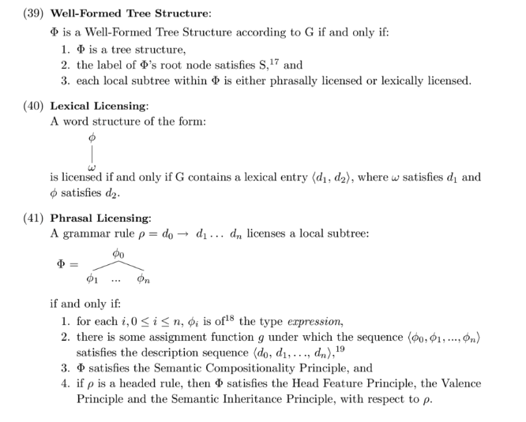
The Definition of Well-Formed Structures

Slide 7
An Example
A cat slept.
Can we build this with our tools?
Given the constraints our grammar puts on well-formed sentences, is this one?

Slide 8
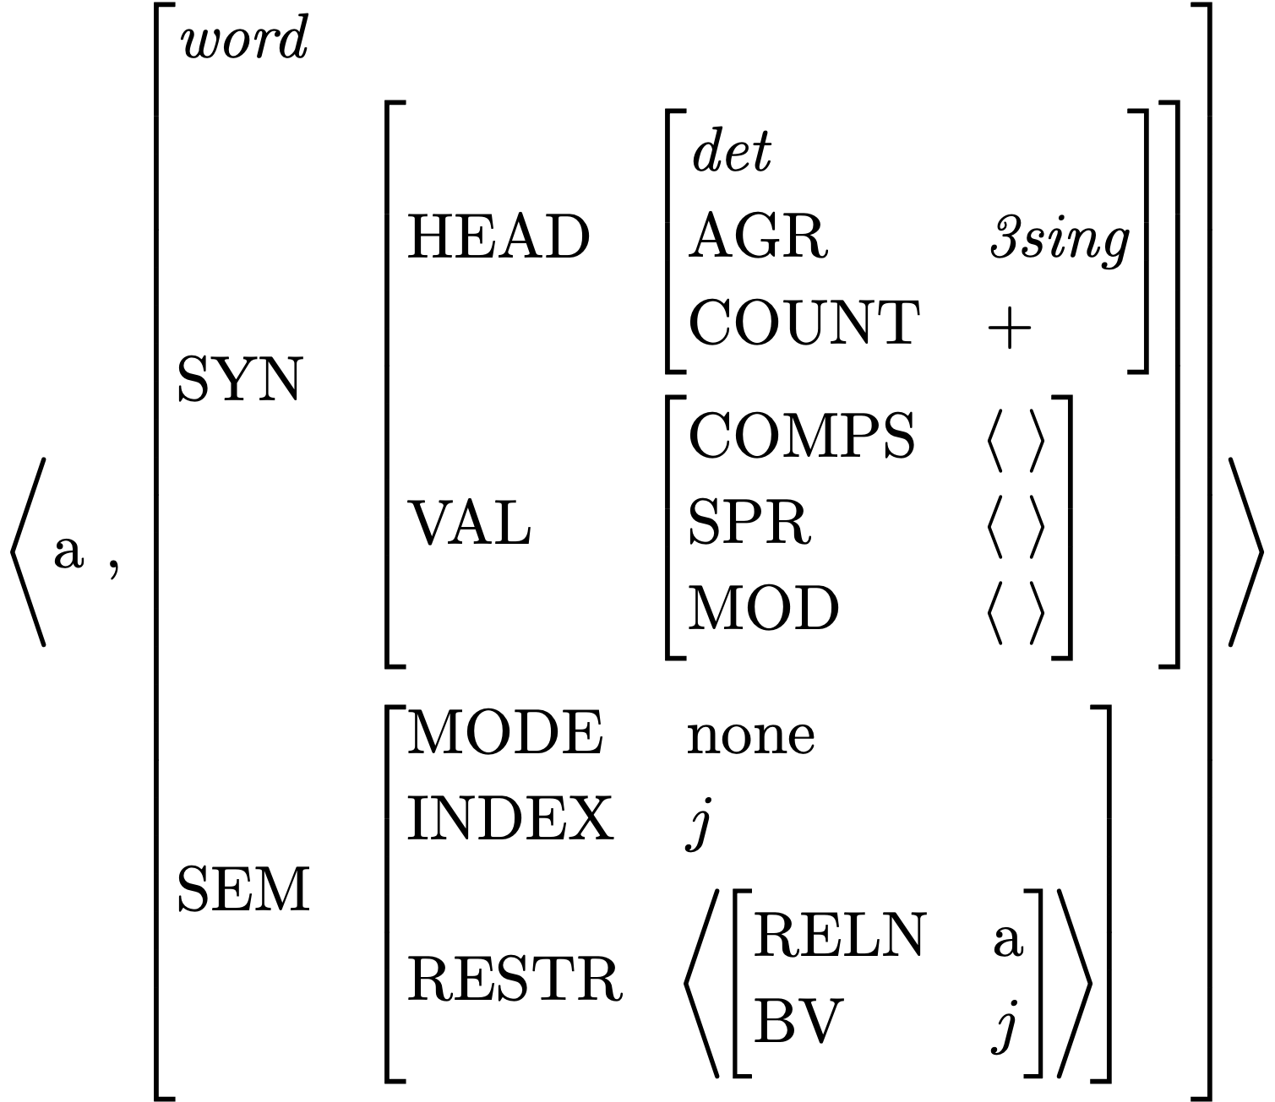
Lexical Entry for a
Is this a fully specified (resolved) description?
What features are unspecified?
How many word structures can this entry license?

Slide 9
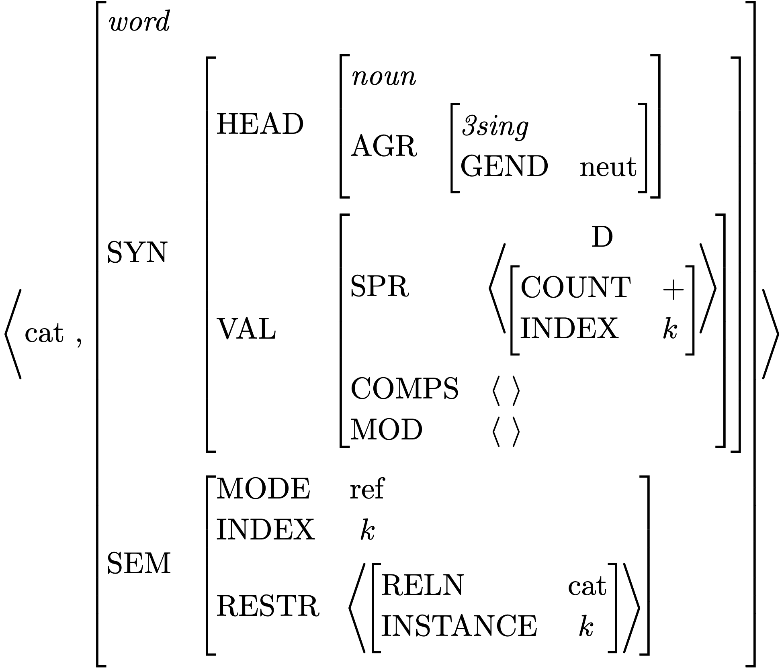
Lexical Entry for cat
Which feature paths are abbreviated?
Is this a fully specified description?
What features are unspecified?
How many word structures can this entry license?

Slide 10
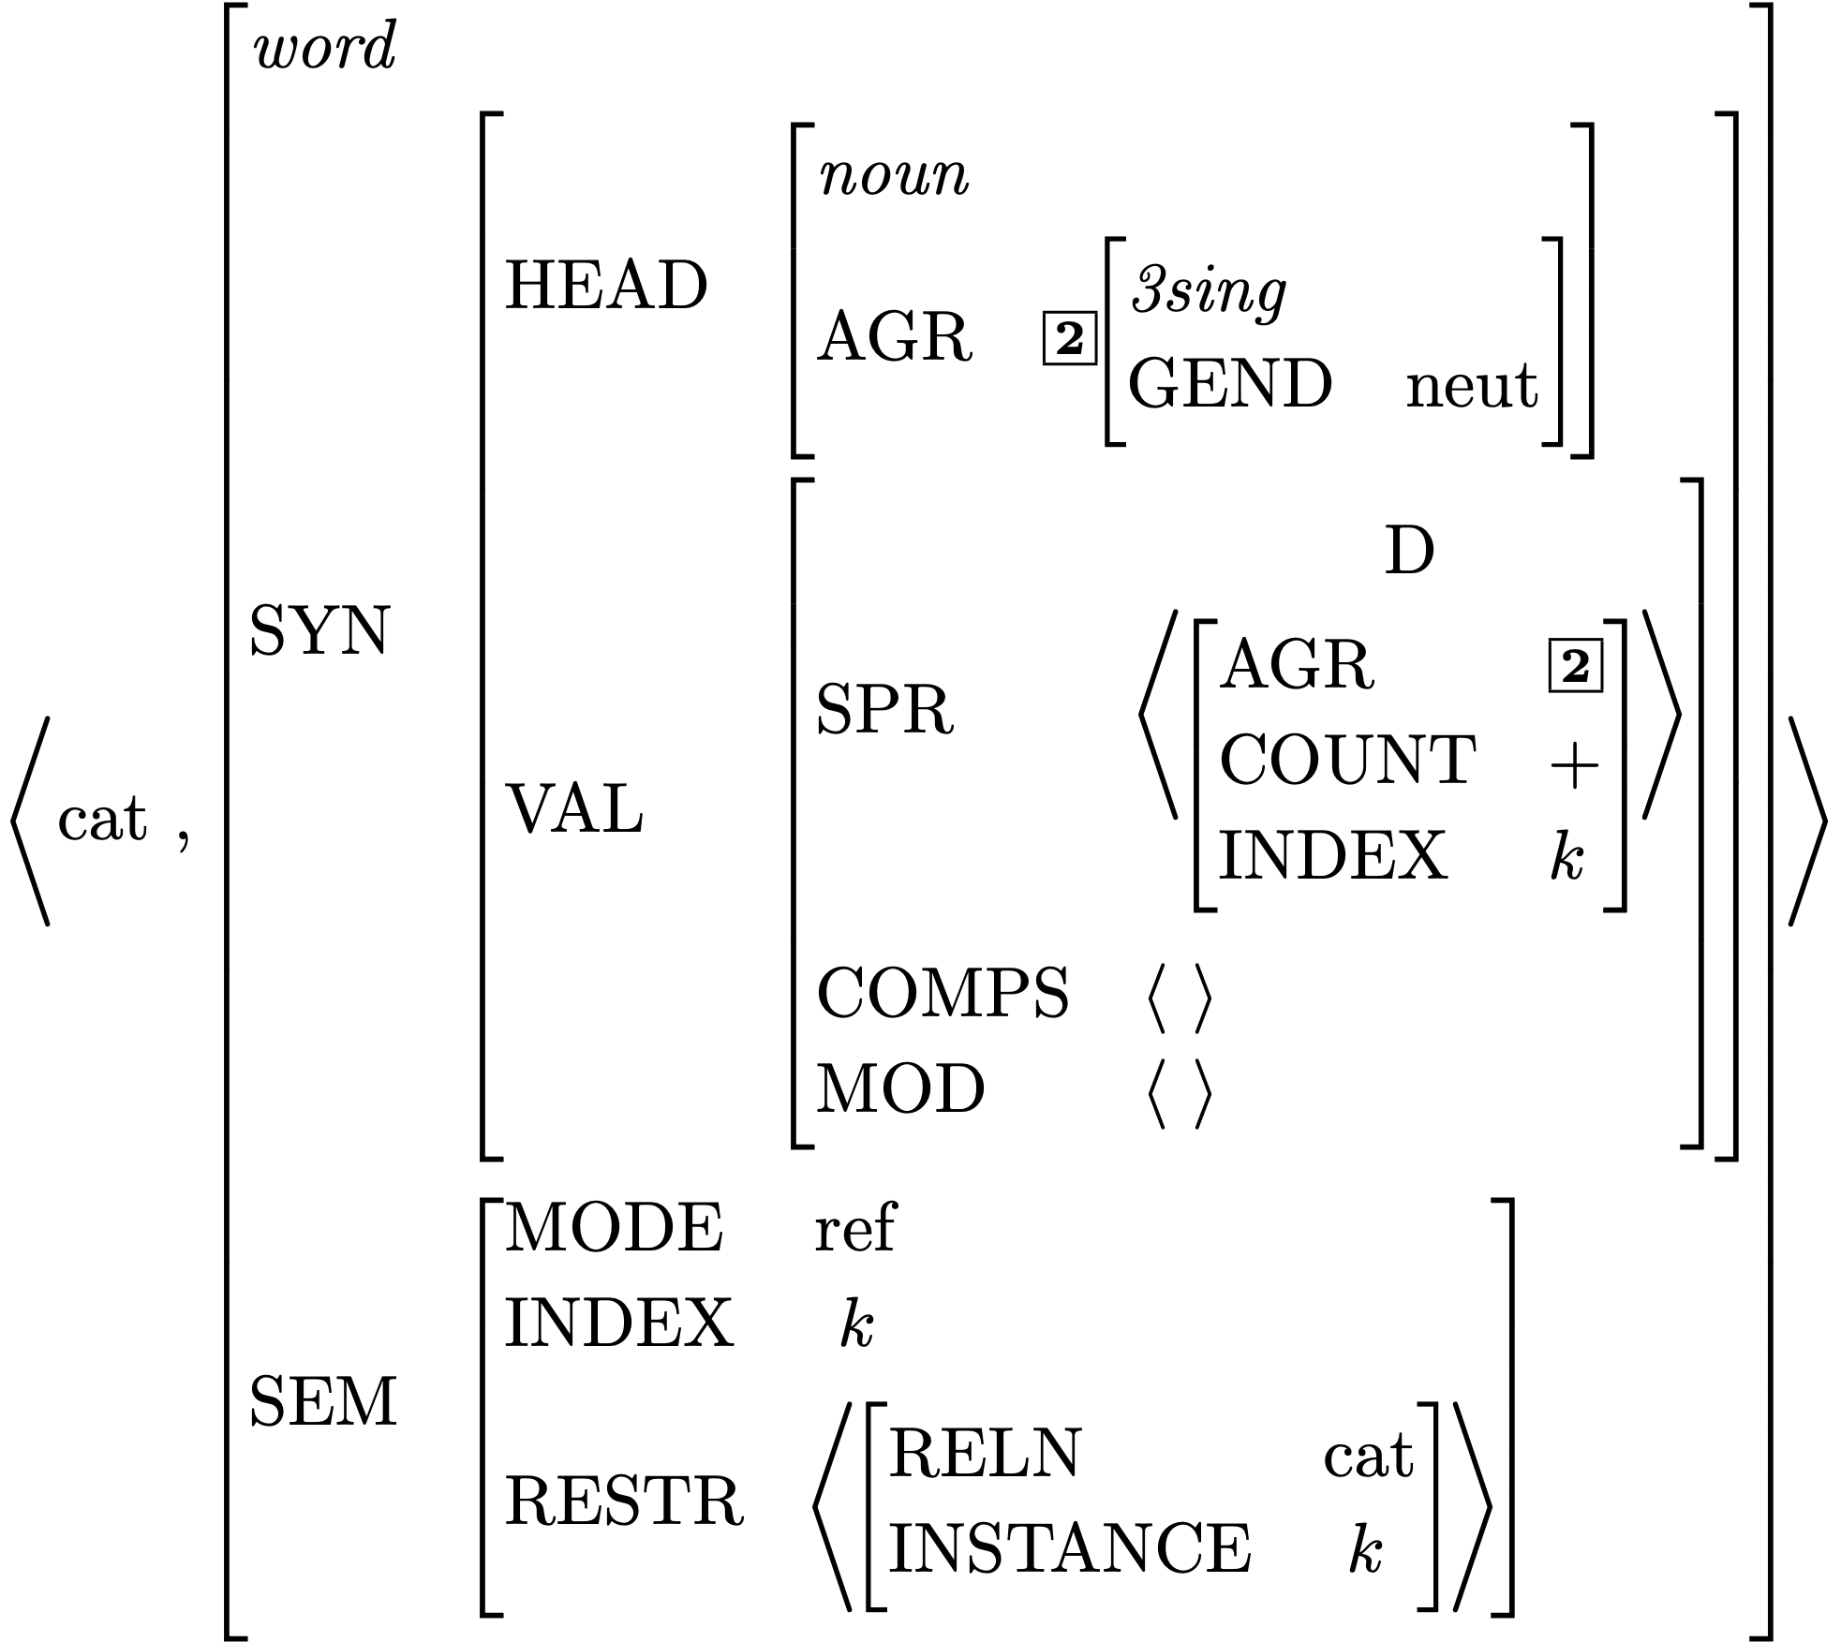
Effect of Principles: the SHAC

Slide 11
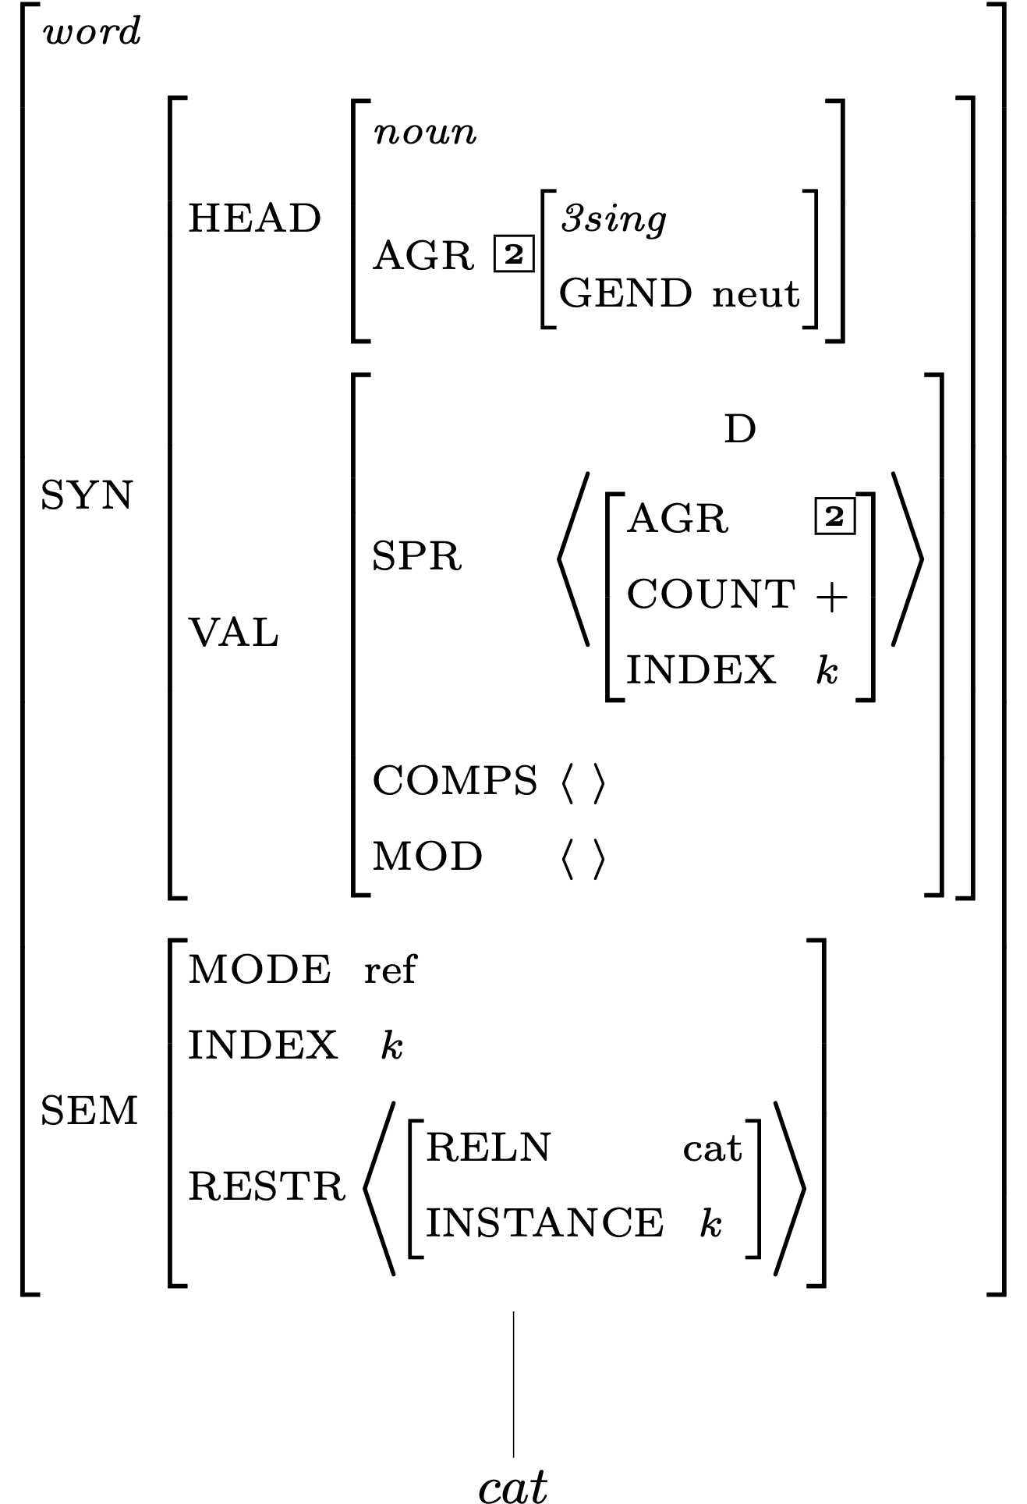
Description of Word Structures for cat

Slide 12
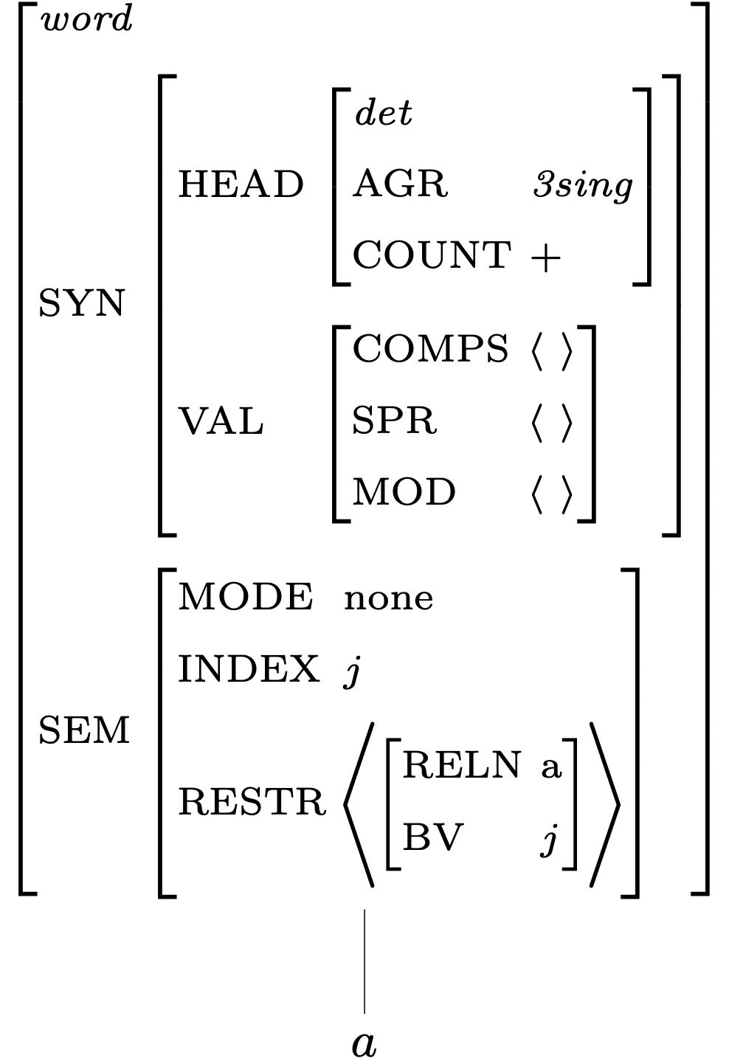
Description of Word Structures for a

Slide 13
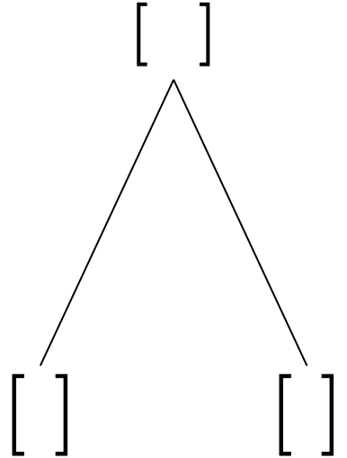
Building a Phrase

Slide 14
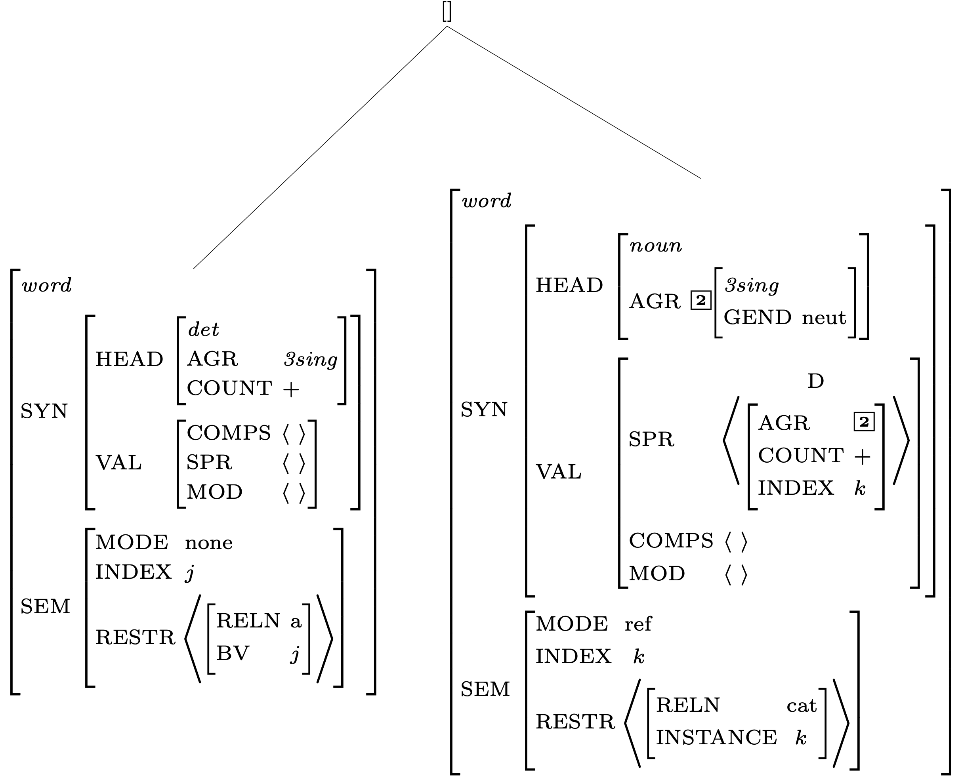
Constraints Contributed by Daughter Subtrees

Slide 15
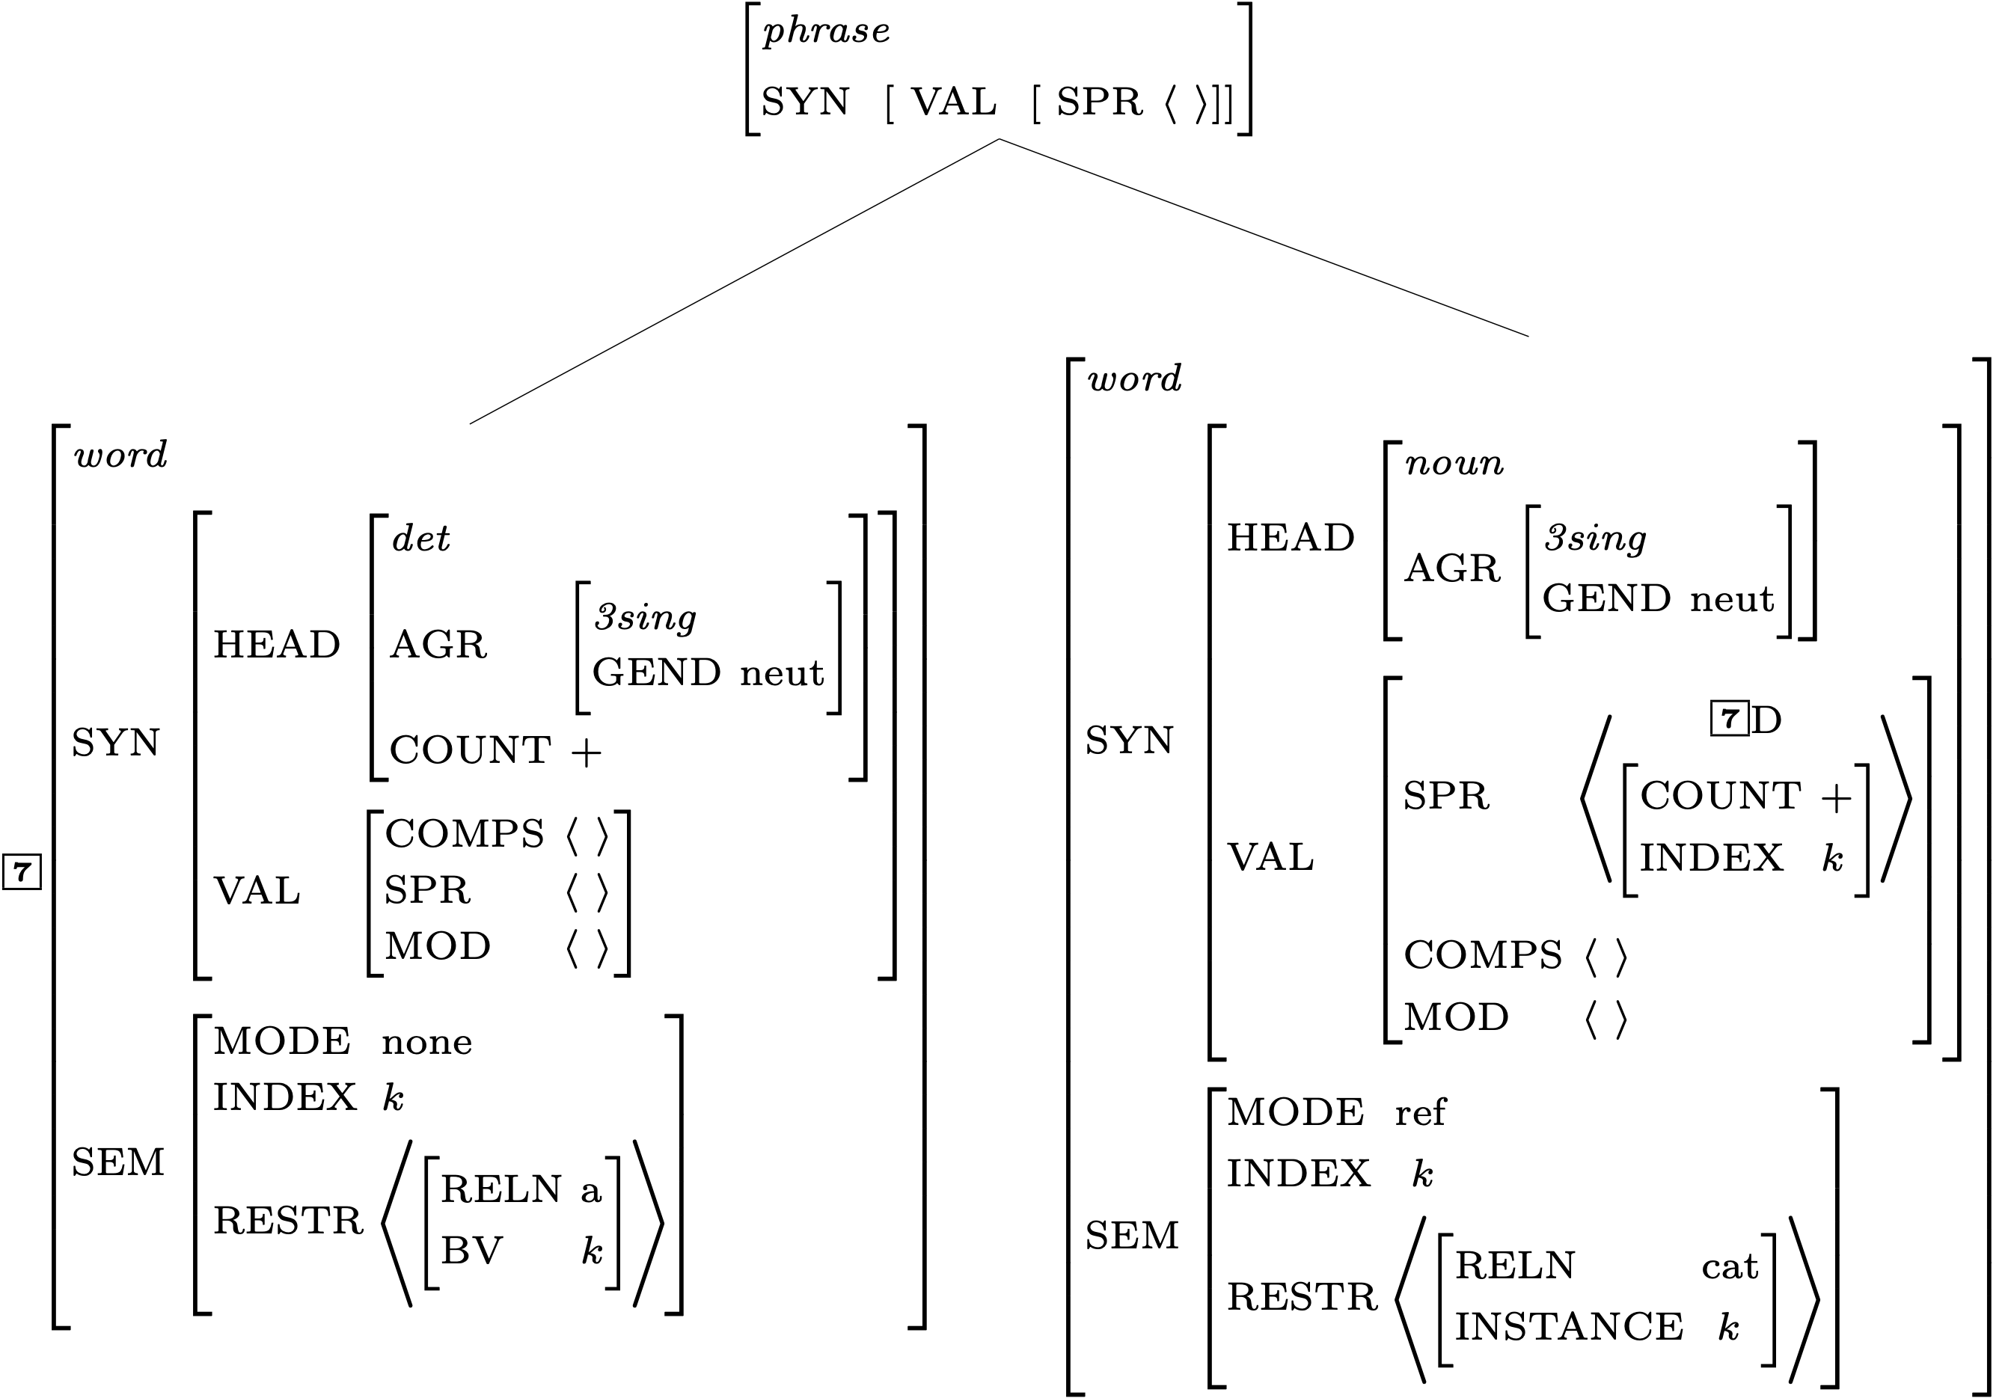
Constraints Contributed by the Grammar Rule

Slide 16
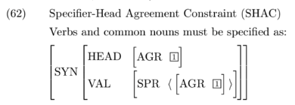
A Constraint Involving the SHAC

Slide 17
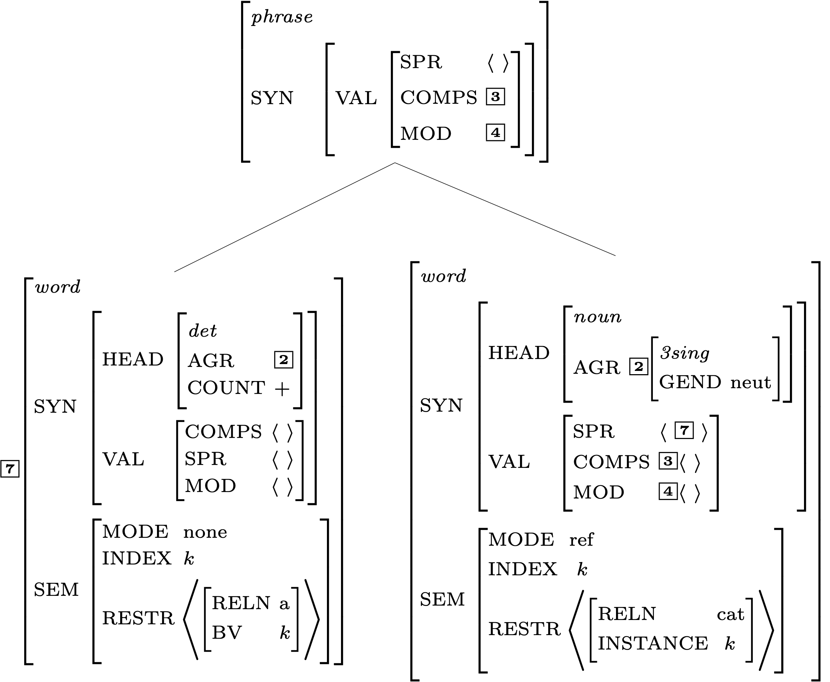
Effects of the Valence Principle

Slide 18
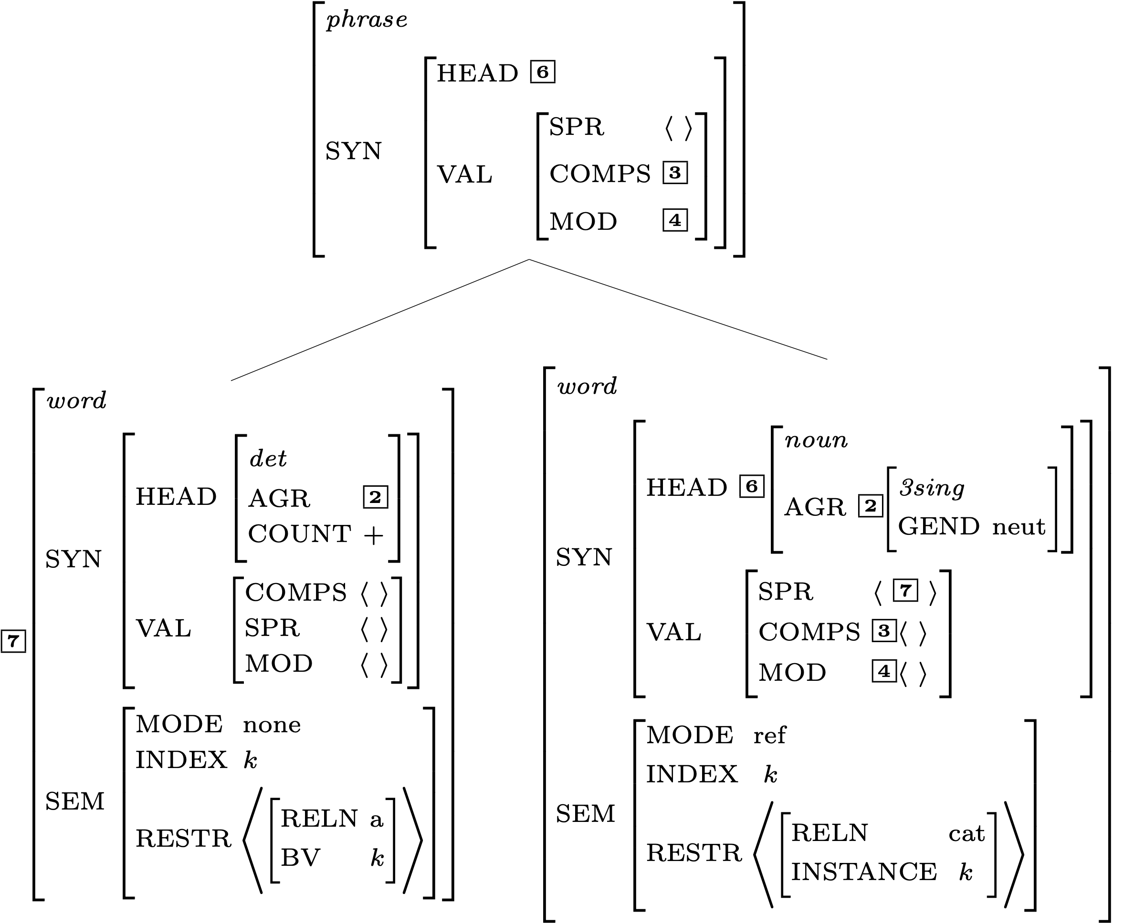
Effects of the Head Feature Principle

Slide 19
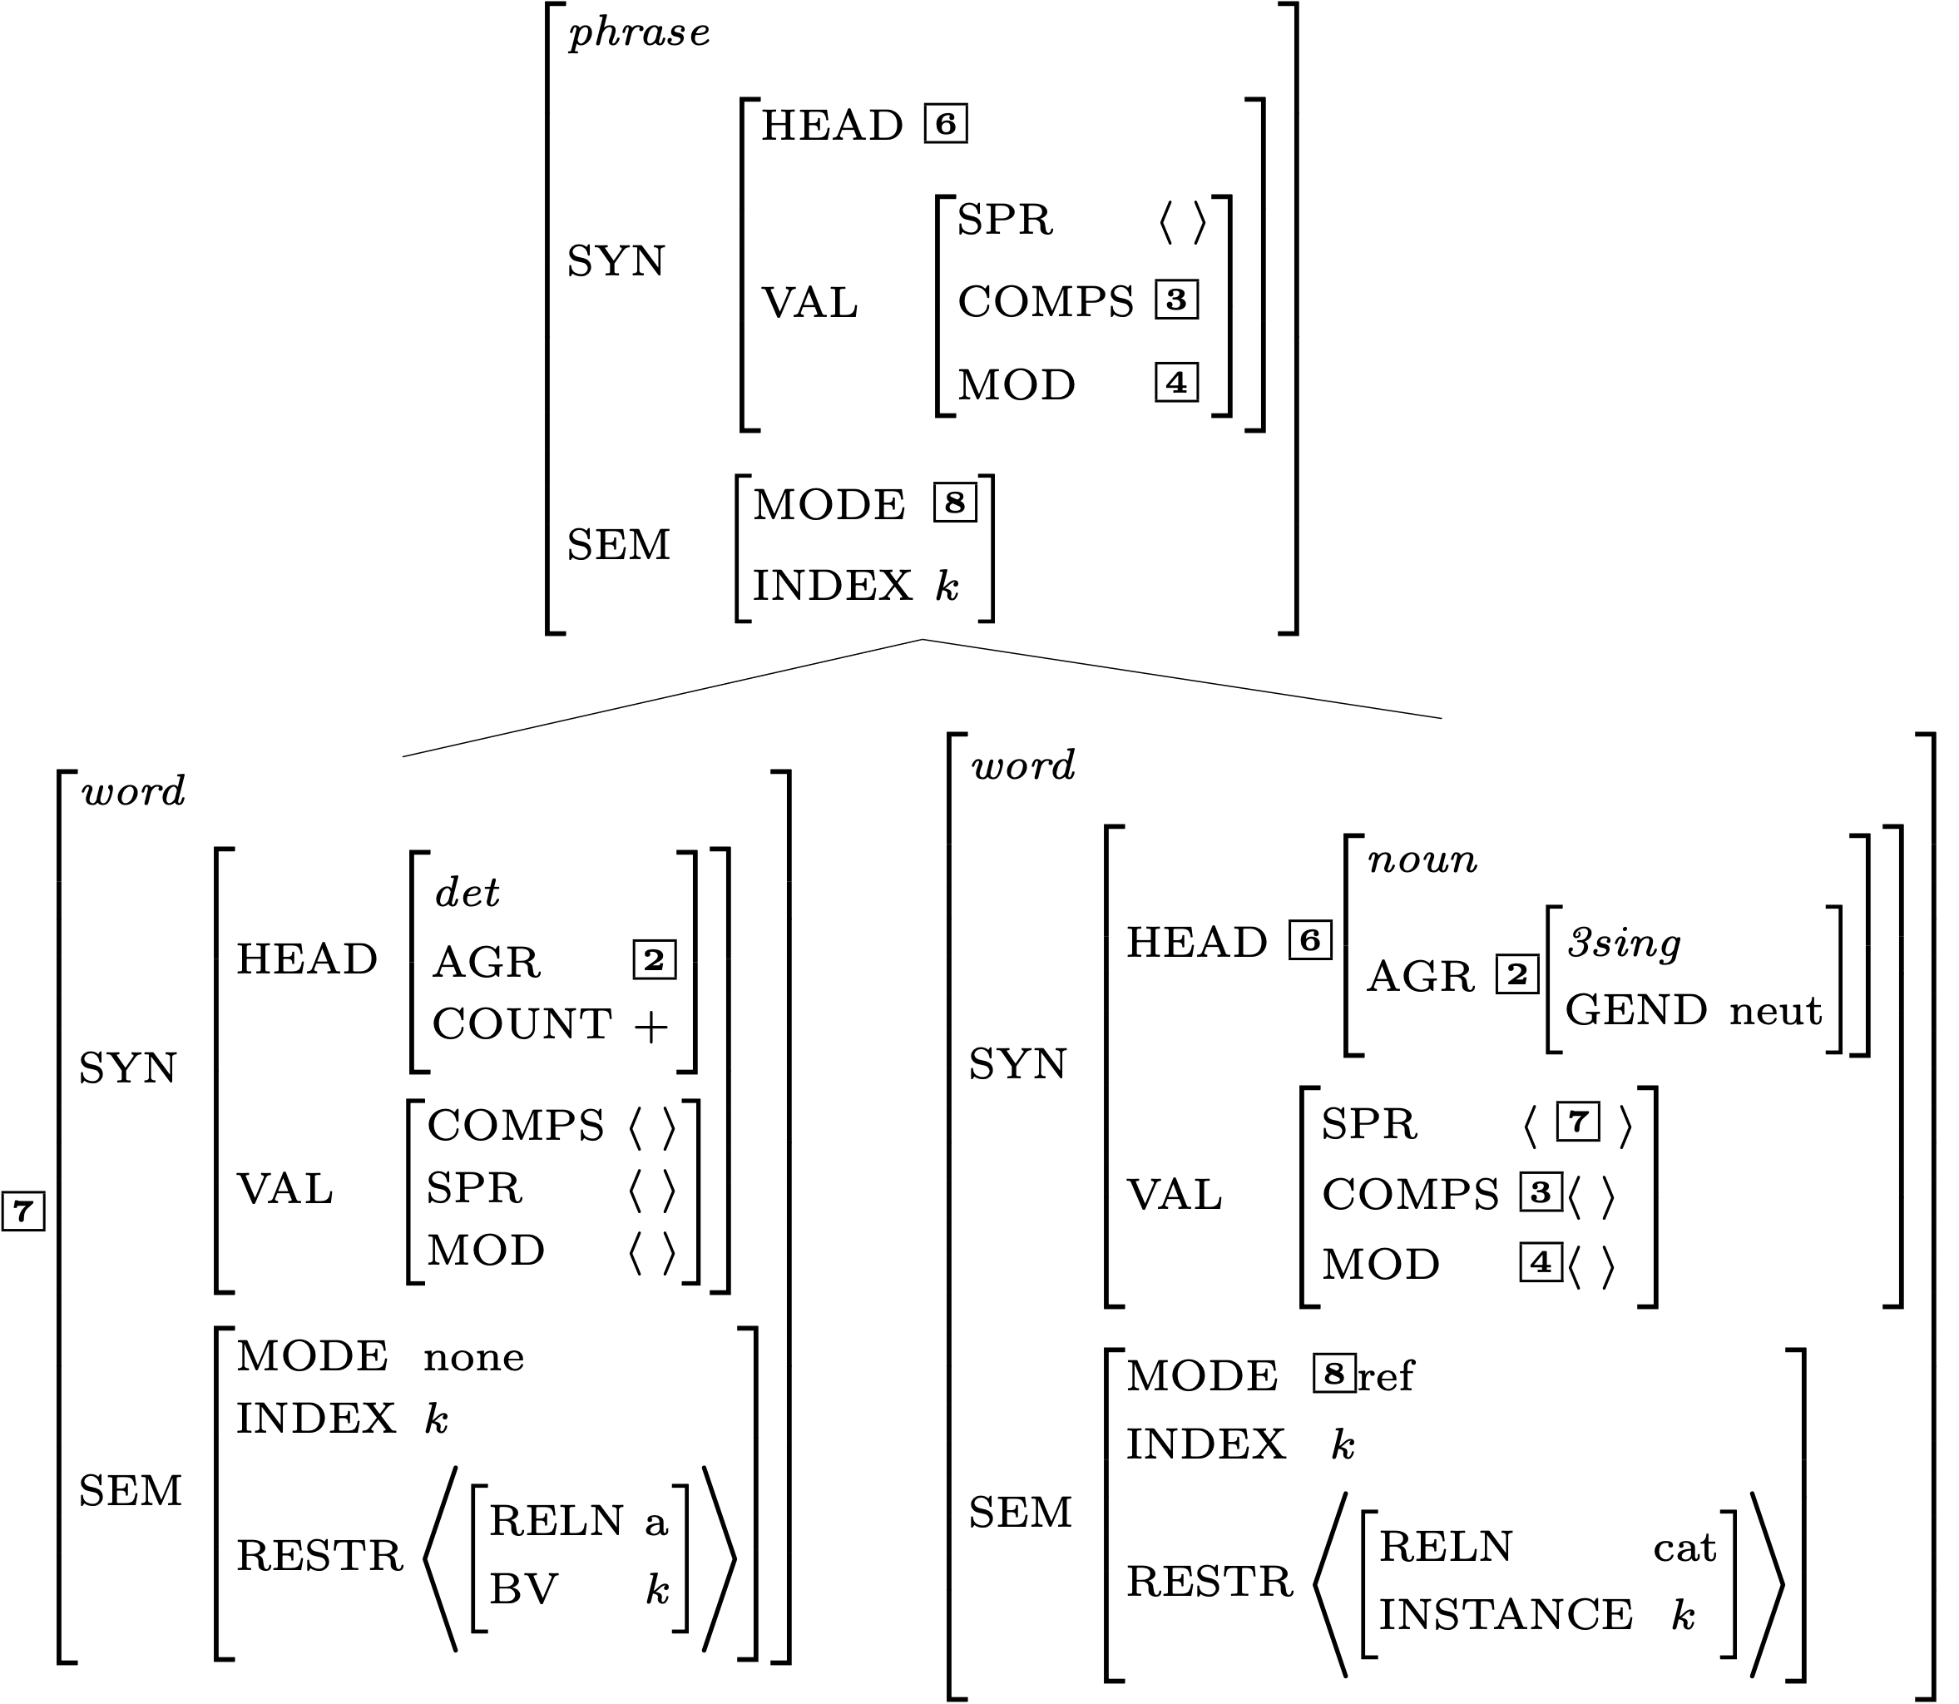
Effects of the Semantic Inheritance Principle

Slide 20
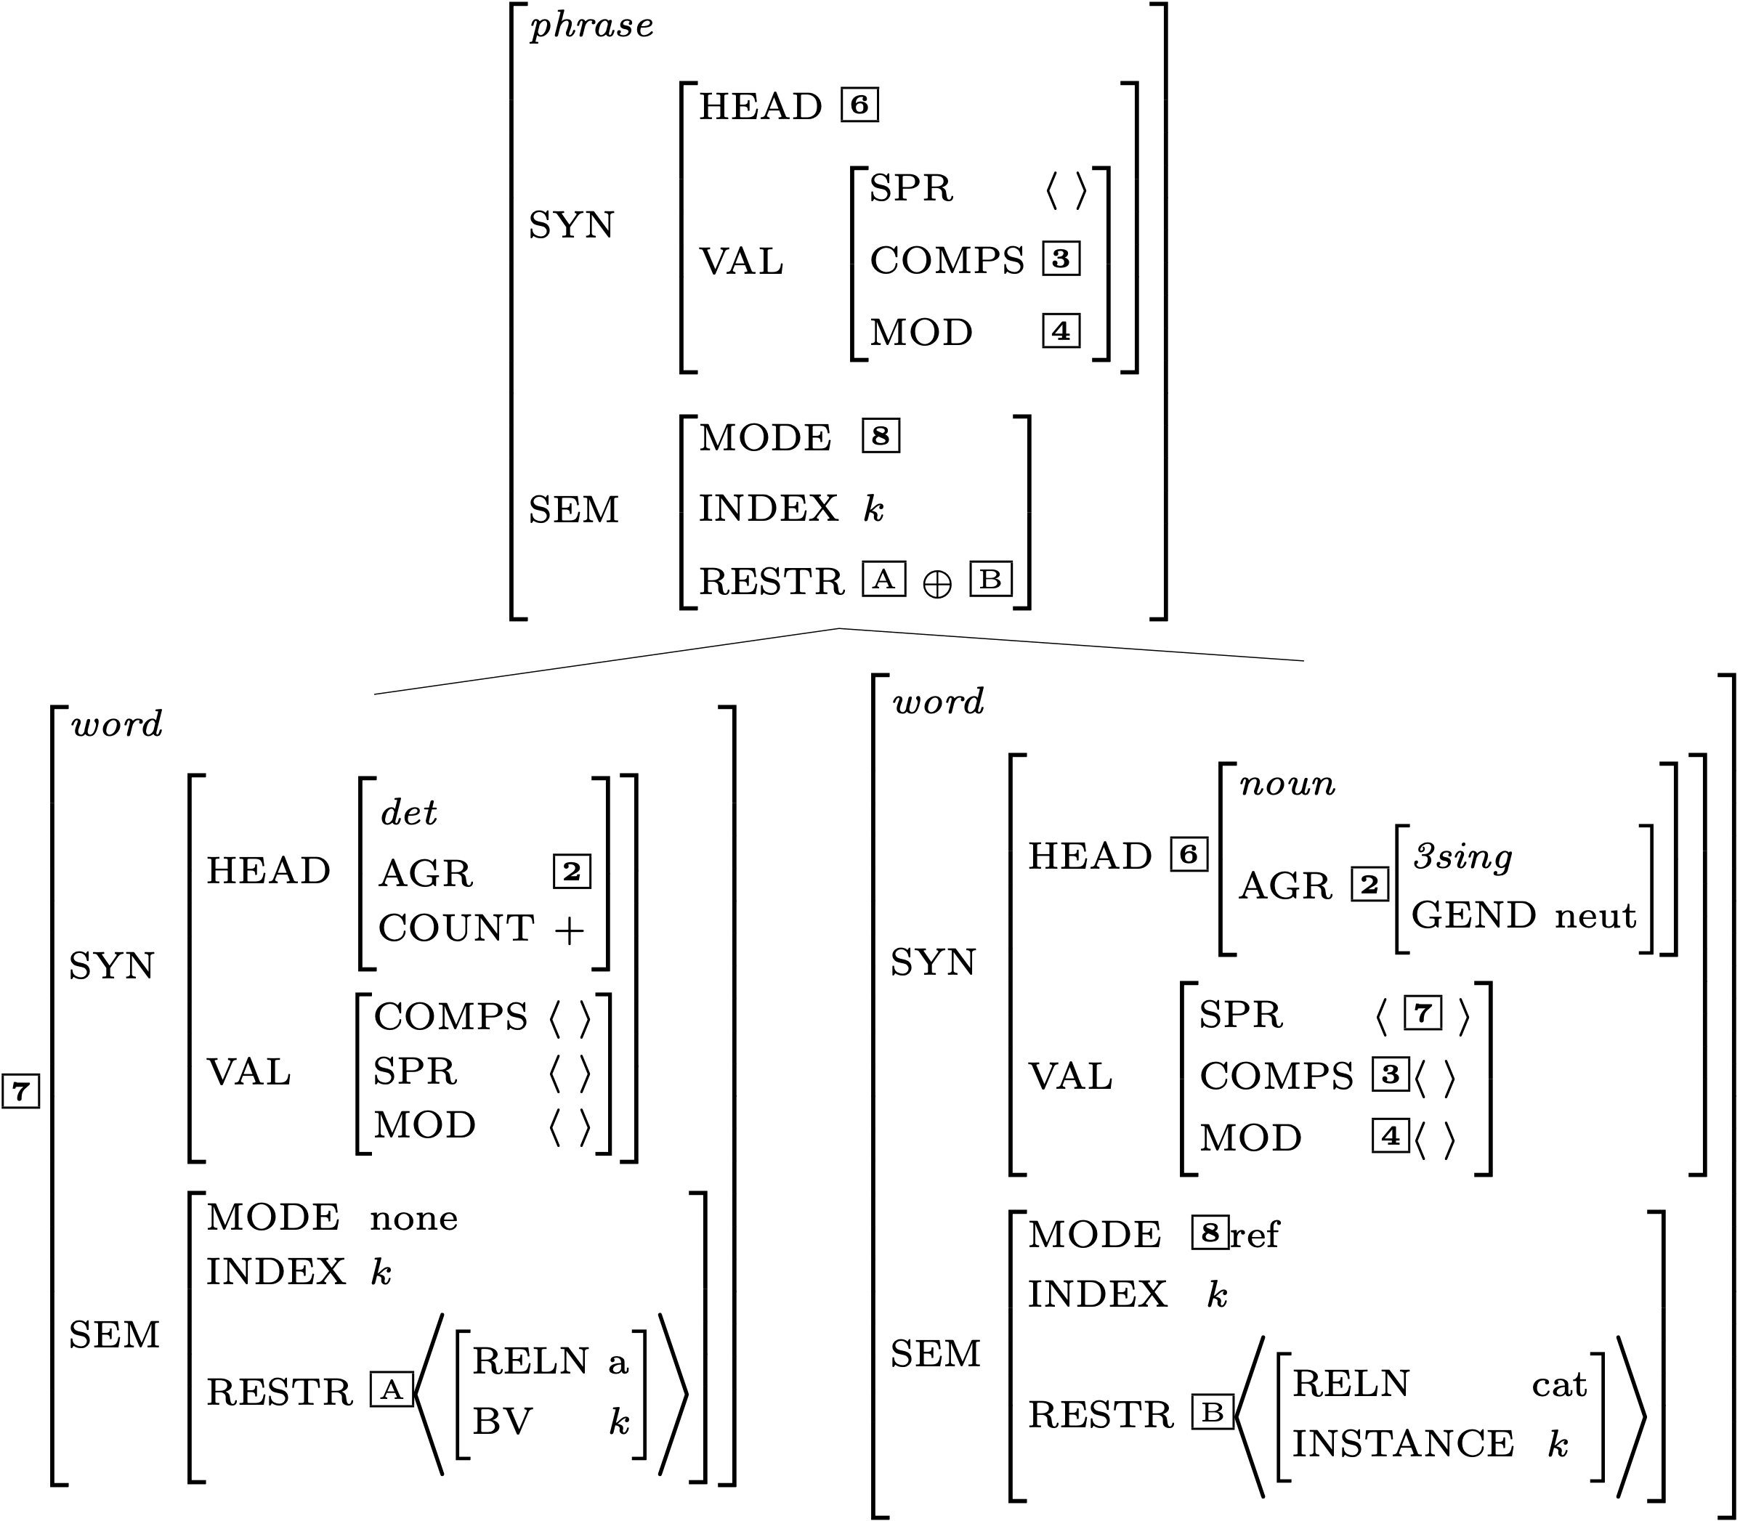
Effects of the Semantic Compositionality Principle

Slide 21
Is the Mother Node Now Completely Specified?

Slide 22
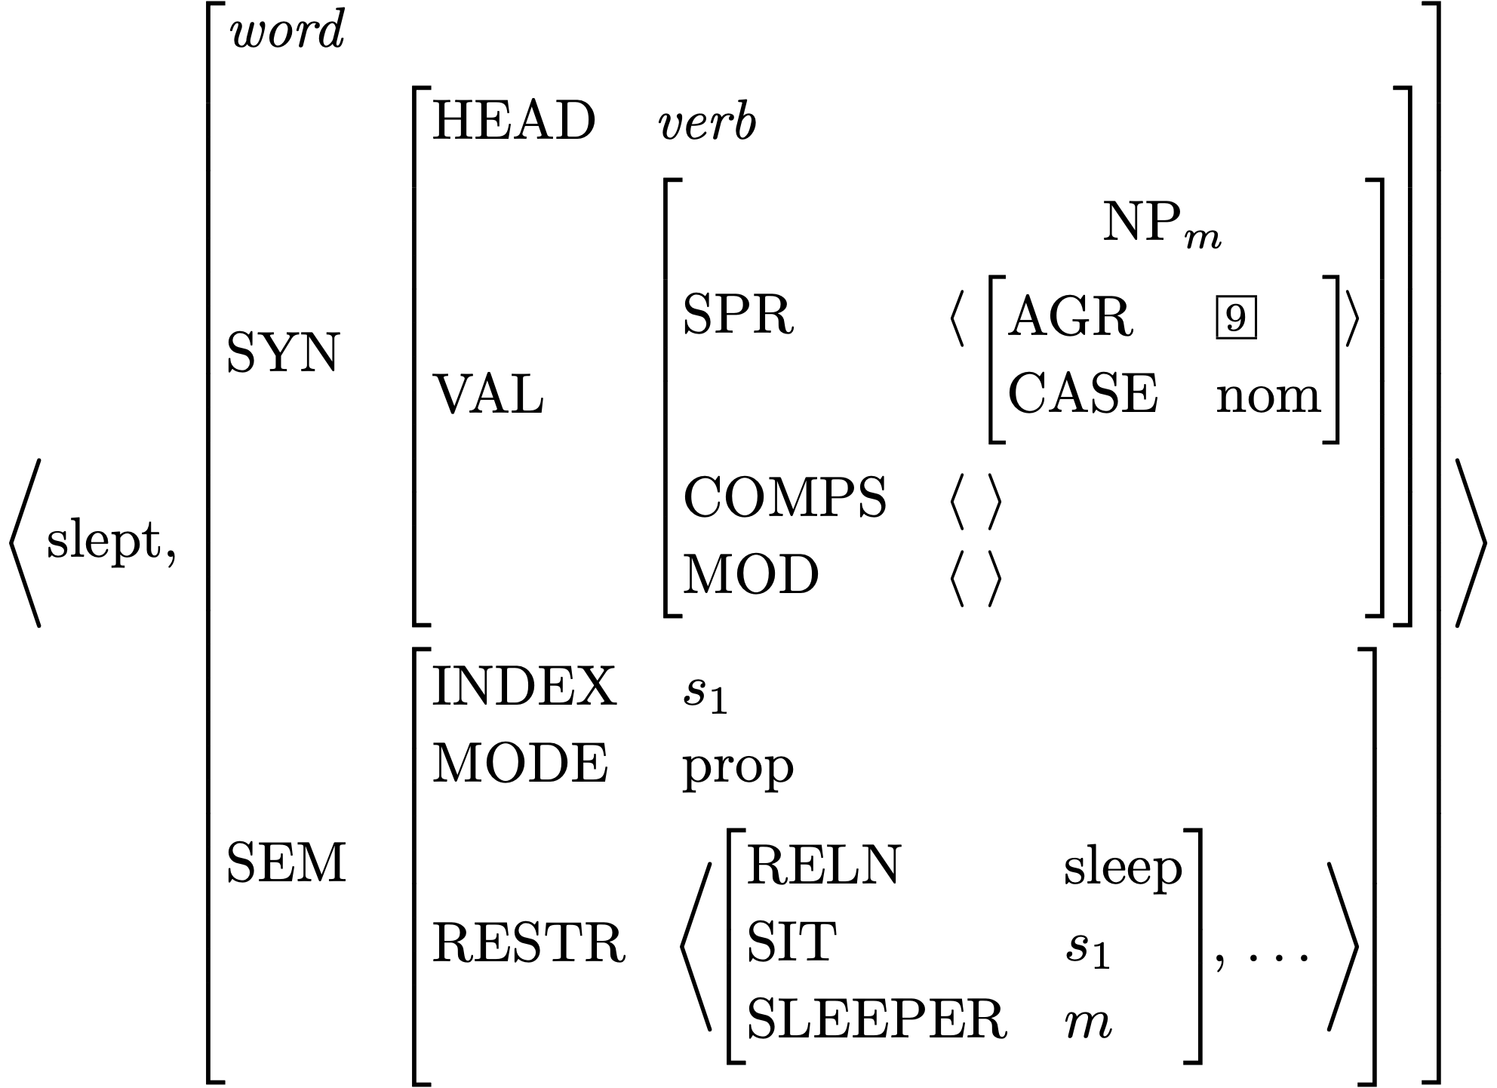
Lexical Entry for slept

Slide 23
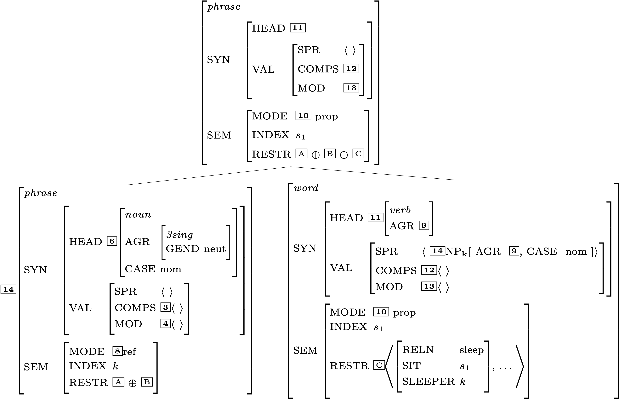
Another Head-Specifier Phrase
Key
 | HSR
 | SHAC
 | Val Prin
 | HFP
 | SIP
 | SCP

Slide 24
Is this description fully specified?

Slide 25
Does the top node satisfy the initial symbol?

Slide 26
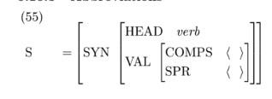
Does the top node satisfy the initial symbol?

Slide 27
RESTR of the S node

Slide 28
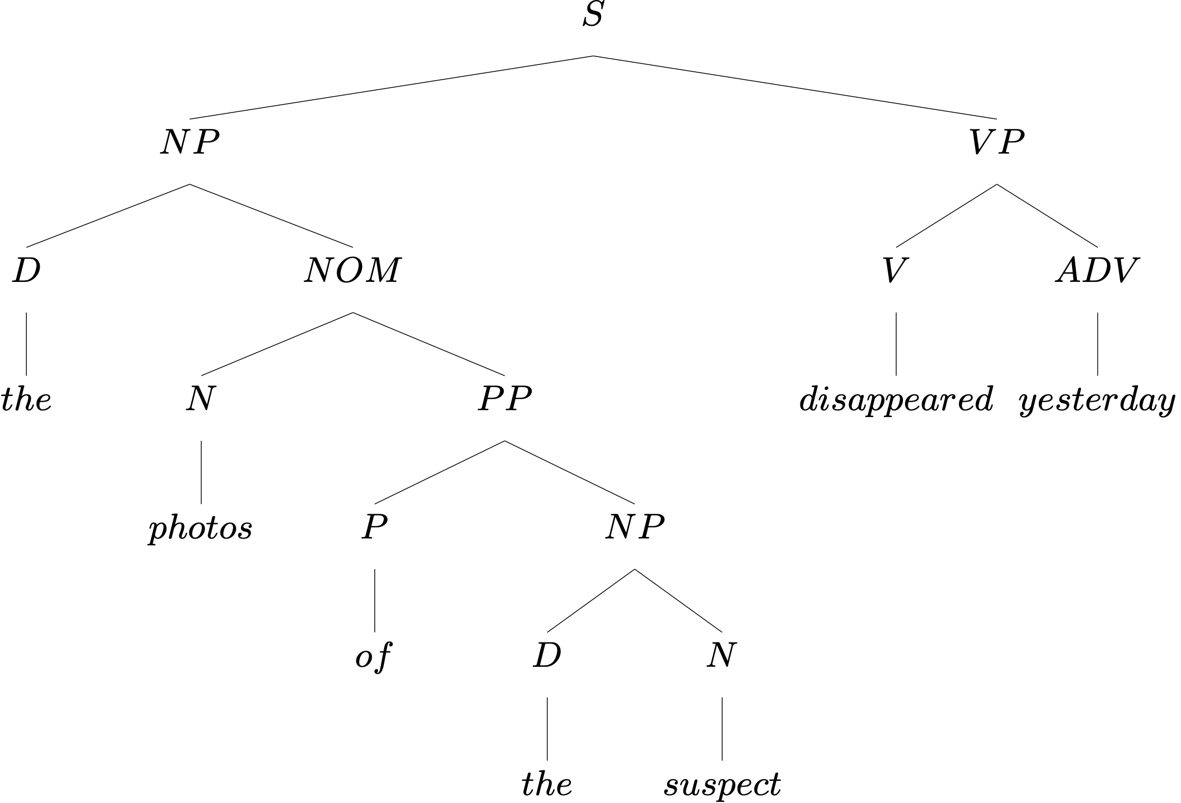
Another Example
What rule builds each subtree?

Slide 29
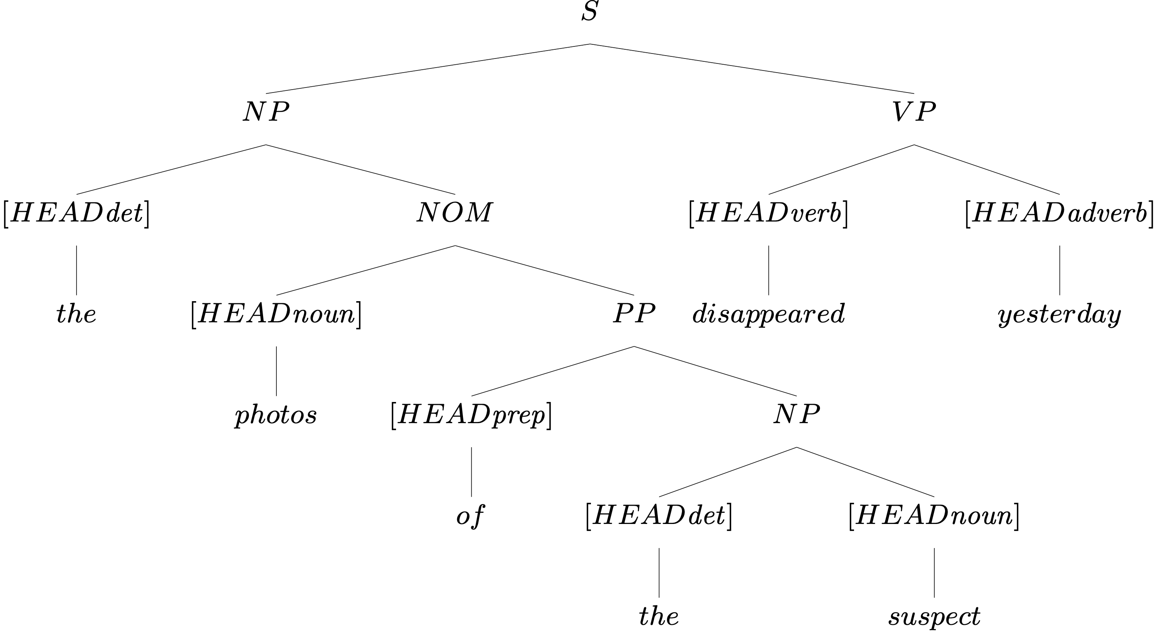
Head Features from Lexical Entries

Slide 30
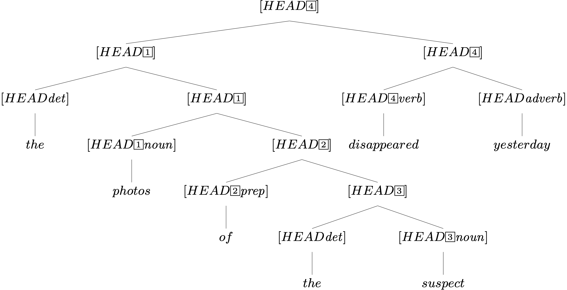
Head Features from Lexical Entries, plus HFP

Slide 31
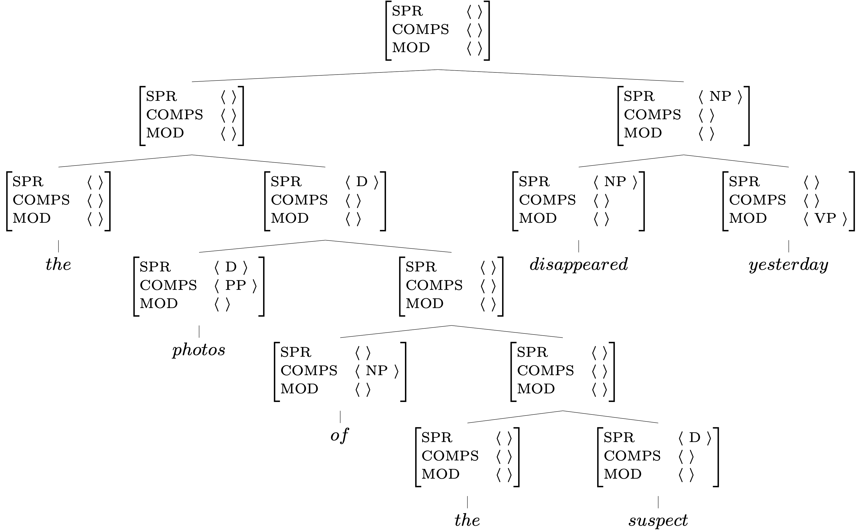
Valence Features:
Lexicon, Rules, and the Valence Principle
Key
 | Lexicon
 | Val. Prin.
 | Rules

Slide 32
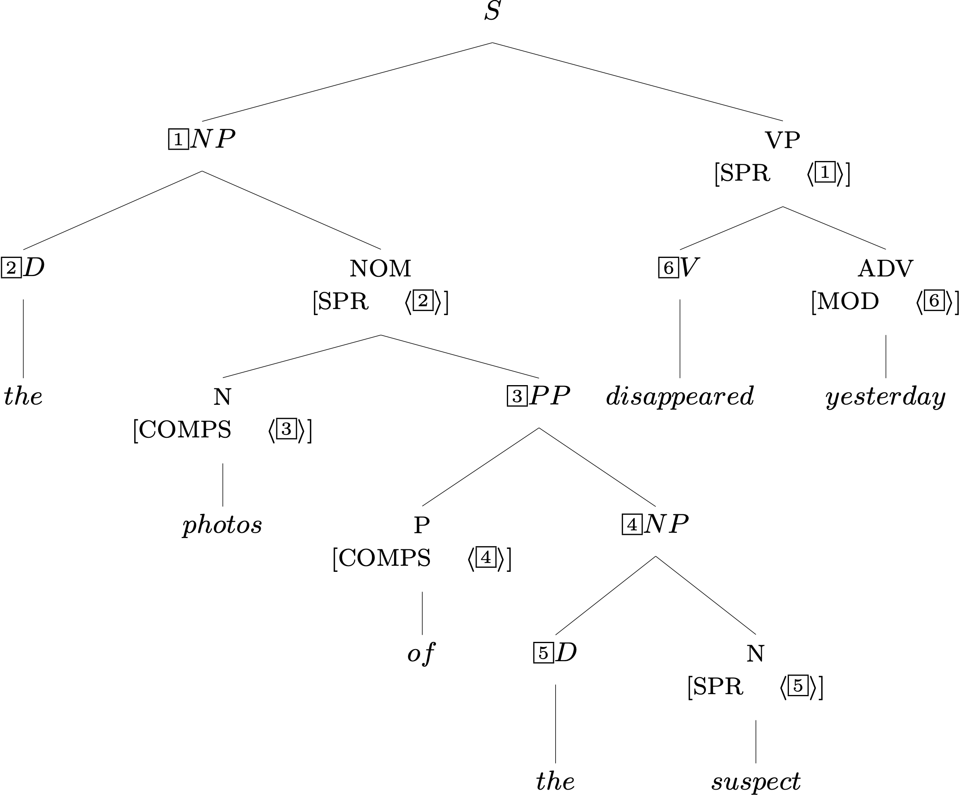
Required Identities: Grammar Rules

Slide 33
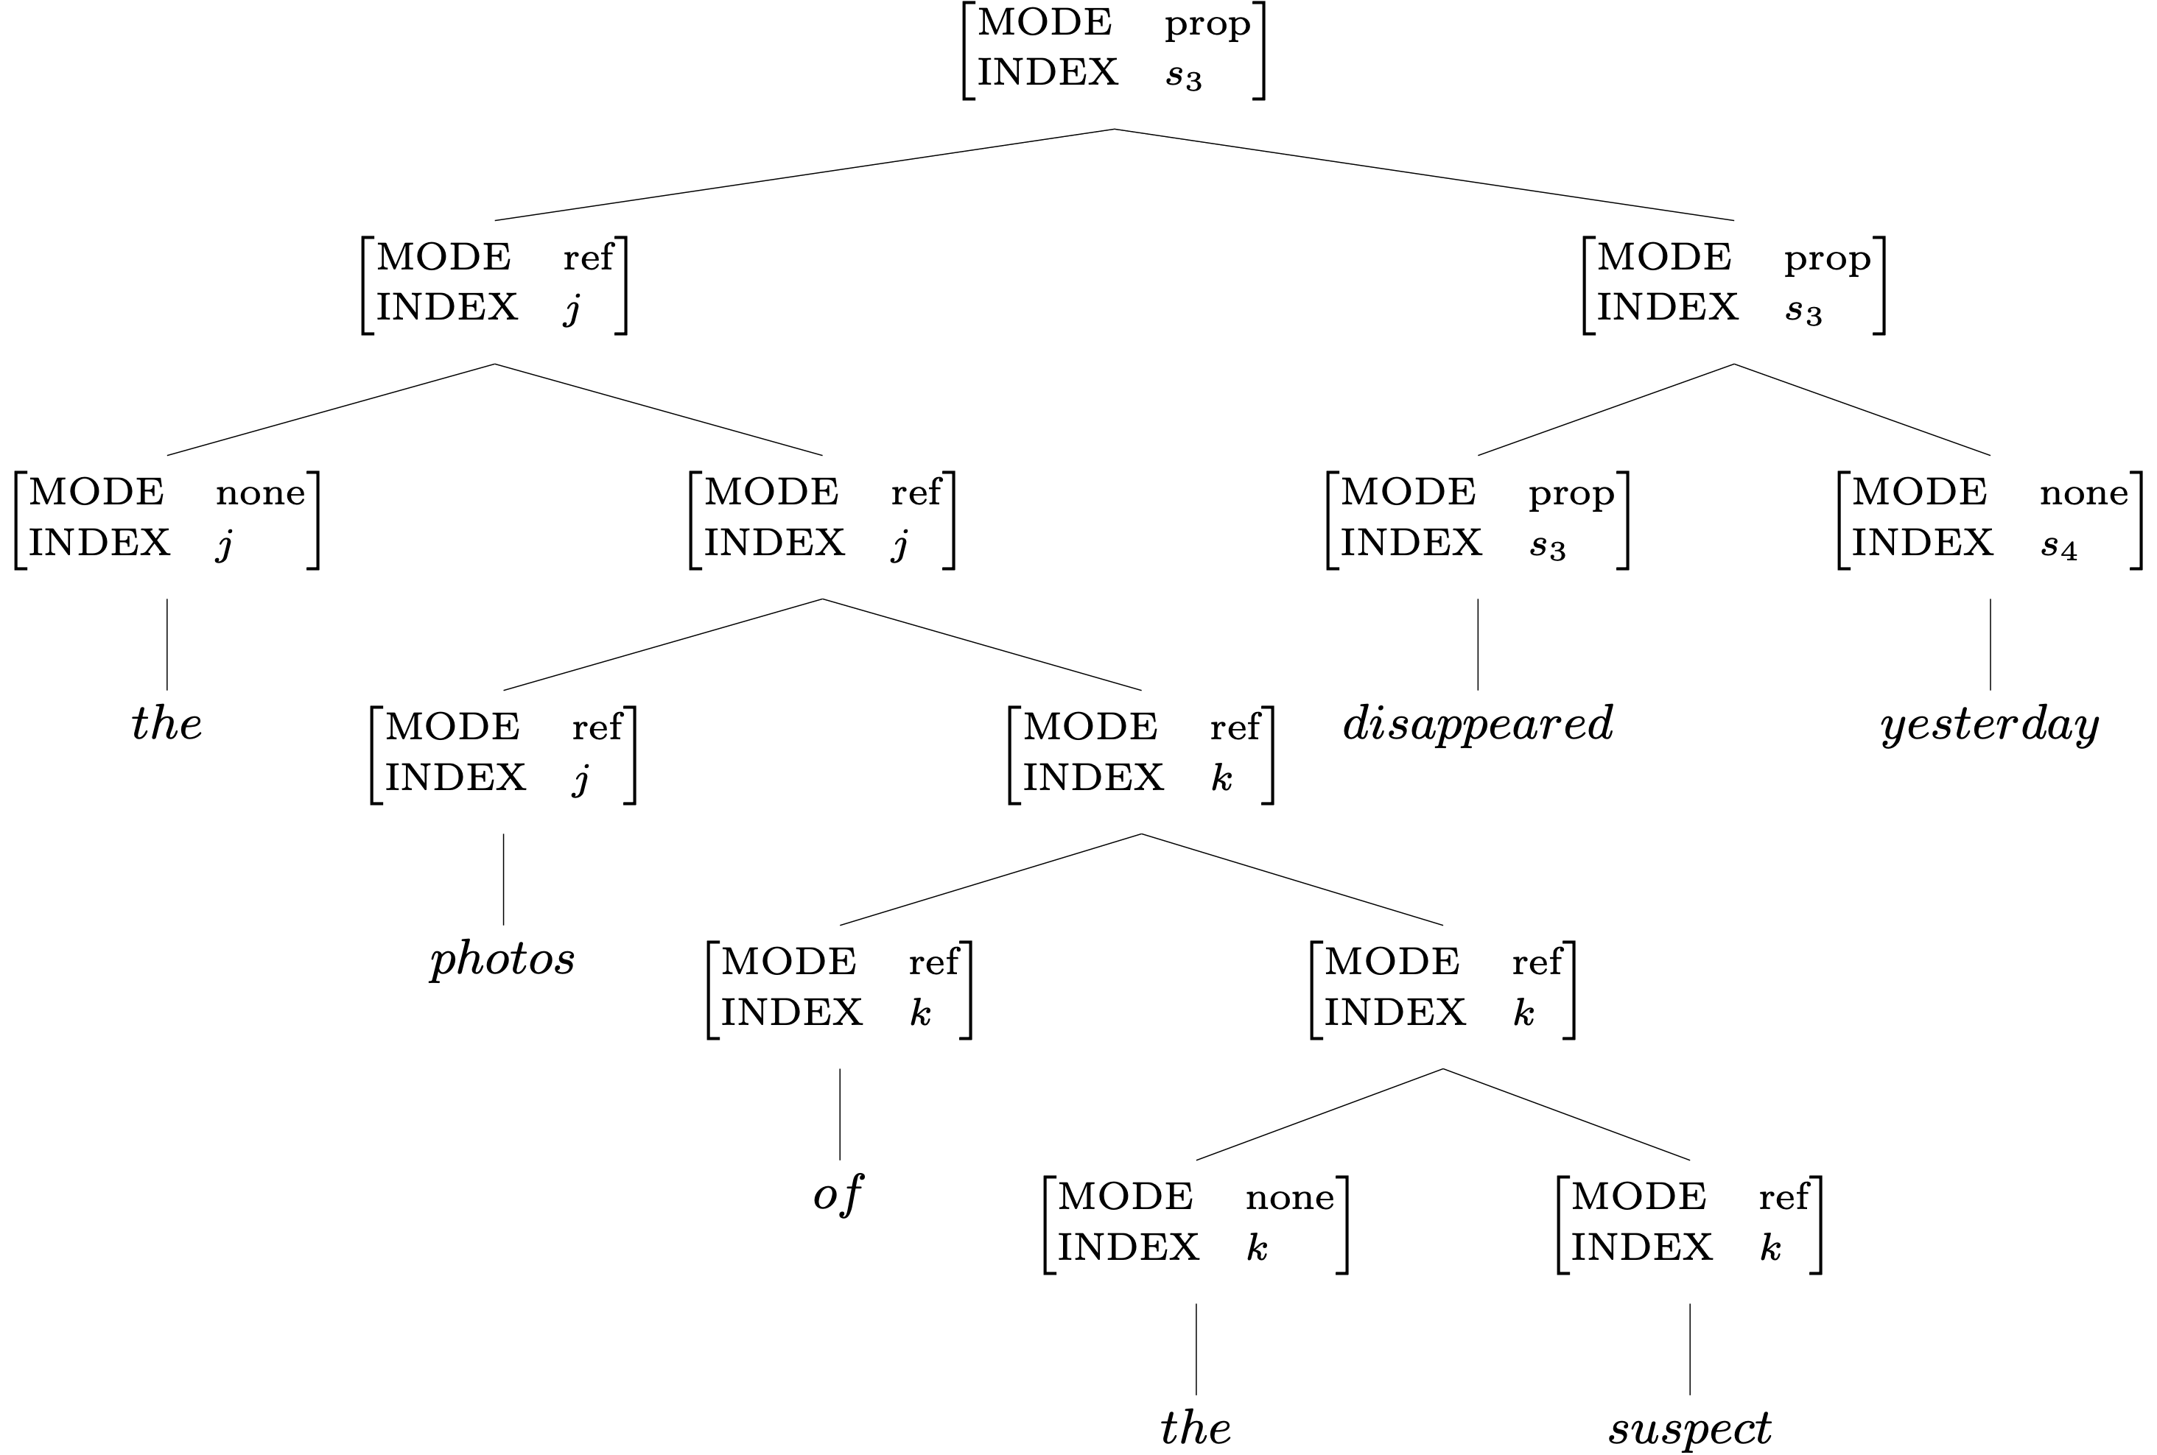
Two Semantic Features: the Lexicon & SIP

Slide 34
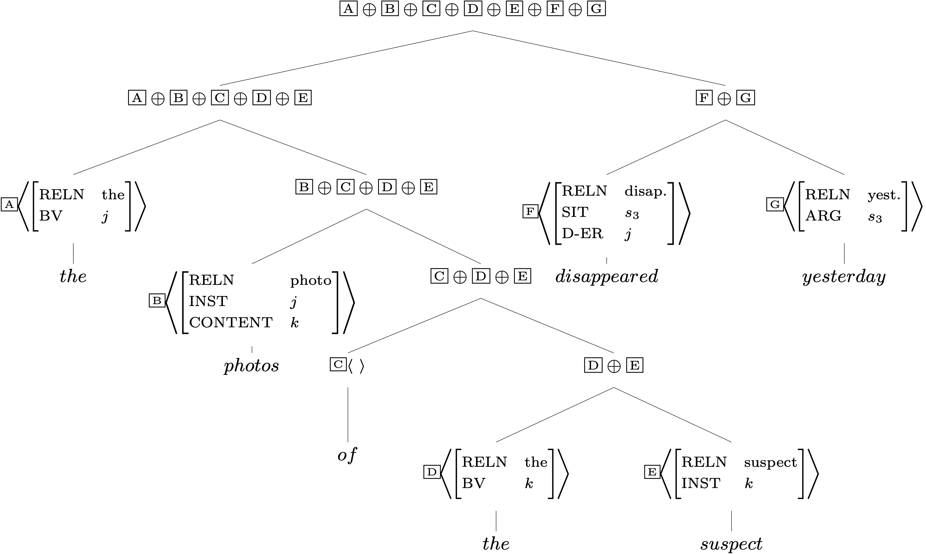
RESTR Values and the SCP

Slide 35
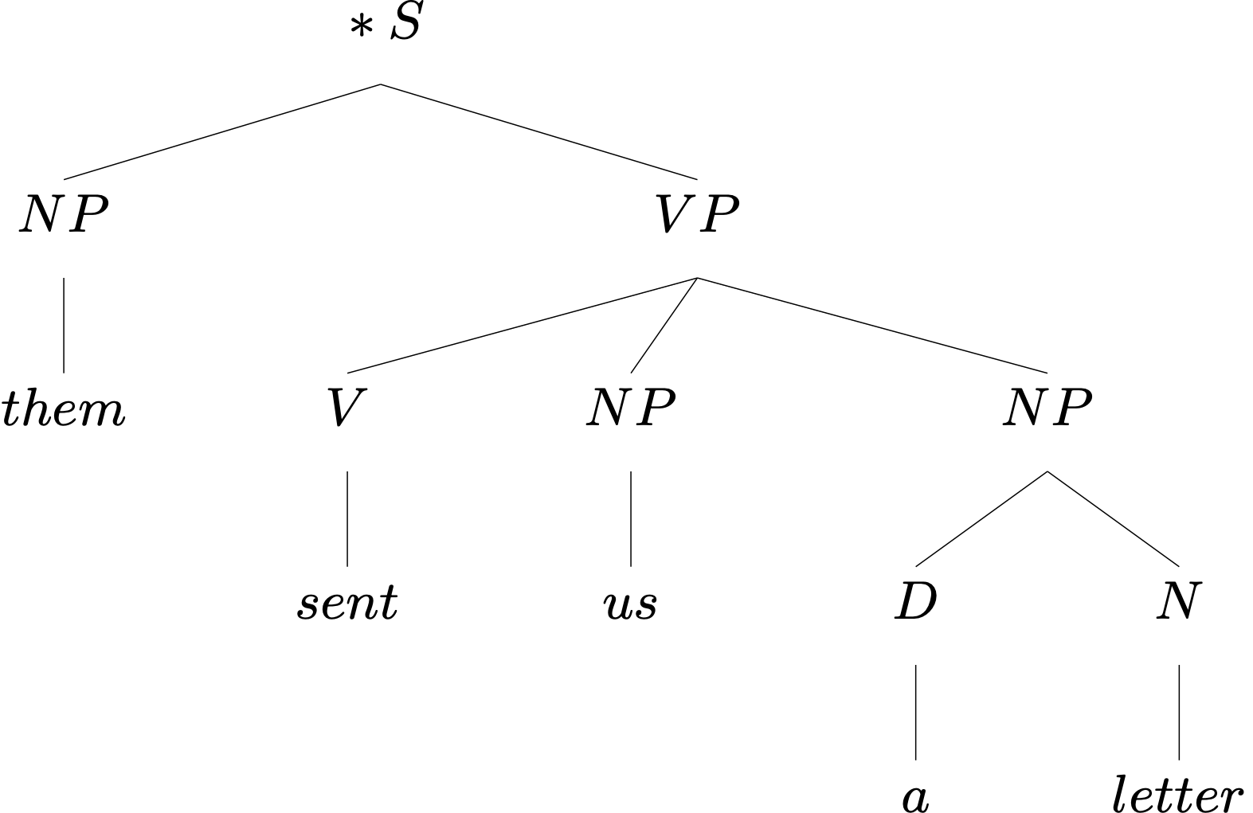
An Ungrammatical Example
What’s wrong with this sentence?

Slide 36
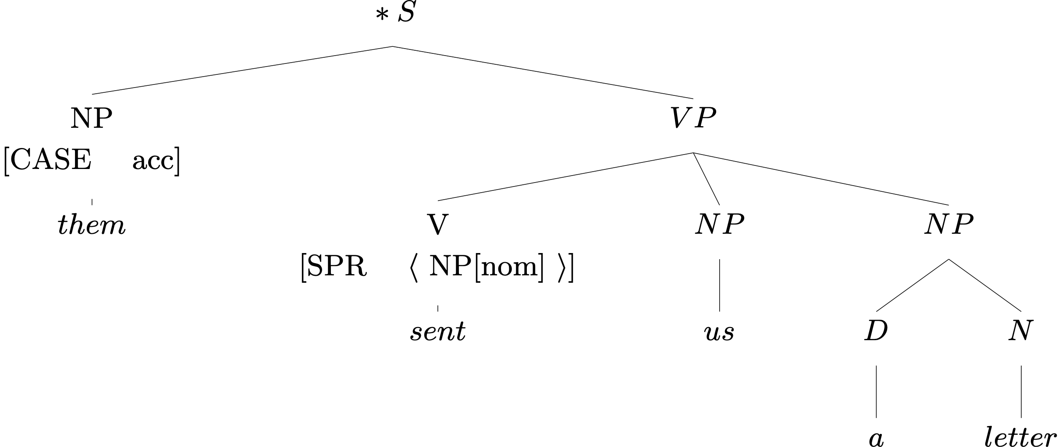
An Ungrammatical Example
What’s wrong with this sentence?
So what?

Slide 37
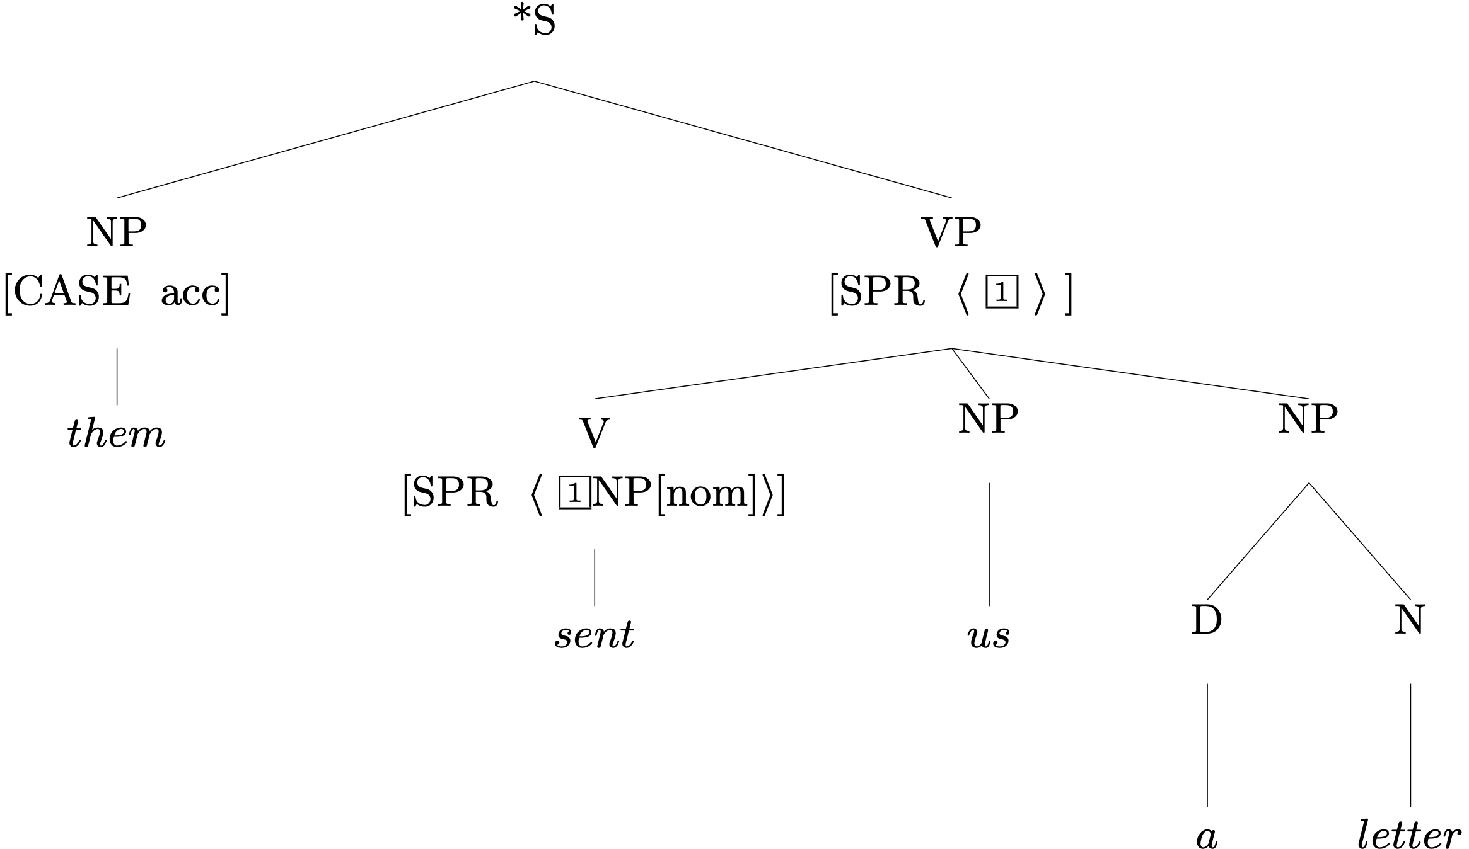
An Ungrammatical Example
The Valence Principle

Slide 38
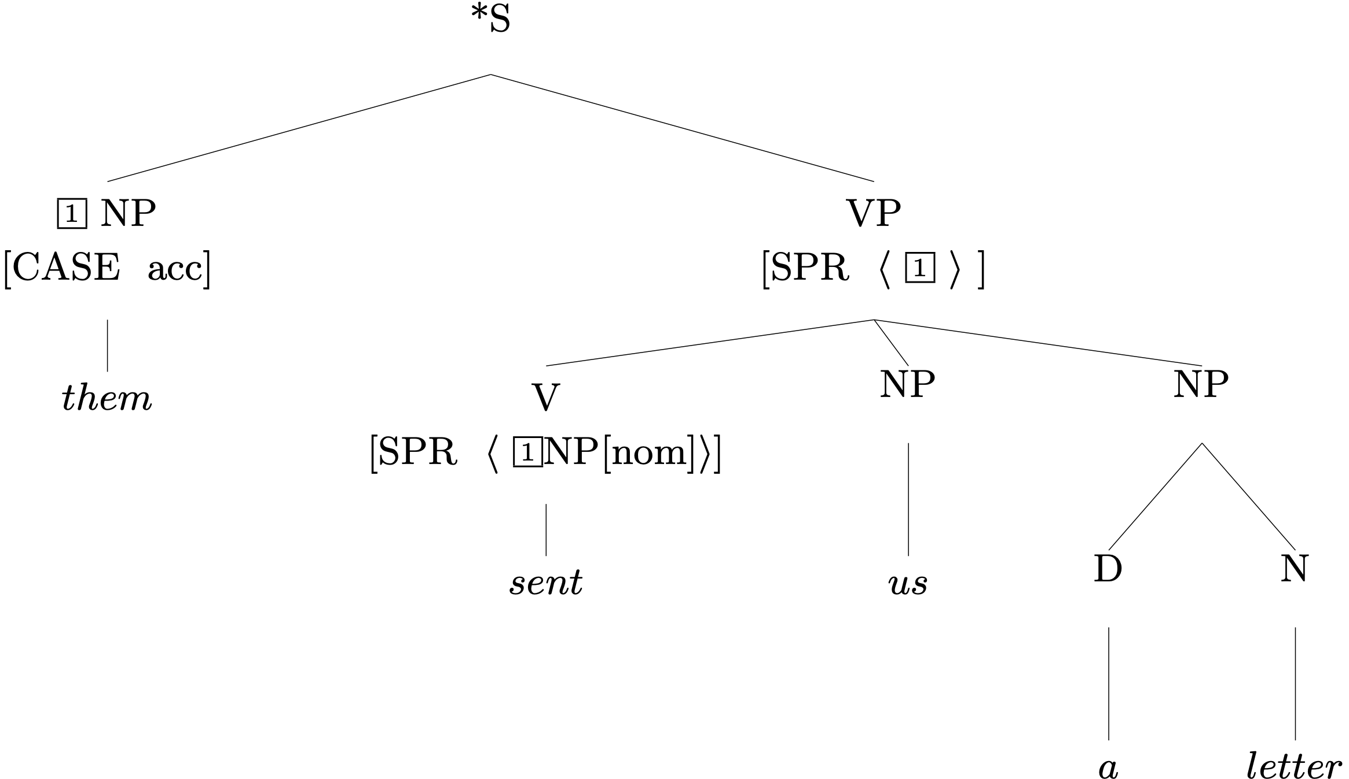
An Ungrammatical Example
Head Specifier Rule
¬contradiction®

Slide 39
Exercise in Critical Thinking
Our grammar has come a long way since Ch 2, as we've added ways of representing different kinds of information:
generalizations across categories
semantics
particular linguistic phenomena: valence, agreement, modification
What else might we add? What facts about language are as yet unrepresented in our model?

Slide 40
Overview
What we’re trying to do
The pieces of our grammar
Two extended examples
Reflection on what we’ve done, what we still have to do

