Slide 1
Ling 566
Jan 28, 2019
How the Grammar Works

Slide 2
Overview
What we’re trying to do
The pieces of our grammar
Two extended examples
Reflection on what we’ve done, what we still have to do
Reading questions

Slide 3
What We’re Trying To Do
Objectives
Develop a theory of knowledge of language
Represent linguistic information explicitly enough to distinguish well-formed from ill-formed expressions
Be parsimonious, capturing linguistically significant generalizations.
Why Formalize?
To formulate testable predictions
To check for consistency
To make it possible to get a computer to do it for us

Slide 4
How We Construct Sentences
The Components of Our Grammar
Grammar rules
Lexical entries
Principles
Type hierarchy (very preliminary, so far)
Initial symbol (S, for now)
We combine constraints from these components.
Q: What says we have to combine them?

Slide 5
An Example
A cat slept.
Can we build this with our tools?
Given the constraints our grammar puts on well-formed sentences, is this one?

Slide 6
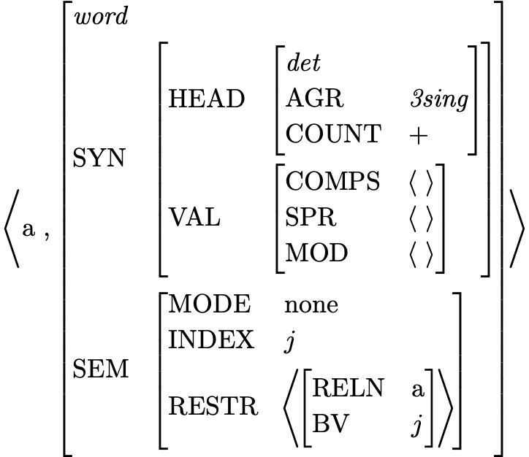
Lexical Entry for a
Is this a fully specified description?
What features are unspecified?
How many word structures can this entry license?

Slide 7
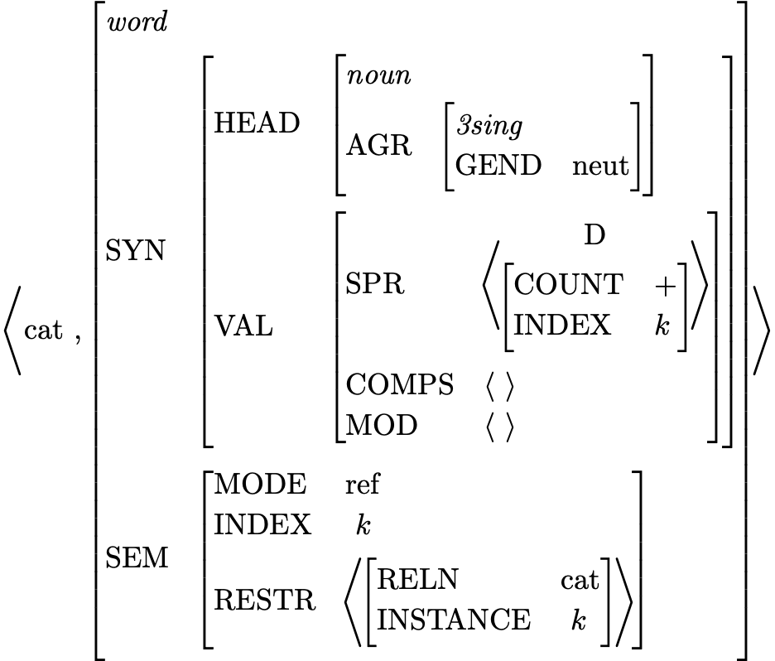
Lexical Entry for cat
Which feature paths are abbreviated?
Is this a fully specified description?
What features are unspecified?
How many word structures can this entry license?

Slide 8
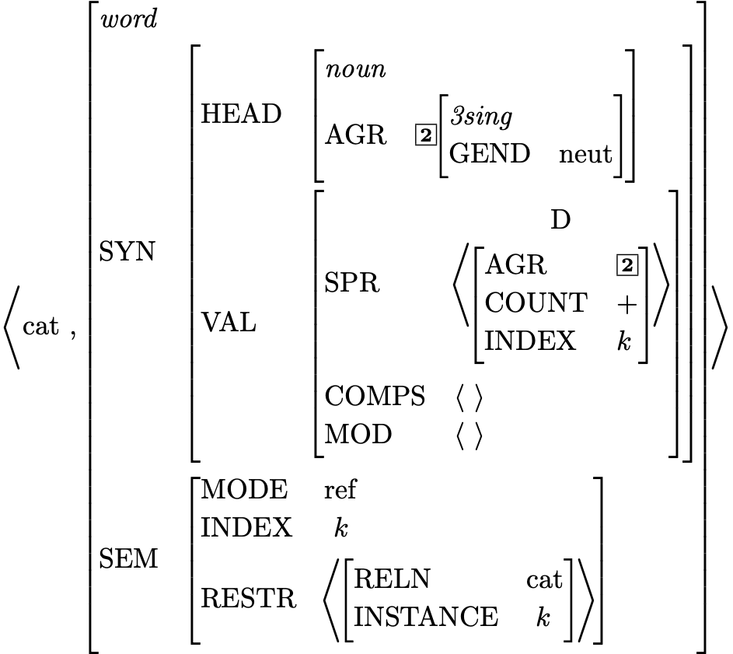
Effect of Principles: the SHAC

Slide 9
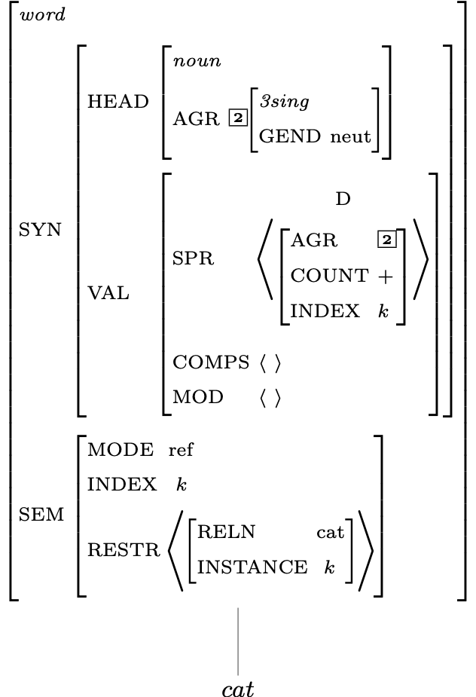
Description of Word Structures for cat

Slide 10
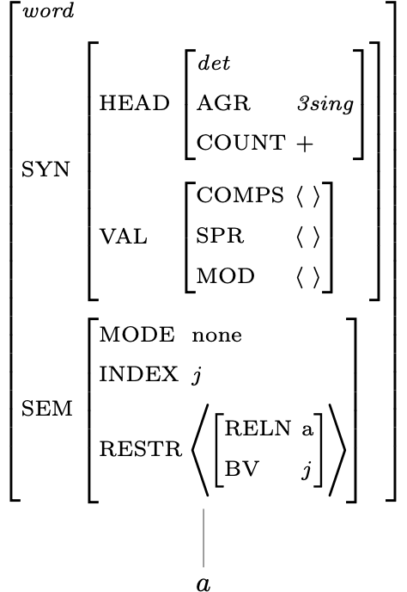
Description of Word Structures for a

Slide 11
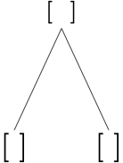
Building a Phrase

Slide 12
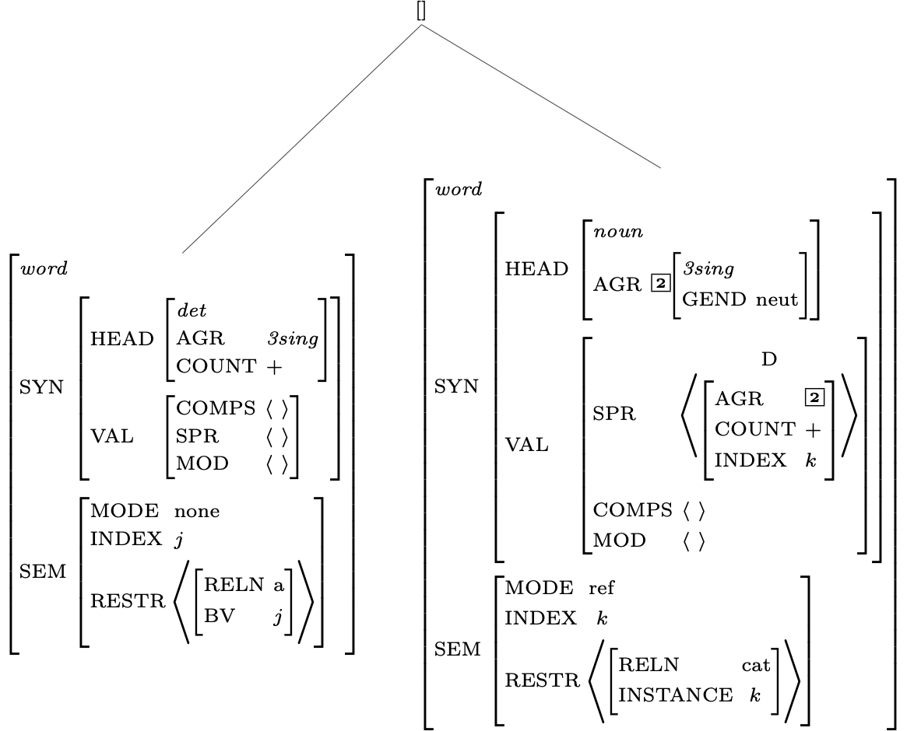
Constraints Contributed by Daughter Subtrees

Slide 13
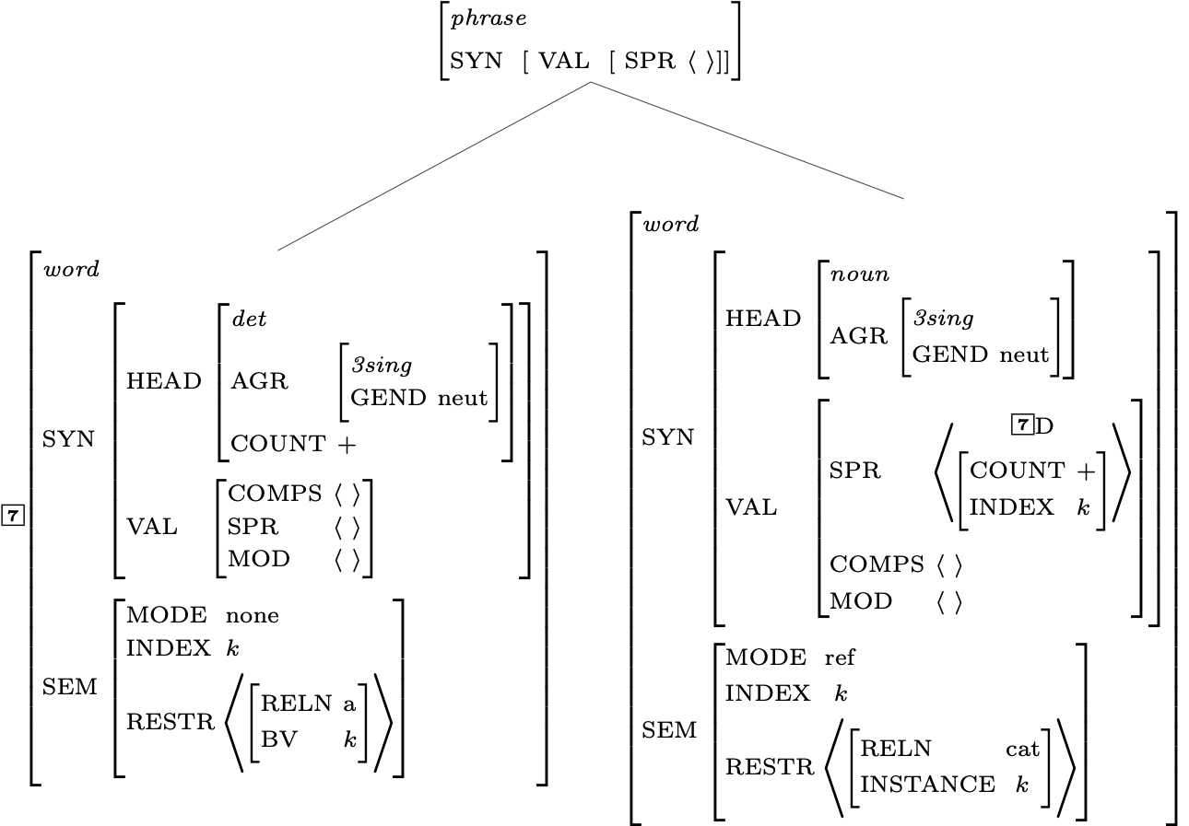
Constraints Contributed by the Grammar Rule

Slide 14
A Constraint Involving the SHAC

Slide 15
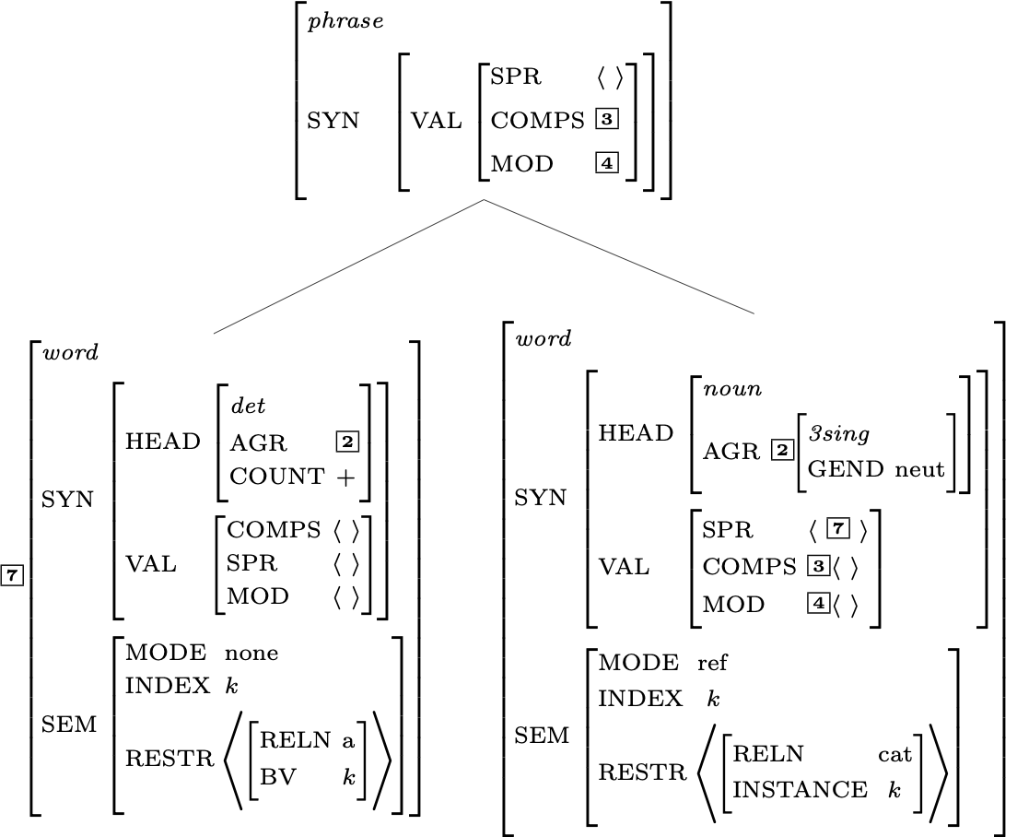
Effects of the Valence Principle

Slide 16
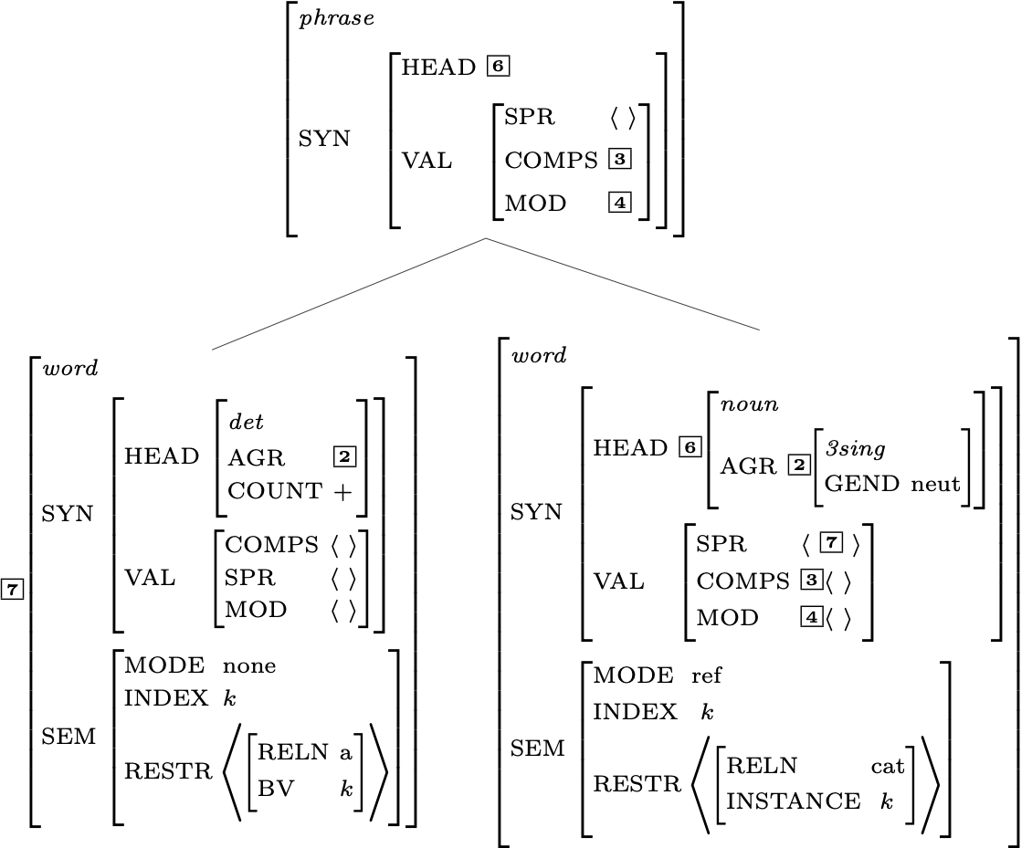
Effects of the Head Feature Principle

Slide 17
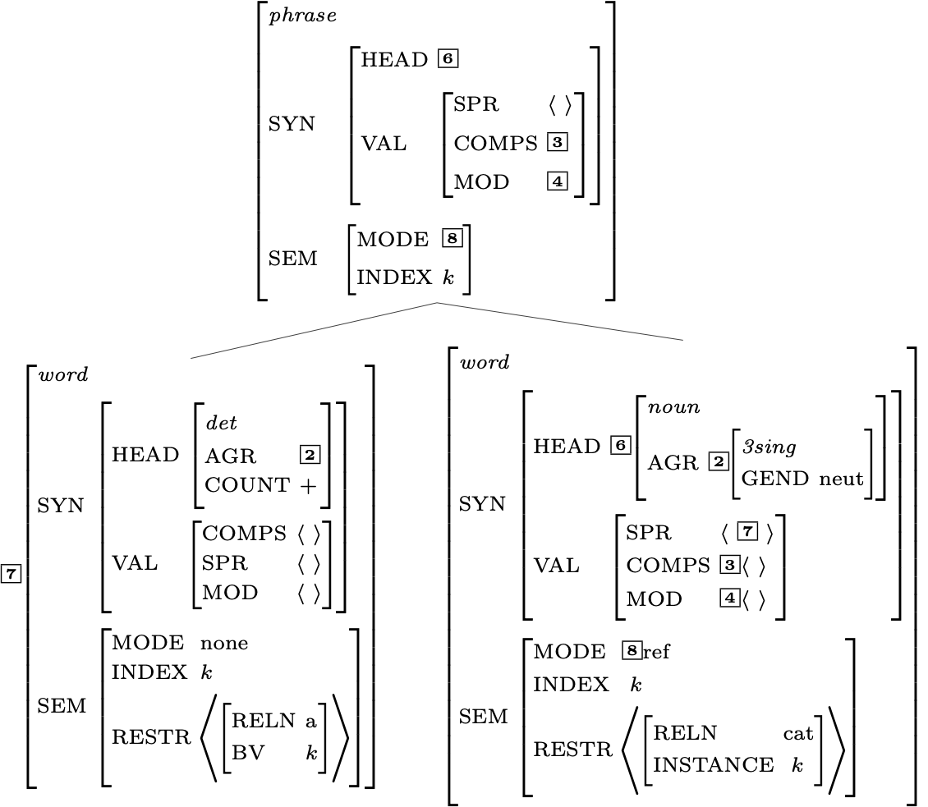
Effects of the Semantic Inheritance Principle

Slide 18
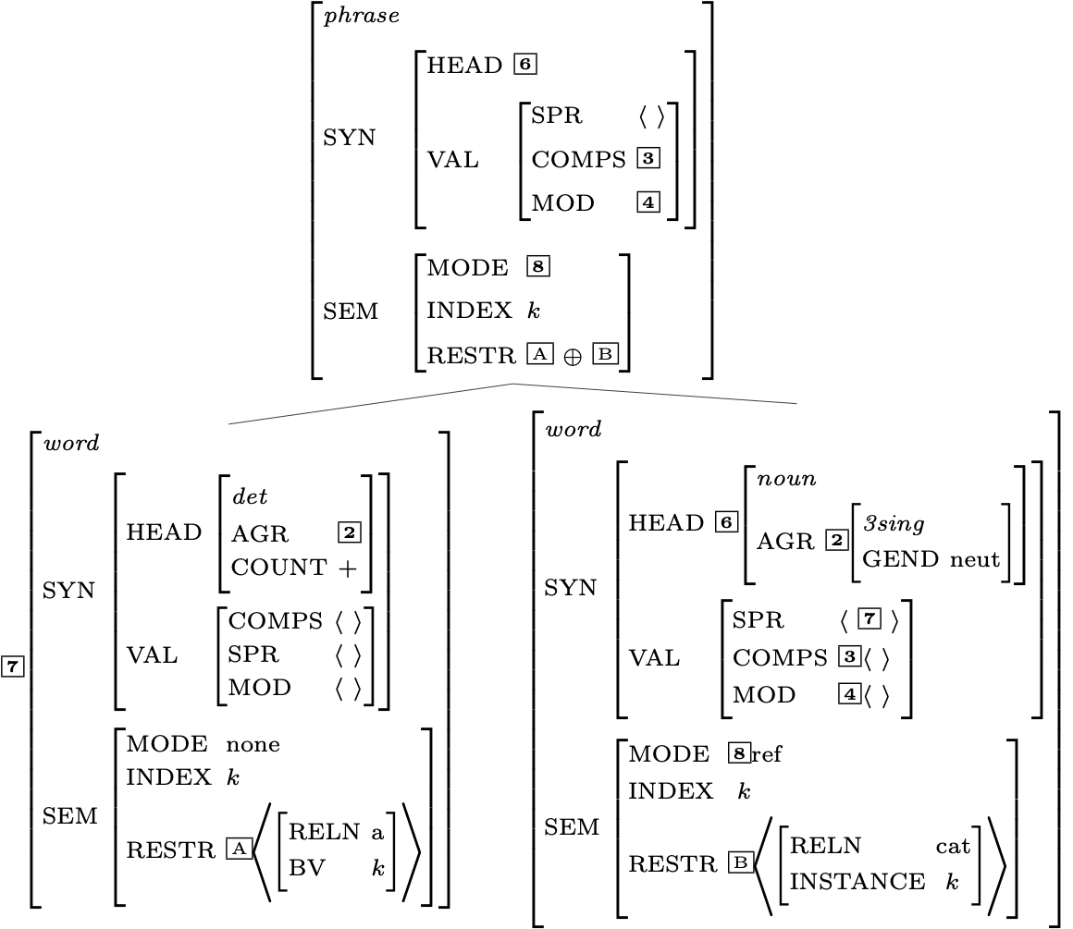
Effects of the Semantic Compositionality Principle

Slide 19
Is the Mother Node Now Completely Specified?

Slide 20
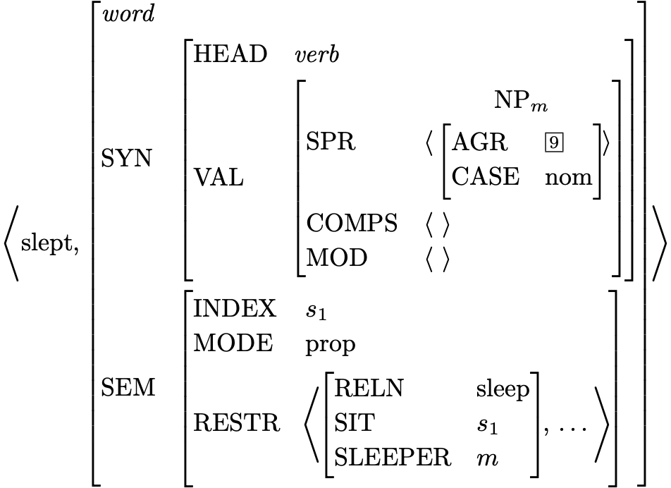
Lexical Entry for slept

Slide 21
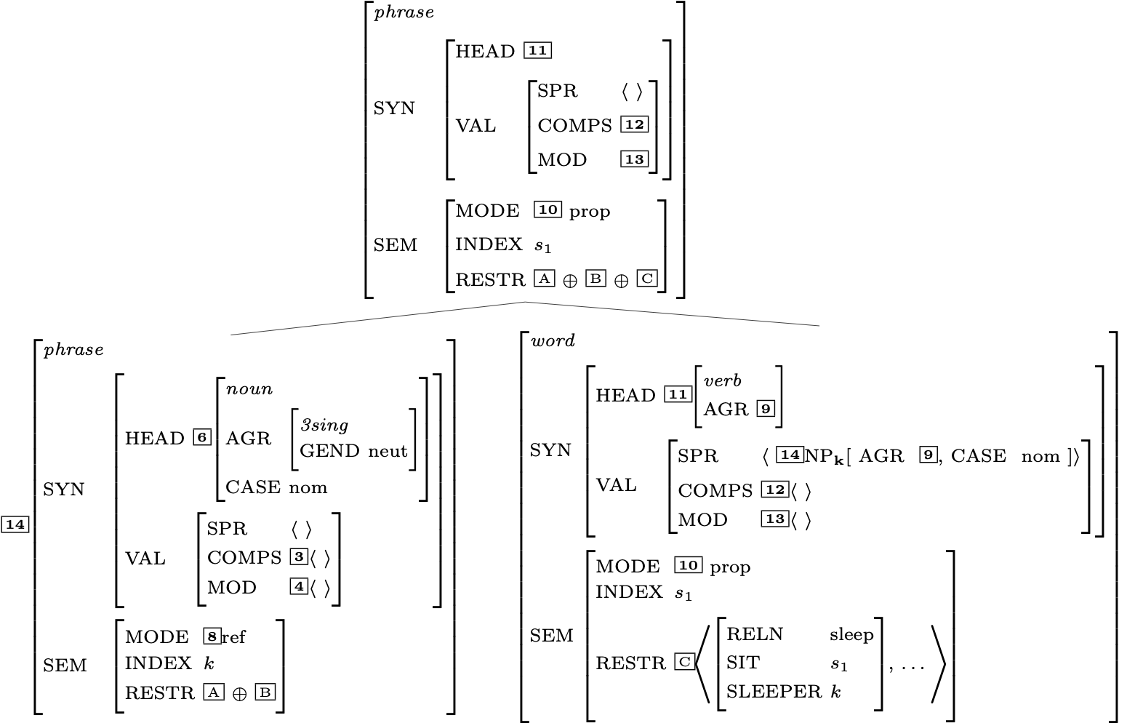
Another Head-Specifier Phrase
Key
 | HSR
 | SHAC
 | Val Prin
 | HFP
 | SIP
 | SCP

Slide 22
Is this description fully specified?

Slide 23
Does the top node satisfy the initial symbol?

Slide 24
RESTR of the S node

Slide 25
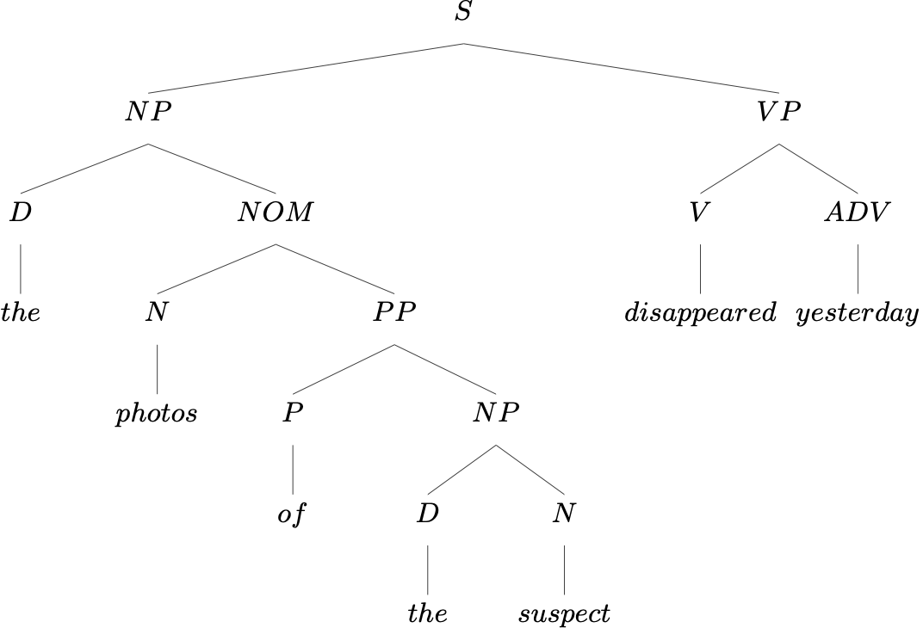
Another Example

Slide 26
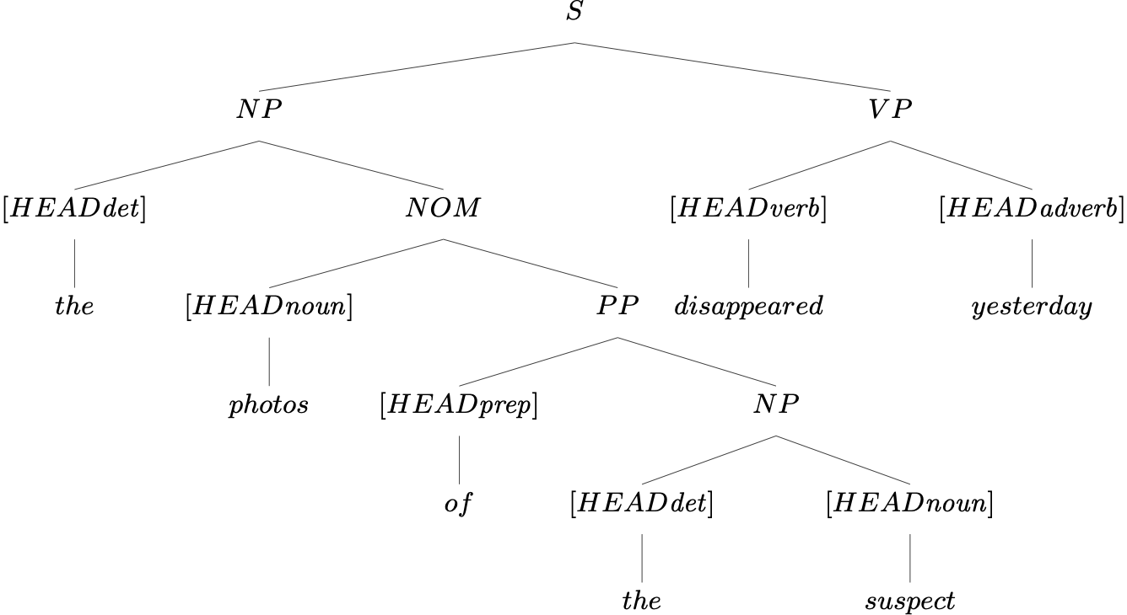
Head Features from Lexical Entries

Slide 27
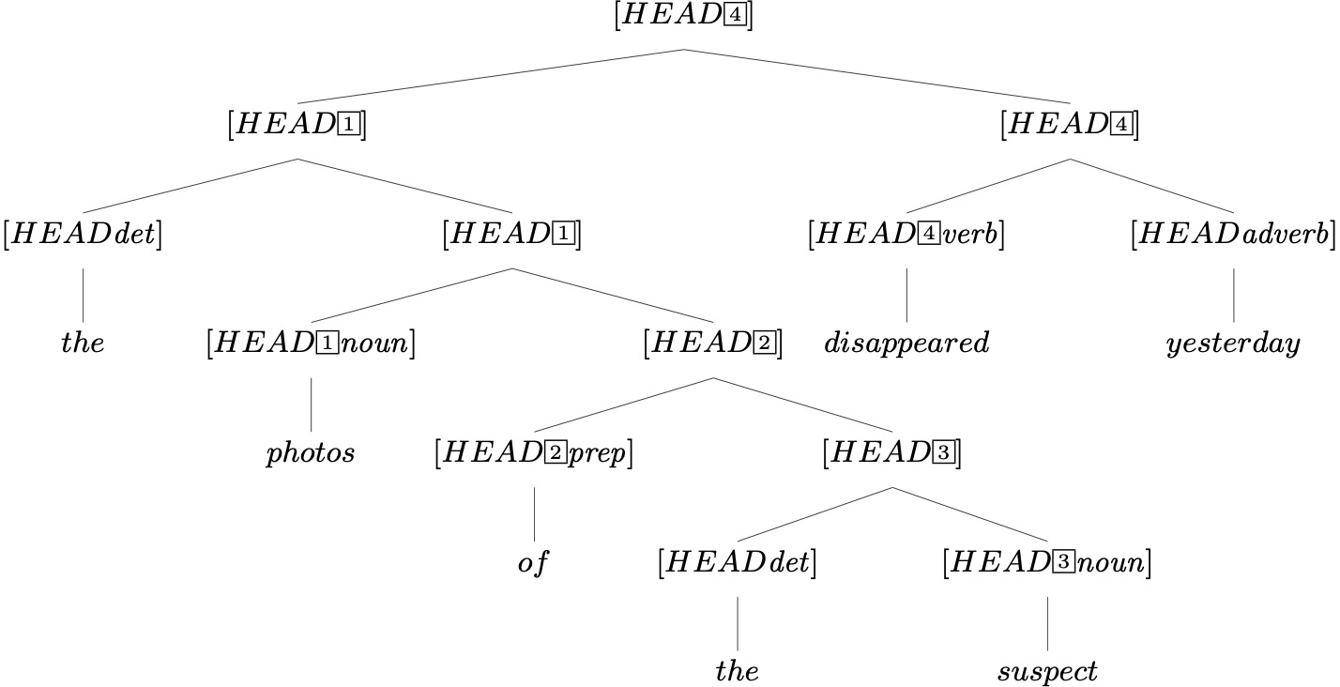
Head Features from Lexical Entries, plus HFP

Slide 28
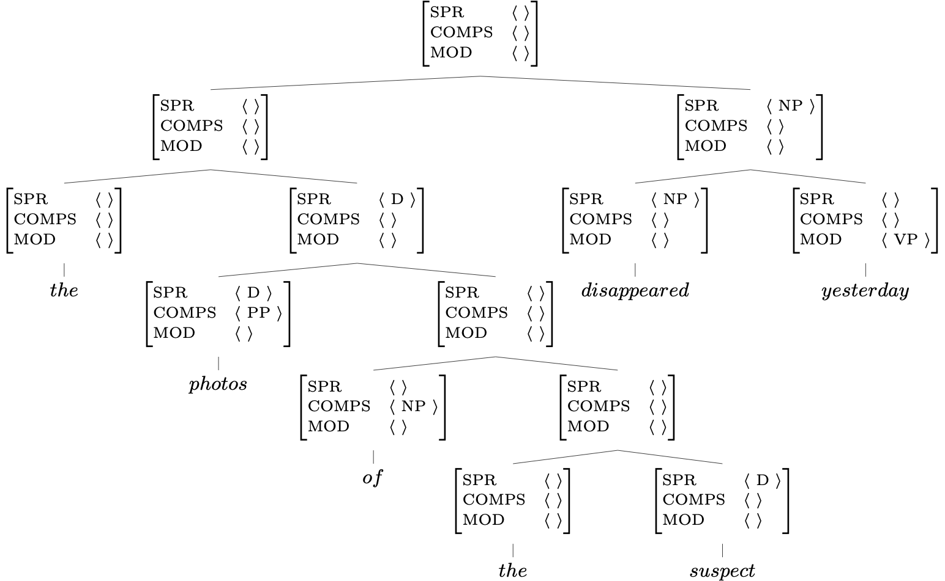
Valence Features:
Lexicon, Rules, and the Valence Principle
Key
 | Lexicon
 | Val. Prin.
 | Rules

Slide 29
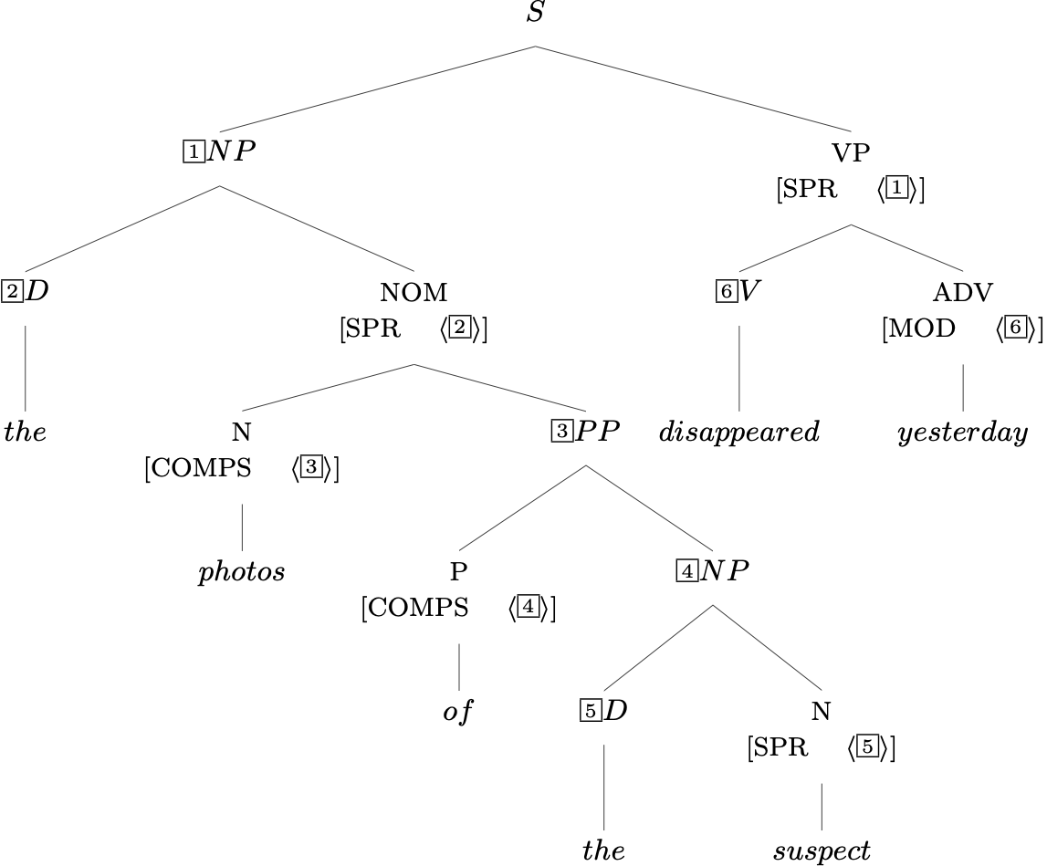
Required Identities: Grammar Rules

Slide 30
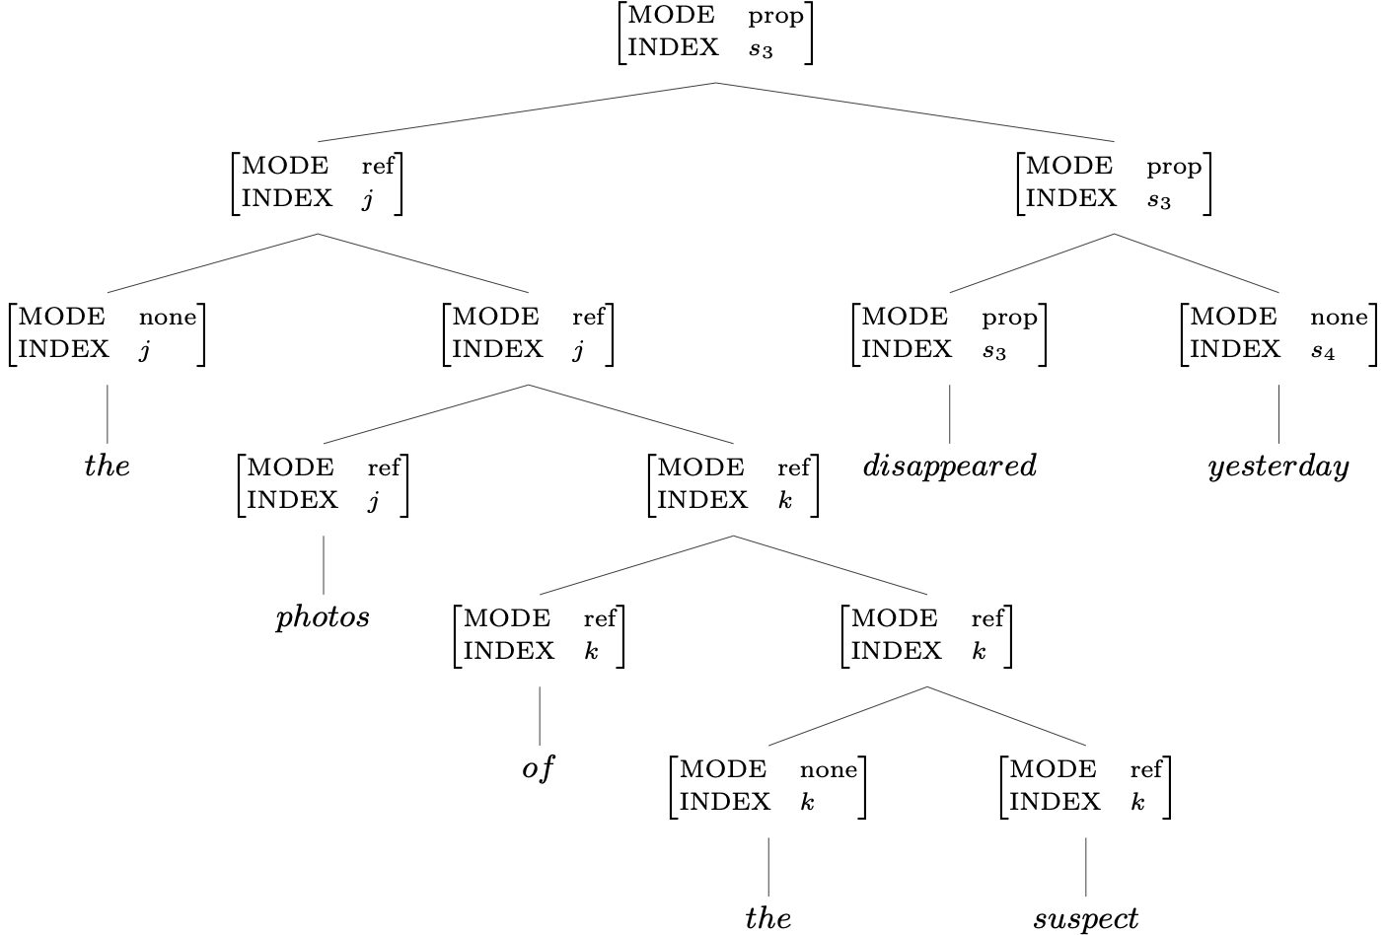
Two Semantic Features: the Lexicon & SIP

Slide 31
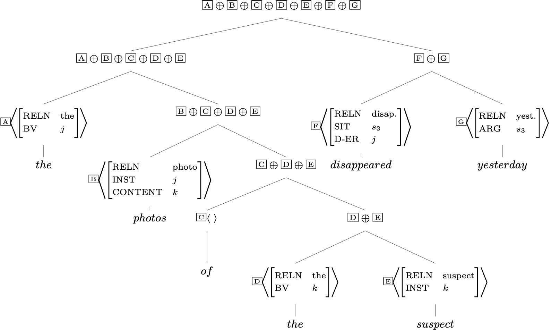
RESTR Values and the SCP

Slide 32
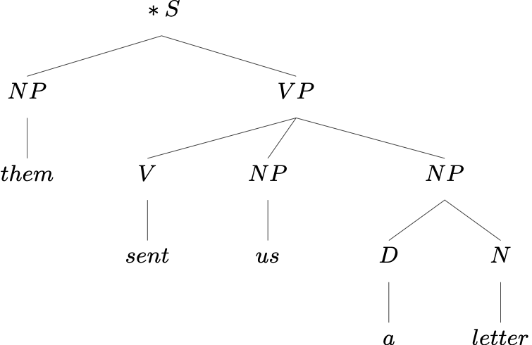
An Ungrammatical Example
What’s wrong with this sentence?

Slide 33
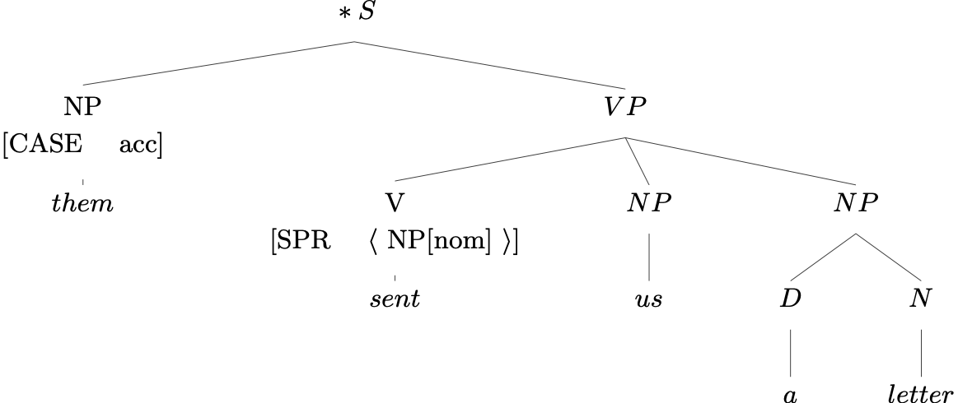
An Ungrammatical Example
What’s wrong with this sentence?
So what?

Slide 34
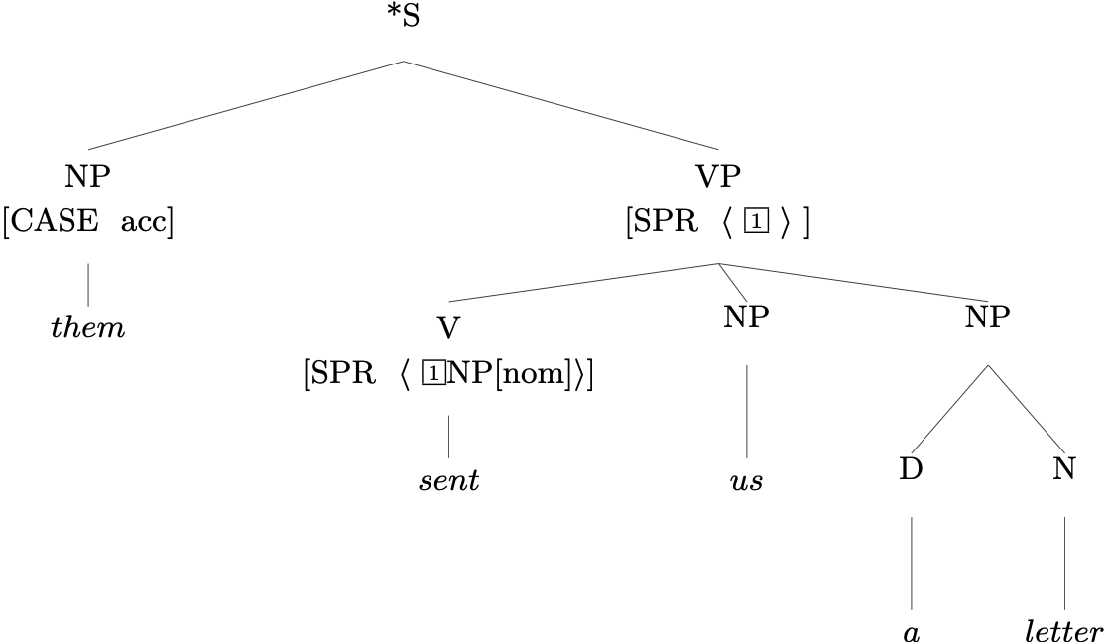
An Ungrammatical Example
The Valence Principle

Slide 35
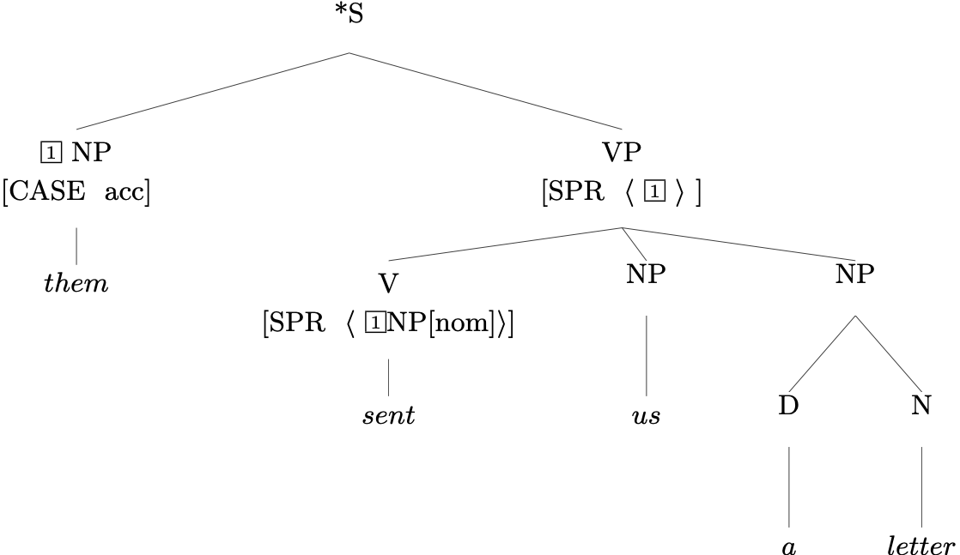
An Ungrammatical Example
Head Specifier Rule
¬contradiction®

Slide 36
Exercise in Critical Thinking
Our grammar has come a long way since Ch 2, as we've added ways of representing different kinds of information:
generalizations across categories
semantics
particular linguistic phenomena: valence, agreement, modification
What else might we add? What facts about language are as yet unrepresented in our model?

Slide 37
Overview
What we’re trying to do
The pieces of our grammar
Two extended examples
Reflection on what we’ve done, what we still have to do
Reading questions

Slide 38
Reading Questions
I also noticed that the example start to add NP tag in the tree structure, is that also the rule for VP or PP?

Slide 39
Reading Questions
Why isn't CASE inside of AGR?
Why is GEN inside of AGR?

Slide 40
Reading Questions
Taking the example in (24), the explanation says "The COMPS values of these two nodes are identical, as guaranteed by the Valence Principle". However, wouldn't the NP phrase have an empty COMPS list even if the head daughter had items on its COMP list because of the Head-Complement rule? I understand this rule to mean that no phrasal nodes will have complements, is that correct?

Slide 41
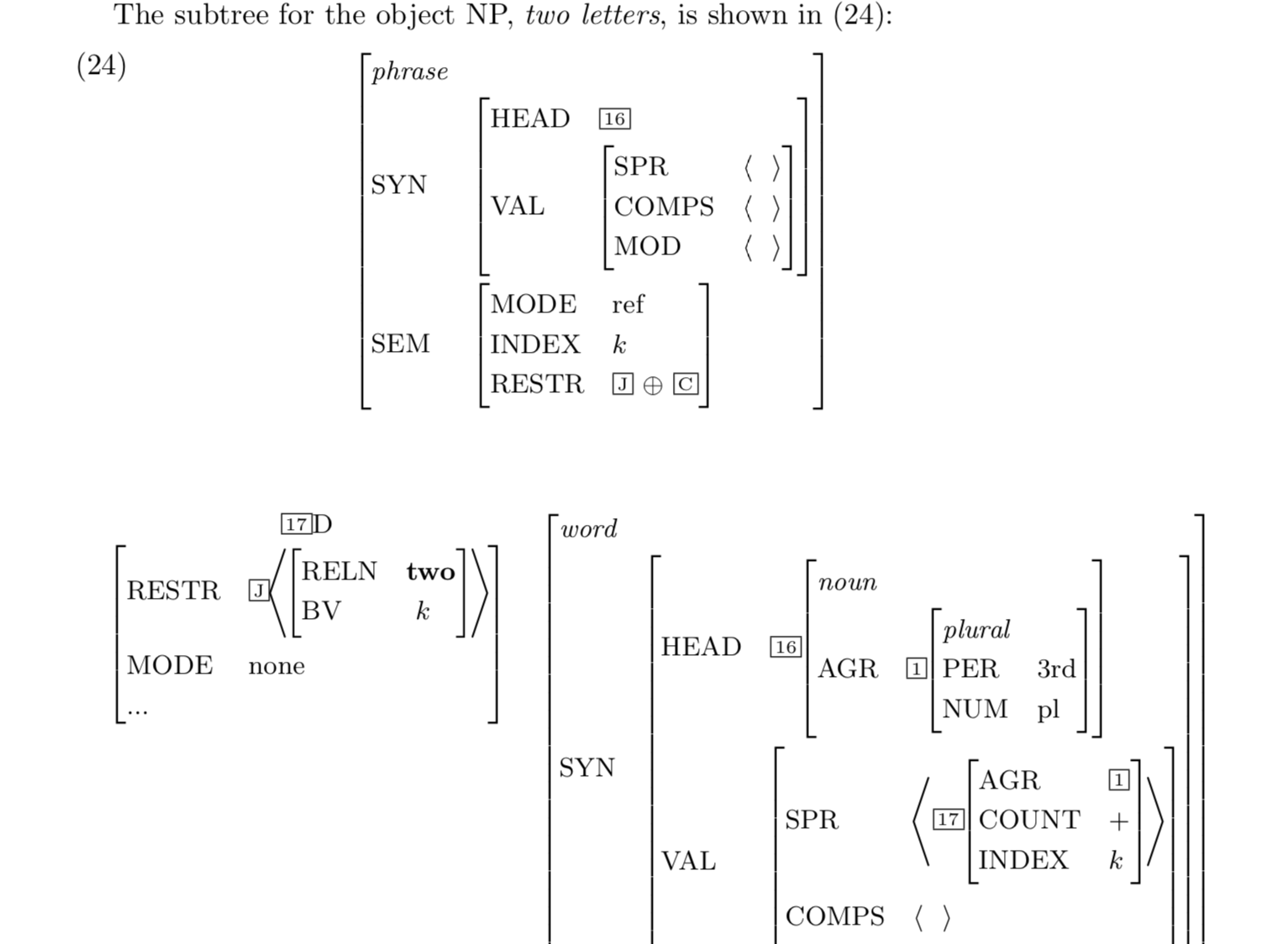

Slide 42
Reading Questions
On p. 179 the text says that the RESTR value of a certain node is a "list consisting of the following seven predications (in the indicated order)...”. I thought in chapter 5 we said the RESTR list was order-independent. Is the order here specific just so that the reader can match the full predications to their tags in the tree?

Slide 43
Reading Questions
The RESTR for "letter" includes the ADDRESSEE m, which does not necessarily need to be fulfilled syntactically, according to the explanation on pg. 171, "...we have not imposed any constraint requiring that semantic roles be realized syntactically." But I find this unsettling -- how is it that the sentence can resolve when some of its semantic slots remain unfilled? Is it because the COMPS list for the lexical item "letter" contains an optional PP? More generally, is it only OK to exclude semantic roles' realization if they are syntactically optional in COMPS lists? Is that how we deal with pro-drop languages like Spanish -- by making their SPR slot optional?

Slide 44
Reading Questions
Another related, but more specific, question from the reading -- if we wanted to enforce the reading that "us" in the sentence They sent us a letter is both the ADDRESSEE and the SENDEE, could we replace INDEX j in the lexical tree for "us" with INDEX m?

Slide 45
Reading Questions
How is it that we do not require semantic roles to be realized? Does this mean that the grammar could potentially admit sentences that are semantically strange? I do see how this could be helpful for Spanish as Julia mentioned where the subject can be dropped, but does this mean the same can be done for English based on this lack of enforcement in the grammar?

Slide 46
Reading Questions
What would be a good way (other than a probabilistic method, because that's the first thing I can think of) to encode the interpretations that one might assume about a sentence, even though that specific interpretation isn't explicitly stated in the semantic structure for a word or sentence?
More generally, how does the semantic framework we've built deal with coreference? If we had the sentence "The food was so hot that we could not eat it", would the semantics of our grammar be able to capture that "food" and "it" refer to the same entity?

Slide 47
Reading Questions
What about "a letter fell off of the mail truck"? or "the icon for the email application looks like a letter"? Would there still be an "addressee" field on the semantic trees for these sentences?

