Slide 1
Syntax: Context-free Grammars
Ling 571
Deep Processing Techniques for NLP
January 7, 2015

Slide 2
Roadmap
Motivation: Applications
Context-free grammars (CFGs)
Formalism
Grammars for English
Treebanks and CFGs
Speech and Text

Slide 3
Applications
Shallow techniques useful, but limited
Deeper analysis supports:
Grammar-checking – and teaching
Question-answering
Information extraction
Dialogue understanding

Slide 4
Grammar and NLP
Grammar in NLP is NOT prescriptive high school grammar
Explicit rules
Split infinitives, etc
Grammar in NLP tries to capture structural knowledge of language of a native speaker
Largely implicit
Learned early, naturally

Slide 5
Representing Syntax
Context-free grammars
CFGs: 4-tuple
A set of terminal symbols: Σ
A set of non-terminal symbols: N
A set of productions P: of the form A -> α
Where A is a non-terminal and α in (Σ U N)*
A designated start symbol S

Slide 6
CFG Components
Terminals:
Only appear as leaves of parse tree
Right-hand side of productions (rules) (RHS)
Words of the language
Cat, dog, is, the, bark, chase
Non-terminals
Do not appear as leaves of parse tree
Appear on left or right side of productions (rules)
Constituents of language
NP, VP, Sentence, etc

Slide 7
CFG Components
Productions
Rules with one non-terminal on LHS and any number of terminals and non-terminals on RHS
S -> NP VP
VP -> V NP PP | V NP
Nominal -> Noun | Nominal Noun
Noun -> dog | cat | rat
Det -> the

Slide 8
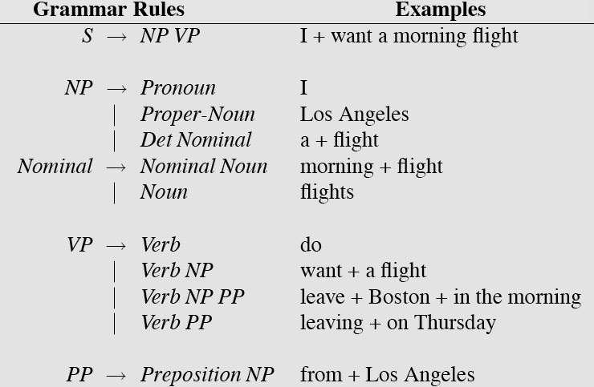
L0 Grammar

Slide 9
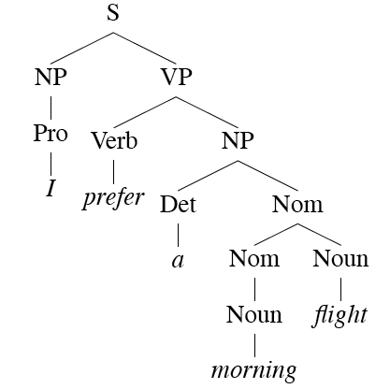
Parse Tree

Slide 10
Parsing Goals

Slide 11
Parsing Goals
Accepting:
Legal string in language?
Formally: rigid

Slide 12
Parsing Goals
Accepting:
Legal string in language?
Formally: rigid
Practically: degrees of acceptability

Slide 13
Parsing Goals
Accepting:
Legal string in language?
Formally: rigid
Practically: degrees of acceptability
Analysis
What structure produced the string?
What sequence of rule applications derives this string

Slide 14
Parsing Goals
Accepting:
Legal string in language?
Formally: rigid
Practically: degrees of acceptability
Analysis
What structure produced the string?
What sequence of rule applications derives this string
Produce one (or all) parse trees for the string

Slide 15
Parsing Goals
Accepting:
Legal string in language?
Formally: rigid
Practically: degrees of acceptability
Analysis
What structure produced the string?
What sequence of rule applications derives this string
Produce one (or all) parse trees for the string
Generation
Given a grammar, produce all legal strings of language

Slide 16
Word Classes
Pre-terminals:
# of word classes depends on
the task
the granularity chosen: fine/coarse
Brown corpus: 87 pre-terminal tags
Penn Treebank: 49 pre-terminal tags

Slide 17
Closed Class Words
Function words:
Relatively few in language, but
Very high frequency

Slide 18
Closed Class Words
Function words:
Relatively few in language, but
Very high frequency
E.g.,
DT: determiner: a, an, the, that
MD: modal: do, can, may
EX: existential there
….

Slide 19
Open Class Words
Content words
Open-ended set of words, but
Individual frequencies may be very low

Slide 20
Open Class Words
Content words
Open-ended set of words, but
Individual frequencies may be very low
Nouns: (ala grade school definition)
Person, place or thing..
E.g. NN: singular common noun – the dog, etc

Slide 21
Open Class Words
Content words
Open-ended set of words, but
Individual frequencies may be very low
Nouns: (ala grade school definition)
Person, place or thing..
E.g. NN: singular common noun – the dog, etc
Verbs: describe states or events
E.g. VBD: past tense verb – the dog barked

Slide 22
Open Class Words
Content words
Open-ended set of words, but
Individual frequencies may be very low
Nouns: (ala grade school definition)
Person, place or thing..
E.g. NN: singular common noun – the dog, etc
Verbs: describe states or events
E.g. VBD: past tense verb – the dog barked
Adjectives: describe properties of nouns
E.g. JJ: simple adjective – the furry dog

Slide 23
Open Class Words
Content words
Open-ended set of words, but
Individual frequencies may be very low
Nouns: (ala grade school definition)
Person, place or thing..
E.g. NN: singular common noun – the dog, etc
Verbs: describe states or events
E.g. VBD: past tense verb – the dog barked
Adjectives: describe properties of nouns
E.g. JJ: simple adjective – the furry dog
Adverbs: modify verbs, adjectives; specify time, place, etc
E.g.: RB: the dog ran quickly

Slide 24
Some English Grammar
Sentences:

Slide 25
Some English Grammar
Sentences:
Declarative: S -> NP VP
I want a flight from Ontario to Chicago

Slide 26
Some English Grammar
Sentences:
Declarative: S -> NP VP
I want a flight from Ontario to Chicago
Imperative: S -> VP
Show me the cheapest fare.

Slide 27
Some English Grammar
Sentences:
Declarative: S -> NP VP
I want a flight from Ontario to Chicago
Imperative: S -> VP
Show me the cheapest fare.
S -> Aux NP VP
Can you give me the same information for United?

Slide 28
Some English Grammar
Sentences:
Declarative: S -> NP VP
I want a flight from Ontario to Chicago
Imperative: S -> VP
Show me the cheapest fare.
S -> Aux NP VP
Can you give me the same information for United?
S -> Wh-NP VP
What airlines fly from Burbank to Denver?

Slide 29
Some English Grammar
Sentences: Full sentence or clause; a complete thought
Declarative: S -> NP VP
I want a flight from Ontario to Chicago
Imperative: S -> VP
Show me the cheapest fare.
S -> Aux NP VP
Can you give me the same information for United?
S -> Wh-NP VP
What airlines fly from Burbank to Denver?
S -> Wh-NP Aux NP VP
What flights do you have from Chicago to Baltimore?

Slide 30
The Noun Phrase

Slide 31
The Noun Phrase
NP -> Pronoun | Proper Noun (NNP) | Det Nominal
Head noun + pre-/post-modifiers
It , Flight 852,…

Slide 32
The Noun Phrase
NP -> Pronoun | Proper Noun (NNP) | Det Nominal
Head noun + pre-/post-modifiers
Determiners:

Slide 33
The Noun Phrase
NP -> Pronoun | Proper Noun (NNP) | Det Nominal
Head noun + pre-/post-modifiers
Determiners:
Det -> DT
the, this, a, those

Slide 34
The Noun Phrase
NP -> Pronoun | Proper Noun (NNP) | Det Nominal
Head noun + pre-/post-modifiers
Determiners:
Det -> DT
the, this, a, those
Det -> NP ‘s
United’s flight, Chicago’s airport

Slide 35
In and around the Noun
Nominal -> Noun
PTB POS: NN, NNS, NNP, NNPS
flight, dinner, airport

Slide 36
In and around the Noun
Nominal -> Noun
PTB POS: NN, NNS, NNP, NNPS
flight, dinner, airport
NP -> (Det) (Card) (Ord) (Quant) (AP) Nominal
The least expensive fare, one flight, the first route

Slide 37
In and around the Noun
Nominal -> Noun
PTB POS: NN, NNS, NNP, NNPS
flight, dinner, airport
NP -> (Det) (Card) (Ord) (Quant) (AP) Nominal
The least expensive fare, one flight, the first route
Nominal -> Nominal PP
The flight from Chicago

Slide 38
Verb Phrase and Subcategorization
Verb phrase includes Verb, other constituents
Subcategorization frame: what constituent arguments the verb requires

Slide 39
Verb Phrase and Subcategorization
Verb phrase includes Verb, other constituents
Subcategorization frame: what constituent arguments the verb requires
VP -> Verb disappear

Slide 40
Verb Phrase and Subcategorization
Verb phrase includes Verb, other constituents
Subcategorization frame: what constituent arguments the verb requires
VP -> Verb disappear
VP -> Verb NP book a flight

Slide 41
Verb Phrase and Subcategorization
Verb phrase includes Verb, other constituents
Subcategorization frame: what constituent arguments the verb requires
VP -> Verb disappear
VP -> Verb NP book a flight
VP -> Verb PP PP fly from Chicago to Seattle

Slide 42
Verb Phrase and Subcategorization
Verb phrase includes Verb, other constituents
Subcategorization frame: what constituent arguments the verb requires
VP -> Verb disappear
VP -> Verb NP book a flight
VP -> Verb PP PP fly from Chicago to Seattle
VP -> Verb S I think I want that flight

Slide 43
Verb Phrase and Subcategorization
Verb phrase includes Verb, other constituents
Subcategorization frame: what constituent arguments the verb requires
VP -> Verb disappear
VP -> Verb NP book a flight
VP -> Verb PP PP fly from Chicago to Seattle
VP -> Verb S I think I want that flight
VP -> Verb VP I want to arrange three flights

Slide 44
CFGs and Subcategorization
Issues?

Slide 45
CFGs and Subcategorization
Issues?
I prefer United has a flight.

Slide 46
CFGs and Subcategorization
Issues?
I prefer United has a flight.
How can we solve this problem?

Slide 47
CFGs and Subcategorization
Issues?
I prefer United has a flight.
How can we solve this problem?
Create explict subclasses of verb
Verb-with-NP
Verb-with-S-complement, etc…

Slide 48
CFGs and Subcategorization
Issues?
I prefer United has a flight.
How can we solve this problem?
Create explict subclasses of verb
Verb-with-NP
Verb-with-S-complement, etc…
Is this a good solution?

Slide 49
CFGs and Subcategorization
Issues?
I prefer United has a flight.
How can we solve this problem?
Create explict subclasses of verb
Verb-with-NP
Verb-with-S-complement, etc…
Is this a good solution?
No, explosive increase in number of rules
Similar problem with agreement

Slide 50
Treebanks
Treebank:
Large corpus of sentences all of which are annotated syntactically with a parse
Built semi-automatically
Automatic parse with manual correction
Examples:
Penn Treebank (largest)
English: Brown (balanced); Switchboard (conversational speech); ATIS (human-computer dialogue); Wall Street Journal; Chinese; Arabic
Korean

Slide 51
Treebanks
Include wealth of language information
Traces, grammatical function (subject, topic, etc), semantic function (temporal, location)
Implicitly constitutes grammar of language
Can read off rewrite rules from bracketing
Not only presence of rules, but frequency
Will crucial in building statistical parsers

Slide 52
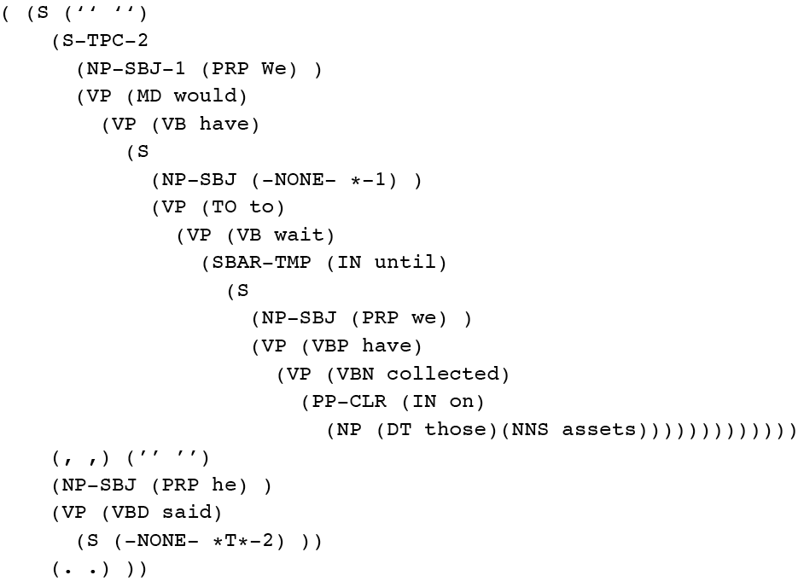
Treebank WSJ Example

Slide 53
Treebanks & Corpora
Many corpora on patas
patas$ ls /corpora
birkbeck enron_email_dataset grammars LEAP TREC
Coconut europarl ICAME med-data treebanks
Conll europarl-old JRC-Acquis.3.0 nltk
DUC framenet LDC proj-gutenberg
Many large corpora from LDC
Many corpus samples in nltk

Slide 54
Treebank Issues

Slide 55
Treebank Issues
Large, expensive to produce

Slide 56
Treebank Issues
Large, expensive to produce
Complex
Agreement among labelers can be an issue

Slide 57
Treebank Issues
Large, expensive to produce
Complex
Agreement among labelers can be an issue
Labeling implicitly captures theoretical bias
Penn Treebank is ‘bushy’, long productions

Slide 58
Treebank Issues
Large, expensive to produce
Complex
Agreement among labelers can be an issue
Labeling implicitly captures theoretical bias
Penn Treebank is ‘bushy’, long productions
Enormous numbers of rules
4,500 rules in PTB for VP
VP-> V PP PP PP
1M rule tokens; 17,500 distinct types – and counting!

Slide 59
Spoken & Written
Can we just use models for written language directly?

Slide 60
Spoken & Written
Can we just use models for written language directly?
No!

Slide 61
Spoken & Written
Can we just use models for written language directly?
No!
Challenges of spoken language
Disfluency
Can I um uh can I g- get a flight to Boston on the 15th?
37% of Switchboard utts > 2 wds

Slide 62
Spoken & Written
Can we just use models for written language directly?
No!
Challenges of spoken language
Disfluency
Can I um uh can I g- get a flight to Boston on the 15th?
37% of Switchboard utts > 2 wds
Short, fragmentary
Uh one way

Slide 63
Spoken & Written
Can we just use models for written language directly?
No!
Challenges of spoken language
Disfluency
Can I um uh can I g- get a flight to Boston on the 15th?
37% of Switchboard utts > 2 wds
Short, fragmentary
Uh one way
More pronouns, ellipsis
That one

Slide 64
Grammar Equivalence and Form
Grammar equivalence
Weak: Accept the same language, May produce different analyses
Strong: Accept same language, Produce same structure
Canonical form:
Chomsky Normal Form (CNF)
All CFGs have a weakly equivalent CNF
All productions of the form:
A-> B C where B,C in N, or
A->a where a in Σ

Slide 65
Tree Adjoining Grammars
Mildly context-sensitive (Joshi, 1979)
Motivation:
Enables representation of crossing dependencies
Operations for rewriting
“Substitution” and “Adjunction”
X
X
A
A
A
A
A
A

Slide 66
TAG Example
NP
S
NP
VP
N
NP
VP
N
VP
Ad
V
NP
Maria
pasta
quickly
eats
S
NP
VP
N
VP
VP
Ad
Maria
NP
V
quickly
N
eats
pasta

Slide 67
Computational Parsing
Given a grammar, how can we derive the analysis of an input sentence?
Parsing as search
CKY parsing
Earley parsing
Given a body of (annotated) text, how can we derive the grammar rules of a language, and employ them in automatic parsing?
- Treebanks & PCFGS

